Slide 1
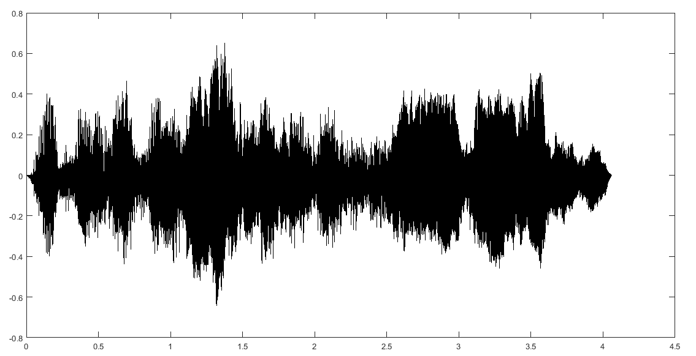
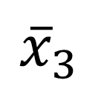

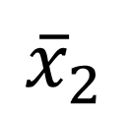
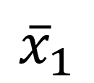


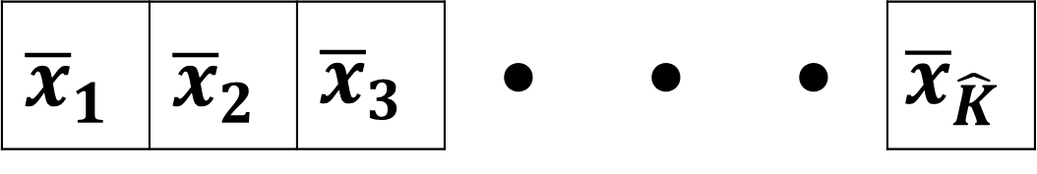

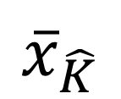
 |  |  |  |  |  |  |  |  | • | •
 |  |  |  |  |  |  |  |  | • | •
 |  |  |  |  |  |  |  |  | • | •
• | • | • | • | • | • | • | • | • | • | • | • | •
 |  |  |  |  |  |  |  |  | • | •
13
$$K$$
audio
ekstraksi
nilai MFCC
MFCC
pembuangan
log energi
penghitungan nilai
rata-rata per frame
 |  |  |  |  |  |  |  |  | • | •
 |  |  |  |  |  |  |  |  | • | •
• | • | • | • | • | • | • | • | • | • | • | • | •
 |  |  |  |  |  |  |  |  | • | •
 |  |  |  |  |  |  |  |  | • | •
12
$$K$$
rata-rata MFCC
$$K$$
pembagian wilayah
selebar w dengan
jarak antarwilayah s
MFCC tanpa
log energi
s
s
s
s
 |  |  |  |  |  |  |  |  | • | •
$${\overline{x}}_{1}$$ | $${\overline{x}}_{2}$$ | $${\overline{x}}_{3}$$ | • | • | • | $${\overline{x}}_{\hat{K}}$$
w
w
w
w
$$\hat{K}$$
$${\overline{x}}_{1}$$
$${\overline{x}}_{2}$$
$${\overline{x}}_{3}$$
$${\overline{x}}_{\hat{K}}$$
rata-rata MFCC yang
dibagi menurut s dan w
pemendekan
fitur
fitur MFCC

Slide 2


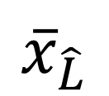

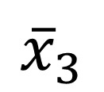

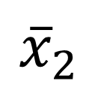
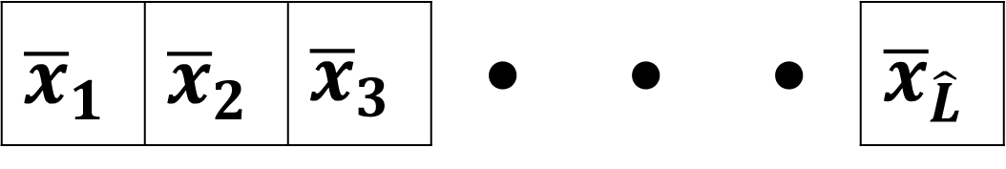
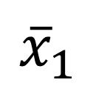

 |  | •
 |  | •
 |  | •
 |  | •
 |  | •
 |  | •
 |  | •
 |  | •
 |  | •
 |  | •
 |  | •
• | • | • | •
 |  | •
 |  |  |  |  |  |  |  |  | • | •
 |  |  |  |  |  |  |  |  | • | •
• | • | • | • | • | • | • | • | • | • | • | • | •
 |  |  |  |  |  |  |  |  | • | •
12
$$K$$
$$K$$
MFCC tanpa
log energi
transpose
12
MFCC transpose
tanpa log energi
ekstraksi
nilai SDCC
penghitungan nilai
rata-rata per frame
 |  |  |  |  |  |  |  |  | • | •
 |  |  |  |  |  |  |  |  | • | •
 |  |  |  |  |  |  |  |  | • | •
 |  |  |  |  |  |  |  |  | • | •
• | • | • | • | • | • | • | • | • | • | • | • | •
 |  |  |  |  |  |  |  |  | • | •
 |  |  |  |  |  |  |  |  | • | •
36
$$L$$
rata-rata SDCC
per frame
$$L$$
pembagian wilayah
selebar w dengan
jarak antarwilayah s
SDCC
s
s
s
s
 |  |  |  |  |  |  |  |  | • | •
$${\overline{x}}_{1}$$ | $${\overline{x}}_{2}$$ | $${\overline{x}}_{3}$$ | • | • | • | $${\overline{x}}_{\hat{L}}$$
w
w
w
w
$$\hat{L}$$
$${\overline{x}}_{1}$$
$${\overline{x}}_{2}$$
$${\overline{x}}_{3}$$
$${\overline{x}}_{\hat{L}}$$
pemendekan
fitur
fitur SDCC
pemendekan fitur

