Slide 1

HTML & CSS
By Viktor Vipolzov
Riga, 2014

Slide 2
What is HTML?
HTML is short for "HyperText Markup Language". That may sound scary, but it simply means it is a language for describing web-pages using ordinary text. HTML is not a complex programming language.

Slide 3
HTML Files
Every web page is actually a HTML file. Each HTML file is just a plain-text file, but with a .html file extension instead of .txt, and is made up of many HTML tags as well as the content for a web page.
A web site will often contain many html files that link to each other. You can edit HTML files with your favourite editor.

Slide 4
HTML Tags
HTML tags are the hidden keywords within a web page that define how the browser must format and display the content.
Most tags must have two parts, an opening and a closing part. For example, <html> is the opening tag and </html> is the closing tag. Note that the closing tag has the same text as the opening tag, but has an additional forward-slash ( / ) character.
There are some tags that are an exception to this rule, and where a closing tag is not required. The <img> tag for showing images is one example of this.
Each HTML file must have the essential tags for it to be valid, so that web browsers can understand it and display it correctly.

Slide 5
Example №1
<!DOCTYPE html>
<html lang="en">
<head>
  <meta charset="UTF-8">
  <title>Page Title</title>
</head>
<body>
  <h1>Heading</h1>
  <p>Paragraph</p>
  <img src="cute-cat.jpg" alt="cute cat">
</body>
</html>

Slide 6
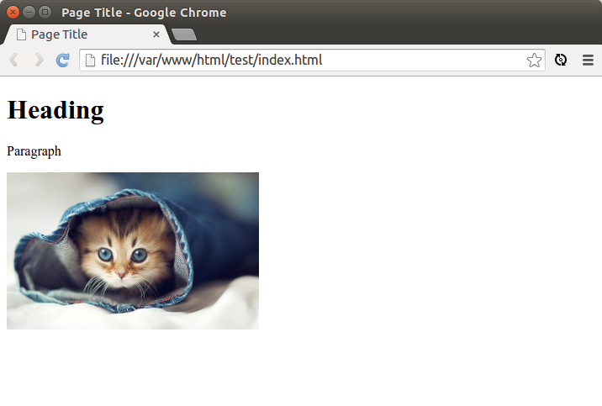
Result

Slide 7
What is XHTML?
XHTML is a variant of HTML that uses the syntax of XML, the Extensible Markup Language. XHTML has all the same elements (for paragraphs, etc.) as the HTML variant, but the syntax is slightly different. Because XHTML is an XML application, you can use other XML tools with it (such as XSLT, a language for transforming XML content).

Slide 8
The differences between HTML and XHTML
Tags in XHTML must be closed in the proper order
Tags in XHTML must be closed
Tags (as well as their attributes) in XHTML must be in lowercase
Attributes must be quoted
XHTML documents can only have one root tag

Slide 9
How about HTML5?
HTML5 is the fifth revision and newest version of the HTML standard. It offers new features that provide not only rich media support, but also enhance support for creating web applications that can interact with the user, his/her local data, and servers, more easily and effectively than was possible previously.

Slide 10
What is CSS?
CSS is a plain text file format used for formatting content on web pages. CSS stands for Cascading Style Sheet and is used by web pages to help keep information in the proper display format. CSS files can help define font, size, color, spacing, border and location of HTML information on a web page, and can also be used to create a continuous look throughout multiple pages of a website.

Slide 11
Example №2
<!DOCTYPE html>
<html lang="en">
<head>
  <meta charset="UTF-8">
  <title>Page Title</title>
  <link rel="stylesheet" href="style.css">
</head>
<body>
  <h1>Heading</h1>
  <p>Paragraph</p>
  <img src="cute-cat.jpg" alt="cute cat">
</body>
</html>

Slide 12
Example №2
body {
  text-align: center;
}
p {
  font-weight: bold;
}
img {
  border: 3px solid blue;
}

Slide 13
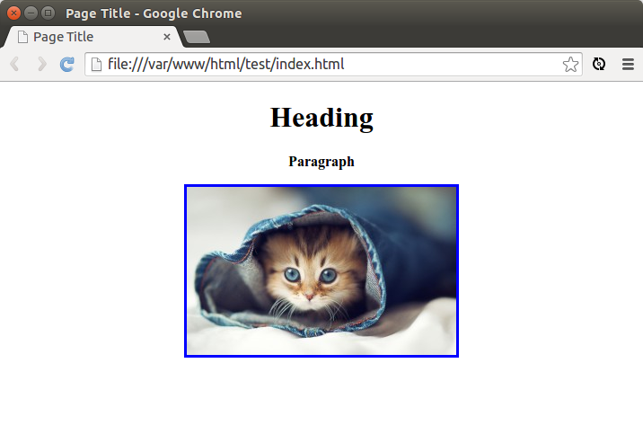
Result

Slide 14

CSS preprocessors
CSS allow you to do lots of things, but some features are missing to developers. What about variable, constants, and general faster syntax? As normal CSS can’t do that, people created preprocessors to allow the use of variables on CSS files and then parse it to regular stylesheets.

Slide 15
Thanks

