Slide 1


Slide 2
EPiServerless
Notes:
https://martinfowler.com/articles/serverless.html

Slide 3




wałdis iljuczonok (aka technical fellow)
tech guy at getadigital.com
(Microsoft .Net + EPiServer) ◦ MVP
@tech_fellow

Slide 4
evolution

Slide 5







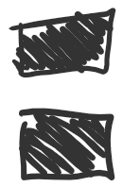





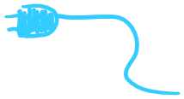
on premises

Slide 6
machine in the cloud (IaaS)

Slide 7
application services (PaaS)

Slide 8
microservices (?aaS)

Slide 9
functions

Slide 10
Serverless?
Notes:
It’s a horrible naming. Of course there is a server, but you just don’t manage that.
There is no magic – somebody else is managing the servers and you instantly get runtimes to host/run you code.

Slide 11
Azure Functions is a serverless compute service that enables you to run code on-demand without having to explicitly provision or manage infrastructure.
Use Azure Functions to run a script or piece of code in response to a variety of events.

Slide 12
Azure Functions is a serverless compute service that enables you to run code on-demand without having to explicitly provision or manage infrastructure.
Use Azure Functions to run a script or piece of code in response to a variety of events.
Notes:
Running server applications without managing infra
Has concrete restrictions
Deployments are different
H-scaling is done automatically
Triggered by events (binding)

Slide 13
Abstraction of the server
Event-driven / instant scale
Micro-billing

Slide 14
Benefits

Slide 15
Scaling Costs
Reduced Operational Costs
Easier Management
Green’-er’ Computing
Notes:
* - somebody takes care of your stuff
* - built used other services (commoditized)
* - Pay only for what you need
* - typical enterprise server utilizes only 5-15% of CPU / per year
* -

Slide 16
Drawbacks

Slide 17
Vendor Lock-in
Multitenancy
No In-server State
Startup Latency
Execution Duration
API Endpoint Versioning

Slide 18
Azure Serverless Components

Slide 19

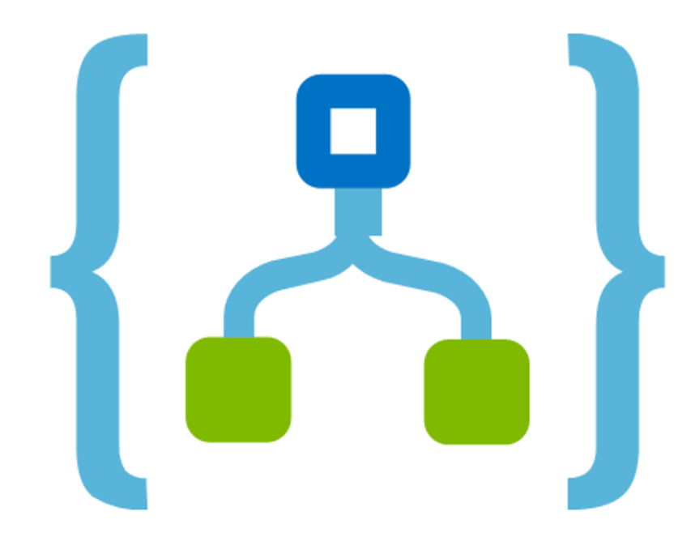

Event Grid
Logic Apps
Functions
Serverless Events
Serverless Workflow
Serverless Compute

Slide 20
Azure Functions

Slide 21
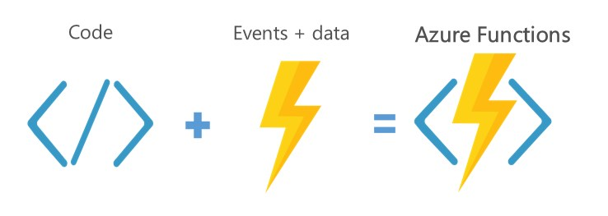

Slide 22
Start in Portal (sandbox)
C#, F#, node.js, Python, PHP, Batch and more
Schedule event driven tasks
Expose as HTTP API endpoints
Auto-scaling (Horiz.)
Integrate with Logic Apps

Slide 23
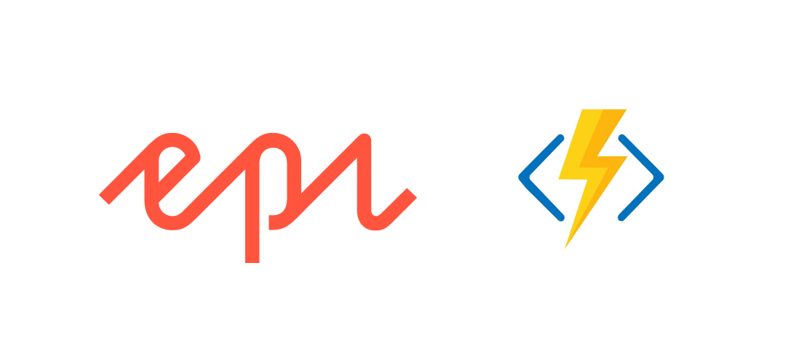

Slide 24
Building *Real* Site

Slide 25
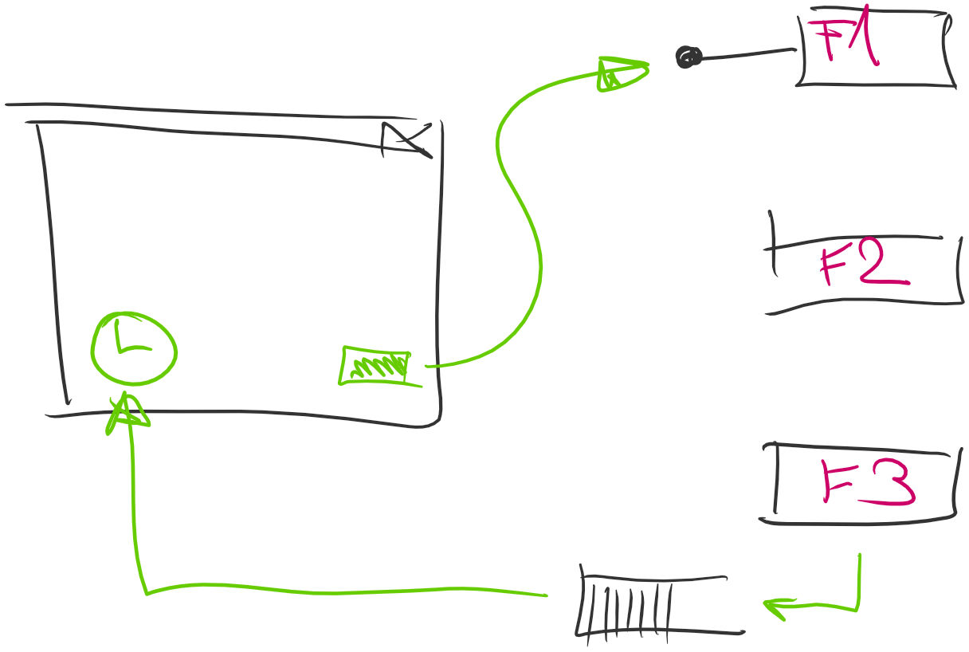
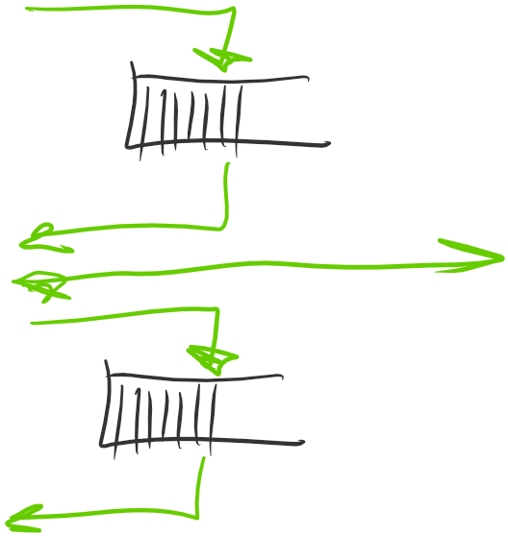

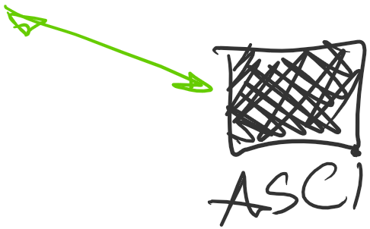
Notes:
How you can share the code – there is a crazy thing called ”DLL”!

Slide 26
Going Clouds

Slide 27
VS Publish
CLI
via CI Tools

Slide 28
Azure Functions Billing

Slide 29
Consumption Plan
App Service Plan

Slide 30
Function Best Practices

Slide 31
Single thing (* not necessarily simple)
Idempotent
Finish as soon as possible
Persistant storage across functions

Slide 33
Functions Visualizer
Notes:
https://functions-visualizer.azurewebsites.net/

Slide 35
Durable Functions *
* - in preview

Slide 36
#r "Microsoft.Azure.WebJobs.Extensions.DurableTask"
public static async Task<AsciiArtResult>
Run(DurableOrchestrationContext context)
{
...
var analysisRequest = new AnalysisReq
{
BlobRef = outBlob.Name,
Width = request.Width
};
var resultFromF2 = await context.CallFunctionAsync<AsciiArtResult>(
"Function2",
analysisRequest);
...
return resultFromF2;
}

Slide 37
#r "Microsoft.Azure.WebJobs.Extensions.DurableTask"
public static async Task<AsciiArtResult>
Run(DurableOrchestrationContext context)
{
...
var analysisRequest = new AnalysisReq
{
BlobRef = outBlob.Name,
Width = request.Width
};
var resultFromF2 = await context.CallFunctionAsync<AsciiArtResult>(
"Function2",
analysisRequest);
...
return resultFromF2;
}

Slide 38
Next Steps?

Slide 39
//aka.ms/functions

Slide 40
wałdis iljuczonok (aka technical fellow)
tech guy at getadigital.com
(Microsoft .Net + EPiServer) ◦ MVP
@tech_fellow

