Slide 1
ScalaCL and Chisel
Valdis Ādamsons

Slide 2
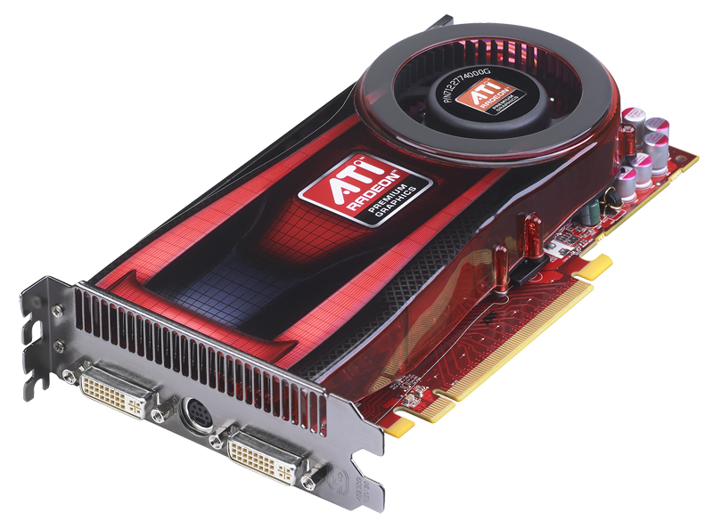
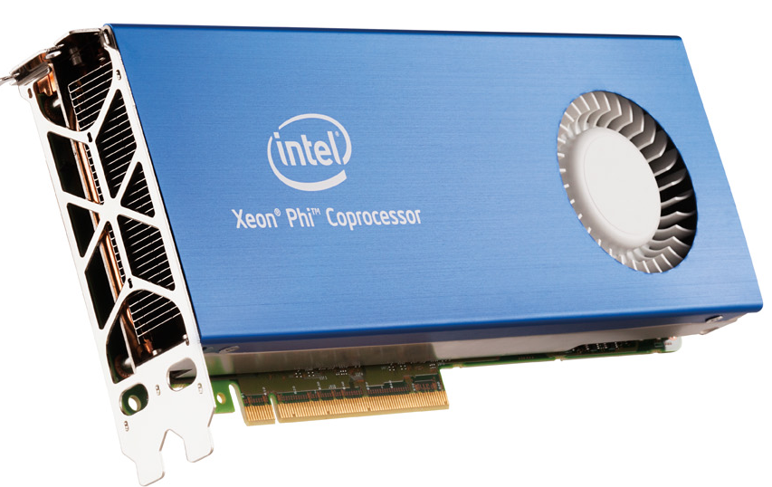
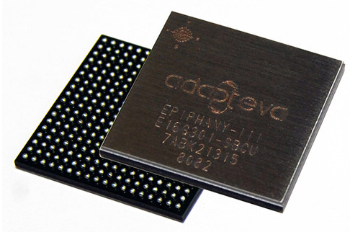
OpenCL
Not to be confused with OpenGL
CLC code (i.e. the kernels) runs on the device
The kernels are called using a C/C++ API
Supported devices:
Most graphics cards
Intel Phi cards
CPUs using vector instructions
FPGAs
Other devices, like Adapteva Empathy processor
etc.

Slide 3
OpenCL computation model
The job is split into many tasks
Processing elements(PEs) execute these tasks
Each processing element(PE) does the same instructions, but on different data(task)
Not everything translates well to OpenCL ☹
Wavefront (aka. Warp)
Compute unit
PE “Core”
PE “Core”
Compute unit
PE “Core”
PE “Core”
…
PE “Core”
PE “Core”
PE “Core”
PE “Core”
…
…
…
Task
Task
Task
Task
…
Task
Task
Task
Task
…
…

Slide 4
ScalaCL syntax
Test.scala
import scalacl._
import scala.math._
object Test {
def main(args: Array[String]): Unit = {
implicit val context = Context.best
val rng = (100 until 100000).cl
val sum = rng.map(_ * 2)
.zipWithIndex
.map(p => p._1 / (p._2 + 1))
.sum
println("sum = " + sum)
}
}
Exercise: spot the OpenCL here!

Slide 5
ScalaCL syntax
Test.scala
import scalacl._
import scala.math._
object Test {
def main(args: Array[String]): Unit = {
implicit val context = Context.best
val rng = (100 until 100000).cl
val sum = rng.map(_ * 2)
.zipWithIndex
.map(p => p._1 / (p._2 + 1))
.sum
println("sum = " + sum)
}
}
Here it is!

Slide 6
Vs Rootbeer
ArraySumApp.java
package rootbeer.examples.arraysum;
import java.util.List;
import java.util.ArrayList;
import org.trifort.rootbeer.runtime.Kernel;
import org.trifort.rootbeer.runtime.Rootbeer;
import org.trifort.rootbeer.runtime.Context;
public class ArraySumApp {
public int[] sumArrays(List<int[]> arrays){
List<Kernel> jobs = new ArrayList<Kernel>();
int[] ret = new int[arrays.size()];
for(int i = 0; i < arrays.size(); ++i){
jobs.add(new ArraySum(arrays.get(i), ret, i));
}
Rootbeer rootbeer = new Rootbeer();
Context context = rootbeer.createDefaultContext();
context.init(1024*1024*4);
rootbeer.run(jobs, context);
return ret;
}
public static void main(String[] args){
ArraySumApp app = new ArraySumApp();
List<int[]> arrays = new ArrayList<int[]>();
for(int i = 0; i < 1024; ++i){
int[] array = new int[512];
for(int j = 0; j < array.length; ++j){
array[j] = j;
}
arrays.add(array);
}
int[] sums = app.sumArrays(arrays);
for(int i = 0; i < sums.length; ++i){
System.out.println("sum for arrays["+i+"]: "+sums[i]);
}
}
}
ArraySum.java
package rootbeer.examples.arraysum;
import java.util.List;
import java.util.ArrayList;
import org.trifort.rootbeer.runtime.Kernel;
public class ArraySum implements Kernel {
private int[] source;
private int[] ret;
private int index;
public ArraySum (int[] src, int[] dst, int i){
source = src; ret = dst; index = i;
}
public void gpuMethod(){
int sum = 0;
for(int i = 0; i < source.length; ++i){
sum += source[i];
}
ret[index] = sum;
}
}
…instead of
“(0 until 512).cl.sum”

Slide 7
ScalaCL status
Free and open source
6 lines to enable in a SBT project
Some operations might still be running on the CPU! The compiler can warn you.
Two different versions
https://code.google.com/p/scalacl/
A Scala compiler plugin
Functional, not production ready
https://github.com/ochafik/ScalaCL
Implemented using Scala macros
Work-in-progress, not yet functional

Slide 8
Chisel
Hardware design framework
Free and open source
2 lines to enable in a SBT project
Best compatible with Linux
Uses Scala to “reinvent Verilog”
Number of wires for results are inferred
Functional constructions can create parameterized circuits
Implicit clock available by default
and much more
Plenty of examples available
https://chisel.eecs.berkeley.edu/

Slide 9
A simple example
GCD.scala
import Chisel._
class GCD extends Module {
val io = new Bundle {
val a = UInt(INPUT, 16)
val b = UInt(INPUT, 16)
val e = Bool(INPUT)
val z = UInt(OUTPUT, 16)
val v = Bool(OUTPUT)
}
val x = Reg(UInt())
val y = Reg(UInt())
when (x > y) { x := x - y }
unless (x > y) { y := y - x }
when (io.e) { x := io.a; y := io.b }
io.z := x
io.v := y === UInt(0)
}

Slide 10
More complex logic
Max.scala (fragment)
class MaxN(n: Int, w: Int) extends Module{
private def Max2(x: UInt, y: UInt) = Mux(x > y, x, y)
val io = new Bundle {
val in = Vec.fill(n){ UInt(INPUT, w) }
val out = UInt(OUTPUT, w)
}
io.out := io.in.reduceLeft(Max2)
}
…also there is an example for a simple processor – 3 registers and 2 operations. (Risc.scala)

Slide 11
From Chisel to working FPGA
Chisel
Scala code
Verilog
code
FPGA manufacturer's
tools
Device bitcode
Device
programmer
C simulation code
Constraints
FPGA
“What pin is what?”

Slide 12
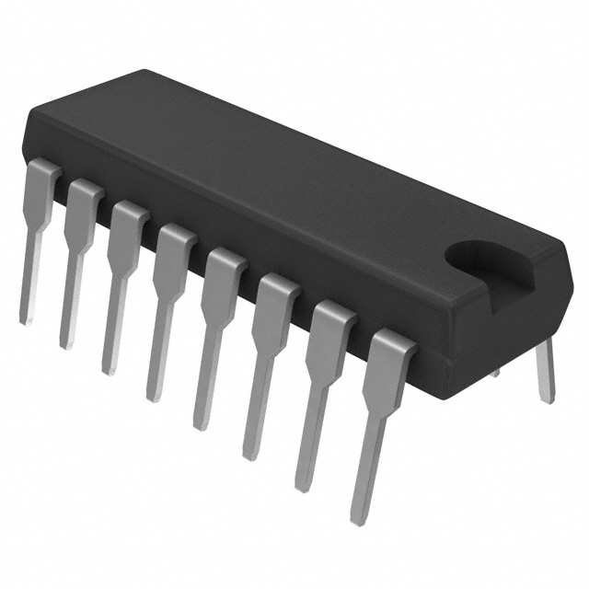
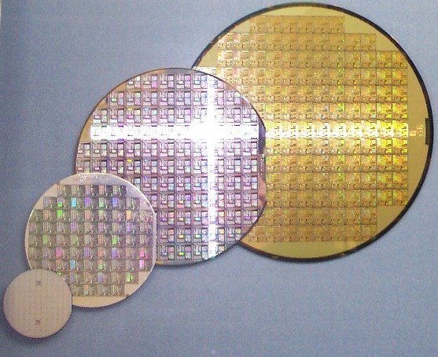
ASICs
Application Specific Integrated Circuit – Your own custom microchips
The same Verilog code
Prices have gone down
Shuttle services – get a piece of the wafer
Specialized companies offer full service
No longer a matter of millions of $, but thousands of $

Slide 13
Thanks for your attention.
Any other questions?
Presentation available on
https://github.com/valdisxp1/scalaCL-chisel-presentation

