Slide 1
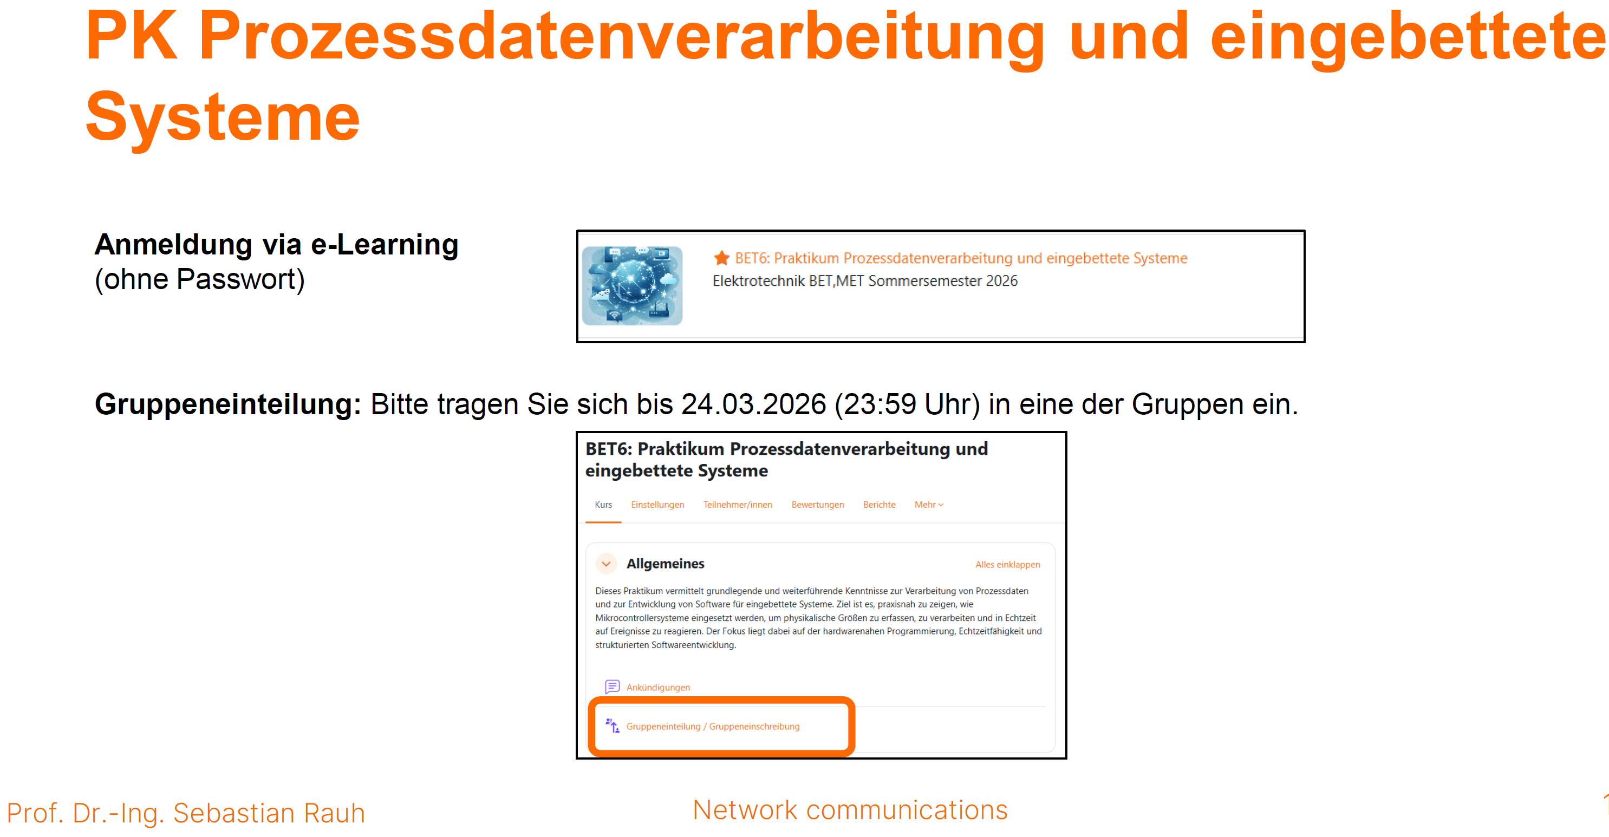

Slide 2

Voice Control
Introduction

Slide 3
Parallel classes
German:
Thursday 10:00 – 13:15 (4 SWS)
Room 5.1.06
BET: Prozessdatenverarbeitung und eingebettete Systeme
BET: Sprachsteuerung (SPO 2025)
BET: Sprachsteuerung (ältere SPO kann nicht mehr separat angeboten werden)
English:
Thursday 14:15 – 15:00 (1 SWS)
Room 1.E.33
IRO: Speech recognition and speech synthesis
BRO: Spracherkennung und Sprachsynthese
Identical content, identical exam

Slide 4
Requirements
Hardware: Bring your own device – Notebook
Software:
Python, e.g. 3.11 or higher
Jupyter Notebooks

Slide 5
Goals and motivation
Python programming,
Pair programming and test driven development
Audio analysis and signal processing,
Denoising,
Machine Learning
12 Weeks
Week01_PythonTutorial
…
Week12_MachineLearning_SpeechToText_TextToSpeech
Each week corresponds to 1 Jupyter Notebook
explains a single topic
Gives you a programming exercise
Gives you a set of tasks for exam preparation

Slide 6
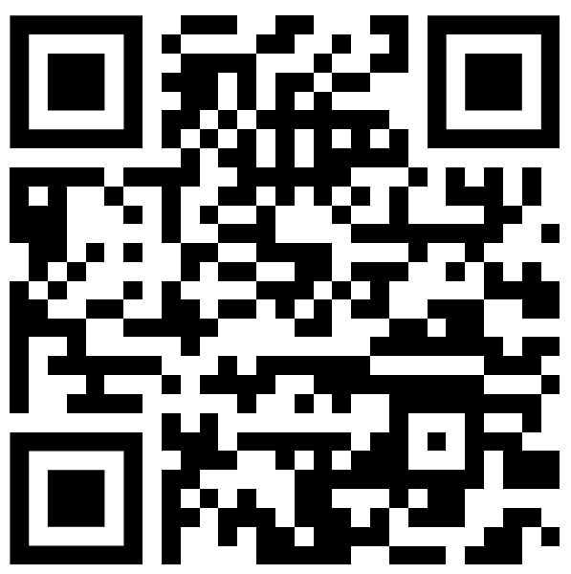
Tasks for German course
Asynchronous tasks part A (2 hours):
Download the files of the week
For last week: Compare own solutions with reference
Read and understand the weekly Jupyter Notebook
Read the weekly tasks for exam preparation
Prepare and publish in FAQ one question regarding the content of
Jupyter Notebook
Exam preparation
Synchronous tasks (4 hours):
Discuss questions in FAQ
Discuss Jupyter Notebook
Solve the programming exercise
Discuss first exam preparation tasks
Asynchronous tasks part B (2 hours):
Solve exam preparation tasks
Link to eLearning

Slide 7
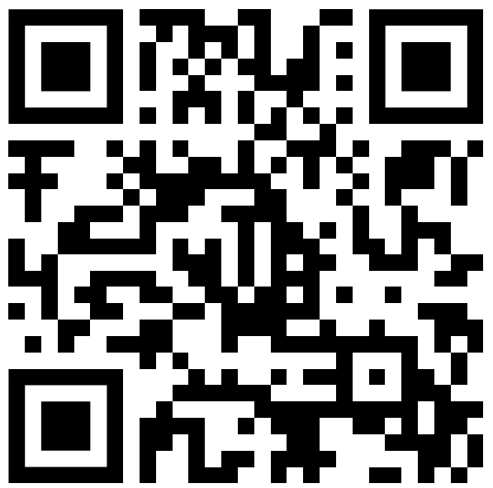
Tasks for English course
Asynchronous tasks part A (6 hours):
Download the files of the week
For last week: Compare own solutions with reference
Read and understand the weekly Jupyter Notebook
Read the weekly tasks for exam preparation
Prepare and publish in FAQ one question regarding the content of
Jupyter Notebook
Exam preparation
Solve the programming exercise
Solve first exam preparation tasks
Synchronous tasks (1 hours):
Discuss questions in FAQ
Discuss open points for Jupyter Notebook
Discuss open points for exam preparation tasks
Asynchronous tasks part B (1 hours):
Solve exam preparation tasks
Link to eLearning

Slide 8
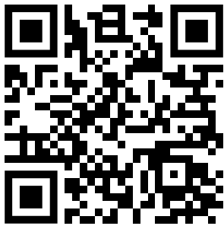
Tasks (short version)
At home:
Every Monday: Download the files from the cloud.
Work with the current Jupyter Notebook.
Publish two questions in FAQ:
One regarding the Jupyter Notebook and
One regarding the exam preparations.
Link to cloud files

Slide 9
Time schedule
1 week: Python tutorial
5 weeks: theory part A
1 week: mock exam
5 weeks: theory part B
Remaining weeks: exam preparation

Slide 10
Time schedule
Each Monday, the cloud is already updated
download newest files
Read the tasks of the week (Focus: work with the Jupyter Notebook)
Do the tasks of the week☺
Week 1: 16.03. – 20.03.
Week 2: Acoustic Conference and Easter: no lessons, but FAQ and self learning
On Sunday, 05.04.,
the software should run and
Week 1 and week 2 should be finished by you.
Week 3: 06.04. – 10.04.
Week 4: 13.04. – 17.04.
…

Slide 11
Support for the students
Weekly support:
use the time in the class room for questions
Every weekend, the reference solutions are published
Normal consultation hours: please take a look at my website (google->“spiertz thws“)
Midterm support: mock exam
Asynchronous feedback by FAQ forum (moderated by me)
Immediate feedback for programming exercises by unit tests

Slide 12
Grade improvement
Special task in april and may:
Successfull participating means: if you pass the exam, your grade will be improved by one step, e.g. 3.7 -> 3.3
I need four voice recordings (2 female, 2 male) under different background noise situation.
The recording time will be in the range of 5-10 minutes per person.
These recordings will be published anonymously.
I will also participate.
The scientific topic: the lombard effect

Slide 13
Summary
Until 05.04.
Install recent Python version
Install Jupyter Notebook
(Visual Studio Code and Github Copilot are optionally recommended)
After 05.04. start your weekly schedule:
Monday: download recent files
Until Thursday:
Work with the material
Publish two questions in FAQ (one regarding the Jupyter Notebook, one regarding the exam preparations)

Slide 14
Thanks a lot for your attention...
Martin Spiertz
+49 9721 940 - 8770
martin.spiertz@thws.de

