Slide 1
Dynamic Weighted Majority

Slide 2
The algorithm
To handle concept drift
Dynamic ensemble of basic classifiers
The ensemble makes a mistake => new classifier added
Individual classifier makes a mistake => it’s weight is decreased
Notes:
Start with one classifier.
Classifiers starting weight is one, and the weights are normalized at each timestamp
There is the parameter Beta, between [0, 1], controls weight update. There is a threshold theta, if the classifier’s weight is below that, it is dropped.
One more parameter, a period, controls how many inputs have to be processed before a weight update

Slide 3
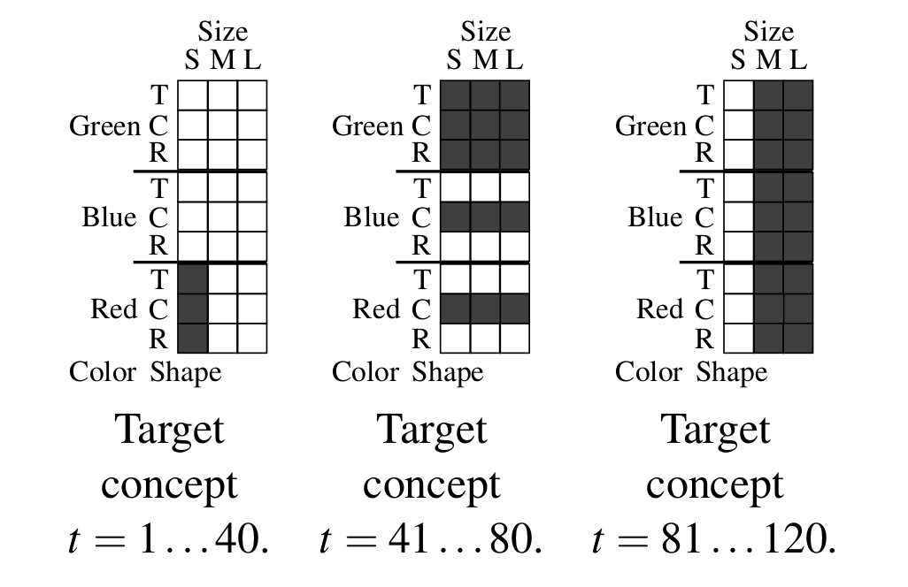
The data
Stagger concepts
Notes:
Three concepts, 120 timestamps for training.
At each timestamp, a 100 test samples are genrated for the given concept.

Slide 4
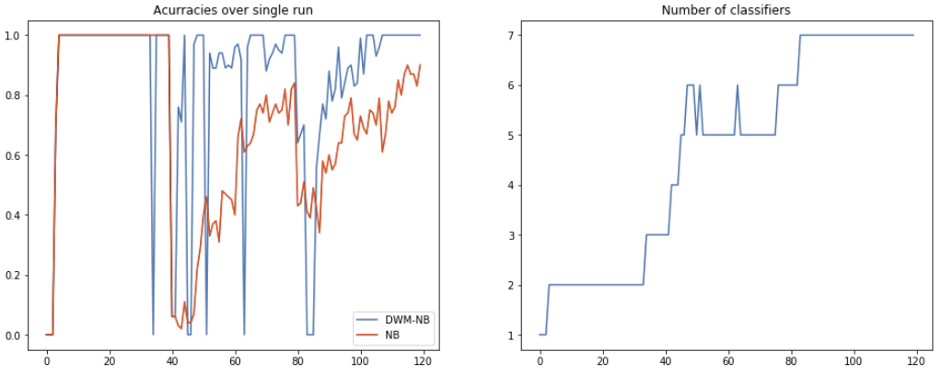
Single run
Notes:
Big swings in DWM => when a new classifier is created, its weight is high, but actually it wasn’t trained on many data points.
Also it is already visible that during the second and third concept, DWM-NB performs better.

Slide 5
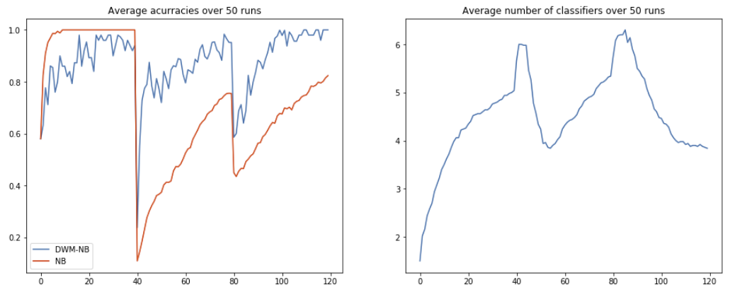
Average of 50 runs
Notes:
The curve is smoother when averaged over multiple runs.
Also the peaks in the number of classifiers is visible when the drift happens.

Slide 6
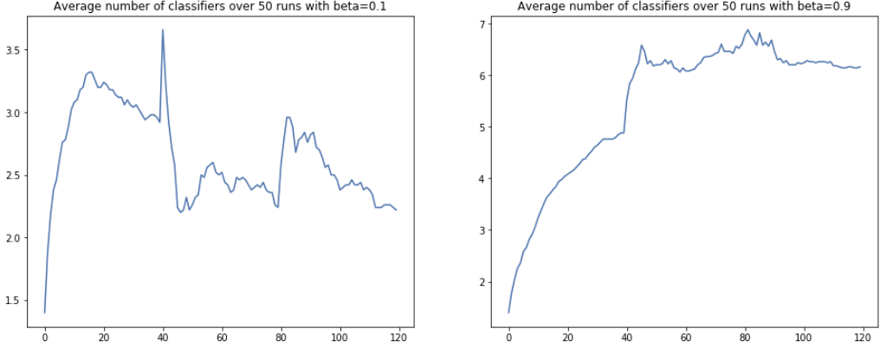
Effect of Beta
Notes:
Does not affect performance.
When beta is small, the curve oscillates a bit more, classifiers are being added and removed frequently, and a low number of them are kept overall.
When beta is high, classifiers are only dropped after many mistakes, and a high number of them are kept.

Slide 7
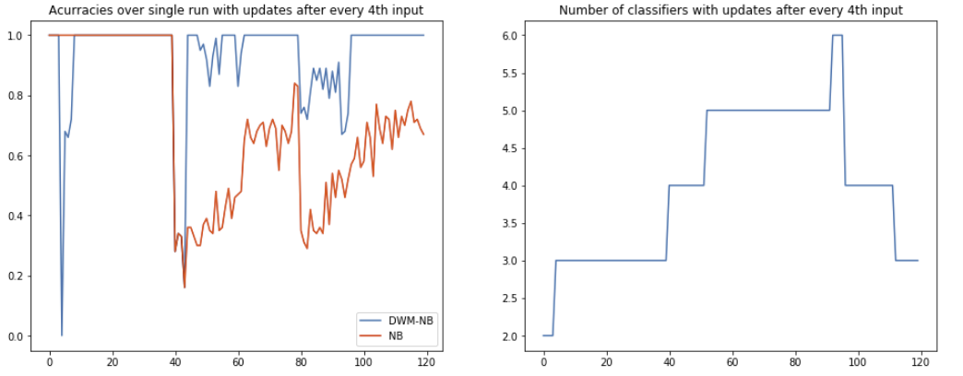
Effect of the period parameter
Notes:
By increasing the period parameter, there are less performance swings, and less classifiers are added and created overall, as expected.

