Slide 1


AUTHORS Armenante Valerio Capaldo Marco Di Salvo Dario
SafeStreets
Notes:
This presentation is about our work on SafeStreets mandatory project.

Slide 2
RASD Presentation Outline
System’s boundaries: world & machine phenomena
Goals of the software system
System requirement and domain assumption
Formal Analysis Using Alloy
Notes:
For what concern RASD we will focus on goals, requirement and domain assumption relative to the software system. Then some phenomena are going to be described together with formal analysis made using Alloy.

Slide 3


Goals of the software system
[G1-G3] | Customers can be uniquely identified, thanks to completion of Registration/ Authentication Process.
[G4] | Allows Users to notify authorities when traffic violations occur.
[G5] | Allows Authority Members (AM) to receive the notifications about traffic violations in order to increase the local security.
[G6-G7] | Allows AM and Users to mine information on statistics built by the software itself.
[G8] | Builds a cross information analysis between municipality’s data and itself data in order to improve reliability of the service and suggests to municipality possible interventions.
[G9] | Allows municipality (in particular local police authority) to retrieve traffic violations in order to generate relative traffic tickets.
[G10] | Builds statistics using information related to emitted traffic tickets
Notes:
Those are goal of our SafeStreets application. Main functionality require a form (or something like that) which allow User to notify Authority and Authority Member to receive and handle that notification. Statistics are built for both observed violation and fines relative to them.
Advanced functionalities has then as goal merge SafeStreets own data with those caming from Municipality and make possible to generate relative traffic tickets.

Slide 4


Requirement and domain assumption 1/2
[R17] | Mobile application must provide a section where Users can fill a form, uploading images about the occurred traffic violations.
[R26] | System must be able to recognize possible kind of altered information contained in a traffic violation sent by a User.
[R28] | Software system shows statistics related to unsafe areas thanks to highest number of violations.
[R38] | SafeStreets provides an algorithm able to cross information which derives from its own and municipality’s statistics.
[R44] | SafeStreets must be able to send information related to a traffic violation to the nearest local police station which consequently generates traffic tickets.
Notes:
Most important requirements that our application has to sutisfy in order to achieve showed goals are the following: then list all.

Slide 5

Requirement and domain assumption 2/2
[D5] | Devices used by end users are supposed to have a camera and an integrated and enabled GPS sensor.
[D8] | Each already uploaded notification of violation is correctly received and stored by the system.
[D10] | Municipality can fulfil the improvements suggested by the software.
[D13] | Municipality service is well integrated with SafeStreets.
[D15] | System is supposed to be well integrated with ReadingPlate algorithm that has been already designed and is correctly working.
[D18] | External service (FindOwnerPlate) is well integrated with SafeStreets that permits to retrieve personal data of the vehicle’s owner.
Notes:
In order to make all functionalities working and reliable of course some assumptions like those regarding well integration of external algorithm and services that SafeStreets has to communicate with. Position of user whose perform a report and data server on which those information has stored are supposed to be reliable. In addition, since SafeStreets hint possible intervention to Municipality is supposed they have enough resources to put in practice those suggestions.

Slide 6
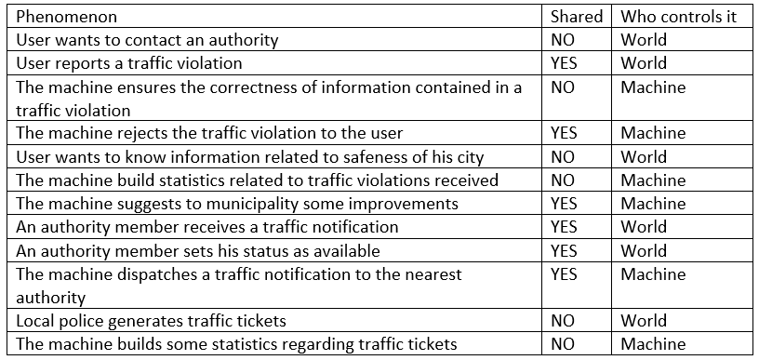
System’s boundaries: World and Machine phenomena
Table: World and Machine Phenomena

Slide 7

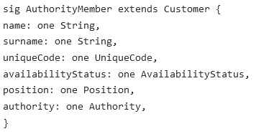
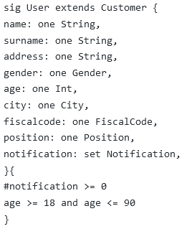
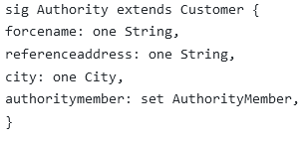
Formal analysis using Alloy: Main signatures 1/2
4. Authority Member Signature
1. Customer abstract Signature
2. User Signature
3. Authority Signature

Slide 8

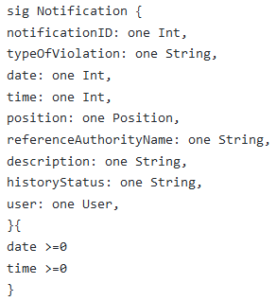
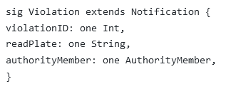

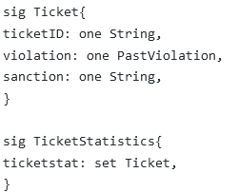
Formal analysis using Alloy: Main signatures 2/2
3. User & Authority Statistics Signature
1. Notification Signature
2. Violation Signature
4. Ticket & Statistics Signature

Slide 9



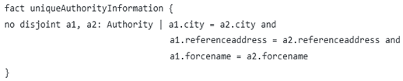


Formal analysis using Alloy: Model constraint
1. Customers cardinality
4. AM is unavailable if assigned handling a Notification
2. Availability of AM
5. Authority district is a unique triple of value
3. Notification ID is unique
6. All emitted Tickets are relative to a Past Violation

Slide 10
DD Presentation Outline
System’s Components
Components’ Interfaces
Meaningful Interactions
Implementation, Integration and Testing

Slide 11
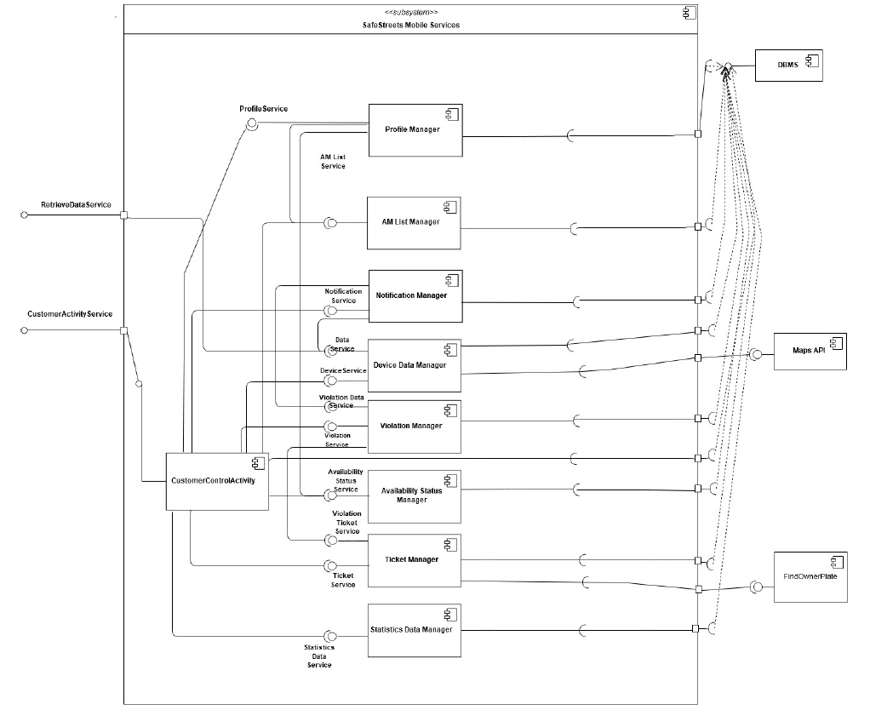
System Components
Component of Mobile Service.

Slide 12
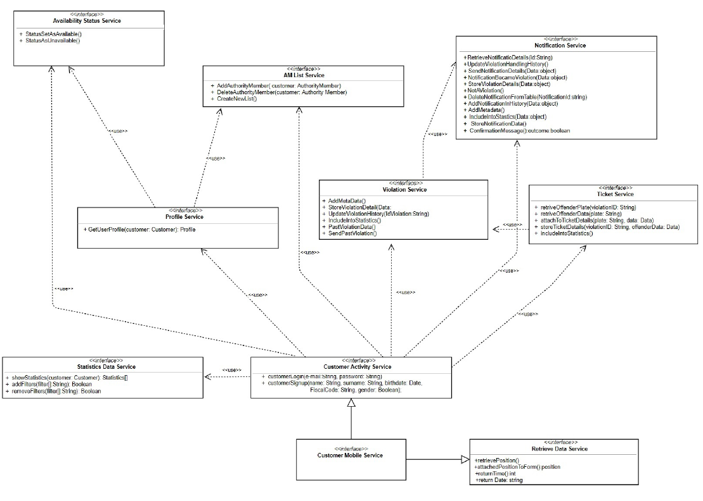
Component Interfaces
Component Interfaces Customer Mobile Service.

Slide 13
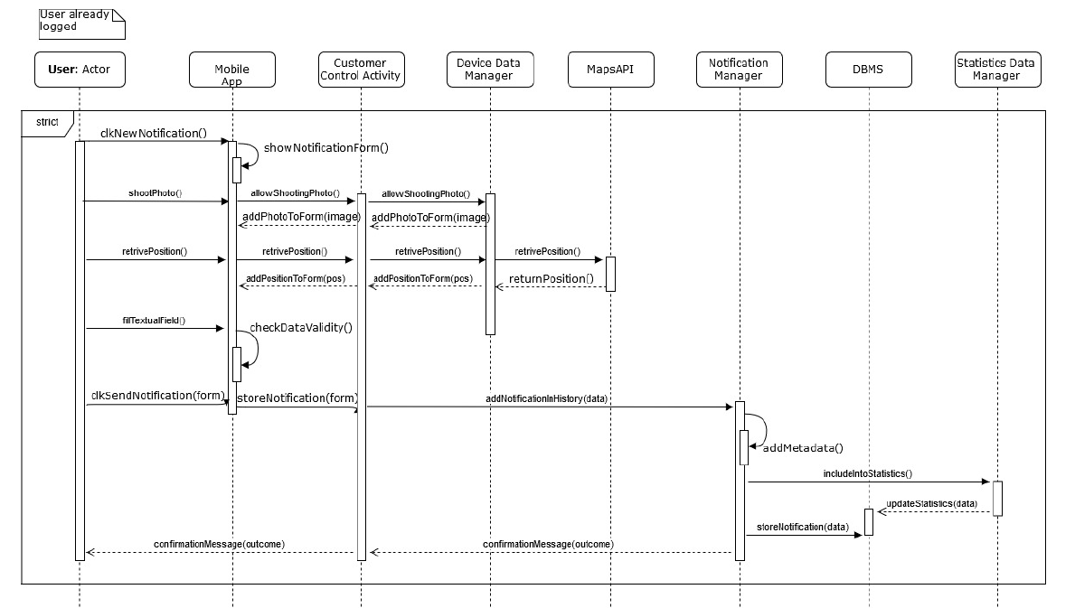
Meaningful Interactions
User send notification
runtime view.

Slide 14
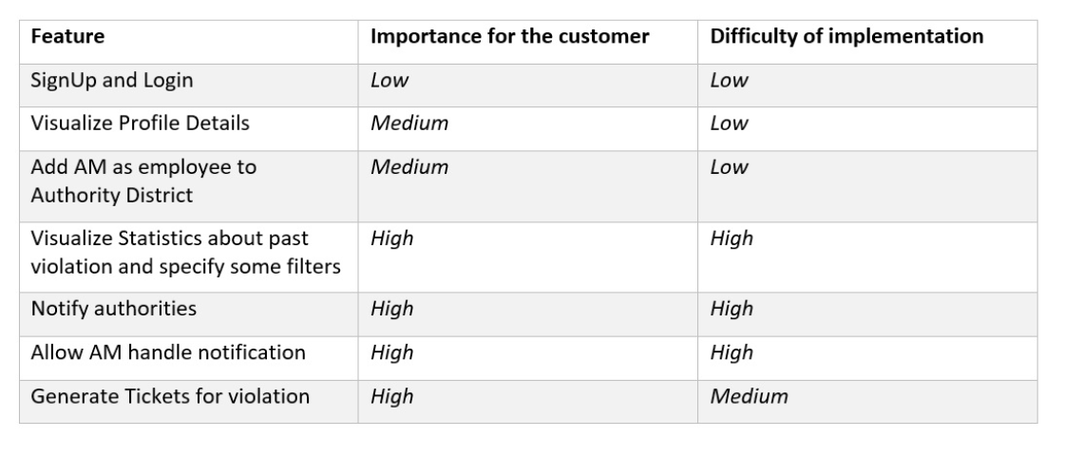
Implementation, Integration and Testing
Importance for the .. D customer, difficulty of . D implementation.
Testing: bottom-up …approach used
Test component once at . time then proceed for . . integration phase

