Slide 1
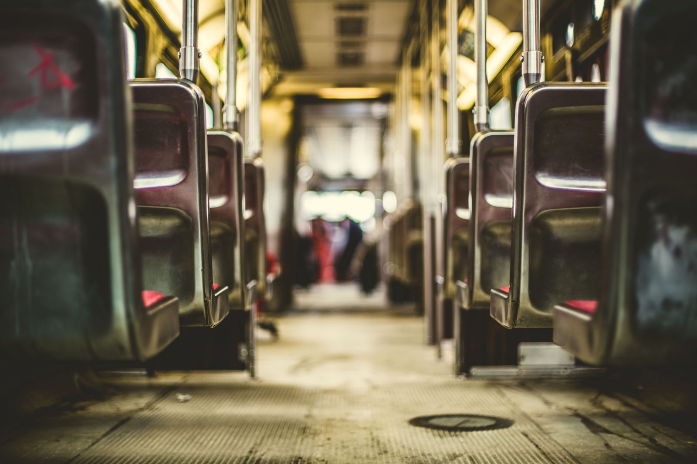
Big Data and Data Science UTA Accident Data
Adesh Valecha
Sushruti Acharya
Ashutosh Sharma

Slide 2
Addressing the Business Problem
In the occurrence of the accidents it is important to identify that whether the accident is a matter of concern or not. For this we need to find out that the accidents are avoidable or unavoidable.
Moreover, Bus operator is one who is most crucial entity associated with an accidents. We need to identify efficiency, driving skills, training required for the driver by analyzing their performance (score).

Slide 3
Analysis goals
Our analysis comprises of two goals:
1. We build the following classification model:
Decision Tree
Random Forest
Gradient Boost Tree
SVN
To analyze and classify the UTA Accident data to determine which accidents are avoidable and which are unavoidable.

Slide 4
Analysis goals
Our analysis comprises of two goals:
2. Our next goal is to analyze and build the following regression model:
Linear Regression,
Generalized Linear Regression,
Decision Tree Regressor,
Random Forest Regressor,
GBT Regressor
To predict the score of the drivers associated with the accidents based upon different data variables.

Slide 5
Data Used
The data has been provided by UTA department.
We are using the UTA accident data of last Six years (2013-2018).
The are two different datasets we are using:
Camera Flag Data Set
Accident Data Set

Slide 6
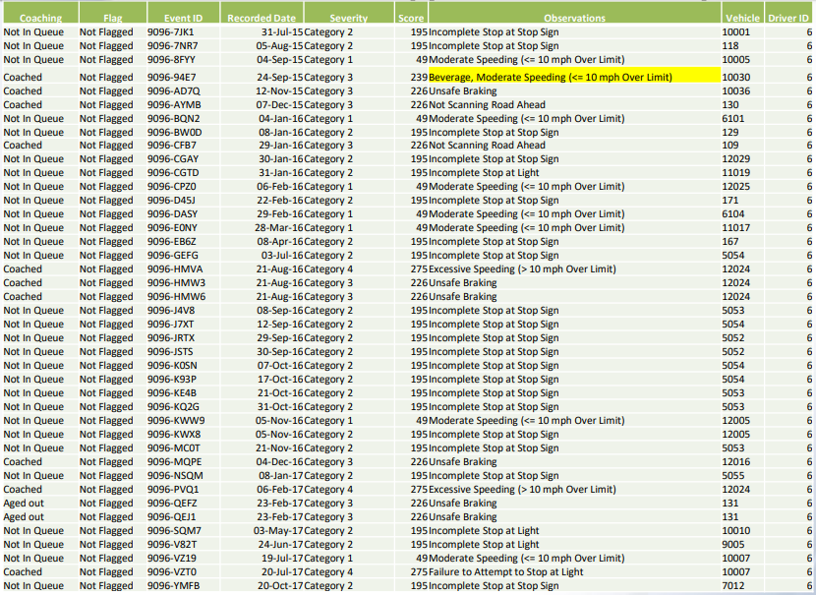
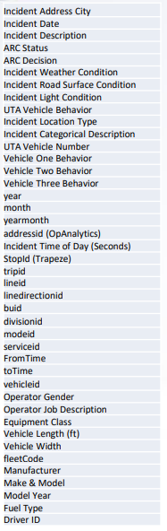
Camera Flag Data Set
Accident Data Set

Slide 7
Data Mining Task - Classification
Data Preparation & Exploration
We have considered only those records which are reviewed by the accident review committee, where ARC Status = "ARCR"
Removed columns such as Incident Categorical Description’, 'Incident Description’, 'UTA Vehicle Number','addressid (OpAnalytics) as they are not significant features for data mining tasks
Additionally, considered only those records with ARC Decision as avoidable and unavoidable
Removed records with NULL values.
Renamed the columns as RFormula accept column names without spaces.

Slide 8
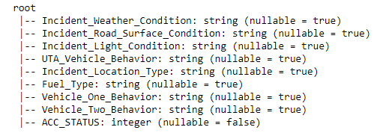
Prepared Data Schema for Classification

Slide 9
Model Evaluation
We are evaluating decision tree classifier model on Normalized data and using top7 features provided by Chisquare method. We observed that we are getting better accuracy results on using normalized data. Hence, we are using normalized data for building different classification models.
On comparing the evaluation metric results we found that Decision Tree Classifier and SVN are performing better than the other classification models.
Decision Tree Classifier
Precision(class1): 0.863 Recall(class1): 0.858
F-Score(class1): 0.86 Precision(class2): 0.639 Recall(class2): 0.649
F-Score(class2): 0.644 Accuracy: 0.799
SVN Classifier
Precision(class1): 0.848 Recall(class1): 0.879
F-Score(class1): 0.863 Precision(class2): 0.656 Recall(class2): 0.594
F-Score(class2): 0.623
Accuracy: 0.799

Slide 10
Data Mining Task - Regression
Data Preparation & Exploration
We have considered only those records which are reviewed by the accident review committee, where ARC Status = "ARCR".
Removed columns such as Incident Categorical Description','Incident Description','UTA Vehicle Number','addressid (OpAnalytics) as they are not significant features for data mining tasks.
Removed records with NULL values.
Renamed the columns as RFormula accept column names without spaces.

Slide 11
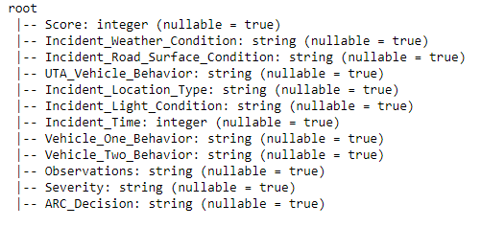
Prepared Data Schema for Regression

Slide 12
Model Evaluation
On comparing the evaluation results we found that Linear Regression and Generalized Linear Regression are performing better than the other regression models.
Linear Regression
LR: MAE: 0.3 RMSE: 3.22 R2: 1.0
Generalized Linear Regression
GLR: MAE: 0.2 RMSE: 3.12 R2: 1.0

Slide 13
Issues and Challenges
Our biggest challenge was the project switch. We changed our data set and project on the last moment. But we kept our nerves and did a good job as team
We were able to implement both classification and regression models and our next task is to refine our results by doing the performance tuning
We started our project just couple of weeks back and we were able to put more than 30 hours to achieve the results
Total hours to be budgeted for a real-world data mining project like this would be around 35 hours considering 10% scheduled slippage

Slide 14
Risk Management
Based on the experience on this project, we found that there should ample amount of data for performing the data mining task which will allow to build more accurate models.
Data cleaning task should be focused more, as it will directly impact the precision of the data models.

Slide 15
Thank You!

