Slide 1

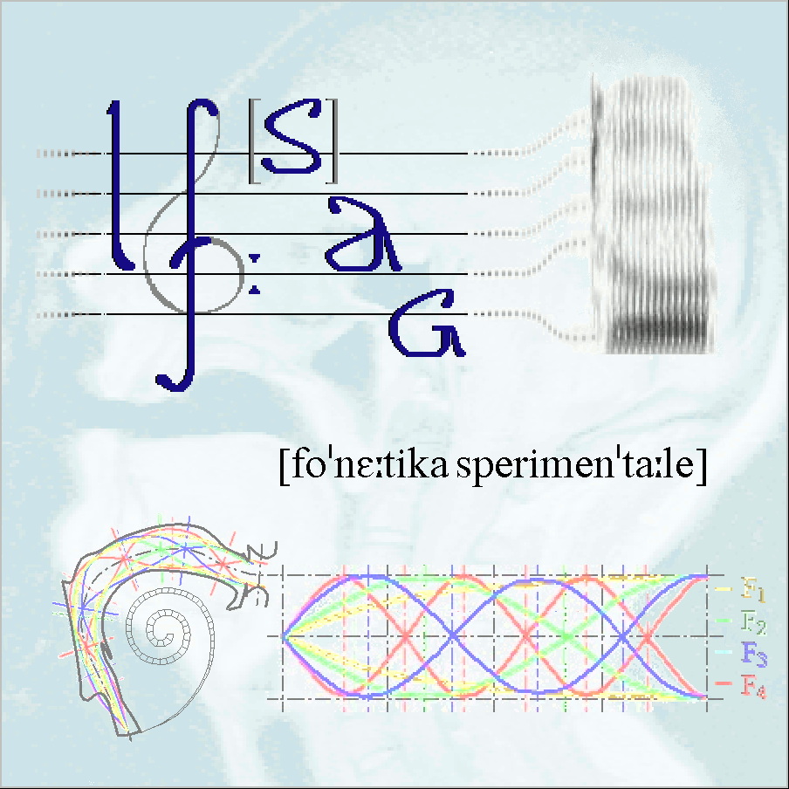

Identifying languages: testing human abilities
http://www.evalita.it/2014
Antonio Romano
Laboratorio di Fonetica Sperimentale “Arturo Genre”
Università degli Studi di Torino
http://www.lfsag.unito.it/EVALITA2014/index.html

Slide 2
Introduction
You will be asked to listen to short speech samples (10 s max) in some languages and to assign to each of them a language name (by selecting it from a list which will be displayed during the listening).
CLICK to see which are the test languages
1

Slide 3
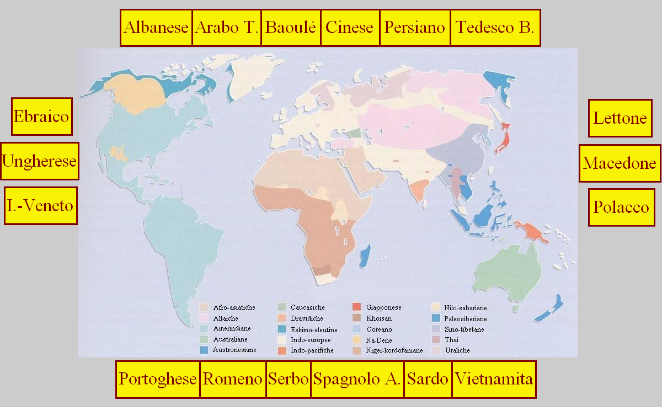
The languages of the test [CLICK]
Mind the order
Albanian
Arabic
Chinese
Farsi
Bavarian (German d.)
Lista
Hebrew
Latvian
Hungarian
Macedonian
Istroveneto
Polish
Portuguese (Cabo Verde sp.)
Spanish (Argentina)
Romanian
Serbian
Sardinian
Vietnamese
2

Slide 4
How it works?
At the beginning of the test, an interactive window will be displayed with a language list.
A first sound sample is played.
Select the language name, then – if you want to confirm your choice – click on the “OK” virtual button.
Your answer is thus recorded and the following sound sample is played.
Make your choice as soon as possible, but take the time you need in order to satisfactorily assess your answer
(you are even allowed to listen again to each sound sample).
[CLICK to see a simulation of the interactive window]
3

Slide 5
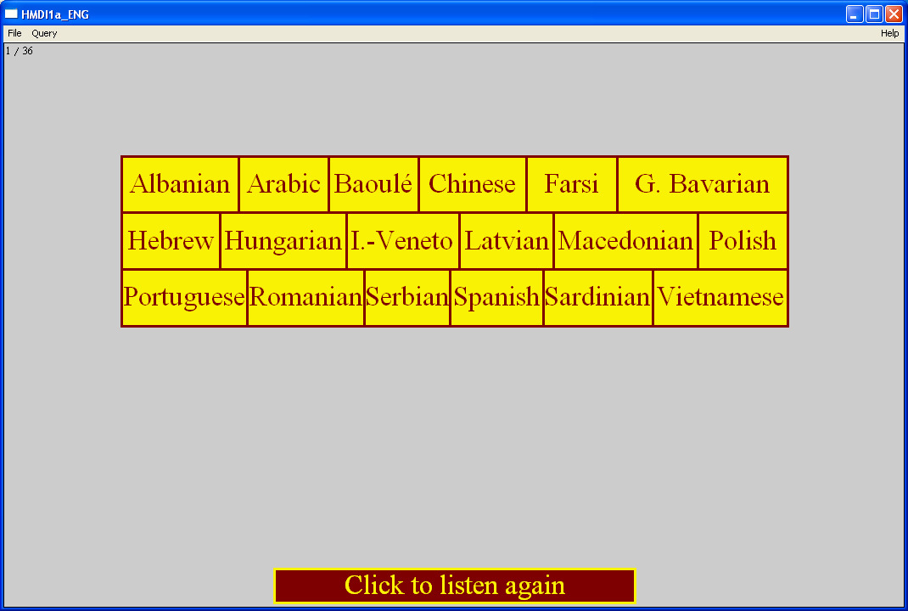
The interactive window
[CLICK]
Watch carefully the position of each language name before to start in order to speed up the the assignment task
[CLICK to continue]
4

Slide 6
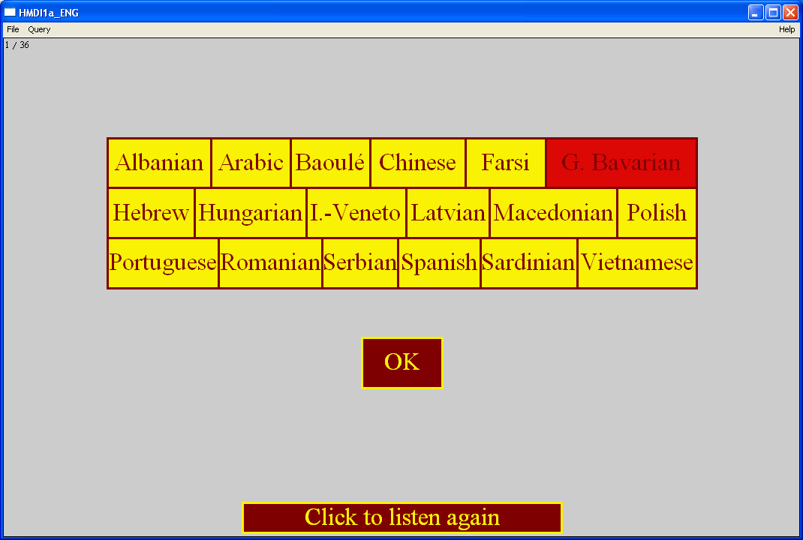
Example of the phases of a choice
[CLICK]
[CLICK to continue]
5

Slide 7
This introduction is ending.
After leaving this ppt you will be directed to an interactive PRAAT routine…
6

Slide 8
Please execute PRAAT, load the HMDI script and launch it by clicking on the “Run” button…
6

Slide 9
When you finished, don’t forget to “Extract Results” and save the ResultsMFC object as a textfile (with your initials) and send it to:
antonio.romano@unito.it
Thank you for your help!
7

