Slide 1

Pitch deck

Slide 2
About us
At Contoso, we empower organizations to foster collaborative thinking to further drive workplace innovation. By closing the loop and leveraging agile frameworks, we help businesses grow organically and foster a consumer-first mindset.

Slide 3

Company overview

Slide 4

Product overview
First beautifully designed product that's both stylish and functional

Slide 5
Problem
Market gap: few, if any, products on the market help customers like we do
Customers: 66% of US consumers spend money on multiple products that only partially resolves their issue
Financials: millennials account for about a quarter of the $48 billion spent on other products in 2018
Costs: loss of productivity costing consumers thousands of dollars
Usability: customers want something easy to use that helps make their life easier

Slide 6

Product benefits
Online store and market swap

Slide 7
Our competition
Our product is priced below that of other companies on the market
Design is simple and easy to use, compared to the complex designs of the competitors
Affordability is the main draw for our consumers to our product
Company A product is more expensive
Companies B & C product is expensive and inconvenient to use
Companies D & E product is affordable, but inconvenient to use

Slide 8
Product overview
Unique
First to market
Tested
Authentic
Only product specifically dedicated to this niche market
First beautifully designed product that's both stylish and functional
Conducted testing with college students in the area
Designed with the help and input of experts in the field

Slide 9
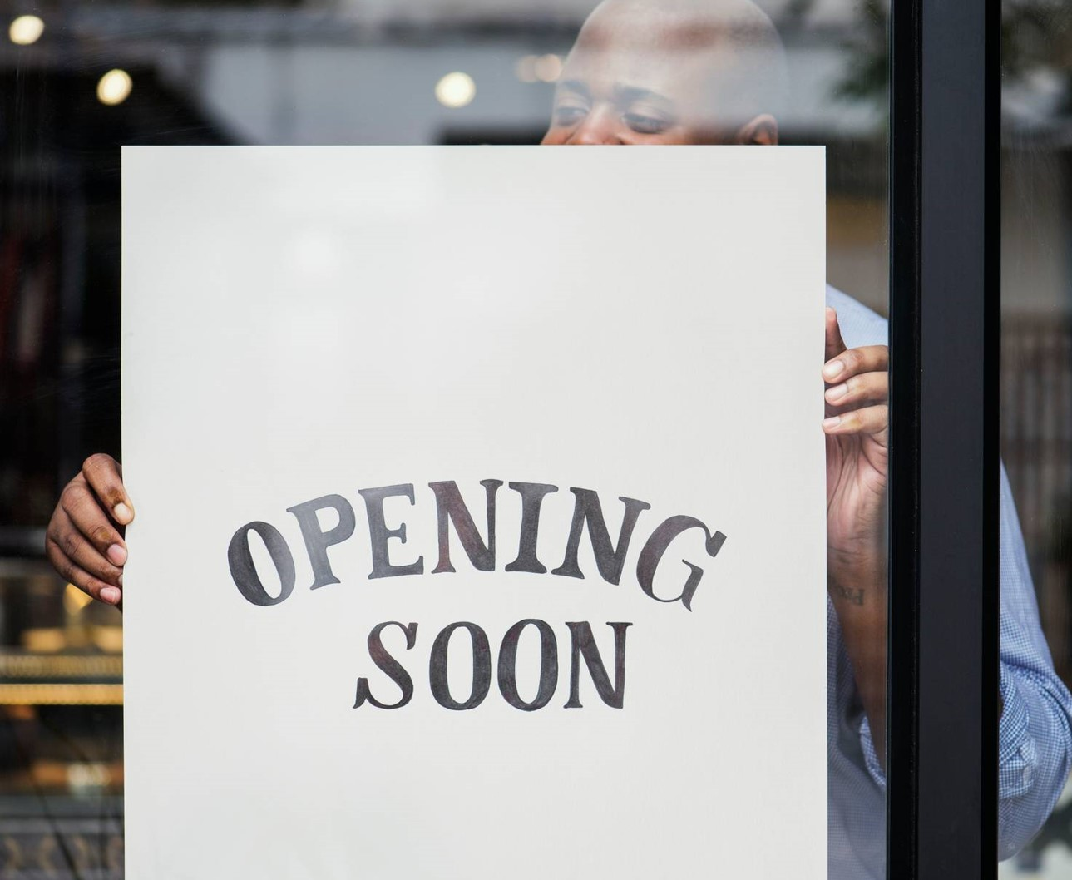
Growth strategy
Feb 20XX: roll out product to high profile or top-level participants to help establish the product
May 20XX: release the product to the public and monitor press release and social media accounts
Oct 20XX: gather feedback and adjust product design as necessary

Slide 10
Market overview
Opportunity to build
Fully inclusive market
Total addressable market
Freedom to invent
Selectively inclusive market
Serviceable available market
 | Clients | Orders | Gross revenue | Net revenue
20XX | 10 | 100 | $10,000 | $7,000
20XX | 20 | 200 | $20,000 | $16,000
20XX | 30 | 300 | $30,000 | $25,000
20XX | 40 | 400 | $40,000 | $30,000

Slide 11
Solution
Our product makes consumer lives easier, and no other product on the market offers the same features
Gen Z (18-25 years old)
Reduce expenses for replacement products
Simple design that gives customers the targeted information they need
Close the gap
Target audience
Cost savings
Easy to use

Slide 12
Financials
 | Year 1 | Year 2 | Year 3
Income
Users | 50,000 | 400,000 | 1,600,000
Sales | 500,000 | 4,000,000 | 16,000,000
Average price per sale | 75 | 80 | 90
Revenue @ 15% | 5,625,000 | 48,000,000 | 216,000,000
Gross profit | 5,625,000 | 48,000,000 | 216,000,000

Slide 13
Thank you
Brita Tamm
502-555-0152
brita@firstupconsultants.com
www.firstupconsultants.com

