Slide 1
Introduction to data processing and cleaning
Module 3: Day 2
Valentina Giunchiglia and Dragos Gruia

Slide 2
Schedule of today
Module 3: Day 2
Morning
PRESENTATION: What is data cleaning and processing?
GUIDED WORKSHOP: COVID and Cognition
Afternoon
INDIVIDUAL WORKSHOP: Dementia and Cognition
PRESENTATION: How to write a report?

Slide 3
Module 3: Day 2
Why is it important?
Machine learning algorithm predicts the marking rather than the melanoma
Winkler et al. 2019

Slide 4
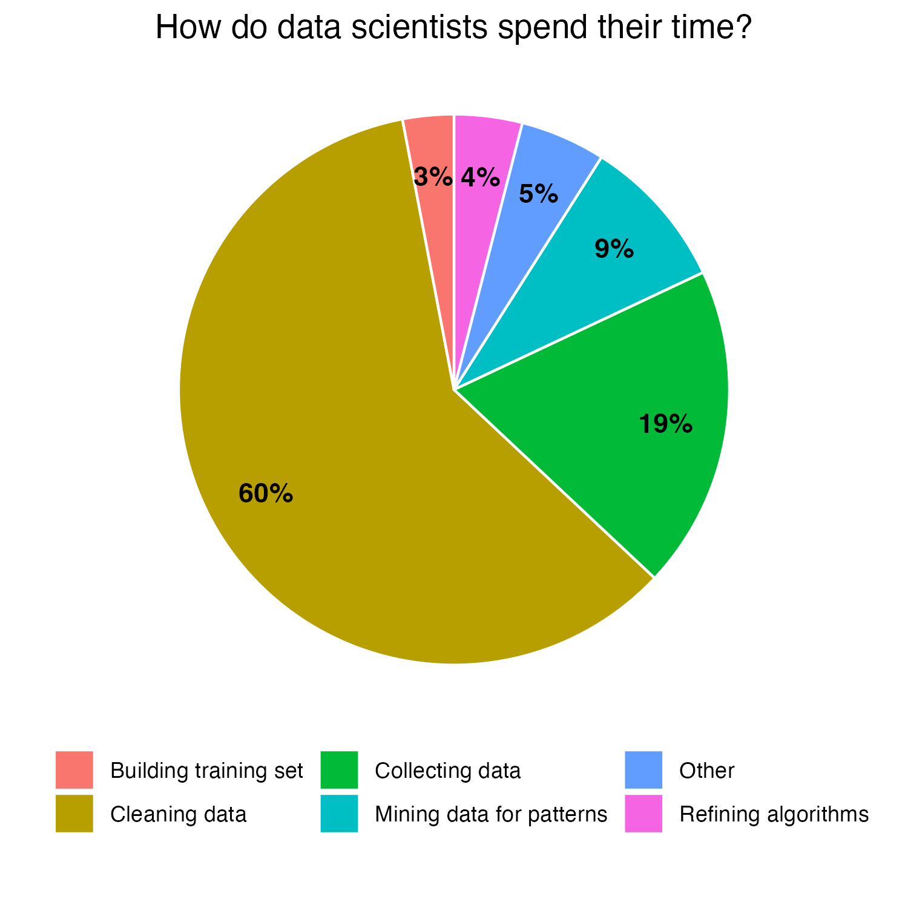
Module 3: Day 2
Why is it important?
Data quality cost pyramid
1
Prevention
x10 Data cleaning
x100 Problem fixing
Sebastianelli et al. 2020

Slide 5
Module 3: Day 2
Data cleaning and processing
DATA CLEANING
DATA PROCESSING
VS
Process of fixing and removing incorrect, corrupted, incomplete, duplicated, and incorrectly formatted data from a dataset
Process of data conversion from a given form to a more easy-to-use one based on the aims of the analysis

Slide 6
Module 3: Day 2
Data cleaning and processing
DATA CLEANING
DATA PROCESSING
VS
Process of fixing and removing incorrect, corrupted, incomplete, duplicated, and incorrectly formatted data from a dataset
Process of data conversion from a given form to a more easy-to-use one based on the aims of the analysis

Slide 7
Module 3: Day 2
Data cleaning
DATA CLEANING
Process of fixing and removing incorrect, corrupted, incomplete, duplicated, and incorrectly formatted data from a dataset

Slide 8

Module 3: Day 2
Data cleaning: irrelevant data
Irrelevant data and data structure
Do you have row and column names?
Are column and row names interpretable?
Which data do you need for your analysis?
Add column and row names
Modify column and row names
Filter data
Computational resources and interpretability

Slide 9
Module 3: Day 2
Data cleaning: data constraints
Data Constraints
1. Data Type:
Are numerical columns int or float?
Are categorical variables str?
Data Range:
Are the numerical columns within the expected range? (Ex: Age)
Convert to proper data types
Different solutions:
Set to NA
Set equal to max or min
Remove participants
Check for typing error

Slide 10
Module 3: Day 2
Data cleaning: duplicates
De-duplication
-> Why do you have duplicates?
Are there fully duplicated rows?
Are there partially duplicates rows?
Removal of duplicates
Different solutions (depend on WHY):
Merge the partial duplicates
Remove the partial duplicates
Select one of the partial duplicates
Keep entry that are duplicates and set rest as NA

Slide 11
Module 3: Day 2
Data cleaning: formatting
Data formatting
Are there unique names for each category (e.g. Education?)
Are text data consistently formatted? (Ex: dates)
Are there special characters?
Different solutions based on data:
Map different categories to unique names
Set as NA categories with different formatting (if right category not clear)
Infer right category from different data entries
Different solutions:
Match right formatting
Set as NA (if not interpretable)
Infer from other data points
Remove special characters (iMPORTANT for free text)

Slide 12
Module 3: Day 2
Data cleaning: uniformity
Data Uniformity
Do all numerical values have the same units (Ex: ms)?
Are columns with similar information consistent (Ex: age and age in decade)?
Different solutions:
Standardise units (if easy to understand)
Set as NA
Different solutions:
Correct the inconsistent values
Set as NA

Slide 13
Module 3: Day 2
Data cleaning: missing data
Missing data
-> Are the data missing at random or not? Why are they missing?
1. Are there missing data? How many? (IMPORTANT: Always check the number of missing data)
Different solutions:
Drop participants with more than N NA
Drop columns with more than N NA
Impute missing data with mean/median
Impute missing data with ML algorithms
Infer missing data from other data points
You cannot analyse data if there are missing values

Slide 14
Module 3: Day 2
Data cleaning: outliers
Outliers detection
1. Are there outliers? (WHY?)
Are they really outliers?
Different solutions:
Filter out the outliers (e.g. set as NA)
Winsorize the outliers
Set as mean/median
It really depends on the type of outliers!!

Slide 15
Module 3: Day 2
Data cleaning: feature scaling
Feature scaling
1. Are the numerical data properly scaled?
Different solutions:
Data stadardisation: rescale data to have a mean of 0 and standard deviation of 1
Data normalisation: rescale values in a range between 0 and 1
Scaling is really important in Machine learning

Slide 16
Let’s apply what you have learnt to real data!
Module 3: Day 2

