Slide 1
Introduction to programming
2022/2023
Valentina Giunchiglia and Dragos Gruia

Slide 2
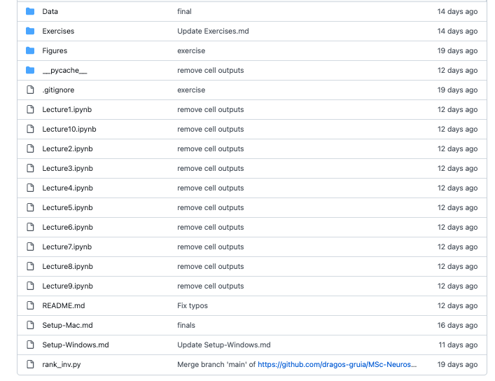

Pre-material
https://github.com/dragos-gruia/MSc-Neuroscience-Python-Course-Development
We expect you to have completed ALL the lectures

Slide 3
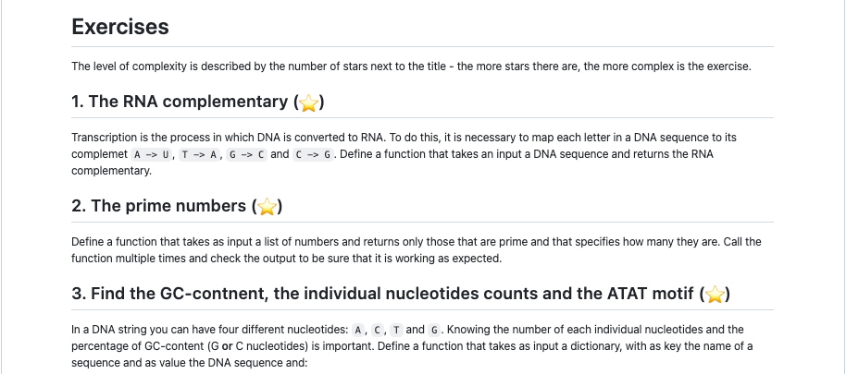
Pre-material
https://github.com/dragos-gruia/MSc-Neuroscience-Python-Course-Development
If you didn’t complete all the exercise, it’s fine. BUT the only way to learn how to code is by coding yourself
You NEED to understand coding to be able to complete M3

Slide 4
Schedule of today
Morning
Afternoon
Two alternatives:
Option 1: Review of primer coding exercises + Q&A
Option 2: visualization with seaborn
Let’s code!!
8 exercises that review the material you completed in the primer
You have 20 minutes to solve each exercise
Don’t worry!! We are here to help

Slide 5
Option 1 or Option 2?
Unfinished primer exercises
Questions about the lectures or the exercises
Completed all lectures
Completed all primer exercises
No questions about the lectures nor the exercises
OPTION 1
OPTION 2

Slide 6
Time to code!
8 exercises
3 levels of complexity
30 minutes per exercise
Work alone or in pairs (the more you code alone, the more you learn)
We are here to help!

Slide 7
Exercise 1: the leap years ⭐️
Write a function that prints the next 20 leap years starting from 2022.
Input: (2022, 20)
Desired output
2024, 2028, 2032, 2036, 2040, 2044, 2048 ….

Slide 8
Exercise 1: Solution
def leap_year(year_start, nyears):
years = []
count_year = 0
count_leap_year = 0
while count_leap_year < nyears:
year = year_start + count_year
if year % 4 == 0 and (year % 100 != 0 or year % 400 == 0):
years.append(year)
count_leap_year = count_leap_year+1
count_year = count_year+1
return years
leap_year(2022, 20)

Slide 9
Exercise 2: characters numbers ⭐️
Write a function that calculates the number of characters in each song written by Taylor Swift. Save these in a different series and print them. Also print the highest number of characters that a song had.
Input: ("Data/spotify_taylorswift.csv", "popularity", "name”)
Example songs = pd.Series(['Clean', 'All Too Well', 'Lover', 'Ivy'])
Desired output
5, 12, 5, 3
12

Slide 10
Exercise 2: Solution
Import numpy as np
Import pandas as pd
def character_songs(path_to_file, col_title):
df = pd.read_csv(path_to_file)
songs_title = df[col_title]
lengths_songs = []
for song in songs_title:
lengths_songs.append(len(song))
print(pd.Series(lengths_songs))
print(np.max(lengths_songs))
character_songs("Data/spotify_taylorswift.csv", "name")

Slide 11
Exercise 3: popularity more than average⭐️ ⭐️
Write a function that goes through each one of Taylor’s songs and prints the names of all the ones which have higher than average popularity.
Input: ("Data/spotify_taylorswift.csv", "popularity", "name”)
Example songs = pd.Series(['Clean', 'All Too Well', 'Lover', 'Ivy’])
Example popularity = pd.Series([0.2, 0.6, 0.8, 0.4])
Desired output:
All Too Well, Lover

Slide 12
Exercise 3: Solution
Import pandas as pd
Import numpy as np
def more_popular(path_to_file, col_popularity, col_title):
df = pd.read_csv(path_to_file)
average = np.mean(df[col_popularity])
df_popular = df[df[col_popularity] > average][col_title]
print(df_popular.tolist())
more_popular("Data/spotify_taylorswift.csv", "popularity", "name")

Slide 13
Exercise 4: Find the Vowels⭐️ ⭐️
Write a function that prints the words that contain at least 2 vowels from a series.
Input: ser = pd.Series(['Apple', 'Orange', 'Plan', 'Python', 'Money'])
Desired output
Apple, Orange, Money

Slide 14
Exercise 4: Solution
def findVowels(ser):
vowels = ["a", "e","i", "o", "u"]
for ind, word in enumerate(ser):
vow_counts = 0
for letter in word:
if letter.lower() in vowels:
vow_counts = vow_counts +1
if vow_counts >= 2:
print(ind, " ", word)
words = pd.Series(['Apple', 'Orange', 'Plan', 'Python', 'Money’])
findVowels(words)

Slide 15
Exercise 5: Pig Latin⭐️ ⭐️
Write function that translates a text to Pig Latin and back. English is translated to Pig Latin by taking the first letter of every word, moving it to the end of the word and adding ‘ay’.
Input: “The quick brown fox”
Desired output
“Hetay uickqay rownbay oxfay”

Slide 16
Exercise 5: Solution
def piglatin(sentence):
list_words = sentence.split(" ")
new_sent = ""
for word in list_words:
new_word = word[1:]+word[0].lower()+"ay"
new_sent = new_sent + new_word + " "
return new_sent
example = "The quick brown fox"
piglatin(example)

Slide 17
Exercise 6: top 10 songs ⭐️ ⭐️
Write a function that finds the top 10 songs with the highest danceability and then prints the one with the highest popularity.
Input: ("Data/spotify_taylorswift.csv", "name", "danceability", "popularity")
Desired output
['I Think He Knows', 'Treacherous - Original Demo Recording’ …]
Most popular song: Paper Rings

Slide 18
Exercise 6: Solution
Import numpy as np
Import pandas as pd
def top10_songs(path_to_file, col_name, col_beats, col_popular):
df = pd.read_csv(path_to_file)
dfsort = df.sort_values(by = col_beats, ascending = False)
top10 = dfsort[0:10]
top10_names = top10[col_name].tolist()
print(top10_names)
most_pop_song = top10[top10[col_popular] == np.max(top10[col_popular])]
most_pop_song =[col_name]
print("\n")
print("Most popular song:", most_pop_song.item())
top10_songs("Data/spotify_taylorswift.csv", "name", "danceability", "popularity")

Slide 19
Exercise 7: what day is it? ⭐️ ⭐️ ⭐️
Create a function that outputs the day of the week in which each of Taylor Swift’s songs were published.
Input: ("Data/spotify_taylorswift.csv", ”release_date")
Example dates = pd.Series(['01 Jan 2010', '02-02-2011', '20120303', '2013/04/04', '2014-05-05'])
Desired output
Date: [0, 1, 2, 3, 4, 5…]
Day of week: [friday', 'friday', 'friday', 'friday', 'friday’, …]

Slide 20
Exercise 7: Solution
def day_of_week(path_to_file, col_date):
df = pd.read_csv(path_to_file)
dates = df[col_date]
days_dict = {0: "Sunday", 1: "Monday", 2: "Tuesday",
3: "Wednesday", 4: "Thursday", 5: "friday", 6: "Saturday"}
dates_num = [], days_week = []
for n, d in enumerate(dates):
leap_year_this = False
year =(int(d[2:4]) + (int(d[2:4])//4)) % 7
monthcode = "033614625035"
month = int(monthcode[int(d[5:7])])
if int(d[0:4]) > 1900 and int(d[0:4]) < 2000:
century = 0
elif int(d[0:4]) > 2000:
century = 6
if int(d[0:4]) in leap_year(1990, 30):
leap_year_this = True
total = year + month + century + int(d[8:10])
if leap_year_this:
total = total - 1
total = total % 7
day_week = days_dict[total]
dates_num.append(n)
days_week.append(day_week)
print("Dates:", dates_num)
print("Day of week", days_week)
You need to use the leap_year function that you already defined

Slide 21
Exercise 8: Building a pyramid⭐️ ⭐️ ⭐️
Write a function that prints a pyramid-like pattern with numbers starting from 1 and increasing by one each time you go down the pyramid (up to 8)
Input: 8
Desired output
1
2 2
3 3 3
4 4 4 4

Slide 22
Exercise 8: Solution
def pyramid(range_pyr):
k = range_pyr - 1
for i in range(0, range_pyr):
for j in range(0, k):
print(end=" ")
k = k - 1
for j in range(0, i+1):
print(i, end=" ")
print("\r")
pyramid(8)

