Slide 1
Introduction to programming
Valentina Giunchiglia and Dragos Gruia

Slide 2
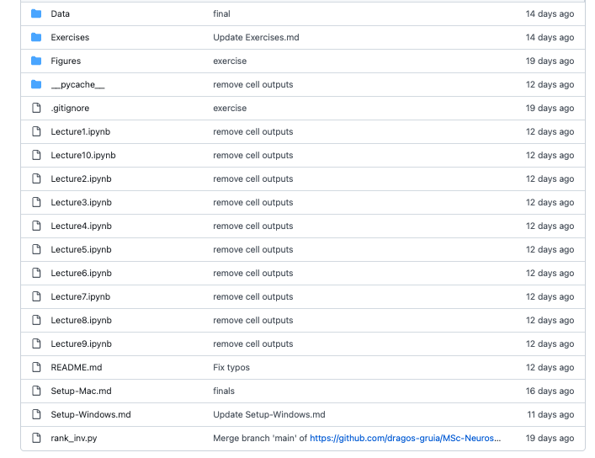

Pre-material
https://github.com/dragos-gruia/MSc-Neuroscience-Python-Course-Development
We expect you to have completed ALL the lectures

Slide 3
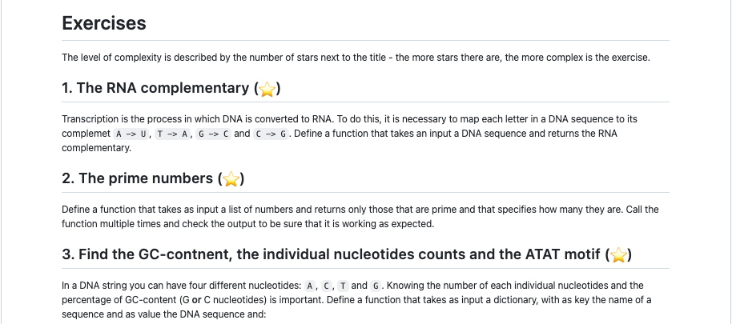
Pre-material
https://github.com/dragos-gruia/MSc-Neuroscience-Python-Course-Development
If you didn’t complete all the exercise, it’s fine. BUT the only way to learn how to code is by coding yourself
You NEED to understand coding to be able to complete M3

Slide 4
Schedule of today
Morning
Afternoon
Two alternatives:
Option 1: Review of primer coding exercises + Q&A
Option 2: visualization with seaborn
Let’s code!!
8 exercises that review the material you completed in the primer
You have 20 minutes to solve each exercise
Don’t worry!! We are here to help

Slide 5
Option 1 or Option 2?
Unfinished primer exercises
Questions about the lectures or the exercises
Completed all lectures
Completed all primer exercises
No questions about the lectures nor the exercises
OPTION 1
OPTION 2

Slide 6
Time to code!
8 exercises
3 levels of complexity
20 minutes per exercise
Work alone or in pairs (the more you code alone, the more you learn)
We are here to help!

Slide 7
Exercise 1: the leap years ⭐️

