Slide 1
Introduction to data processing and cleaning
Valentina Giunchiglia and Dragos Gruia

Slide 2
Schedule of today
Morning
PRESENTATION: What is data cleaning and processing?
GUIDED WORKSHOP: COVID and Cognition
Afternoon
INDIVIDUAL WORKSHOP: Dementia and Cognition
PRESENTATION: How to write a report?

Slide 3
Why is it important?
Machine learning algorithm predicts the marking rather than the melanoma
Winkler et al. 2019

Slide 4
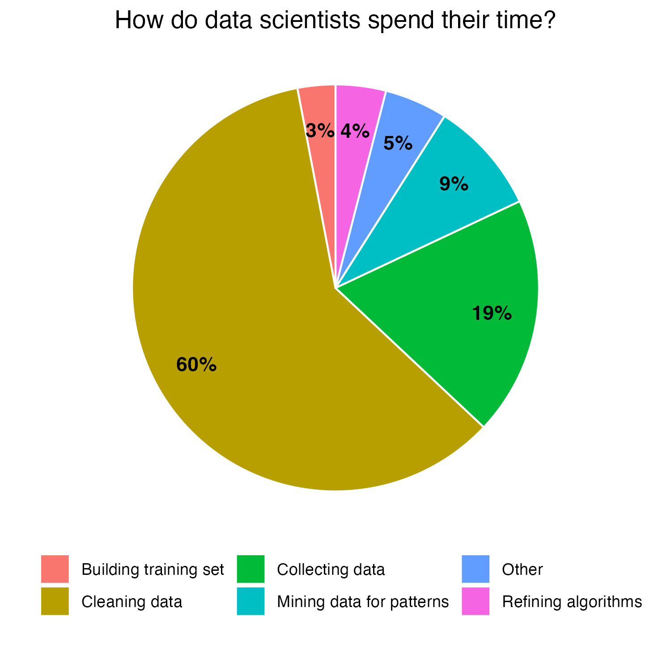
Why is it important?
Data quality cost pyramid
1
Prevention
x10 Data cleaning
x100 Problem fixing
Sebastianelli et al. 2020

Slide 5
Data cleaning and processing
DATA CLEANING
DATA PROCESSING
VS
Process of fixing and removing incorrect, corrupted, incomplete, duplicated, and incorrectly formatted data from a dataset
Process of data conversion from a given form to a more easy-to-use one based on the aims of the analysis

Slide 6
Data cleaning and processing
DATA CLEANING
DATA PROCESSING
VS
Process of fixing and removing incorrect, corrupted, incomplete, duplicated, and incorrectly formatted data from a dataset
Process of data conversion from a given form to a more easy-to-use one based on the aims of the analysis

Slide 7
Irrelevant data
De-duplication
Data Formatting
Missing data
Data normalozation
Data standardization
Outliers removal
Removal of irrelevant data
Duplicated data
Data Formatting
Data type
DATA CLEANING
Data Range
Missing data
Data Uniformity
Process of fixing and removing incorrect, corrupted, incomplete, duplicated, and incorrectly formatted data from a dataset
Outliers
Data Normalization
Data Standardizatio

