Slide 1



Predicting trajectories of acute illness using RNA velocity of whole blood​
a.k.a. The last 7 8 years of my life
Bioinformatics Webinar, 3rd March 2026
Dr Claire Dunican
Bioinformatician, Pediatric Infectious Disease
1

Slide 2
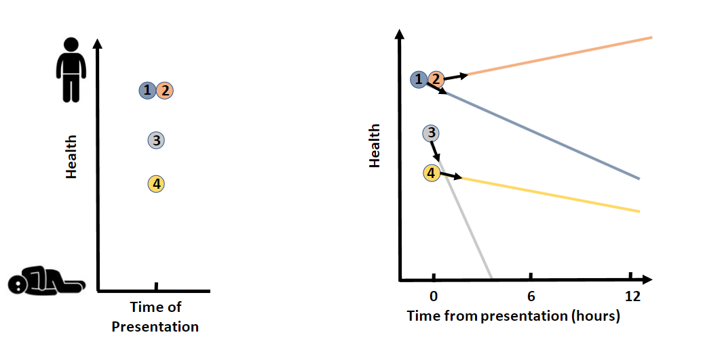
The problem: disease trajectory variation
Recovery
Death
2
2
Notes:
2

Slide 3
Our Solution: develop a method to predict future disease trajectories
3
3

Slide 4
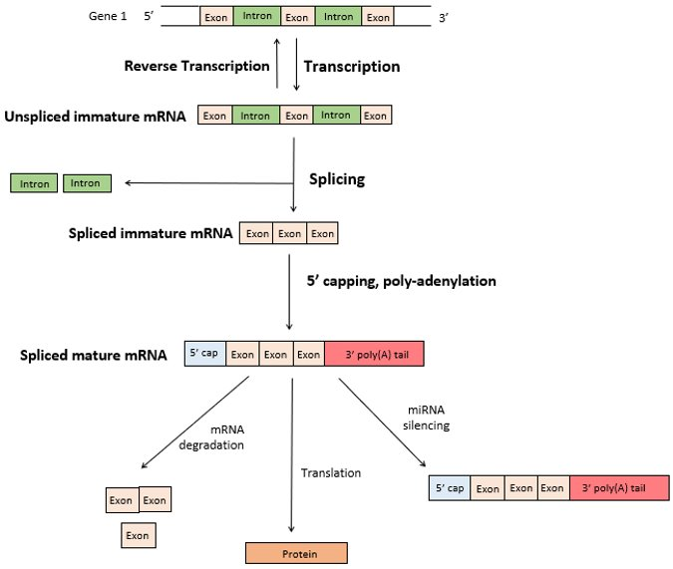
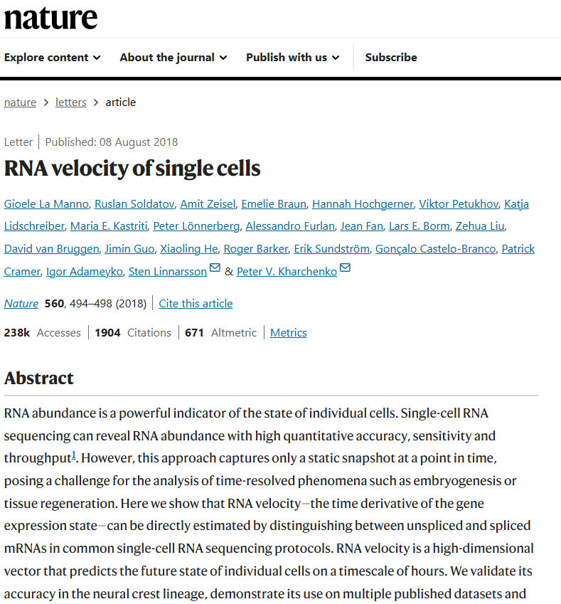
Background: RNA Velocity
Getting more out of transcriptomics
4
4

Slide 5
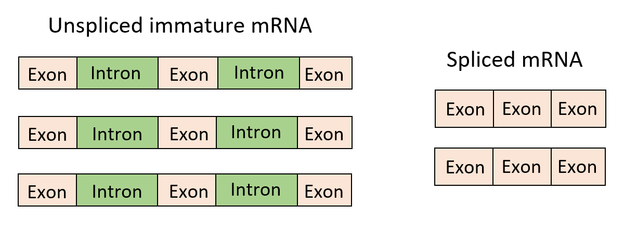
Background: RNA Velocity
(What we normally refer to when talking about mRNA)
5
5
Notes:
08/07/2026
5
And uses their inherent differences (presence of intron) to distinguish them and quantify or estimate them seprateky

Slide 6
Background: RNA Velocity
Current
Spliced
Future
unspliced
:
Positive Velocity
Gene expression
6
6
Notes:
To simplify that done, more unsplised than spliced….
6

Slide 7
Background: RNA Velocity
Current
Spliced
Future
unspliced
:
Negative Velocity
Gene expression
7
7
Notes:
To simplify that done, more unsplised than spliced….
7

Slide 8
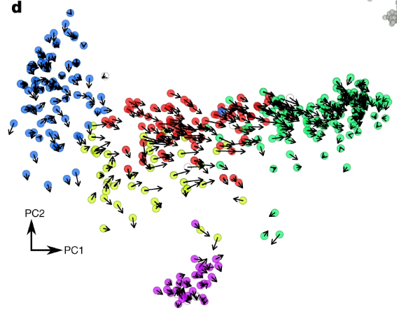
Background: RNA Velocity
PCA – Principal Component Analysis
RNA Velocity fate map
Single cells
Patient samples
RNA velocity arrows
Without longitudinal sampling!
La Manno, G., Soldatov, R., Zeisel, A., Braun, E., Hochgerner, H., Petukhov, V., Lidschreiber, K., Kastriti, M.E., Lönnerberg, P., Furlan, A.& Fan, J, (2018). RNA velocity of single cells. Nature, 560 (7719), 494-498.
8
8
Notes:
Rna velocities are magnitude and length of rna velocity vakyes
Hence non-zero RNA velocity values can be defined as a deviation from the gene being in a steady state because they indicate that the actual unspliced transcript abundance is different from that predicted by the steady state model. A positive RNA Velocity indicates that the observed unspliced transcript abundance is higher than the predicted and hence there is gene expression upregulation. A negative RNA Velocity indicates that the observed unspliced transcript abundance is lower than the predicted or expected level and hence there is gene expression downregulation.
8

Slide 9
VeloCD
A theoretical example
“Patients with fatal outcomes”
“Patients with non-fatal outcomes”
?
?
New patient
Probability( --> )
Probability( --> )
Probability threshold
Predicted trajectory
9
9
Notes:
9

Slide 10
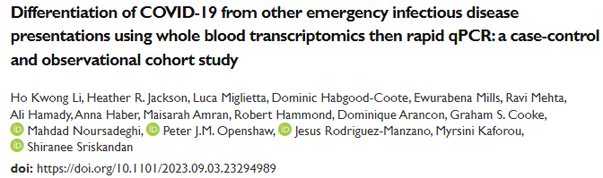

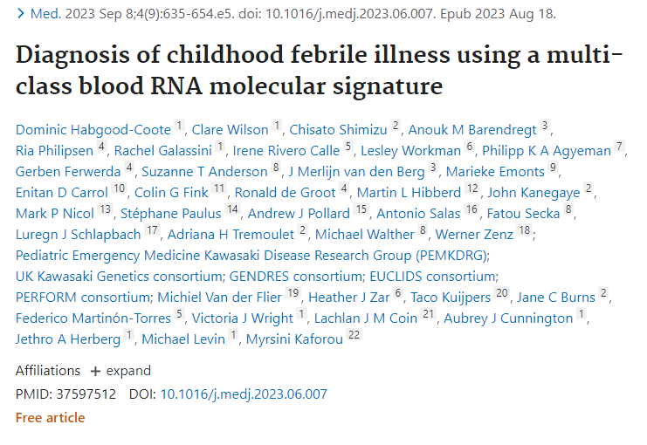
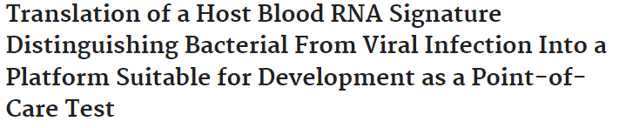
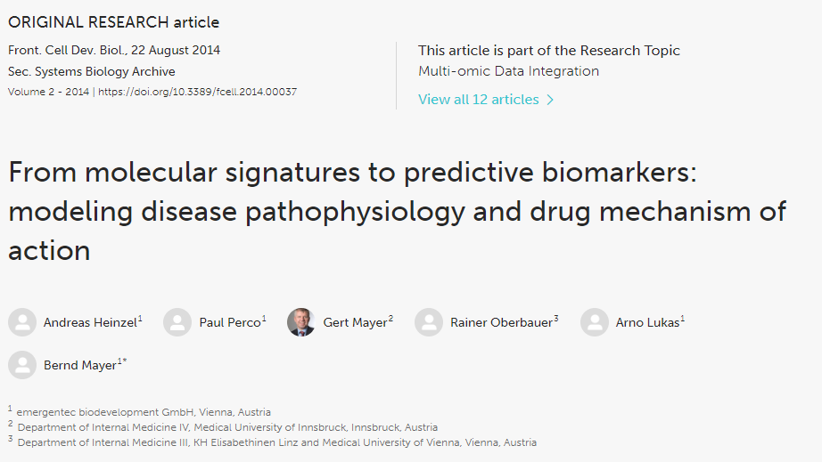
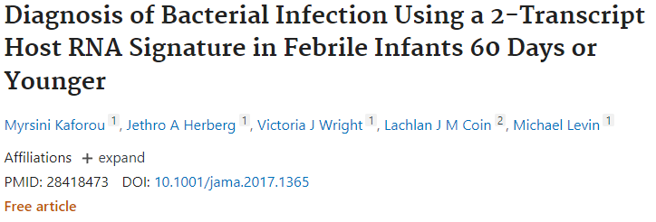
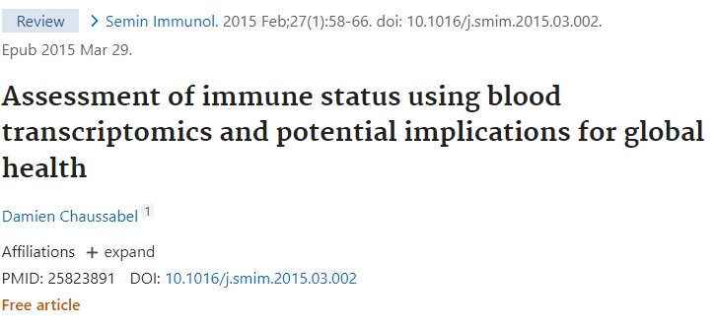
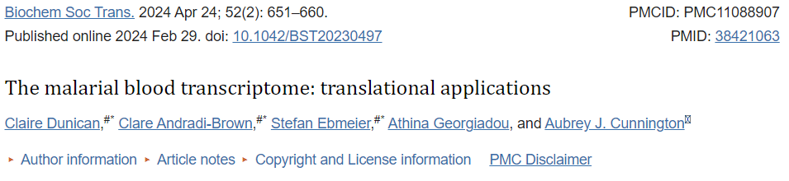
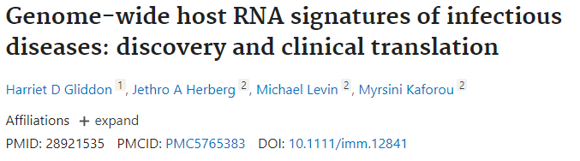
Assumption 1: current disease states == current transcriptomic state
Assumption 2: future disease trajectories == future transcriptomic states
10
10

Slide 11
Project development timeline
1. Development in time-course datasets of simple biological processes – circadian rhythm and Plasmodium intraerythrocytic life cycle stages --> My PhD thesis
2. Demonstration of use in time-course clinical datasets of whole-blood, predicting the future onset of:
a) Influenza A
b) SARS-CoV-2
3. Single time-point dataset: TB-IRIS
4. Demonstration of use in a large time-point clinical datasets: PERFORM
5. Reviewer demands: analysis of an additional SARS-CoV-2 and non-infectious disease datasets
6. Application to sepsis - ongoing work
7. Algorithm further development – PhD application in progress
For each dataset we demonstrated how the algorithms assumptions are met and then performed prediction analysis.
Nat Comms publication
11
11

Slide 12
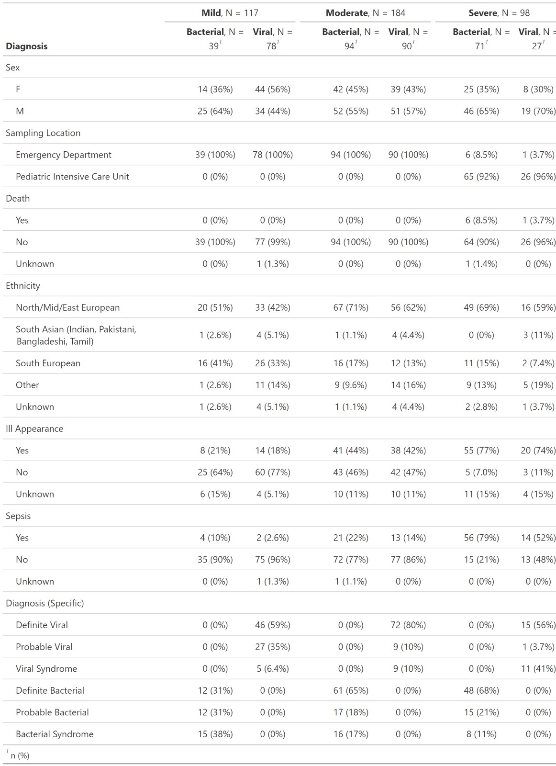
Results
The PERFORM study
“Febrile illness to Optimize Real-life Management across the European Union”
Subset with bacterial or viral diagnosis (n=399)
Recruited in the emergency department (ED) or PICU
Divided the patients by severity: mild, moderate and severe
Hospital recruited healthy controls also available
Definitions
Mild – sent home post-recruitment (recruitment was in the ED)
Moderate – sent to the ward (recruitment in the ED)
Severe – in the PICU (recruited in the PICU or ED)
12
12

Slide 13
Results
Proof of concept in the PERFORM study
Reference groups: mild and severe groups recruited in the ED and PICU respectively
Patients who were sent home (mild)
Patients in the PICU (severe)
?
New patient
Test groups: moderate group recruited in the ED (7 of which later went to the PICU), 7 severe subjects recruited in the ED, 20 mild patients held back from the previous analysis
13
13
Notes:
13

Slide 14
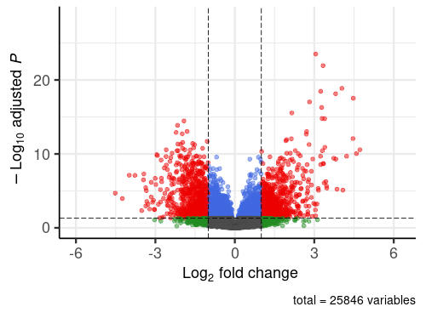
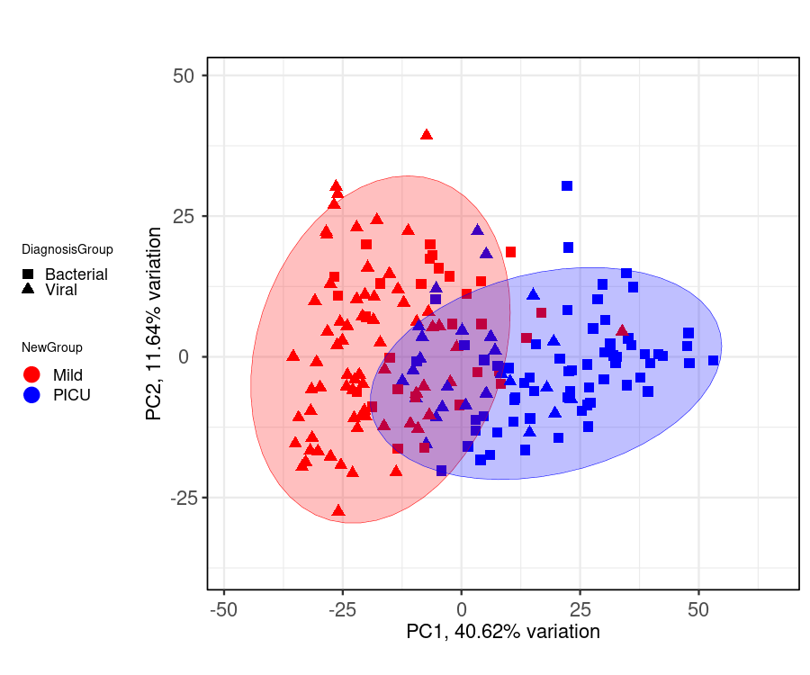
Results
Assumption 1: current transcriptomic state are representative of current disease states​
Diagnostic group
Severity group
14
14

Slide 15
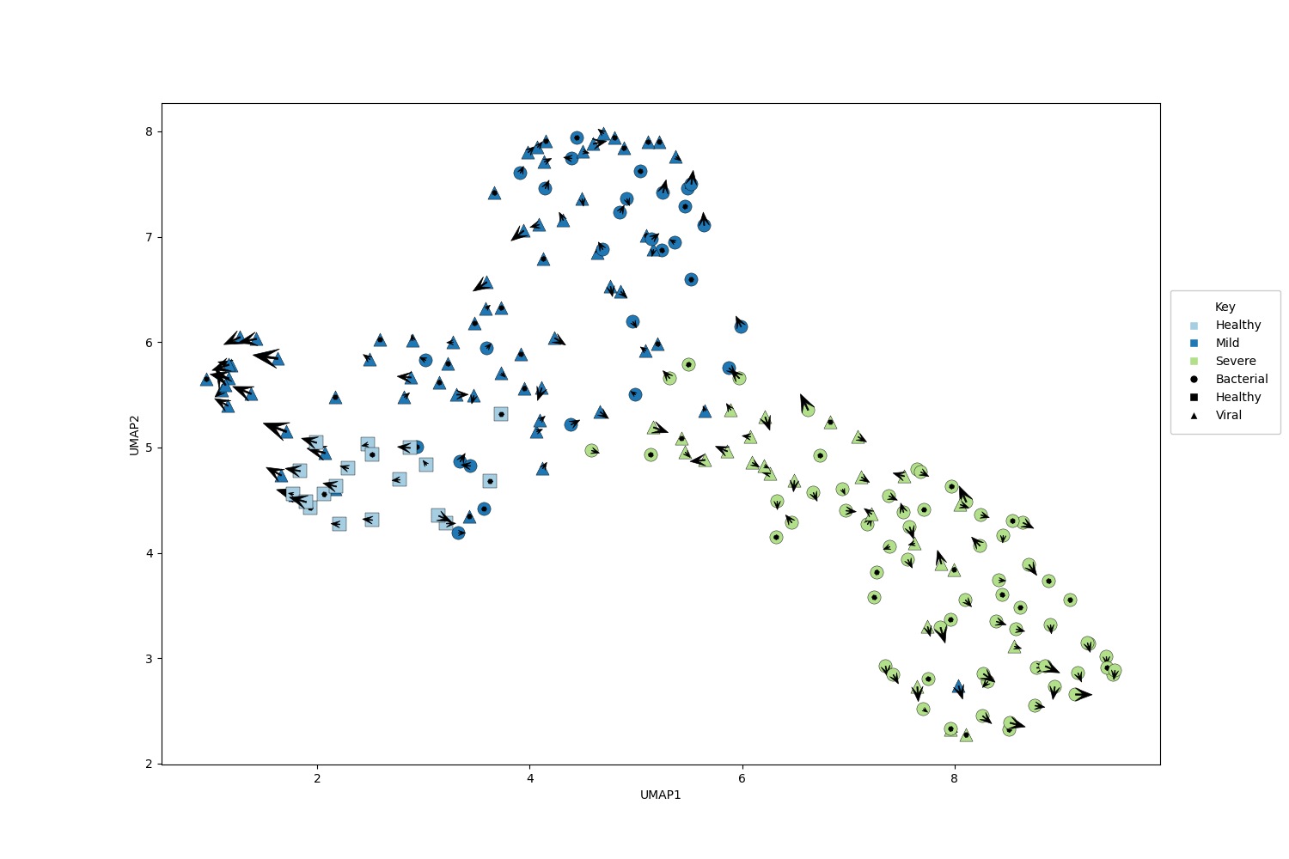
Results
Assumption 2: transcriptomic trajectories are representative of future disease trajectories
Recovery
Healthy
Deterioration
15
15

Slide 16
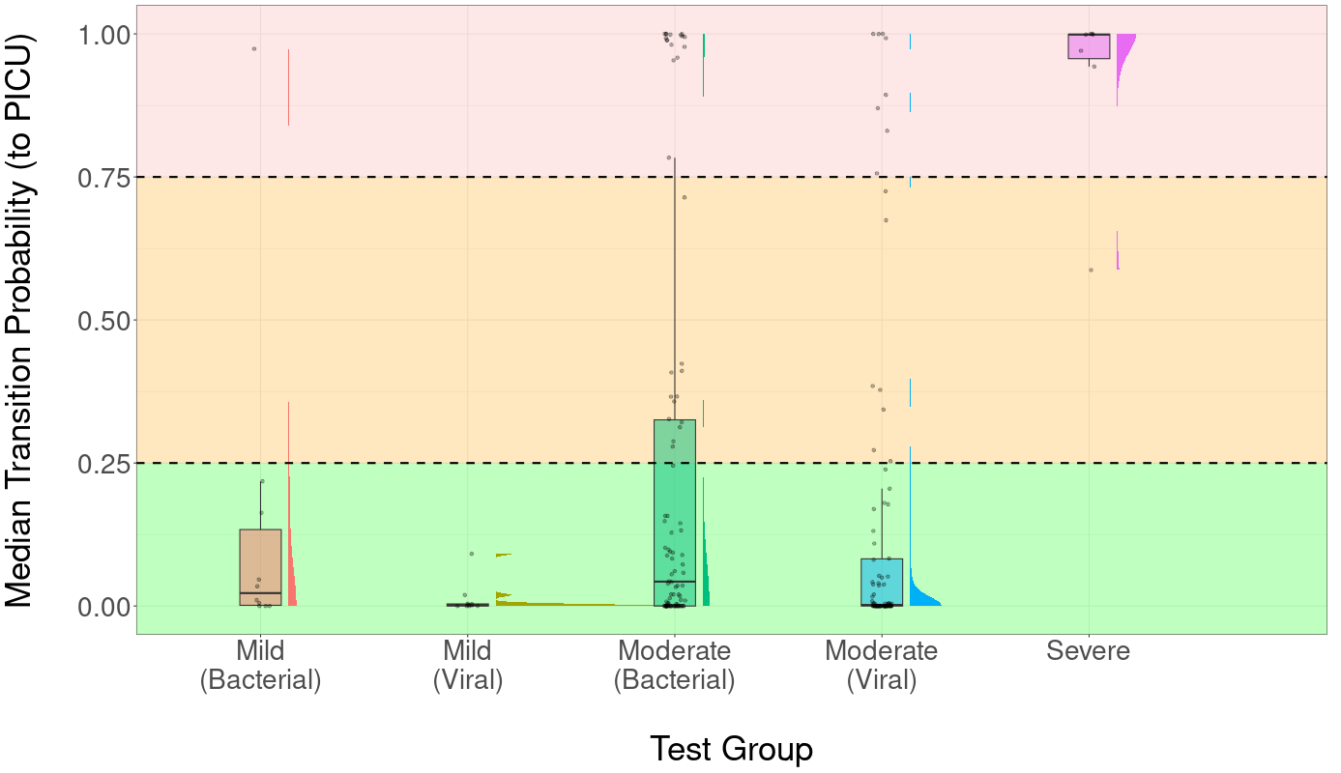
Results
Were sent to the PICU
(n=1 viral, n=6 bacterial)
were sent home
were sent to the ward
n=7 later sent to the PICU
16
16
Notes:
However, these 7 subjects had a median TP value of 0.36 (range 0.0-1.0), which was significantly higher than the median TP value in those not requiring later admission to PICU (n=177, median TP 0.0070, range X-Y, Wilcoxon signed rank p-value 0.045).
16

Slide 17
Results
ORs indicate that individuals in the more severe class (presence of sepsis, very urgent triage code etc.) are more likely to be in the high transition probability (TP, to the PICU) group.
Clinical Feature | TP ≥ 0.25 N (%) | TP < 0.25 N (%) | Odds Ratio | 95% Confidence Interval |  | p-value
On-presentation
Gender Female Male | 19 (44.19) 24 (55.81) | 62 (43.97) 79 (56.03) | 1.01 | 0.48, 2.12 |  | 1.00
Triage Code Very Urgent Standard | 27 (69.23) 12 (30.77) | 79 (59.40) 54 (40.60) | 1.53 | 0.68, 3.63 |  | 0.35
Ill Appearance Yes No | 19 (51.35) 18 (48.65) | 60 (47.24) 67 (52.76) | 1.18 | 0.53, 2.62 |  | 0.71
Life Saving Intervention Yes No | 4 (9.30) 39 (90.70) | 13 (9.42) 125 (90.58) | 1.00 | 0.22, 4.44 |  | 1.00
Phenotype Bacterial Viral | 28 (65.12) 15 (34.88) | 66 (46.81) 75 (53.19) | 2.11 | 0.99, 4.65 |  | 0.038
Future Severity
Surgery Performed Yes No | 11 (25.58) 32 (74.42) | 11 (7.80) 130 (92.20) | 4.02 | 1.44, 11.28 | 0.0052
Transfer to the PICU
Yes No | 4 (9.30) 39 (90.70) | 3 (2.13) 138 (97.87) | 4.67 | 0.76, 33.18 | 0.053
17
17

Slide 18
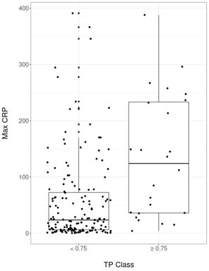
Results
Therefore, we demonstrated proof of principle that VeloCD can capture the relationship between predictions and future disease severity….

Slide 19
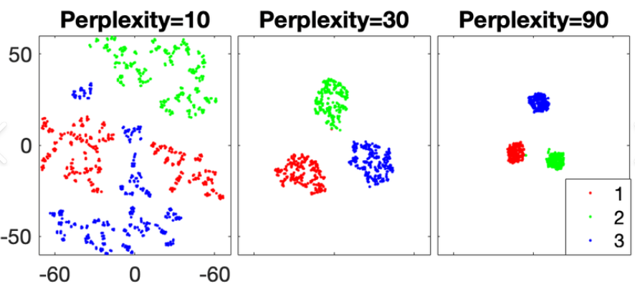
This is just a "proof of principle" of a complex algorithm
What is proof of principle?
What comes next?
During algorithm development, I found many potential pitfalls areas of future improvement:
Choice of hyperparameters (NN, TPNN)
Choice of low-dimensional embedding methodology
Inherent stochasticity in tSNE and UMAP

Slide 20
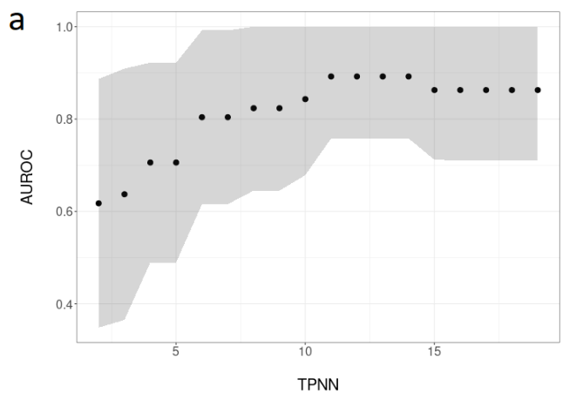
How should we handle this?
Full transparency in the values used, the full range explored and an exploration of how the performance varies between hyperparameter values
Some kind of median between tSNE and UMAP generations?

Slide 21
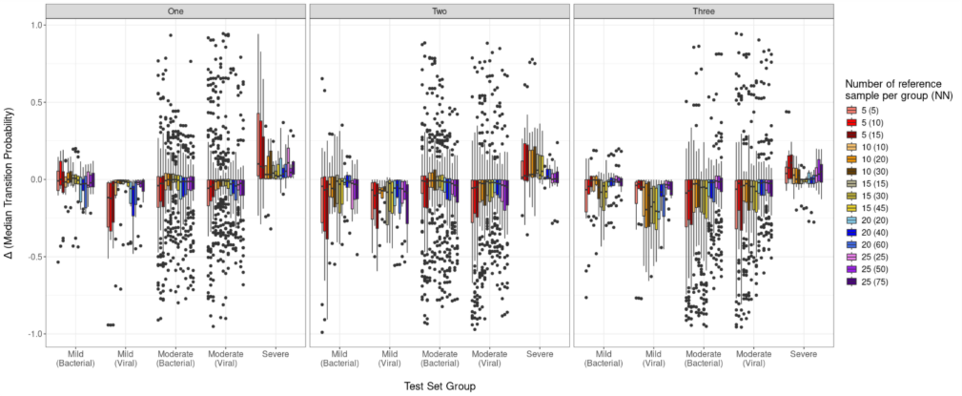
How many reference samples? what are the best reference samples?
Notes:
21
21
21
21

Slide 22
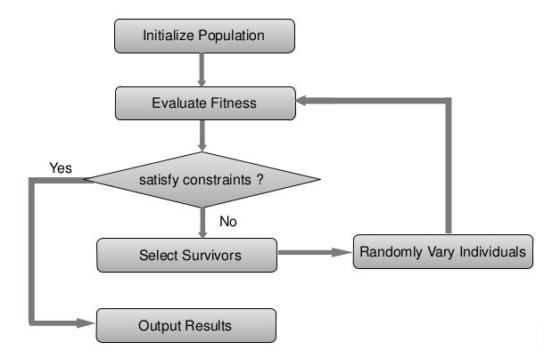
Genetic algorithms to optimize hyperparameter selection

Slide 23
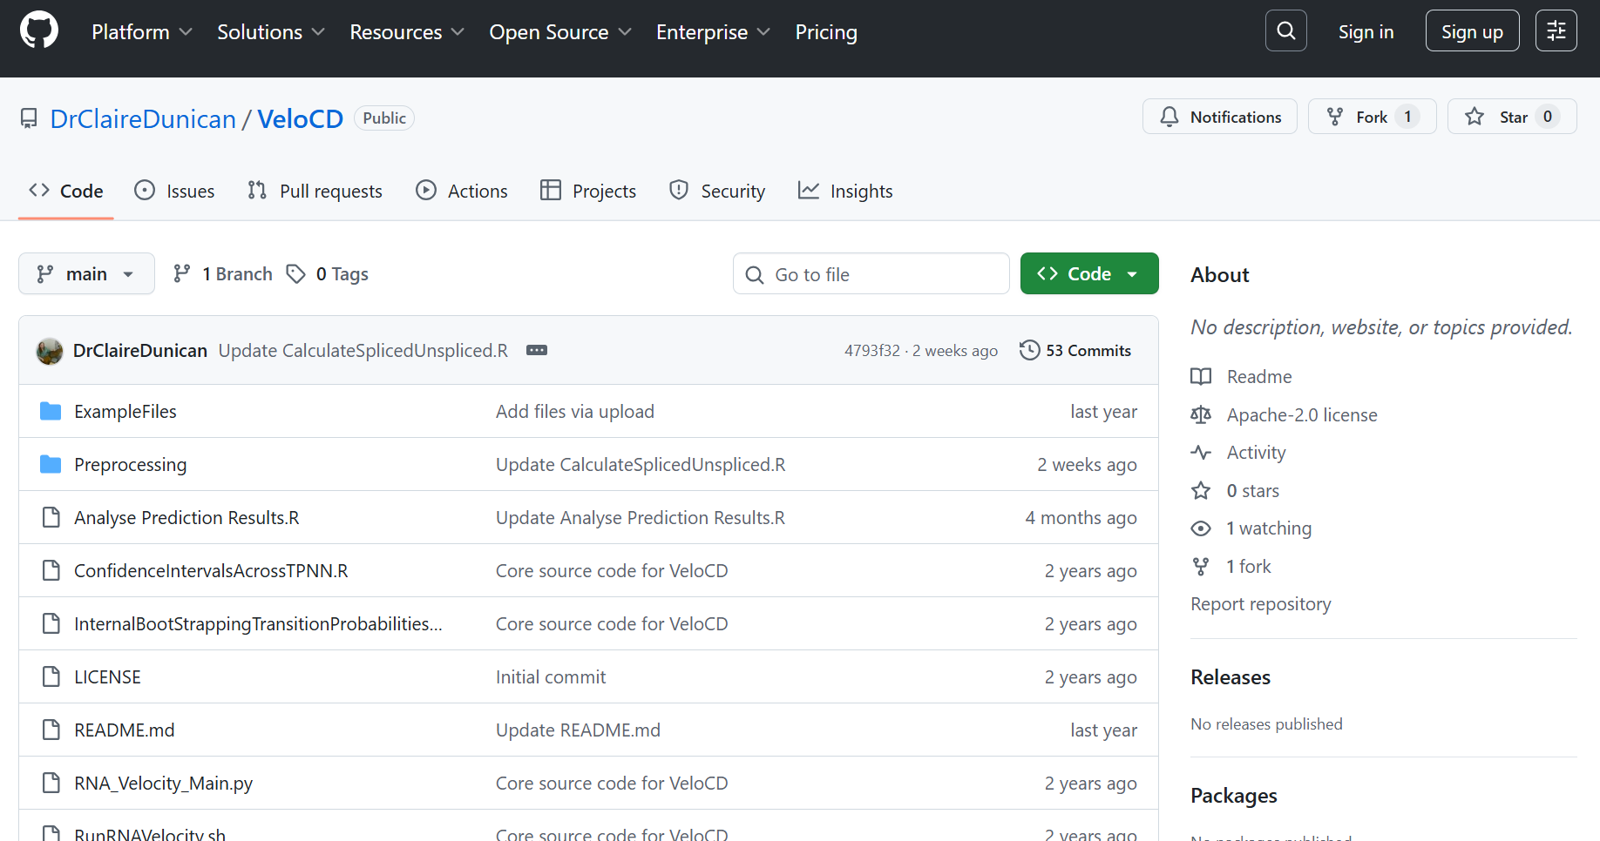

Slide 24
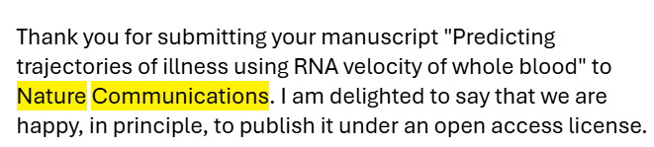

The present...
After 7.5 long years the preprint is out......and it has been accepted for publication at Nature Communications
24

Slide 25
The future...
Immediate: further work on its application to sepsis, optimization of predictions using machine learning (autoencoders and genetic algorithms)
Medium term: moving past RNA-Seq data to point of care unspliced and spliced transcript measurements...
Long term goal is to adapt this tool into something that could impact clinical care decision making...

Slide 26
Take home messages
Knowing when to stop – when is the project no longer proof of principle? What are the next steps? When should it be handed other to others to progress?
Acknowledging the limitations of the work – how to frame, report upon and improve

Slide 27




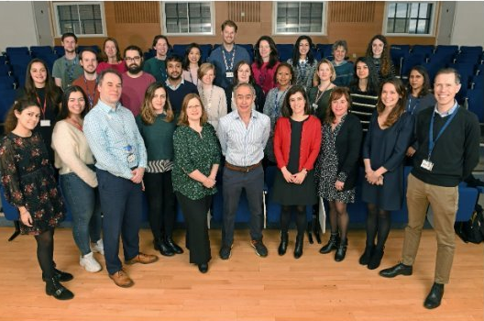




Acknowledgements
Core Team: Myrsini Kaforou, Mauricio Barahona, Aubrey Cunnington.
CHIM datasets: Christopher Chiu
TB-IRIS: Rachel PJ Lai, Graeme Meintjes
PERFORM: Clare Wilson, Mike Levin, Jethro Herberg, Vic Wright, Dominic Habgood-Coote, Tisham De
The Imperial PERFORM and DIAMONDS teams
The PaedsID Team (especially the malaria and Bioinformatics subgroups)
Ashleigh Green
27
27
Notes:
27

