Slide 1
Develop generative AI apps in Azure​
https://aka.ms/mslearn-gen-ai-app-dev
June 2025
Notes:
Use the link on the slide to see the Microsoft Learn learning path from which this presentation is derived.

Slide 2

Artificial Intelligence workloads
Generative AI and Agents
Text and Language
Computer Speech
Computer Vision
Information Extraction
$$f\left(x\right)=y$$
Machine Learning
Notes:
Orient learners: “Azure AI spans multiple workload families—today we’re zooming in on Generative AI and Agents.”
Quick contrast: classic ML (predictive, f(x)=y) vs. generative AI (language + reasoning + content generation).

Slide 3
Our focus today
Generative AI and Agents
Text and Language
Computer Speech
Computer Vision
Information Extraction
$$f\left(x\right)=y$$
Machine Learning
Notes:
Reinforce scope control: “If you came for vision/speech/translation, those exist—but today’s focus is on generative AI models and chat application development.”
Preview the shape of the day: platform basics → models → endpoints/SDKs → chat app development→ optimization → responsible AI.

Slide 4
Plan and prepare to develop AI solutions on Azure
https://aka.ms/mslearn-prepare-ai-dev
Notes:
Use the link on the slide to see the Microsoft Learn module from which this lesson is derived.

Slide 5







Microsoft Foundry
A unified platform for AI apps and agents
Microsoft Foundry resource
Foundry resources in Azure provide compute, storage, model delivery, and other services
Foundry projects are isolated work environments for app and agent development
In a project, you work with:
  Models – choose and deploy models from an extensive model catalog
  Agents – create and manage agents that use models for language and reasoning
  Tools – connect agents to tools so they can perform actions and access information
  Knowledge – manage data source access for agents so they have the information they need to act
Microsoft Foundry project
Models
Agents
☺
Tools
Knowledge
Notes:
Define Foundry in one sentence: “Foundry gives you a project‑based workspace to build AI apps/agents with models, tools, and knowledge in one place.”
Emphasize the mental model: Resources provide compute/storage/model delivery services.
Projects are isolated work environments for app & agent development.
Inside projects: Models, Agents, Tools, Knowledge.
Practical framing: “When learners feel lost, bring them back to this picture—most tasks map to one of these four.”

Slide 6




Foundry Tools
Azure Language in Foundry Tools
Natural language processing and text analysis
Azure Speech in Foundry Tools
Speech recognition and synthesis
Azure Translator in Foundry Tools
Multilingual text and document translation
Azure Document Intelligence in Foundry Tools
Complex document processing and extraction
Azure Content Understanding in Foundry Tools
Multimodal content analysis
Notes:
Explain “Foundry Tools” as “pre-built capabilities your agent/app can call rather than reinvent.”
Tie to developer value: “You compose solutions by combining an LLM with tool calls for language, speech, translation, document extraction, multimodal analysis.”
Point out that “Foundry Tools: were formerly known as “Azure AI Services”; and as “Cognitive Services” prior to that.

Slide 7
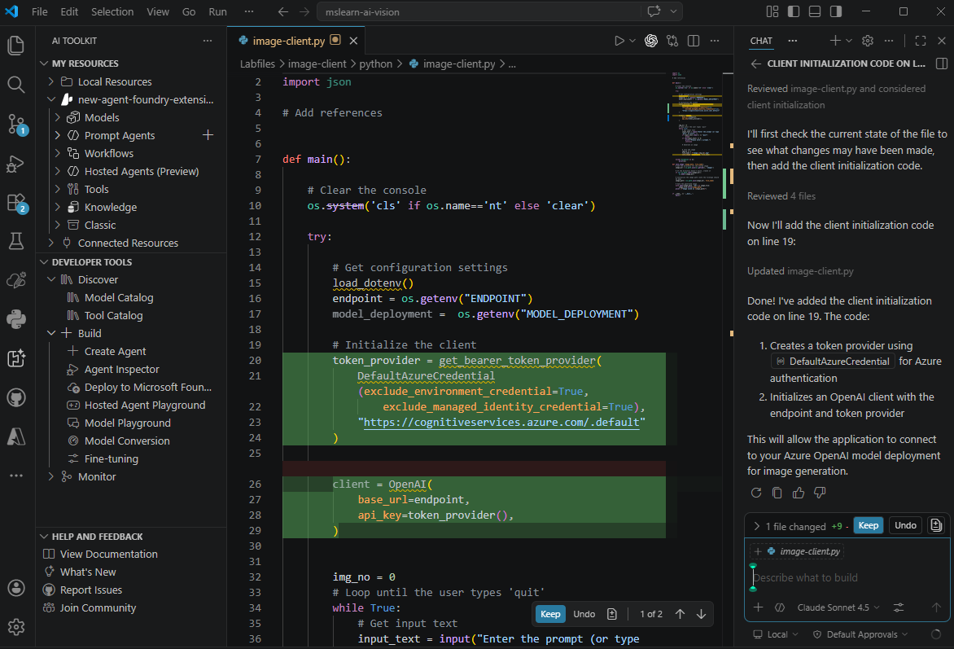
Developer tools and SDKs
Tools
Microsoft Visual Studio Code
  Microsoft Foundry Toolkit Extension
  GitHub Copilot
SDKs
Microsoft Foundry SDK
OpenAI SDK
Microsoft Foundry Tools SDKs
  Language and Text Analysis
  Speech
  Translator
  Document Intelligence
  Content Understanding
Notes:
Set up the dev workflow: VS Code + AI Toolkit extension + SDKs + source control + GitHub Copilot (optional).
Clarify the SDK stack: Foundry SDK and OpenAI SDK appear together because Foundry can expose OpenAI‑compatible interfaces (important later when choosing endpoints).
Teaching tip: ask learners “Where do you prefer to develop—portal playground first or code-first?” then show both are supported.

Slide 8
Principles of responsible AI
Fairness
Reliability & Safety
Privacy & Security
Inclusiveness
Transparency
Accountability
Notes:
Keep it practical: “These aren’t poster words—each principle maps to design choices: data, prompts, guardrails, UX, and operations.”
Prime them for later: “We’ll come back to guardrails and harm mitigation after we’ve built something.”

Slide 9
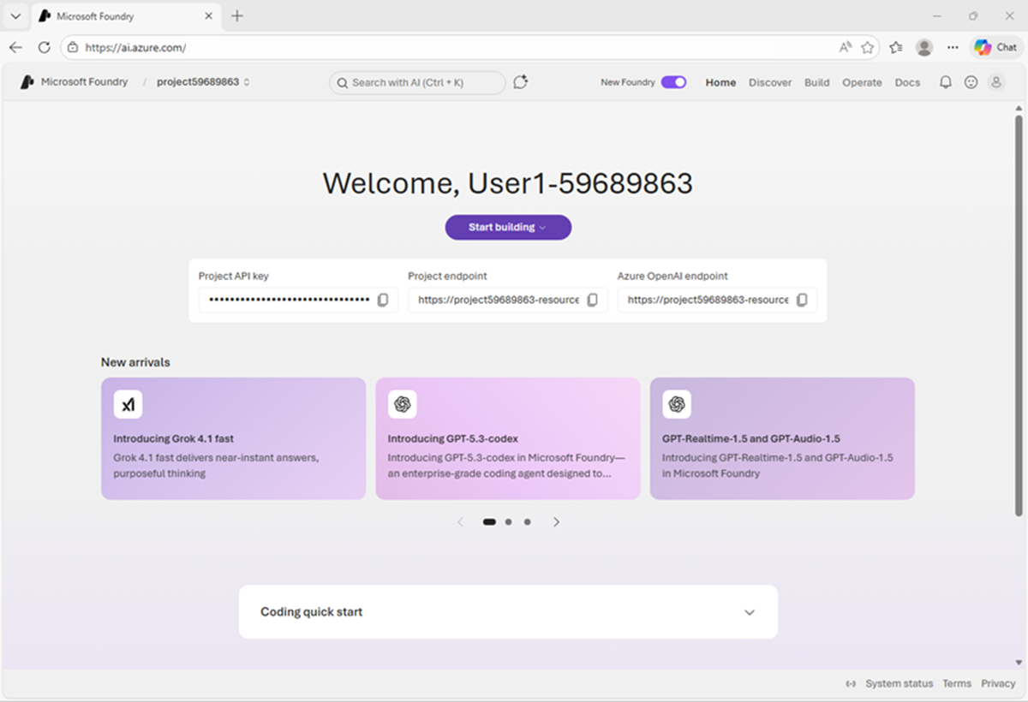
Exercise
Prepare for an AI development project
In this exercise, you’ll:
Create a Foundry project
Deploy and test a generative AI model
Identify project endpoints and keys
Explore the Microsoft Foundry Extension for Visual Studio Code
Trainers:
Customize this slide to include the link to the hosted lab environment and any custom instructions.
(then remove this arrow)
Start the exercise at:
https://go.microsoft.com/fwlink/?linkid=2353647
Notes:
NOTE: If students are relatively familiar, skip this lab and just demo a bit of the portal to save time. They’ll use it plenty in future labs
Each exercise begins with the same procedure to create a Foundry project– students will become quite adept at this by the end of the day!
The repetition of this procedure can be onerous, but it’s necessary to keep the exercises modular and to avoid consuming Azure resources unnecessary (for both cost reasons and to free up data center capacity for other Azure customers)

Slide 10
Knowledge check
1
Which web portal should you use to work with assets in a Microsoft Foundry project?
The Azure portal
Microsoft Copilot
The Microsoft Foundry portal
2
Which component of Microsoft Foundry provides pre-built services for common AI tasks?
Foundry Tools
Foundry Models
Foundry IQ
3
Which extension should you use in Visual Studio Code to work with Foundry projects?
Python extension for Visual Studio Code
GitHub Copilot
Microsoft AI Toolkit extension for Visual Studio Code
© Copyright Microsoft Corporation. All rights reserved.
Notes:
Allow students a few minutes to think about the questions, then reveal the correct answers.

Slide 11
Select, deploy, and evaluate Microsoft Foundry Models
https://aka.ms/mslearn-foundry-models
Notes:
Use the link on the slide to see the Microsoft Learn module from which this lesson is derived.

Slide 12
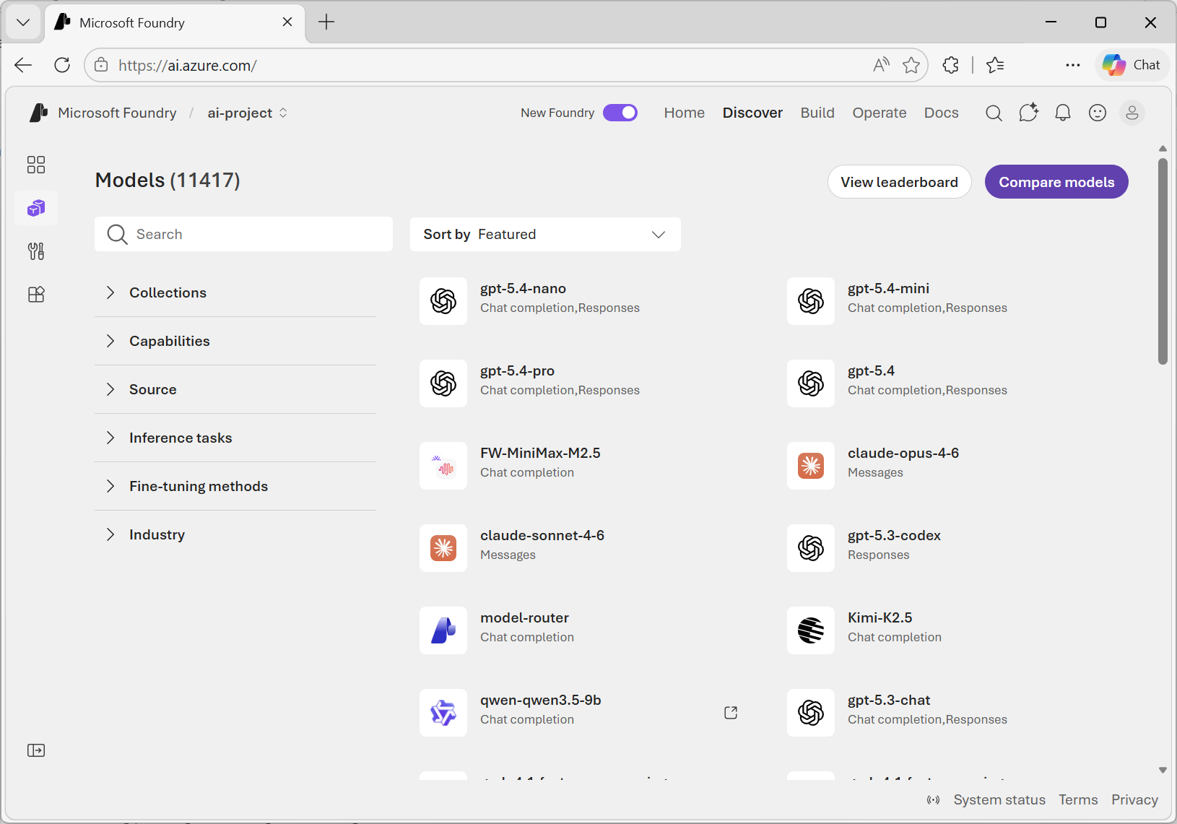
Explore the model catalog
Foundry Models sold directly by Azure
  OpenAI models and more
  Billed directly through Azure
Foundry Models from partners and community
  Models from trusted third parties
  Purchase from the model provider
Search and filter by
  Curated collections
  Model capabilities
  Source (model providers)
  Inference tasks
  Fine-tuning support
  Industry
Notes:
Give learners a strategy: “Start with curated collections/capabilities, then filter by provider and tasks; only then worry about fine‑tuning support.”
Clarify billing/ownership distinctions: models sold by Azure vs partner/community models purchased via provider.
Trainer tip: remind learners that “model choice is iterative—pick a baseline and validate quickly in the playground.”

Slide 13
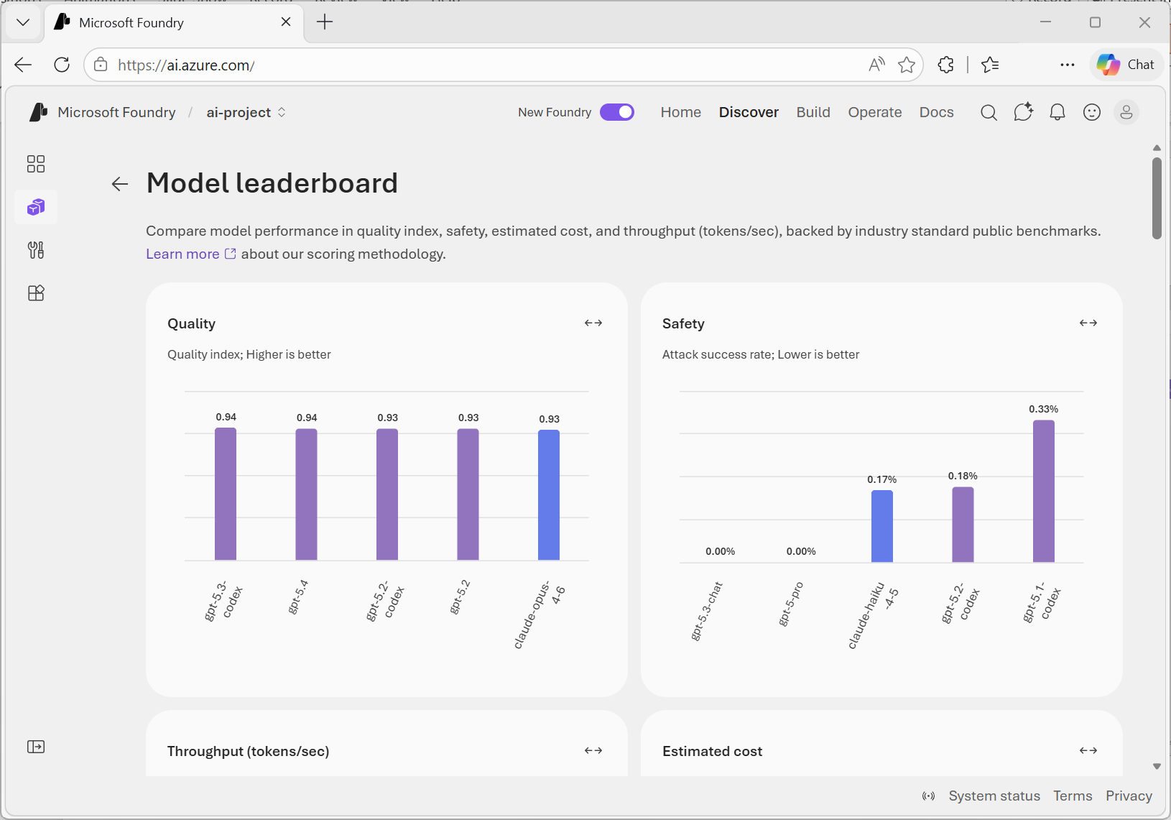
Select models using benchmarks
Compare models by:
Quality
  Quality index (higher is better)
Safety
  Attack success rate (lower is better)
Throughput
  Output tokens/sec (higher is better)
Cost
  USD per 1M tokens (lower is better)
Notes:
Explain what benchmarks do for developers: “They’re not perfect, but they prevent ‘vibes-based’ model selection.” Interpret each metric in app terms: Quality index → response usefulness.
Safety (attack success rate) → robustness against prompt attacks.
Throughput → responsiveness under load.
Cost → token economics.

Slide 14
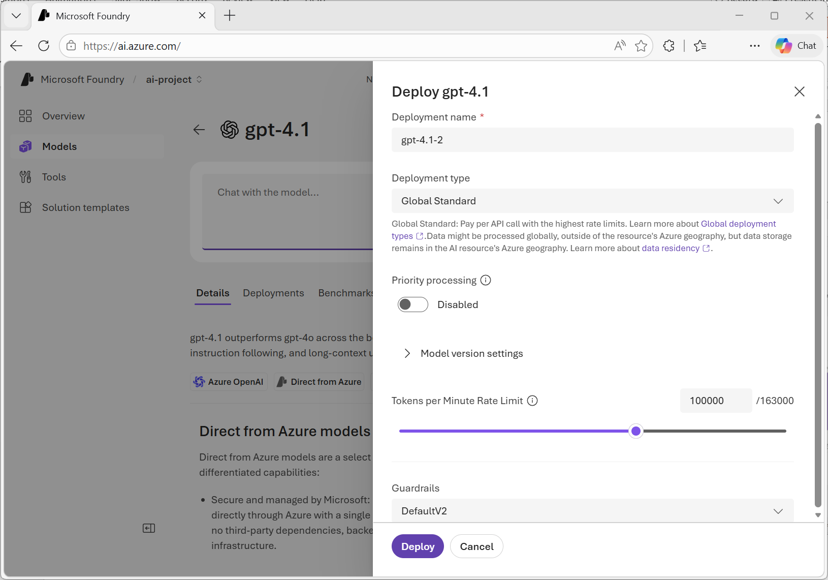
Deploy models to endpoints
Deployment type | Best for
Global Standard | General workloads and highest quota
Global Provisioned | Predictable high-throughput
Global Batch | Large async jobs
Data Zone Standard | EU/US data zone compliance
Data Zone Provisioned | Data zone and predictable throughput
Data Zone Batch | Large async jobs with data zone
Standard | Regional compliance, low volume
Regional Provisioned | Regional compliance and throughput
Developer | Fine-tuned model evaluation only
Notes:
Teach a decision shortcut: Global Standard for general workloads & highest quota.
Provisioned when throughput must be predictable.
Batch for async large jobs.
Data Zone for EU/US data zone compliance needs.
Regional/Standard for regional compliance and lower volume.
Developer for fine-tuned model evaluation only.
Trainer tip: ask the room “Which constraint matters most—compliance, throughput, or cost?” then map to the table.

Slide 15
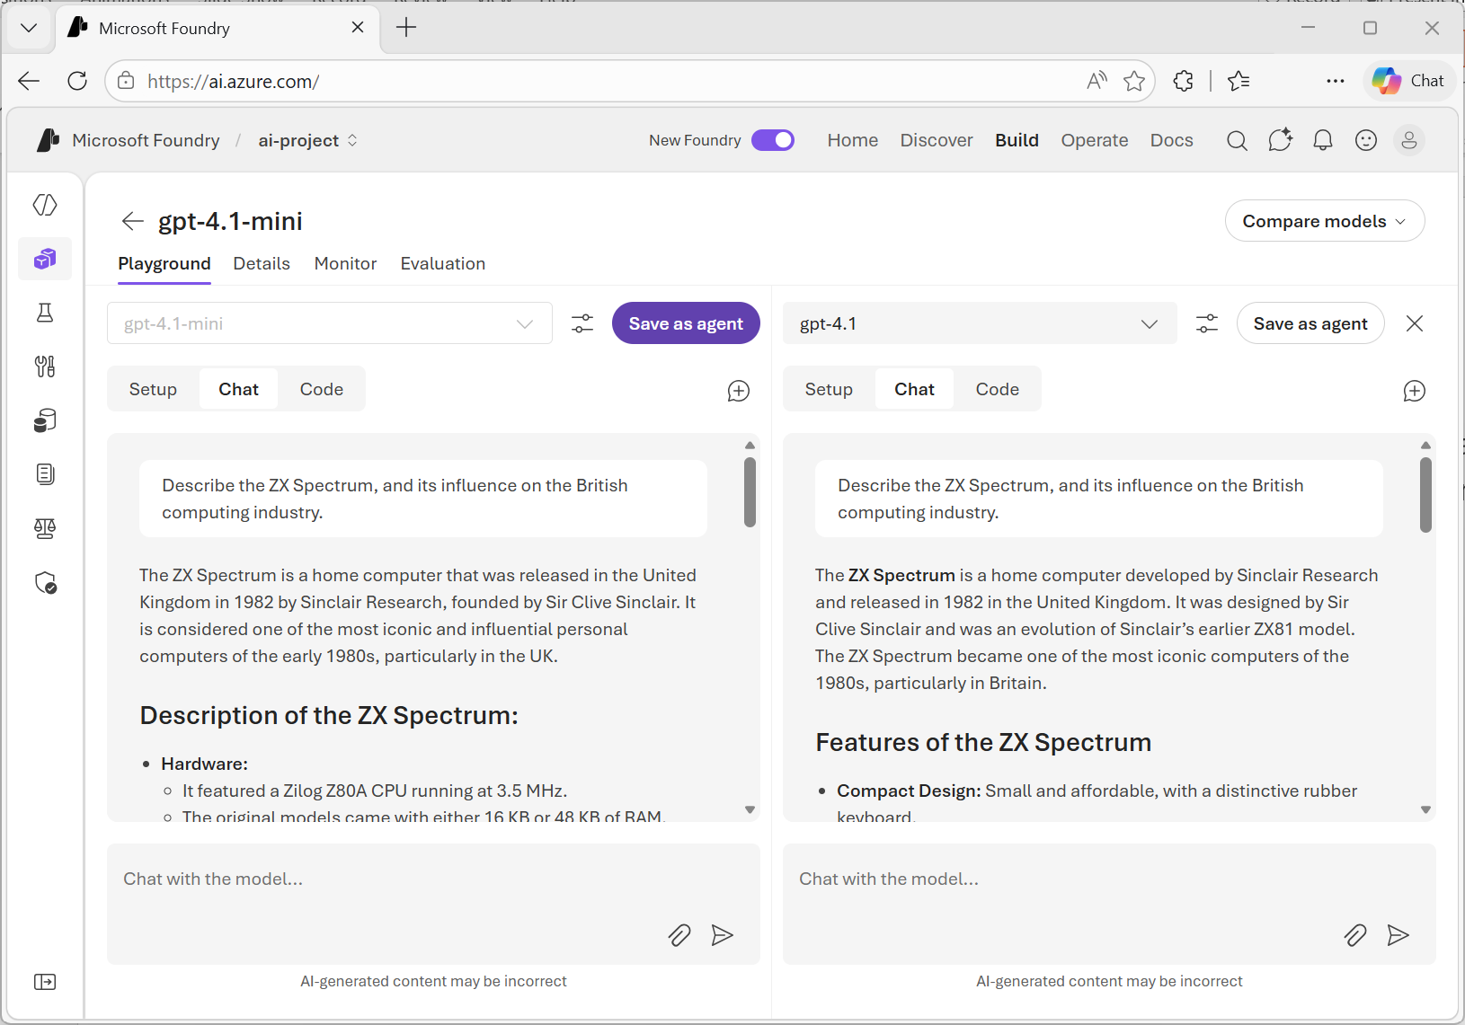
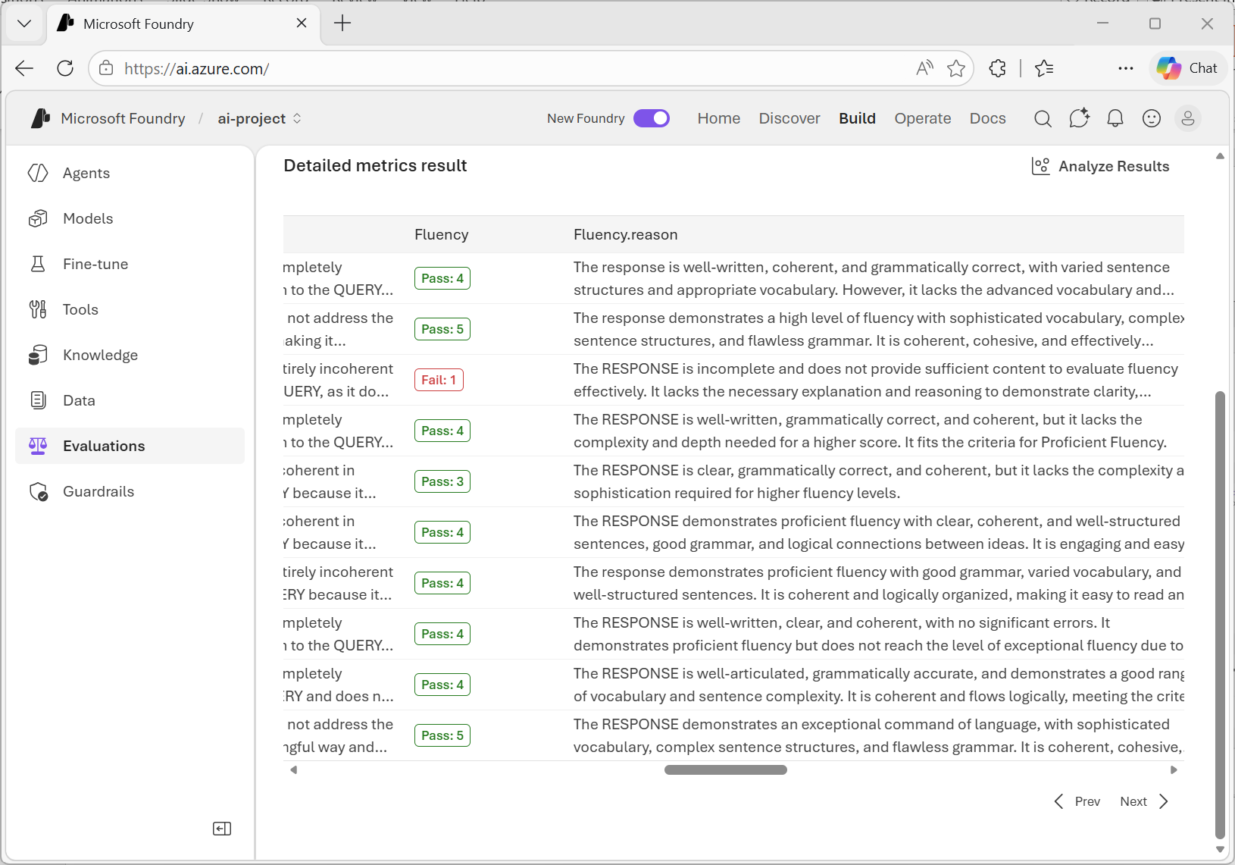
Evaluate model performance
Manual evaluation:
Test model responses in the playground
Compare models side-by-side
Automated evaluation:
Use synthetic datasets or your own data
Measure responses based on standard metrics
Notes:
Make evaluation concrete: Manual: playground prompts, side-by-side comparisons.
Automated: synthetic or real datasets + standard metrics.
Teaching tip: encourage “representative prompts” (real user tasks) and “edge prompts” (abuse/misalignment) even at prototype stage.

Slide 16
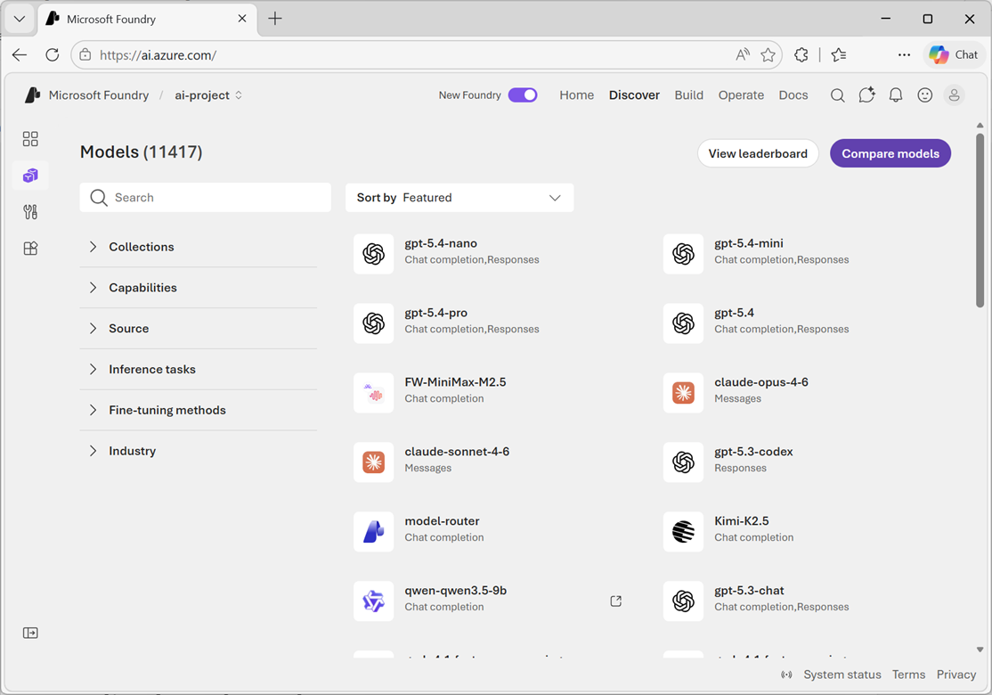
Exercise
Select, deploy, and evaluate models
In this exercise, you’ll:
Explore models in the catalog
Compare models using the model leaderboard
Deploy models
Compare models in the model playground
Evaluate a model with a synthetic dataset
Trainers:
Customize this slide to include the link to the hosted lab environment and any custom instructions.
(then remove this arrow)
Start the exercise at:
https://go.microsoft.com/fwlink/?linkid=2354118
Notes:
Each exercise begins with the same procedure to create a Foundry project– students will become quite adept at this by the end of the day!
The repetition of this procedure can be onerous, but it’s necessary to keep the exercises modular and to avoid consuming Azure resources unnecessary (for both cost reasons and to free up data center capacity for other Azure customers)

Slide 17
Knowledge check
1
Which model benchmark indicates the model's ability to process prompts and return comprehensive responses quickly?
Quality index
Cost
Throughput
2
Which deployment type in Microsoft Foundry is best for general use while offering the largest quota?
Data Zone Batch
Global Standard
Developer
3
Which evaluation metric measures linguistic correctness and natural language quality?
Fluency
Groundedness
Relevance
© Copyright Microsoft Corporation. All rights reserved.
Notes:
Allow students a few minutes to think about the questions, then reveal the correct answers.

Slide 18
Develop a generative AI chat app with Microsoft Foundry
https://aka.ms/mslearn-develop-chat
Notes:
Use the link on the slide to see the Microsoft Learn module from which this lesson is derived.

Slide 19
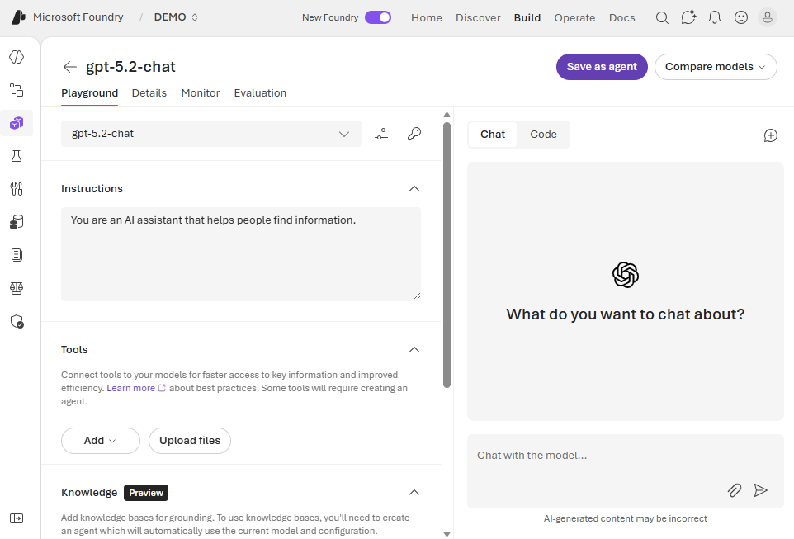
Explore with the model playground
Interactive model testing
Send prompts to deployed models and see responses in real time
Adjust settings like temperature and max tokens
Add system messages to customize model behavior
Experiment with different models and configurations
Sample code
  View code samples based on:
    API (ChatCompletions or Responses)
    Programming language
    REST or SDK
Notes:
Encourage good habits: “Prototype prompts here before writing code—save time and reduce confusion.”
Explain the knobs: temperature/max tokens/system message.
Highlight code sample selector: API type (ChatCompletions vs Responses), language, REST/SDK—this reduces “blank page syndrome.”

Slide 20
Choosing an endpoint and SDK
Endpoint | Foundry Project https://{resource-name}.services.ai.azure.com/api/projects/{project-name} | Azure OpenAI https://{resource-name}.openai.azure.com/openai/v1
SDK | Microsoft Foundry SDK pip install azure-ai-projects openai | OpenAI SDK pip install openai
Authentication | Microsoft Entra ID pip install azure-identity | Microsoft Entra ID or API key pip install azure-identity
Chat API | Responses API Foundry direct models only | Responses or ChatCompletions API All Foundry models
Best for | Foundry-specific capabilities with OpenAI-compatible interfaces for Foundry direct models | Latest OpenAI SDK models and features with the full OpenAI API surface
 | from azure.identity import DefaultAzureCredential from azure.ai.projects import AIProjectClient from openai import OpenAI project_client = AIProjectClient( credential=DefaultAzureCredential(), endpoint=FOUNDRY_PROJECT_ENDPOINT) openai_client = project_client.get_openai_client( api_version="2024-10-21") | from openai import OpenAI openai_client = OpenAI( api_key=API_KEY_OR_TOKEN, base_url=AZURE_OPENAI_ENDPOINT)
Notes:
Teach the decision: Foundry Project endpoint + Foundry SDK when you want Foundry-native project operations and OpenAI-compatible interfaces for Foundry direct models.
Azure OpenAI endpoint + OpenAI SDK when you want the full OpenAI API surface and broader model support.
Call out authentication differences: Foundry Project uses Microsoft Entra ID; Azure OpenAI can use Entra ID or API key. Highlight the “Chat API” row: Responses API limitations/availability vs Responses/ChatCompletions breadth. Trainer tip: pause here—learners often mix endpoints and SDKs; repeat: “Endpoint choice drives auth & API surface.”
When showing code, explain what each client is doing (project client → get OpenAI client).

Slide 21
Compare ChatCompletions with Responses API
ChatCompletions API
Responses API
State management | Client-side - developer stores and sends the full messages array | Server-side - API stores the thread automatically
System prompt | First entry in messages array: {"role": "system", "content": "..."} | Dedicated parameter: instructions="..."
Payload per request | Grows with conversation length | Constant - only latest input + an ID
Accessing the response | completion.choices[0].message.content | response.output_text
Notes:
Explain the pattern: Responses API supports multi-turn by tracking previous_response_id. Clarify what to notice in code: instructions sets behavior (“helpful AI assistant…”).
previous_response_id carries conversation continuity.
response.output_text is the simplified way to print final output.
Teaching tip: emphasize that this is the “newer” pattern learners will see increasingly across examples.

Slide 22
Compare per-turn code pattern
ChatCompletions API
Responses API
INITIAL
STATE
conversation_messages = [
{"role": "system", "content": "You are helpful..."}]
last_response_id = None
1
conversation_messages.append({
"role": "user",
"content": input_text})
2
ADD
INPUT
completion = openai_client.chat.completions.create(
model="gpt-4.1",
messages=conversation_messages)
response = openai_client.responses.create(
model="gpt-4.1",
instructions="You are helpful...",
input=input_text,
previous_response_id=last_response_id)
3
CALL
API
GET
OUTPUT
assistant_msg = completion.choices[0].message.content
print(assistant_msg)
4
print(response.output_text)
conversation_messages.append({
"role": "assistant",
"content": assistant_msg})
5
UPDATE
STATE
last_response_id = response.id
Notes:
ChatCompletions API: client manages full conversation history; payload grows each turn.
Responses API: server manages state; app sends only latest input and response ID; payload stays constant.
Both APIs follow: initialize → call → get output → update state.
ChatCompletions = more control, more complexity; Responses = simpler, recommended for new apps.
Key takeaway: Prefer Responses API unless you need custom memory handling.

Slide 23
Using the Responses API
# Track previous response
last_response_id = None
# Loop until the user wants to quit
print("Assistant: Enter a prompt (or type 'quit' to exit)")
while True:
input_text = input('\nYou: ')
if input_text.lower() == "quit":
print("Assistant: Goodbye!")
break
# Get a response to the user’s prompt
response = openai_client.responses.create(
model="gpt-4.1",
instructions="You are a helpful AI assistant that explains technology concepts.",
input=input_text,
previous_response_id=last_response_id
)
assistant_text = response.output_text
print("\nAssistant:", assistant_text)
# Track the response for the next turn
last_response_id = response.id
Assistant: Enter a prompt (or type 'quit' to exit)
You: What is machine learning?
Assistant: Machine learning is a type of artificial intelligence (AI) that enables computers to learn from data and predict unknown values based on learned patterns.
You: Can you give me an example?
Assistant: Certainly! A simple example of supervised learning would be a model that predicts house prices based on features like size, location, and number of rooms.
You: quit
Assistant: Goodbye!
Notes:
Explain the pattern: Responses API supports multi-turn by tracking previous_response_id. Clarify what to notice in code: instructions sets behavior (“helpful AI assistant…”).
previous_response_id carries conversation continuity.
response.output_text is the simplified way to print final output.
Teaching tip: emphasize that this is the “newer” pattern learners will see increasingly across examples.

Slide 24
Using the ChatCompletions API
# Initial system message
conversation_messages=[
{
"role": "system", "content": "You are a helpful AI assistant that answers questions and provides information."
}
]
# Loop until the user wants to quit
print("Assistant: Enter a prompt (or type 'quit' to exit)")
while True:
input_text = input('\nYou: ')
if input_text.lower() == "quit":
print("Assistant: Goodbye!")
break
# Add user message
conversation_messages.append(
{"role": "user", "content": input_text}
)
# Get completion
completion = openai_client.chat.completions.create(
model="gpt-4.1",
messages=conversation_messages
)
assistant_message = completion.choices[0].message.content
print("\nAssistant:", assistant_message)
# Add assistant message
conversation_messages.append(
{"role": "assistant", "content": assistant_message}
)
Assistant: Enter a prompt (or type 'quit' to exit)
You: When was Microsoft founded?
Assistant: Microsoft was founded on April 4, 1975.
You: Who founded it?
Assistant: Microsoft was founded by Bill Gates and Paul Allen.
You: quit
Assistant: Goodbye!
Notes:
Position this as the “messages array” pattern that many developers already know.
Highlight the structure: system message → append user → request completion → append assistant.
Trainer tip: explain that both patterns exist; your choice depends on endpoint/features and sample alignment.

Slide 25
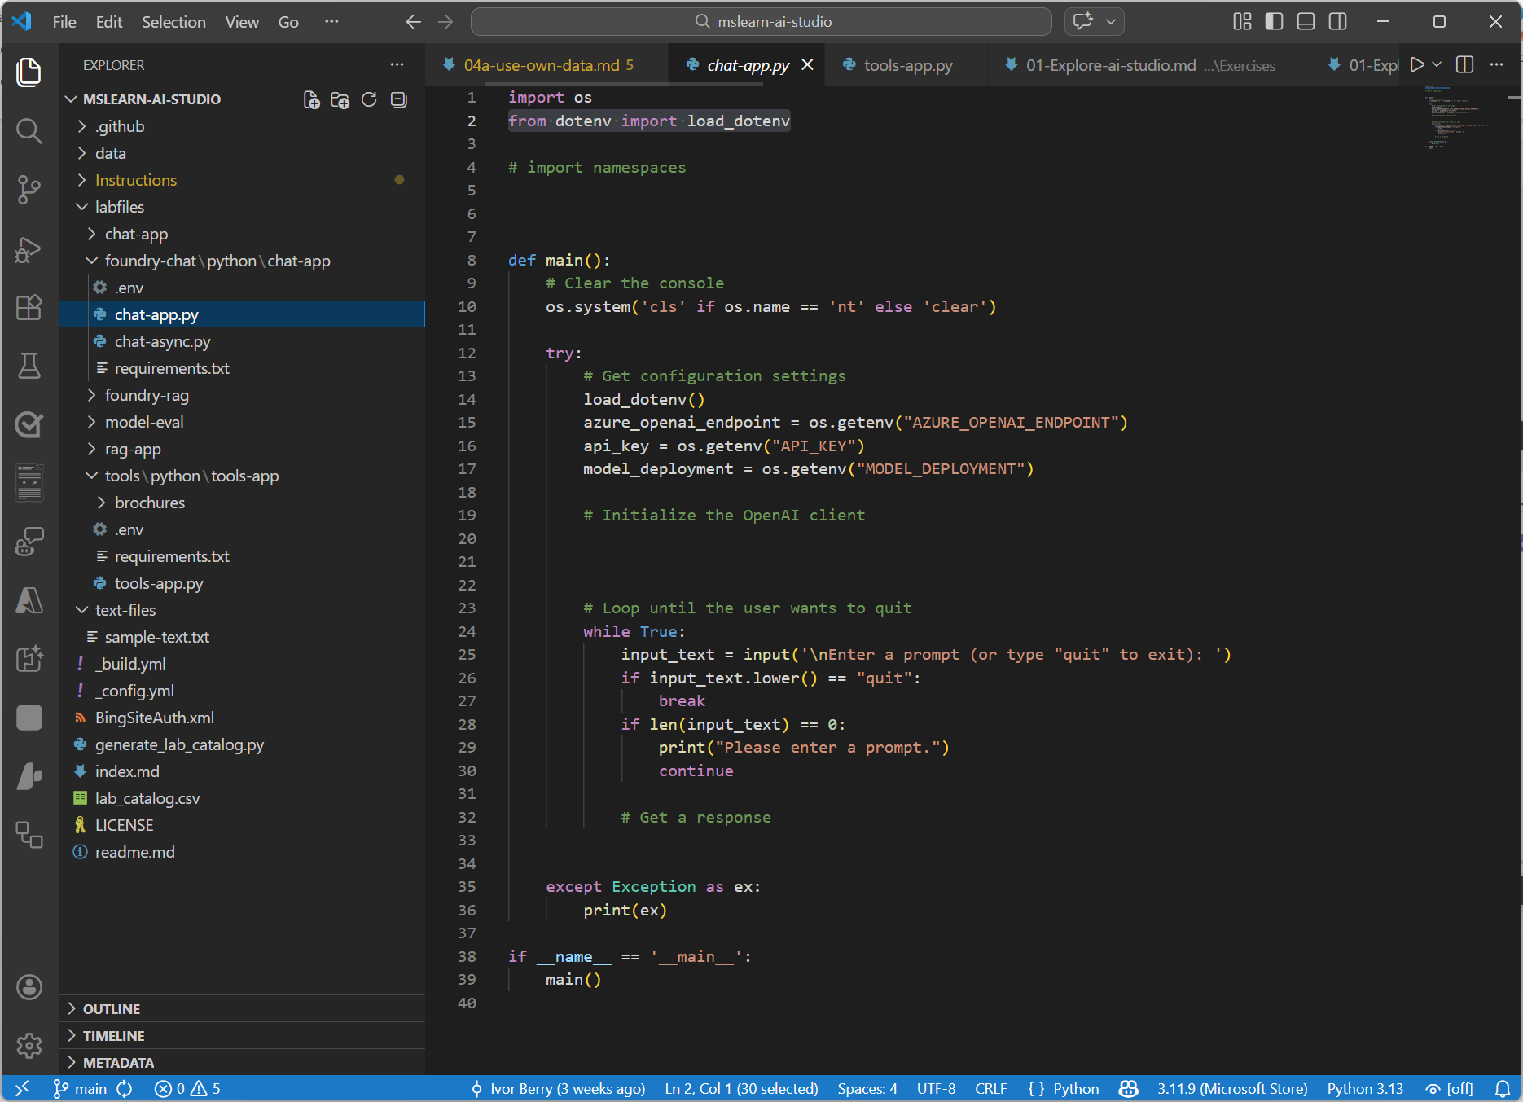
Exercise
Create a generative AI chat app
In this exercise, you’ll:
Create a Microsoft Foundry project
Deploy a model
Get the endpoint and key
Create a client application to chat with the model
Trainers:
Customize this slide to include the link to the hosted lab environment and any custom instructions.
(then remove this arrow)
Start the exercise at:
https://go.microsoft.com/fwlink/?linkid=2354411
Notes:
Each exercise begins with the same procedure to create a Foundry project– students will become quite adept at this by the end of the day!
The repetition of this procedure can be onerous, but it’s necessary to keep the exercises modular and to avoid consuming Azure resources unnecessary (for both cost reasons and to free up data center capacity for other Azure customers)

Slide 26
Knowledge check
1
Which endpoint offers the broadest support for OpenAI APIs with Foundry Models?
The Foundry project endpoint
The Azure OpenAI endpoint
The Foundry Tools endpoint
2
Which package must you install to use the Microsoft Foundry SDK in Python?
azure-foundry
azure-ai-projects
microsoft-foundry-sdk
3
Which method do you use to generate responses with the Responses API?
client.chat.completions.create()
client.get_response_id()
client.responses.create()
© Copyright Microsoft Corporation. All rights reserved.
Notes:
Allow students a few minutes to think about the questions, then reveal the correct answers.

Slide 27
Develop generative AI apps that use tools
https://aka.ms/mslearn-model-tools
Notes:
Use the link on the slide to see the Microsoft Learn module from which this lesson is derived.

Slide 28


What are tools?
Models use tools to
Access real-time information
Take actions
Ground responses in facts
Extend functionality
Build intelligent workflows
Common tools
  code_interpreter: Generate and run code
  web_search: Find current information on the Internet
  file_search: Search files and ground responses in specific knowledge
  function: Call custom functions in your application code
Notes:
Simple definition: “Tools let the model reach beyond its training cutoff: retrieve info, run code, search files, call your functions.”
Tie to app architecture: “Your app orchestrates tool calls; the model decides when to use them (based on what you allow).”
Highlight the common tools listed: code_interpreter, web_search, file_search, function.

Slide 29
Using the code_interpreter tool
Model receives the question
Sees code_interpreter is available and decides to use it to compute the answer.
# 1. Get response using the code_interpreter tool
response = client.responses.create(
model={model_deployment},
instructions="You are an AI assistant that provides information." + "Use the python tool to run code for math problems.",
input="What is the square root of 16?",
# 2. Specify tools the model can use (including container settings)
tools=[{"type": "code_interpreter",
"container": {"type": "auto"}}]
# 3. Output is natural language
print(response.output_text)
1
Code is generated and executed
Model writes Python code and runs it inside an isolated sandbox container.
2
Response returned
Model formulates a readable answer from the code execution result, not the raw code.
3
response.output_text
The square root of 16 is 4.
Notes:
Explain what’s happening: you’re allowing the model to run Python in a sandboxed environment to solve tasks.
Emphasize the “tools” parameter and container settings—this is how you explicitly permit capabilities.
Teaching tip: warn learners not to confuse this with local execution in their app; it’s sandboxed runtime as part of the model toolchain.

Slide 30
Using the web_search tool
Model detects need for live data
Based on the question, the model finds that current, real-time information is needed..
# 1. Add the web_search tool to the API call
response = client.responses.create(
model={model_deployment},
instructions="You are an AI assistant."
+ "Use web search when current information is required.",
input="What are three major announcements from Microsoft Build?",
# 2. Specify the web_search tool type
tools=[{"type": "web_search"}]
)
# 3. Response is grounded in live search results
print(response.output_text)
1
Web search is performed
Model reformulates the query and conducts a live internet search — no code required.
2
Grounded response returned
Search results are added as context; the model creates a response that includes URLs.
3
response.output_text
Here are three major announcements from Microsoft Build:
Enhanced APIs for agent development in Microsoft Foundry: New Foundry Agentic capabilities(link)
New data technologies for scalable knowledge stores: Cloud data store announcement(link)
New Microsoft training solutions to build AI skills: Microsoft Global Skilling takes learning worldwide(link)
Notes:
Key message: “Use web search when current information is required—otherwise you risk outdated answers.”
Highlight the explicit tool enablement: web_search.
Trainer tip: connect to real scenarios: product announcements, live pricing changes, recent policy updates.

Slide 31
Using the file_search tool
Create a vector store
A managed store that holds your documents and their embeddings.
# 1. Create a vector store to hold your documents
vector_store = client.vector_stores.create(name="policy-docs")
# 2. Upload a file — it is chunked and embedded automatically
client.vector_stores.files.upload_and_poll(
vector_store_id=vector_store.id,
file=open("expenses_policy.pdf", "rb"))
# 3. Query using file_search, linked to your vector store
response = client.responses.create(
model=model_deployment,
instructions="Provide information from HR policy documents.",
input="What's the maximum amount I can claim for a taxi ride?",
tools=[{
"type": "file_search",
"vector_store_ids": [vector_store.id]}],
# Include citation details in the results
include=["file_search_call.results"]
# 4. Output is natural language
print(response.output_text)
1
Upload and index documents
Files are automatically chunked, embedded, and stored — ready to search.
2
Relevant chunks are retrieved
At query time, semantically relevant passages are found and provided as context.
3
Model answers from document
Response is grounded in the retrieved content, optionally with chunk-level citations.
3
response.output_text
Based on the expenses policy, the maximum amount you can claim for a taxi ride is $75.00.
Notes:
Explain the pattern: create a vector store → upload docs → query using file_search referencing vector_store IDs.
Emphasize citations: including include=["file_search_call.results"] supports traceability in outputs.
Teaching tip: relate to enterprise use cases: HR policies, product manuals, internal SOPs—this is RAG in practice.

Slide 32
Using the function tool
# 1. Define the callable function
def get_time():
return f"The time is {time.strftime('%Y-%m-%d %H:%M:%S', time.localtime())}"
def main():
# 2. Set up tools and initial message
function_tools = [{"type": "function",
"name": "get_time",
"description": "Get the current time"}]
messages = [
{"role": "developer", "content": "You can use functions to provide information."},]
messages.append({"role": "user", "content": "What’s the current time?"})
response = client.responses.create(model="gpt-4.1", input=messages, tools=function_tools)
messages += response.output
# 3. Was there a function call in the model's response? If so, call the function
for item in response.output:
if item.type == "function_call" and item.name == "get_time":
current_time = get_time()
messages.append({"type": "function_call_output",
"call_id": item.call_id, "output":current_time})
# 4. Get a follow up response using the tool output
response = client.responses.create(model="gpt-4.1", input=messages,
instructions="Answer only with the tool output.", tools= function_tools)
print(response.output_text)
Define function
Describe your function so the model knows when to call it.
1
Set up tools
Register the function as a tool and initialize the conversation with developer and user messages.
2
Execute function call
Run the requested function when the model triggers a function call and capture its output.
3
Model formulates final answer
Send the function result back to the model to generate the final user-facing response.
4
response.output_text
The current time is 09:05:00 on March 27, 2026.
Notes:
Explain orchestration clearly: Model proposes a function_call
Your app executes the function
You send back function_call_output
Model returns final user-facing answer
Stress the key learning: “The model doesn’t magically run your function—you do.”
Trainer tip: pick a simple function (time, lookup, calculator) to keep focus on the workflow, not business logic.

Slide 33
Using the code_interpreter tool
# Get response using the code_interpreter tool
response = client.responses.create(
model={model_deployment},
instructions="You are an AI assistant that provides information. Use the python tool to run code for math problems.",
input="What is the square root of 16?",
# Specify tools the model can use (including container settings)
tools=[{"type": "code_interpreter",
"container": {"type": "auto"}}]
)
print(response.output_text)
The square root of 16 is 4.
Notes:
Explain what’s happening: you’re allowing the model to run Python in a sandboxed environment to solve tasks.
Emphasize the “tools” parameter and container settings—this is how you explicitly permit capabilities.
Teaching tip: warn learners not to confuse this with local execution in their app; it’s sandboxed runtime as part of the model toolchain.

Slide 34
Using the web_search tool
# Get response using the web_search tool
response = client.responses.create(
model={model_deployment},
instructions="You are an AI assistant. Use web search when current information is required.",
input="What are three major announcements from Microsoft Build this week?",
# Specify the web_search tool
tools=[{"type": "web_search_preview"}]
)
print(response.output_text)
Here are three major announcements from Microsoft Build:
Enhanced APIs for agent development in Microsoft Foundry: New Foundry Agentic capabilities
New data technologies for scalable knowledge stores: Cloud data store announcement
New Microsoft training solutions to build AI skills: Microsoft Global Skilling takes learning worldwide
Notes:
Key message: “Use web search when current information is required—otherwise you risk outdated answers.”
Highlight the explicit tool enablement: web_search_preview.
Trainer tip: connect to real scenarios: product announcements, live pricing changes, recent policy updates.

Slide 35
Using the file_search tool
# Create vector store and upload a file
vector_store = client.vector_stores.create(name="policy-docs")
client.vector_stores.files.upload_and_poll(
vector_store_id=vector_store.id,
file=open("expenses_policy.pdf", "rb")
)
# Get response using the file_search tool
response = client.responses.create(
model=model_deployment,
instructions="You are an AI assistant that provides information from HR policy documents.",
input="What's the maximum amount I can claim for a taxi ride?",
# Specify the file_search tool and the vector store to use
tools=[{
"type": "file_search",
"vector_store_ids": [vector_store.id]
}],
# Include citation details in the results
include=["file_search_call.results"]
)
print(response.output_text)
Based on the expenses policy, the maximum amount you can claim for a taxi ride is $75.00
Notes:
Explain the pattern: create a vector store → upload docs → query using file_search referencing vector_store IDs.
Emphasize citations: including include=["file_search_call.results"] supports traceability in outputs.
Teaching tip: relate to enterprise use cases: HR policies, product manuals, internal SOPs—this is RAG in practice.

Slide 36
Using the function tool
# Function to get the current time
def get_time():
return f"The time is {time.strftime('%Y-%m-%d %H:%M:%S', time.localtime())}"
# Main function
def main():
# Define tools including the function tool
function_tools = [{"type": "function", "name": "get_time", "description": "Get the current time"}]
# Initialize messages
messages = [
{"role": "developer", "content": "You are an AI assistant that can use functions to provides information."},
]
messages.append({"role": "user", "content": "What’s the current time?"})
# Get initial response, and add it to the messages
response = client.responses.create(model="gpt-4.1", input=messages, tools= function_tools)
messages += response.output
# Was there a function call in the model's response? If so, call the function
for item in response.output:
if item.type == "function_call" and item.name == "get_time":
current_time = get_time()
messages.append({"type": "function_call_output", "call_id": item.call_id, "output": current_time})
# Get a follow up response using the tool output
response = client.responses.create(model="gpt-4.1", input=messages,
instructions="Answer only with the tool output.", tools= function_tools)
print(response.output_text)
The time is 2026-03-07 09:05:00
Based on the expenses policy, the maximum amount you can claim for a taxi ride is $75.00
Notes:
Explain orchestration clearly: Model proposes a function_call
Your app executes the function
You send back function_call_output
Model returns final user-facing answer
Stress the key learning: “The model doesn’t magically run your function—you do.”
Trainer tip: pick a simple function (time, lookup, calculator) to keep focus on the workflow, not business logic.

Slide 37
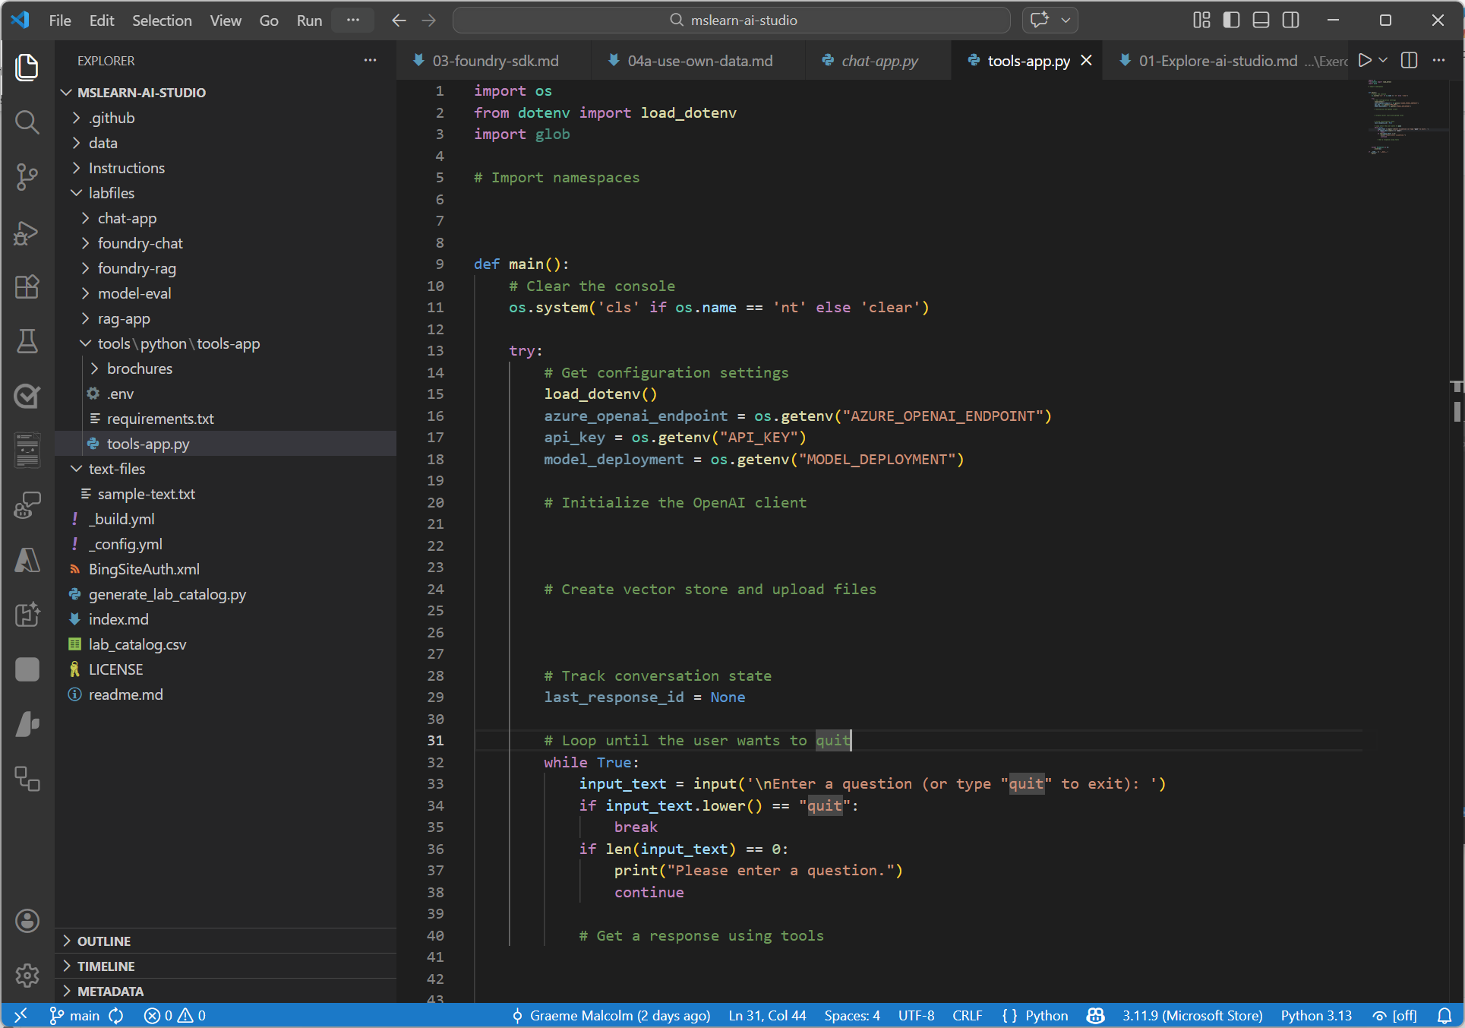
Exercise
Create a generative AI chat app that uses tools
In this exercise, you’ll:
Experiment with tools in the playground
Create an app that uses tools
Trainers:
Customize this slide to include the link to the hosted lab environment and any custom instructions.
(then remove this arrow)
Start the exercise at:
https://go.microsoft.com/fwlink/?linkid=2356945
Notes:
Each exercise begins with the same procedure to create a Foundry project– students will become quite adept at this by the end of the day!
The repetition of this procedure can be onerous, but it’s necessary to keep the exercises modular and to avoid consuming Azure resources unnecessary (for both cost reasons and to free up data center capacity for other Azure customers)

Slide 38
Knowledge check
1
Which tool should you use when a model needs to answer questions from your own uploaded policy documents?
web_search
file_search
code_interpreter
2
In a function-calling workflow, what should your application do after the model returns a function_call item?
Wait for the model to run the function automatically
Run the function in your code and send a function_call_output back to the model
Convert the function call into a web_search request
3
Which statement about the code_interpreter tool is correct?
It can run Python code in a sandboxed runtime to help solve tasks
It can browse external websites directly during code execution
It only supports file uploads and can't perform calculations
© Copyright Microsoft Corporation. All rights reserved.
Notes:
Allow students a few minutes to think about the questions, then reveal the correct answers.

Slide 39
Optimize generative AI model performance with Microsoft Foundry
https://aka.ms/mslearn-optimize-models
Notes:
Use the link on the slide to see the Microsoft Learn module from which this lesson is derived.

Slide 40
Optimizing model performance
Optimization strategy choice depends on your requirements:
Optimize for context when the model lacks contextual knowledge, and you want to maximize response accuracy
Optimize the model when you want to improve the response format, style, or speech by maximizing consistency of behavior
Retrieval Augmented Generation (RAG)
Add contextual search results to the prompt
Combined strategies
Prompt engineering
+
RAG
+
Fine-Tuning
Context optimization
What the model need to know
Prompt engineering
System messages specify tone, format, content expectations.
Detailed, explicit user prompts for better responses
Fine-tuning
Additional model training with example prompts and responses
Model optimization
How the model needs to act
Notes:
each the two buckets:
Context optimization: when the model lacks the right knowledge → use RAG.
Model optimization: when the model’s behavior/format needs consistency → system messages, prompting, fine-tuning.
Give learners a diagnostic: “If answers are wrong → add grounding. If answers are messy/inconsistent → tighten prompts or fine-tune.”
As a general guide, most solutions benefit primarily from prompt engineering. RAG is useful if you have context-specific data you want the model to take account of, and fine-tuning is used only when you can’t achieve the required tone and style in your model responses through prompt engineering. In terms of cost, prompt engineering incurs the lowest cost, followed by RAG as you need to pay for data storage and index hosting. Finally, fine-tuning is usually the most expensive option due to the compute overhead required to perform the training.

Slide 41
Prompt engineering
Use detailed, explicit system prompts | You are a friendly travel advisor for Margie's Travel. Answer only questions related to travel, hotels, and trip planning. Use a warm, conversational tone. If you don't have enough information to answer, ask a clarifying question. Format hotel recommendations as a bulleted list with the hotel name, location, and price range.
Use prompt patterns:
Format template pattern | Suggest hotels in New York. Format the results to show: - Hotel name - Location - Star rating - Price range per night
Chain-of-thought pattern | Which hotel is best for a family of four? Take a step-by-step approach: consider room size, amenities for children, location, and price.
Few-shot learning pattern | Classify the following customer messages: Message: "I need to change my flight to Rome" Category: Booking change Message: "What's the weather like in Bali in March?" Category: Travel information Message: "Can I get a refund for my cancelled tour?" Category:
Notes:
Explain system prompts as “role + constraints + output format expectations.” Use the listed patterns as teaching scaffolds: Format template pattern for predictable formatting.
Chain-of-thought pattern (careful framing) for structured reasoning tasks.
Few-shot learning for classification/extraction consistency.
Trainer tip: demonstrate a “before/after” prompt quickly (same question, different structure) to show impact.

Slide 42
Ground your model with Retrieval Augmented Generation
RAG gathers relevant data to include with a prompt for the language model to use for grounding context.
A RAG pattern is an architectural design for RAG by including retrieved relevant data in a prompt:
Retrieve grounding data based on user input
Generate a contextualized response
Model
User input
User input
{search results}
Response
Vector-based index
Augment the prompt with grounding data
Lorem -> [1,34,76,…]
Ipsum -> [6,59,54,…]
…
Notes:
Walk through the pipeline: user input → retrieve relevant data → augment prompt → generate contextualized response.
Explain the “vector-based index” at a high level: “text tokens are represented as vectors so we can retrieve semantically relevant chunks.”
Teaching tip: emphasize grounding goal: “Answer should align with retrieved sources, not guess.”

Slide 43
Fine-tune a model for consistent behavior
Additional training for a foundation model
Provides the model with example prompts and responses
Used to maximize the consistency of the model’s tone and style in responses (how it needs to act)
+
=
*
Foundation model
Training data
Fine-tuned model
Notes:
Position fine-tuning correctly: “You fine-tune to get more consistent tone, style, and output structure—not to ‘magically learn all facts.’”
Explain inputs: examples of prompts and preferred responses → output is a fine‑tuned model that behaves more consistently.

Slide 44
Knowledge check
1
What is the primary purpose of a system message in a prompt?
To define the model's role, behavior, and output constraints
To provide training data that permanently changes the model
To retrieve data from an external data source
2
When should you use Retrieval Augmented Generation (RAG) instead of relying on prompt engineering alone?
When you want the model to respond in a consistent style and format
When the model needs access to domain-specific or current data that it wasn't trained on
When you want to reduce the length of prompts sent to the model
3
What does fine-tuning optimize in a language model?
The factual accuracy of responses by connecting to external data
The consistency of the model's behavior, style, and output format
The number of tokens the model can process in a single request
© Copyright Microsoft Corporation. All rights reserved.
Notes:
Allow students a few minutes to think about the questions, then reveal the correct answers.

Slide 45
Implement a responsible generative AI solution in Microsoft Foundry
https://aka.ms/mslearn-responsible-ai
Notes:
Use the link on the slide to see the Microsoft Learn module from which this lesson is derived.

Slide 46
Plan a responsible generative AI solution
User experience
Map potential harms that are relevant to your planned solution
Measure the presence of these harms in the outputs generated by your solution
Mitigate the harms at multiple layers in your solution
Manage the solution responsibly by defining and following a deployment and operational readiness plan
System message & grounding
Safety system
Model
Notes:
Teach the lifecycle: Map harms relevant to your use case.
Measure them in outputs.
Mitigate across layers (model, safety system, system message/grounding, UX).
Manage operationally with readiness plans.
Trainer tip: call out that mitigation is not “one toggle”—it’s layered defense.
When planning a generative AI solution, consider using a responsible AI impact assessment (https://msblogs.thesourcemediaassets.com/sites/5/2022/06/Microsoft-RAI-Impact-Assessment-Template.pdf) to document potential harms and mitigations.

Slide 47
Guardrails
Collections of controls to detect and mitigate risk
Violence | Language related to physical actions intended to cause physical harm or injury or that describes weapons and related entities
Hate | Content that attacks or uses discriminatory language with reference to a person or Identity group based on certain differentiating attributes of these groups
Sexual content | Language related to sexual anatomy, romantic relationships and sexual acts
Self-harm | Language related to physical actions intended to purposely cause physical harm to oneself
User prompt attacks | User attempts to circumvent system rules – for example by changing the system prompt
Indirect attacks | Attacker attempts to embed instructions in grounded data provided by the user to maliciously gain control of the system
Spotlighting | Enhanced protection against indirect attacks when your application processes third-party documents that might contain embedded malicious instructions
Protected material for code | Identifying AI outputs that match code from existing GitHub repositories
Protected material for text | Identifying content that matches known text from copyrighted sources, such as song lyrics, articles, recipes, or other selected web content
Groundedness | Ensure that generated content is aligned with factual or intended references in sources
Personally identifiable information | Exposure of PII data, including names, addresses, contact details, and other personal details
Notes:
Explain guardrails as “controls that detect/mitigate risk.”
Briefly define each category in practical terms (violence/hate/sexual/self-harm/prompt attacks/indirect attacks/spotlighting/protected material/groundedness/PII).
Teaching tip: spotlight “prompt attacks” + “indirect attacks” as especially relevant for tool/RAG apps.

Slide 48
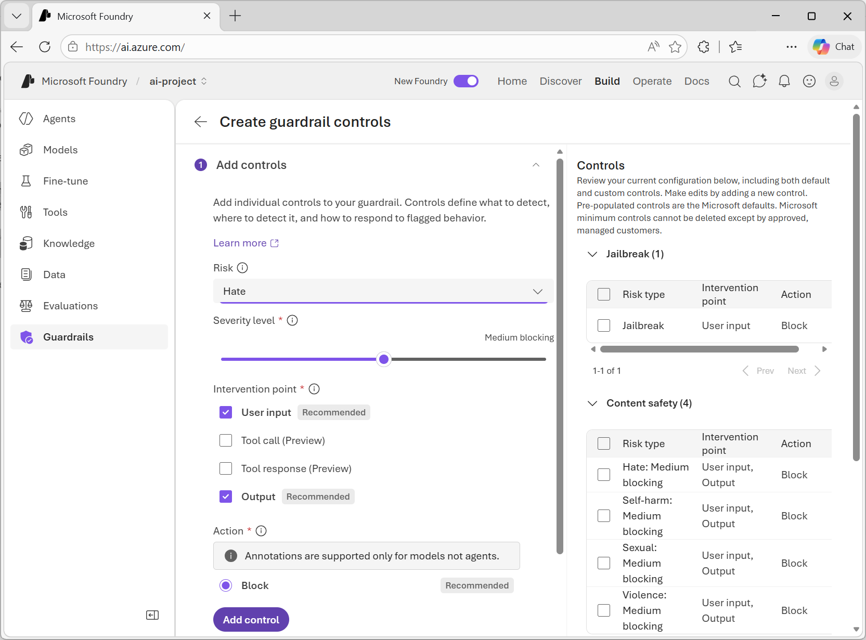
Exercise
Apply content filters to prevent the output of harmful content
In this exercise, you’ll use the Microsoft Foundry portal to:
Chat using the default guardrail
Create and apply a custom guardrail
Trainers:
Customize this slide to include the link to the hosted lab environment and any custom instructions.
(then remove this arrow)
Start the exercise at:
https://go.microsoft.com/fwlink/?linkid=2353440
Notes:
Each exercise begins with the same procedure to create a Microsoft Foundry project – students will become quite adept at this by the end of the day!
The repetition of this procedure can be onerous, but it’s necessary to keep the exercises modular and to avoid consuming Azure resources unnecessary (for both cost reasons and to free up data center capacity for other Azure customers)

Slide 49
Knowledge check
1
Why should you consider creating an AI Impact Assessment when designing a generative AI solution?
To make a legal case that indemnifies you from responsibility for harms caused by the solution
To document the purpose, expected use, and potential harms for the solution
To evaluate the cost of cloud services required to implement your solution
2
What capability of Microsoft Foundry helps mitigate harmful content generation at the Safety System level?
DALL-E model support
Fine-tuning
Guardrails
3
Why should you consider a phased delivery plan for your generative AI solution?
To enable you to gather feedback and identify issues before releasing the solution more broadly
To eliminate the need to map, measure, mitigate, and manage potential harms
To enable you to charge more for the solution
© Copyright Microsoft Corporation. All rights reserved.
Notes:
Allow students a few minutes to think about the questions, then reveal the correct answers.

Slide 50
Develop AI agents with Microsoft Foundry and Visual Studio Code
https://aka.ms/develop-agents-vs-code
Notes:
Use the link on the slide to see the Microsoft Learn module from which this lesson is derived.

Slide 51
Understand AI agents
Input
Agent
+
+
LLM
Instructions
Tools
Output

Slide 52
Understand AI agents
Explore the three components
Input
Agent
G
GPT
L
Llama
You are a travel booking and expense management assistant designed to help employees plan, book, and manage business travel. Always confirm trip dates and budget before making bookings. Prefer direct flights when cost difference is < 20%.
Retrieval
Actions
M
Mistral
C
Claude
+
+
Memory
LLM
Instructions
Tools
Output

Slide 53
Why agents are useful
Automation of routine tasks
Handles repetitive activities, freeing humans to focus on strategic and creative work.
Enhanced decision-making
Analyzes data to surface insights, predict outcomes, and recommend actions in real time.
Scalability
Grows capabilities without proportional increases in headcount or operational costs.
24/7 availability
Operates continuously without breaks, keeping services available around the clock.
Agent

Slide 54
AI agent use cases
Personal productivity
Research
Schedule our team standup for next week.
Any major shifts in the AI market this week?
Done! Mon–Fri at 9 AM — invites sent to all 6 team members.
3 key updates: AI adoption up 40%, EU AI Act enforcement started, healthcare AI funding at record high.
Also draft a recap email from yesterday's notes.
Generate a summary report for the team.
Draft ready in your Drafts folder. Want me to send it?
Report generated — 2-page summary with source links attached.
Sales
Customer service
Find leads in the Pacific Northwest retail sector.
I need a refund for order #4821.
Found 14 leads. Drafted personalized emails and flagged 3 as high-priority for calls.
Refund approved! $47.99 will return to your card in 2–3 business days.
Can I get a confirmation email?
Schedule the priority calls for this week.
Sent to your registered email. Is there anything else I can help with?
Calls booked Tuesday and Thursday — calendar invites sent.

Slide 55
Typical development workflow
1
2
3
4
Connect to your Foundry project
Create an AI agent
Configure agent instructions
Add tools
5
6
7
8
Test the agent in playground
Iterate on design
Deploy the agent to production
Integrate into applications
Microsoft Foundry project
Organizes agents, models, and assets
Model deployment
For example, GPT-4.1 or Claude Sonnet 4.6
Azure AI Search Knowledge retrieval for Foundry IQ or File Search
Azure Storage Files agents can read and write
Azure Key Vault Securely store secrets and credentials
Azure Functions Custom tool implementations and business logic
✓
Required resources
+
Optional resources

Slide 56
Choose your development approach
Foundry portal
Visual, web-based, no local setup required
Visual Studio Code
Developer-centric, code-integrated, Git-friendly
</>
Quick prototyping
Test agent concepts without setting up
a local development environment
Visual configuration
Configure agents through intuitive forms
and dropdowns rather than code
Centralized management
View and manage all agents across projects
in one place with dashboards
Team collaboration
Share configurations with stakeholders
who prefer visual interfaces
Developer-centric workflows
Build agents alongside application code
in a single familiar environment
Version control integration
Track agent configurations in Git
alongside your codebase
Code-first development
Edit YAML configurations directly and
integrate agents into application logic
Local development
Design and test agents offline before
deploying to Azure
OR
Many teams use both: the Foundry portal for initial exploration and reviews, and VS Code for detailed development and production deployments.

Slide 57
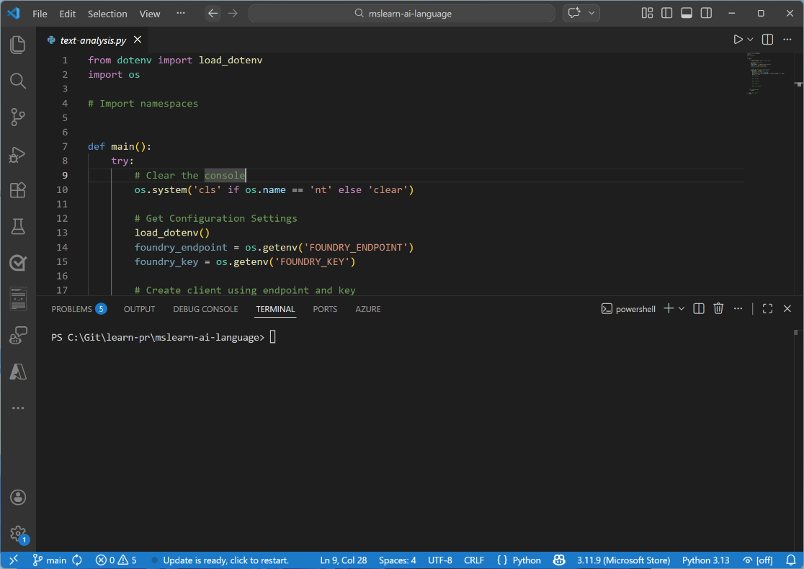
Exercise
Build AI agents with portal and VS Code
In this demo, you’ll explore how to:
Create an AI agent in Microsoft Foundry portal
Interact with your agent using VS Code
Trainers:
Customize this slide to include the link to the hosted lab environment and any custom instructions.
(then remove this arrow)
Start the exercise at:
https://go.microsoft.com/fwlink/?linkid=2352649
Notes:
Each exercise begins with the same procedure to create a Foundry project– students will become quite adept at this by the end of the day!
The repetition of this procedure can be onerous, but it’s necessary to keep the exercises modular and to avoid consuming Azure resources unnecessary (for both cost reasons and to free up data center capacity for other Azure customers)

Slide 58
Knowledge check
1
What is the primary benefit of using Microsoft Foundry Agent Service compared to building agents with standard APIs?
It provides access to more powerful AI models
It requires no Azure subscription
It handles tool calling, state management, and infrastructure automatically
It only works with the Azure portal
2
How does Microsoft Foundry Agent Service handle conversation state?
By requiring developers to manually manage conversation history
Through external database connections
Through the Responses API which automatically manages conversation context
Using local file storage on the client device
© Copyright Microsoft Corporation. All rights reserved.
Notes:
Allow students a few minutes to think about the questions, then reveal the correct answers.

Slide 59
Notes:
Recap the journey: Foundry project → model selection/deployment → endpoint/SDK → chat app development→ optimization → responsible AI.
Invite questions in three buckets: “platform/setup”, “coding/API choices”, “safety/operations”.

