Slide 1
Develop AI Agents on Azure
https://aka.ms/mslearn-develop-ai-agents
Notes:
Use the link on the slide to see the Microsoft Learn module from which this lesson is derived.

Slide 2

Artificial Intelligence workloads
Generative AI and Agents
Text and Language
Computer Speech
Computer Vision
Information Extraction
$$f\left(x\right)=y$$
Machine Learning
Notes:
Orient learners: “Azure AI spans multiple workload families—today we’re zooming in on Generative AI and Agents.”
Quick contrast: classic ML (predictive, f(x)=y) vs. generative AI (language + reasoning + content generation).

Slide 3
Our focus today
Generative AI and Agents
Text and Language
Computer Speech
Computer Vision
Information Extraction
Generative AI and Agents
$$f\left(x\right)=y$$
Machine Learning
Notes:
Reinforce scope control: “If you came for vision/speech/translation, those exist—but today’s focus is on agents.”

Slide 4
Develop AI agents with Microsoft Foundry and Visual Studio Code
https://aka.ms/develop-agents-vs-code
Notes:
IMPORTANT: Only present this section if you’re using this as a 1 day course. If you are teaching AI-103, this section is a duplicate of the end from the previous day.

Slide 5
Understand AI agents
Input
Agent
+
+
LLM
Instructions
Tools
Output

Slide 6
Understand AI agents
Explore the three components
Input
Agent
G
GPT
L
Llama
You are a travel booking and expense management assistant designed to help employees plan, book, and manage business travel. Always confirm trip dates and budget before making bookings. Prefer direct flights when cost difference is < 20%.
Retrieval
Actions
M
Mistral
C
Claude
+
+
Memory
LLM
Instructions
Tools
Output

Slide 7
Why agents are useful
Automation of routine tasks
Handles repetitive activities, freeing humans to focus on strategic and creative work.
Enhanced decision-making
Analyzes data to surface insights, predict outcomes, and recommend actions in real time.
Scalability
Grows capabilities without proportional increases in headcount or operational costs.
24/7 availability
Operates continuously without breaks, keeping services available around the clock.
Agent

Slide 8
AI agent use cases
Personal productivity
Research
Schedule our team standup for next week.
Any major shifts in the AI market this week?
Done! Mon–Fri at 9 AM — invites sent to all 6 team members.
3 key updates: AI adoption up 40%, EU AI Act enforcement started, healthcare AI funding at record high.
Also draft a recap email from yesterday's notes.
Generate a summary report for the team.
Draft ready in your Drafts folder. Want me to send it?
Report generated — 2-page summary with source links attached.
Sales
Customer service
Find leads in the Pacific Northwest retail sector.
I need a refund for order #4821.
Found 14 leads. Drafted personalized emails and flagged 3 as high-priority for calls.
Refund approved! $47.99 will return to your card in 2–3 business days.
Can I get a confirmation email?
Schedule the priority calls for this week.
Sent to your registered email. Is there anything else I can help with?
Calls booked Tuesday and Thursday — calendar invites sent.

Slide 9
Typical development workflow
1
2
3
4
Connect to your Foundry project
Create an AI agent
Configure agent instructions
Add tools
5
6
7
8
Test the agent in playground
Iterate on design
Deploy the agent to production
Integrate into applications
Microsoft Foundry project
Organizes agents, models, and assets
Model deployment
For example, GPT-4.1 or Claude Sonnet 4.6
Azure AI Search Knowledge retrieval for Foundry IQ or File Search
Azure Storage Files agents can read and write
Azure Key Vault Securely store secrets and credentials
Azure Functions Custom tool implementations and business logic
✓
Required resources
+
Optional resources

Slide 10
Choose your development approach
Foundry portal
Visual, web-based, no local setup required
Visual Studio Code
Developer-centric, code-integrated, Git-friendly
</>
Quick prototyping
Test agent concepts without setting up
a local development environment
Visual configuration
Configure agents through intuitive forms
and dropdowns rather than code
Centralized management
View and manage all agents across projects
in one place with dashboards
Team collaboration
Share configurations with stakeholders
who prefer visual interfaces
Developer-centric workflows
Build agents alongside application code
in a single familiar environment
Version control integration
Track agent configurations in Git
alongside your codebase
Code-first development
Edit YAML configurations directly and
integrate agents into application logic
Local development
Design and test agents offline before
deploying to Azure
OR
Many teams use both: the Foundry portal for initial exploration and reviews, and VS Code for detailed development and production deployments.

Slide 11
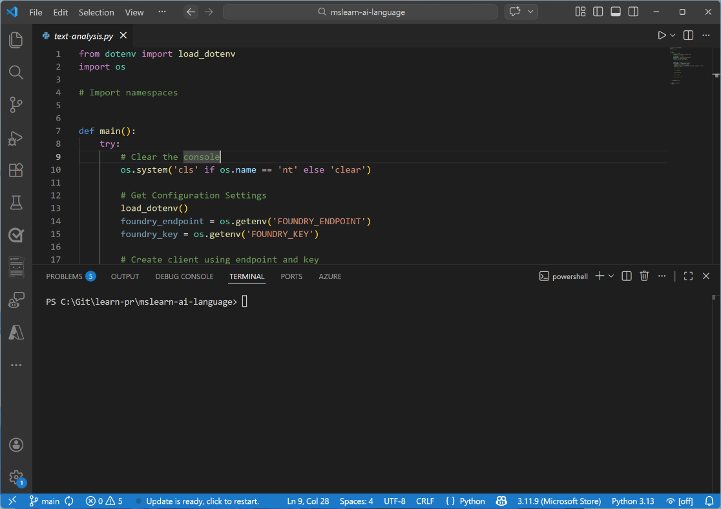
Demo
Build AI agents with portal and VS Code
In this demo, you’ll explore how to:
Create an AI agent in Microsoft Foundry portal
Interact with your agent using VS Code
Trainers:
Customize this slide to include the link to the hosted lab environment and any custom instructions.
(then remove this arrow)
Start the exercise at:
https://go.microsoft.com/fwlink/?linkid=2352649
Notes:
Each exercise begins with the same procedure to create a Foundry project– students will become quite adept at this by the end of the day!
The repetition of this procedure can be onerous, but it’s necessary to keep the exercises modular and to avoid consuming Azure resources unnecessary (for both cost reasons and to free up data center capacity for other Azure customers)

Slide 12
Knowledge check
1
What is the primary benefit of using Microsoft Foundry to build your agents compared to building agents with standard language model APIs?
It provides access to more powerful AI models
It requires no Azure subscription
It handles tool calling, state management, and infrastructure automatically
It only works with the Azure portal
2
How does the Microsoft Foundry SDK handle conversation state?
By requiring developers to manually manage conversation history
Through external database connections
Through the Responses API which automatically manages conversation context
Using local file storage on the client device
© Copyright Microsoft Corporation. All rights reserved.
Notes:
Allow students a few minutes to think about the questions, then reveal the correct answers.

Slide 13
Integrate custom tools into your agent
https://aka.ms/mslearn-agent-custom-tools
Notes:
Use the link on the slide to see the Microsoft Learn module from which this lesson is derived.

Slide 14
Why use custom tools?
1
?
2
Agent
Tool
User
3
1
User asks an agent about the weather conditions in a ski resort.
The agent determines it has access
to a tool that can use an API to get meteorological information and calls it.
The tool returns the weather report, and the agent informs the user.
2
3

Slide 15
Options for implementing custom tools
Custom function
Describe custom functions to an agent and let it dynamically identify and call the right function with the correct arguments.
Supports multiple programming languages for integrating custom logic and workflows.
Azure Functions
Build intelligent, event-driven applications with minimal overhead.
Triggers determine when a function executes; bindings streamline connections to input and output data sources.
OpenAPI specification
Build intelligent, event-driven applications with minimal overhead.
Triggers determine when a function executes; bindings streamline connections to input and output data sources.
Azure Logic Apps
Build intelligent, event-driven applications with minimal overhead.
Triggers determine when a function executes; bindings streamline connections to input and output data sources.
</>
Function calling
Event-driven
OpenAPI 3.0
Low-code

Slide 16
Exercise
Build an agent with custom tools
In this exercise, you’ll:
Create a function for the agent to use
Define the function tools
Create the agent that uses the function tools
Send a message to the agent and process the response
Process function calls and display the agent’s response
Trainers:
Customize this slide to include the link to the hosted lab environment and any custom instructions.
(then remove this arrow)
Start the exercise at:
https://go.microsoft.com/fwlink/?linkid=2353623
Notes:
Each exercise begins with the same procedure to create a Foundry project– students will become quite adept at this by the end of the day!
The repetition of this procedure can be onerous, but it’s necessary to keep the exercises modular and to avoid consuming Azure resources unnecessary (for both cost reasons and to free up data center capacity for other Azure customers)

Slide 17
Knowledge check
1
What are custom tools, and how can they help you develop effective agents?
Callable functions that an agent can use to extend its capabilities
Extensions for Visual Studio Code to create and deploy agents
Fine-tuned models that the agent uses to generate custom output
2
You need to integrate functionality from an OpenAPI 3.0-based web service. What should you do?
Add the JSON schema to the agent's instructions
Rewrite the web service as a Python function and hard-code it
Add the web service as an OpenAPI specification tool to the agent definition
© Copyright Microsoft Corporation. All rights reserved.
Notes:
Allow students a few minutes to think about the questions, then reveal the correct answers.

Slide 18
Integrate MCP tools with Azure AI agents
https://aka.ms/mslearn-agent-mcp
Notes:
Use the link on the slide to see the Microsoft Learn module from which this lesson is derived.

Slide 19
Understand Model Context Protocol for AI agents
WITHOUT MCP
WITH MCP
One integration per tool
Integrate once, discover everything
AI Agent
AI Agent
vs
MCP Server
Tool A
Tool B
Tool C
manual setup
manual setup
manual setup
Tool A
Tool B
Tool C
Notes:
Highlight the benefits of MCP, allowing configuration once to connect to various tools and making that same connection available to multiple agents

Slide 20
Integrate agent tools using an MCP server and client
MCP Server
Host tool definitions
@mcp.tool
MCP Client
Initialize session
Fetch available tools
Wrap each tool
ClientSession(...)
session.list_tools()
session.call_tool
Agent
Register to agent’s toolset
FunctionTool
Notes:
Overview of MCP agent tool integration
The MCP server hosts tool definitions decorated with @mcp.tool.
The MCP client initializes an MCP client connection to the server.
The MCP client fetches the available tool definitions with session.list_tools().
Each tool is wrapped in an async function that invokes session.call_tool
The tool functions are bundled into FunctionTool that makes them usable by the agent.
The FunctionTool is registered to the agent's toolset.

Slide 21
Exercise
Connect MCP tools to Foundry Agents
In this exercise, you’ll:
Connect a Foundry Agent to a remote MCP server
Connect a Foundry Agent to custom MCP server tools
Trainers:
Customize this slide to include the link to the hosted lab environment and any custom instructions.
(then remove this arrow)
Start the exercise at:
https://go.microsoft.com/fwlink/?linkid=2353400
Notes:
Each exercise begins with the same procedure to create a Foundry project– students will become quite adept at this by the end of the day!
The repetition of this procedure can be onerous, but it’s necessary to keep the exercises modular and to avoid consuming Azure resources unnecessary (for both cost reasons and to free up data center capacity for other Azure customers)

Slide 22
Knowledge check
1
What role does the MCP server play in the MCP agent tool integration?
Runs the AI agent and processes user prompts directly
Manages network connections between multiple agents
Hosts tool definitions and makes them available for discovery by the client
2
How does an MCP client retrieve available tools from the MCP server?
By calling session.list_tools() to get the current tool catalog
By reading a static JSON file from the server directory
By subscribing to server events via a WebSocket connection
© Copyright Microsoft Corporation. All rights reserved.
Notes:
Allow students a few minutes to think about the questions, then reveal the correct answers.

Slide 23
Build knowledge-enhanced AI agents with Foundry IQ
https://aka.ms/mslearn-agent-foundry-iq
Notes:
Use the link on the slide to see the Microsoft Learn module from which this lesson is derived.

Slide 24
Remember Retrieval Augmented Generation (RAG)
Retrieve grounding data based on user input
Generate a contextualized response
Model
User input
User input +
{search results}
Response
Vector-based index
Augment the prompt with grounding data
Lorem -> [1,34,76,…]
Ipsum -> [6,59,54,…]
…
Notes:
Use if necessary to recall RAG

Slide 25
Retrieval Augmented Generation (RAG) for agents
LIMITATION
Simple agent
RAG-powered agent
Knowledge cutoff | Outdated answers Unaware of anything past its training cutoff date | Always current Retrieves live documents from connected knowledge bases
No private data | Generic only No access to internal procedures or product specs | Org-specific Searches internal knowledge bases for company content
Lack of context | Irrelevant advice Ignores org workflows, approval chains, and security policies | Contextually aware Grounds advice in retrieved org policies and workflows
Fabricated responses | Compliance risk Confident-sounding answers with no source to verify | Verifiable sources Cites the exact document behind every response
Scalability | Duplicated effort Every team rebuilds the same RAG pipeline independently | Shared platform One knowledge platform (e.g., Foundry IQ) serves all teams

Slide 26

Explore Foundry IQ
A managed knowledge platform built into Microsoft Foundry
Define your knowledge bases once, connect any number of agents to them
DATA SOURCES
CONNECTED AGENTS
Foundry IQ
Centrally managed knowledge bases — auto-indexed, continuously synced, and accessible to any authorized agent
  SharePoint
  Support agent
  OneLake
Product documentation
  HR assistant
SharePoint
Blob
Support
Dev
  Blob Storage
HR policies
  Dev agent
SharePoint
HR
  SQL / APIs
API reference
Blob
SQL
Dev

Slide 27
Configure data sources
Indexed
Direct
Real-time
Pre-processed
High relevance
Custom
No index needed
Raw file access
Always current
Live retrieval
No data copy
Azure AI Search Index
BEST FOR
Enterprise search with custom ingestion pipelines and AI enrichment
Azure Blob Storage
BEST FOR
Document files in Azure Storage — PDFs, DOCX, text, and more
Web
BEST FOR
Current public information retrieved via Bing at query time
SharePoint (Indexed)
BEST FOR
Advanced search on SharePoint content with custom query pipelines
OneLake
BEST FOR
Unstructured data and documents in Microsoft Fabric’s unified data lake
SharePoint (Remote)
BEST FOR
Live SharePoint content with Microsoft 365 governance and permissions
Notes:
Additional datasources can be connected, this serves as an example of the most common ones.

Slide 28
Configure retrieval with Foundry IQ
Effective instructions specify three critical behaviors
  When to retrieve
Tell the agent to always use the knowledge base, never rely on training data
retrieval_instructions = """You are a helpful HR assistant.
CRITICAL RULES:
You must ALWAYS search the knowledge base before answering any question
You must NEVER answer from your own knowledge or training data
Every answer MUST include citations
If the knowledge base doesn't contain the answer, respond with "I don't have that information in our current documentation. Please contact HR directly at hr@company.com"
Your role is to provide accurate, verifiable information from company documentation."""
  How to cite
Specify the exact format for source attribution
  What to do when unsure
Define fallback behavior when information isn't found

Slide 29
Exercise
Integrate an AI agent with Foundry IQ
In this exercise, you’ll:
Create an agent
Configure your data and Foundry IQ
Test the agent in the playground
Connect to your agent from a client application
Test the integration
Trainers:
Customize this slide to include the link to the hosted lab environment and any custom instructions.
(then remove this arrow)
Start the exercise at:
https://go.microsoft.com/fwlink/?linkid=2347700
Notes:
Each exercise begins with the same procedure to create a Foundry project– students will become quite adept at this by the end of the day!
The repetition of this procedure can be onerous, but it’s necessary to keep the exercises modular and to avoid consuming Azure resources unnecessary (for both cost reasons and to free up data center capacity for other Azure customers)

Slide 30
Knowledge check
1
What is the primary advantage of Retrieval Augmented Generation (RAG) over simple AI agents?
RAG eliminates the need for large language models
RAG enables agents to ground responses in current organizational information and provide source transparency
RAG automatically retrains the language model when documents change
2
Which data source option provides real-time access to SharePoint content with Microsoft 365 governance?
SharePoint Indexed, which pre-processes content into Azure AI Search
SharePoint Remote, which queries SharePoint sites and libraries in real-time
Azure Blob Storage, which connects to SharePoint files stored as blobs
© Copyright Microsoft Corporation. All rights reserved.
Notes:
Allow students a few minutes to think about the questions, then reveal the correct answers.

Slide 31
Integrate your agent with Microsoft 365
https://aka.ms/mslearn-integrate-m365
Notes:
Use the link on the slide to see the Microsoft Learn module from which this lesson is derived.

Slide 32
Understanding agent applications
When you publish an agent, Microsoft Foundry creates an Agent Application resource with:
Dedicated invocation URL
A stable endpoint that remains consistent as you update agent versions.
Agent identity
A distinct Microsoft Entra identity separate from your development project
User data isolation
Inputs and interactions from one user aren't available to other users

Slide 33
Publish your agent
1
2
3
4
Select your agent version
Start the publishing process
Configure Azure Bot Service
Complete the metadata
Name Display name for your agent in the Teams store
Description Brief explanation of what your agent does
Icons Upload small and large PNG icons
Publisher information Your organization name and contact details
Privacy policy URL to your organization's privacy policy
Terms of use URL to your terms of service
metadata
5
6
Choose your publish scope
Prepare and optionally download the package
Shared scope
Agent appears under "Your agents" in the store. Available immediately. Best for testing and small teams.
Organization scope
Agent appears under "Built by your org" in the store.
Requires admin approval. Best for production deployments.
OR

Slide 34
Demo
Publish a Foundry agent to Teams
In this demo, you’ll explore how to:
Create an agent in the portal
Add knowledge with File Search
Publish to Microsoft Teams
Publish to Microsoft 365 Copilot
Update published agents
Trainers:
Customize this slide to include the link to the hosted lab environment and any custom instructions.
(then remove this arrow)
Start the exercise at:
https://go.microsoft.com/fwlink/?linkid=2352775
Notes:
Each exercise begins with the same procedure to create a Foundry project– students will become quite adept at this by the end of the day!
The repetition of this procedure can be onerous, but it’s necessary to keep the exercises modular and to avoid consuming Azure resources unnecessary (for both cost reasons and to free up data center capacity for other Azure customers)

Slide 35
Knowledge check
1
What Azure resource does the Foundry portal automatically create when you publish an agent to Microsoft Teams?
Azure Functions
Azure Bot Service
Azure Cosmos DB
Azure Logic Apps
2
What is Microsoft Work IQ?
A machine learning model for workplace analytics
A CLI and MCP server that connects AI agents to Microsoft 365 data
A replacement for Microsoft Teams
A Visual Studio Code extension for building agents
© Copyright Microsoft Corporation. All rights reserved.
Notes:
Allow students a few minutes to think about the questions, then reveal the correct answers.

Slide 36
Build agent-driven workflows using Microsoft Foundry
https://aka.ms/mslearn-agent-workflows
Notes:
Use the link on the slide to see the Microsoft Learn module from which this lesson is derived.

Slide 37
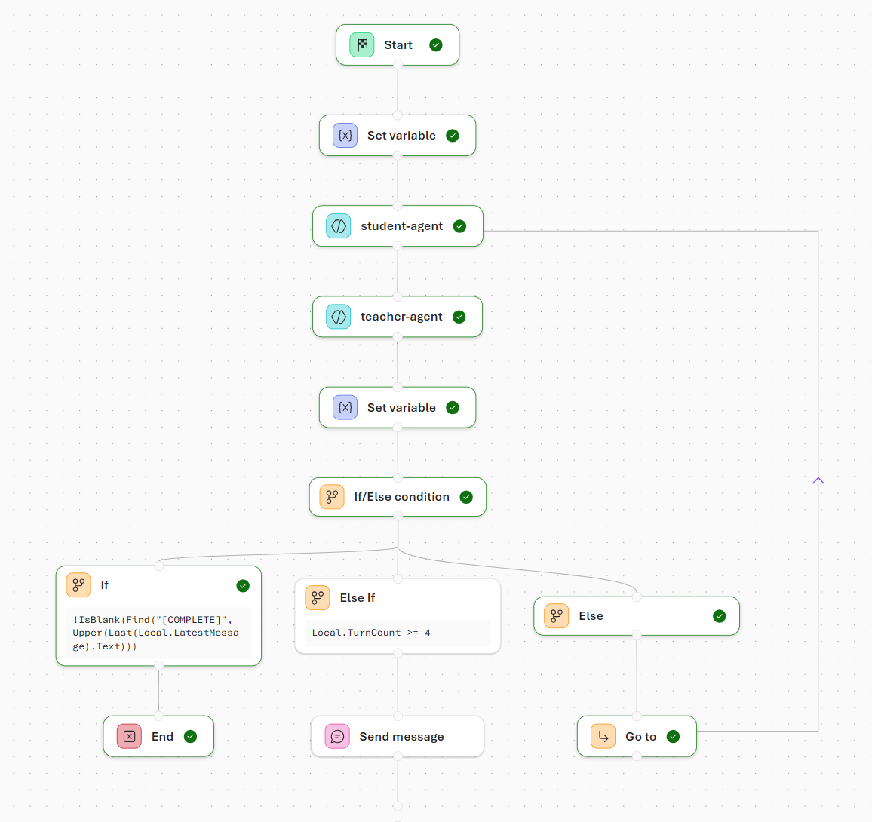
Understand workflows
Orchestrate AI-driven actions
Rather than writing code, you define a sequence of steps using a visual, declarative approach that describe what should happen and when, allowing the platform to manage execution and state.
Connect the nodes
Each node performs a specific function. Some nodes invoke agents, while others evaluate conditions, manage data, or communicate with users. Together, these nodes form an execution path that determines how requests move through the system.

Slide 38
Identify workflow patterns
Step 1
Automate
Agent A
Agent B
Step 2
No
Approve?
Orchestrator
Step 3
Yes
Output
Continue
Agent C
Agent D
Sequential
Human-in-the-loop
Group chat
Steps execute in a fixed order, each passing its output to the next. Best for predictable multi-stage pipelines.
Workflow pauses for human approval or input before continuing. Balances automation with oversight.
Multiple specialized agents collaborate dynamically. Control shifts based on context, allowing agents to build on each other's outputs.

Slide 39
Explore core components of a workflow
Executors
The main workers in a workflow. Each executor receives input, performs actions, and passes outputs along — driving the workflow toward its goal.
Executors can represent AI agents or custom logic components.
Edges
Direct
One executor feeds directly into the next in sequence.
Conditional
Triggers only when a condition is met; otherwise skipped.
Switch-case
Routes to different executors based on predefined conditions
Fan-out
Sends a single message to multiple executors simultaneously.
Fan-in
Combines messages from multiple executors into one final step
Events
WorkflowStartedEvent
Triggered when workflow execution begins.
WorkflowOutputEvent
Emitted when the workflow produces an output.
WorkflowErrorEvent
Occurs when an error is encountered during execution.
ExecutorInvokeEvent
Fired when an executor starts processing a task.
ExecutorCompleteEvent
Fired when an executor finishes its work.
RequestInfoEvent
Logged when an external request is issued.

Slide 40
Demo
Build a workflow in Microsoft Foundry
In this demo, you’ll explore how to:
Create a customer support triage workflow
Preview the workflow
Use your workflow in code
Trainers:
Customize this slide to include the link to the hosted lab environment and any custom instructions.
(then remove this arrow)
Start the exercise at:
https://go.microsoft.com/fwlink/?linkid=2353408
Notes:
Each exercise begins with the same procedure to create a Foundry project– students will become quite adept at this by the end of the day!
The repetition of this procedure can be onerous, but it’s necessary to keep the exercises modular and to avoid consuming Azure resources unnecessary (for both cost reasons and to free up data center capacity for other Azure customers)

Slide 41
Knowledge check
1
Which type of node in a Foundry workflow is used to invoke an AI agent?
Logic node
Agent node
Data transformation node
2
Which node type would you use to handle multiple items in a workflow without duplicating nodes?
If/Else node
For-Each node
Send message node
© Copyright Microsoft Corporation. All rights reserved.
Notes:
Allow students a few minutes to think about the questions, then reveal the correct answers.

Slide 42
Develop an AI agent with Microsoft Agent Framework
https://aka.ms/mslearn-agent-framework
Notes:
Use the link on the slide to see the Microsoft Learn module from which this lesson is derived.

Slide 43
Explore Microsoft Agent Framework core components
Agents
Consistent interface enabling multi-agent orchestration. Supports function calling, multi-turn conversations, structured outputs, and streaming responses out of the box.
Function tools
Containers for custom functions that extend agent capabilities. Agents automatically discover and invoke functions to integrate with external APIs and services.
Chat providers
Abstractions for connecting to AI services under a common interface. All providers are interchangeable through the BaseAgent abstraction.
Conversation management
Structured message system with typed roles and AgentSession for persistent conversation context across multiple interactions.
Workflow orchestration
Patterns for complex multi-agent collaboration including human-in-the-loop support. Agents can hand off tasks or participate in group conversations.
Built-in tools
Prebuilt capabilities provided by the service, ready to use without additional configuration.
Notes:
Highlight the differences of the Agent Framework

Slide 44
Create an AI agent
1
Create a Microsoft Foundry project
Add the project connection string to your Microsoft Agent Framework application code
Set up authentication credentials with AzureCliCredential
Connect to your project client with the AzureOpenAIResponsesClient class
Create an Agent instance with the client, instructions, and tools you want to use
2
3
4
5

Slide 45
Add tools to AI agents
Built-in tools
Custom function tools
Code interpeter
Executes Python code for calculations, data analysis, and more
Create a custom function tool by defining a Python function and decorating it with the @tool decorator
Create your tool by defining a regular Python function with proper type annotations
File search
Searches through and analyzes documents
Pass your custom functions to the ChatAgent during creation using the tools parameter
Web search
Retrieves information from the internet
Once tools are registered, the AI agent automatically selects and orchestrates the appropriate tools based on user requests, without requiring manual invocation.

Slide 46
Exercise
Develop an Azure AI agent
In this exercise, you’ll:
Install the Microsoft AI Toolkit VS Code extension
Deploy a model
Clone the starter code repository
Write code for an agent app
Run the app
Trainers:
Customize this slide to include the link to the hosted lab environment and any custom instructions.
(then remove this arrow)
Start the exercise at:
https://go.microsoft.com/fwlink/?linkid=2353605
Notes:
NOTE: If low on time, this is the best one to skip
Each exercise begins with the same procedure to create a Foundry project– students will become quite adept at this by the end of the day!
The repetition of this procedure can be onerous, but it’s necessary to keep the exercises modular and to avoid consuming Azure resources unnecessary (for both cost reasons and to free up data center capacity for other Azure customers)

Slide 47
Knowledge check
1
What are the key steps to create a Microsoft Foundry Agent using the Microsoft Agent Framework?
Deploy a custom AI model before creating an agent definition in the Azure portal
Initialize the agent by defining a model in the AgentThread constructor
Create an AzureAIAgentClient, define a ChatAgent with instructions and tools, and create an AgentThread
2
Which component in the Microsoft Agent Framework manages conversation state and stores messages?
AgentThread
ChatAgent
AzureAIAgentClient
© Copyright Microsoft Corporation. All rights reserved.
Notes:
Allow students a few minutes to think about the questions, then reveal the correct answers.

Slide 48
Orchestrate a multi-agent solution using the Microsoft Agent Framework
https://aka.ms/mslearn-agent-framework-multi-agent
Notes:
Use the link on the slide to see the Microsoft Learn module from which this lesson is derived.

Slide 49
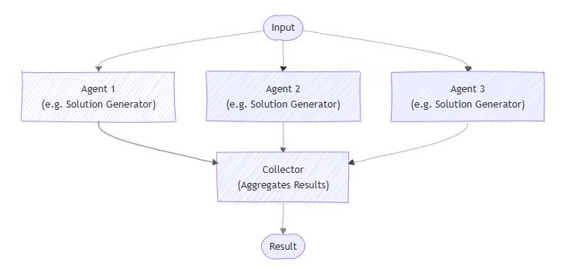
Use concurrent orchestration
Run tasks in parallel
Independent agents execute simultaneously
Results merged at completion
Optimized for speed
Notes:
Use concurrent orchestration when multiple agents or tasks can run in parallel without dependencies. This pattern reduces latency by executing work simultaneously and is ideal for independent analysis, enrichment, or validation steps. Emphasize that coordination happens after all agents complete.

Slide 50
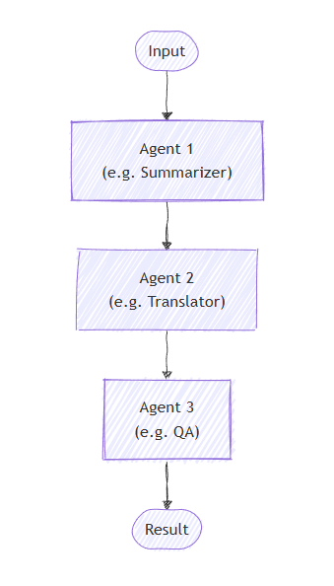
Use sequential orchestration
Step-by-step execution
Each step depends on the previous output
Predictable, ordered flow
Easy to reason about
Notes:
Sequential orchestration is used when each step depends on the output of the previous one. This pattern is best for predictable, ordered workflows such as data collection → analysis → response generation. Highlight its simplicity and ease of reasoning.

Slide 51
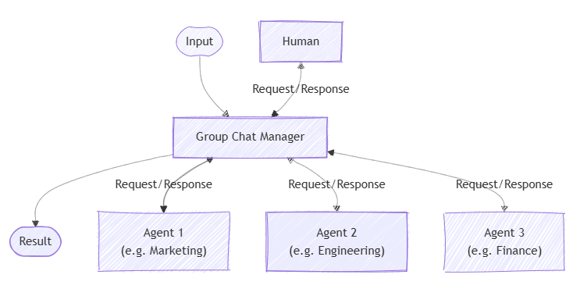
Use group chat orchestration
Collaborative agent reasoning
Agents share a common conversation
Control shifts dynamically
Best for brainstorming and synthesis
Notes:
Group chat orchestration enables multiple agents to collaborate dynamically in a shared conversation. Control can shift between agents based on context, allowing them to build on each other’s responses. This is well suited for brainstorming, research synthesis, and complex problem solving.

Slide 52
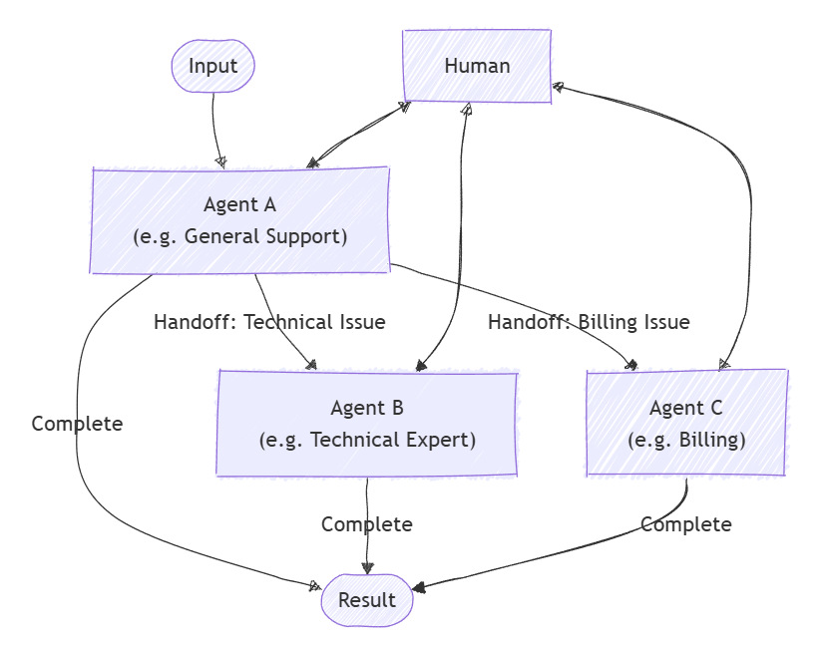
Use handoff orchestration
Delegate by expertise
One agent transfers control to another
Clear ownership per stage
Ideal for role‑based workflows
Notes:
Handoff orchestration transfers control from one agent to another based on expertise or task boundaries. This allows each agent to focus on what it does best while maintaining a coherent user experience. Call out its usefulness for multi‑stage or role‑based workflows.

Slide 53
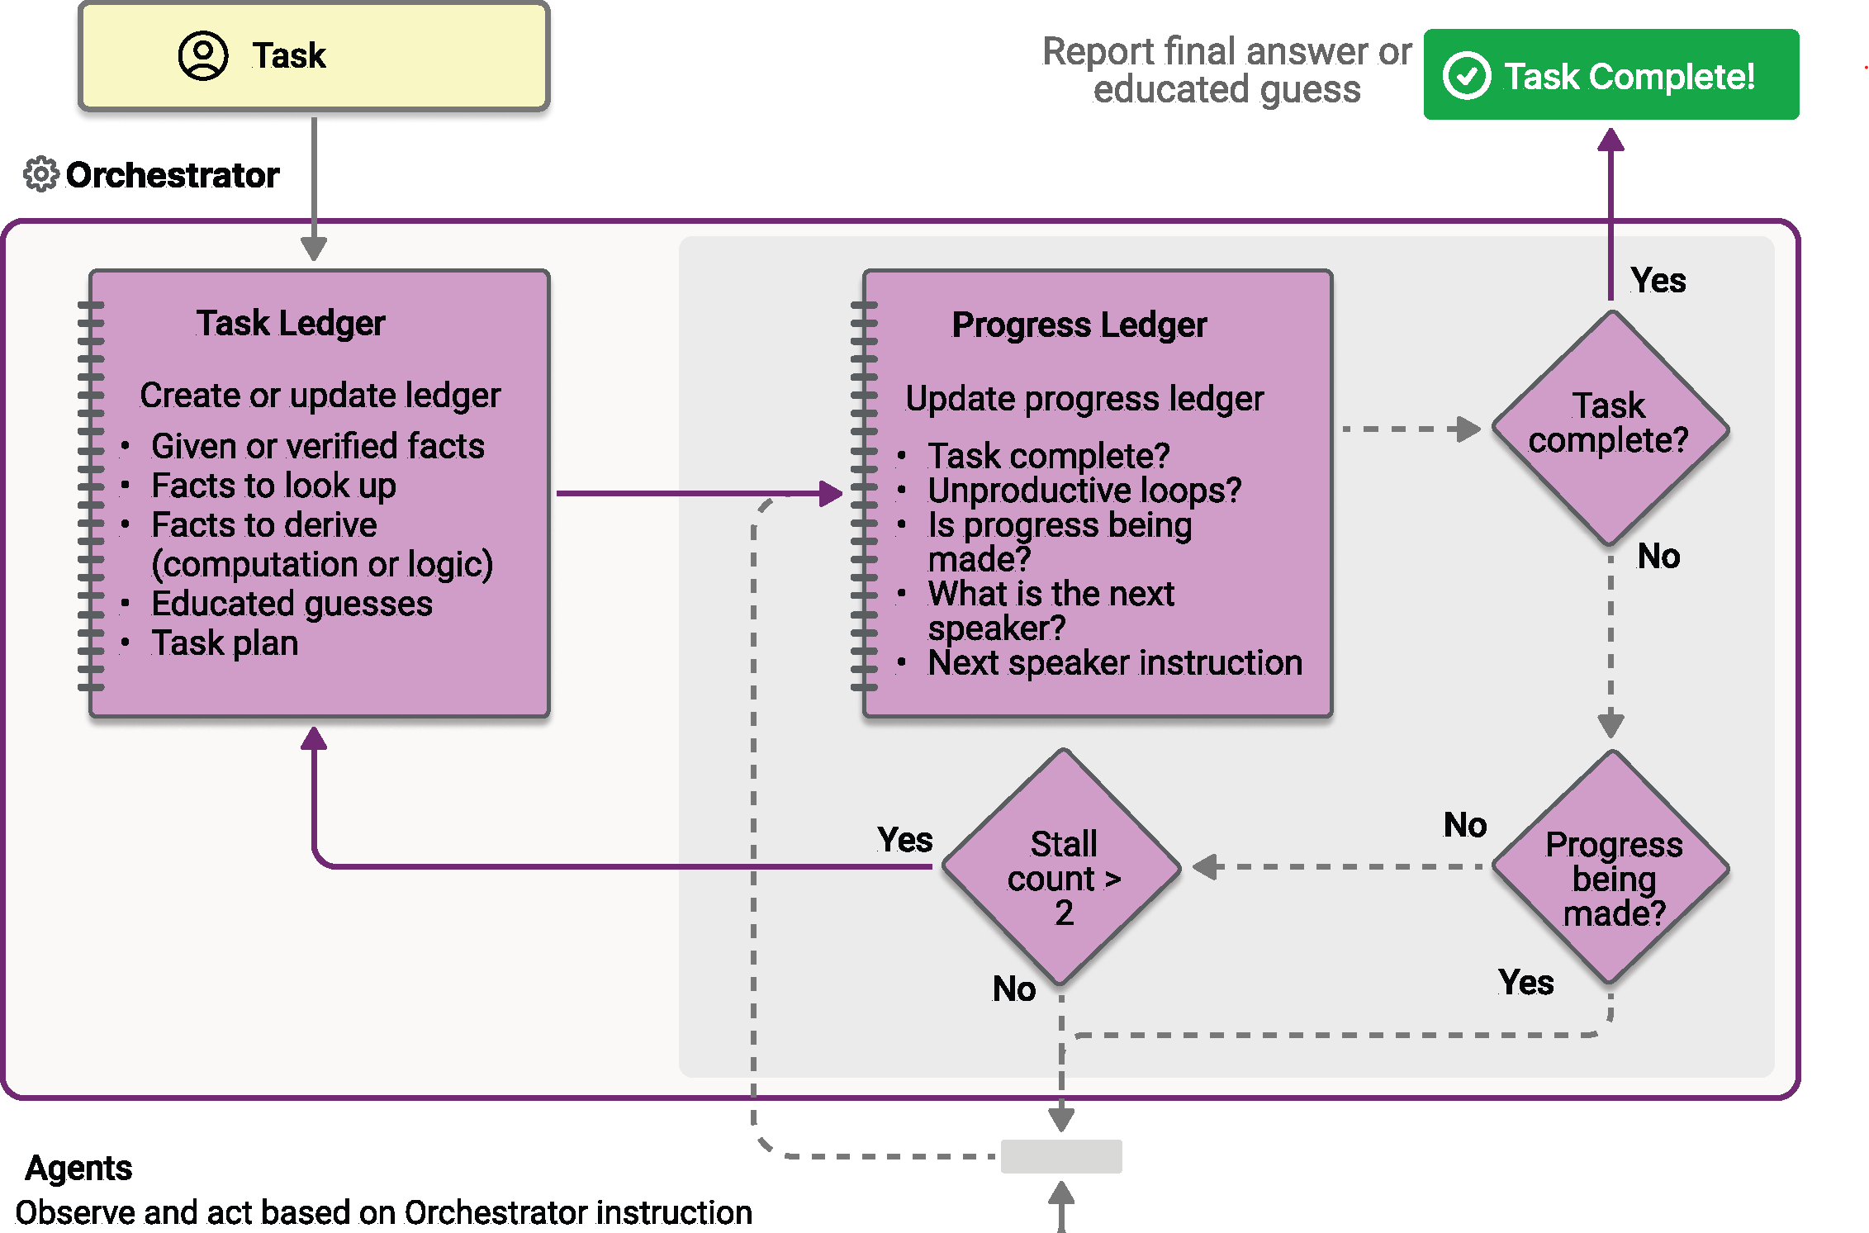
Use Magentic orchestration
Adaptive, emergent collaboration
No fixed execution order
Agents self-organize
Suited for complex, open-ended problems
Notes:
Magentic orchestration enables flexible, adaptive collaboration where agents dynamically decide how to contribute. Instead of a fixed flow, agents self‑organize based on the problem and intermediate results. Position this as an advanced pattern for emergent, non‑linear problem solving.

Slide 54
Exercise
Develop a multi-agent solution
In this exercise, you’ll:
Install the Microsoft AI Toolkit VS Code extension
Deploy a model
Create AI agents
Create a sequential orchestration
Run the app
Trainers:
Customize this slide to include the link to the hosted lab environment and any custom instructions.
(then remove this arrow)
Start the exercise at:
https://go.microsoft.com/fwlink/?linkid=2353606
Notes:
Each exercise begins with the same procedure to create a Foundry project– students will become quite adept at this by the end of the day!
The repetition of this procedure can be onerous, but it’s necessary to keep the exercises modular and to avoid consuming Azure resources unnecessary (for both cost reasons and to free up data center capacity for other Azure customers)

Slide 55
Knowledge check
1
What's the first step in the Microsoft Agent Framework's unified orchestration workflow?
Select and create an orchestration pattern
Define your agents and describe their capabilities
Start a runtime to manage execution
2
For brainstorming and collaborative problem solving among multiple agents, which orchestration pattern is most suitable?
Group Chat
Magentic
Sequential
© Copyright Microsoft Corporation. All rights reserved.
Notes:
Allow students a few minutes to think about the questions, then reveal the correct answers.

