Slide 1
Develop natural language solutions in Azure​
https://aka.ms/mslearn-language
June 2025
Notes:
Use the link on the slide to see the Microsoft Learn learning path from which this presentation is derived.

Slide 2

Artificial Intelligence workloads
Generative AI and Agents
Text and Language
Computer Speech
Computer Vision
Information Extraction
$$f\left(x\right)=y$$
Machine Learning
Notes:
Use this slide to orient learners to the AI workload landscape. Emphasize that today’s focus is Text and Language, but learners should understand how it fits alongside vision, speech, and ML. Reinforce that generative AI and agents increasingly sit on top of these foundational workloads.

Slide 3
Our focus today
Generative AI and Agents
Text and Language
Computer Speech
Computer Vision
Information Extraction
$$f\left(x\right)=y$$
Machine Learning
Notes:
Set expectations: this slide deck focuses on language, speech, and translation workloads in Azure. Position the session within the broader AI‑103 course. Explicitly tell learners what won’t be covered in depth (for example, custom ML training). Help learners mentally scope the exercises they’ll complete.

Slide 4
Analyze text with Azure Language in Foundry Tools
https://aka.ms/mslearn-analyze-text
Notes:
Use the link on the slide to see the Microsoft Learn module from which this lesson is derived.

Slide 5

Azure Language in Foundry Tools
Entities:
John Smith (person)
Contoso Bank (organization)
Seattle (place)
  Prebuilt models for:
    Language detection
    Named entity recognition
    PII detection
PII:
Person
Account number
Email address
Phone number
Language=English (en)
Notes:
Introduce Azure Language as a prebuilt capability exposed through Foundry. Stress the value proposition: no model training required for common NLP tasks.
Walk through each capability quickly, using the example output to make it concrete. Call out PII detection as especially relevant for compliance‑sensitive workloads.

Slide 6


Using the Text Analytics API
Connect to the API
  Endpoint:
    Microsoft Foundry resource*
  Credentials:
    Microsoft Foundry project API key
    Microsoft Entra ID
Use a TextAnalyticsClient to call the appropriate function for your task
  Request: One or more text documents
  Response: Task-specific collection of results (one per document)
Endpoint
https://{foundry_resource}.services.ai.azure.com/
TextAnalyticsClient
…
Microsoft Entra ID
API Key
* cognitiveservices.azure.com is also supported
Notes:
Explain the connection pattern: endpoint + credentials + client SDK. Call out Microsoft Entra ID as the preferred auth option for production. Note that Foundry abstracts endpoint management across services.

Slide 7
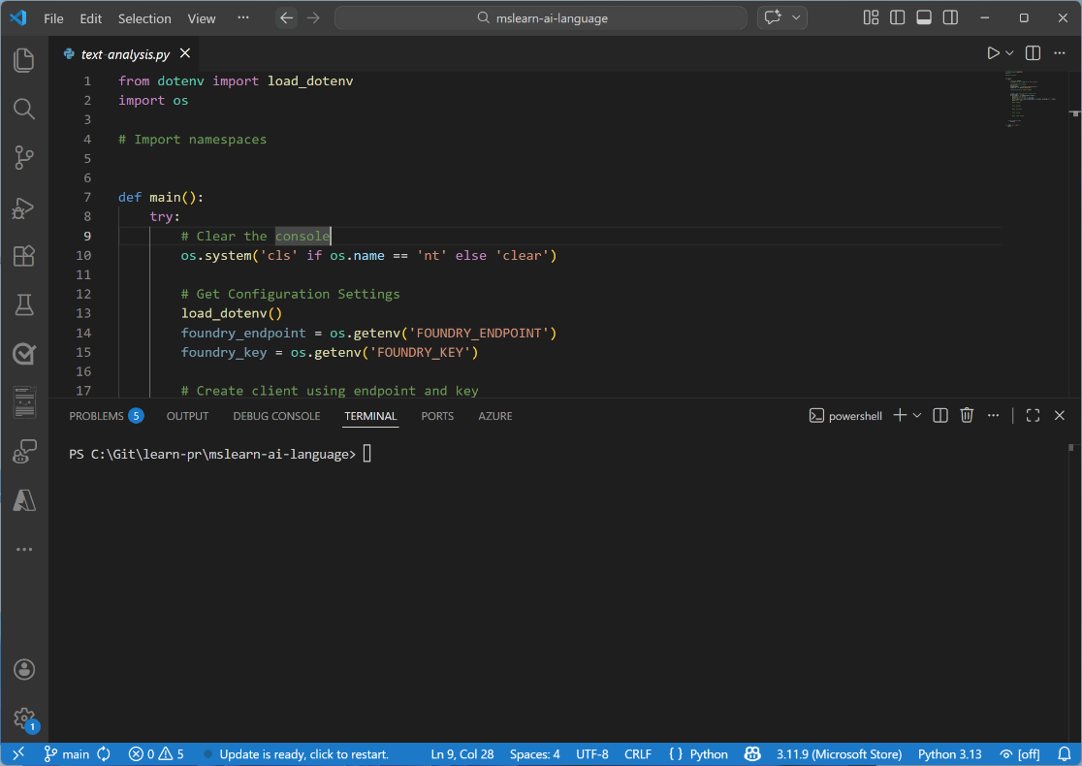
Exercise
Analyze text
In this exercise, you’ll use Azure Language to:
Detect Language
Extract Entities
Extract PII
Trainers:
Customize this slide to include the link to the hosted lab environment and any custom instructions.
(then remove this arrow)
Start the exercise at:
https://go.microsoft.com/fwlink/?linkid=2356343
Notes:
Each exercise begins with the same procedure to create a Foundry project– students will become quite adept at this by the end of the day!
The repetition of this procedure can be onerous, but it’s necessary to keep the exercises modular and to avoid consuming Azure resources unnecessary (for both cost reasons and to free up data center capacity for other Azure customers)

Slide 8
Knowledge check
1
How should you create an application that analyzes news articles and extracts key people, places, and dates that are mentioned for indexing?
Use a generative AI model with a custom function tool that matches strings using a regular expression.
Use Azure Language in Foundry Tools to extract PII entities.
Use Azure Language in Foundry Tools to extract named entities.
2
You want to publish extracts from customer testimonials on a web site. You need to remove personal details from the text before publishing it. What should you do?
Use Azure Language in Foundry Tools to find and redact PII entities.
Use Azure Language in Foundry Tools to detect the language and publish only the testimonials in English.
Use a gpt-4.1 model to create new AI-generated customer reviews.
© Copyright Microsoft Corporation. All rights reserved.
Notes:
Allow students a few minutes to think about the questions, then reveal the correct answers.

Slide 9
Develop a text analysis agent with the Azure Language MCP server
https://aka.ms/mslearn-language-mcp
Notes:
Use the link on the slide to see the Microsoft Learn module from which this lesson is derived.

Slide 10

The Azure Language MCP server
Host
Microsoft Foundry
…?
MCP Client
Azure Language in Foundry Tools
…!
Agent
MCP Server
A user sends a prompt to an agent
The agent determines task (or tasks) to be performed
The agent checks available MCP tools to find the best match
The agent calls the selected tool through the MCP server, passing the relevant input text
The MCP server processes the request using the appropriate Azure Language capability and returns results
The agent combines the results into a natural language response for the user
Notes:
Transition from direct API calls to agent‑based integration. Position MCP as an abstraction layer that tools agents can reason over.
Walk through the flow step‑by‑step, following the arrows. Emphasize that tool selection is agent‑driven, not hard‑coded. Reinforce separation of concerns: agent reasoning vs service execution.

Slide 11
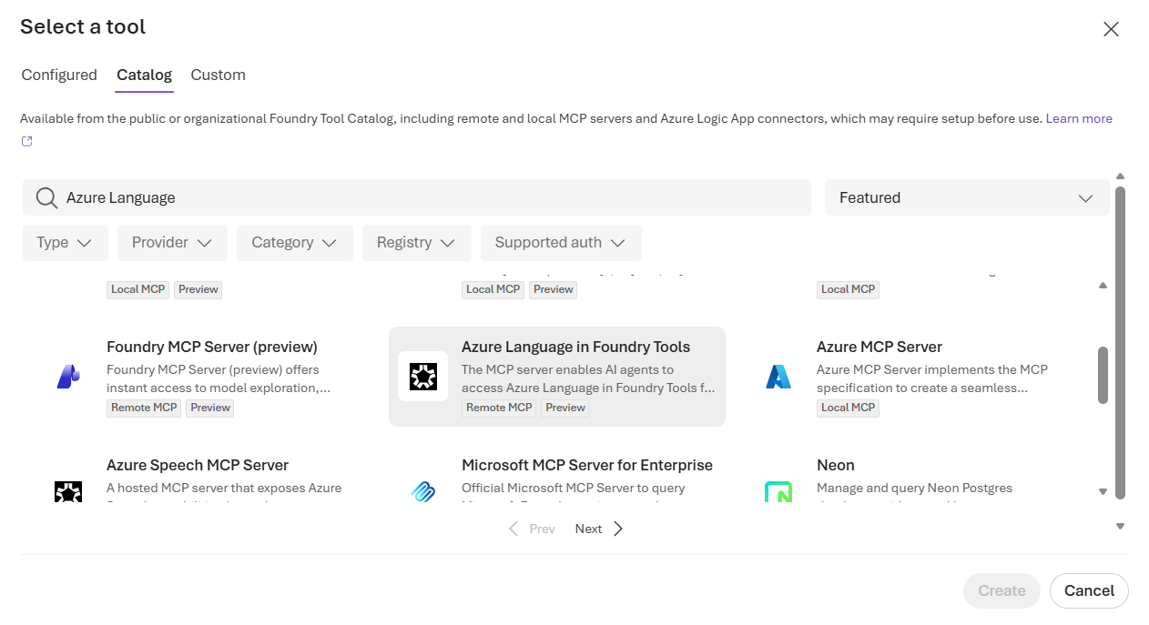
Using the Azure Language MCP server
  Create an agent
  Add the Azure Language MCP Server tool
  Specify agent instructions to select the tool when appropriate
  Test in the agent playground
  Build a client application that uses the agent
Notes:
Highlight that most work is configuration, not code. Stress the importance of clear tool descriptions for good agent routing. Mention that testing happens before any client app is built.

Slide 12
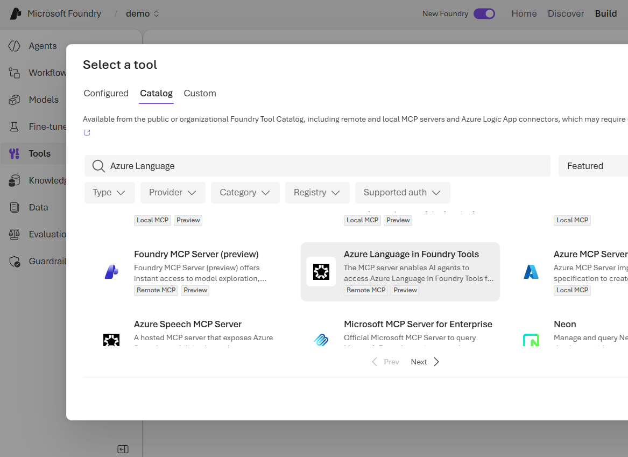
Exercise
Develop a text analysis agent
In this exercise, you’ll:
Create an agent in Microsoft Foundry
Add and test the Azure Language MCP tool
Create a client application for the agent
Trainers:
Customize this slide to include the link to the hosted lab environment and any custom instructions.
(then remove this arrow)
Start the exercise at:
https://go.microsoft.com/fwlink/?linkid=2356518
Notes:
Each exercise begins with the same procedure to create a Foundry project– students will become quite adept at this by the end of the day!
The repetition of this procedure can be onerous, but it’s necessary to keep the exercises modular and to avoid consuming Azure resources unnecessary (for both cost reasons and to free up data center capacity for other Azure customers)

Slide 13
Knowledge check
1
What is the primary role of the Azure Language MCP server?
To train and fine-tune custom language models for use by AI agents
To expose Azure Language text analysis capabilities as MCP tools for agents
To deploy and manage large language models in an Azure subscription
2
How does an agent determine which Azure Language MCP tool to call when processing a user's prompt?
The developer writes routing logic to direct each prompt to a specific tool
The agent matches the prompt to tool descriptions received from the MCP server
The MCP server analyzes the prompt and automatically routes it to a tool
© Copyright Microsoft Corporation. All rights reserved.
Notes:
Allow students a few minutes to think about the questions, then reveal the correct answers.

Slide 14
Develop a speech-capable generative AI application
https://aka.ms/mslearn-generative-ai-speech
Notes:
Use the link on the slide to see the Microsoft Learn module from which this lesson is derived.
This module is mostly about using the lab for teaching, so feel free to add any interesting content to this section

Slide 15
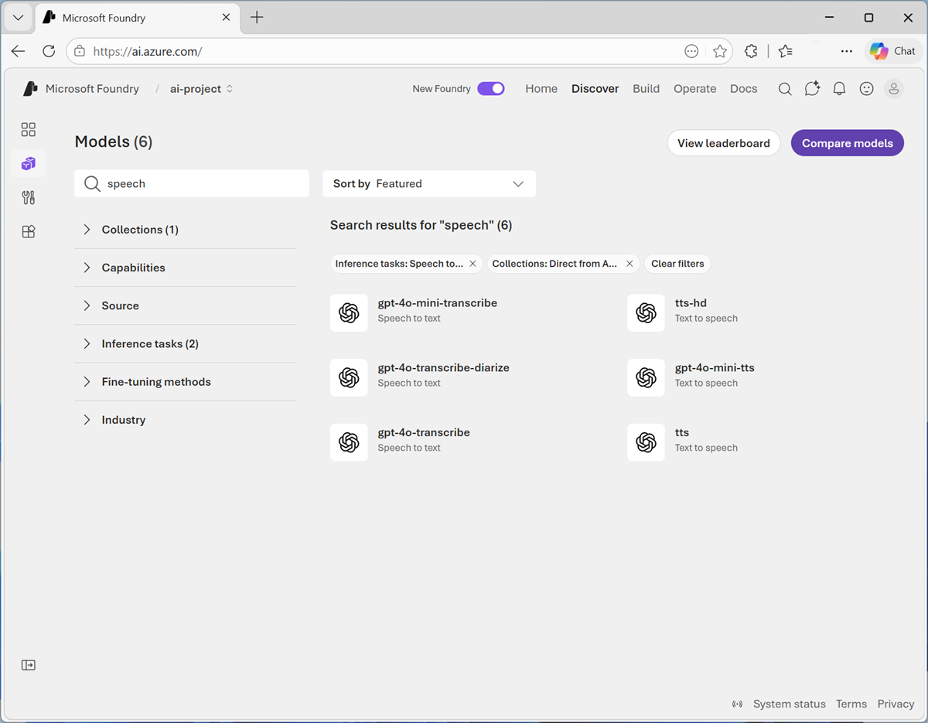
Speech-capable models in Microsoft Foundry Models
Filter and search for:
  Generative AI models that can transcribe speech to text
  Generative AI models that can synthesize text to speech
Notes:
Transition from text to speech workloads. Frame speech as both an input and output modality for generative AI. Reference common use cases like call transcription and voice bots.
Explain that Foundry lets you filter by capability, not just model family. Emphasize the difference between transcription and synthesis models. Note that model names may evolve, but capabilities remain consistent.

Slide 16


Using speech-capable generative AI models
Microsoft Foundry
Foundry Models
gpt-4o-transcribe
gpt-4o-tts
Transcription models:
Prompt includes binary audio data
Response contains transcribed speech
Speech synthesis models:
Prompt includes text
Response contains audio data
Notes:
Clarify input/output expectations for each model type. Emphasize that audio is treated as binary data, not text. Call out that transcription and synthesis are separate workloads.

Slide 17

Exercise
Use speech-capable generative AI models
In this exercise, you’ll:
Find and deploy speech-capable models in Microsoft Foundry
Create a speech synthesis app
Create a speech transcription app
Trainers:
Customize this slide to include the link to the hosted lab environment and any custom instructions.
(then remove this arrow)
Start the exercise at:
https://go.microsoft.com/fwlink/?linkid=2356363
Notes:
Each exercise begins with the same procedure to create a Foundry project– students will become quite adept at this by the end of the day!
The repetition of this procedure can be onerous, but it’s necessary to keep the exercises modular and to avoid consuming Azure resources unnecessary (for both cost reasons and to free up data center capacity for other Azure customers)

Slide 18
Knowledge check
1
Which model can you use to generate text from speech?
gpt-4o-mini
gpt-4o-mini-tts
gpt-4o-mini-transcribe
2
Which model can you use to synthesize speech from text?
gpt-4o-mini
gpt-4o-mini-tts
gpt-4o-mini-transcribe
Notes:
Use the slide animation to reveal the correct answers.

Slide 19
Create speech-enabled apps with Microsoft Foundry
https://aka.ms/mslearn-speech-app

Slide 20

Azure Speech in Foundry Tools
    Speech to text: Transcribe spoken audio
    Text to speech: Synthesize speech
    Voice Live: Real-time conversational speech interactions
    Speech translation: Multilingual translation
Notes:
Position this as the SDK‑based approach, not agent‑based. Reinforce alignment with earlier Foundry concepts.
Walk through the breadth of Speech capabilities. Highlight Voice Live as a differentiator for real‑time scenarios and translation as a cross‑cutting feature. We’ll cover both of these in more depth later. For now, we’ll focus on speech t text and text to speech.

Slide 21

Using Azure Speech in Foundry Tools
Connect to the API
  Endpoint:
    Microsoft Foundry resource*
    Global/Regional endpoint
  Credentials:
    Microsoft Foundry project API key
    Microsoft Entra ID
Create a SpeechConfig object
  Proxy object for speech API operations
Endpoint
https://{foundry_resource}.services.ai.azure.com/
SpeechConfig
API Key
Microsoft Entra ID
* cognitiveservices.azure.com is also supported
Notes:
Explain the role of SpeechConfig as the central configuration object. Reinforce auth options and endpoint consistency with other services. Note that Foundry unifies Speech access patterns.

Slide 22
Speech to text
Connection to Azure Speech
Result includes:
Duration
Offset
Properties
Reason
Text transcript
SpeechConfig
Reason for result:
RecognizedSpeech
NoMatch
Cancelled
  Details
RecognizeOnceAsync()
Microphone (default) or file
SpeechRecognizer
AudioConfig
Notes:
Walk through the recognition lifecycle. Explain result reasons and why NoMatch matters in production. Mention that RecognizeOnceAsync() is simplest but not continuous.

Slide 23
Text to speech
Connection to Azure Speech
Results include
Audio stream
Properties
Reason
Result ID
SpeechConfig
Reason for result:
SynthesizingAudioCompleted
Cancelled
  Details
SpeakTextAsync()
Speaker (default) or file
SpeechSynthesizer
Voice
Audio Format
AudioOutputConfig
Notes:
Emphasize voice selection and output format. Clarify where audio is rendered (speaker vs file). Note that synthesis results include metadata useful for debugging.

Slide 24
Speech Synthesis Markup Language (SSML)
XML-based language with customization options:
Speaking styles (Neural voices only)
Pauses and silence
Phonemes (phonetic pronunciations)
  Prosody (speaking pitch, range, rate, etc.)
  "say-as" (number, date, time, address, etc.)
  Insert recorded speech or background audio
SpeakSsmlAsync( ssml-string );
<speak version="1.0" xmlns="http://www.w3.org/2001/10/synthesis"
xmlns:mstts="https://www.w3.org/2001/mstts" xml:lang="en-US">
<voice name="en-US-AriaNeural">
<mstts:express-as style="cheerful">
I say tomato
</mstts:express-as>
</voice>
<voice name="en-US-GuyNeural">
I say <phoneme alphabet="sapi" ph="t ao m ae t ow"> tomato </phoneme>.
<break strength="weak"/>Lets call the whole thing off!
</voice>
</speak>
Multiple voices in a single synthesis
Speaking style
Phonetic pronunciation
Pause
Notes:
Explain SSML as optional but powerful. Walk through the example to show multiple voices and styles. Emphasize use cases like pronunciation control and pacing.

Slide 25
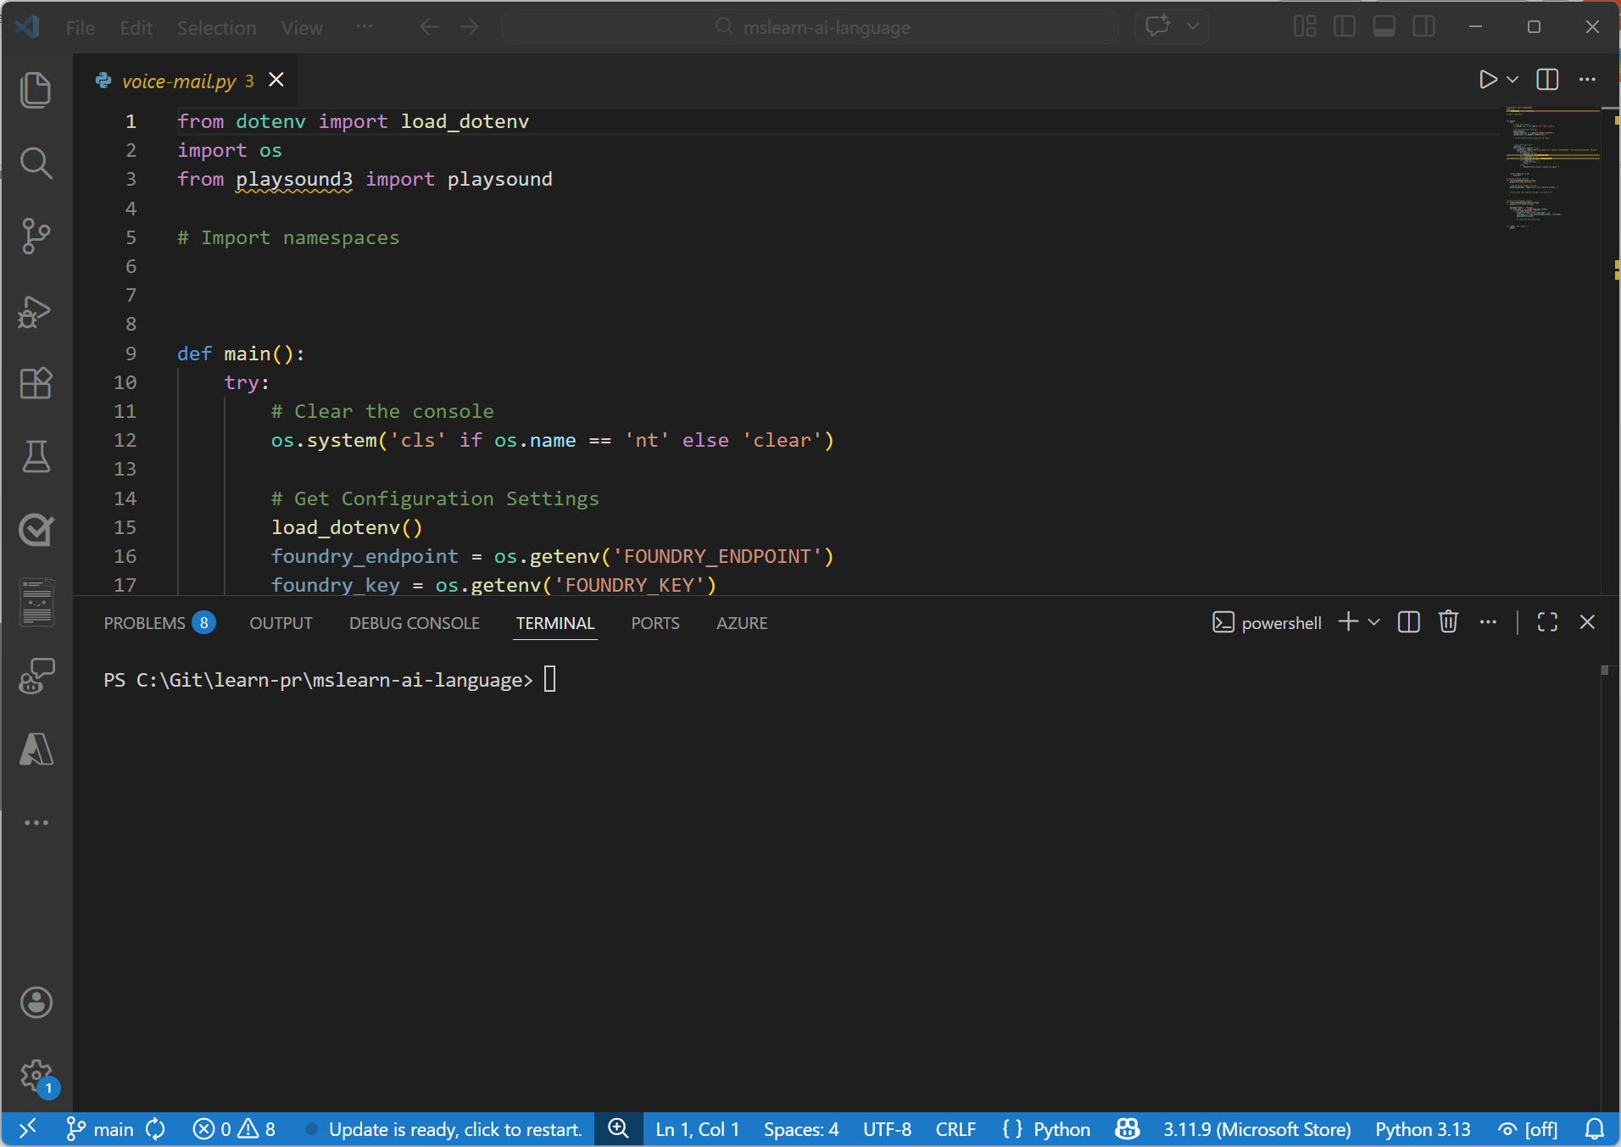
Exercise
Recognize and synthesize speech
In this exercise, you’ll use Azure Speech to build an app that can:
Synthesize speech
Recognize speech
Trainers:
Customize this slide to include the link to the hosted lab environment and any custom instructions.
(then remove this arrow)
Start the exercise at:
https://go.microsoft.com/fwlink/?linkid=2356350
Notes:
Each exercise begins with the same procedure to create a Foundry project– students will become quite adept at this by the end of the day!
The repetition of this procedure can be onerous, but it’s necessary to keep the exercises modular and to avoid consuming Azure resources unnecessary (for both cost reasons and to free up data center capacity for other Azure customers)

Slide 26
Knowledge check
1
What information do you need from your Microsoft Foundry resource to consume it using the Azure Speech SDK?
The endpoint and key
The primary and secondary keys
The Azure subscription ID and resource group name
2
Which object should you use to specify that the speech input to be transcribed to text is in an audio file?
SpeechConfig
AudioConfig
SpeechRecognizer
3
How can you change the voice used in speech synthesis?
Specify a SpeechSynthesisOutputFormat enumeration in the SpeechConfig object
Set the SpeechSynthesisVoiceName property of the SpeechConfig object to the desired voice name
Specify a filename in the AudioConfig object
Notes:
Use the slide animation to reveal the correct answers.

Slide 27
Develop a speech agent with the Azure Speech MCP server
https://aka.ms/mslearn-speech-mcp

Slide 28

The Azure Speech MCP server
Host
Microsoft Foundry
…?
MCP Client
Azure Speech in Foundry Tools
…!
Agent
MCP Server
A user sends a prompt to an agent, containing text or a link to an audio file
The agent determines task (or tasks) to be performed
The agent checks available MCP tools to find the best match
The agent calls the selected tool through the MCP server, passing the relevant input
The MCP server processes the request using Azure Speech (text to speech or speech to text)
In the case of text to speech, the generated audio is saved as a file in Azure storage
The agent responds to the user with transcribed text or a link to the generated audio file
Azure Storage
Notes:
Transition back to agent‑based architecture, now with speech.
Walk through the flow, emphasizing Azure Storage for audio artifacts. Explain why a storage account is required for generated audio. Reinforce agent‑driven tool selection again.

Slide 29
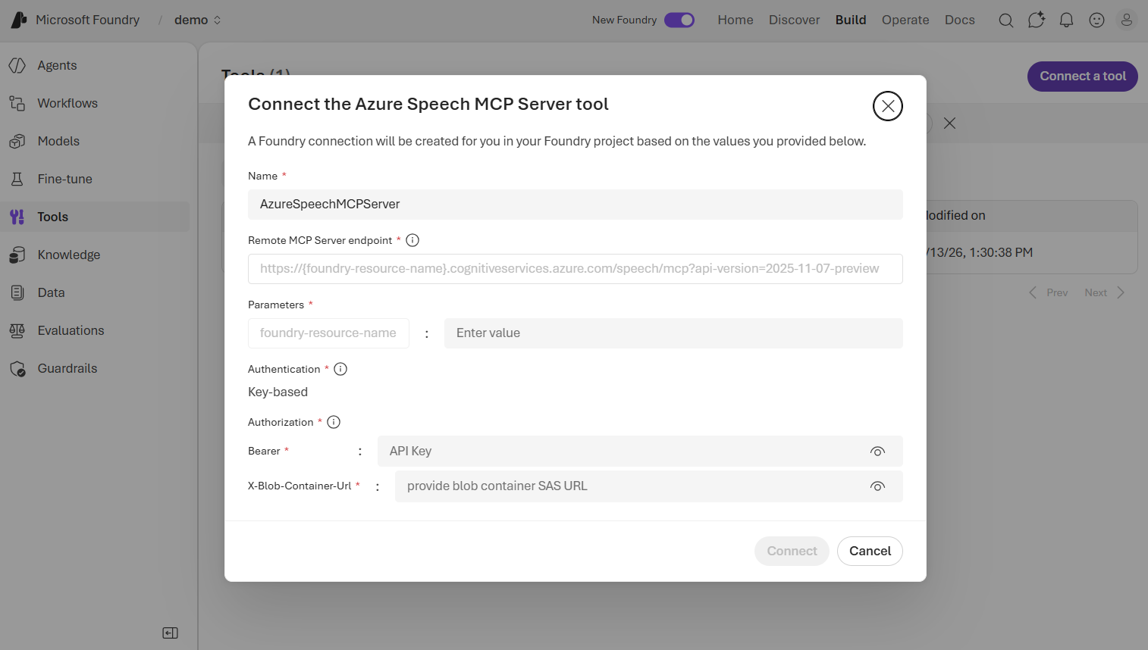
Using the Azure Speech MCP server
  Create an agent
  Connect the Azure Speech MCP Server tool
    Requires an Azure Storage container SAS URL
  Specify agent instructions to select the tool when appropriate
  Test in the agent playground
  Build a client application that uses the agent
Notes:
Call out the SAS URL requirement explicitly.
Reinforce that agent instructions guide tool choice.
Encourage testing with both text and audio inputs.

Slide 30
Exercise
Use Azure Speech in an agent
In this exercise, you’ll:
Create an agent in Microsoft Foundry
Add and test the Azure Speech MCP tool
Create a client application for the agent
Trainers:
Customize this slide to include the link to the hosted lab environment and any custom instructions.
(then remove this arrow)
Start the exercise at:
https://go.microsoft.com/fwlink/?linkid=2356519
Notes:
Each exercise begins with the same procedure to create a Foundry project– students will become quite adept at this by the end of the day!
The repetition of this procedure can be onerous, but it’s necessary to keep the exercises modular and to avoid consuming Azure resources unnecessary (for both cost reasons and to free up data center capacity for other Azure customers)

Slide 31
Knowledge check
1
What two core capabilities does the Azure Speech MCP server expose to agents?
Language translation and text summarization
Speech-to-text recognition and text-to-speech synthesis
Named entity recognition and sentiment analysis
2
Why does the Azure Speech MCP server require an Azure Storage account?
To store the agent's instructions and configuration settings
To store input audio files and output audio files generated by the speech tools
To cache the MCP server's tool definitions for faster discovery
3
What credentials are needed when connecting the Azure Speech MCP server to a Foundry agent?
An OAuth 2.0 token and a managed identity endpoint URL
A Foundry resource key and a SAS URL for a blob container
A client certificate and the Azure subscription ID
Notes:
Use the slide animation to reveal the correct answers.

Slide 32
Develop an Azure Speech Voice Live Agent in Microsoft Foundry
https://aka.ms/mslearn-voice-live-agent

Slide 33
Azure Speech Voice Live
Real-time, event-based conversation framework
Connects models to speech conversations in a Voice Live session
Authentication options are:
  Microsoft Entra ID (keyless)
  API key
Advanced features include:
  Real-time audio processing with support for multiple formats like PCM16 and G.711
  Voice options, including OpenAI voices and Azure custom voices
  Avatar integration using WebRTC for video and animation
  Built-in noise reduction and echo cancellation
Azure Speech in Foundry Tools
Foundry Models
Voice Live session
Notes:
Introduce real‑time conversational voice as a distinct pattern. Emphasize that this is event‑driven, not request/response.
Point out that the model itself does not need to support real-time speech (or any speech at all!) Azure Speech can provide the speech to text and text to speech support for models that don’t have them natively.
Walk through advanced features carefully. Emphasize interrupt handling and real‑time audio processing. Call out authentication options explicitly.

Slide 34
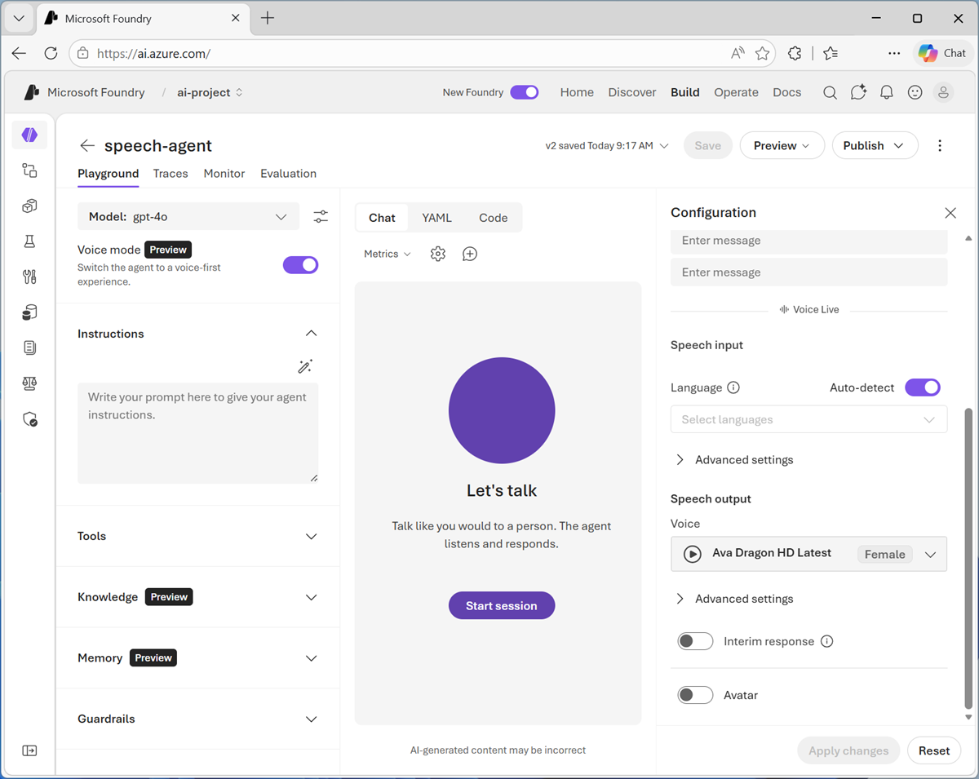
Creating a Voice Live agent
Enable Audio mode in the agent playground
  Configure Voice Live settings for the agent
Create a client app that uses the Voice live SDK to:
  Connect to the agent
  Configure audio hardware input and output
  Establish a Voice Live session
  Monitor audio systems for activity
  Process events (such as user speech input and responses from the agent)
Notes:
Stress that most setup happens in the agent playground – though you can also configure Voice Live settings for an agent when creating it programmatically.
Explain the importance of handling Voice Live events correctly. Mention monitoring audio state as a best practice.

Slide 35
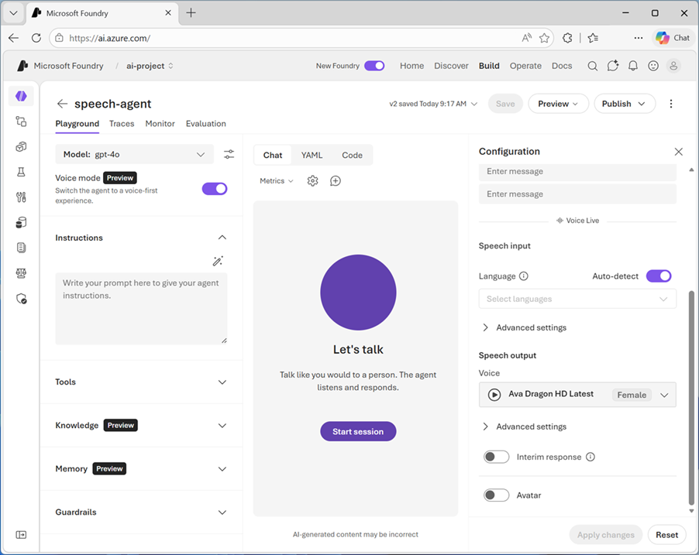
Exercise
Develop a Voice Live agent
In this exercise, you’ll:
Enable and configure Azure Speech Voice Live for an agent
Implement a conversational app that uses the agent
Trainers:
Customize this slide to include the link to the hosted lab environment and any custom instructions.
(then remove this arrow)
Start the exercise at:
https://go.microsoft.com/fwlink/?linkid=2356168
Notes:
Each exercise begins with the same procedure to create a Foundry project– students will become quite adept at this by the end of the day!
The repetition of this procedure can be onerous, but it’s necessary to keep the exercises modular and to avoid consuming Azure resources unnecessary (for both cost reasons and to free up data center capacity for other Azure customers)

Slide 36
Knowledge check
1
What are the two authentication methods supported by the Voice Live API?
OAuth 2.0 and JWT (JSON Web Tokens)
Basic authentication and API keys
Microsoft Entra (keyless) and API key
2
How do you configure and test Voice Live agent integration in the Foundry Portal?
You can’t – Voice Live is only accessible through the REST API or Python SDK
In the Azure Speech in Foundry Tools Voice Live playground
Enable Voice mode in the agent playground
3
How can you stop audio playback when a user interrupts the voice agent?
You can’t – the user must wait for the agent to finish
Handle the INPUT_AUDIO_BUFFER_SPEECH_STARTED event
Reset the Voice Live session and clear the conversation history
Notes:
Use the slide animation to reveal the correct answers.

Slide 37
Translate text and speech with Microsoft Foundry Tools
https://aka.ms/mslearn-translate
Notes:
Feel free to skip this section. Included only for completeness.

Slide 38
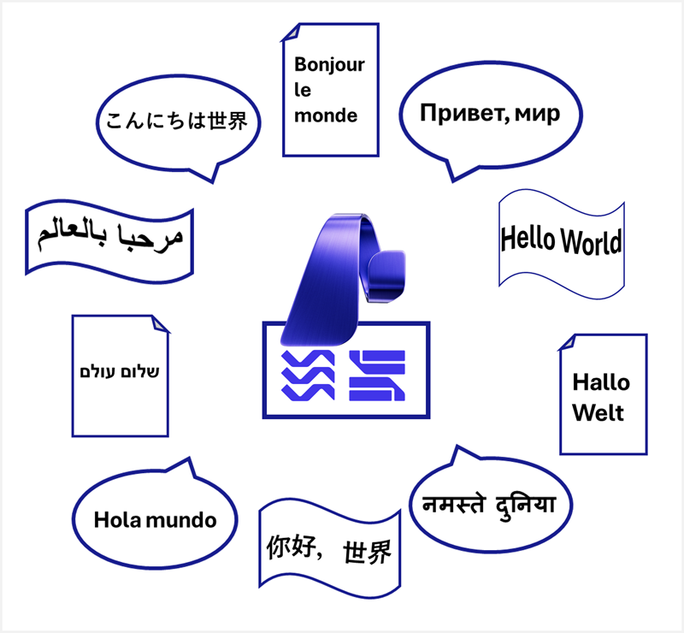
Translation in Microsoft Foundry
    Azure Translator in Foundry Tools
    Multilingual translation for:
      Text
      Documents
    Azure Speech in Foundry Tools
    Multilingual speech translation:
      Speech to text
      Speech to speech
Notes:
Transition to translation workloads. Emphasize parity between text and speech translation concepts.
Differentiate Translator vs Speech translation. Reinforce that speech translation builds on speech recognition.

Slide 39

Translate text with Azure Translator
Connect to the API
  Endpoint:
    Microsoft Foundry resource
    Global / Regional translator endpoint
  Credentials:
    Microsoft Foundry project API key
    Authentication token
Use a TextTranslationClient to perform tasks
  Get supported languages (for example “en” : “English”)
  Translate text (“こんにちは” = “Hello”)
  Transliterate text (“こんにちは” = “Kon'nichiwa”)
Endpoint
https://{foundry_resource}.cognitiveservices.azure.com/
TextTranslationClient
API Key
Auth Token
Notes:
Walk through translation vs transliteration. Reinforce supported language discovery as a first step.
Explain global and regional endpoints as “general” endpoints that are not tied to a particular resource (billing is assigned using the key / credential information you provide). For this reason, you can connect to a Translator resource by specifying a region and key/credential, without having to specify a specific Foundry endpoint.

Slide 40
Translating speech with Azure Speech
Connect to the API
  Endpoint:
    Microsoft Foundry resource*
    Global/Regional endpoint
  Credentials:
    Microsoft Foundry project API key
    Microsoft Entra ID
Create a SpeechTranslationConfig object for the connection
Use the TranslationRecognizer object for translation operations
Endpoint
https://{foundry_resource}.services.ai.azure.com/
TranslationRecognizer
SpeechTranslationConfig
API Key
Microsoft Entra ID
* cognitiveservices.azure.com is also supported
Notes:
Explain why a separate SpeechTranslationConfig exists.

Slide 41
Synthesizing Speech Translations
Event-based synthesis
  Only supported for 1:1 translation (single target language)
  Specify desired voice in the TranslationConfig
  Use the Synthesizing event to retrieve audio stream
    Create an event handler and use Result.GetAudio() to retrieve byte stream
Manual synthesis
  Use for multiple target languages
  Translate to text then use Text-to-Speech API to synthesize each translation in the results
SpeechTranslationConfig
TranslationRecognizer
Synthesizing…
AudioOutputConfig
event_handler()
SpeechTranslationConfig
TranslationRecognizer
SpeechConfig
SpeechSynthesizer
AudioOutputConfig
Notes:
Contrast event‑based vs manual synthesis. Explain when each approach is appropriate. Highlight limitations for multi‑language synthesis.

Slide 42
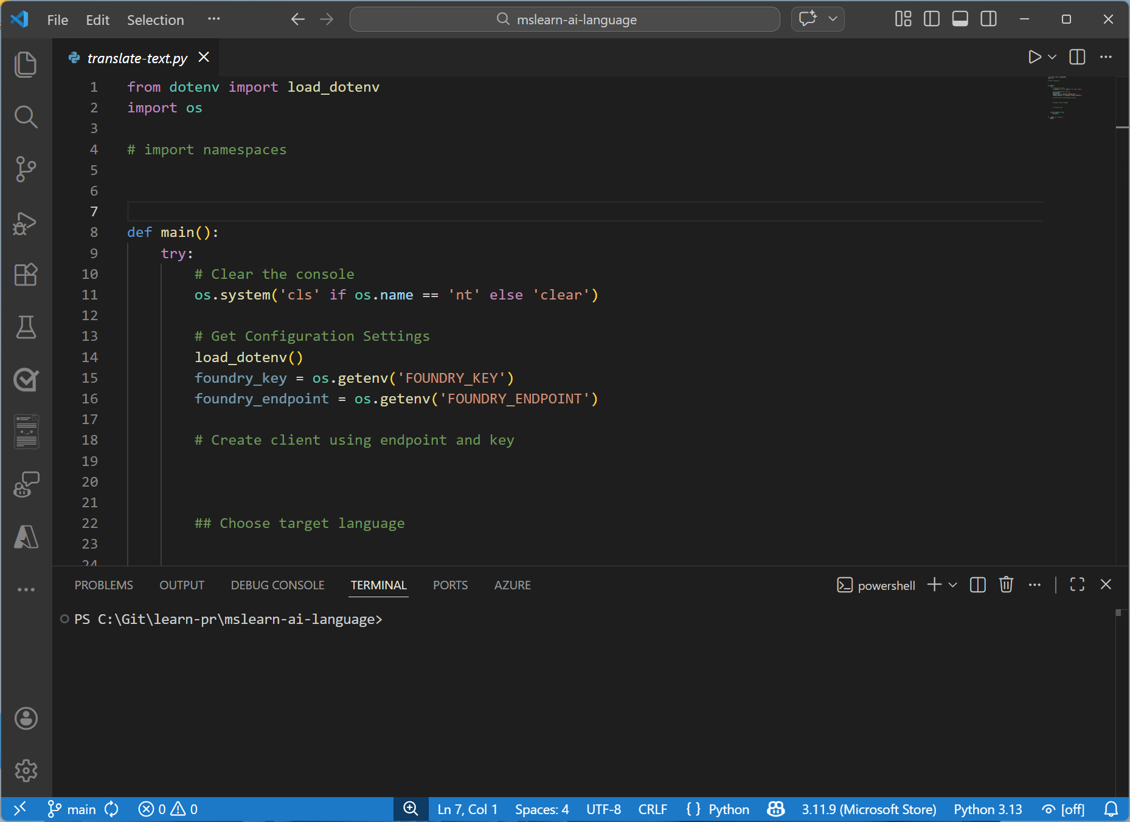
Demo
Translate text and speech
In this demo, you’ll:
Use Azure Translator in Foundry Tools to translate text
Use Azure Speech in Foundry Tools to translate speech
Start the exercise on your own at:
https://go.microsoft.com/fwlink/?linkid=2356176
Notes:
Each exercise begins with the same procedure to create a Foundry project– students will become quite adept at this by the end of the day!
The repetition of this procedure can be onerous, but it’s necessary to keep the exercises modular and to avoid consuming Azure resources unnecessary (for both cost reasons and to free up data center capacity for other Azure customers)

Slide 43
Knowledge check
1
What function of an Azure Translator TextTranslationClient object should you use to convert the Chinese word "你好" to the English word "Hello"?
get_supported_language
translate
transliterate
2
What function of an Azure Translator TextTranslationClient object should you use to convert the Russian word "спасибо" in Cyrillic characters to "spasibo" in Latin characters?
get_supported_language
translate
transliterate
3
Which Azure Speech SDK object should you use to specify the language(s) into which you want speech translated?
SpeechConfig
SpeechTranslationConfig
AudioConfig
Notes:
Use the slide animation to reveal the correct answers.

Slide 44
Closing slide
Notes:
Summarize key takeaways: Language, Speech, Translation, Agents. Encourage learners to explore Foundry models and MCP further.

