Slide 1
Develop AI Apps and Agents on Azure ​
Conclusion

Slide 2

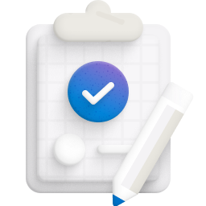

Thank you for attending this course
Here are some reminders
Celebrate your
new skills
Let us know
how we did
Become
Microsoft Certified
Redeem your achievement
Share with us and your network
Give us your feedback
Survey will be sent via email
Explore additional resources to help prepare
Schedule your exam

Tag us social: #AlwaysLearning

Slide 3
What could be next in your learning journey?
Explore the AI Learning Hub
https://learn.microsoft.com/ai

Slide 4
Final slide with logo
Thank you.

