Slide 1
Walk-in slide

Slide 2
Develop AI Apps and Agents on Azure
Introduction
August 2025

Slide 3
Hello!
Trainers:
Customize this content with your information, image, and background. Delete this note before teaching.
Thank you for joining me today
Instructor: <Name>
<Title or other credentials, e.g., Microsoft Certified Trainer>
<Affiliation/Company>
<A few words about my technical and professional experience>
twitter.com/[Name]
linkedin.com/[Name]
[first.last]@[email.com]
Blog

Slide 4
About this course
What we’ll cover
This course is intended for software developers wanting to build AI infused applications that leverage Microsoft Foundry. Topics in this course include developing generative AI apps, building AI agents, and solutions that implement knowledge connections or tools in your agentic applications. This course also covers multimodal capabilities and understanding of complex content.
Intended audience
This course was designed for software engineers concerned with building, managing and deploying AI solutions that leverage Microsoft Foundry. They are familiar with Python and have knowledge on using APIs and SDKs to build agents and generative AI solutions on Azure.

Slide 5
Course schedule
Topic | Day
Develop generative AI apps | 1
Develop AI agents on Azure | 2
Develop natural language solutions in Azure | 3
Extract insights from visual data on Azure | 4
Notes:
It’s expected that at least 50% of the course is interactive labs, and up to 50% is presentation. Be clear this is a collection of 4 1-day courses, so if they are to take one of those 1-day options after this, it will be the same content. (AI 3016/3026/3003/3008)
The schedule on this slide is a guide to help you understand the topic of the day, and assumes a start time of 9am, and end time of 5pm, two 15-minute breaks and a 1-hour lunch.
(If you are delivering a custom subset of the content in this course, edit the table as appropriate)

Slide 6


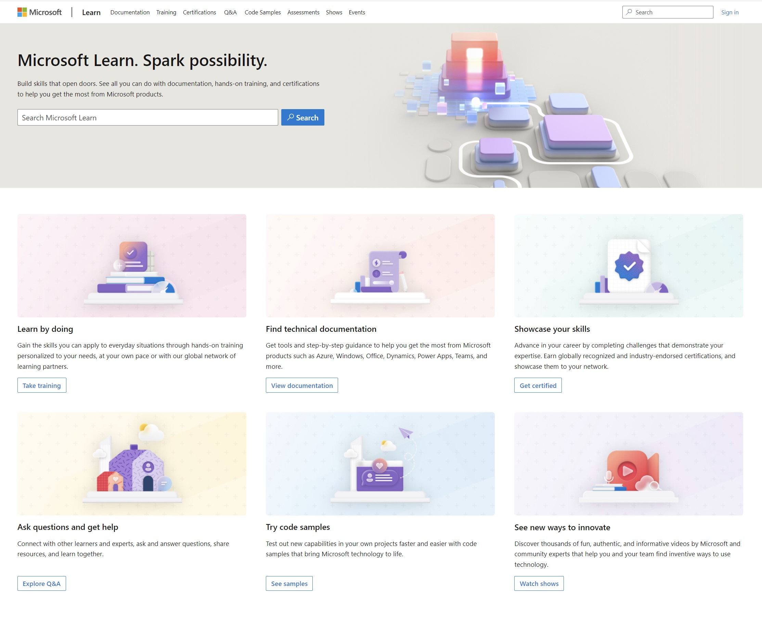
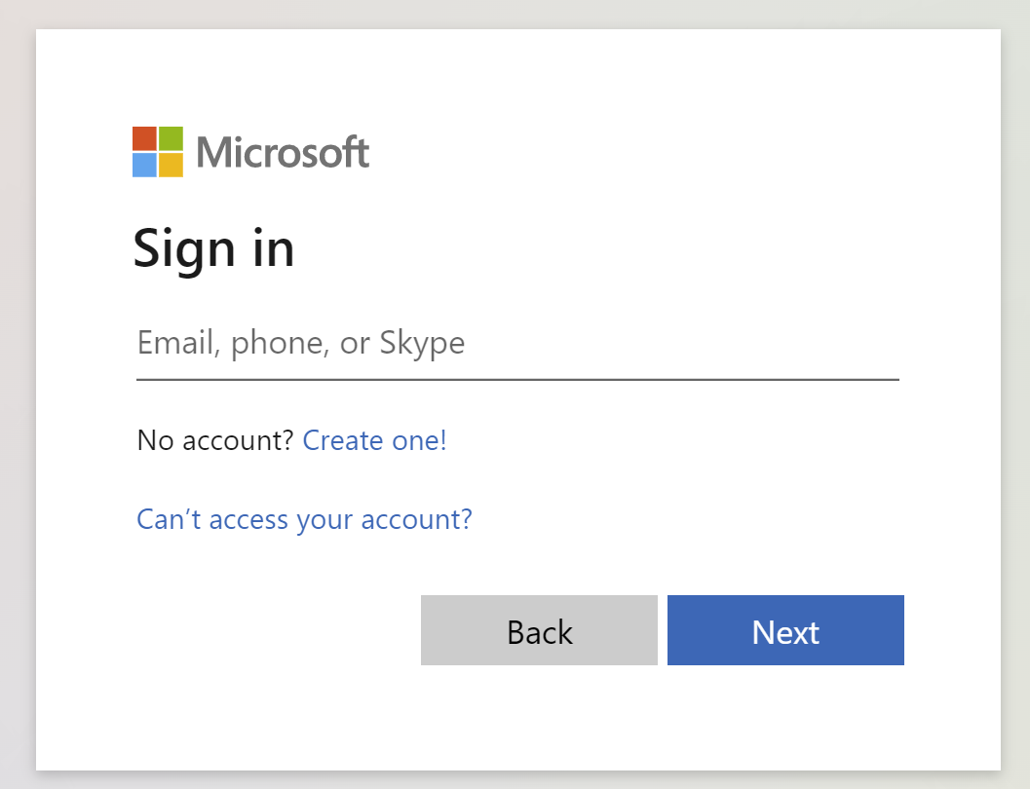
Get the most out of your Microsoft Learn profile
Create your Microsoft Learn profile
at learn.microsoft.com
Select Sign in at the top, right corner of any Microsoft Learn page.
Follow the Microsoft account authentication process.
If the account that you have chosen to sign-in with doesn't already have a Microsoft Learn profile, you’ll be guided to create one.
Verify, track, and share your training and certification progress and accomplishments—all on one platform
Claim your achievement code for this course and share you have completed it.
Access your course material and track progress on your learning activities.
Share and verify your Microsoft Certifications via email, on social networking platforms, and on your résumé.
Download and print transcripts and certificates.
Manage your upcoming activities and certification exam appointments.
www.aka.ms/MyMicrosoftLearnProfile

Slide 7
Access your course material
All course content is available on Microsoft Learn
https://aka.ms/Course-AI-103
Trainers:
Update the lab URL for the hosted lab environment as appropriate (if you have a single source). Or delete this box.
Then delete this note.
This course includes lab exercises:
We’ll go through this content together and as the course progresses, I will advise you on which modules to review.
The content on Microsoft Learn may include details not covered in the class due to time constraints.
You can provide feedback for modules on Microsoft Learn. Find how at the bottom of each page.
Detailed exercise instructions are included in your lab environment.
https://go.microsoft.com/fwlink/?linkid=2310820

Slide 8

Become
Microsoft Certified
92%
of certified IT professionals feel more confident in their abilities after earning certifications¹
Get recognized by earning industry validation for technical knowledge. Ensure you stay current with the necessary skills and expertise for continued success​.
Start at learn.microsoft.com/certifications
Microsoft role-based and specialty certifications require annual renewal.²
Learn about certification renewal at aka.ms/RenewYourCert
¹ “2023 Value of IT Certification | Candidate Report,” Pearson VUE, 2023 ² Microsoft fundamentals certifications don’t expire

