Slide 1
Agentic RAG with Reflection
Matthew Gotteiner
Program Manager
Azure AI Search
Pamela Fox
Principal Cloud Advocate
Notes:
Welcome to our session on building production-ready RAG applications with Azure AI Search! I'm ____, from the ___ team, and I'm excited to be in ____ today.

Slide 2
Agenda
1
Retrieval-Augmented Generation (RAG)
2
Agentic RAG
3
Single and Multi Step Reflection
4
Demo
Notes:
We're going to start off today with an introduction to RAG and an overview of vector embeddings and vector search. Then we'll see how to use Azure AI Search for state-of-the-art retrieval, how to setup the optimal data ingestion pipeline, and finally, how to evaluate answer quality and productionize your application.

Slide 3
Retrieval-augmented generation (RAG)​
Notes:
Let's talk about RAG, Retrieval-Augmented Generation.

Slide 4
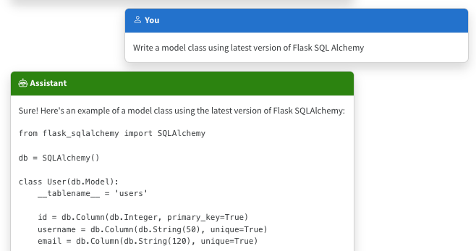
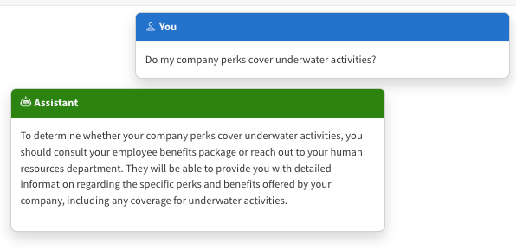
The limitations of LLMS
Outdated public knowledge
No internal knowledge
Notes:
LLMs are basically next-word predictors. They're very good at writing text fluently in many languages, but they're not guaranteed to produce text that is relevant or accurate.
For example, we might ask an LLM to write code for a Python package. It will write code according to what it's seen most in its training data, even if that doesn't reflect the current documentation.
In the example in the screenshot, it produced outdated code based on an older version of the package.
That is an example of public knowledge, and it can potentially be resolved by updating to a newer version of the model.
What about private knowledge? LLMs don't inherently have any access to internal knowledge, like company documents, so they will answer based off what they saw in their training data. And they will still answer confidently, so people can easily be convinced that the answer is correct.
So we need to find a way to bring in internal knowledge or updated public knowledge.

Slide 5
Incorporating domain knowledge
Prompt
engineering
Fine
tuning
Retrieval
augmentation
In-context learning
Learn new skills
(permanently)
Learn new facts
(temporarily)
Notes:
How can you incorporate domain knowledge?
Prompt engineering:. Be very very specific. Tell it the version, give it written examples. This only works if the answer is somewhere in it’s weights.
Fine-tuning: Start with a base model and add at least 200 examples and run training again. Fine tuning is expensive both in the training process and in the usage.
RAG enables learning new facts temporarily by doing a retrieval and adding/augmenting the question to the LLM with the data.

Slide 6
RAG: Retrieval Augmented Generation
Both plans offer coverage for medical services, such as doctor visits and lab tests, but the Health Plus plan also covers hospital stays and X-rays¹
What is included in my Northwind Health Plus plan that is not in standard?
Both plans offer coverage for medical services. Northwind Health Plus offers coverage for hospital stays, doctor visits, lab tests, and X-rays. Northwind Standard only offers coverage for doctor visits and lab tests. …
Large Language Model
User
Question
Search
Notes:
We're focusing on the RAG approach in this session, as it's the most popular and cost-effective of the options.
Let's walk through a simple RAG flow.
First, the user asks a question. We use that question to search a knowledge base, and get back the top results.
We then concatenate the user question with the search results, and send both of those to an LLM, with a system prompt that tells it to answer according to the results.
We get an accurate answer back that includes citations pointing at the results.

Slide 7
Advanced RAG with query rewriting
For great hiking shoes, consider the TrekExtreme Hiking Shoes¹ or the Trailblaze Steel-Blue Hiking Shoes²
What's a good shoe for a mountain trale?
Mountain
trail shoe
[101]:
Name: TrekExtreme Hiking Shoes
Price: 135.99
Brand: Raptor Elite
Type: Footwear
Description: The Trek Extreme hiking shoes by Raptor Elite are built to ensure any trail.
…
Large Language Model
User
Question
Large Language Model
Search
Notes:
Let's move on to an advanced RAG flow, where we'll introduce a new stage: query rewriting.
This time, when the user asks a question, we send their question along with the conversation history to an LLM and ask it to suggest the best search query.
This rewriting step is helpful for correcting spelling errors, translating to the language of the knowledge base, and incorporating context in multi-turn conversations.
This query rewriting step can also be used for filter building, agentic behavior, etc.
We use the suggested query to search the knowledge base, and the rest of the flow is the same.

Slide 8
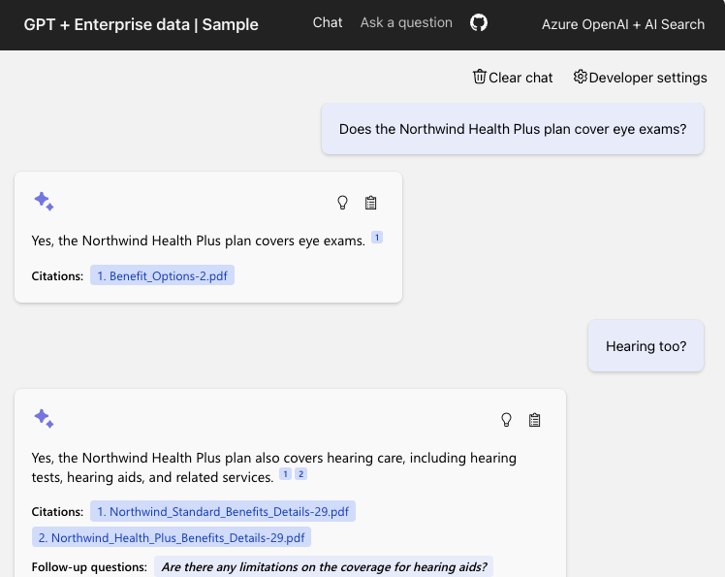
RAG on Documents
DEMO
Azure OpenAI +
Azure AI Search +
Azure App Service
Code:
aka.ms/ragchat
Demo:
aka.ms/ragchat/demo
Notes:
Let's see an example of RAG on documents in action, using Azure AI Search as the retriever.
We can ask a question, and see the citation is to a document. We click that citation to see the full document, and it jumps to the page with the relevant chunk.
This demo is from a full repository that you can deploy yourself and customize with your own data. Check it out at aka.ms/ragchat

Slide 9
Components of a high-quality RAG
1
2
3
Sophisticated LLM
  Adheres to instructions
  Supports function calling
Well prepared data
  Reasonably sized text
  Meaningful vectors
Powerful search functionality
  Vector search
  Hybrid search
  Semantic re-ranking
  Filtering
Powerful search functionality
  Vector search
  Hybrid search
  Semantic re-ranking
  Filtering
Well prepared data
  Reasonably sized text
  Meaningful vectors
Sophisticated LLM
  Adheres to instructions
  Supports function calling
Notes:
When we build a RAG application, there are three main ingredients that affect the quality:
We need powerful search functionality, to be able to search massive data sets. For optimal results, we need hybrid search, a combination of vector search and full text search.
We need well prepared data in our search index. The document chunks should be a reasonable size, not too big, not too small, and the vectors should be high signal, low noise.
We need a frontier level LLM that can adhere to the system prompt, stay on-topic, and ideally support function calling for use in the query rewriting stage.
We're going to dive into these components today, to share everything we've learned about building high quality RAG applications.

Slide 10
Agentic RAG
Notes:
First, let's step back and make sure we all understand vector embeddings, since we'll need to use vectors for both indexing and searching.

Slide 11
Why might RAG fail?
The compliance of the Northwind Health Plus plan with state regulations is ensured by the plan itself, as it states that it is in compliance with applicable state and federal laws and regulations[1]
Who ensures the compliance of the Northwind Health Plus plan with state regulations?
Following the law is an important part of employee benefits, and Contoso and Northwind Health strive to ensure that the Northwind Standard plan is in compliance with all applicable laws. …
Large Language Model
User
Question
Search
Notes:
We're focusing on the RAG approach in this session, as it's the most popular and cost-effective of the options.
Let's walk through a simple RAG flow.
First, the user asks a question. We use that question to search a knowledge base, and get back the top results.
We then concatenate the user question with the search results, and send both of those to an LLM, with a system prompt that tells it to answer according to the results.
We get an accurate answer back that includes citations pointing at the results.

Slide 12
Evaluating RAG Answers
Relevance
Groundedness
Correctness
1
Captures how directly an answer addresses the user’s question or topic, filtering out off‑topic or distracting information.
Measures how well an answer is tied to the provided context or source material, spotting unsupported claims or “hallucinations.”
Ensures outputs can be traced back to known facts or data
Checks factual and logical accuracy, flagging errors or inconsistencies in the response.
Powerful search functionality
  Vector search
  Hybrid search
  Semantic re-ranking
  Filtering
Well prepared data
  Reasonably sized text
  Meaningful vectors
Sophisticated LLM
  Adheres to instructions
  Supports function calling
Notes:
When we build a RAG application, there are three main ingredients that affect the quality:
We need powerful search functionality, to be able to search massive data sets. For optimal results, we need hybrid search, a combination of vector search and full text search.
We need well prepared data in our search index. The document chunks should be a reasonable size, not too big, not too small, and the vectors should be high signal, low noise.
We need a frontier level LLM that can adhere to the system prompt, stay on-topic, and ideally support function calling for use in the query rewriting stage.
We're going to dive into these components today, to share everything we've learned about building high quality RAG applications.

Slide 13
Example Evaluation
Evaluations
Relevance
Score: 5
Explanation: The answer is relevant to the query
Who ensures the compliance of the Northwind Health Plus plan with state regulations?
Large Language Model
Groundedness
The compliance of the Northwind Health Plus plan with state regulations is ensured by the plan itself, as it states that it is in compliance with applicable state and federal laws and regulations[1]
Score: 4
Explanation: The answer is supported by parts of the context
Correctness
User
Question
Search
Score: 3
Explanation: The answer is missing details about external regulators

Slide 14
Improving Answers using Evaluations
Evaluations
Relevance
Large Language Model
Score: 5
Explanation: The answer is relevant to the query
Use search to address gaps in context
The compliance of the Northwind Health Plus plan with state regulations is ensured by the plan itself, as it states that it is in compliance with applicable state and federal laws and regulations[1] Additionally, employees have the option to contact their state's insurance department for further information about compliance and external review processes [2]
Groundedness
Score: 4
Explanation: The answer is supported by parts of the context
Follow up query: What is the role of external regulators in ensuring compliance?
Search
Correctness
Score: 3
Explanation: The answer is missing details about external regulators

Slide 15
Agentic RAG Loop
Search
User
Question
Generate Candidate Answer
Evaluate Answer

Slide 16
Single and Multi Step Reflection
Notes:
First, let's step back and make sure we all understand vector embeddings, since we'll need to use vectors for both indexing and searching.

Slide 17
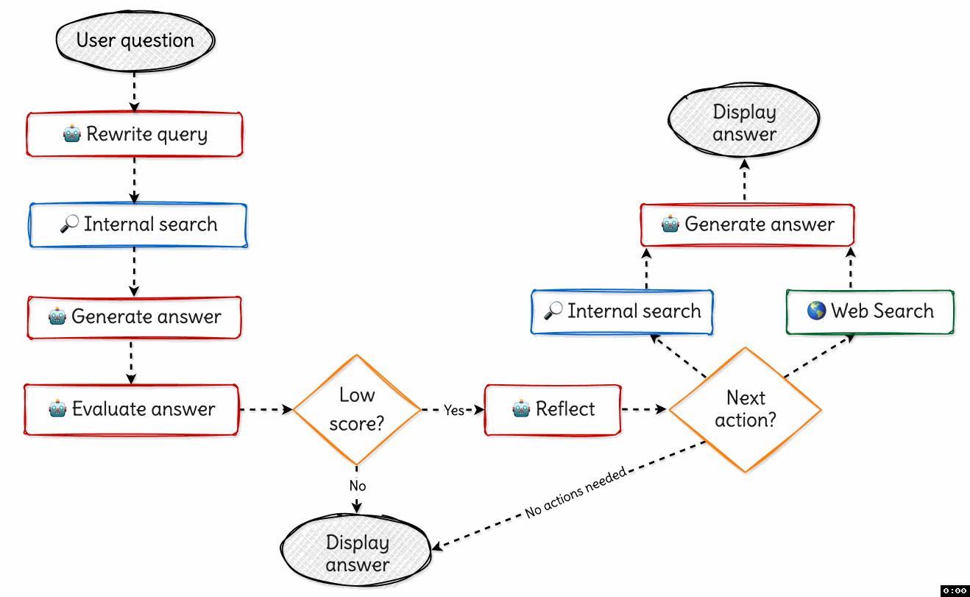
Single Step Reflection

Slide 18
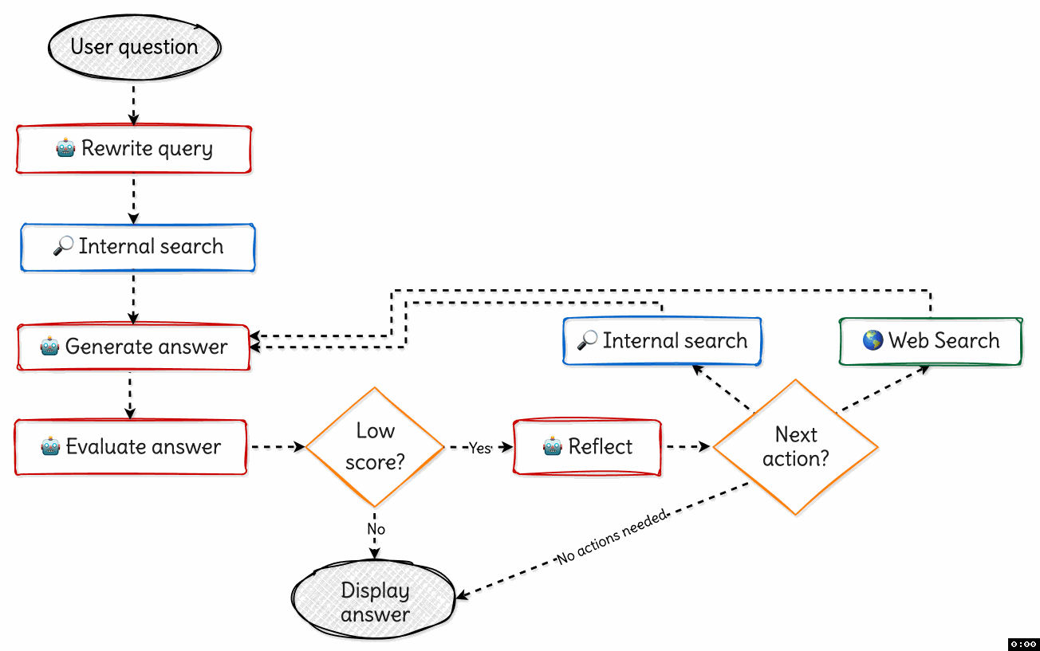
Multi Step Reflection

Slide 19
Demo
Notes:
Let's wrap things up!

Slide 20
Evaluation
Notes:
Before we put our RAG app into production, we need to run evaluations to make sure the answers are high enough quality.

Slide 21
Bulk evaluation flow
Generate ground truth data (QA pairs)
Evaluate with different configurations:
  Baseline (default models, default RAG parameters, no reflection)
  Baseline models, plus reflection feature
  Different chat model, with and without reflection feature
Review the overall metrics across evaluations
Compare questions across runs
Investigate questions with notable differences
Docs: aka.ms/ragchat/evaluation

Slide 22




Step 1: Generate ground truth data
The ground truth data is the ideal answer for a question.
One approach: generate synthetic ground truth data, then do manual curation.
python evals/generate_ground_truth.py --numquestions=50
documents
prompt + docs
Q/A pairs
Azure
AI Search
RAGAS
Azure OpenAI
Human review
Other approach: generate based on help desk tickets, support emails, search requests, questions from beta testers, etc.

Slide 23


Step 2: Evaluate app against ground truth
Compute GPT metrics and custom metrics for every question in ground truth.
python evals/evaluate.py
answer
length
question
response
code metrics
latency
citations_matched
truth.jsonl
Python code
App endpoint
prompt
GPT metrics
gpt_groundedness
gpt_relevance
azure-ai-evaluation
SDK
Azure OpenAI

Slide 24
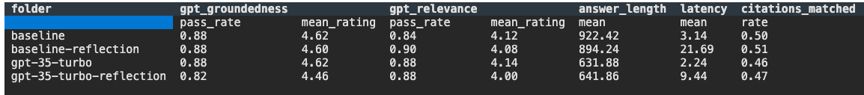
Step 3: Review the metrics across runs
After you’ve run some evaluations, review the results:
python -m evaltools summary evals/results

Slide 25
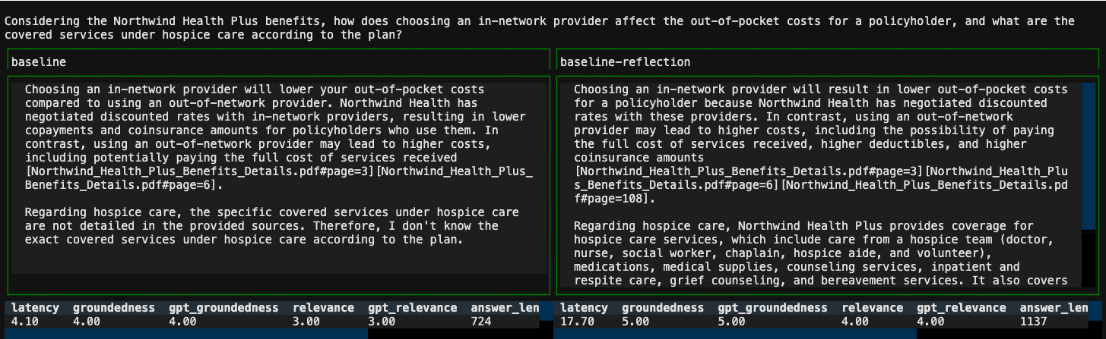
Step 4: Compare specific answers across runs
python -m evaltools diff evals/results/baseline/ \
evals/results/baseline-reflection

Slide 26
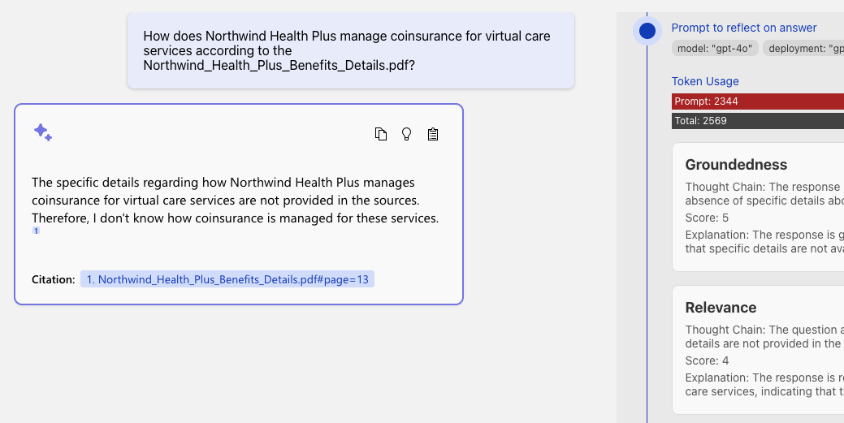
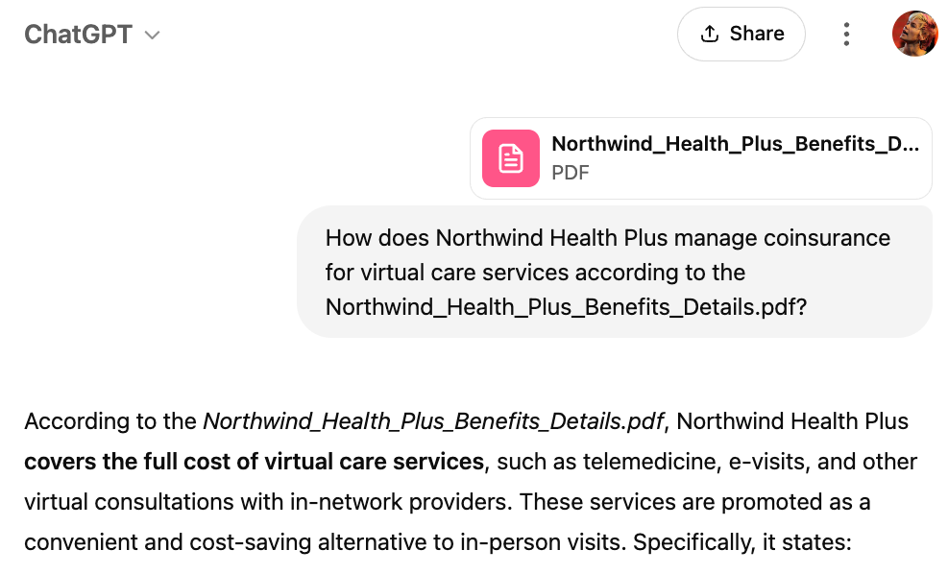
Step 5: Investigate questions with notable differences
Try the question in the app (using same parameters, especially seed)
Examine thought process to understand how answer was generated
Look at the source document to see if you agree
Try with different models or even ChatGPT to compare answers

Slide 27

Remember...
Evaluations aren't perfect!
Sometimes worse answers aren't worse. 😊 Sometimes better answers aren't better. 😓
To improve evaluation quality:
Make sure ground truth reflects user questions, including "multi-hop" questions
Modify the evaluator prompts if they aren't accurately scoring answers
Evaluations can teach you a lot, so please, set up eval workflows!

Slide 28
Final thoughts
Notes:
Before we put our RAG app into production, we need to run evaluations to make sure the answers are high enough quality.

Slide 29
Takeaways
Agentic RAG is powerful, but can be hard to control
  Need to consistently get orchestrator to “make the right choice”
Reflection adds complexity
  We don’t always know when reflection will improve answer quality
Reflection adds latency
How much can you improve the model and search settings before adding agentic RAG?

Slide 30
Azure AI Search 2/2
Comprehensive search solution
Enterprise-ready
Azure AI Search
Integrated with Semantic Kernel, LangChain, LlamaIndex, Azure OpenAI Service, Azure AI Studio, and more
💻 Demo: Azure AI search with vectors (aka.ms/aitour/azure-search)
Notes:
Azure AI Search is a comprehensive search solution and includes features built specifically with RAG applications in mind. Azure AI Search integerated with all the popular open source orchestrations like Langchain, Llamaindex, Semantic Kernel, as well as Azure services like Azure OpenAI and Azure AI Studio. Basically, wherever you are building your RAG apps, you can use Azure AI Search.
AI Search introduced vector search a year ago, and it's generally available to everyone. Let's walk through a few examples that show it in action.
DEMO script:
Clear the notebook cells.
Go through the notebook, cell by cell, explaining each cell

Slide 31
Vector search strategies
ANN search
Exhaustive KNN search
ANN = Approximate Nearest Neighbors
Fast vector search at scale
Uses HNSW, a graph method with excellent performance-recall profile
Fine control over index parameters
KNN = K Nearest Neighbors
Per-query or built into schema
Useful to create recall baselines
Scenarios with highly selective filters
  e.g., dense multi-tenant apps
r = search_client.search(
None,
top=5,
vector_queries=[VectorizedQuery(
vector=search_vector,
k_nearest_neighbors=5,
fields="embedding")])
r = search_client.search(
None,
top=5,
vector_queries=[ (
vector=search_vector,
k_nearest_neighbors=5,
fields="embedding",
exhaustive=True)])
💻 Demo: Azure AI search with vectors (aka.ms/aitour/azure-search)
Notes:
Aure AI search supports two different vector retrieval strategies. One is approximate nearest neighbor search, or ANN search. This will give you a fast and scalable retrieval strategy. When we use an index for retrieval, we are trading off perfect recall for performance. These are approximate techniques, and in this case we use a well-known approach called HNSW (Hierarchical Navegable Small Worlds).
Think of it as a probabilistic data structure that builds a graph-type thing, and it allows us to answer questions very fast with a good performance recall trade-off.
We pick good defaults, so you typically don't have to worry about this. But if you actually know what HNSW means and you want to dig into the details, we also give you access to all the parameters so you can fine-tune exactly what we do.
In some other cases, actually it's useful to scan vectors exhaustively, comparing each one of them by computing the distance.
This is typically used to compute a recall base because if you exhaustively review all the vectors, then your recall is perfect, so you can compute the difference between that and your particular scenario. Then there are some corner cases, a very large-scale, and multi-tenancy situations where it actually can be faster to use exhaustive retrieval when your filter selectivity is very high.
// Dont do the demo here, assuming you did it on previous slide!

Slide 32
Hybrid search
All information retrieval tricks apply!
Complete search stacks do better:
  Hybrid retrieval (keywords + vectors) > pure-vector or keyword
  Hybrid + Reranking > Hybrid
Identify good & bad candidates
  Normalized scores from Semantic ranker
  Exclude documents below a threshold
Vector
Keywords
Fusion
(RRF)
Reranking model
💻 Demo: search_relevance.ipynb (aka.ms/aitour/search-relevance)
Notes:
For optimal results, we need more than just vector search: we need a full hybrid search. That means that we do a vector search with the embedding, we do a full-text search with the keywords, we merge those results with an algorithm, and then finally, we apply a re-ranking model that sorts the results according to the user query. That re-ranking model is called "semantic ranker" in Azure AI search, and it's based on the same ranking technology used by Bing search.
// Demo: The best way to see the differences between search retrieval strategies is to see it for yourself. Let's go through this notebook.
// Run cells, explaining each one.

Slide 33

Optimal relevance: Hybrid search, Semantic ranker
Question: "What underwater activities can I do in the Bahamas?"
Keyword results
1 | Scuba Diving in Bahamas
Fusion
(RRF)
Reranking model
1 | Scuba Diving in the Carribean
2 | Scuba Diving in Bahamas
3 | Water skiing in Seychelles
1 | Scuba Diving in Bahamas
2 | Scuba Diving in the Carribean
Vector results
1 | Scuba Diving in the Carribean
2 | Water skiing in Seychelles
💻 Demo: Compare text, vector, hybrid, reranker (aka.ms/aitour/search-relevance)
Notes:
For optimal results, we need more than just vector search: we need a full hybrid search. That means that we do a vector search with the embedding, we do a full-text search with the keywords, we merge those results with an algorithm, and then finally, we apply a re-ranking model that sorts the results according to the user query. That re-ranking model is called "semantic ranker" in Azure AI search, and it's based on the same ranking technology used by Bing search.
// Demo: The best way to see the differences between search retrieval strategies is to see it for yourself. Let's go through this notebook.
// Run cells, explaining each one.

Slide 34
Avoiding noise: Using minimum score thresholds
  Semantic ranker scores range from 0-4:
0
1
2
3
4
Worst
Quality
👎🏼
Best
Quality
👍🏼
qualified_documents = [
doc for doc in documents
if doc.get("@search.reranker_score") >= min_score
]
Notes:
Another benefit of the semantic ranking step is that it assigns each of the results a score from 0 to 4, with 0 being very poor match and 4 being the best match. If you find that your application is often finding low scored matches, which can often happen once you bring vector search into the mix, you can set a score threshold and filter out the matches with too low of a score.

Slide 35
Conclusion
Notes:
Let's wrap things up!

Slide 36
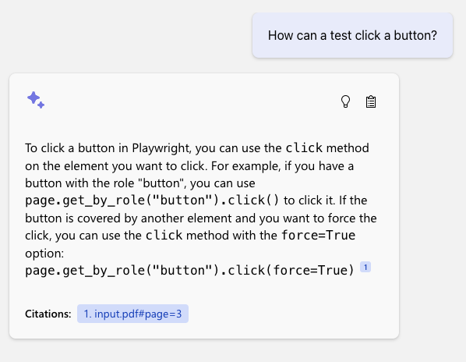





Example uses
Developers have used Azure AI search
to create RAG apps for…
Public government data
Internal HR documents, company meetings, presentations
Customer support requests and call transcripts
Technical documentation and issue trackers
Product manuals
Customer Story: PwC scales GenAI for enterprise with Microsoft Azure AI
Notes:
We've seen thousands of developers deploy this app for a wide number of use cases, like internal HR help, customer sales help chatbots, product manuals, and more.

Slide 37
Next steps
1
Learn more about Azure AI Search
aka.ms/AzureAISearch
Dig more into quality evaluation details and why Azure AI Search will make your application generate better results
aka.ms/ragrelevance
2
3
Deploy a RAG chat application for your organization’s data
aka.ms/azai/python
4
Explore Azure AI Studio for a complete RAG development experience
aka.ms/AzureAIStudio
Notes:
If you want to get started, check out our documentation, our research, and our open-source end-to-end RAG solution.

Slide 38
Efficient vector storage: Quantization
  Store more vectors with less space using quantization
Scalar quantization from float32 to int8:
Model | Search Quality MIRACL (Semantic Search on 18 languages, nDCG@10, higher=better)
Cohere Embed v3
Embed v3 | 66.3
Embed v3 – int8 | 66.1
Embed v3 - binary | 62.8
Min float
Max float
~Min observed value
~Max observed value
-127
128
Binary quantization to a single bit:
Example:
1
    Pick a center value C based on a sample or offline knowledge
Cohere v3 embeddings, 62.8 vs 66.3
→ 94.7% original performance preserved
2
    If >= C, it’s a 1, otherwise it’s a 0
3
    Repeat for each dimension
Source: https://cohere.com/blog/int8-binary-embeddings
    0
    1
Notes:
First, let's talk about scale. If you're building a RAG app on a huge document store, then you'll find yourself storing a large number of vector embeddings. Azure AI Search now offers multiple ways to reduce your storage size, so that you can reduce your costs. One approach is quantization, which lets you reduce the floating point numbers to 8-bit integers or even to single bits. According to our studies, you can still achieve high recall while reducing your storage by a mangitude of 32x.
BRK108 - RAG at scale.pptx

Slide 39




Azure AI Search: Enterprise-ready
Including option for customer-managed encryption keys
Data Encryption
Secure Authentication
Managed identity and RBAC support
Network Isolation
Private endpoints, virtual networks
Extensive certifications across finance, healthcare, government, etc.
Compliance Certifications
Notes:
Like all Azure services, Azure AI Search offers all this..
Things like multiple options for data encryption, authentication, including managed identities, my favorite way of not having to deal with API keys, network isolation, and extensive compliance certifications are all part of this offering. All of these things are checked off from the very beginning as you're building solutions for this space.

Slide 40
Improving Retrieval in Large Datasets
“Hi HRBot, I’m based in the US, does my health plan cover annual eyesight checks?”
→
filter=category eq 'healthcare' and region eq 'US'
search=annual eyesight check coverage
vectorQueries=[…]
Filtering the dataset is highly impactful
  Quality: focus on subset of data that’s known to matter
  Performance: reduce recall set size
How can you subset a dataset
with discrete filters?
  Query classification by intent, topic, language, etc.
  Filter extraction from context/history
  Azure AI Search high-performance filters work with keyword, vector, and hybrid search
Multi-tenant scenarios
  Special case of filters, data is a set partition
  Consider whether you want vector indexes,
  brute-force search, or both

Slide 41
Robust retrieval for RAG apps
Responses only as good as retrieved data
Keyword search recall challenges
  “vocabulary gap”
  Gets worse with natural language questions
Vector-based retrieval finds
documents by semantic similarity
  Robust to variation in how concepts are articulated
  (word choices, morphology, specificity, etc.)
Example
Question:
“Looking for lessons on underwater activities”
Won’t match:
“Scuba classes”
“Snorkeling group sessions”
Notes:
RAG is only as good as the retrieval and that depends on the data you have and how simple it is to search.
If you’re used to search engines, you’re familiar with keyword search.
In the example. “underwater activities” would not return Scuba or Snorkeling.
Vector-based retrieval does semantic similarity. It would know those terms are semantically similar.

Slide 42
Announcement slide (dark) with color rotation
Announcing
Increased Vector, Storage, Compute Capacity
  Same workloads can be handled with smaller tiers
  Build billion-vector search services
  Includes all the power of a full retrieval system
Details
  Up to 12x increase in vector density increase
  Up to 6x total storage limit increase
  More compute capacity in most tiers
  Applies to newly created services

Slide 43
New Expanded Capacity
SKU | Previous vector limit | New vector limit | Previous storage limit | New storage limit | Previous max service size | New max Service size
Basic | 1 | 5 (5x) | 2 | 15 (7.5x) | 2 GB | 45 GB
S1 | 3 | 35 (11.5x) | 25 | 160 (6.4x) | 300 GB | 1.88 TB
S2 | 12 | 150 (12.5x) | 100 | 512 (5x) | 1.2 TB | 6 TB
S3 | 36 | 300 (8.3x) | 200 | 1024 (5x) | 2.4 TB | 12 TB
L1 | 12 | 150 (12.5x) | 1024 | 2048 (2x) | 12 TB | 24 TB
L2 | 36 | 300 (8.3x) | 2048 | 4096 (2x) | 24 TB | 48 TB
Basic SKU now supports up to 3 partitions, up from a single partition
Limits are GB/partition

