Slide 1
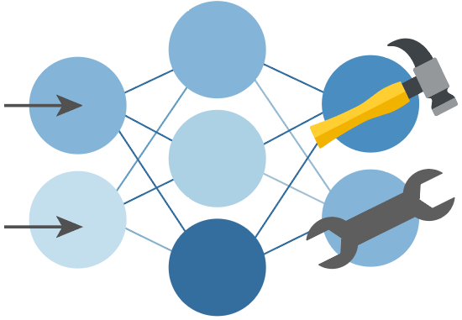

Python + Agents
🛠️ Feb 24: Building your first agent in Python
🧠 Feb 25: Adding context and memory to agents
📊 Feb 26: Monitoring and evaluating agents
🔀 Mar 3: Building your first AI-driven workflows
🕸️ Mar 4: Orchestrating advanced multi-agent workflows
🙋🏽 Mar 5: Adding a human-in-the-loop to workflows
🔗 Register at aka.ms/PythonAgents/series

Slide 2
Python + Agents
🕸️ Orchestrating advanced multi-agent workflows
aka.ms/pythonagents/slides/advancedworkflows
Pamela Fox
Python Cloud Advocate
www.pamelafox.org

Slide 3
Today we'll cover...
Concurrent workflows with fan-out and fan-in edges
Aggregation patterns: summary, ranking, voting, extraction
Conditional routing with concurrent execution
Built-in orchestrations:
  ConcurrentBuilder
  MagenticBuilder for dynamic planning
  HandoffBuilder for dynamic routing
E2E application with workflows

Slide 4
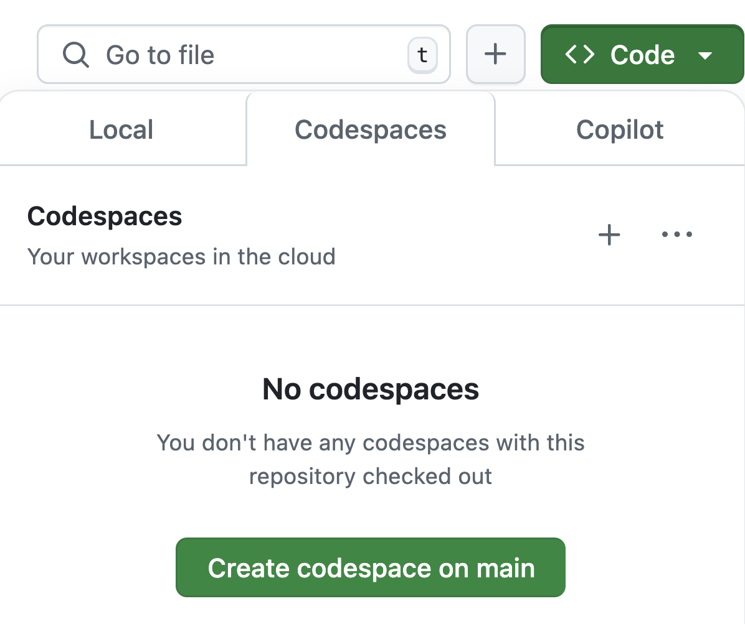
Want to follow along?
1. Open this GitHub repository:
aka.ms/python-agentframework-demos
2. Use "Code" button to create a GitHub Codespace:
3. Wait a few minutes for Codespace to start up ⏱️
4. Run git pull to ensure you have the latest changes

Slide 5
Recap: What's an agentic workflow?
An agentic workflow is a flow that involves an agent at some point, typically to handle decision making or answer synthesis.
🤖
Agent
Processing
or
Data Lookup
Processing
or
Data Lookup
Input
LLM
Output
Tool
Tool
In agent-framework, a workflow is a graph with Executor nodes and edges between:
Input
Executor
edge
Executor
edge
Executor
Output

Slide 6
Concurrent execution

Slide 7
Sequential execution vs. Concurrent execution
Input
Input
Executor
Executor
Executor
Executor
Output
Output
Executors run in parallel
and outputs are aggregated.
Only one executor runs at a given time.
Notes:
https://learn.microsoft.com/agent-framework/workflows/events

Slide 8
Anatomy of a concurrent workflow
This is a common topology, where inputs fan-out and outputs fan-in to aggregator:
fan-out edges
Executor
fan-in edges
aggregator
Input
Executor
Output
Executor
Also possible:
workflows with dynamic fan-out (optional executors)
workflows without an explicit aggregator
Notes:
https://learn.microsoft.com/agent-framework/workflows/events

Slide 9
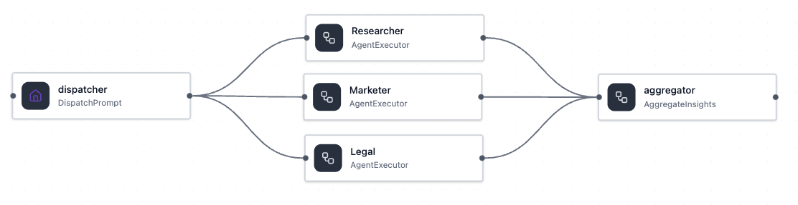
Using fan-in/fan-out edges in workflows
agent-framework
Use WorkflowBuilder with add_fan_out_edges and add_fan_in_edges:
workflow = (WorkflowBuilder(
name="FanOutFanInEdges",
description="Explicit fan-out/fan-in using edge groups.",
start_executor=dispatcher,
output_executors=[aggregator])
.add_fan_out_edges(dispatcher, [researcher, marketer, legal])
.add_fan_in_edges([researcher, marketer, legal], aggregator)
.build())
Full example: workflow_fan_out_fan_in_edges.py

Slide 10
Aggregating results from fan-out edges
agent-framework
class AggregateInsights(Executor):
@handler
async def aggregate(
self,
results: list[AgentExecutorResponse],
ctx: WorkflowContext[Never, str]):
for result in results:
# Process result.executor_id and result.agent_response.text
await ctx.yield_output(consolidated)
Full example: workflow_fan_out_fan_in_edges.py

Slide 11
Aggregation

Slide 12
Aggregation patterns for fan-in agents
Agent A
output A
Input
Aggregator
Final output
Agent B
output B
Pattern | Aggregator implementation | Final output | When to use?
Concatenation | String operations or template | Formatted str | You control the layout exactly
Output synthesis | LLM call to summarize outputs | Natural prose | You want a human-readable summary
Majority vote | Count most common output label | Winner label | Multiple judges classify same input
Structured extraction | LLM call with structured outputs | Pydantic model | Downstream code needs typed data
Score & rank | LLM-as-a-judge call to score outputs | Ranked list | Generate N options, pick the best
Notes:
We already saw concatenation with previous example

Slide 13
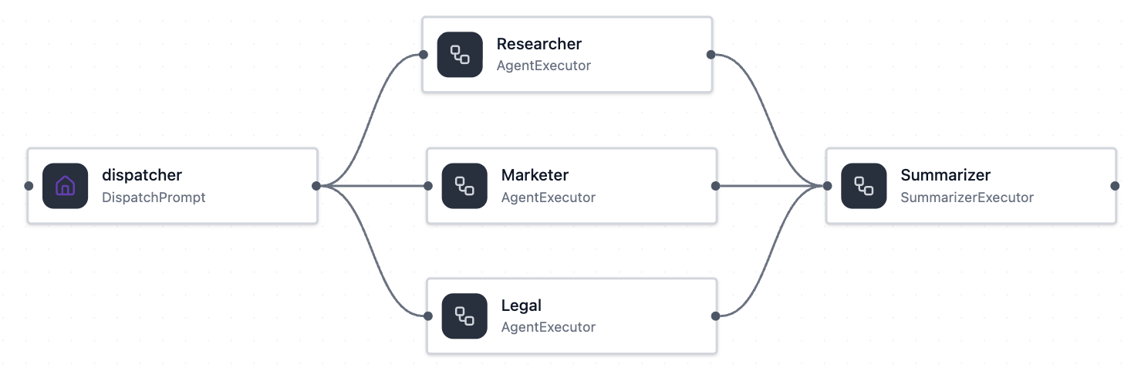
Aggregation with LLM summary
agent-framework
LLM
"Research shows.."
The aggregator node uses an LLM call to aggregate the combined outputs from agents.
"The competitors..."
"In summary,..."
"According to laws,"
class SummarizerExecutor(Executor):
def __init__(self, client: OpenAIChatClient, id: str):
super().__init__(id=id)
self.agent = Agent(client=client, name=id, instructions="Summarize...")
@handler
async def run(self, results, ctx):
sections = [f"[{r.executor_id}]\n{r.agent_response.text}"
for r in results]
response = await self.agent.run("\n".join(sections))
await ctx.yield_output(response.text)
Full example: workflow_aggregator_summary.py

Slide 14
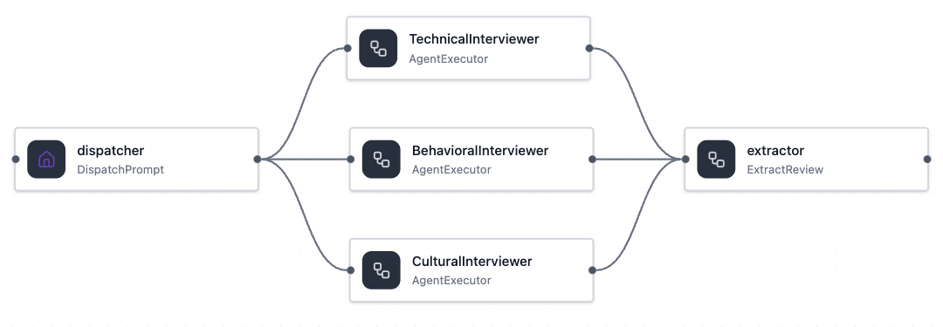
Aggregation with structured extraction
agent-framework
class CandidateReview(BaseModel):
technical_score: int
technical_reason: str
behavioral_score: int
behavioral_reason: str
recommendation: Literal[
"strong hire", "no hire",
"hire with reservations"]
LLM
"Strong coding..."
"Lacked leadership.."
"recommendation": "no hire"
"technical_score": 9
"behavioral_score": 5
"A bit snarky..."
class ExtractReview(Executor):
@handler
async def extract(self, results, ctx):
combined = "\n".join(r.agent_response.text for r in results)
messages = [Message(role="system", text="Review candidate."),
Message(role="user", text=combined)]
response = await self._client.get_response(messages,
options={"response_format": CandidateReview})
await ctx.yield_output(response.value)
Full example: workflow_aggregator_structured.py

Slide 15
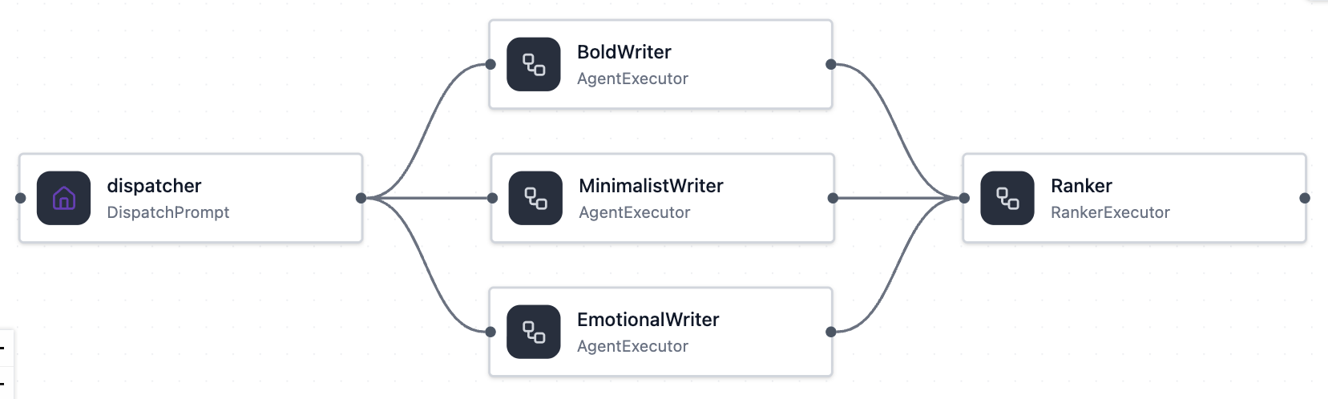
Aggregation with LLM-ranking
agent-framework
LLM
"Conquer your commute!"
The aggregator node uses an LLM call to rank the outputs from the agents.
"Reliable. Affordable."
BoldWriter: 9
MinimalistWriter: 7
EmotionalWriter: 6
"Affordable electric freedom"
class RankerExecutor(Executor):
@handler
async def run(self, results, ctx):
slogans = [f"{r.executor_id}: \"{r.agent_response.text}\"" for r in results]
messages = [Message(role="system", text=("Score each slogan 1-10 with a reason")),
Message(role="user", text="Candidate slogans:\n" + "\n".join(slogans))]
response = await self._client.get_response(messages,
options={"response_format": RankedSlogans})
await ctx.yield_output(response.value)
Full example: workflow_aggregator_ranked.py

Slide 16
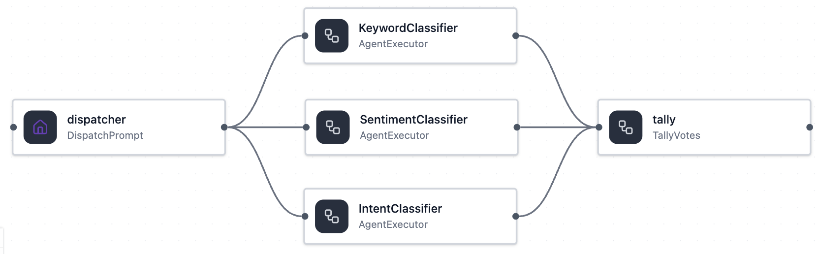
Aggregation with majority vote
agent-framework
category: "feature"
Each agent outputs their vote, and the aggregator calculates the most popular choice.
category: "bug"
category: "bug"
category: "bug"
class TallyVotes(Executor):
@handler
async def tally(self, results: list[AgentExecutorResponse],
ctx: WorkflowContext[Never, str]):
votes = []
for result in results:
classification: Classification= result.agent_response.value
votes.append(classification.category.value)
winner, count = Counter(votes).most_common(1)[0]
await ctx.yield_output(winner)
Full example: workflow_aggregator_voting.py

Slide 17
Conditional routing + concurrency

Slide 18
Conditional routing with concurrent execution
Agent A
selection
Input
Agent B
Agent C
The input is sent to any number of concurrent executors based off a selection function.

Slide 19
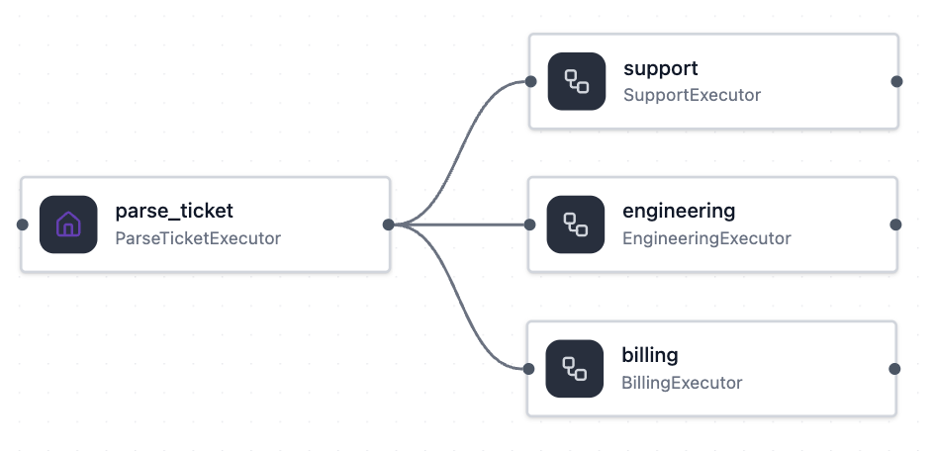
Workflows with multi-selection edge groups
agent-framework
Based off the selection_func, the workflow sends the input to the selected executors for concurrent processing.
workflow = (WorkflowBuilder(name="MultiSelectionEdgeGroup",
start_executor=parse_ticket)
.add_multi_selection_edge_group(
parse_ticket,
[support, engineering, billing],
selection_func=select_targets)
.build())
Full example: workflow_multi_selection_edge_group.py

Slide 20
Built-in workflow orchestrations
https://learn.microsoft.com/agent-framework/workflows/orchestrations/
Notes:
"Everything we've built so far — sequential, conditional, fan-out — the developer decides the topology. Now we let the agents decide."

Slide 21
ConcurrentBuilder
https://learn.microsoft.com/agent-framework/workflows/orchestrations/concurrent

Slide 22
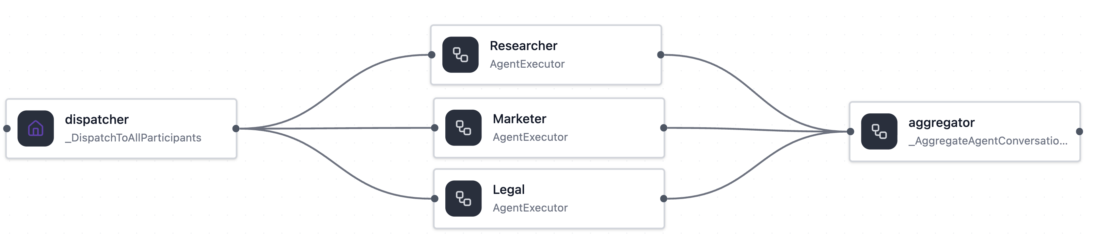
Using the built-in ConcurrentBuilder workflow
agent-framework
from agent_framework.orchestrations import ConcurrentBuilder
workflow = ConcurrentBuilder(
participants=[researcher, marketer, legal]).build()
The workflow assumes that participants accept and emit conversation-shaped data, so executors must be Agents or custom Executors that process conversations.
The extra start/end nodes normalize input and output to list[Message].
Full example: workflow_agents_concurrent.py
Notes:
https://learn.microsoft.com/agent-framework/workflows/events

Slide 23
MagenticBuilder for dynamic planning
https://learn.microsoft.com/agent-framework/workflows/orchestrations/magentic
Notes:
"Everything we've built so far — sequential, conditional, fan-out — the developer decides the topology. Now we let the agents decide."

Slide 24
Magentic-One workflow orchestration
Magentic-One orchestrator
Task ledger
Given or verified facts
Facts to look up
Facts to derive
Task plan
Progress ledger
Task complete?
Is progress being made?
What's next agent?
Next agent instruction
Task complete?
Yes
Final result
No
Yes
Stall
count
> 1
No
Progress being
made?
Yes
Agent A
Agent B
Agent C
https://arxiv.org/abs/2411.04468

Slide 25
Magentic-One: Initial plan development
The orchestrator uses this prompt to plan:
To address this request we have assembled the following team:
- local_agent: A local assistant that can suggest local activities or places to visit.
- language_agent: A helpful assistant that can provide language tips for a given destination.
- travel_summary_agent: A helpful assistant that can summarize the travel plan.
Based on the team composition, and known and unknown facts, please devise a short bullet-point plan for addressing the original request. Remember, there is no requirement to involve all team members. A team member's particular expertise may not be needed for this task.
Specialist agents

Slide 26
Magentic-One: Progress ledger updates
The orchestrator assesses progress after every turn, picks the next agent and tells it what to do.
Has the task been done?
{"is_request_satisfied": {
"answer": "no", "reason": "..."
},
"is_in_loop": {
"answer": "no", "reason": "..."
},
"is_progress_being_made": {
"answer": "yes", "reason": "...",
},
"next_speaker": {
"answer": "travel_summary_agent", "reason": "...",
},
"instruction_or_question": {
"answer": "Summarize the proposal", "reason": "...",
}}
Are agents repeating themselves?
Are we moving forward?
Who should go next?
What should they do?

Slide 27
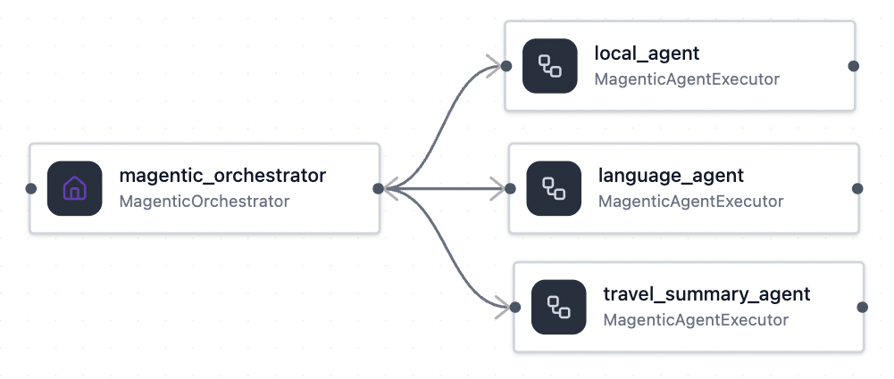
Using the built-in MagenticBuilder workflow
agent-framework
orchestrator
The MagenticOrchestrator node contains a StandardMagenticManager, which wraps the provided manager_agent, and plans and delegates tasks.
magentic_workflow = MagenticBuilder(
participants=[local_agent, language_agent, travel_summary_agent],
manager_agent=manager_agent,
max_round_count=10,
max_stall_count=1,
max_reset_count=1,
).build()
Full example: workflow_magenticone.py

Slide 28
Magentic orchestration vs. Agent-as-tools
📋 plan
Manager
Supervisor Agent
☑️ ledger
select
select
tool call
tool result
tool call
tool result
Agent A
Agent B
Agent A
Agent B
store
store
💬 chat history
Planning | Explicit (plan with progress ledger) | Implicit (reactive tool call decisions)
Loop detection | Progress ledger checks is_in_loop | No built-in loop detection
Agent context | Full shared chat history | Isolated per-call context
Token cost | Higher (plan + ledger+ shared history) | Lower
Notes:
Each sub-agent is a tool called by the supervisor.

Slide 29
Dynamic routing with HandoffBuilder
Notes:
"Everything we've built so far — sequential, conditional, fan-out — the developer decides the topology. Now we let the agents decide."

Slide 30
From fixed graphs to dynamic routing
FIXED GRAPH
DYNAMIC ROUTING
Developer defines edges. LLM picks a path.
Agents decide the next step at runtime.
B
B
edge(B, C)
C
agent decides
edge(A, B)
A
A
?
C
D
edge(A, D)
D
• All edges declared at build time
• LLM selects which branch, not which agent
• Topology is static — predictable and testable
• No predefined edges between agents
• Routing emerges from conversation state
• Topology is dynamic — flexible and adaptive
WorkflowBuilder · SequentialBuilder · ConcurrentBuilder
HandoffBuilder
Notes:
We already saw concatenation with previous example

Slide 31
Handoff orchestration
The start agent just kicks off the flow.
Any agent can hand off control to any other agent at runtime.
The receiving agent fully owns the conversation until it hands back.
Agent B
start agent
handoff
Agent A
handoff
handoff
Agent C
No edges are defined up front – routing emerges from conversation state.
Notes:
We already saw concatenation with previous example

Slide 32
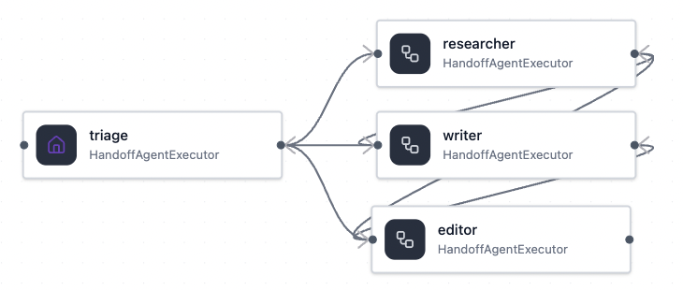
Using the built-in HandoffBuilder workflow
agent-framework
By default, all agents in a handoff orchestration can handoff to every other agent.
In autonomous mode, they will never ask the user for input.
start agent
workflow = (HandoffBuilder(
name="content_pipeline",
participants=[triage, researcher, writer, editor],
termination_condition=lambda conversation: (len(conversation) > 0
and conversation[-1].text.strip().startswith("FINAL:")))
.with_start_agent(triage)
.with_autonomous_mode()
.build())
Full example: workflow_handoffbuilder.py

Slide 33
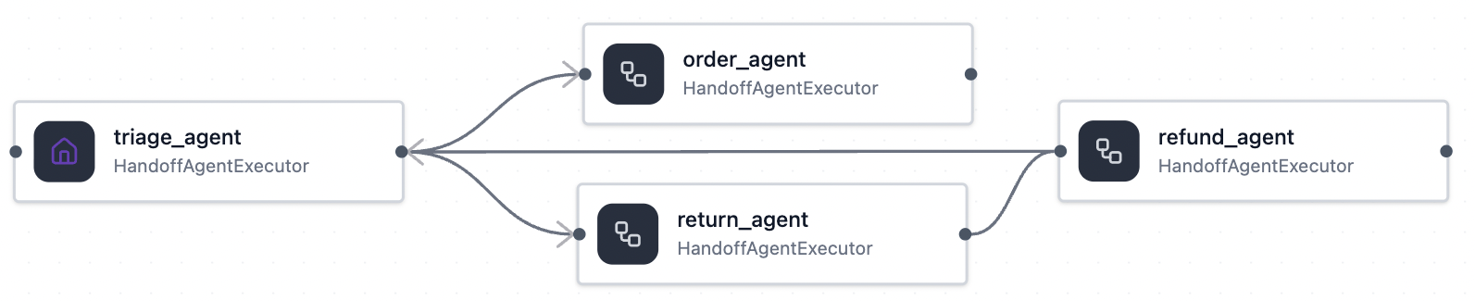
HandoffBuilder with handoff rules
agent-framework
start agent
workflow = (HandoffBuilder(
participants=[triage_agent, order_agent, return_agent, refund_agent],
termination_condition=lambda conversation: (
len(conversation) > 0 and "goodbye" in conversation[-1].text.lower()))
.with_start_agent(triage_agent)
.add_handoff(triage_agent, [order_agent, return_agent])
.add_handoff(return_agent, [refund_agent, triage_agent])
.add_handoff(order_agent, [triage_agent])
.add_handoff(refund_agent, [triage_agent])
.with_autonomous_mode().build())
Full example: workflow_handoffbuilder_rules.py

Slide 34
Handoff orchestration vs. Agent-as-tools
Delegated ownership
Centralized ownership
Start agent
Supervisor Agent
handoff
handoff
tool call
tool call
handoff
handoff
tool result
tool result
Agent A
handoff
Agent B
Agent A
Agent B
handoff
Control Flow | Active agent transfers control to another agent (peer-to-peer). | Supervisor calls sub-agent tools, control returns to supervisor.
Task Ownership | Ownership moves to receiving agent. | Supervisor retains ownership end-to-end.
Context Management | Conversation context is handed over. | Supervisor selects what context each tool gets.
Notes:
Each sub-agent is a tool called by the supervisor.

Slide 35
End-to-end application

Slide 36
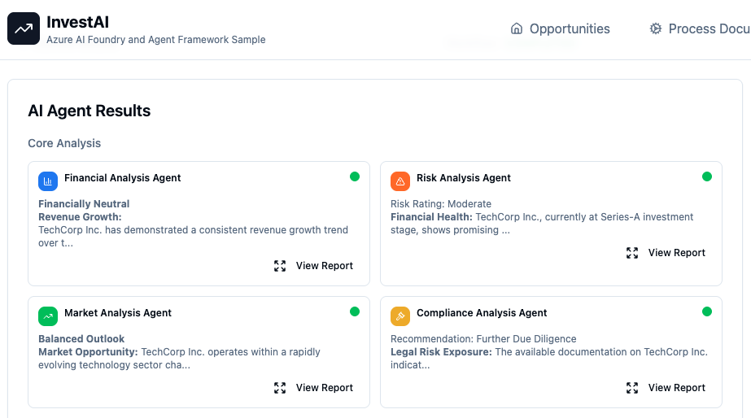
Agentic AI investment analysis
Agent Framework*
FastAPI
Azure OpenAI
Azure Cosmos DB
Azure Blob Storage
*Uses an older MAF version,
upgrades are pending.
https://github.com/Azure-Samples/Agentic-AI-Investment-Analysis-Sample
Notes:
https://aiinvest-web-dev.blueground-1750adc3.westus2.azurecontainerapps.io/

Slide 37
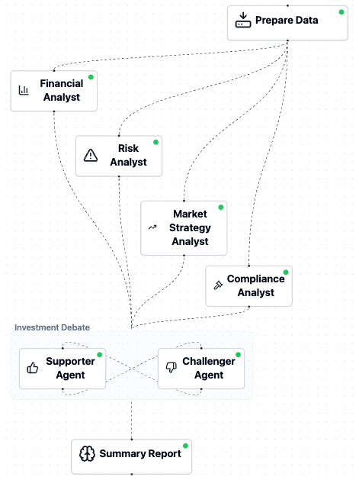
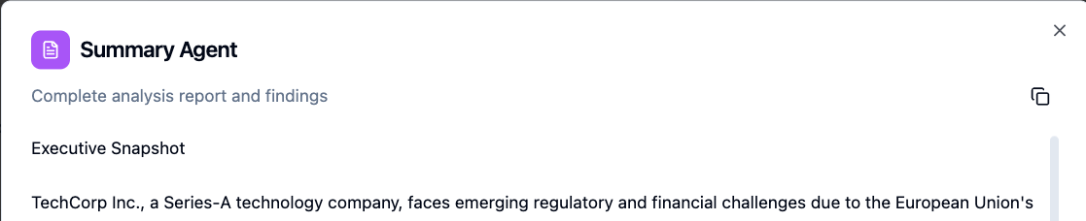
Investment workflow with fan-out/fan-in
workflow = WorkflowBuilder()
.set_start_executor(data_prep_executor)
.add_fan_out_edges(data_prep_executor,
[financial_analyst, risk_analyst,
market_analyst, compliance_analyst])
.add_fan_in_edges(
[financial_analyst, risk_analyst,
market_analyst, compliance_analyst],
analysis_aggregator)
.add_edge(analysis_aggregator, debate_executor)
.add_edge(debate_executor, summary_report_generator)
.build()
Full file: investment_workflow.py
Notes:
Each sub-agent is a tool called by the supervisor.

Slide 38
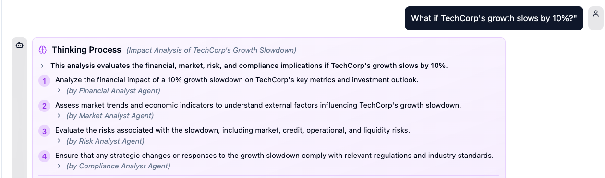
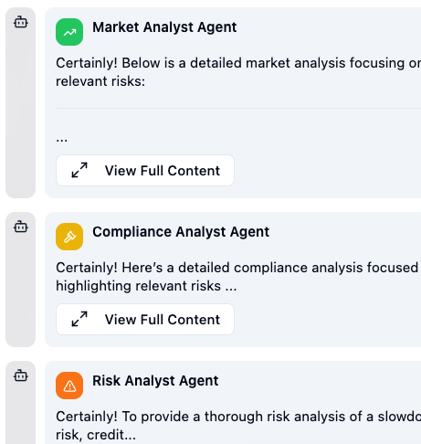
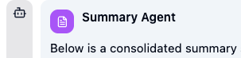

What-if workflow with fan-in/fan-out
workflow = WorkflowBuilder()
.set_start_executor(planner_agent)
.add_fan_out_edges(planner_agent,
[financial_analyst_agent, risk_analyst_agent,
market_analyst_agent, compliance_analyst_agent])
.add_fan_in_edges(
[financial_analyst_agent, risk_analyst_agent,
market_analyst_agent, compliance_analyst_agent],
summarizer_agent)
.build()
Full file: what_if_workflow.py
Notes:
Each sub-agent is a tool called by the supervisor.

Slide 39
Next steps
Register:
https://aka.ms/PythonAgents/series
Watch past recordings:
aka.ms/pythonagents/resources
Join office hours after each session in Discord:
aka.ms/pythonai/oh
🛠️ Feb 24: Building your first agent in Python
🧠 Feb 25: Adding context and memory to agents
📊 Feb 26: Monitoring and evaluating agents
🔀 Mar 3: Building your first AI-driven workflows
🕸️ Mar 4: Orchestrating advanced multi-agent workflows
🙋🏽 Mar 5: Adding a human-in-the-loop to workflows

