Slide 1
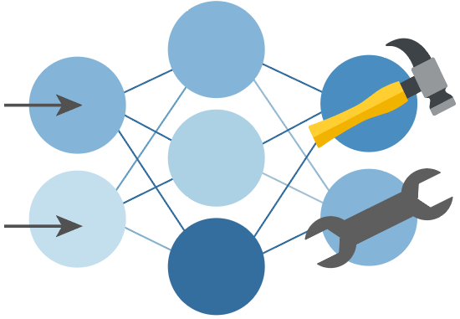

Python + Agents
🛠️ Feb 24: Building your first agent in Python
🧠 Feb 25: Adding context and memory to agents
📊 Feb 26: Monitoring and evaluating agents
🔀 Mar 3: Building your first AI-driven workflows
🕸️ Mar 4: Orchestrating advanced multi-agent workflows
🙋🏽 Mar 5: Adding a human-in-the-loop to workflows
🔗 Register at aka.ms/PythonAgents/series

Slide 2
Python + Agents
🛠️ Building your first agent in Python
aka.ms/pythonagents/slides/building
Pamela Fox
Python Cloud Advocate
www.pamelafox.org

Slide 3
Today we'll cover...
What's an agent?
How tool-calling works
Building agents with agent-framework
Integrating agents with MCP servers tools
Agent middleware
Multi-agent architectures

Slide 4
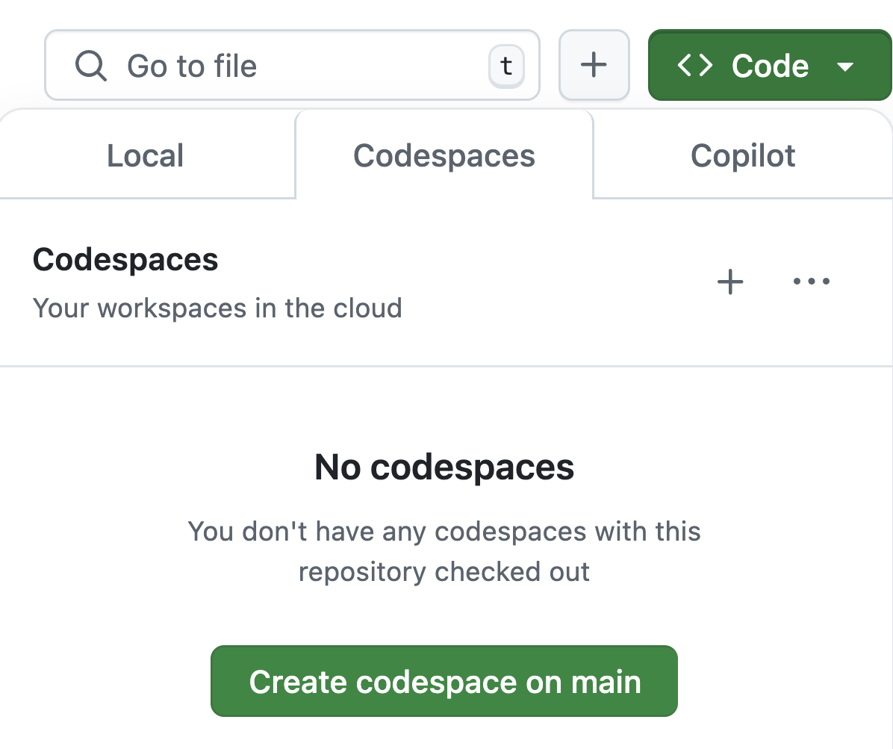
Want to follow along?
1. Open this GitHub repository:
aka.ms/python-agentframework-demos
2. Use "Code" button to create a GitHub Codespace:
3. Wait a few minutes for Codespace to start up ⏱️

Slide 5
Agents 101

Slide 6
What is an agent?
🤖
Agent
An AI agent uses an LLM to run tools in a loop to achieve a goal.
Input
👤
Agents are often augmented by:
📚 Context
🧠 Memory
✅ Planning
👩🏽‍💻 Humans
🛠️
Tools
LLM
🥅
Goal
https://simonwillison.net/2025/Sep/18/agents/

Slide 7
Python AI agent frameworks
Framework | Description
agent-framework | A framework from Microsoft with support for agentic patterns and full integration with Azure offerings. (Successor to autogen and semantic-kernel)
langchain v1 | An agent-centric framework built on top of Langgraph, with optional Langsmith monitoring
pydantic-ai | A flexible framework designed for type safety and observability (Logfire/OTel), from the creators of Pydantic
openai-agents | A framework from OpenAI that is optimized for use with OpenAI models (especially Responses API/reasoning).
We'll be experimenting with these frameworks today:

Slide 8
Calling tools without a framework

Slide 9
What is "tool calling"?
* Also known as "function calling"
Tool calling permits an LLM to not just generate text, but also generate function calls based off function definitions
The LLM responds with the function name and the arguments necessary to satisfy the request
This makes it easy to connect LLMs with APIs, databases, and arbitrary Python logic.
What's the weather in Paris?
👩🏽‍🦱
get_weather("Paris")
LLM
https://platform.openai.com/docs/guides/function-calling

Slide 10
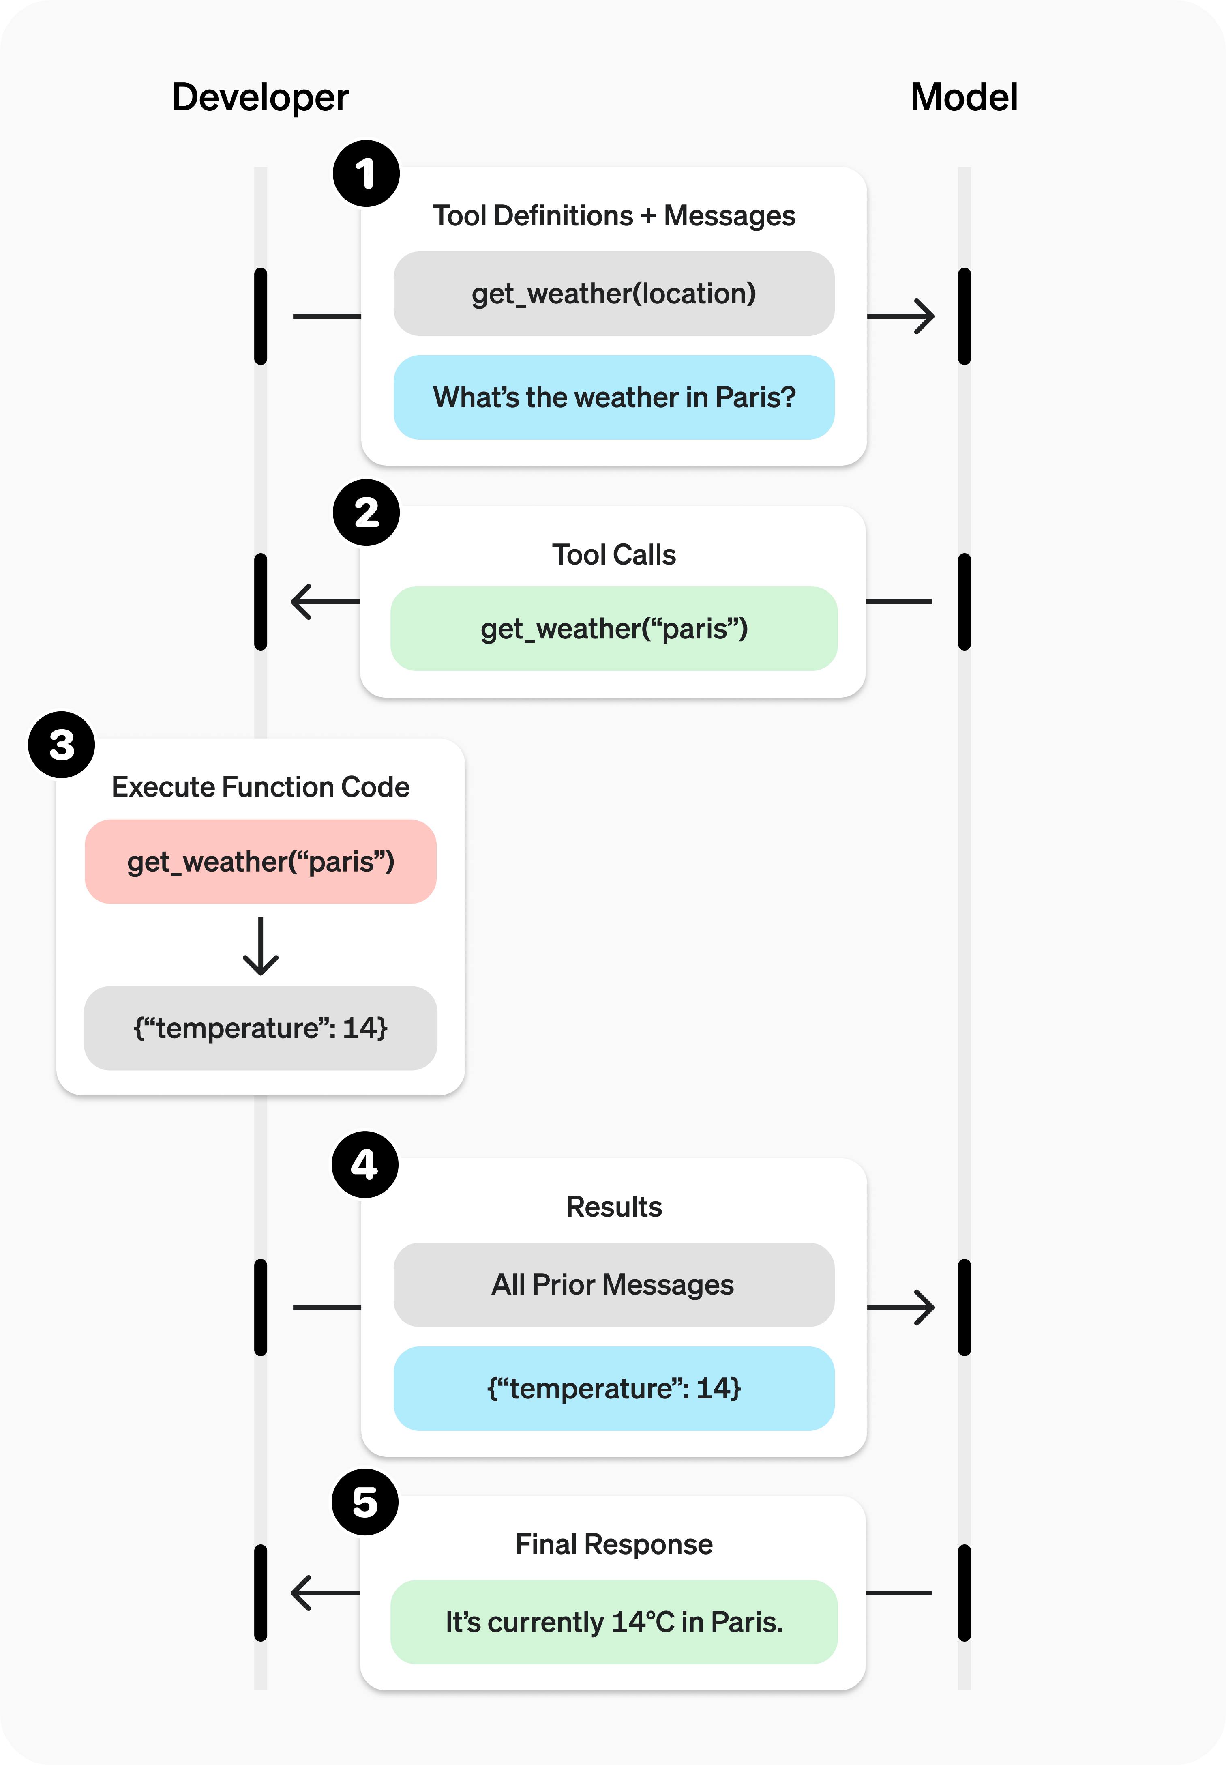
Tool calling flow
1. The code tells LLM what tools they can call
2. The LLM responds with suggested tool name and arguments
3. The code calls function for that tool
4. The code sends prior messages and return value from tool function to LLM
5. The LLM responds based off full history
https://platform.openai.com/docs/guides/function-calling

Slide 11
Step 1) Tell the LLM what functions it can call
tools = [{
"type": "function",
"function": {
"name": "lookup_weather",
"description": "Lookup the weather for a given city name or zip code.",
"parameters": {
"type": "object",
"properties": {
"city_name": {
"type": "string",
"description": "The city name",
},
"zip_code": {"type": "string",
"description": "The zip code"
}}}}}]
response = client.chat.completions.create(
model="gpt-5",
messages=[
{"role": "system",
"content": "You're a weather chatbot."},
{"role": "user",
"content": "is it sunny in LA, CA?"},
],
tools=tools,
)
Full example: openai_tool_calling.py

Slide 12
Step 2) Get function name and args from response
if response.choices[0].message.tool_calls:
tool_call = response.choices[0].message.tool_calls[0]
function_name = tool_call.function.name
function_arguments = json.loads(tool_call.function.arguments)
print(function_name)
print(function_arguments)
else:
print(response.choices[0].message.content)
lookup_weather
{"city_name":"Los Angeles"}

Slide 13
Step 3) Call a local function based on response
def lookup_weather(city_name=None, zip_code=None):
print(f"Looking up weather for {city_name or zip_code}...")
return {"city_name": city_name, "zip_code": zip_code,
"weather": "sunny", "temperature": 75}
# ..Make call to the LLM here...
if response.choices[0].message.tool_calls:
tool_call = response.choices[0].message.tool_calls[0]
function_name = tool_call.function.name
function_arguments = json.loads(tool_call.function.arguments)
if function_name == "lookup_weather":
lookup_weather(**function_arguments)
Looking up weather for Los Angeles...

Slide 14
Step 4) Send tool results to LLM for final answer
if response.choices[0].message.tool_calls:
tool_call = response.choices[0].message.tool_calls[0]
function_name = tool_call.function.name
function_arguments = json.loads(tool_call.function.arguments)
if function_name == "lookup_weather":
messages.append(response.choices[0].message)
result = lookup_weather(**function_arguments)
messages.append({
"role": "tool", "tool_call_id": tool_call.id, "content": json.dumps(result)})
response = client.chat.completions.create(
model="gpt-5", messages=messages, tools=tools)
print(response.choices[0].message.content)
Yes — it's currently sunny in Los Angeles, CA with a temperature around 75°F.

Slide 15
Building agents with agent-framework
https://learn.microsoft.com/agent-framework/

Slide 16
Single agent with tool
Agent architecture:
The agent can use a tool to help answer a user's question.
Request
"how's weather in SF?"
LLM
Tool
LLM
"San Francisco"
get_weather
{"temperature": 60,
"condition": "sunny"}
Response
"It's 60 degrees outside and the sun is shining! 🌞"

Slide 17
Single agent with tool
agent-framework
Define tools using Python functions, with typed args, return type, and docstring:
@tool
def get_weather(
city: Annotated[str, Field(description="City name, spelled out fully")],
) -> dict:
"""Returns weather data, a dict with temperature and description."""
return {"temperature": 72, "description": "Sunny"}
agent = Agent(client=client,
instructions="You're an info agent. Answer questions cheerfully.",
tools=[get_weather])
response = await agent.run("Whats weather today in San Francisco?")
print(response.text)
Full example: agent_tool.py

Slide 18
Single agent with multiple tools
Agent architecture:
The agent must decide which tool to use and what order to call tools in.
Weekend planner agent
LLM
LLM
Tool A
Tool B
Tool C
get_weather
get_activities
get_current_date

Slide 19
Single agent with tools
agent-framework
@tool
def get_current_date() -> str:
return datetime.now().strftime("%Y-%m-%d")
@tool
def get_weather(
city: Annotated[str, Field(description="The city to get weather for")]) -> dict:
...
@tool
def get_activities(
city: Annotated[str, Field(description="The city to get activities for")],
date: Annotated[str, Field(description="Date, in format YYYY-MM-DD.")]) -> list:
...
agent = Agent(client=client, instructions="You help users plan their weekends.",
tools=[get_weather, get_activities, get_current_date])
Full example: agent_tools.py

Slide 20
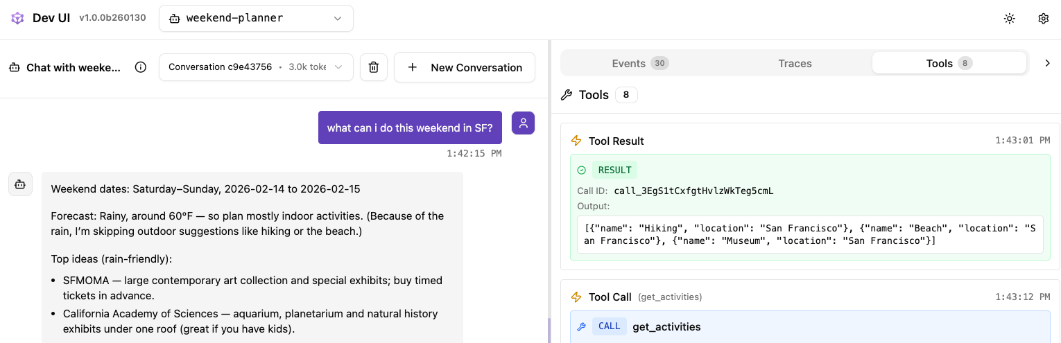
Local experimentation with DevUI
agent-framework
DevUI makes it easy to chat with your agents and trace tool calls:
from agent_framework.devui import serve
serve(entities=[agent], auto_open=True)

Slide 21
Integrating agents with MCP server tools

Slide 22
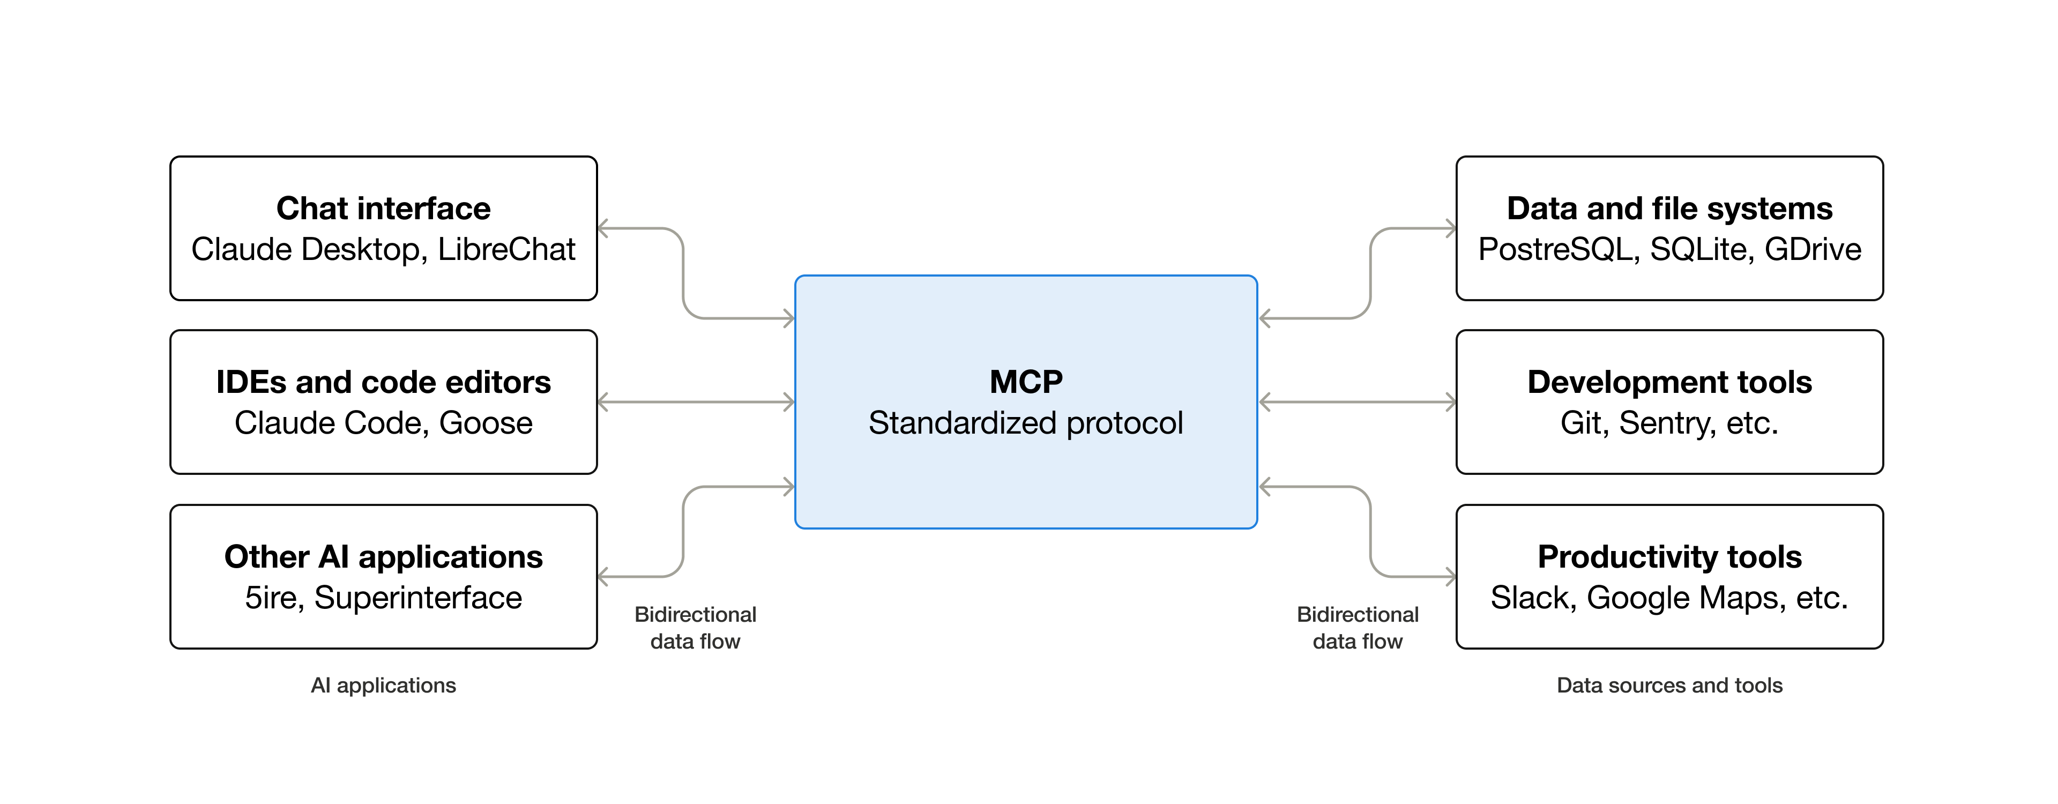

Model Context Protocol
An open protocol created by Anthropic that standardizes the interaction between LLMs and external tools, data sources, and applications.
https://modelcontextprotocol.io/
Notes:
An embedding encodes an input as a list of floating-point numbers.
”dog” → [0.017198, -0.007493, -0.057982,…]
Different embedding models output different embeddings, with varying lengths.

Slide 23
MCP client + server architecture
MCP Host
VS Code, Claude Code,
Your agent! 🤖
MCP Server A
MCP Client A
MCP
Tools
Prompts
Resources
MCP Server B
MCP Client B
MCP
Tools
Prompts
Resources
https://modelcontextprotocol.io/docs/learn/architecture
Notes:
An embedding encodes an input as a list of floating-point numbers.
”dog” → [0.017198, -0.007493, -0.057982,…]
Different embedding models output different embeddings, with varying lengths.

Slide 24
Single agent with MCP servers
Agent architecture:
First the agent queries each MCP server to discover their tools.
tools?
MCP Server A
🤖
Tool X, Tool Y
tools?
MCP Server B
Tool Z
Then the agent decides which of the MCP tools to call.
Tool X
🤖
LLM
Tool Y
Tool Z

Slide 25
Agent with local MCP server
agent-framework
First run the server:
uv run examples/mcp_server.py
Then run the agent:
async with (
MCPStreamableHTTPTool(name="Local MCP Server",
url="http://localhost:8000/mcp") as mcp_server,
Agent(client=client,
instructions=f"You help users with tasks using the available tools.
Today's date is {datetime.now().strftime('%Y-%m-%d')}.",
tools=[mcp_server]) as agent,
):
response = await agent.run("I bought laptop today for $1200 on my visa.")
Full example: agent_mcp_local.py

Slide 26
Agent with remote MCP server
agent-framework
async with (
MCPStreamableHTTPTool(
name="Microsoft Learn MCP",
url="https://learn.microsoft.com/api/mcp") as mcp_server,
Agent(
client=client,
instructions="You help with Microsoft documentation questions. Use the available tools to search for relevant docs.",
tools=[mcp_server]) as agent,
):
response = await agent.run(
"How do I create an Azure Blob storage account using the az cli?")
Full example: agent_mcp_remote.py

Slide 27
Agent middleware

Slide 28
Agent middleware
Agent architecture:
Middleware can be called at different stages in the process of running an agent:
Function
Middleware
Tool
🤖
tools?
Input
Agent
Middleware
Chat
Middleware
Agent
LLM
Response
AgentContext:
messages
is_streaming
metadata
agent
result: mutate this to change agent response
terminate: set this flag to stop processing
ChatContext:
messages
is_streaming
metadata
chat_client
chat_options
result: mutate this to change chat response
terminate: set this flag to stop processing
Each middleware receives a context:
FunctionInvocationContext:
metadata
function
arguments
result: mutate this to change the return value
terminate: set this flag to stop processing

Slide 29
Agent Middleware example
agent-framework
A middleware should process, call_next(), then optionally post-process:
async def timing_agent_middleware(
context: AgentContext,
call_next: Callable[[], Awaitable[None]],
) -> None:
start = time.perf_counter()
logger.info("[⏲️ Timing Agent Middleware] Starting agent execution")
await call_next()
elapsed = time.perf_counter() - start
logger.info(f"[⏲️ Timing Agent Middleware] Execution took {elapsed:.2f}s")
Full example: agent_middleware.py

Slide 30
Chat Middleware example
agent-framework
A middleware can access the context for more details:
async def logging_chat_middleware(
context: ChatContext,
call_next: Callable[[], Awaitable[None]],
) -> None:
logger.info(f"Sending {len(context.messages)} messages to AI")
await call_next()
logger.info("AI response received")
Full example: agent_middleware.py

Slide 31
Function Middleware example
agent-framework
The context may change after next(context) is called:
async def logging_function_middleware(
context: FunctionInvocationContext,
call_next: Callable[[], Awaitable[None]]
) -> None:
logger.info(f"Calling {context.function.name} with: {context.arguments}")
await call_next()
logger.info(f"Function {context.function.name} returned: {context.result}")
Full example: agent_middleware.py

Slide 32
Class-based middleware
agent-framework
A middleware can be defined as a subclass with a process() method:
class MessageCountChatMiddleware(ChatMiddleware):
def __init__(self) -> None:
self.total_messages = 0
async def process(self,
context: ChatContext,
call_next: Callable[[], Awaitable[None]]) -> None:
self.total_messages += len(context.messages)
logger.info(f"Messages in this request: {len(context.messages)},
total so far: {self.total_messages}")
await call_next()
Full example: agent_middleware.py

Slide 33
Middleware with termination
agent-framework
A middleware can set terminate() to stop execution of current agent run:
class BlockingAgentMiddleware(AgentMiddleware):
async def process(self, context: AgentContext,
call_next: Callable[[], Awaitable[None]]) -> None:
last_message = context.messages[-1] if context.messages else None
for word in self.blocked_words:
if word.lower() in last_message.text.lower():
context.terminate = True
context.result = AgentResponse(
messages=[Message(role="assistant",
text=f"I can't process requests about '{word}'.")])
return
await call_next()
Full example: agent_middleware.py

Slide 34
Registering middleware per agent
agent-framework
Register middleware functions and class instances on the ChatAgent:
blocking_middleware = BlockingAgentMiddleware(blocked_words=["nuclear"])
timing_function_middleware = TimingFunctionMiddleware()
message_count_middleware = MessageCountChatMiddleware()
agent = Agent(
client=client,
instructions="Help users plan weekends.",
tools=[get_weather, get_current_date],
middleware=[
timing_agent_middleware, blocking_middleware,
logging_function_middleware, timing_function_middleware,
logging_chat_middleware, message_count_middleware])
Full example: agent_middleware.py

Slide 35
Registering middleware per run
agent-framework
You can also register middleware for a particular run of an agent:
async def extra_agent_middleware(
context: AgentContext,
call_next: Callable[[], Awaitable[None]]) -> None:
logger.info("This middleware only applies to this run")
await call_next()
logger.info("Run completed")
response = await agent.run("What's the weather like in Portland?",
middleware=[extra_agent_middleware])
Full example: agent_middleware.py

Slide 36
Middleware scenarios
Agent Middleware:
Logging & timing
Content filtering / blocking
Authorization checks
Result caching
Result override
Thread summarization
Dynamic system prompts
Chat Middleware:
Token tracking
Latency tracking
Budget enforcement
PII redaction
Response moderation
Model fallback
Model call limits
Function Middleware:
Audit logging
Permission checks
Input validation
Caching results
HITL approval
Tool call limits
Tool retry with backoff
Once you build a middleware for one agent, you can reuse across other agents.
You might create a central package of middleware for many agents to use.

Slide 37
Multi-agent architectures

Slide 38
Supervisor agent with sub-agents
Agent architecture:
The supervisor agent decides which specialist agents should handle a task.
Each agent may still have associated tools to call.
General architecture
Parenting helper agent
Supervisor Agent
Supervisor Agent
Agent A
Agent B
Weekend Planning Agent
Meal
Planning Agent
Search Activities
Check Weather
Search Recipes
Check Fridge

Slide 39
Supervisor agent with sub-agents
agent-framework
weekend_agent = Agent(client=client,
instructions="You help users plan weekend activities based on weather",
tools=[get_weather, get_activities, get_current_date])
meal_agent = Agent(client=client,
instructions="You help users plan meals + choose the best recipes",
tools=[find_recipes, check_fridge])
@tool
async def plan_weekend(query: str) -> str:
response = await weekend_agent.run(query)
return response.text
@tool
async def plan_meal(query: str) -> str:
response = await meal_agent.run(query)
return response.text
supervisor_agent = Agent(client=client,
instructions="You're a supervisor managing a weekend planner & meal planner",
tools=[plan_meal, plan_weekend])
Full example: agent_supervisor.py

Slide 40
Multi-agent workflows
Agent architecture:
For more complex multi-agent architectures, build workflows:
Agent 2
Input
Agent 1
Agent 4
Agent 3
Workflows can include conditional edges, approvals, human-in-the-loop, and non-agent nodes as well.
Join week 2 of this series to learn how to build workflows with agent-framework!

Slide 41
Next steps
Register:
https://aka.ms/PythonAgents/series
Watch past recordings:
aka.ms/pythonagents/resources
Join office hours after each session in Discord:
aka.ms/pythonai/oh
🛠️ Feb 24: Building your first agent in Python
🧠 Feb 25: Adding context and memory to agents
📊 Feb 26: Monitoring and evaluating agents
🔀 Mar 3: Building your first AI-driven workflows
🕸️ Mar 4: Orchestrating advanced multi-agent workflows
🙋🏽 Mar 5: Adding a human-in-the-loop to workflows

Slide 42
Appendix 🐉

Slide 43
Learn more
Documentation:
https://learn.microsoft.com/agent-framework/
Watch Ignite talks:
AI powered automation & multi-agent orchestration in Azure AI Foundry
Innovation Session: Your AI Apps and Agent Factory
Multi-Agent Apps with Microsoft Agent Framework or LangGraph
Build A2A and MCP Systems using SWE Agents and agent-framework
AI builder’s guide to agent development in Foundry Agent Service
Join weekly Office Hours:
https://github.com/microsoft/agent-framework/blob/main/COMMUNITY.md

Slide 44
Migration tips

Slide 45
MAF vs Semantic Kernel and AutoGen
 | Semantic Kernel | AutoGen | Agent Framework
Focus | Stable SDK with enterprise connectors, workflows, and observability | Experimental multi-agent orchestration from research | Unified SDK combining innovation + enterprise readiness
Interop | Plugins, connectors, and support for MCP, A2A, OpenAPI | Tool integration supported; lacks standardized cross-runtime protocols | Built-in connectors, MCP + A2A + OpenAPI
Memory | Multiple vector store connectors and memory store abstraction (e.g. Azure SQL Elasticsearch, MongoDB) | Support for in-memory / buffer history + external vector store memory options (ChromaDB, Mem0, etc) | Pluggable memory across stores (first-party and third-party), persistent & adaptive memory stored with retrieval, hybrid appraoches
Orchestration | Deterministic + dynamic orchestration (Agent Framework, Process Framework) | Dynamic LLM orchestration (debate, reflection, facilitator/worker, group chat) | Deterministic + dynamic orchestration (Agent Orchestration, Workflow Orchestration)
Enterprise readiness | Telemetry, observability, compliance hooks | Minimal | Observability, approvals, CI/CD, long-running durability, hydration
https://devblogs.microsoft.com/foundry/introducing-microsoft-agent-framework-the-open-source-engine-for-agentic-ai-apps/

Slide 46
Autogen → Agent-framework
AutoGen pioneered many orchestration patterns (GroupChat, GraphFlow, event-driven runtimes), which are now unified in Agent Framework under the Workflow abstraction that supports checkpointing, pause/resume, and human-in-the-loop flows.
The AssistantAgent maps directly to the new ChatAgent, which is multi-turn by default and continues tool invocation until a result is ready.
FunctionTool wrappers migrate to the @ai_function decorator, with automatic schema inference and support for hosted tools like code interpreter or web search.
Most single-agent migrations require only light refactoring; multi-agent migrations benefit from the new Workflow model with stronger composability and durability.
Migration guide:
https://learn.microsoft.com/agent-framework/migration-guide/from-autogen/
Code samples (Python):
https://github.com/microsoft/agent-framework/tree/main/python/samples/autogen-migration

Slide 47
Semantic Kernel → Agent-framework
Replace Kernel and plugin patterns with the Agent and Tool abstractions.
Agents now manage threads natively, simplify invocation with RunAsync / RunStreamingAsync, and register tools inline without attributes or plugin wrappers.
Existing vector store integrations (Azure AI Search, Postgres, Cosmos DB, Redis, Elasticsearch, etc.) continue to work through connectors.
Plugins like Bing, Google, OpenAPI, and Microsoft Graph port directly as tools, often exposed via MCP or OpenAPI.
Migration guide:
https://learn.microsoft.com/agent-framework/migration-guide/from-semantic-kernel/
Code samples:
https://learn.microsoft.com/agent-framework/migration-guide/from-semantic-kernel/samples

Slide 48
Use GitHub Copilot for migration
Try out a prompt like:
Port this code from AutoGen to Agent Framework, following the guide at https://learn.microsoft.com/en-us/agent-framework/migration-guide/from-autogen/
Find relevant code samples here if needed:
https://github.com/microsoft/agent-framework/tree/main/python/samples/autogen-migration

Slide 49
E2E sample

Slide 50
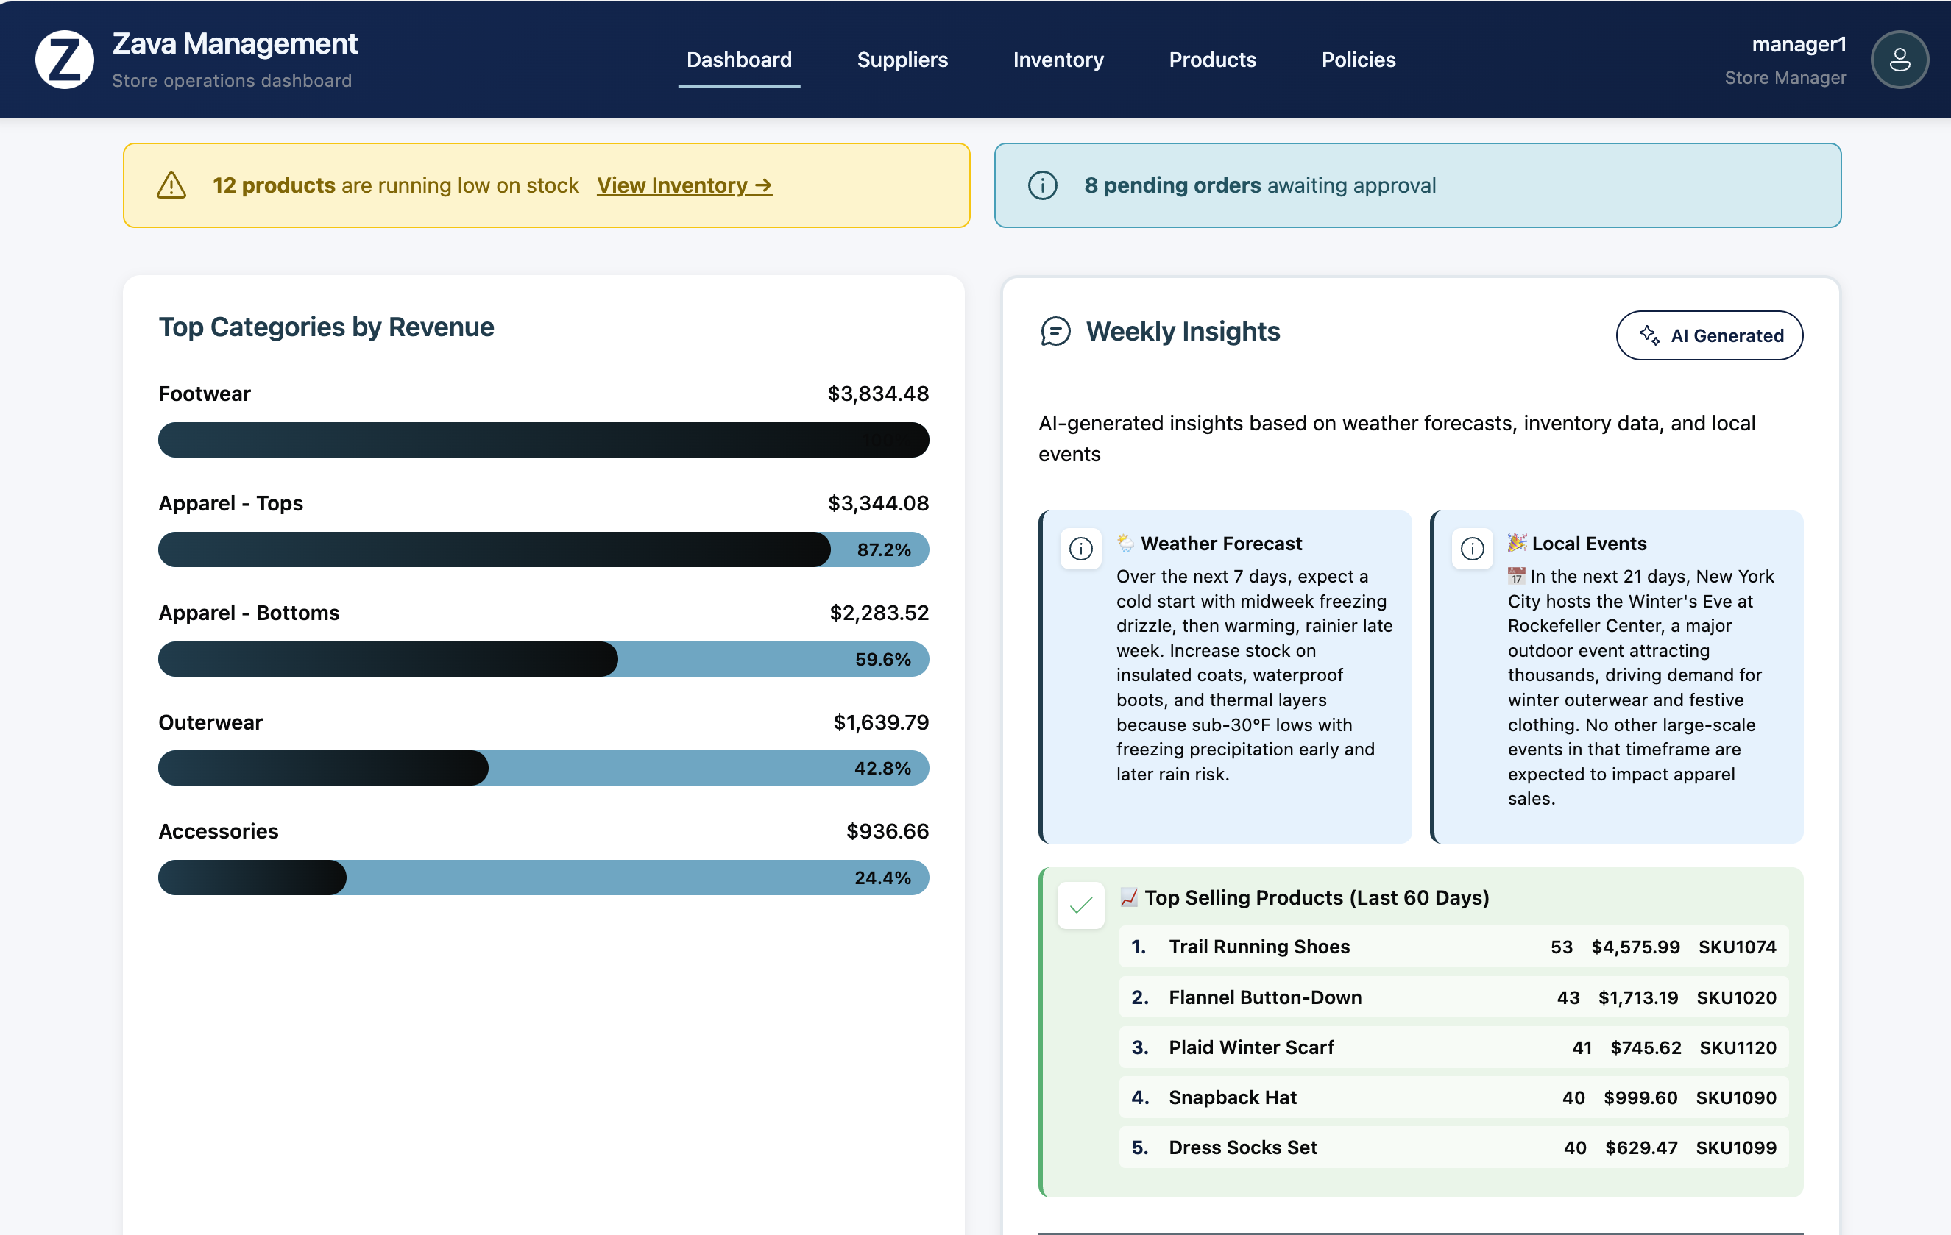
Sample: Agentic Shop
This app uses docker-compose to deploy 2 MCP servers, an API server (that runs agents), plus a frontend server.
agent = chat_client.create_agent(
name="Retail Insights Analyzer",
tools=[finance_mcp],
)
response = await agent.run(
"Top 5 selling products for store 1",
response_format=ProductsAgentResponse
)
products = response.value.products
https://github.com/tonybaloney/agentic-popup-shop

