Slide 1
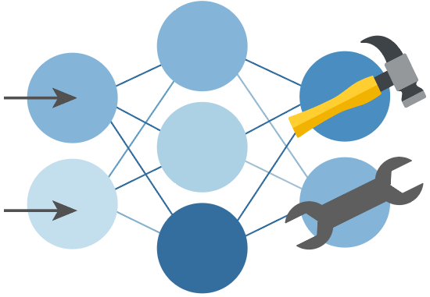

Python + Agents
🛠️ Feb 24: Building your first agent in Python
🧠 Feb 25: Adding context and memory to agents
📊 Feb 26: Monitoring and evaluating agents
🔀 Mar 3: Building your first AI-driven workflows
🕸️ Mar 4: Orchestrating advanced multi-agent workflows
🙋🏽 Mar 5: Adding a human-in-the-loop to workflows
🔗 Register at aka.ms/PythonAgents/series

Slide 2
Python + Agents
🧠 Adding context and memory to agents
aka.ms/pythonagents/slides/contextmemory
Pamela Fox
Python Cloud Advocate
www.pamelafox.org

Slide 3
Today we'll cover different kinds of context...
What is context?
Memory
  Sessions
  Chat history
  Dynamic memory
Knowledge providers
Context management

Slide 4
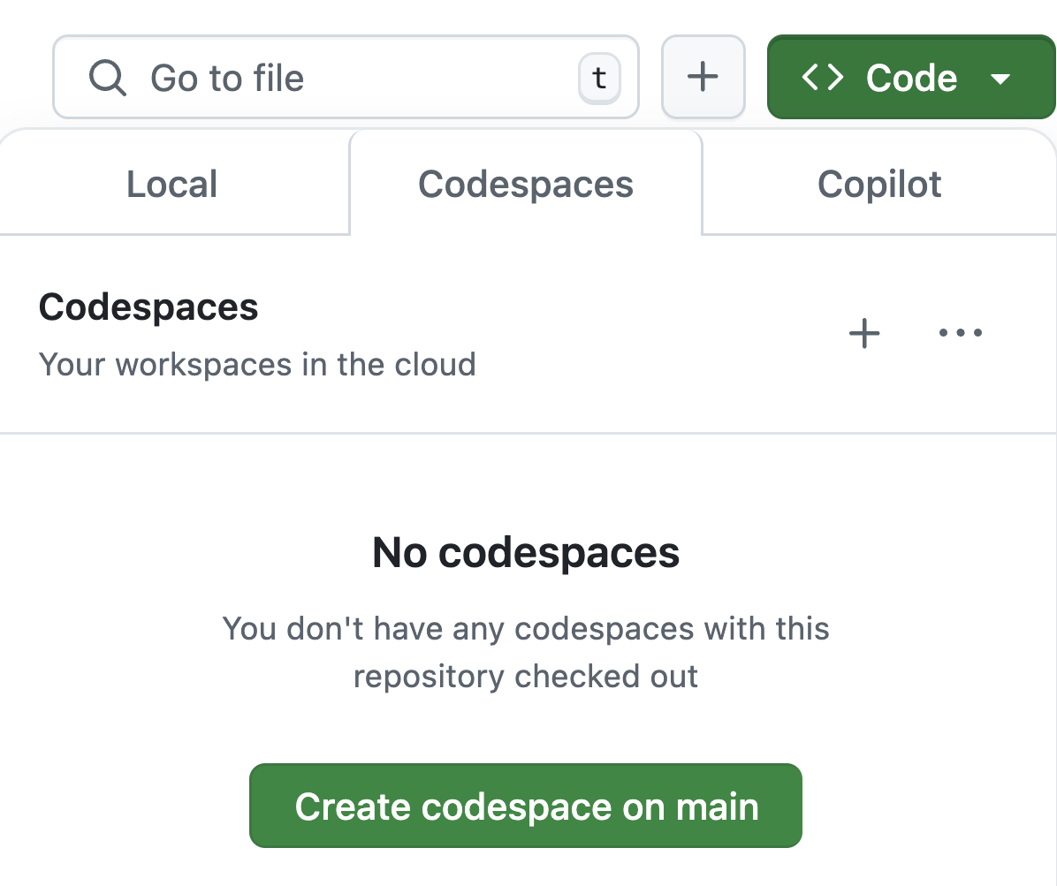
Want to follow along?
1. Open this GitHub repository:
aka.ms/python-agentframework-demos
2. Use "Code" button to create a GitHub Codespace:
3. Wait a few minutes for Codespace to start up ⏱️

Slide 5
Recap: What's an agent?
🤖
Agent
An AI agent uses an LLM to run tools in a loop to achieve a goal.
Input
👤
Agents are improved by better context:
📚 Knowledge
🧠 Memory
👩🏽‍💻 Humans
🛠️
Tools
LLM
🥅
Goal

Slide 6
Context is everything
The context to an agent is all the inputs that help the agent decide what action it will take next and how it will respond.
📋 Overall instructions
💻 Environment information
📚 Domain-specific knowledge
🧠 Memories from previous conversations
💬 Past messages in the session
🛠️ Tool descriptions, calls, results
You're a friendly weather assistant.
Today's date is Feb 25, 2026.
There is an emergency alert today for CA citizens due to wildfire risk.
The current user lives in California.
⚙️
Weather in Tokyo?
👤
get_weather("Tokyo")
LLM
Sunny, 25°C
🔧
It's sunny in Tokyo at 25°C
LLM

Slide 7
🧠 Memory

Slide 8
Memory
Can LLM remember past messages?
Can app remember past conversations?
Can LLM remember facts from past conversations?
Session
Within conversation, just messages and tool calls
Can be stored in-memory OR persisted to a database to restore conversation later
May require truncation or summarization
Chat history
Must be stored in a persistent database
Across conversations, typically tied to user ID
Dynamic memory
Must be stored in a persistent database
Retrieve memories, optionally using search to find most relevant
https://learn.microsoft.com/agent-framework/user-guide/agents/agent-memory

Slide 9
💬 Conversation sessions
Notes:
Most basic form of memory – what were we talking about earlier?!

Slide 10
Conversation sessions
A session includes all the past messages:
⚙️
You're a weather assistant.
🤖
Agent
👤
Weather in Tokyo?
Input
👤
LLM
get_weather("Tokyo")
🔧
Sunny, 25°C
🛠️
Tools
It's sunny in Tokyo at 25°C
LLM
LLM
👤
How about London?
LLM
get_weather("London")
🥅
Response
🔧
Rainy, 12°C
LLM
London is rainy at 12°C

Slide 11
Conversation session (In-memory)
agent-framework
By default, a session stores the conversation messages in memory:
from agent_framework import Agent
from agent_framework.openai import OpenAIChatClient
agent = Agent(
client=OpenAIChatClient(),
instructions="You are a helpful assistant.")
session = agent.create_session()
response = await agent.run("Hello, my name is Alice", session=session)
Full example: agent_session.py

Slide 12
Persistent chat history

Slide 13
Persistent chat history
⚙️
You're a weather assistant.
id | messages
session123 | system: You're a weather assistant. user: Weather in Tokyo? ...
session456 | system: You're a weather assistant. user: Will it rain in CA? ....
👤
Weather in Tokyo?
LLM
get_weather("Tokyo")
🔧
Sunny, 25°C
Database
LLM
It's sunny in Tokyo at 25°C
👤
How about London?
Implementation details:
Will entire session fit in one row?
If not, how to handle?
How will sessions be linked to users?
Will the sessions be searchable?
LLM
get_weather("London")
🔧
Rainy, 12°C
LLM
London is rainy at 12°C

Slide 14
Persistent chat history in Redis
⚙️
You're a weather assistant.
key | value [LIST]
session123
👤
Weather in Tokyo?
LLM
get_weather("Tokyo")
{"role": "system", "content": "You're a weather assistant."}
{"role": "user", "content": "Weather in Tokyo?"}
{"role": "assistant", "tool_call": "get_weather"}
🔧
Sunny, 25°C
Redis
LLM
It's sunny in Tokyo at 25°C
👤
How about London?
LLM
get_weather("London")
Implementation details:
Keys are session IDs
The values are lists of messages that can be truncated to the most recent N
🔧
Rainy, 12°C
LLM
London is rainy at 12°C

Slide 15
Persistent chat history
agent-framework
Redis support is built-in, so you can directly use RedisHistoryProvider:
from agent_framework.redis import RedisHistoryProvider
redis_provider = RedisHistoryProvider(
redis_url="redis://localhost:6379",
source_id="redis_chat")
agent = Agent(
client=OpenAIChatClient(),
instructions="You are a helpful weather agent.",
tools=[get_weather],
context_providers=[redis_provider])
session = agent.create_session(session_id=str(uuid.uuid4()))
Full example: agent_history_redis.py

Slide 16
Persistent chat history in SQLite
⚙️
You're a weather assistant.
id | thread_id | message
1 | session123 | {"role": "system", "content": "You're a weather assistant."}
2 | session123 | {"role": "user", "content": "Weather in Tokyo?"}
3 | session123 | {"role": "assistant", "tool_call": "get_weather"}
4 | session456 | {"role": "system", "content": "You're a weather assistant."}
👤
Weather in Tokyo?
LLM
get_weather("Tokyo")
🔧
Sunny, 25°C
SQLite
LLM
It's sunny in Tokyo at 25°C
👤
How about London?
LLM
get_weather("London")
Implementation details:
Rows are single messages, retrieved based off incrementing ID order
No limits to # of messages in session
🔧
Rainy, 12°C
LLM
London is rainy at 12°C

Slide 17
Persistent chat history with custom storage
agent-framework
For DBs without built-in support, write a subclass that implements BaseHistoryProvider:
class SQLiteHistoryProvider(BaseHistoryProvider):
def __init__(self, db_path: str):
...
async def get_messages(self, session_id, **kwargs) -> list[Message]:
cursor = self._conn.execute(
"SELECT message_json FROM messages WHERE session_id = ? ORDER BY id",
(session_id,))
return [Message.from_json(row[0]) for row in cursor.fetchall()]
async def save_messages(self, session_id, messages, **kwargs) -> None:
self._conn.executemany(
"INSERT INTO messages (session_id, message_json) VALUES (?, ?)",
[(session_id, msg.to_json()) for msg in messages])
self._conn.commit()
Full example: agent_history_sqlite.py

Slide 18
Dynamic memory

Slide 19
Dynamic memory
Implementation matters!
Retrieving memories:
All or only most relevant?
Storing memories:
Whole message?
LLM-synthesized memory?
Forgetting memories:
Oldest? Obsolete?
🛠️ Tools
Input
LLM
Agent
Response
input
store memory
retrieve memories
Memory store

Slide 20
Dynamic memory with Redis
agent-framework
RedisProvider:
Retrieving memories:
Searches with full-text, vector, or hybrid search
Storing memories:
Entire user and assistant messages (no tool calls)
Forgetting memories:
No mechanism- memories remain forever
🛠️ Tools
Input
LLM
Agent
Response
input
store memory
retrieve memories
RedisProvider
key | value
userA_0 | user: weather in CA?
userA_1 | assistant: sunny
userA_2 | user: awesome!
Redis

Slide 21
Dynamic memory with Redis
agent-framework
from agent_framework.redis import RedisContextProvider
user_id = str(uuid.uuid4())
memory_provider = RedisContextProvider(
redis_url=REDIS_URL,
index_name="agent_memory_demo",
overwrite_index=True,
prefix="memory_demo",
application_id="weather_app",
agent_id="weather_agent",
user_id=user_id,
)
agent = Agent(
client=OpenAIChatClient(),
instructions="You are a helpful weather assistant.",
context_providers=[memory_provider],
tools=[get_weather])
Full example: agent_memory_redis.py

Slide 22
Dynamic memory with Mem0
agent-framework
Mem0Provider:
Retrieving memories:
Searches the associated database (Qdrant default)
Storing memories:
LLM suggests new memories
Forgetting memories:
LLM suggests memory removal or updating
🛠️ Tools
Input
LLM
Agent
Response
LLM
input
retrieve memories
add/update/del memory
Mem0Provider
id | user_id | memory
1 | userA_0 | Lives in CA
2 | userA_1 | Loves the sun
Qdrant

Slide 23
Mem0Provider: Memory update process
"Compare new memories
to old memories
and recommend action (ADD/UPDATE/DELETE/NONE)"
"Review response
and suggest memories"
Response
LLM
Extracted memories
LLM
new memory | action
Hates snow | ADD
Lives in NY | UPDATE
Loves the sun | NONE
new memory
Hates snow
Lives in NY
Loves the sun
old memory
Lives in CA
Loves the sun
insert/update/delete memories
search for
similar memories
id | user_id | memory
1 | userA_0 | Lives in NY
2 | userA_1 | Loves the sun
3 | userA_2 | Hates snow
Qdrant

Slide 24
Dynamic memory with Mem0
agent-framework
Use a built-in memory provider (like Mem0Provider) or write your own context provider:
from agent_framework.mem0 import Mem0ContextProvider
from mem0 import AsyncMemory
user_id = str(uuid.uuid4())
mem0_client = await AsyncMemory.from_config(mem0_config)
memory_provider = Mem0ContextProvider(user_id=user_id, mem0_client=mem0_client)
agent = Agent(
client=OpenAIChatClient(),
instructions="You are a helpful weather assistant.",
context_providers=[memory_provider],
tools=[get_weather])
Full example: agent_memory_mem0.py

Slide 25
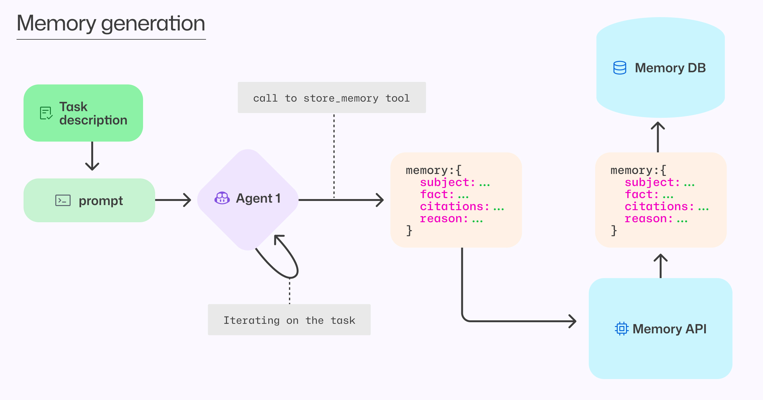
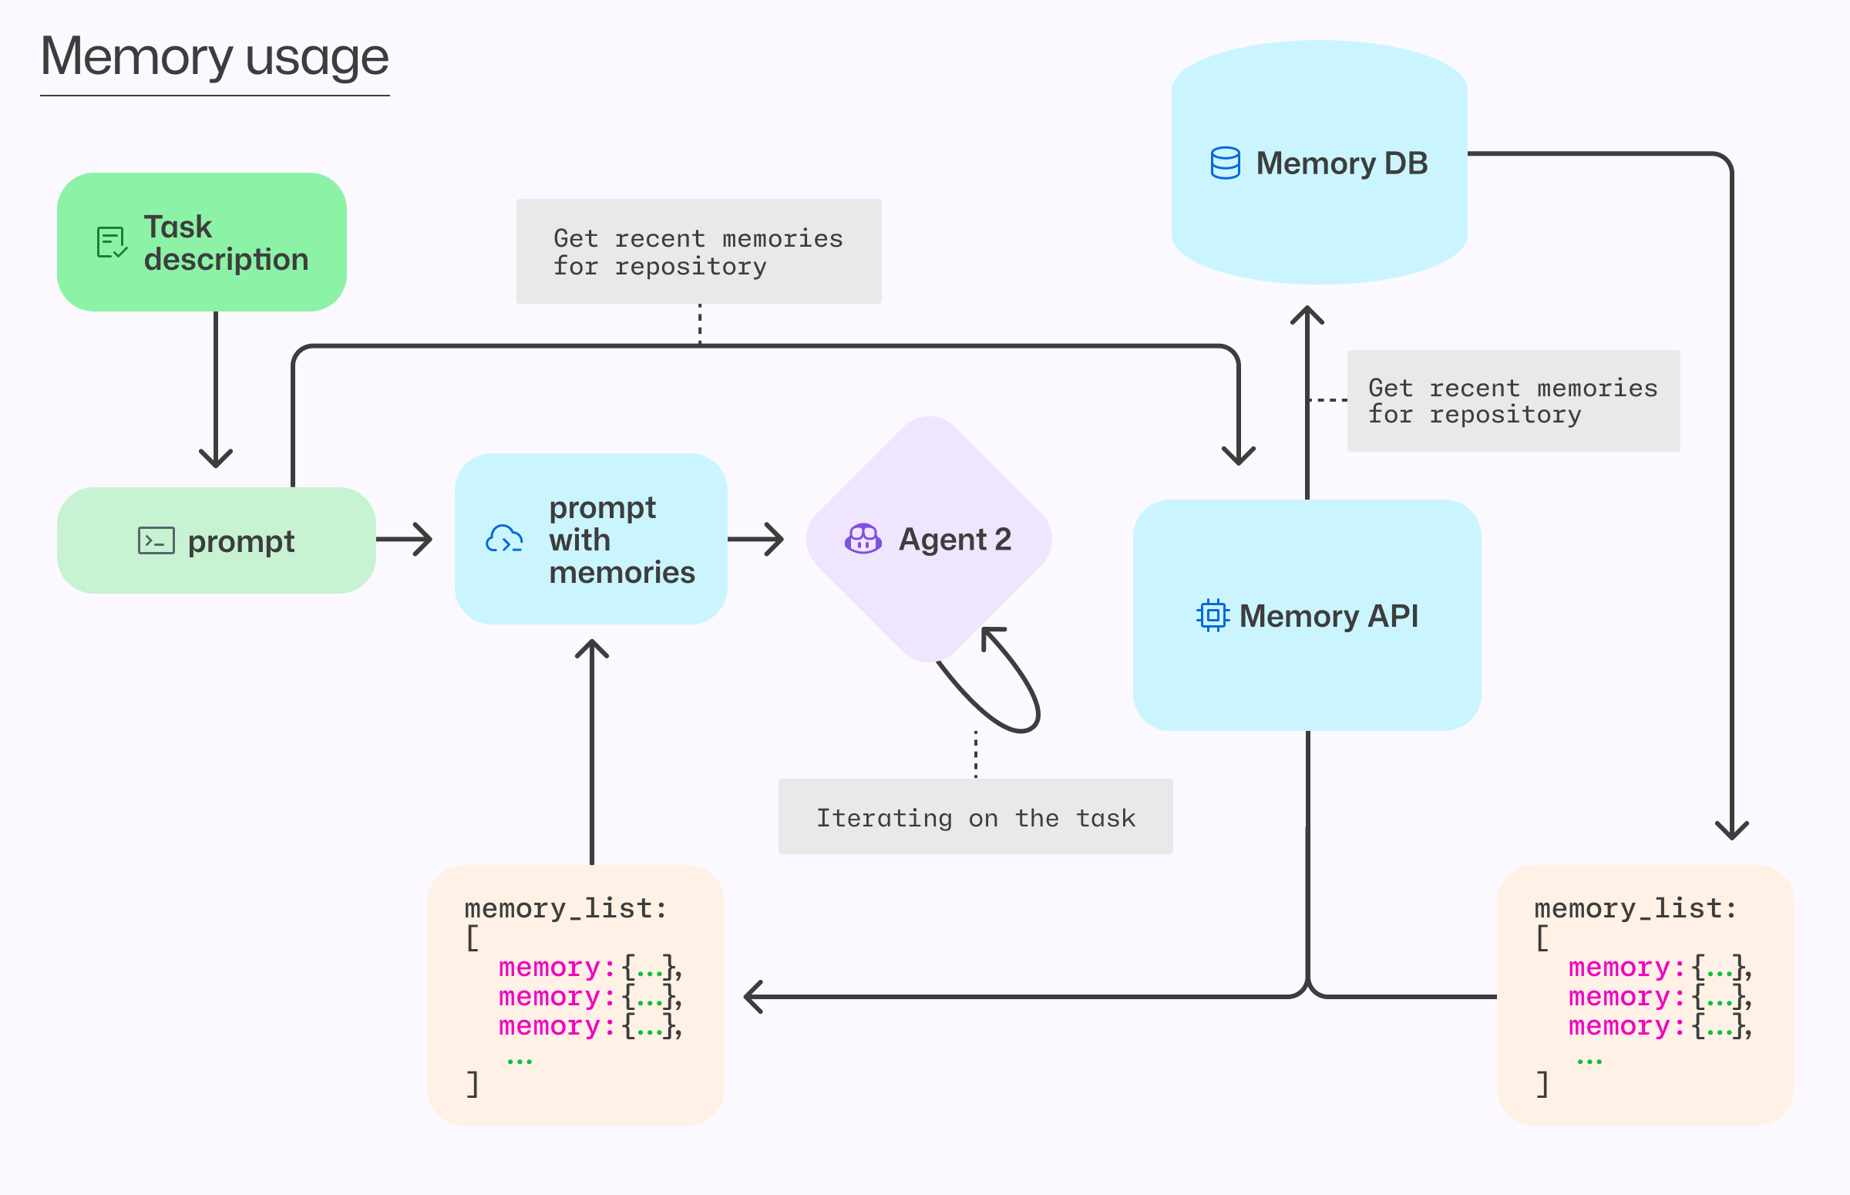
Memory in production: GitHub Copilot
All memories include citations, which are verified for accuracy before memories are used.
A memory which can no longer be verified is removed.
Learn more:
https://github.blog/ai-and-ml/github-copilot/building-an-agentic-memory-system-for-github-copilot/

Slide 26
📚 Knowledge

Slide 27
Knowledge retrieval
The agent retrieves knowledge before asking the LLM to call tools.
Why not just use a tool to retrieve knowledge?
In many scenarios, the agent always needs domain-specific knowledge to ground its response, so it's unnecessary to ask an LLM to decide to use the tool.
🛠️ Tools
Input
LLM
Agent
Response
search with input
relevant knowledge
Knowledge store

Slide 28
Knowledge retrieval from SQLite database
agent-framework
Create a subclass of BaseContextProvider to retrieve data for the given input:
class SQLiteKnowledgeProvider(BaseContextProvider):
async def before_run(self, *, agent, session, context, state):
user_text = context.input_messages[-1].text
results = self._search(user_text)
if results:
context.extend_messages(self.source_id,
[Message(role="user", text=self._format_results(results))])
agent = Agent(client=client,
instructions=("You are an outdoor-gear shopping assistant."),
context_providers=[knowledge_provider])
response = await agent.run("Do you have anything for kayaking?")
Full example: agent_knowledge_sqlite.py

Slide 29
Improve retrieval with hybrid search
Keyword search
protection from rain on rocky paths
1 | TrailBlaze Hiking Boots
2 | SummitPack 40L Backpack
Reciprocal Rank Fusion
(RRF)
1 | TrailBlaze Hiking Boots
2 | SummitPack 40L Backpack
3 | ArcticShield Down Jacket
Vector search
1 | TrailBlaze Hiking Boots
2 | ArcticShield Down Jacket
3 | SummitPack 40L Backpack

Slide 30
Knowledge retrieval from PostgreSQL
agent-framework
PostgreSQL can do a hybrid search with an embedding model and SQL query:
WITH semantic_search AS (
SELECT id, RANK() OVER (ORDER BY embedding <=> %(embedding)s::vector(256)) AS rank
FROM products
ORDER BY embedding <=> %(embedding)s::vector(256)
LIMIT 20
),
keyword_search AS (
SELECT id, RANK() OVER (ORDER BY ts_rank_cd(
to_tsvector('english', name || ' ' || description), query) DESC)
FROM products, plainto_tsquery('english', %(query)s) query
WHERE to_tsvector('english', name || ' ' || description) @@ query
ORDER BY ts_rank_cd(...) DESC
LIMIT 20
)
SELECT
COALESCE(semantic_search.id, keyword_search.id) AS id,
COALESCE(1.0 / (60 + semantic_search.rank), 0.0) +
COALESCE(1.0 / (60 + keyword_search.rank), 0.0) AS score
FROM semantic_search
FULL OUTER JOIN keyword_search ON semantic_search.id = keyword_search.id
ORDER BY score DESC
LIMIT 3
Full example: agent_knowledge_postgres.py

Slide 31
Improve retrieval for multi-turn conversations
Conversation
Tip: Use a query rewriting step when the input is an entire conversation, as the final message may be missing important context.
i need protection from rain on rocky paths.
Check out our Down Jacket and Hiking Boots!
"Suggest a search query based on this conversation"
Rewritten query
protective jackets and boots for hiking in snow
Knowledge store
what similar gear do you have for snowy situations?
LLM
search

Slide 32
Query rewriting in a context provider
agent-framework
Use an LLM to rewrite the query based off the user/agent messages so far:
class PostgresQueryRewriteProvider(BaseContextProvider):
async def before_run(self, agent, session, context, state):
conversation = [
m for m in context.get_messages() + context.input_messages
if m.role in ("user", "assistant") and m.text]
search_query = await self._rewrite_query(conversation)
results = self._search(search_query)
if results:
context.extend_messages(self.source_id,
[Message(role="user", text=self._format_results(results))])
Full example: agent_knowledge_pg_rewrite.py

Slide 33
Knowledge retrieval with Azure AI Search
Azure AI Search has a knowledge base feature which has query rewriting and hybrid search built-in, plus multi-source selection and a reflection step.
Knowledge sources
Output
Search Indexes
Merged results
Search
Input
Query planning
Query 1
OneLake
Conversation
Activity log
Query 2
SharePoint
Answer synthesis
Bing
Iterative retrieval
Search step uses hybrid search with semantic re-ranking when supported by the knowledge source
Learn more:
Python+AI RAG stream: aka.ms/pythonai/resources
Ignite talk on Agentic RAG with Azure AI Search: aka.ms/agenticrag/ignite/video
Notes:
Before the search step:
Query rewriting ("what do you have for kayaking?" → "kayaking gear")
Multiple knowledge sources with source selection ("kayaking" → "outdoor_products_db")
After the results return:
Re-ranking model (["paddle", "boat"] → ["boat", "paddle"])
Reflection and iterative search ("results not good enough?" → "search again!")
You can also implement many techniques implementing retrieval as a tool!

Slide 34
Knowledge retrieval from Azure AI Search
agent-framework
Use the built-in AzureAISearchContextProvider to retrieve from a knowledge base:
from agent_framework.azure import AzureAISearchContextProvider
search_provider = AzureAISearchContextProvider(
endpoint=SEARCH_ENDPOINT, credential=DefaultAzureCredential(),
knowledge_base_name=KNOWLEDGE_BASE_NAME, mode="agentic")
agent = Agent(
client=client,
instructions="You are a helpful shopping assistant.",
context_providers=[search_provider])
async with search_provider:
session = agent.create_session()
response = await agent.run("What interior paint do you have?",
session=session)
response = await agent.run("What supplies do I need to apply it?",
session=session)
Full example: agent_knowledge_aisearch.py

Slide 35
Context management

Slide 36
Context window
The context window of an LLM is the amount of input tokens that an LLM can process at a given time.
Context windows have been steadily increasing over time:
Model | Release date | Context window (tokens)
GPT‑3 | 2020 | 2K
GPT‑3.5 Turbo | Feb 2024 | 4K-16K
GPT‑4 | Mar 2023 | 8K-32K
GPT‑4 Turbo | Dec 2023 | 128K
Claude 3 (Sonnet/Opus) | Feb 2025 | 200K
Claude Opus 4.6 | Feb 2026 | 1M

Slide 37
Do we still need to worry about context size?
  Absolutely!
1
  The context windows are
  finite (128K-2M)
Accuracy
2
  When an LLM receives too much information, it can get easily distracted by irrelevant details.
3
  The more tokens you send, the higher the cost, the slower the response.
Number of documents in input context
Source: Lost in the Middle
See also: Context rot research from Chroma

Slide 38
Context compaction with summarization
Context window: 200K
Context window: 200K
Summary of past messages
25%
"Summarize..."
25%
Implementation details:
How often to summarize?
What's most important to summarize?
Do you store original messages for later?
LLM
50%
50%
75%
75%
100%
100%

Slide 39
Summarization middleware
agent-framework
We can subclass AgentMiddleware to summarize messages and replace them.
agent.run("user message")
SummarizationMiddleware
"Summarize..."
context tokens > threshold?
LLM
BEFORE RUN:
AGENT RUN:
call_next()
messages = [summary]
AFTER RUN:
context tokens += response tokens

Slide 40
Summarization middleware
agent-framework
class SummarizationMiddleware(AgentMiddleware):
async def process(self, context, call_next):
# Before the agent runs
if context.session and self.context_tokens > self.token_threshold:
history = context.session.state["memory"]["messages"]
summary = await self._summarize(history) # LLM call
context.session.state["memory"]["messages"] =
[Message(role="assistant", text=f"[Summary]\n{summary}")]
self.context_tokens = 0
await call_next() # Runs the standard agent loop
# After the agent runs
if context.result and context.result.usage_details:
self.context_tokens += context.result.usage_details["total_token_count"]
Full example: agent_summarization.py

Slide 41
Context reduction with subagents
A single agent is risky...
Better: Coordinator agent calls sub-agents
🤖
Coordinator agent
🤖
Agent
LLM
LLM
🤖
10K summary
Sub-agent
LLM
20K
40K
60K
list_files
read_file
search
20K
40K
60K
list_files
read_file
search
😳 Context can explode due to large tool call results growing over time
Sub-agent returns a summary of tool call results.
Notes:
Sub-agents: Agent calls a sub-agent that gets the relevant context and then only provides the summary version that's helpful for the main task
(See deep-agents in Langchain)

Slide 42
Coordinator agent with sub-agents
agent-framework
# Sub-agent: researches codebase in its own isolated context
research_agent = Agent(client=client,
instructions="Read and search files, return a concise summary under 200 words.",
tools=[list_project_files, read_project_file, search_project_files],
)
@tool
async def research_codebase(question: str) -> str:
"""Delegate research to the sub-agent. Returns only a summary."""
response = await research_agent.run(question)
return response.text
# Coordinator agent: only sees summaries, never raw file contents
coordinator = Agent(client=client,
instructions="Answer questions about code. Use research_codebase to investigate.",
tools=[research_codebase])
Full example: agent_with_subagent.py

Slide 43
Context reduction with subagents: Token usage
The coordinator's context window stays small, despite sub-agent using more tokens. In multi-turn conversations, this difference would compound with each turn.
Single agent
6,714
1,598
8,312
Coordinator agent | Sub-agent
623 | 8,494
514 | 580
1,137 | 9,074
vs.
Input tokens
Output tokens
Total tokens
The final answer returned was a high-quality answer in both scenarios.
Notes:
Sub-agents: Agent calls a sub-agent that gets the relevant context and then only provides the summary version that's helpful for the main task
(See deep-agents in Langchain)

Slide 44
When to use sub-agents?
✅ Use sub-agents when...
Tools return large outputs
Task requires multiple chained tool calls
Main agent has multiple responsibilities
Long-running, multi-turn conversations
Sub-tasks need specialized instructions
❌ Skip sub-agents when...
Tool responses are small and simple
Single tool call gets the answer
Main agent needs to see raw tool output
Low latency is critical (extra LLM round-trip)
Notes:
Large outputs: The sub-agent absorbs raw data (file contents, search results) and returns only a summary. Our demo showed 6,714 input tokens without vs 623 with — 10.8x reduction.
Multi-step research: When answering requires several chained tool calls, the sub-agent isolates all intermediate work. The coordinator never sees the chain.
Multiple responsibilities: If the coordinator also handles planning, user interaction, or other tools, keeping its context clean helps it stay focused and reduces confusion (we saw redundant tool calls in the bloated version).
Multi-turn: Context bloat compounds across turns. Sub-agents prevent per-turn tool output from accumulating in history.
Specialized instructions: A research sub-agent can be told "return < 200 words" while a coding sub-agent gets "write complete implementations."
Skip for short responses: The overhead of an extra LLM round-trip isn't worth it for a tool that returns 50 tokens.
Skip when raw output needed: If the main agent must review exact code before editing it, isolating it loses necessary detail.
Cost tradeoff: Our test showed ~23% more total tokens with sub-agents (10,211 vs 8,312), but the coordinator's context was 91% smaller.

Slide 45
Next steps
Register:
https://aka.ms/PythonAgents/series
Watch past recordings:
aka.ms/pythonagents/resources
Join office hours after each session in Discord:
aka.ms/pythonai/oh
🛠️ Feb 24: Building your first agent in Python
🧠 Feb 25: Adding context and memory to agents
📊 Feb 26: Monitoring and evaluating agents
🔀 Mar 3: Building your first AI-driven workflows
🕸️ Mar 4: Orchestrating advanced multi-agent workflows
🙋🏽 Mar 5: Adding a human-in-the-loop to workflows

