Slide 1
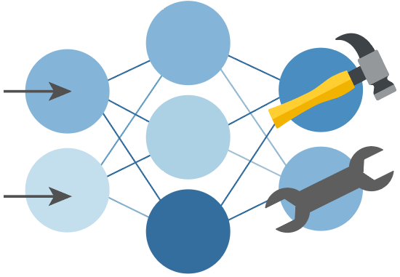

Python + Agents
🛠️ Feb 24: Building your first agent in Python
🧠 Feb 25: Adding context and memory to agents
📊 Feb 26: Monitoring and evaluating agents
🔀 Mar 3: Building your first AI-driven workflows
🕸️ Mar 4: Orchestrating advanced multi-agent workflows
🙋🏽 Mar 5: Adding a human-in-the-loop to workflows
🔗 Register at aka.ms/PythonAgents/series

Slide 2
Python + Agents
🔀 Building your first AI-driven workflows
aka.ms/pythonagents/slides/workflows
Pamela Fox
Python Cloud Advocate
www.pamelafox.org

Slide 3
Today we'll cover...
Workflows: executors, edges, messages, and outputs
Building a basic sequential workflow
Using agents as workflow executors
Visualizing workflow runs with DevUI
Branching with conditional edges and switch-case routing
Structured outputs for more reliable workflow routing
Workflow state management
Full-stack web application with an agentic workflow

Slide 4
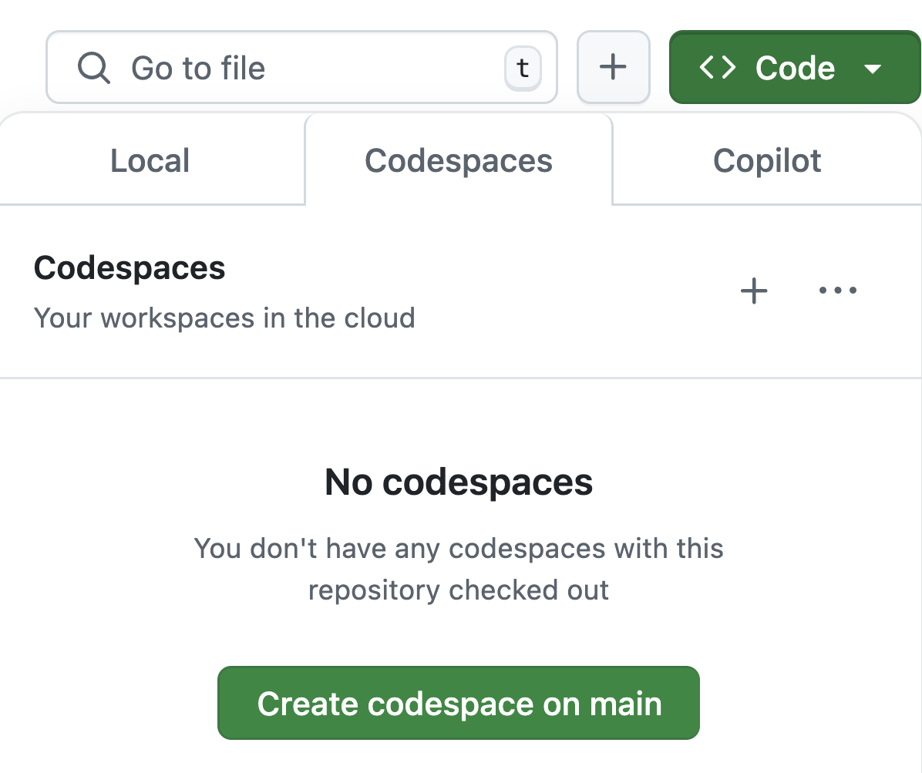
Want to follow along?
1. Open this GitHub repository:
aka.ms/python-agentframework-demos
2. Use "Code" button to create a GitHub Codespace:
3. Wait a few minutes for Codespace to start up ⏱️

Slide 5
Recap: What's an agent?
🤖
Agent
An AI agent uses an LLM to run tools in a loop to achieve a goal.
Input
👤
🛠️
Tools
LLM
🥅
Goal

Slide 6
Workflows

Slide 7
What's a workflow?
An agentic workflow is any flow that involves an agent at some point,
typically to handle decision making or answer synthesis.
Processing
or
Data Lookup
🤖
Processing
or
Data Lookup
Input
Agent
Output
Tool
Tool
Not all calls in our systems should be agentic!
Every call to an LLM increases the non-determinism of a system and possibility of failure or safety risk. 😬

Slide 8
Anatomy of a workflow
agent-framework
A workflow is a graph with Executor nodes and edges between them:
Input
Executor
edge
Executor
edge
Executor
Output
Each executor subclass defines handler methods that receive messages and may send messages to next executor and/or yield outputs:
class SampleExecutor(Executor):
@handler
async def sample_handler(self, text: str, ctx: WorkflowContext[str]):
await ctx.send_message(text.upper())
class OutputExecutor(Executor):
@handler
async def sample_handler(self, text: str, ctx: WorkflowContext[Never, str]):
await ctx.yield_output(text)

Slide 9
Building a workflow
agent-framework
Use WorkflowBuilder() to connect instances of Executor() subclasses:
from agent_framework import WorkflowBuilder
extract = ExtractExecutor(id="extract")
chunk = ChunkExecutor(id="chunk")
embed = EmbedExecutor(id="embed")
workflow = WorkflowBuilder(start_executor=extract)
.add_edge(extract, chunk)
.add_edge(chunk, embed).build()
events = await workflow.run(pdf_path)
outputs = events.get_outputs()
Input
ExtractExecutor
ChunkExecutor
EmbedExecutor
Full example: workflow_rag_ingest.py
Output

Slide 10
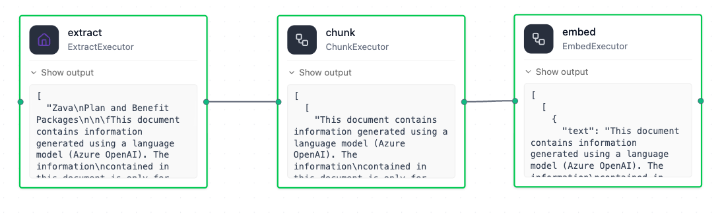
Visualize workflows with DevUI
agent-framework
Install the devui package:
agent-framework-devui
Point devui to the workflow:
from agent_framework.devui import serve
serve(entities=[workflow], auto_open=True)
Run the workflow and see the progress through each node:

Slide 11
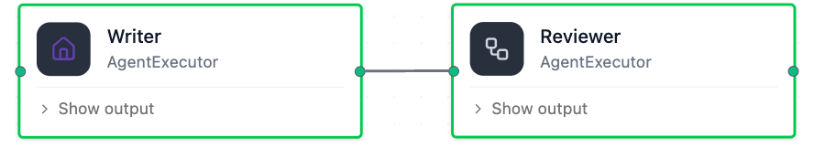
Workflows with Agent executors
agent-framework
Every Agent instance can also be used as an Executor in a workflow:
writer = Agent(client=client,
name="Writer",
instructions="You are a concise content writer.")
reviewer = Agent(client=client,
name="Reviewer",
instructions="Review content based on clarity, accuracy, and structure.")
workflow = WorkflowBuilder(start_executor=writer)
.add_edge(writer, reviewer)
.build()
Full example: workflow_agents.py
Notes:
Handoffs?

Slide 12
Streaming events from workflows
agent-framework
Emit events from workflows by specifying stream=True:
async for event in workflow.run(prompt, stream=True):
if event.type == "started":
print(f"[started] for workflow {workflow.name}")
elif event.type == "executor_invoked":
print(f"[executor_invoked] from executor {event.executor_id}")
elif event.type == "output" and isinstance(event.data, AgentResponseUpdate):
print(event.data.text, end="", flush=True)
elif event.type == "executor_completed":
print(f"[executor_completed] from executor {event.executor_id}")
elif event.type == "executor_failed":
print(f"[executor_failed] from executor {event.executor_id}: {event.data}")
elif event.type == "error":
print(f"[error] {event.data}")
Full example: workflow_agents_streaming.py
Notes:
https://learn.microsoft.com/agent-framework/workflows/events

Slide 13
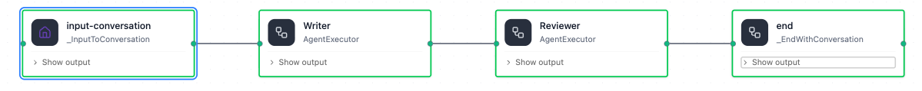
Built-in workflow builder: SequentialBuilder
agent-framework
If you're building a linear conversation pipeline, you can use SequentialBuilder:
from agent_framework.orchestrations import SequentialBuilder
workflow = SequentialBuilder(participants=[writer, reviewer])
.build()
The workflow assumes that participants accept and emit conversation-shaped data, so executors must be Agents or custom Executors that process conversations.
The extra start/end nodes normalize input and output to list[Message].
Full example: workflow_agents_sequential.py
Notes:
https://learn.microsoft.com/agent-framework/workflows/events

Slide 14
Branching workflows

Slide 15
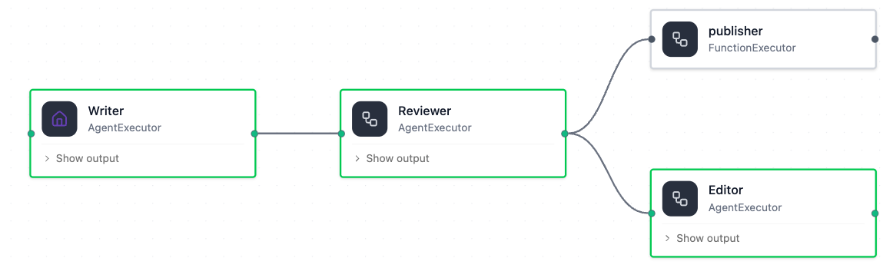
Workflow with conditional branching
agent-framework
Each edge in a graph can have a condition (function that returns True/False).
def needs_revision(message) -> bool:
return message.agent_response.text.upper().startswith("REVISION NEEDED")
def is_approved(message) -> bool:
return message.agent_response.text.upper().startswith("APPROVED")
workflow = (WorkflowBuilder(start_executor=writer)
.add_edge(writer, reviewer)
.add_edge(reviewer, publisher, condition=is_approved)
.add_edge(reviewer, editor, condition=needs_revision)
.build())
Full example: workflow_conditional.py
Notes:
Handoffs?

Slide 16
Text output is fragile for workflow control
System prompt for the Reviewer agent:
Your response MUST begin with exactly one of these two tokens:
APPROVED — if the draft is clear, accurate, and well-structured.
REVISION NEEDED — if it requires improvement.
Condition functions that route based on Reviewer response:
def needs_revision(message) -> bool:
return message.agent_response.text.upper().startswith("REVISION NEEDED")
def is_approved(message) -> bool:
return message.agent_response.text.upper().startswith("APPROVED")
What can go wrong?
Result:
Leading whitespace/newline/prefix | Review result: APPROVED | ⁉️ No condition matched
Localization | APROBADO | ⁉️ No condition matched
False positive approval | APPROVED, but major issues remain.. | 😱 Routes to wrong path
Mixed output | APPROVED....REVISION REQUIRED... | 🤔 Unclear intent
Notes:
Handoffs?

Slide 17
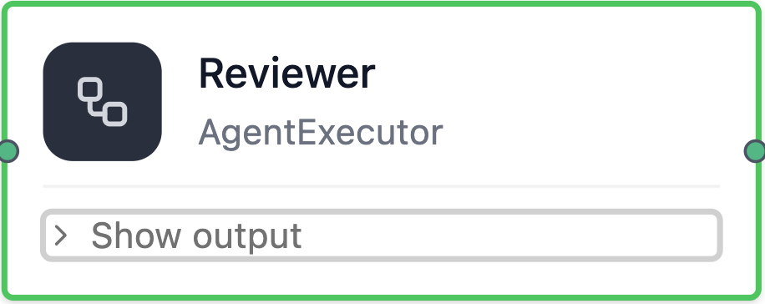
Unstructured text vs. structured output
The default output for an LLM is free text:
If an LLM supports structured outputs, you can force output to conform to schema:
REVISION NEEDED
Problems to fix
- Remove em dashes. Replace each "—" with a comma, semicolon, or parentheses.".
{
"decision": "REVISION NEEDED",
"feedback": "Problems to fix: Remove em dashes. Replace each "—" with a comma, semicolon, or parentheses."
}
Notes:
Handoffs?

Slide 18
Using structured outputs for workflow decisions
agent-framework
Specify response_format for Agent and convert response to that model:
class ReviewDecision(BaseModel):
decision: Literal["APPROVED", "REVISION_NEEDED"]
feedback: str
final_post: str | None = None
reviewer = Agent(client=client,
name="Reviewer",
instructions=("You are a strict content reviewer."
"If draft is ready, set decision=APPROVED and include final post in final_post. "
"If it needs changes, set decision=REVISION_NEEDED and provide feedback."),
response_format=ReviewDecision)
def is_approved(message: Any) -> bool:
result = ReviewDecision.model_validate_json(message.agent_response.text)
return result.decision == "APPROVED"
Full example: workflow_conditional_structured.py
Notes:
Handoffs?

Slide 19
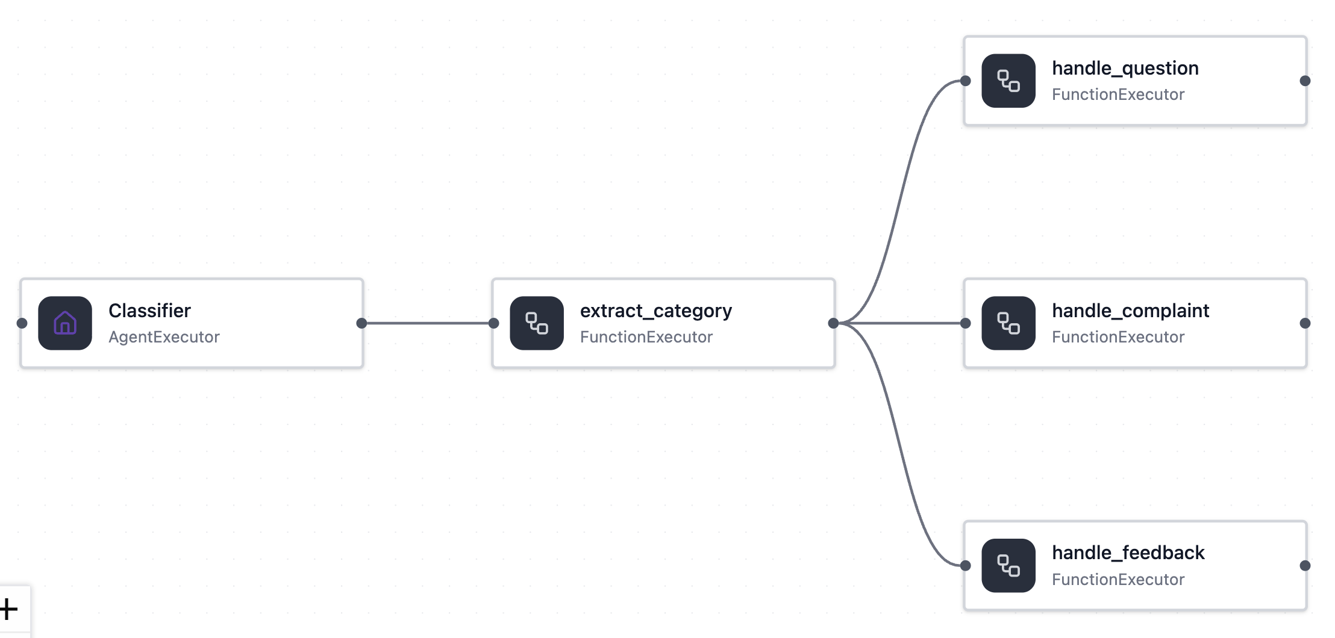
Category-based routing with structured outputs
agent-framework
category=="Question":
how do I reset my password?
category=="Complaint":
{
"category": "Question",
"reasoning": "The input is asking a question."
}
Default:
Notes:
Handoffs?

Slide 20
Using switch-case edges in workflows
agent-framework
Add a switch-case edge group with an executor that categorizes output:
classifier = Agent(..., response_format=ClassifyResult)
@executor(id="extract_category")
async def extract_category(response, ctx):
result = ClassifyResult.model_validate_json(response.agent_response.text)
await ctx.send_message(result)
workflow = (WorkflowBuilder(start_executor=classifier)
.add_edge(classifier, extract_category)
.add_switch_case_edge_group(extract_category,
[Case(condition=is_question, target=handle_question),
Case(condition=is_complaint, target=handle_complaint),
Default(target=handle_feedback)])
.build())
Full example: workflow_switch_case.py
Notes:
Handoffs?

Slide 21
State management

Slide 22
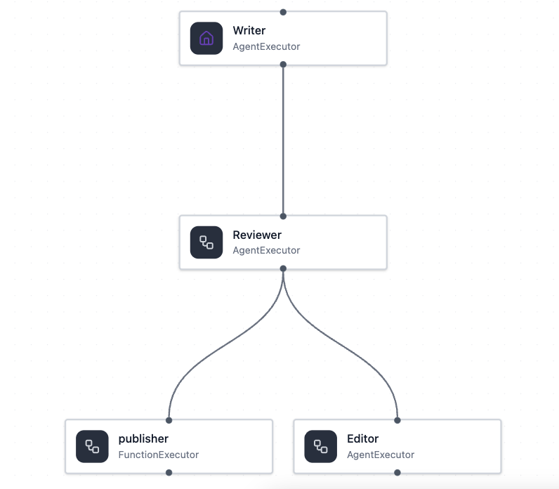
When do we need workflow state?
Without state:
With state:
stores
"These are 5 reasons why..."
state:
key | value
post_text | "These are 5 reasons why..."
{
"decision": "APPROVED",
"post_text": "These are 5.."
}
{
"decision": "APPROVED"
}
reads
Reviewer must carry content that it didn't produce, just to pass it downstream.
Reviewer only decides. Draft is stored once and read by any step that needs it.
Notes:
Handoffs?

Slide 23
Storing and accessing state in workflows
agent-framework
@executor(id="store_post_text")
async def store_post_text(response, ctx):
ctx.set_state("post_text", response.agent_response.text.strip())
await ctx.send_message(response)
@executor(id="publisher")
async def publisher(response, ctx):
content = str(ctx.get_state("post_text", "")).strip()
await ctx.yield_output(f"✅ Published:\n\n{content}")
workflow = (WorkflowBuilder(start_executor=writer, max_iterations=8)
  .add_edge(writer, store_post_text)
  .add_edge(store_post_text, reviewer)
  .add_edge(reviewer, publisher, condition=is_approved)
  .add_edge(reviewer, editor, condition=needs_revision)
  .add_edge(editor, store_post_text)
  .build())
store state
access state
Full example: workflow_conditional_state.py
Notes:
Handoffs?

Slide 24

⚠️ Shared workflow state leaks between requests
Be careful about using a shared Workflow instance across multiple runs:
workflow = WorkflowBuilder(start_executor=writer, ...).build()
stores
state:
accesses
key | value
post_text | "These are 5 reasons why..."
stores
accesses
If two runs execute in parallel, they can run into a race condition!
Notes:
Handoffs?

Slide 25
⚠️ Shared agents accumulate conversation history
Be careful about using a module-level Agent instance shared across workflow runs:
writer = Agent(...)
workflow = WorkflowBuilder(start_executor=writer, ...).build()
Run 1: "Write a post about AI jobs"
user: "Write a post about AI jobs"
assistant: "AI agents are transforming..."
history:
✅ Published: "AI agents are transforming..."
Run 2: "Write a post about remote work"
R1
user: "Write a post about AI jobs"
assistant: "AI agents are transforming..."
user: "Write a post about remote work"
assistant: "Remote jobs are at risk due to AI.."
R1
✅ Published: "Remote jobs are at risk due to AI..."
Notes:
Handoffs?

Slide 26
State isolation via factory functions
agent-framework
Use a factory function to create Agent instances and build the Workflow:
def create_workflow():
writer = Agent(name="Writer", ...)
reviewer = Agent(name="Reviewer", ...)
editor = Agent(name="Editor", ...)
return (WorkflowBuilder(start_executor=writer, max_iterations=8)
.add_edge(writer, store_post_text)
.add_edge(store_post_text, reviewer)
.add_edge(reviewer, publisher, condition=is_approved)
.add_edge(reviewer, editor, condition=needs_revision)
.add_edge(editor, store_post_text)
.build())
workflow = create_workflow(client)
events = await workflow.run(prompt)
Full example: workflow_conditional_state_isolated.py
Notes:
Handoffs?

Slide 27
Using workflows in applications

Slide 28
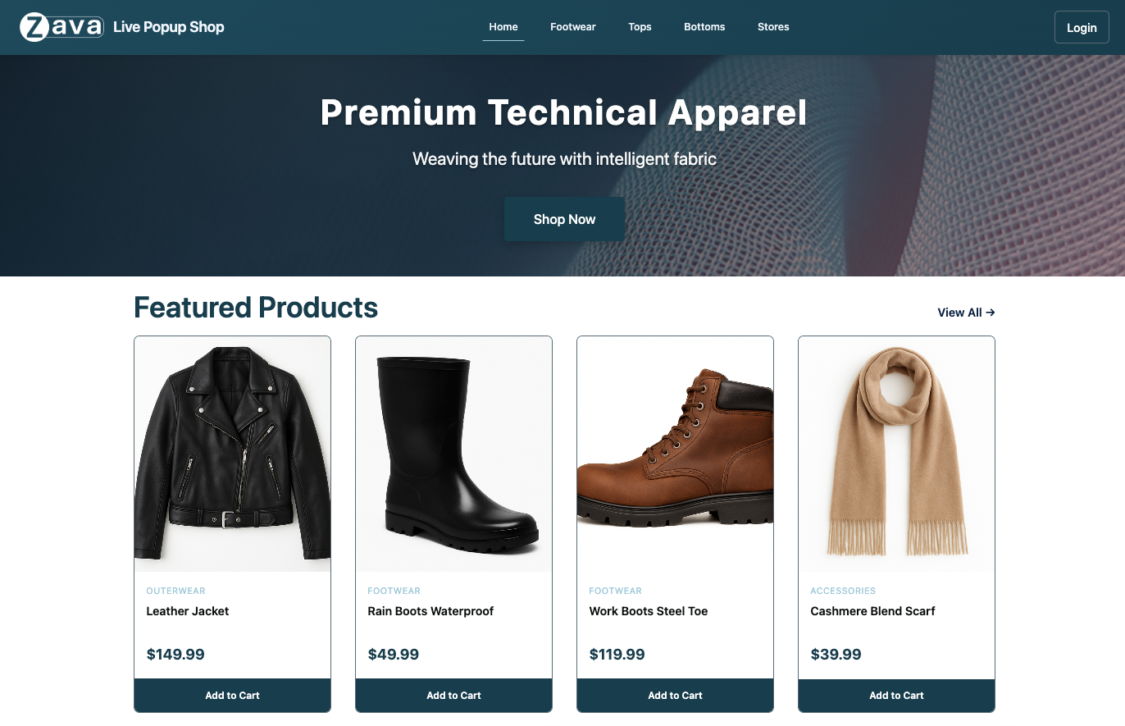
Retail shop with agentic workflows
Notes:
Handoffs?

Slide 29
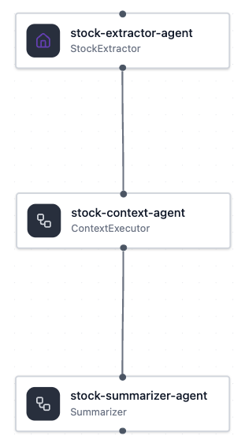
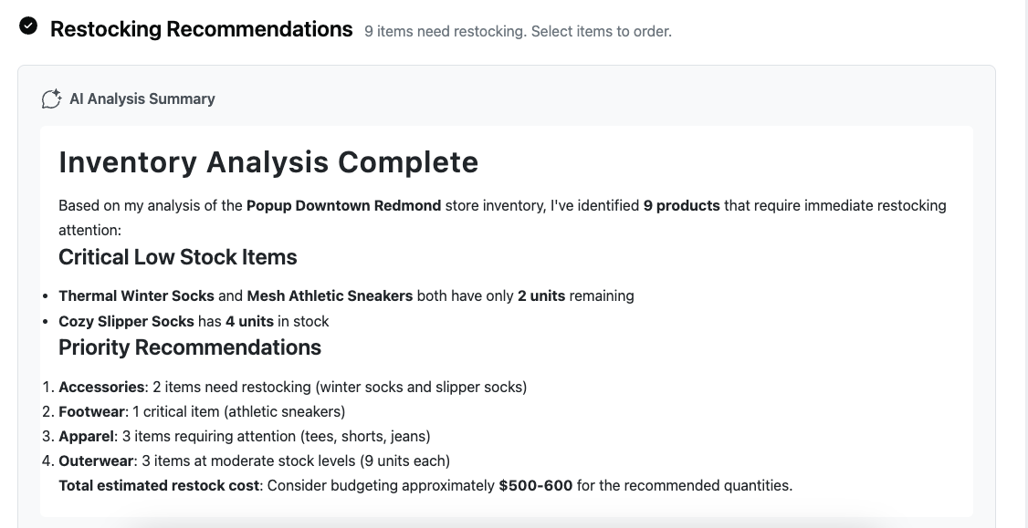
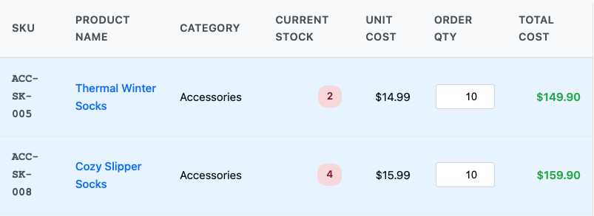
Sequential workflow: Restocking inventory
Inventory MCP
[Item A, Item B, Item D]
Structured Outputs
Prioritization
[Item B, Item D, Item A]
Summarization
"Based on my analysis..."
Notes:
Handoffs?

Slide 30
Next steps
Register:
https://aka.ms/PythonAgents/series
Watch past recordings:
aka.ms/pythonagents/resources
Join office hours after each session in Discord:
aka.ms/pythonai/oh
🛠️ Feb 24: Building your first agent in Python
🧠 Feb 25: Adding context and memory to agents
📊 Feb 26: Monitoring and evaluating agents
🔀 Mar 3: Building your first AI-driven workflows
🕸️ Mar 4: Orchestrating advanced multi-agent workflows
🙋🏽 Mar 5: Adding a human-in-the-loop to workflows

Slide 31
Appendix

Slide 32
Building a workflow
agent-framework
Or use the built-in
workflow builder subclasses
for common scenarios:
ConcurrentBuilder()
SequentialBuilder()
GroupChatBuilder()
HandoffBuilder()
MagenticBuilder()
Join us tomorrow to learn more!
https://learn.microsoft.com/agent-framework/user-guide/workflows

Slide 33
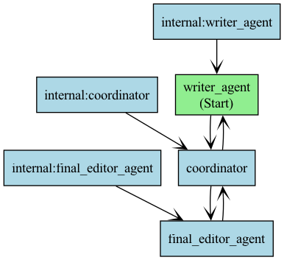
Visualize workflows with diagrams
agent-framework
from agent_framework import WorkflowViz
viz = WorkflowViz(workflow)
viz.export(format="svg")
print(viz.to_mermaid())
flowchart TD
writer_agent["writer_agent (Start)"];
final_editor_agent["final_editor_agent"];
coordinator["coordinator"];
internal_writer_agent --> writer_agent;
internal_final_editor_agent --> final_editor_agent;
internal_coordinator --> coordinator;
writer_agent --> coordinator;
coordinator --> writer_agent;
final_editor_agent --> coordinator;
coordinator --> final_editor_agent;
https://learn.microsoft.com/agent-framework/user-guide/workflows/visualization

Slide 34
Evaluate with a custom LLM-based judge
First define prompt and examples in a prompty file:
Rate the friendliness of the response between one to five stars using this scale:
One star: The response is unfriendly or hostile.
Two stars: The response is mostly unfriendly.
Three stars: The response is neutral.
Four stars: The response is mostly friendly.
Five stars: The response is very friendly.
...
Then run the evaluation from the prompty file:
friendliness_eval = load_flow(source="friendliness.prompty", model={"configuration": model_config})
friendliness_score = friendliness_eval(query=query, response=response)
Full example: quality_eval_custom.py

Slide 35
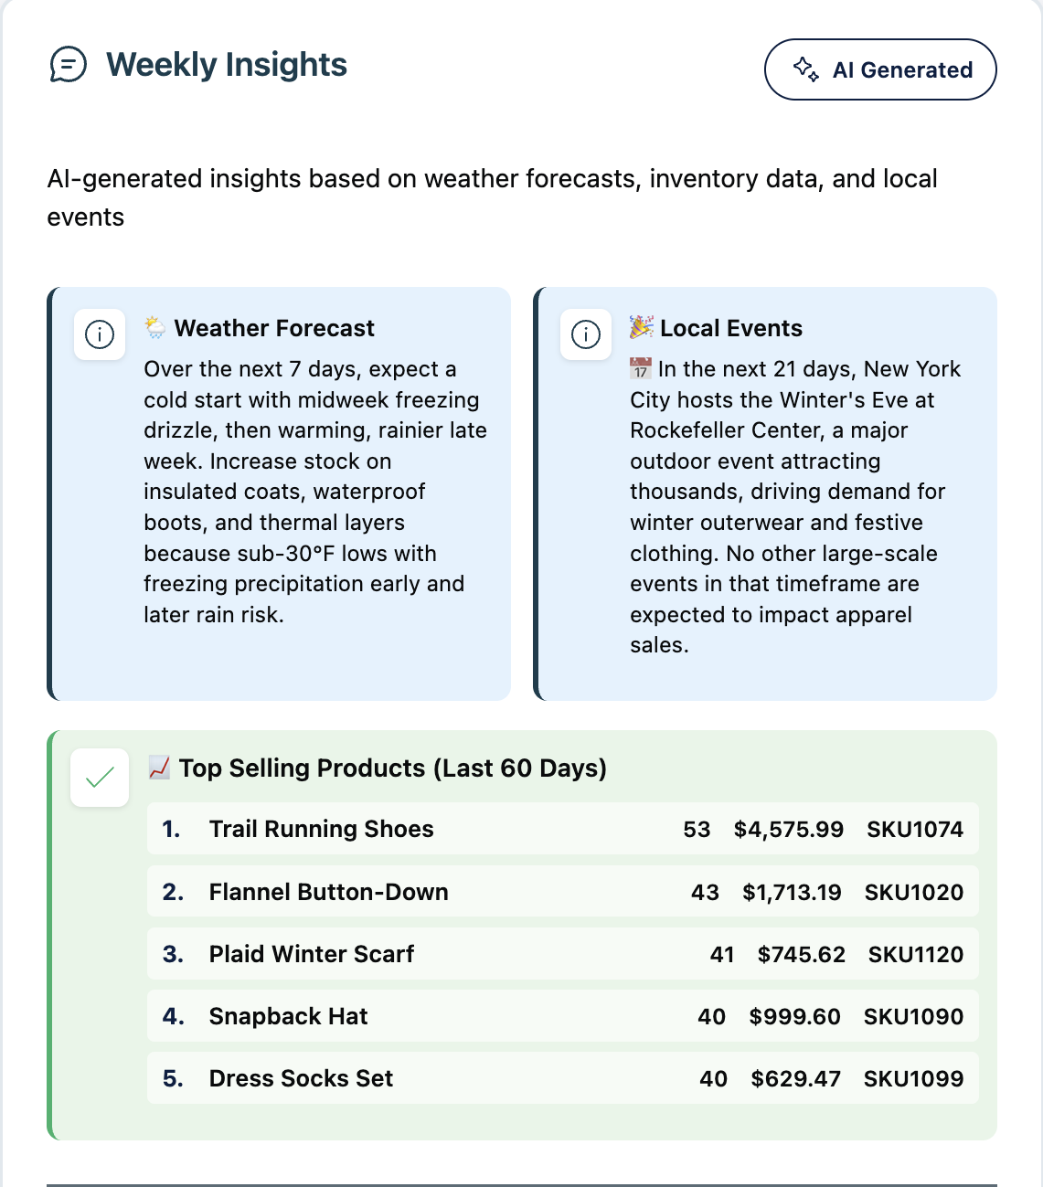
Sequential workflow: Restocking inventory
Inventory MCP
[Item A, Item B, Item D]
Structured Outputs
Prioritization
[Item B, Item D, Item A]
Summarization
"Based on my analysis..."
Notes:
Handoffs?

Slide 36
More built-in LLM-based evaluators
GroundednessEvaluator
SimilarityEvaluator
Query | Context | Response | Ground truth
RelevanceEvaluator
CoherenceEvaluator
FluencyEvaluator
Try them all: quality_eval_all_builtin_judges.py

