Slide 1
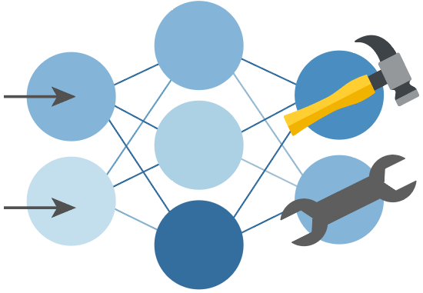

Python + Agents
🛠️ Feb 24: Building your first agent in Python
🧠 Feb 25: Adding context and memory to agents
📊 Feb 26: Monitoring and evaluating agents
🔀 Mar 3: Building your first AI-driven workflows
🕸️ Mar 4: Orchestrating advanced multi-agent workflows
🙋🏽 Mar 5: Adding a human-in-the-loop to workflows
🔗 Register at aka.ms/PythonAgents/series

Slide 2
Python + Agents
🙋🏽 Adding a human-in-the loop to workflows
aka.ms/pythonagents/slides/hitl
Pamela Fox
Python Cloud Advocate
www.pamelafox.org

Slide 3
Today we'll cover...
Why HITL matters for agents and workflows
Tool approval: gating sensitive operations
Requests and responses: structured human interaction
Checkpoints and resuming: durable HITL workflows
Handoff with HITL: interactive multi-agent routing
E2E application with workflows

Slide 4
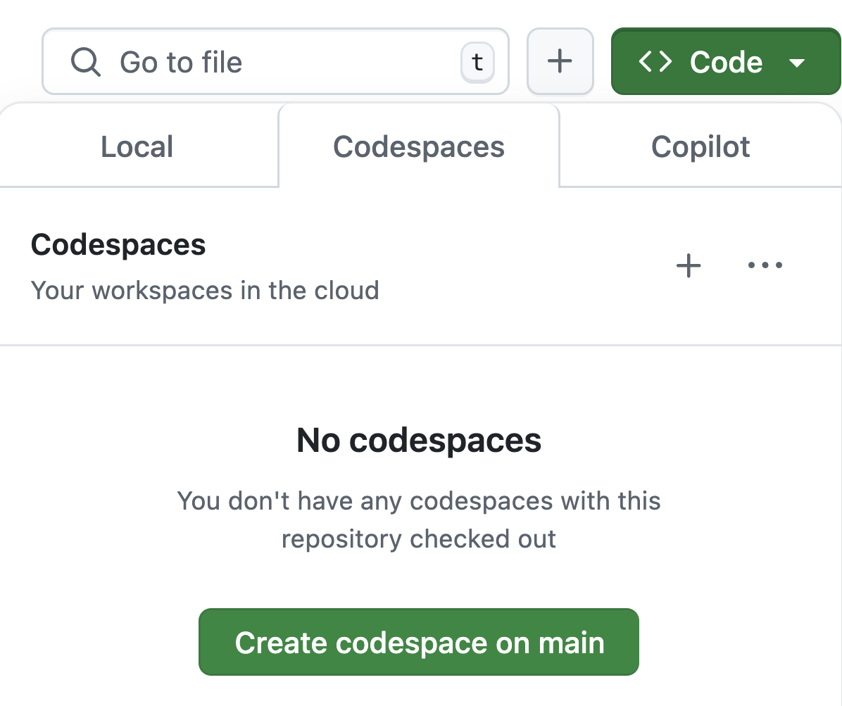
Want to follow along?
1. Open this GitHub repository:
aka.ms/python-agentframework-demos
2. Use "Code" button to create a GitHub Codespace:
3. Wait a few minutes for Codespace to start up ⏱️
4. Run git pull to ensure you have the latest changes

Slide 5
Recap: What's an agentic workflow?
An agentic workflow is a flow that involves an agent at some point, typically to handle decision making or answer synthesis.
🤖
Agent
Processing
or
Data Lookup
Processing
or
Data Lookup
Input
LLM
Output
Tool
Tool
In agent-framework, a workflow is a graph with Executor nodes and edges between:
Input
Executor
edge
Executor
edge
Executor
Output

Slide 6
Human-in-the-loop
If an agent wants to take an action, a human should often review it first.
👍🏼
Action
Event
Processing
or
Data Lookup
👩🏽‍💻
Agent
Discard
👎🏼

Slide 7
Why add a human in the loop?

Slide 8
Why add a human in the loop?
LLMs can produce uncertain, inconsistent, or incorrect outputs.
Human checkpoints provide:
🎯 Accuracy | Verify factual correctness before acting
🛡️ Safety | Gate sensitive operations (refunds, emails, deployments)
🤝 Trust | Users see what the system will do before it acts
📋 Compliance | Audit trail of human approvals for regulated workflows
🚦Control | Humans can redirect, refine, or halt a workflow at any point

Slide 9
HITL patterns in agent-framework
Tool approval | Sensitive tool calls must be approved before execution
Requests and responses | Workflow needs human input to continue (answers, choices, feedback)
Checkpoints & resuming | Long-running tasks where human may not be immediately available
Handoff with HITL | Dynamic multi-agent routing with interactive user input between handoffs
Notes:
Which are agents vs workflows?

Slide 10
Tool approval
https://learn.microsoft.com/agent-framework/agents/tools/tool-approval

Slide 11
When do we need tool approval?
Without approval:
Agent decides to send email
Tool executes automatically
Email sent (possibly wrong!)
With approval:
Agent wants to send email
Workflow pauses
Human reviews: "Send email?"
Human approves ✓ or rejects ✗
Tool executes only if approved
😬
😮‍💨
Consider requiring tool approval for:
Financial operations (refunds, purchases)
Communications (emails, messages)
Destructive operations (deletions, deployments)
Any irreversible action
Notes:
Executor A calls ctx.request_info() -> workflow pauses
Human responds -> @response_handler fires -> workflow resumes

Slide 12
Defining tools that require approval
Set approval_mode to either "always_require" or "never_require" (default):
@tool(approval_mode="never_require")
def lookup_receipt(
receipt_id: Annotated[str, "The receipt ID to look up"],
) -> dict[str, str]:
"""Look up a receipt by ID and return its details."""
...
@tool(approval_mode="always_require")
def submit_expense_report(
description: Annotated[str, "Description of the expense report"],
total_amount: Annotated[str, "Total amount to reimburse"],
receipt_ids: Annotated[str, "Comma-separated receipt IDs included"]
) -> str:
"""Submit an expense report for reimbursement. Requires approval."""
...
Full example: agent_tool_approval.py
Notes:
Full example: workflow_hitl_tool_approval.py

Slide 13
Handling tool approval in the event loop
Check if the agent's result contains any user_input_requests:
result = await agent.run(query)
while len(result.user_input_requests) > 0:
new_inputs: list[Any] = [query]
for request in result.user_input_requests:
func_call = request.function_call
new_inputs.append(Message("assistant", [request]))
approval = input(" Approve? (y/n): ").strip().lower()
approved = approval == "y"
new_inputs.append(Message("user",
[request.to_function_approval_response(approved)]))
result = await agent.run(new_inputs)
Full example: agent_tool_approval.py
Notes:
Full example: workflow_hitl_tool_approval.py

Slide 14
Requests and responses
https://learn.microsoft.com/agent-framework/workflows/requests-and-responses

Slide 15
Requests and responses in workflows
Executors can pause a workflow and ask for human input:
Application code
Workflow Executor
Human
workflow.run(msg)
ctx.request_info(data)
event.type == "request_info"
⏸️ Workflow pauses
prompt user
💬 provide input
workflow.run(responses)
@response_handler()
▶️ Workflow resumes
Notes:
The request_info/response cycle is driven by application code:
1. Executor calls ctx.request_info(request_data=..., response_type=str)
2. Workflow emits WorkflowEvent with type="request_info"
3. Application collects event, prompts user, gathers reply
4. Application calls workflow.run(responses={request_id: reply})
5. @response_handler receives the original request + user reply

Slide 16
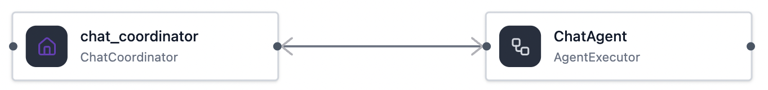
Simple chat with HITL: Workflow topology
In this workflow, the coordinator calls request_info until user replies "done":
Input
AgentExecutorRequest
LLM
AgentExecutorResponse (str)
Human
request_info
"done"
yield_output()
Output
Full example: workflow_hitl_requests.py
Notes:
"This diagram shows the most basic form of HITL routing: an unconditional pause.
Notice the request_info call happens every single turn. More importantly, look at
who makes the decision to stop. The human has two paths, one of which is typing 'done',
which triggers yield_output. Because the LLM is just generating raw text, it has
no way to reliably signal 'I am finished' to the workflow. So we have to put the
burden of the exit condition on the human."

Slide 17
Executor code for handling requests and responses
Executor calls request_info to request HITL and defines @response_handler to handle reply:
class ChatCoordinator(Executor):
@handler
async def on_agent_response(self, result: AgentExecutorResponse,
ctx: WorkflowContext) -> None:
await ctx.request_info(
request_data=UserPrompt(message=result.agent_response.text),
response_type=str)
@response_handler
async def on_human_reply(self, original_request: UserPrompt, reply: str,
ctx: WorkflowContext[AgentExecutorRequest, str]) -> None:
if reply.strip().lower() == "done":
await ctx.yield_output("Conversation ended.")
return
await ctx.send_message(
AgentExecutorRequest(messages=[Message("user", text=reply)],
should_respond=True), target_id=self._agent_id)
Full example: workflow_hitl_requests.py

Slide 18
App code for handling requests and responses
The app checks for "request_info" events, requests input(), runs workflow with responses:
stream = workflow.run(first_message, stream=True)
while True:
pending = {}
async for event in stream:
if event.type == "request_info":
pending[event.request_id] = event.data
elif event.type == "output":
print(f"\n{event.data}")
if not pending:
break
for request_id, request in pending.items():
print(f"\n🤖 Agent: {request.message}")
reply = input("💬 You (or 'done'): ")
pending[request_id] = reply
stream = workflow.run(stream=True, responses=pending)
Full example: workflow_hitl_requests.py
Notes:
"Why iterate over pending.items()?" — In this simple example there's always
exactly one request per turn. But the loop is the correct general pattern because:
(1) workflow.run(responses=...) expects a dict mapping request IDs to replies,
(2) other HITL patterns can produce multiple requests per turn (e.g., an agent
calling several approval-required tools at once, or concurrent executors each
emitting a request). The loop costs two extra lines and teaches the right idiom.

Slide 19
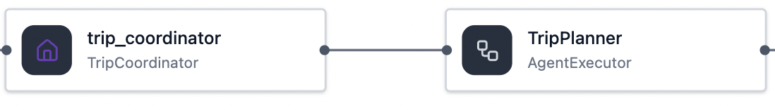
HITL with structured outputs: Workflow topology
In this workflow, the coordinator calls request_info based on agent's structured output:
Input
AgentExecutorRequest
LLM
response_format=
PlannerOutput
AgentExecutorResponse (PlannerOutput)
.status
"need_info"
"complete"
🙋🏽‍♂️ Human
request_info
yield_output()
Output
Full example: workflow_hitl_requests_structured.py
Notes:
"Contrast this with the previous topology. Here, we've moved the routing logic
off the human and given it to the agent. Notice the condition after the coordinator receives the response— the
framework now inspects the agent's structured output status first. The workflow
pauses for a request *only* if the LLM tells it to. And look at the human's role
on the left: they just answer questions. The exit branch on the right is now
controlled by the agent deciding it has gathered enough information to stop."

Slide 20
Agent definition with structured outputs
The agent must always respond with a status and either a question or itinerary:
class PlannerOutput(BaseModel):
status: Literal["need_info", "complete"]
question: str | None = None
itinerary: str | None = None
planner_agent = Agent(
name="TripPlanner",
instructions="You are a helpful trip planner.",
chat_client=client,
default_options={"response_format": PlannerOutput},
)
Full example: workflow_hitl_requests_structured.py
Notes:
"Now let's look at the agent itself.
We define a Pydantic model with two literal statuses: 'need_info' or 'complete'.
By passing this as the response_format, we are forcing the LLM to categorize
its own state. It will either ask a question, or provide the final itinerary.
This gives us the reliable routing hooks you just saw in the diagram."

Slide 21
Executor code for handling structured response
Executor calls request_info to request HITL based on the agent's structured response:
class TripCoordinator(Executor):
@handler
async def on_agent_response(self, result: AgentExecutorResponse,
ctx: WorkflowContext):
output: PlannerOutput = result.agent_response.value
if output.status == "need_info":
await ctx.request_info(
request_data=UserPrompt(message=output.question), response_type=str)
else:
await ctx.yield_output(output.itinerary)
@response_handler
async def on_human_answer(self, original_request: UserPrompt, answer: str,
ctx: WorkflowContext[AgentExecutorRequest, str]):
user_msg = await ctx.send_message(
AgentExecutorRequest(messages=[Message("user", text=answer)],
should_respond=True), target_id=self._agent_id)
Full example: workflow_hitl_requests_structured.py

Slide 22
Checkpoints and resuming
https://learn.microsoft.com/agent-framework/workflows/checkpoints

Slide 23
The need for checkpoints in HITL workflows
Without checkpoints:
Workflow pauses for human input
Human is offline
Process crashes or restarts
All progress lost!
With checkpoints:
Workflow pauses for human input
Human is offline
Checkpoint saved to disk 💾
Process exits
...hours later...
New process starts
Loads checkpoint from disk 📂
Human provides input
Workflow resumes where it left off
😬
😮‍💨
Notes:
Executor A calls ctx.request_info() -> workflow pauses
Human responds -> @response_handler fires -> workflow resumes

Slide 24
Workflow lifecycle with checkpoints
Process A
workflow.run(input)
ctx.request_info()
Process B
💾 Checkpoint saved
💾 checkpoints/
new_workflow.run(
checkpoint_id="chk1")
ID | value
chk1 | executor states pending requests messages shared state
Process exits
💾 Checkpoint restored
🔄 request_info event re-emitted
Workflow resumes
Notes:
Here's what happens under the hood. Process A runs the workflow until it hits
a request_info call. At that point, a checkpoint is saved to disk — that includes
executor states, pending messages, and the pending request itself. Process A can
now safely exit. Hours later, Process B starts up, creates a fresh workflow, and
calls run with just the checkpoint ID. The framework restores all the state and
re-emits the pending request_info event. From that point on, it's the same HITL
loop we already saw — collect the request, prompt the user, call run(responses=...).
The only new thing is that first call to restore from the checkpoint."

Slide 25
Configuring checkpoint storage for workflows
Agent framework provides InMemoryCheckpointStorage or FileCheckpointStorage
Set checkpoint_storage to a built-in storage or a custom storage class:
from agent_framework import FileCheckpointStorage
storage = FileCheckpointStorage(storage_path=CHECKPOINT_DIR)
workflow = (WorkflowBuilder(
start_executor=prepare_brief,
checkpoint_storage=storage)
.add_edge(prepare_brief, writer)
.add_edge(writer, review_gateway)
.add_edge(review_gateway, writer)
.build())
Full example: workflow_hitl_checkpoint.py

Slide 26
Resuming a workflow from checkpoint
When starting the process, check if there is a saved checkpoint for the workflow.
If so, pass the checkpoint_id in when running the workflow:
if checkpoint_id:
stream = workflow.run(checkpoint_id=checkpoint_id, stream=True)
else:
stream = workflow.run(brief, stream=True)
async for event in stream:
if event.type == "request_info":
pending[event.request_id] = event.data
elif event.type == "output":
print(f"\n✅ Workflow completed:\n{event.data}")
Full example: workflow_hitl_checkpoint.py
Your event processing loop does not change.
Any "request_info" events are re-emitted upon workflow restoration.
Notes:
We don't need any special resume logic in the event loop.
The framework re-emits the pending request_info, so your app picks it up
the same way it would on the first run. The only new line is
workflow.run(checkpoint_id=...) instead of workflow.run(message=...)."

Slide 27
Resuming a workflow from checkpoint
Implement on_checkpoint_save and on_checkpoint_restore on Executors,
to serialize any state specific to each instance.
class ReviewGateway(Executor):
def __init__(self, id: str, writer_id: str) -> None:
super().__init__(id=id)
self._writer_id = writer_id
self._iteration = 0
async def on_checkpoint_save(self) -> dict[str, Any]:
return {"iteration": self._iteration}
async def on_checkpoint_restore(self, state: dict[str, Any]):
self._iteration = state.get("iteration", 0)
Full example: workflow_hitl_checkpoint.py
Notes:
You only need to save state that changes during execution. Here, _iteration
starts at zero and increments each time the agent produces a draft. If we don't
checkpoint it, a resumed workflow would think it's on iteration zero again.
But notice we don't save writer_id — that's a constructor parameter that never
changes. When you resume, you rebuild the workflow from scratch with the same
constructor args, so those values are already set. on_checkpoint_save and
on_checkpoint_restore are only for runtime-mutated state that the constructor
wouldn't know about.

Slide 28
Designing your custom checkpoint storage
To store the checkpoints in any backend, implement CheckpointStorage protocol:
Method | Purpose
save(checkpoint) | Persist a snapshot, return ID
load(checkpoint_id) | Restore a snapshot by ID
delete(checkpoint_id) | Remove a snapshot
list_checkpoints(name) | Retrieve all snapshots for a workflow
list_checkpoint_ids(name) | Retrieve only snapshot IDs for a workflow
get_latest(name) | Retrieve most recent snapshot for a workflow
Built-in backends:
• FileCheckpointStorage: JSON files on disk
• InMemoryCheckpointStorage: In-process dict
Custom backends:
Redis, PostgreSQL, Cosmos DB, ...anything!
Notes:
The framework ships with two built-in backends: FileCheckpointStorage which
writes JSON files to disk, and InMemoryCheckpointStorage which is just a dict
in memory — great for tests, but obviously lost when the process exits.
CheckpointStorage is a Protocol, so you can implement these six methods for
any backend you want. Let's see what that looks like with Redis."

Slide 29
Custom checkpoint storage for workflows
To store the checkpoints in any backend, implement CheckpointStorage protocol:
id | workflow_name | timestamp | data
abc123 | content_review | 2026-03-03T00:38:15.893871 | {"state": {"brief": "Introduce our new..
def456 | content_review | 2026-03-03T00:38:28.940753 | {"state": {"brief": "Introduce our new..
ghi789 | content_review | 2026-03-03T00:38:29.207847 | {"pending_request_info_events": ...
Design decisions to consider:
How to scope checkpoints? | Per workflow name? Per user/session? e.g. workflow_name = "review:{user_id}"
How long to keep checkpoints? | Prune after completion? TTL? Keep N latest?
How large are checkpoints? | Checkpoints include full message history. Long conversations = large JSONB blobs.
Who can access checkpoints? | Row-level security? Separate tables per tenant?
Notes:
Before you write code, think about your schema. At minimum you need an ID,
the workflow name for filtering, and a timestamp for ordering. The data column
stores the encoded checkpoint as JSON — the framework handles serialization for you.
The harder questions are around scoping and lifecycle. In a multi-user app, do you
embed the user ID in the workflow name, or add a user_id column? How do you prune
old checkpoints? These are application-level decisions the framework doesn't make
for you.

Slide 30
Custom checkpoint storage with PostgreSQL
Implement all the required methods of CheckpointStorage protocol:
class PostgresCheckpointStorage:
async def save(self, checkpoint: WorkflowCheckpoint) -> str:
encoded = encode_checkpoint_value(checkpoint.to_dict())
async with await AsyncConnection.connect(self._conninfo) as conn:
await conn.execute(
"""INSERT INTO workflow_checkpoints (id, workflow_name, timestamp, data)
VALUES (%s, %s, %s, %s)""",
(checkpoint.checkpoint_id, checkpoint.workflow_name,
checkpoint.timestamp, json.dumps(encoded)))
return checkpoint.checkpoint_id
async def load(self, checkpoint_id: str) -> WorkflowCheckpoint:
async with await AsyncConnection.connect(self._conninfo) as conn:
row = await (await conn.execute(
"SELECT data FROM workflow_checkpoints WHERE id = %s", (checkpoint_id,),
)).fetchone()
return WorkflowCheckpoint.from_dict(decode_checkpoint_value(row["data"]))
Full example: workflow_hitl_checkpoint_pg.py
Notes:
With PostgreSQL, the implementation is even simpler than Redis. save is a
single INSERT ON CONFLICT. load is a SELECT by ID. list_checkpoints, get_latest,
and delete are all one-line SQL queries — no manual indexing needed. The database
handles ordering by timestamp, filtering by workflow name, and atomic updates.
It's a drop-in replacement for FileCheckpointStorage.

Slide 31
Handoff orchestration with HITL
https://learn.microsoft.com/agent-framework/workflows/orchestrations/handoff

Slide 32
Review: Handoff orchestration
HandoffBuilder is a built-in workflow where agents can handoff to each other.
Agent B
start agent
handoff
No edges are defined up front – routing emerges from conversation state.
Agent A
handoff
handoff
Agent C
Handoff is inherently interactive:
When an agent doesn't handoff, it requests user input
Workflow emits HandoffAgentUserRequest events
Application must respond for the workflow to continue
Notes:
We already saw concatenation with previous example

Slide 33
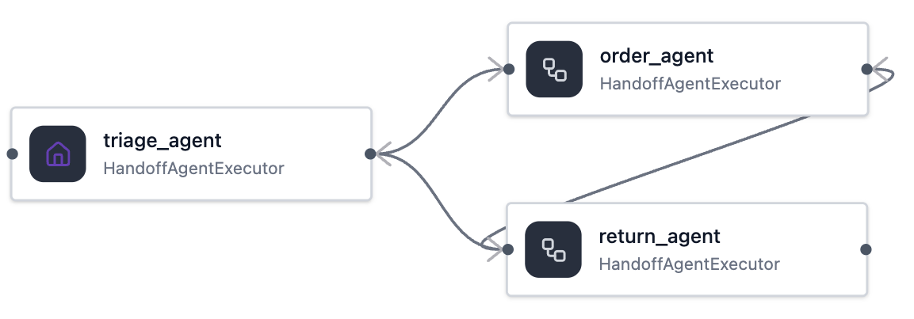
Configuring HandoffBuilder for interactivity
HandoffBuilder is interactive as long as you don't set with_autonomous_mode:
workflow = (HandoffBuilder(
name="customer_support",
participants=[triage_agent, order_agent, return_agent],
termination_condition=lambda conversation: (
len(conversation) > 0 and "goodbye" in conversation[-1].text.lower()))
.with_start_agent(triage_agent)
.build())
Full example: workflow_hitl_handoff.py

Slide 34
Handling HITL requests in HandoffBuilder
Handle all HandoffAgentUserRequest events and respond with user input:
responses: dict[str, Any] = {}
request_id = request_event.request_id
for request_event in pending:
if isinstance(request_event.data, HandoffAgentUserRequest):
agent_response = request_event.data.agent_response
for msg in agent_response.messages:
if msg.text:
print(f"🤖 {msg.author_name}: {msg.text}")
user_input = input("\n👤 You: ").strip()
if user_input.lower() in ("exit", "quit"):
responses[request_id] = HandoffAgentUserRequest.terminate()
else:
responses[request_id] = HandoffAgentUserRequest.create_response(user_input)
stream = workflow.run(responses=responses, stream=True)
Full example: workflow_hitl_handoff.py
Notes:
This is the simplest form of HITL with Handoff. Without autonomous mode,
every time an agent responds without handing off, the framework emits a
HandoffAgentUserRequest. Your app shows the agent's message and prompts
the user. You can also call terminate() to end the workflow early.
This is the default behavior — autonomous mode is the opt-in.

Slide 35
End-to-end application

Slide 36
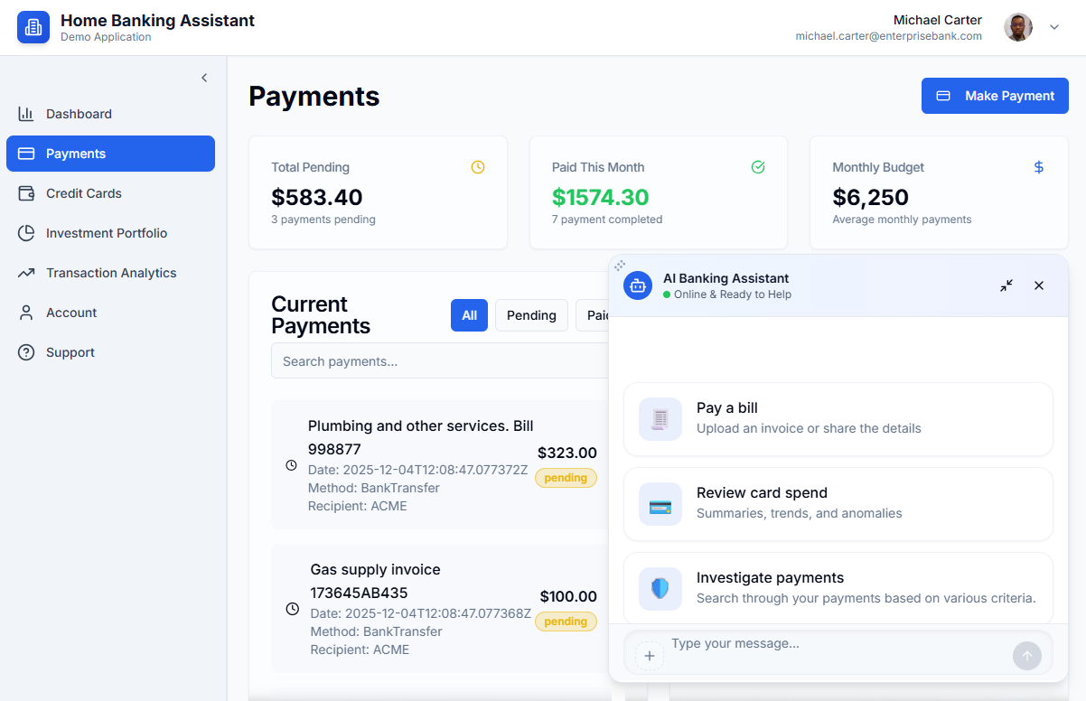
Agentic banking assistant
Python frameworks:
Agent Framework
FastMCP
Azure services:
OpenAI
Document Intelligence
Container Apps
https://github.com/Azure-Samples/agent-openai-python-banking-assistant
Notes:
https://aiinvest-web-dev.blueground-1750adc3.westus2.azurecontainerapps.io/

Slide 37

Agents and MCP servers architecture
Multi-Agent App
FastMCP
Users
Agent Framework
MCP tools:
getAccountByUsername
getAccountDetails
getPaymentMethods
getCreditCards
1
Account Agent
1
Account
Service
Question or task about personal banking account,
transactions, invoice payment
Responsible for all tasks related to banking account info, credit balance, registered payment methods.
MCP tools:
Tools
HTTP
Streaming
submitPayment
MCP1
1
2
Payments
Service
Hand-off to Account
Supervisor Agent
Transaction Agent
MCP tools:
Act as triage agent understanding the user intent based on chat and route the request to the specific domain agent
Responsible for all tasks related to querying user bank movements like income and outcome payments.
1
notifyTransaction
searchTransactions
getTransactionByRecipient
Hand-off to Transaction
3
Reporting
Service
Tools
MCP1, MCP3
Microsoft Foundry
Hand-off to Payment
Payment Agent
Responsible for all tasks related to submit a payment.
Azure Open AI
Azure Document
Intelligence
GPT models
Tools
MCP1, MCP2,
MCP3, ScanInvoice
GPT and embeddings models
Extract entities from Invoices
Notes:
Each sub-agent is a tool called by the supervisor.

Slide 38
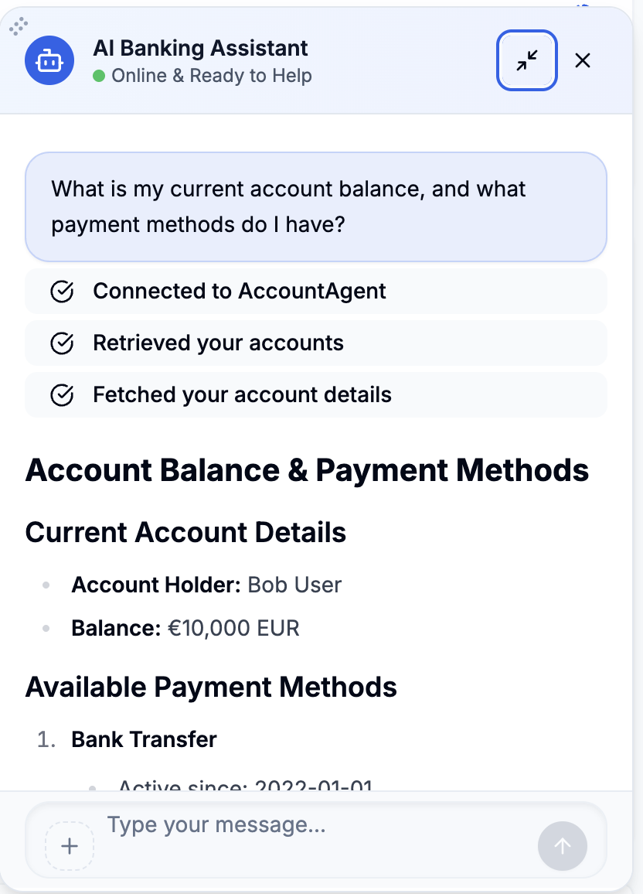
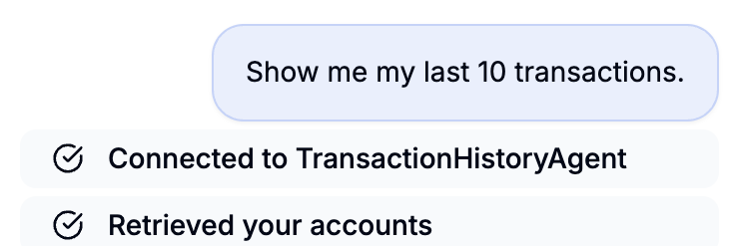
Handoff workflow with checkpointing
workflow = (HandoffBuilder(
participants=[triage_agent,
await self.account_agent.build_af_agent(),
await self.transaction_agent.build_af_agent(),
await self.payment_agent.build_af_agent()])
.with_start_agent(triage_agent)
.with_checkpointing(checkpoint_storage)
.build())
Full file: handoff_orchestrator.py
Notes:
Each sub-agent is a tool called by the supervisor.

Slide 39
Next steps
Register:
https://aka.ms/PythonAgents/series
Watch past recordings:
aka.ms/pythonagents/resources
Join office hours after each session in Discord:
aka.ms/pythonai/oh
🛠️ Feb 24: Building your first agent in Python
🧠 Feb 25: Adding context and memory to agents
📊 Feb 26: Monitoring and evaluating agents
🔀 Mar 3: Building your first AI-driven workflows
🕸️ Mar 4: Orchestrating advanced multi-agent workflows
🙋🏽 Mar 5: Adding a human-in-the-loop to workflows

