Slide 1
Workshop GenAIOps

Slide 2
Conditions and terms of use
© Microsoft Corporation. All rights reserved.
You may use these training materials solely for your personal internal reference and non-commercial purposes. You may not distribute, transmit, resell or otherwise make these training materials available to any other person or party without express permission from Microsoft Corporation. URL’s or other internet website references in the training materials may change without notice. Unless otherwise noted, any companies, organizations, domain names, e-mail addresses, people, places and events depicted in the training materials are for illustration only and are fictitious. No real association is intended or inferred. THESE TRAINING MATERIALS ARE PROVIDED “AS IS”; MICROSOFT MAKES NO WARRANTIES, EXPRESS OR IMPLIED IN THESE TRAINING MATERIALS¹

Slide 3

Learning Units covered in this Module
 | GenAIOps Overview
 | GenAIOps Maturity Levels
 | Enterprise GenAI Lifecycle

Slide 4
GenAIOps Overview

Slide 5
AI Workload Operations
Complexity Levels of GenAI
GenAI Assets & Artifacts
GenAIOps Definition
Operations Best Practices
Benefits of GenAIOps
Challenges of GenAIOps with Solutions
Notes:
Yes, here’s what we will cover in the “GenAIOps Overview” section...
We will begin by exploring various operational frameworks and examining the complexity levels of GenAI use cases.
Next, we’ll discuss the key assets and artifacts associated with GenAI use cases that you need to manage while building GenAIOps.
Finally, we’ll define GenAIOps, delve into operations best practices, highlight the benefits of it , and address challenges with the potential solutions.

Slide 6
Objectives
After completing this Learning, you will be able to:
Understand….
Understanding the operations involved in managing AI workloads
Exploring the different levels of complexity in GenAI
Identifying the assets and artifacts associated with GenAI
Learning the best practices for GenAI operations and challenges and how to mitigate

Slide 7
Lesson 1 – GenAIOps Overview
Notes:
Yes, here’s what we will cover in the “GenAIOps Overview” section...
We will begin by exploring various operational frameworks and examining the complexity levels of GenAI use cases.
Next, we’ll discuss the key assets and artifacts associated with GenAI use cases that you need to manage while building GenAIOps.
Finally, we’ll define GenAIOps, delve into operations best practices, highlight the benefits of it , and address challenges with the potential solutions.

Slide 8
Why GenAIOps
Does your customer have a clear GenAI strategy for integrating tools, design patterns, and practices to ensure smooth, reliable, and scalable operations without reengineering the infrastructure?
How does your customer address organizational silos to ensure alignment, collaboration, and quick problem resolution, including troubleshooting and postmortems?
Does your customer have concerns about privacy, security and grounding?
How does your customer monitor development, scaling, and risk indicators to ensure smooth, adaptive real-time GenAI application performance?
Has your customer already built DevOps or MLOps and can you use your existing Ops for GenAI solutions?
Do developers lack the experience and tools to evaluate, improve and validate the solution for POCs to scale and operate in prod?
Notes:
Before we start, lets address “why genaiops”? Question by asking questions ☺, it’s important to ask yourself or to your customers these key questions.
Let’s begin:
Do you have a clear GenAI strategy for integrating tools, design patterns, and practices to ensure smooth, reliable, and scalable operations without reengineering the infrastructure?
This is crucial because you may have numerous GenAI use cases to implement within a short timeframe, and starting from scratch each time is not practical. For instance:
Establishing an AI Landing Zone is essential to create a solid foundation.
Developing and enforcing best practices across your organization is critical. These should be adopted by default—for example, implementing centralized logging for audits or building infrastructure that scales effortlessly.
Managing model deprecations and retirements is equally important. In this fast-paced field, staying competitive requires adopting the latest, more cost-effective, and better-performing models. Achieving this involves reference architectures and clearly defined guardrails.
Second question: “How does your customer address organizational silos to ensure alignment, collaboration, and quick problem resolution, including troubleshooting and postmortems?”
Building a GenAI solution is only the beginning. What happens next? You need to deploy it and monitor it. You need to handle different challenges such as reliability issues, ethical concerns, operational inefficiencies, over-complexity, and scalability. These challenges require strategic cross-functional collaboration. Involving executives in decisions regarding the adoption or retirement of models, tools, and frameworks is essential to align objectives and maintain operational efficiency.
Next question: “How do you monitor development, scaling, and risk indicators to ensure smooth, adaptive real-time GenAI application performance?”
Firstly, we are aiming “observability”. There are different levels of monitoring that we need to implement such as model level or application or platform level. Understanding data governance is also play a key part here. Once we have good observability we can have continuous improvement in our application life cycle to improve the operational excellence.
And another question to warm up “Have you already built DevOps or MLOps and can you use your existing Ops for GenAI solutions?”
GenAIOps is a game-changing strategy for systematically operationalizing GenAI applications, guiding tool selection, design patterns, and cultural principles to ensure efficient, seamless performance. So while building GenAIOps, you can use your existing Ops solutions and particularly your experience in DevOps, MLOps and DataOps.
Next question “Does your customer have concerns about privacy , security and grounding?” which GenAIOps can help with bringing standard approach for all genai use case deployments.
And finally, do developers lack the experience and tools to effectively evaluate, improve, and scale their solutions? GenAIOps addresses this challenge by providing a comprehensive set of practices and tools that support developers in moving their AI solutions from proof of concept to full production. A core principle of GenAIOps is its focus on automation and templating. By adopting a clear and systematic approach, developers can ensure their solutions are not only scalable but also maintainable over time.
-------------------
Consumers expect LLM-based applications to have real-time or near-real-time latency so an LLMOps strategy should help you make sure your infrastructure can adapt to varying scales of operation.
2: Pstmortems: Understand the root cause, document the incident, learn from the incident, improve practices…

Slide 9
AI Workload Operations
DevOps:
DevSecOps:
DataOps:
MLOps:
LLMOps:
Code Reproducibility
Code Validation
Applications Deployment
Secure Design
Secure Code
Secure CI/CD Pipelines
Secure Operations
Data Quality
Team collaboration
Governance
Model Reproducibility
Model Validation
Model Deployment
Model Retraining
Model Discovery
Model Fine-tuning
Model Validation with AI Assisted Metrics
Model Deployment
GenAIOps
Notes:
AI workloads involve a wide range of operational tasks. Let’s explore these at a high level. First, we can all agree that operations are essential for ensuring efficiency, quality, reliability, security, ethics, and other standards that organizations prioritize for their AI workloads.
At a high level, tasks associated with AI workloads can be categorized into three main areas: Application Development, Data Handling, and AI Model Management.
I will not focus on DevOps, DevSecOps , DataOps and will start with MLOps:
…. MLOps is key for traditional AI Model Management. It addresses the unique challenges of AI, such as the unpredictability of AI outputs and drifts. Key checkpoints in MLOps include Model Reproducibility, Model Validation, Model Deployment, and Model Retraining.
LLMOps focuses on managing Large Language Models (LLMs) in production. It shares some overlap with MLOps but also has unique characteristics, such as Model Discovery, Fine-tuning, and specific LLM Evaluation Metrics. For example, DevOps is more critical than DataOps for operational excellence in LLMs.
Finally, GenAIOps is more comprehensive than LLMOps. While LLMOps focuses on managing models, GenAIOps encompasses the entire GenAI solution, including multiple models, open-source frameworks, applications, and data sources to bring context within a single GenAI solution. GenAIOps draws from DataOps, DevOps, DevSecOps, MLOps, and user-interaction design.
----
Let's start with DevOps, which encompasses the entire application development lifecycle management through automated Continuous Integration and Continuous Deployment pipelines and monitoring. Important checkpoints in DevOps include Code Reproducibility, Code Validation, and Application Deployment.
DevSecOps, on the other hand, emphasizes a “shift-left” culture by integrating security early into the development process. Its main steps include Secure Design, Secure Code, Secure CI/CD Pipelines, and Secure Operations.
And then we have DataOps, which is critical for managing the data lifecycle in AI workloads. DataOps streamlines processes such as data extraction, data transformation, and data loading ETL or ELT.

Slide 10
Complexity Levels of GenAI
1
2
3
4
5
Low
Moderate
High
Advanced
Sophisticated
Simple Content Generation
Ex: Summarization
Context-Aware Generation
Ex: Internal GPT
Retrieval Augmented Generation
Ex: Advanced Q&A
Integrated System Integration
Ex: Automated Customer Support
Autonomous systems
Ex: Multi Agents
Notes:
A key characteristic of low-level complexity is that… applications simply send prompts to the LLM endpoint and display the immediate output without any additional processing or logic. Examples include summarization, entity extraction, and basic translation. This level does not involve memory.
Moving up a notch, moderate-level complexity includes session-based memory, enabling contextual awareness during a single interaction or session. Examples include conversational AI use cases and internal GPT implementations.
The next level is high complexity, where AI incorporates external knowledge or databases to generate richer and more informed responses, such as retrieving relevant facts or performing basic reasoning. Key challenges include managing data quality, ensuring relevance, and avoiding information overload.
Advanced complexity involves function calling and orchestrators, enabling integration with multiple systems for coordinated and advanced functionalities. Examples include automated customer support and intelligent document processing. This level brings personalization as well.
At the sophisticated level, AI systems are fully autonomous, capable of advanced reasoning, decision-making, and seamlessly integrating multiple tools or APIs to handle complex tasks. Examples include autonomous systems and multi-agent environments.
Understanding these complexity levels helps in planning and executing your GenAI solutions effectively. Each level comes with its own set of challenges and requirements, which need to be addressed to ensure successful deployment and operation.

Slide 11
GenAI Assets & Artifacts
LLMs
Data
Code
Integrations
Pre-built Models
[Azure OpenAI or Open Source]
Fine-tuned Models
Inputs
[Prompt Templates, Knowledge Base, VectorDB, Groundtruth Data, Feedback etc]
Outputs
[Inference results,
logs etc]
Plugins
Prompt files (prompty, jinja)
Orchestrators
APIs
Agents
etc
Use case specific required AI services or Storages
Responsible AI (Content Safety, red teaming agents, guardrails etc..)
Notes:
To better understand, we need to have a clear idea of the GenAI assets and artifacts—what we use and create while building GenAI solutions.
First, let's discuss 'LLMs'. These are pre-built models, like Azure OpenAI or various open-source alternatives. They can also be fine-tuned to meet specific needs. These models form the foundation of AI’s ability to understand and generate human-like text, making them essential for applications ranging from chatbots to complex data analysis systems.
Moving on to 'Data', which acts as the fuel for GenAI solutions. Inputs may include prompt templates, a comprehensive knowledge base, VectorDB, ground truth data, and feedback mechanisms, among others. Outputs, on the other hand, refer to what the models or overall solution generate, such as inference results, logs, etc., which are key to analyzing model performance and monitoring.
Next we have 'Code'. This includes various plugins, prompt files like prompt.py and jinja, chains, APIs, and agents which might act autonomously within a system. These elements are essential for integrating and operationalizing GenAI within different environments and for specific tasks.
Lastly, 'Integrations' are crucial for the practical application of AI. These are use-case specific and often include connections to other AI services or storage services to build GenAI workflows efficiently. It’s important to consider these assets and artifacts when developing GenAI operations.
Also there are responsible AI assets such as red teaming agents, content safety and metrics….

Slide 12
GenAIOps =To bring LLM-infused Apps to Production
Bring together People, Process, and Platform to automate LLM-infused software delivery & provide continuous value to your users
People
Process
Platform
Notes:
GenAIOps is briefly bringing LLM based applications into production. I am sure your customers have done many POCs but not all of them have managed to bring them in production. This is very very common pain point for our enterprise customers.
GenAIOps as a concept aligning people involves aligning teams across various departments—such as development, operations, and support—to ensure everyone is on the same page and moving towards a common goal. Empowering people with the right tools and knowledge about LLM capabilities is crucial for fostering innovation and smooth workflow.
Next, let's talk about 'Process'. Streamlining processes is key to the effective deployment of LLM-infused applications. Main outcome is repeatability and consistency to the process, making sure it is well understood, repeatable by others. This includes establishing clear protocols for development, testing, deployment, and maintenance. Automating these processes where possible can lead to more efficient cycle times, reduced errors, and a faster response to market changes or user feedback. Continuous integration and continuous deployment (CI/CD) are required to automate model updates, application evaluations, testing , deployments and also continuous monitoring. You can Automate the entire process from code commit to production.
Lastly, the 'Platform' is what ties everything together. A robust platform that supports the scalability and integration needs of LLM applications is vital. This platform should provide the necessary infrastructure to develop, deploy, and manage AI applications seamlessly such as AI foundry and Azure ML.

Slide 13

“Operating Model” Importance
Control
Innovation
Speed/Agility
Costs
Secure, predictable, and flexible service delivery and operations capability
Faster business innovation through adoption of AI Services
Business agility
and reduced
time-to-market through efficient DevOps teams
Efficient use of public cloud scale
Notes:
Yes, when we talk about the importance of setting up the right operating model for your organization, it means being intelligence-driven. You want control of your operations with secure, predictable, and flexible service delivery and capabilities. This is crucial as it ensures that your AI services are reliable and can be managed effectively.
Innovation is another key aspect. You need to be able to provide faster development and roll-out of your business use cases through the adoption of cloud services, for example. This agility allows you to stay competitive by quickly responding to market demands and leveraging the latest AI technologies.
Speed and agility are also essential. You want to reduce your time to market to maintain a competitive edge. Efficient DevOps teams can help achieve this by streamlining workflows and accelerating deployment cycles.
Lastly, controlling costs is a significant benefit of the right operating model. By leveraging the public cloud, you can limit upfront investment and scale quickly without limit. This ensures that resources are used efficiently, and expenditures are kept in check.

Slide 14
“Operations” Common Best Practices
1
Role based Access (RBAC)
7
Using simple version naming scheme for resource management
2
Network Isolation
8
Automate Testing at All Stages
3
Infrastructure as a Code (IaC)
9
Monitor for Drift, Bias, and Ethics
4
Monitoring
10
Secure the Entire Pipeline
5
Data Encryption
11
Optimize for Scalability and Resource Efficiency
6
Version Control for models, data and code
12
Continuously Improve
Notes:
There are several common best practices that are crucial for any type of operations, and they are especially vital for GenAIOps. First, automating testing at all stages is required because GenAI applications often produce complex and non-deterministic outputs. This helps ensure model robustness, accuracy, and alignment with ethical standards. For example, using adversarial tests to evaluate model responses to edge cases, through frameworks such as PyRIT, can be very effective.
Additionally, automating evaluation metrics for model quality, like BLEU and ROUGE, which are natively supported in AI Foundry, can help maintain high standards. Monitoring for drift, bias, and ethics is also crucial, given that large language models can unintentionally generate biased, harmful, or incorrect outputs. This monitoring helps maintain relevance and accuracy in production over time.
Version control for everything—models, data, and code—is another key practice. This ensures reproducibility, which is critical for debugging, compliance, and iterative improvements. It allows you to maintain consistency and enables rollback to previous states if issues arise.

Slide 15
Why does GenAIOps matter?

Slide 16
Benefits of GenAI Ops
Automation
Cross Functional Integration
Reproducibility
Reusability
Deployments
Governance
= VELOCITY & SECURITY & RAI
Notes:
There are several key benefits that make GenAIOps essential for any organization working with AI.
First, Automation. GenAIOps automates many aspects of AI application development and deployment. This not only accelerates processes but also reduces human error. With the rapid evolution of AI models and technologies, continuous testing and evaluation become crucial. Automated systems ensure that new models are integrated smoothly, and outdated ones are retired efficiently.
Second, Cross-Functional Integration. GenAIOps fosters collaboration by integrating functions across departments. This ensures teams are aligned, with clear objectives and a shared understanding of responsibilities. Proper management of assets and clearly defined responsibilities prevent bottlenecks, promoting seamless operations and efficient teamwork.
Third, Reproducibility. Ensuring that all elements of the AI system—such as data sources, code, and models—can be accurately reproduced is critical for consistency and reliability. Maintaining a versioned history of assets and connections allows for effective change management, enabling systems to evolve without disruption.
Next, Reusability. GenAIOps encourages the creation of reusable templates and procedures, saving time and ensuring the consistent application of best practices across projects. This is particularly beneficial in maintaining efficiency and consistency.
Then, Streamlined Deployments. Simplifying the deployment process, including monitoring and content filtering, makes operations more efficient. Tools like AI Foundry enhance deployment capabilities, making it easier to deploy, monitor, and manage AI models.
Finally, Governance and Compliance. Governance ensures that only approved models are used in production, with policies and gated approvals in place. Compliance protocols help manage risks like data privacy and regulatory requirements. Monitoring and responding to data and model drift ensures the AI system remains accurate, effective, and aligned with its intended purpose over time.
All these benefits collectively enhance the velocity and security of AI operations and responsible AI. Applications are deployed faster, are more robust, and maintain higher security standards.
Now, while these benefits are significant, we also face several challenges when implementing GenAIOps. We will discuss these challenges and the solutions to address them.

Slide 17
GenAIOps Challenges
Solutions
Data Quality or Context
Model Catalog ,Prompt Eng, Finetuning , RAG , Azure AI Simulator
Evaluation
Evaluations SDK or AI Foundry Studio
Scalability
By Design: APIM, Scalable Endpoints
Ethical Concerns
Built-in Content Filtering, Abuse Monitoring, PyRIT, Transparency Note, Impact Assessment Temp, AI Reports in AI Foundry
Regulatory Compliance
By Design: Select the right model deployment type and consider where your data is stored and processed based on the utilized feature on AI Foundry
Continuous Updating and Maintenance
AI Foundry, App Insights for AI Project, Azure Monitor DevOps , Github Actions
Computational Resources for training and deploying
Pretrained models, selection of correct deployment type
Security and Privacy Risks
Encryption, Customer Managed Keys, Entra ID, Private Network, RBAC, Azure Policies
Notes:
There are challenges associated with GenAI Ops as you know…
One of the primary challenges is Data Quality or Context. Large Language Models (LLMs) may replicate and amplify biases from their training data, leading to unreliable outputs. This makes “careful model selection”, “prompt engineering”, “fine-tuning”, and using “Retrieval-Augmented Generation (RAG)” technique essential. Additionally, tools like Azure AI Simulator can help in generating valid synthetic data to improve the quality of fine-tuning and evaluation.
Another challenge is Evaluation. Traditional ML metrics don’t fully apply since there often isn't a single correct answer. Interpretability is another hurdle, as LLMs often operate as "black boxes." Using evaluation SDKs as code first approach or AI Foundry can help address these issues by providing tailored evaluation metrics for LLMs.
Moving on to Scalability, scaling LLMs to meet demand can be complex. However, designing systems with scalable endpoints and utilizing API Management (APIM) can handle increased loads efficiently. Ethical concerns are also significant, as there's a risk of generating harmful or misleading content. Utilizing built-in content filtering, abuse monitoring, and transparency documentation can mitigate these risks.
Regulatory Compliance is another critical challenge. Meeting legal standards like GDPR requires careful handling of data. Designing model deployment regions with data-at-rest considerations and adhering to regulatory guidelines is crucial.
Continuous Updating and Maintenance is necessary to keep LLMs relevant, requiring a strategic approach to retrain models using tools like AML, AI Foundry, and App Insights for AI Project.
Computational Resources for training and deploying LLMs can be resource-intensive and costly. Utilizing pre-trained models and selecting the correct deployment types can optimize resource usage.
Lastly, Security and Privacy Risks are ever-present, with potential for data leaks and vulnerability to adversarial attacks. Ensuring robust security measures, like encryption and private networks, is key.
These solutions collectively ensure that everything from model selection to deployment is handled meticulously, bridging gaps between product, data, engineering, security, and customer teams.
----------
To learn how to select the right models/tools for their use case
An easy way to switch between UI and code​ as they build
An orchestration framework to handle the complex mapping of functions and code
Helpers, building blocks, and app templates​
To evaluate the model, prompt, and overall application pipeline​
To scale their PoCs to production
To continuously monitor AI app performance
Data Quality or Context
Challenge: LLMs may replicate and amplify biases from their training data, leading to unreliable outputs. LLMs are trained on vast amounts of data, and if the data contains biases or inaccuracies, the model may replicate and even amplify them, leading to biased or unreliable outputs. So during the model selection phase, you need to consider this. There are general mdels, industry specific models/ task specific models as well. What data was used and techniques was used. For example Reinforcement learning used or not. You can also improve the model’s output with Fine tuning or RAG for context.
This challenge is also valid for evaluations for fine-tuning process. If you don’t have good quality of data, your fine-tuning will not help to improve the model. Or if you don’t have good quality of groundtruth data, your evaluations will not be valid. You can use simulator to generate valid synthetic data.
Solution: Careful model selection, prompt engineering, fine-tuning, and using Retrieval-Augmented Generation (RAG) can help ensure the data context is appropriate and refined.
Evaluation
Challenge: Traditional ML metrics don’t not fully apply as there often isn't a single correct answer.
Interpretability is another challenge sinece LLMs often operate as "black boxes," making it difficult to understand how they arrive at specific conclusions or predictions, which can hinder trust and accountability. But you can use prompt eng techniques such as chain of thoughts.
Evaluations hard via traditional ML metrics since there is often no single correct answer.
Solution: Use of specific evaluation SDKs like AML Studio or AI Foundry Studio, which are tailored for evaluating LLMs.
Scalability
Challenge: Scaling LLMs to meet the demands.
Solution: Designing systems with scalable endpoints and API Management (APIM) to handle increased loads efficiently. This challenge can be solved by design.
Ethical Concerns
Challenge: Risk of generating harmful or misleading content.
Solution: Utilizing built-in content filtering, PyRIT, and reviewing transparency documentation in model operations.
To reduce the risk of harmful use of the Azure OpenAI Service, the Azure OpenAI Service includes both content filtering and abuse monitoring features.
Regulatory Compliance
Challenge: Meeting legal standards like GDPR, which requires careful handling of data.
Solution: Designing model deployment regions with data-at-rest considerations and adhering strictly to regulatory guidelines.
Continuous Updating and Maintenance
Challenge: LLMs require regular updates to accommodate new information. Necessary to keep LLMs relevant, requiring a strategic approach to retrain models as needed. So you need to collect logs, feedback… You can use AML, AI Foundry, App Insights for AI Project, DevOps Pipelines, Github Actions
Solution: Establishing processes for the frequent adaptation of new requirrements and performance improvements.
Computational Resources for Training and Deploying
Challenge: High costs and extensive resources needed for training and deploying LLMs.
Solution: Utilizing pretrained models and selecting the correct deployment types to optimize resource usage.
Security and Privacy Risks
Challenge: Potential for data leaks and vulnerability to adversarial attacks.
Solution: Ensuring robust security measures where "Your data is yours!" is a guiding principle.
Also Getting Started: Rapid evolution in the field can make starting with LLMs daunting. Ensuring access to the latest guidance and resources is crucial.
GenAIOps ensures that everything from model selection to deployment is handled meticulously, bridging gaps between product, data, engineering, security, and customer teams.
---------------------------
monitor users’ experience and retrain your models if problems arise. Establishing a robust setup to monitor and retrain models is a big job that requires a strategic approach. Identifying potential issues ahead of time and optimizing your models can help you ensure a seamless user experience.
Getting Started slows down: . [The state of the art is evolving so quickly, it makes it difficult to decide what to use. Along with that, guidance and documentation is hard to find about LLM training details.
]
New skillsets required to develop LLM based applications
Continuous Updating and Maintenance: LLMs need to be regularly updated to handle new information and adapt to changing requirements, but managing this process efficiently and accurately is challenging.
Regulatory Compliance: Ensuring that LLMs meet legal and regulatory standards, particularly regarding data privacy (e.g., GDPR), is a complex challenge. . EU AI Act, GDPR, SS1/23 etc.
Deploying the model into correct region, using stateless endpoints, your data should not be used for training …
No need to worry:
Computational Resources: Training and deploying LLMs require significant computational power, memory, and storage, which can be expensive and resource-intensive. Model as a service APIs vs self-managed.
Security and Privacy Risks: LLMs may unintentionally leak sensitive or confidential information from their training data or be vulnerable to adversarial attacks.
----
Challenges in LLMOps
Managing Large Language based flows, from local experimentation to production deployment, has been far from straightforward and isn't a one-size-fits-all task.
Each flow has its unique lifecycle, from initial experimentation to deployment, and each stage presents its own set of challenges.
Organizations often deal with multiple flows concurrently, each with its objectives, requirements, and complexities. This can quickly become overwhelming without proper management tools.
It involves handling multiple flows, their unique lifecycles, experimentation with various configurations, and ensuring smooth deployments.

Slide 18
Lesson 2 - GenAIOps Maturity Levels
Notes:
How can you assess your customers' competence in handling GenAI applications and take appropriate actions to help them improve?

Slide 19
GenAIOps
Maturity Levels
OPTIMIZED
4
MANAGED
3
Operational Excellence and Continuous Improvement
DEFINED
2
Seamless, collaborative environment for CI/CD
Fully automated monitoring and model/prompt refinement
Advanced LLM Workflows and Proactive Monitoring
INITIAL
1
Systematizing LLM Apps Development
Comprehensive prompt management, evaluation, and real-time deployment
Advanced monitoring and automated alerts
Operational Excellence and Continuous Improvement
Iterative model augmentation with prompt engineering and RAG
Structured deployment and prompt-based evaluations
Discovery of models and testing prompts
Basic evaluation and monitoring
Notes:
To understand that we have our GenAIOps maturity levels and take appropriate actions to move to the next level, we need to look at the four maturity stages we have defined.
At the Initial stage, the focus is on Operational Excellence and Continuous Improvement. Here, organizations are discovering models and testing prompts. Basic evaluation and monitoring are key activities in this phase.
At the Defined stage, we move towards Systematizing LLM App Development. This involves iterative model augmentation with prompt engineering and Retrieval-Augmented Generation (RAG). Structured deployment and prompt-based evaluations become more systematic.
When we reach the Managed stage, we are looking at Advanced LLM Workflows and Proactive Monitoring. This includes comprehensive prompt management, evaluation, and real-time deployment. Advanced monitoring and automated alerts are implemented to ensure smooth operations.
Finally, at the Optimized stage, we achieve Operational Excellence and Continuous Improvement with a seamless, collaborative environment for CI/CD. Fully automated monitoring and model/prompt refinement are the hallmarks of this stage.
Understanding these levels helps organizations identify where they currently stand and what steps they need to take to progress. Each level builds on the previous one, adding layers of sophistication and automation to the GenAIOps processes.

Slide 20
Lesson 3 - Enterprise GenAI Lifecycle

Slide 21
GenAIOps Enterprise Lifecycle
How to Implement GenAIOps?
Prototyping
&
“POC to Prod” Demo
Building & Augmenting &
“POC to Prod” Demo
Deploying & Monitoring
&
“POC to Prod” Demo
Managing
Notes:
lets talk about "Enterprise GenAI Lifecycle"
Today we will cover six key sub-topics:
GenAIOps Enterprise Lifecycle - This will be our starting point. We'll explore the fundamental components and the overall workflow that drives GenAIOps.
How to Implement GenAIOps? - We'll provide actionable steps and best practices to implement GenAIOps effectively within your organization.
Prototyping & "POC to Prod" Demo - Here, we'll discuss the importance of prototyping and demonstrate how to transition from Proof from Proof of Concept (POC) to production.
And fourth …. Building & Augmenting & "POC to Prod" Demo - Building on the previous stage, we'll delve into the specifics of augmenting your AI models and demonstrate this process in action.
Next, very critical one… Deploying & Monitoring & "POC to Prod" Demo - Deployment and monitoring are critical for ensuring your AI models perform as expected in the real world. We'll showcase these steps with another demo.
And Finally, Managing - we'll cover the management aspects, including how to continuously monitor, update, and manage your AI solutions to ensure they remain effective and efficient.
To begin, let’s focus on the first agenda item: "GenAIOps Enterprise Life Cycle." This is where it all starts, and understanding its components is crucial for successful implementation.

Slide 22
Enterprise GenAIOps
Automation:
Fine-tuning/ New Model&Version Update/ Prompt&Requirement Update
Define scope & requirements
Data preparation
Discover & Tune & Build Workflow & Integration & Orchestration
Evaluation
Review & approve
Deploy & monitor
Ongoing governance
Data Engineer
Data Modeler
Data Scientist
Prompt Engineer
Developer
AI Engineer
Compliance Officer
Responsible AI Lead
Business Lead
AI Engineer
DevOps Engineer
Developer
Product Lead
IT
Security
Compliance
IT
Security
Compliance
Data Scientist
Prompt Engineer
Developer
AI Engineer
Design solution architecture
Solution Architect | IT | Security | Compliance
Notes:
This lifecycle encompasses several phases, each with its own set of roles and responsibilities.
We start with Defining Scope & Requirements. This phase is critical as it lays the foundation for the AI project. Here, the Product Lead, IT, Security, and Compliance teams collaborate to outline the project's scope and requirements. This ensures that the project aligns with business goals and complies with relevant regulations and security standards.
Next, we move to Data Preparation, where Data Engineers and Data Modelers clean, structure, and enrich the data needed for GenAI use case. This step is crucial to ensure the quality and relevance of the data fed into the models. This data can be used for fine-tuning or RAG or evaluations.
Following data preparation, we enter the Discover & Tune & Build Workflow & Integration & Orchestration phase. Data Scientists, Prompt Engineers, and Developers work collaboratively to fine-tune the model if required, build workflows, and integrate various components. This orchestration ensures that the AI model functions efficiently within its intended environment.
The following phase is evaluation phase involves thorough testing and validation of the AI model by Data Scientists, Prompt Engineers, Developers, and AI Engineers. This step ensures the model meets the predefined criteria for performance, safety, and compliance.
Once the model and application workflow have been evaluated, it moves into the Review & Approve phase. Compliance Officers, Responsible AI Leads, and Business Leads assess the model to ensure it adheres to ethical standards, compliance requirements, and business objectives before it is cleared for deployment.
In the Deploy & Monitor phase, AI Engineers, DevOps Engineers, and Developers package and deploy the model in a production environment. Continuous monitoring post-deployment is essential to ensure the model performs as expected and to quickly identify and rectify any issues.
Finally, Ongoing Governance is crucial to ensure the AI model remains effective and secure over time. IT, Security, and Compliance teams continually assess and update AI operations to adapt to new threats, drifts, regulatory changes, and evolving business needs.

Slide 23
How to implement GenAIOps?

Slide 24

GenAI Lifecycle in the real world: Start small and iterate
Managing
ADVANCE PROJECT
Orchestraion Integration Debugging
ADVANCE PROJECT
Security and data privacy
Deploy LLM App, UI, Model, Workflow
Define Metrics Evaluation
Continuous Evaluation & Monitoring Quota & Cost Management
Techniques - Prompt Engineering, RAG, Fine-tuning
BUSINESS
NEED
Test Prompts
Choose LLM or SLM
Define Use Case
Establish feasibility
Ideation & Exploring
Building & Augmenting
Deploying & Monitoring
Data
REVERT PROJECT
REVERT PROJECT
Prototyping
Ideating & Explore
Optimizing
Design & Customize
Operationalizing
Manage & Optimize
Notes:
Yes,. now, let's delve into the detailed exploration of the GenAI Lifecycle as implemented in real-world scenarios. Today, we'll discuss how this iterative process, tailored for enterprise applications, navigates through various stages of development and deployment, ensuring that each step aligns with business, ethical, and operational standards.
The GenAI lifecycle begins with Prototyping: Ideating & Exploring. This is an exploratory phase where the focus is on ideation and the initial exploration of capabilities. During this phase, developers and data scientists need to Test and Validate their Hypotheses and experiment with different LLMs or SLMs and also with internal data and prompts.
It's important to establish feasibility and define the use case clearly during this phase to ensure that the project aligns with business needs and objectives.
After the Prototyping phase, we move into the Building & Augmenting phase, where the selected model is refined and customized to meet specific enterprise needs. To do that, you can use Retrieval Augmentation Generation (RAG), Prompt Engineering and Fine-Tuning techniques. We target to build the solution in this stage and optimize it and also integrate with necessary systems
Next circle, in the Operationalizing phase, the model is deployed and monitored continuously to ensure it performs as expected and remains compliant with data privacy standards. This phase also involves integrating with CI/CD processes for seamless updates and maintenance.
And finally, this brings us to the Managing phase,the rectangle around these 3 cicrcles, which is the overarching loop that focuses on long-term governance and sustainability. Continuous management ensures the system adheres to business, security , and compliance standards, with regular reviews and updates to address new challenges and opportunities.
Now, let's focus on the first circle of the GenAI lifecycle: Prototyping.

Slide 25
GenAI Lifecycle and Best Practices
ADVANCE PROJECT
Orchestraion Integration Debugging
ADVANCE PROJECT
Security and data privacy
Deploy LLM App, UI, Model, Workflow
Define Metrics Evaluation
Continuous Evaluation & Monitoring Quota & Cost Management
Techniques - Prompt Engineering, RAG, Fine-tuning
BUSINESS
NEED
Test Prompts
Choose LLM or SLM
Establish feasibility
Define Use Case
Prove that it works
Building & Augmenting
Deploying & Monitoring
Data
REVERT PROJECT
REVERT PROJECT
Prototyping
Ideating & Explore
Optimizing
Design & Customize
Operationalizing
Manage & Optimize
Notes:
In this first cycle: Prototyping , we start with a clear Business Need. This means understanding the specific problem or opportunity we are addressing within the organization. We need to Prove that it works, where we choose the right pre-trained Large Language Model (LLM) or Small Language Model (SLM) to address our specific requirements.
There are a few key tasks involved in this stage:
Establishing Feasibility: This involves assessing whether our chosen solution is technically and economically viable and can deliver the desired outcomes within the constraints of our resources.
Defining Use Case: Here, we clearly articulate what problem we are solving.
Now, let's move on to the next slide to discuss these Azure AI Foundry capabilities for Prototyping stage.

Slide 26
Azure AI Foundry Capabilities for “Prototyping”
Azure AI Foundry (Recommended)
Model Catalog
Model Benchmarkings
Azure OpenAI
  Chat Playground
  Completions Playground
  Assistants (Preview)
  Audio Playground (Preview)
  Images
Playgrounds for AI Services
Agents (Preview)
Fine-tuning
Content Understanding (Preview)
Prompt Flow
=
Notes:
Yes, AI Foundry offers a comprehensive suite of capabilities that are especially valuable during the prototyping phase of the Generative AI (GenAI) lifecycle.
Model Catalog: A centralized repository for discovering and managing GenAI models, making it easy to find pre-trained models that align with your specific use case.
Model Benchmarking: Enables comparison of multiple models to identify the best-performing one for your needs.
Model Fine-Tuning: If required, models can be fine-tuned directly within AI Foundry to better suit your application.
Azure OpenAI Integration: Provides access to powerful tools like Chat Playground and Completion Playground for interactive prototype testing and real-time model behavior analysis.
Assistants, Realtime Audio & Image Playgrounds: These features allow for the development of more dynamic and responsive AI prototypes across a variety of business scenarios.
Access to Azure AI Services: Within AI Foundry, you can also explore playgrounds such as Speech and Translator, making it easier to experiment with Azure AI capabilities.
Azure AI Agents Playground: Create intelligent agents directly from the UI by selecting a model, configuring parameters, writing metaprompts, attaching knowledge bases, and adding action flows as needed.
Multimodal Content Understanding: Enables structured insights to be extracted from unstructured data (text, audio, or visual), supporting use cases like RAG, media analysis, and post-call analysis.
Prompt Flow: An orchestration and prompt engineering tool to design, test, and deploy prompt workflows efficiently.
Together, these tools enable teams to move rapidly from concept to functional prototype, accelerating innovation and enabling smooth integration into broader business processes.
In conclusion, Azure’s AI capabilities—through AI Foundry—provide a robust, end-to-end platform for prototyping, supporting an agile, iterative, and collaborative approach to GenAI development.

Slide 27


Base Model Selection
Decide on the high-level model requirements based on the business case
Benchmark and compare different models and their capabilities based on your business and tech goals
Experiment with the best options to understand them in detail by leveraging AI Foundry Playgrounds
Consider cost, quality, latency of models and set the parameters of the model correctly for the use case.
Notes:
To begin with, it's essential to be clear on your business goals and requirements for the solution. Within AI Foundry, you have the option to compare and benchmark different models as we discussed in the previous slide. ,
Also, you can utilize Playgrounds on AI Foundry to try out different models. This hands-on experimentation can give a good understanding of expectations and help choose the services and models to develop with your team.
Key considerations at this stage include:
Accuracy/Quality:
Performance on Specific Tasks
Bias and Ethical Considerations
Risk and Safety
For instance, if the chosen model in the prototyping stage has high accuracy and performs well on specific tasks, this can save both time and resources in the next phases. On the other hand, addressing bias and ethical considerations early on helps in building a responsible AI solution that aligns with the organization's values and regulatory standards.

Slide 28
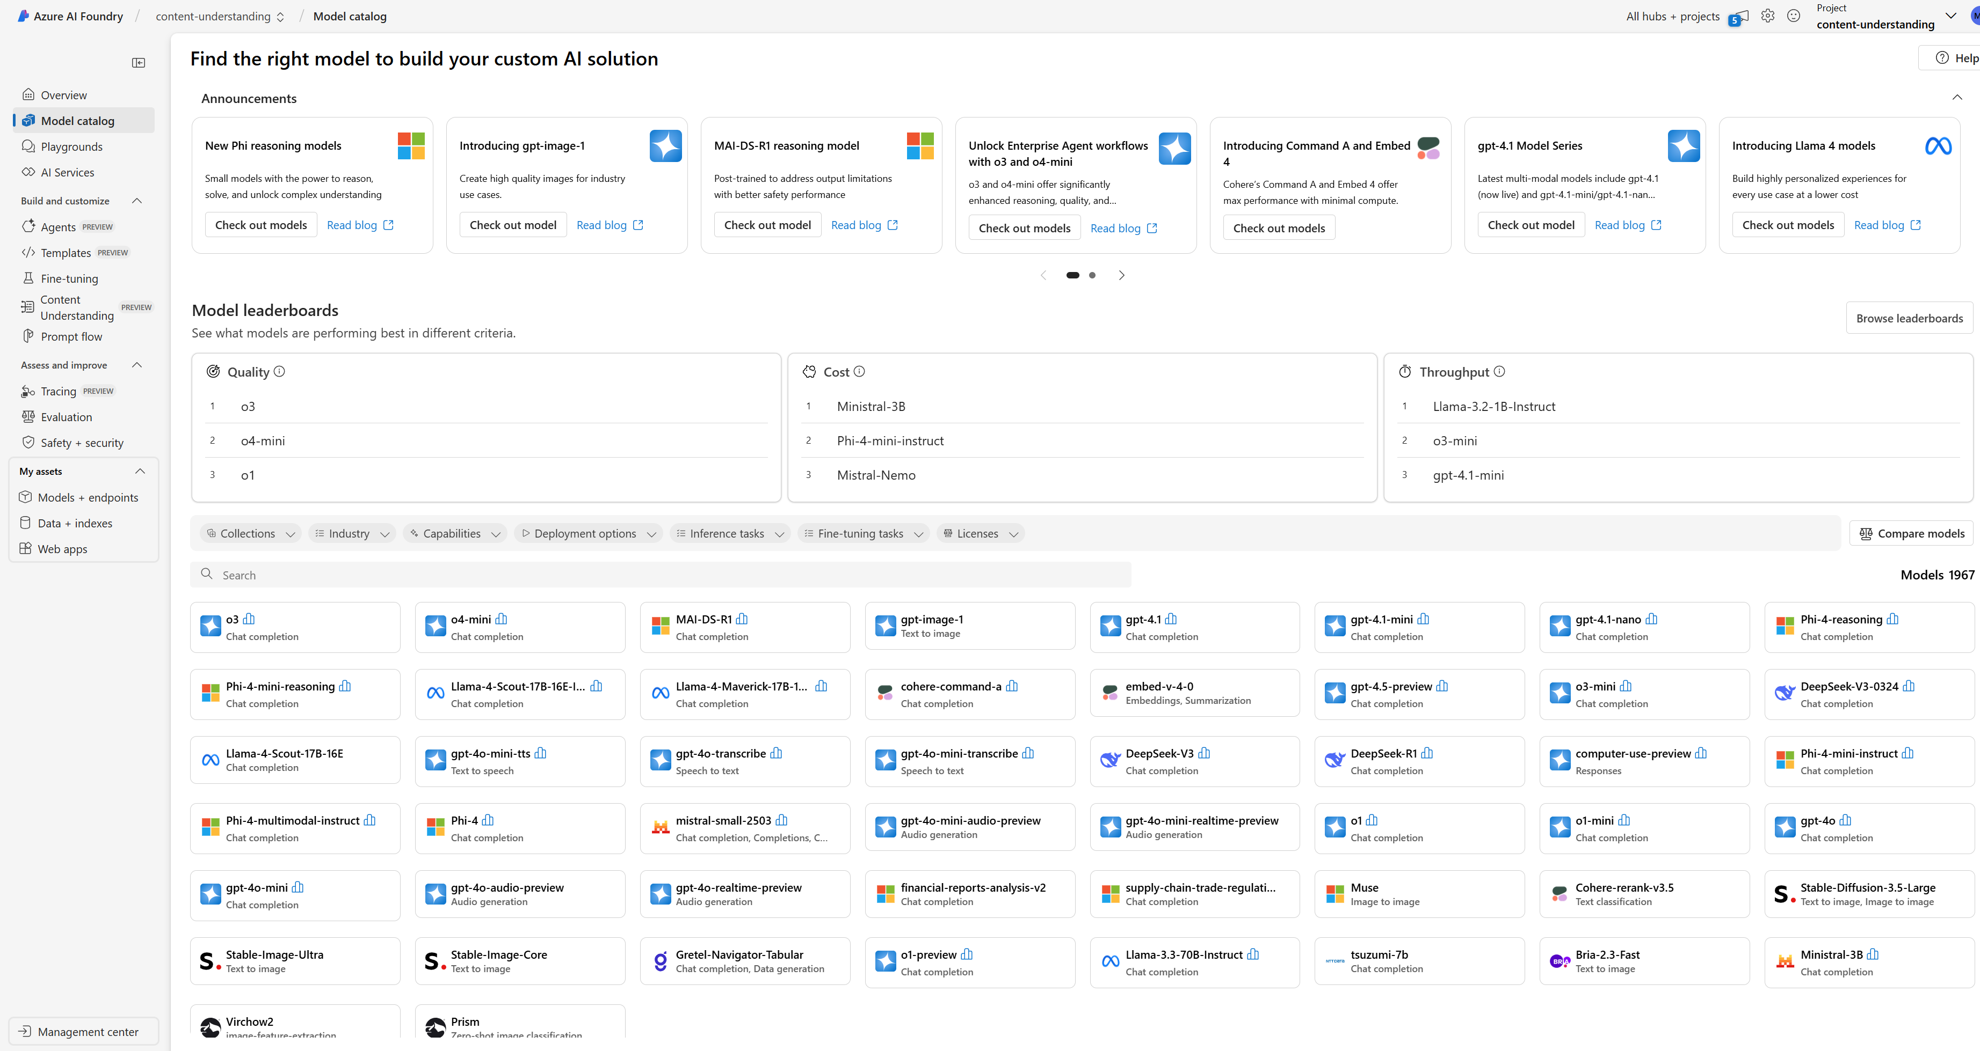

Discover, assess, customize, and deploy foundation models
Azure AI Model Catalog
Customer Benefits
Explore and test thousands of open-source models from Microsoft, OpenAI, Meta, Hugging Face, and Databricks to find the right one for your use case.
Quickly fine-tune models with your own data, without managing any infrastructure.
Deploy Azure OpenAI Service models and Llama 2 models with a built-in safety system by default.
Streamline production-scale deployments with managed endpoints in one click.
Access the catalog: https://ai.azure.com/explore/models?selectedCollection
Notes:
Azure AI Model Catalog is an invaluable resource. It offers several customer benefits that streamline the prototyping process.
Explore and Test Models including AOAI and opensource models
Quick Fine-Tuning
Streamlined Deployments at production-scale with managed endpoints in one click.

Slide 29
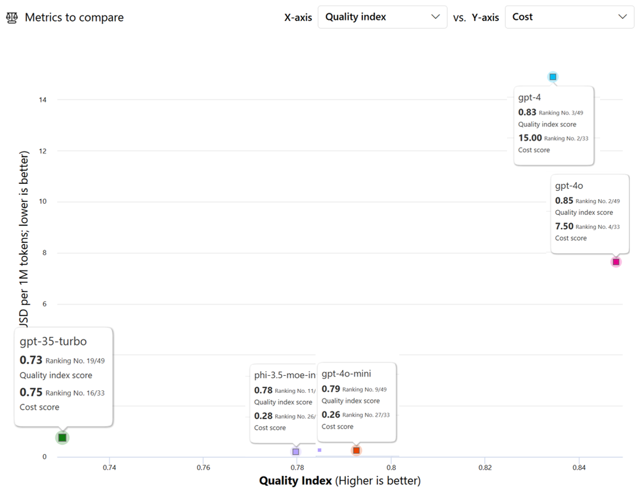
Model Comparison
Trade off
  Cost vs Quality
Cost vs Performance
Benchmark Datasets:
  Human_eval
  Truthfulqa_generation
  OpenBookQA
Notes:
Now, you see “Model comparison” view from AI Foundry. You can compare different models based on Cost vs Quality or Cost vs Performance based on the benchmark datasets.

Slide 30
Use Case: Chat with Your Data
Contoso Electronics provides an experience that allows employees to ask questions about benefits, internal policies, job descriptions, and roles. It supports both chat-based (multi-turn) and Q&A (single-turn) interfaces, and it renders citations.
  The system must support various types of queries that employees may have regarding HR documents.
  The system must be able to scale around busy periods during the day
  Easy to change LLM to use latest more efficient models by the time
Business requirements:
  The system must implement tracing and monitoring for accountability and transparency
  The system must have an easy-to-use UI for staff to interact with
  The system should save all conversations in durable storage within the Contoso environment
Notes:
Let’s briefly define the use case and highlight its key requirements.
Assume that Paulo and I work at Contoso Electronics, and we’ve received a request from the HR team. They’re looking for a virtual assistant designed to support employee interactions related to HR queries. The assistant should be capable of handling both multi-turn conversations and single-turn Q&A, while enhancing the user experience by providing citations for the information it delivers.
The solution must support a broad range of inquiries and remain highly responsive during peak usage periods. It should also offer the flexibility to update the underlying language model to keep pace with the latest advancements in AI, ensuring continued accuracy and efficiency.
Key system requirements also include:
Robust tracing and monitoring for transparency and accountability
A user-friendly interface to encourage adoption
Durable storage of conversation records to support reliability and auditability
Together, these features will ensure the virtual assistant is scalable, transparent, and aligned with enterprise-grade expectations.
______
Let's briefly define the use case and highlight its important requirements.
Lets assume Ha and I work for Contoso ShopWise company and we got these requirements from the Marketing team . They requested an application that extracts product information from unstructured text data sourced from various websites, user reviews, and social media. This extracted information will be used to create detailed product profiles, enabling customers to make informed purchase decisions.
Our business stakeholder highlights Scalability During Busy Periods. They also request Feedback collection to get user input. Of course, monitoring of the solution in production is required. Also, Easy-to-Use user interface to interact with and finally Durable Storage to save all extracted entities.

Slide 31
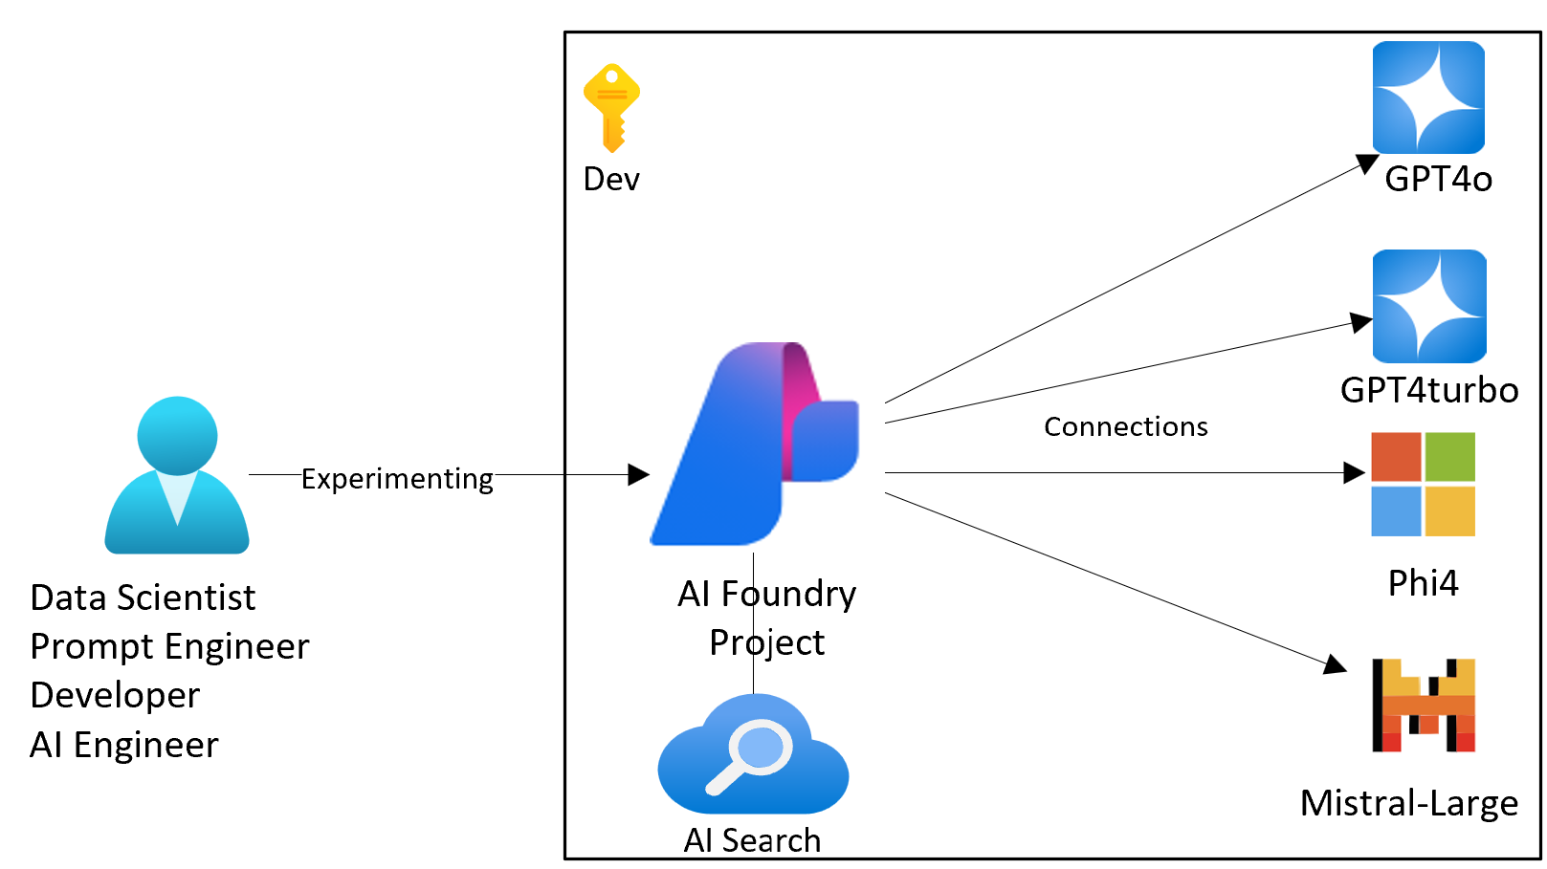


Building Use Case Architecture Diagram Step by Step
Notes:
now let's explain the architecture diagram in the prototyping stage for this use case: HR Virtual Assistant .
In this stage, DS, prompt eng, developer or AI eng can work and start experimenting in the development environment.
After exploring models, we need AI Foundry Project to use playgrounds with deployed models. Additionally, you need to define Connections AI services which you need to use for the use case. In this use case, we need AOAI service and AI Search connections for now.
From the model catalog or in the playground, you can test different deployed models such as GPT-4o, turbo, Llama2, Phi. And you can ingest your documents by using “Add your own data” solution and experiment on the UI.
By having a centralized AI Foundry Project, all team members can collaborate effectively, sharing insights and making real-time adjustments on prompts or selecting different models/versions with different parameters.
Also, AI Foundry provides secure access for the team.

Slide 32



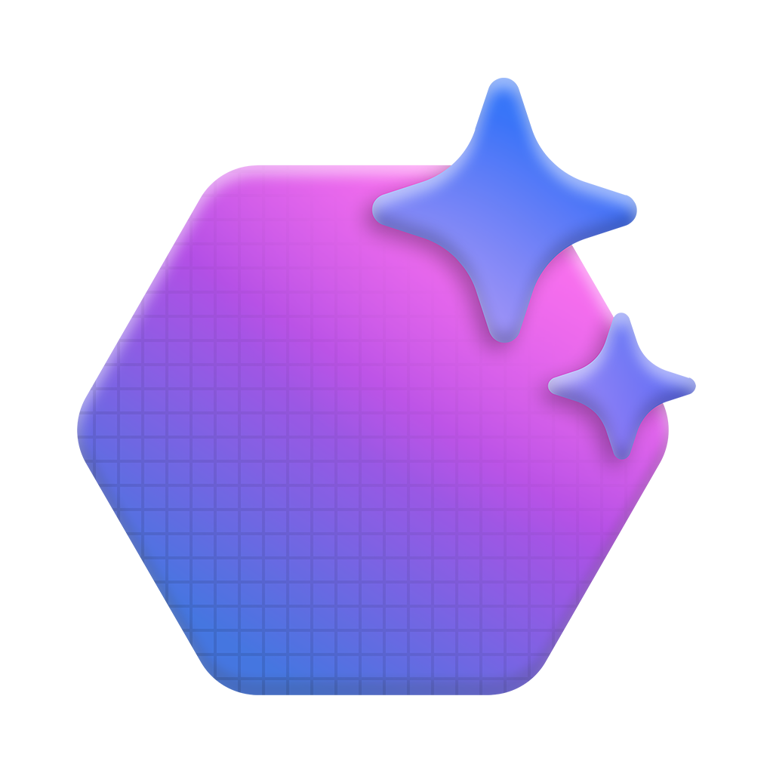


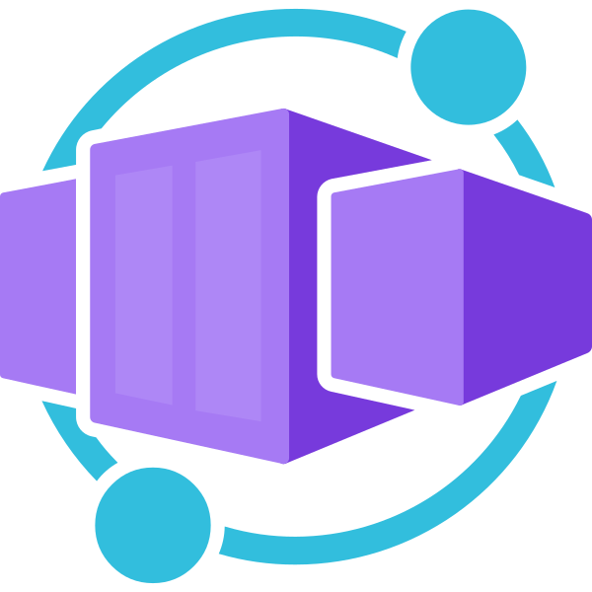
High Level Use Case POC architecture
Subscription
Resource Group
AI Tool Resources
Azure AI Foundry Project
Agents
BYO Resources
Grounding
With Bing
AI Search
Models
Agent
Cosmos DB
Key Vault
Azure Container Apps
Connections
Threads
AI Search
Storage Account
Web UI
Orchestrator
Built-in AI Tools
Notes:
The diagram you see represents the high-level architecture for the proof of concept (POC) supporting Contoso Electronics' virtual assistant use case. This serves as the foundation for our prototyping stage and can be adapted for other use cases by simply modifying the underlying services.
Key Concepts:
A Foundry project is built on an Azure AI Foundry resource. This project type allows for a simple setup, access to agents, and industry leading models from OpenAI, Mistral, Meta, and more. It includes connections for isolated and secure access Deployments to manage and version model endpoints
Each component in this architecture plays a critical role in ensuring that our AI applications are robust, secure and efficient
----------------------------------
Robust – resilient and production-ready
Secure – with enterprise-grade identity and access controls
Efficient – leveraging cloud scalability and optimized resource usage
By utilizing Azure’s cloud infrastructure, we can scale with confidence, optimize costs, and ensure our AI solutions meet the highest standards of performance, governance, and security.

Slide 33



High Level Use Case POC architecture
Subscription
Resource Group
Azure AI Foundry
AI Services
AI Hub
AI Project
Azure
OpenAI
Phi-3.5-mini
Azure Compute
Key Vault
Project Scoped Connections
Deployments
Connected
1
0..N
Resource
AI Search
Content Safety
Connections
Storage Account
Prompt Flow
Search index
Notes:
The diagram you see represents the high-level architecture for the proof of concept (POC) supporting Contoso Electronics' virtual assistant use case. This serves as the foundation for our prototyping stage and can be adapted for other use cases by simply modifying the underlying services.
Key Concepts: AI Hub and AI Project
AI Hub: It serves as the central orchestration layer, connecting various services and components. It includes: Azure Compute, Key Vault, Storage Account
These resources work together to ensure secure, scalable, and reliable infrastructure for AI workloads. The AI Hub also manages connections between internal components and external services, enabling seamless data flow and integration.
AI Project is where specific AI solutions are developed and managed. It includes:
Project-scoped connections for isolated and secure access
Deployments to manage and version model endpoints
Prompt Flow, which enables structured prompt engineering and chaining logic
This section supports rapid iteration and experimentation while maintaining control and visibility.
Each component in this architecture plays a critical role in ensuring that our AI applications are robust, secure and efficient
----------------------------------
Robust – resilient and production-ready
Secure – with enterprise-grade identity and access controls
Efficient – leveraging cloud scalability and optimized resource usage
By utilizing Azure’s cloud infrastructure, we can scale with confidence, optimize costs, and ensure our AI solutions meet the highest standards of performance, governance, and security.

Slide 34
Demonstration
Model Selection POC to PROD
Notes:
Now that we've covered the high-level architecture, let's move on the first demo that Paulo will walk you through “Model Selection” to build a robust and scalable RAG solution for Contoso Electronics. Let's get started with the demo!
------
1) Prototyping Phase - 5min
- Model Selection
- Show the Model Catalog
- Run a model Comparison (4.1 model)
- Try it out one of the models (TBD)
-----------------------
1- Version Control: Model versions monitoring in prod and other configurations
2- Lineage to data, model, prompt for auditability

Slide 35
GenAI Lifecycle and Best Practices
ADVANCE PROJECT
Orchestraion Integration Debugging
ADVANCE PROJECT
Security and data privacy
Deploy LLM App, UI, Model, Workflow
Define Metrics Evaluation
Continuous Evaluation & Monitoring Quota & Cost Management
Techniques - Prompt Engineering, RAG, Fine-tuning
BUSINESS
NEED
Test Prompts
Choose LLM or SLM
Establish feasibility
Define Use Case
Prove that it works
Building & Augmenting
Deploying & Monitoring
Data
REVERT PROJECT
REVERT PROJECT
Prototyping
Ideating & Explore
Optimizing
Design & Customize
Operationalizing
Manage & Optimize
Notes:
In the Prototyping phase, we focus on proving that the AI solution works. We define the scope, and experiment LLMs or SLMs to test our assumptions.
Now, we are in building&augmenting stage where we design, build and customize our solutions. Techniques like Prompt Engineering to find the best prompt with the right model and parameter settings…also RAG to link LLM to enterprise specific data to generate relevant and accurate outputs, and… fine-tuning to customize the model specific to the task to improve performance…
You can also use orchestrators such as Langchain and Semantic Kernel. VS Code, Github or notebooks can be used for code first approach. Additionally, This phase involves manual and automated evaluations to ensure our AI applications are safe and perform well.

Slide 36
Azure AI Foundry Capabilities for “Building & Augmenting”
Azure AI Foundry
Build & Customize
  Templates (Preview)
  Fine-tuning
  Prompt flow
  Content Understanding (Preview)
  Agents (Preview)
Assess & Improve
  Tracing (Preview)
  Evaluation
  Safety + security
Built-in AI Services Integration
Notes:
Let's delve into the Azure AI Foundry capabilities that are instrumental for building and augmenting AI solutions.
Azure AI Foundry, it provides a suite of tools to Build & Customize your AI models, supporting coding in VS Code (Preview). This ensures a seamless transition from development to deployment. You can get benefit from model fine-tuning ,Prompt Flow ., Content Understanding and Agents and continue with code first approach.
For Assess & Improve, Azure AI Foundry offers Tracing (Preview) tools to debug and optimize AI models and applications, along with comprehensive evaluation tools to ensure models meet expected standards. Also it has built-in AI Services Integration providing a cohesive environment for all aspects of AI project development.
By leveraging these capabilities, organizations can significantly enhance their ability to develop, deploy, and scale AI solutions.
I would like to stress the importance of “model evaluation” and “application evaluation” which are unique compared to other operations frameworks.

Slide 37

Building & Augmenting: Evaluations
1. Prepare the Golden Dataset for the evaluations
2. Identify your evaluation metrics and build your evaluation script or flow
3. Run, analyze and decide based on KPIs and requirements; Integrate evaluations into CI/CD pipelines with gated approvals
Notes:
let's move on to the next crucial phase in building and augmenting AI solutions, which is Evaluations. Evaluating generative AI solutions can be challenging. Unlike traditional ML, where accuracy is the primary metric, generative AI may require assessing different metrics for more open-ended outputs.
This step involves preparing the golden dataset, identifying evaluation metrics, and integrating evaluations into CI/CD pipelines.
Firstly, depending on the use case and selected metric, you may need a Golden Dataset such as in JSONL format which contains query and expected responses to evaluate.
One cool new thing here, Azure AI Foundry supports simulators which I will explain more in the following slides. If you don’t have a Golden Dataset or are struggling to create it, these simulators allow you to create both context-appropriate and adversarial simulations for evaluations.
Then, we identify the evaluators that matter to us, accounting for Risk & Safety, Performance, and Custom evaluators. Next step is running these evaluations and integrating our evaluation code into CI/CD pipeline. You will be able to see the evaluations results on AI Foundry…
Additionally, You can design your CI/CD process with a gated approval or automation by defining thresholds to metrics.

Slide 38
Evaluation Metrics in Azure AI Foundry
Text
Text + Image
Text
Generation Quality
Risk & safety
Custom
AI-assisted metrics
Hate and unfairness
Sexual
Violence
Self-harm
Protected materials
AI-assisted metrics
Groundedness
Coherence
Fluency
Relevance
Retrieval score
Similarity
Customize pre-built metrics or build your own metrics or synthetic data simulator with Azure AI Evaluation SDK
Text
Risk & safety
NLP metrics
F1 score, BLEU, ROUGE, GLEU, METEOR
AI-assisted metrics
Direct attack jailbreak
Indirect attack jailbreak
Notes:
Let's go through the evaluation metrics available in Azure AI Foundry. These metrics are essential for ensuring the quality, safety, and effectiveness of your AI models. Within Azure AI Foundry, the evaluation process is divided into three key dimensions: Quality, Risk & Safety, and Custom Evaluators.
Starting with Quality, we have several AI-assisted metrics:
Groundedness:
Relevance:
Coherence:
Fluency:
Similarity Metrics
Next, we have Risk & Safety metrics, which are crucial for evaluating potential risks associated with AI-generated content:
Hate and Unfairness
Sexual, Violence, and Self-Harm:
Protected Materials
Jailbreak:
Lastly, we have Custom Evaluators. These allow you to design tailored evaluation metrics to meet specific needs and goals, providing flexibility and precision in assessing unique aspects of AI-generated content.
The Azure AI Evaluation SDK can be leveraged to build your own metrics or use synthetic data simulators.
Evaluations can indeed be a bit confusing, especially if you're coming from a traditional DevOps background. But think of them as another type of test specific to AI applications that we can add to our pipelines.

Slide 39
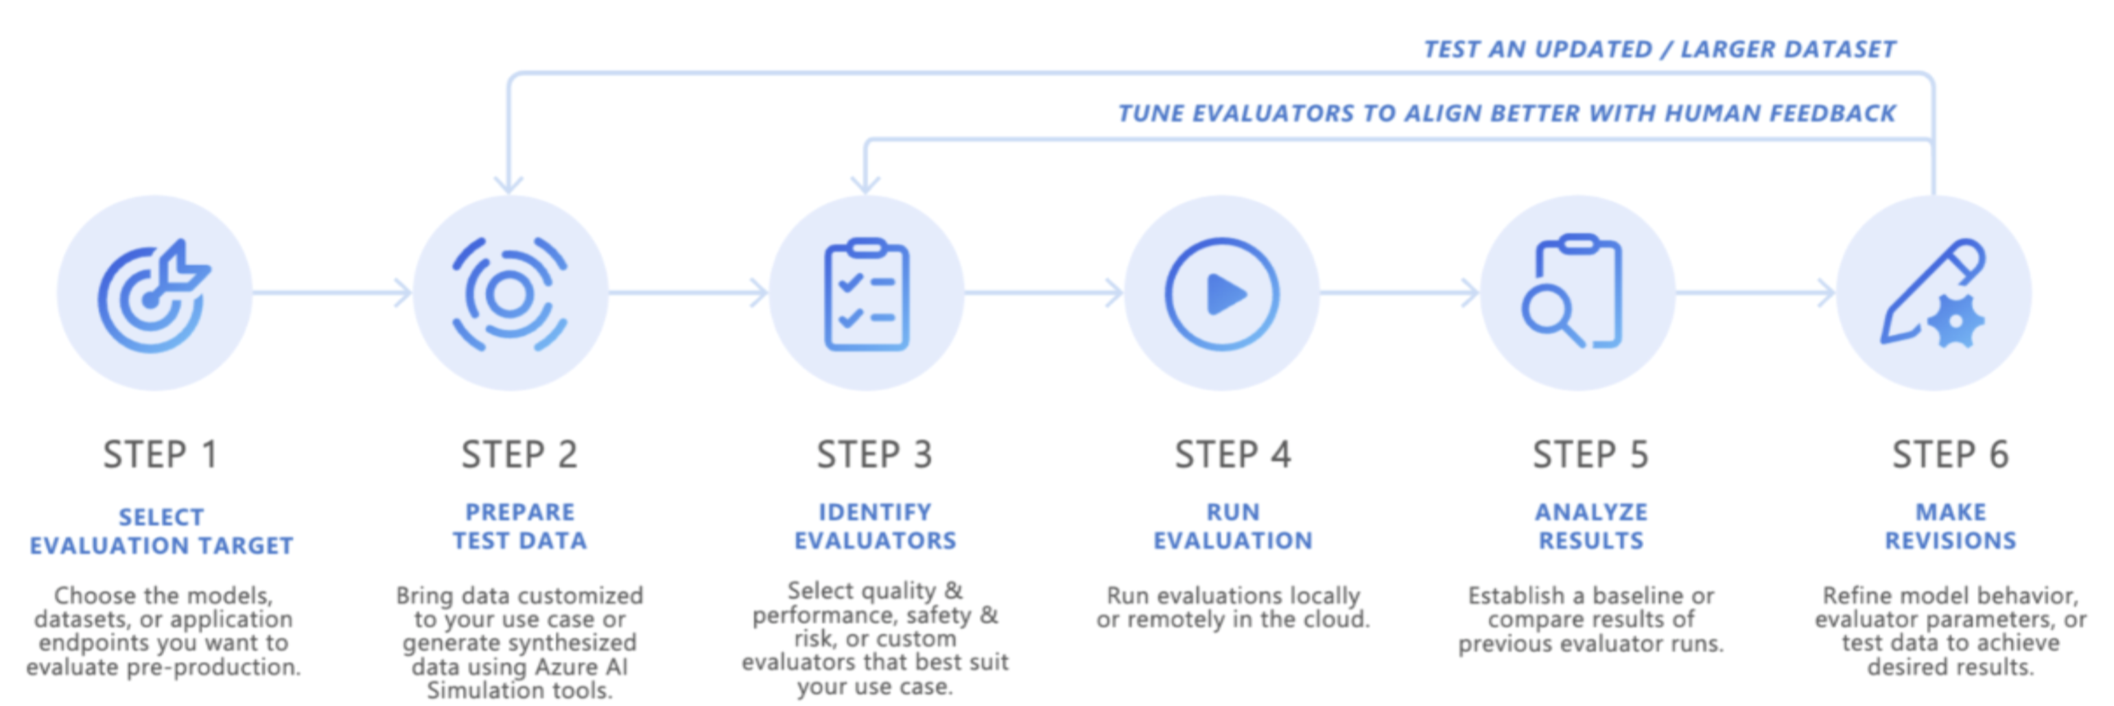
Pre-Production Evaluation Logical Flow
Notes:
I think this flow will clarify most of the questions in your mind. Let's walk through the pre-production evaluation logical flow step by step.
Step 1: Select Evaluation Target
First, you need to choose the models, datasets, or application endpoints we want to evaluate in a pre-production environment.
Step 2: Prepare Test Data
In this step, you prepare the test data. This involves bringing data customized to our use case or generating synthesized data using tools like the Azure AI Simulation tool.
Step 3: Identify Evaluators
In this step, you select the evaluators that best suit your use case. This includes quality and performance evaluators, safety and risk evaluators, or custom evaluators to measure different aspects of the AI model's performance.
Step 4: Run Evaluation
Once you have your evaluators in place, you run the evaluations. This can be done locally or remotely in the cloud, depending on your setup and requirements. Running evaluations helps you simulate real-world scenarios and gather data on how the model performs.
Step 5: Analyze Results
After running the evaluations, you need to analyze the results to find out the strengths and weaknesses of the chosen model and identify areas for improvement.
Step 6: Make Revisions
Based on the analysis, you could focus on selecting different model or changing model parameters or prompt engineering or selecting different evaluators or updating the test data and so on….
By following this logical flow, you can systematically evaluate your GENAI solution and make informed decisions about their readiness for deployment.
Now that we've covered the logical flow, lets look into the practical aspects of evaluations in AI Foundry.

Slide 40
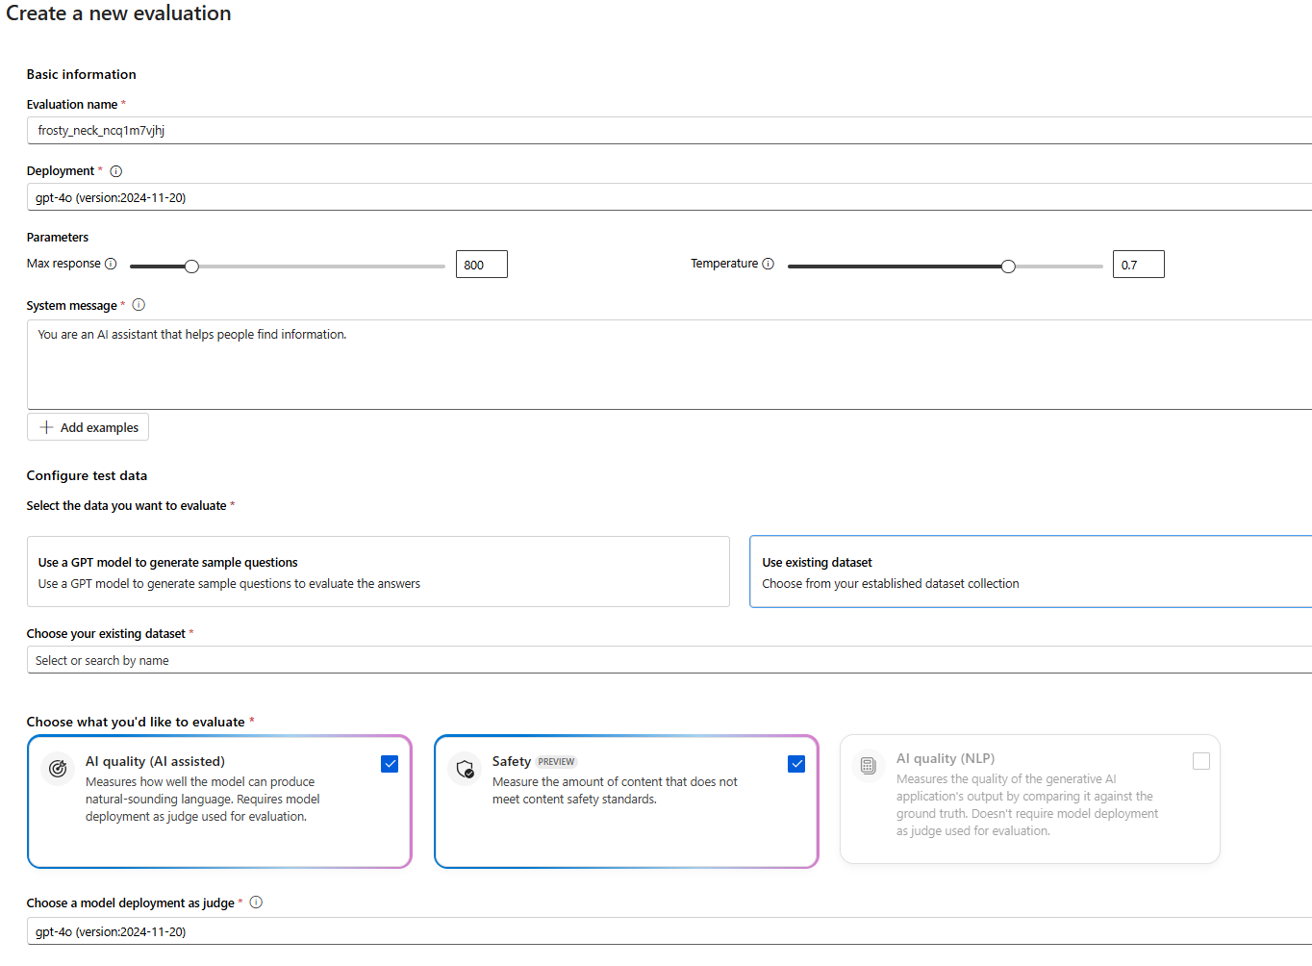
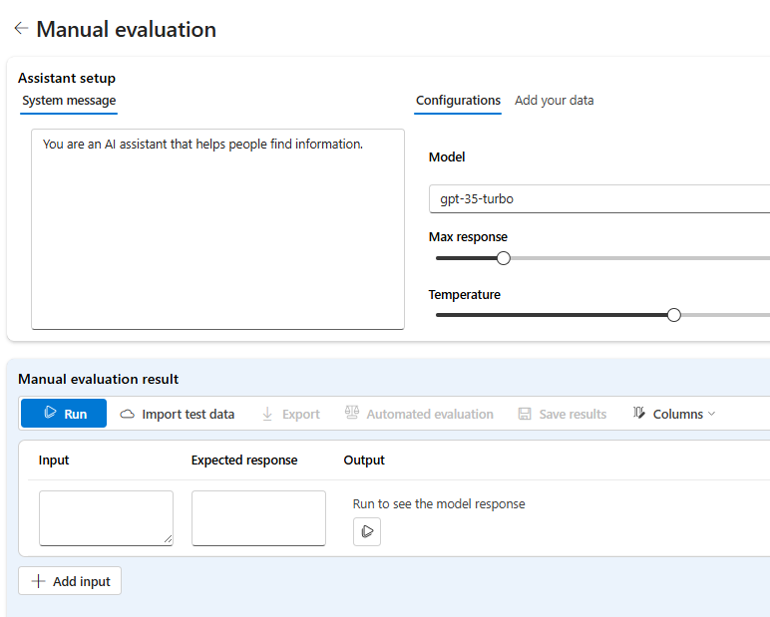
Model Evaluation in AI Foundry
Automated Evaluation
Manual Evaluation
Trade off
  Cost vs Quality
Cost vs Performance
Benchmark Datasets:
  Human_eval
  Truthfulqa_generation
  OpenBookQA
Notes:
. Lets look at both automated and manual evaluation processes.
On the left side of the slide, you can see the automated evaluation. Here, you input the basic information such as the evaluation name, description, and the model you want to test. You can also configure specific parameters like the maximum response length and temperature. This setup allows you to use pre-defined datasets or generate new ones by using LLMs. Additionally, you can choose specific criteria for evaluation, such as safety metrics or AI quality.
On the right side, we have the manual evaluation setup. You can set up the assistant with a system message and configure the model parameters directly. The manual evaluation allows you to input test data and compare the expected response with the model's output.

Slide 41
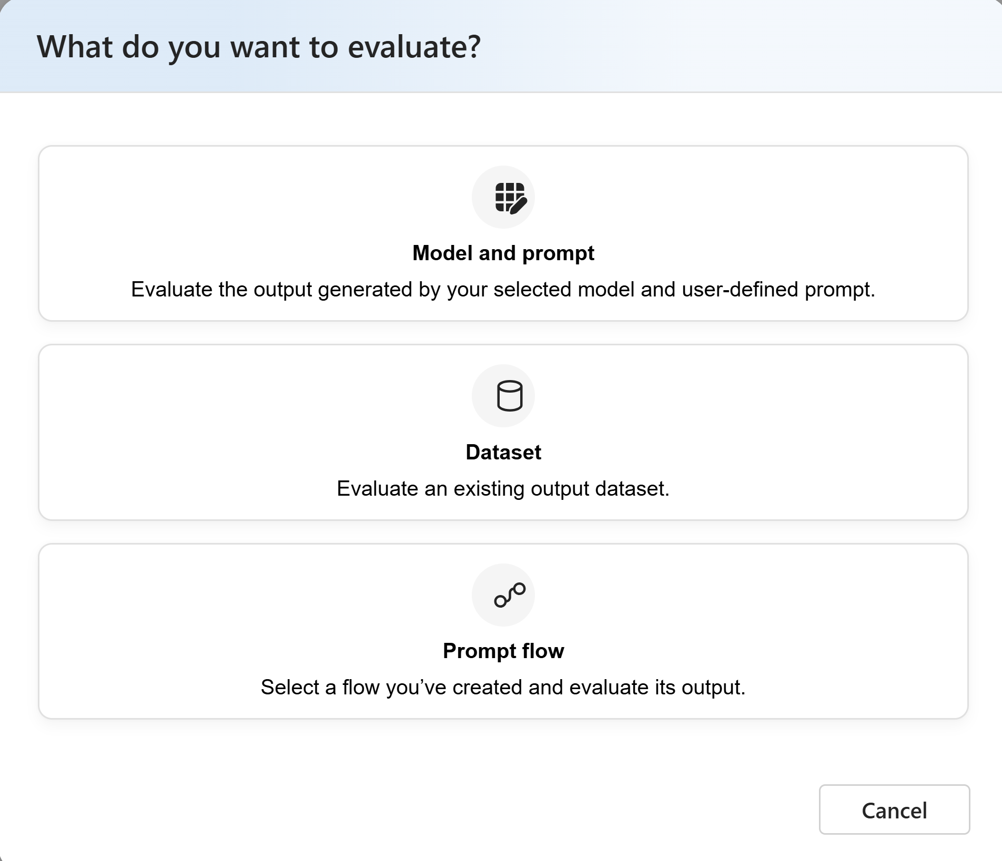
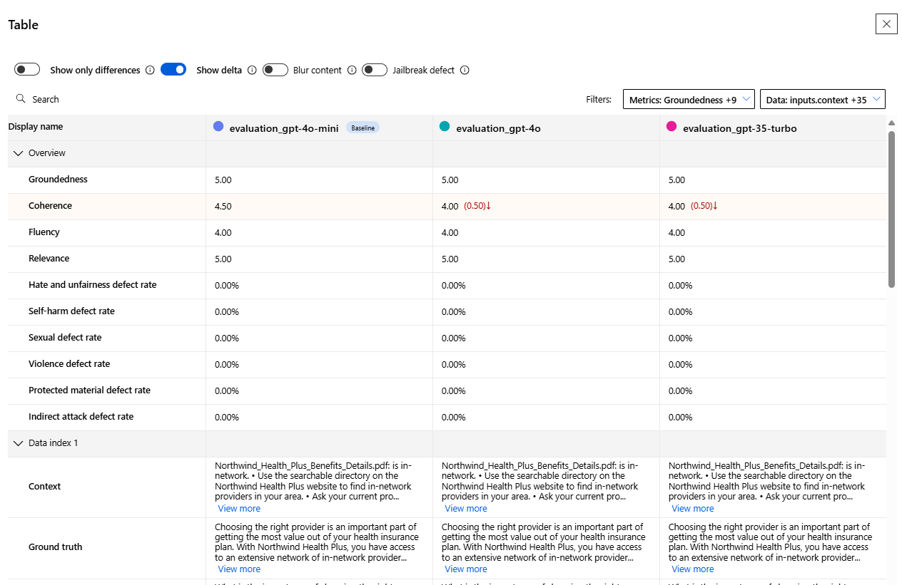
Automated Model Evaluation Options in AI Foundry
Automated Evaluation
Evaluation Outputs
Notes:
On this slide, we see the different options available for automated model evaluation in AI Foundry. The first option is "Model and prompt," which allows you to evaluate the output generated by your selected model and a user-defined prompt. This is useful for testing specific interactions and responses.
The second option is "Dataset." Here, you can evaluate an existing output dataset, which is beneficial for assessing the model's performance across a broader range of data inputs and scenarios.
The third option is "Prompt flow." This allows you to select a flow you've created and evaluate its output. This is particularly useful for complex workflows where multiple prompts and responses are linked together.
On the right side of the slide, you see the evaluation outputs. These include various metrics such as groundedness, coherence, fluency. This comprehensive evaluation helps you understand the model's strengths and areas for improvement.

Slide 42
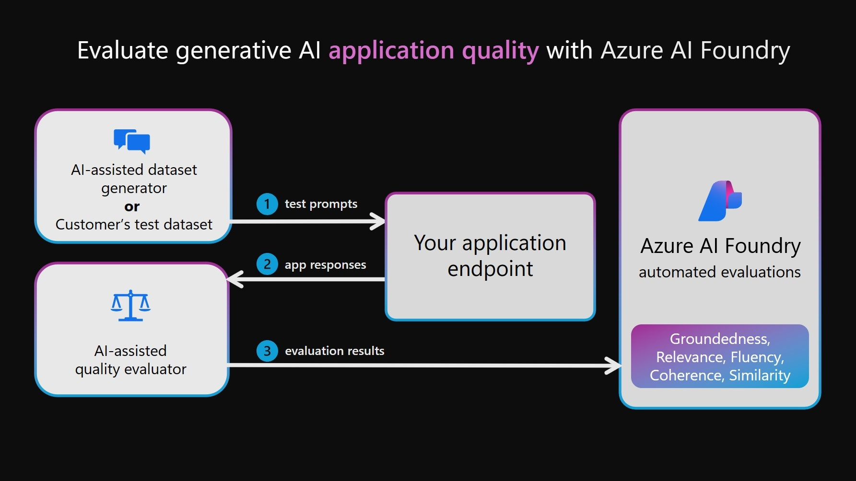
Application Evaluation
Notes:
Lets discuss the application evaluation process with Azure AI Foundry.
As illustrated on this slide, the evaluation process begins with either an AI-assisted dataset generator or a customer’s test dataset. This step is crucial for generating synthetic data and simulating various user interactions, both typical and adversarial. Using Simulator, developers can create an end-to-end synthetic data generation capability to test their application's response to user queries in the absence of production data.
Next, these test prompts are sent to your application endpoint. The application responds to these prompts, and these responses are then fed into the AI-assisted quality evaluator to assess the model's performance against predefined criteria like groundedness, relevance, fluency, coherence, and similarity.

Slide 43
Azure AI Inference SDK (Preview)
Multi Model Support
Tracing
Available in C#,Python, JavaScript
Work with multiple orchestration
Notes:
Now, lets look into another feature which is “Azure AI Inference SDK”, currently in preview. This is really cool because it is designed to further enhance both the evaluation and deployment processes of your AI models.
Firstly, it offers Multi Model Support, allowing you to work with different AI models seamlessly. This flexibility is crucial for testing and deploying multiple models within the same framework, ensuring you can switch or compare models without significant overhead.
Next, the SDK includes Tracing capabilities. This feature helps you track and log the performance and behavior of your models in real-time. Tracing is incredibly valuable for debugging and optimizing your AI applications.
Also it is vailable in C#, Python, and JavaScript, making it accessible to a broad range of developers.
Lastly, it is designed to Work with Multiple Orchestration systems. This means you can deploy and manage your AI models across various orchestration platforms.

Slide 44
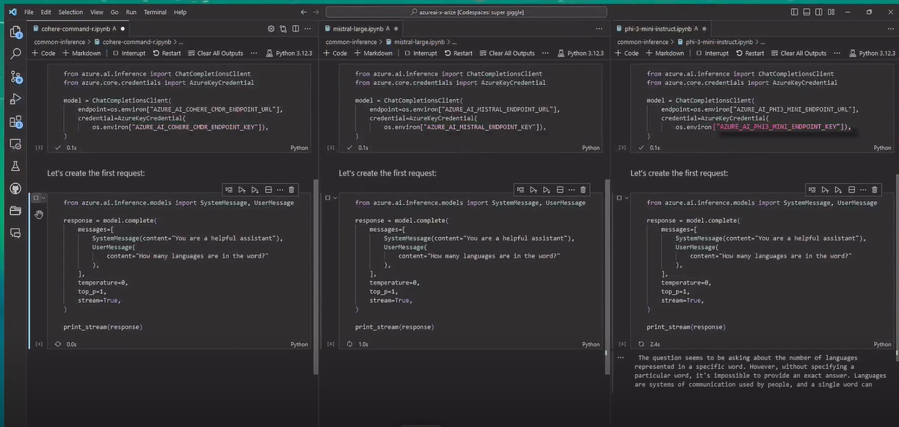
Azure AI Inference SDK (Preview)
Notes:
Azure AI Model Inference API - Azure AI Foundry | Microsoft Learn
Having a uniform way to consume foundational models allow developers to realize all those benefits without sacrificing portability or changing the underlying code.
Easily switch models with inference API without changing code
PG- for GA date?

Slide 45
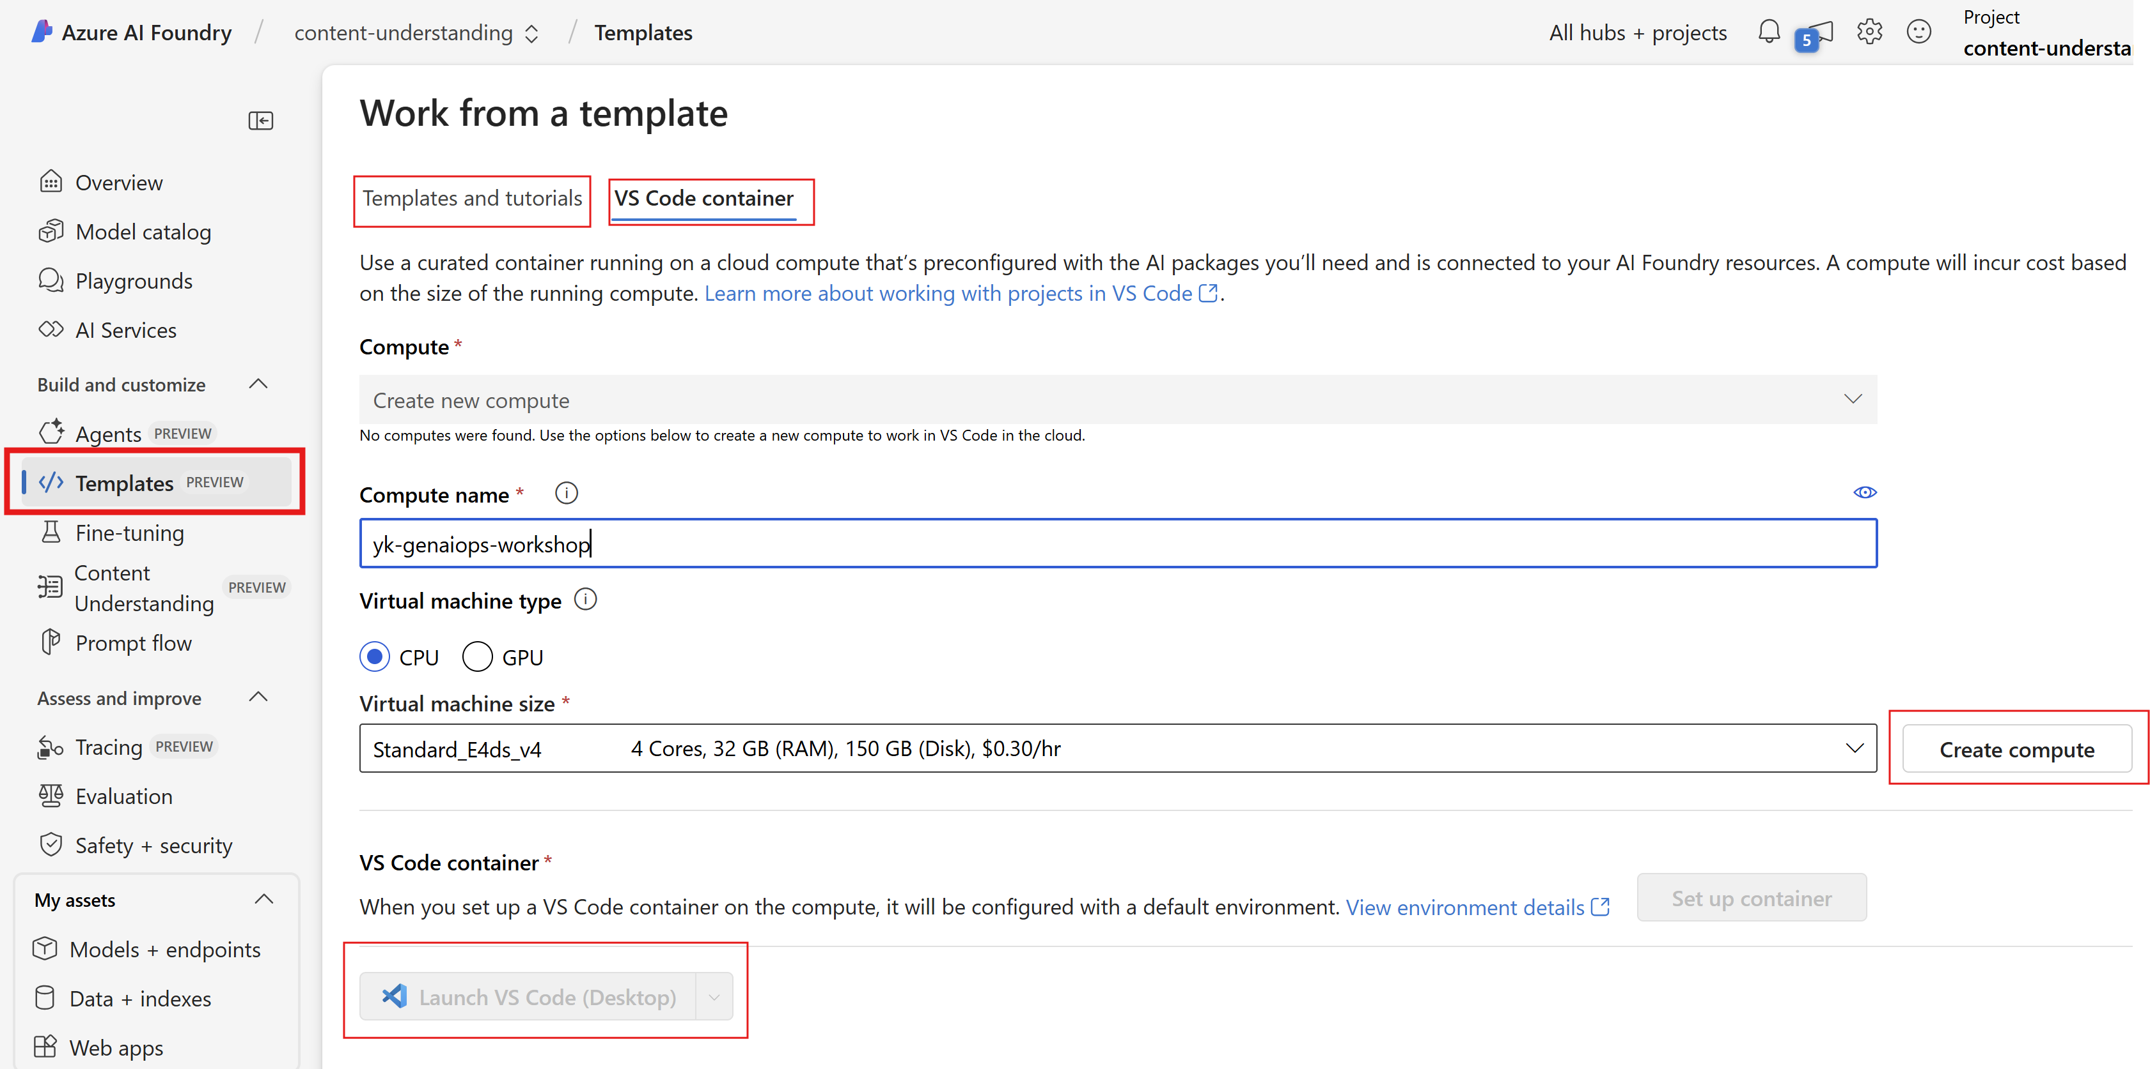
VS Code Integration on AI Foundry (Preview)
Notes:
And another great feature for developers to streamline the development process.
First, you can see the "VS Code container" option, which allows you to use a curated container running on a cloud compute instance. This instance is preconfigured with all the AI packages you'll need and is connected to your AI Foundry resources.
You can create new compute instance or select existing CI, then you can set up the VS Code container. This will configure the environment with all the necessary dependencies. Finally, you can launch VS Code directly from the AI Foundry interface, which will provide you with a seamless development environment to work on your AI projects.
The integration with VS Code really simplifies the process, enabling developers to focus more on coding and less on setup.
You can also find templates and tutorials to help you get started quickly.

Slide 46
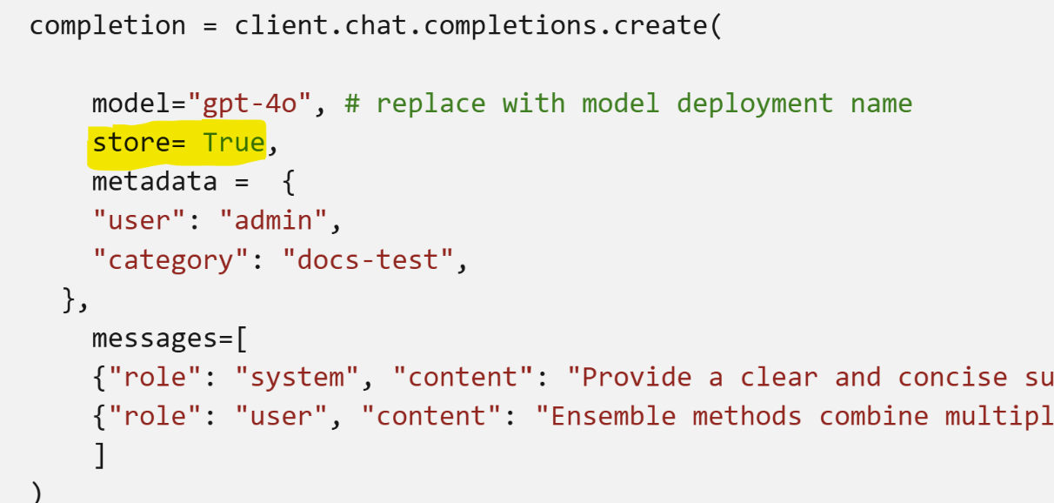
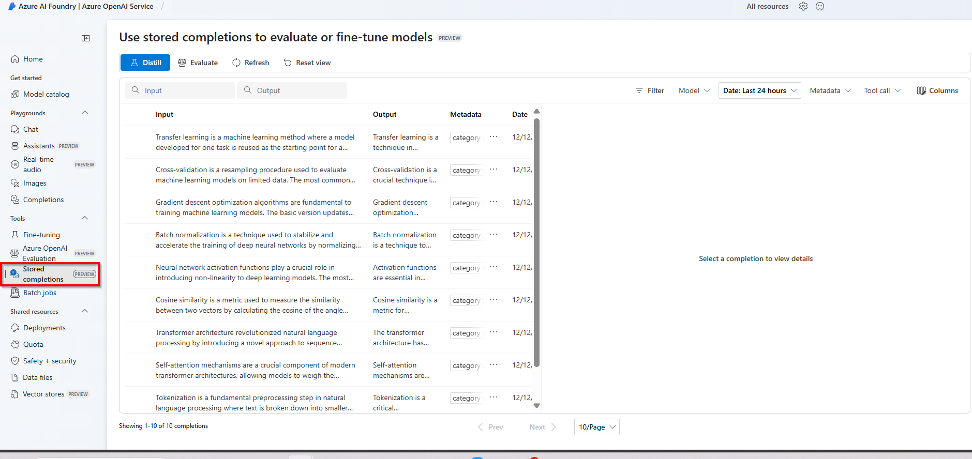
Azure OpenAI Stored Completions
& Distillation (Preview)
Stored completions allow you to capture the conversation history from chat completions sessions to use as datasets for evaluations and fine-tuning.
Notes:
Another important feature in preview which enhances our model evaluation and fine-tuning processes….. which is a powerful feature for capturing conversation history from chat completion sessions. Once stored completions are enabled for an Azure OpenAI deployment, they start appearing in the Azure AI Foundry portal under the Stored Completions pane.
This is particularly useful because stored completions allow you to create datasets from real interaction data. These datasets can be used to evaluate the model's performance across different tasks and dimensions.
And distillation is another valuable process where you can turn your stored completions into a fine-tuning dataset.
Evaluating and fine-tuning models with stored completions can significantly ease your work.
let's move on to our next slide….

Slide 47
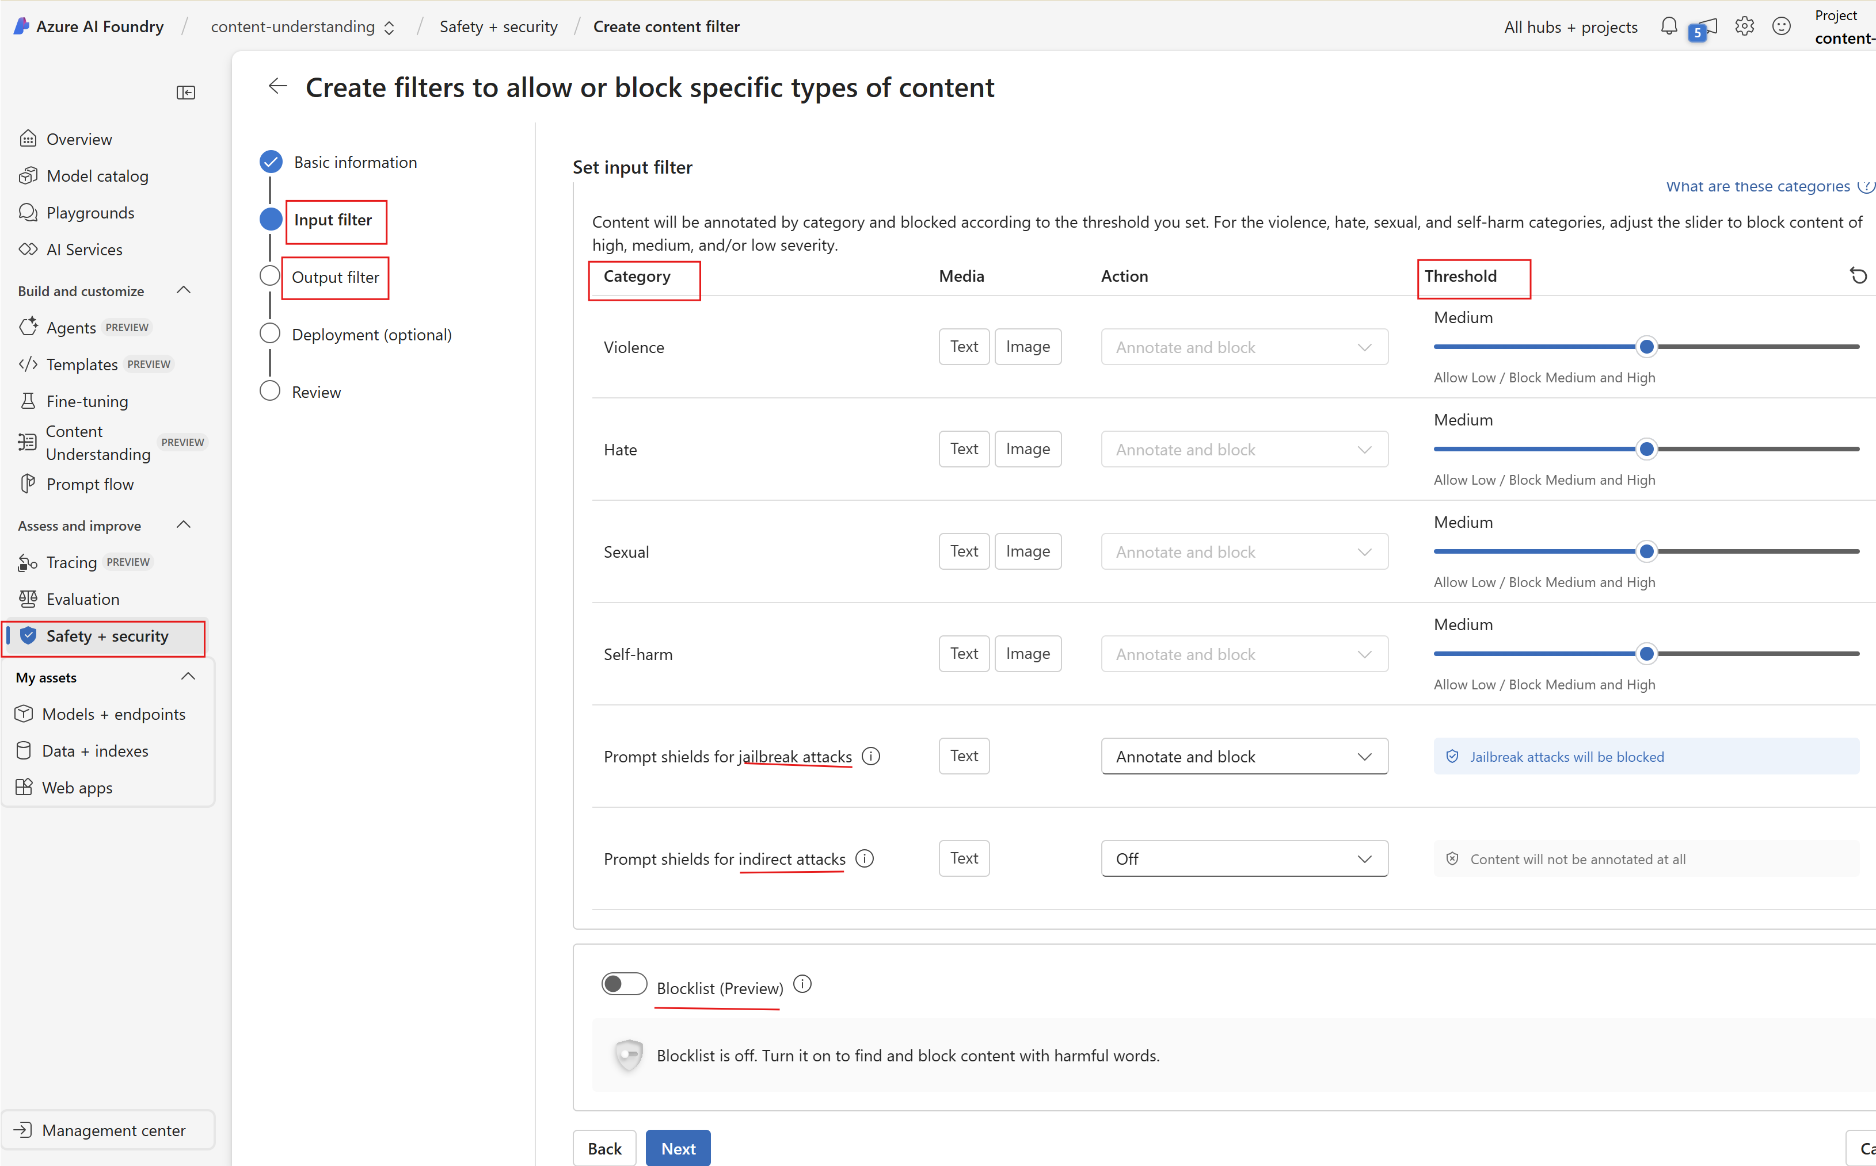
Azure AI Content Safety
Incorporating Responsible AI into GenAI applications
Benefits
Best in class Responsible AI
Effective on AI and human content
Tunable for your use case
Easily Integrated
Already in Azure OpenAI
Native type in Prompt Flow
Or, as a stand-alone service
Notes:
Azure AI Content Safety is already integrated into Azure OpenAI and can be used natively in Prompt Flow or as a stand-alone service. This makes it easy to incorporate into your existing workflows without significant changes.
This service is customizable and you can create different content filtering configurations and attach them to the model deployments.By this way, you have the flexibility using different content filters for different use cases.
Incorporating responsible AI into GenAI applications is crucial for maintaining trust and ensuring ethical use of AI technologies.

Slide 48
APIM as AI Gateway for Production
Traditional
AI Gateway
OpenAI service
per use case
Central AI Gateway
Multiple use cases using consistent hub
Seamless integration
Just update endpoint and keys in existing apps & frameworks
AI routing engine
Based on performance, model or priority
Pluggable Architecture
Centrally add new capabilities to your AI pipelines
Using master keys
Different endpoint per AI service
Capacity management
Flexible rate limiting based on requests/tokens
Resiliency
Enabling building highly reliable AI apps
Many tools,
ad hoc deployments
Usage metrics
Generate usage reports for each use-case/team
Full observability
Detailed insights for performance and exceptions
Decentralized governance
Granular access control
No master keys are used, only gateway keys
Hybrid support
Central gateway & backends can be deployed on-premises
https://github.com/Azure-Samples/ai-hub-gateway-solution-accelerator
Notes:
And AI gateway for production… In the second circle, building and augmenting stage, you need to think about other requirements which are not specific to one use case. So you need AI Hub Gateway providing a streamlined approach to managing AI services in production environments.
In the traditional model, organizations often face several limitations such as managing separate OpenAI services for each use case, dealing with master keys, handling multiple endpoints, and navigating decentralized governance. This can be complex and error-prone.
The AI Hub Gateway addresses these challenges by providing a centralized and unified approach. One of the key features is the Central AI Gateway, which allows multiple use cases to be handled through a consistent hub. This simplifies the management and access to AI services.
Another important feature is the AI Routing Engine, which dynamically routes requests based on performance metrics, model requirements, and priorities. This ensures optimal resource utilization and enhances the overall efficiency of AI operations.
Additionally, the AI Hub Gateway offers robust capacity management with flexible rate limiting to prevent overload and maintain stable performance. It also generates detailed usage metrics, which help in better resource and cost management.
Security is also enhanced with granular access control, eliminating the need for master keys and replacing them with gateway-specific keys.
By adopting the AI Hub Gateway, organizations can significantly enhance their AI capabilities, streamline operations, and improve security and governance.

Slide 49
Conceptual understanding of the use case
aka.ms/GPT-RAG
Well-architected Framework + Zero Trust Principles
Perform:
Customized Data Sourcing
Vector Generation
Ingestion
Azure OpenAI
Bring Your Own Data
AI Search
Embedding Integration
Modular
&
Scalable
Orchestrator
Cosmos DB Integration
Front End
Chat UI
Design Patterns Best Practices
User Friendly Experience
Comprehensive Accessibility Options
Frontend
Notes:
10 BREAK
Now Paulo will explain the conceptual architecture and high level architecture at this stage and demonstrate important capabilities in this “building and augmenting” stage.

Slide 50
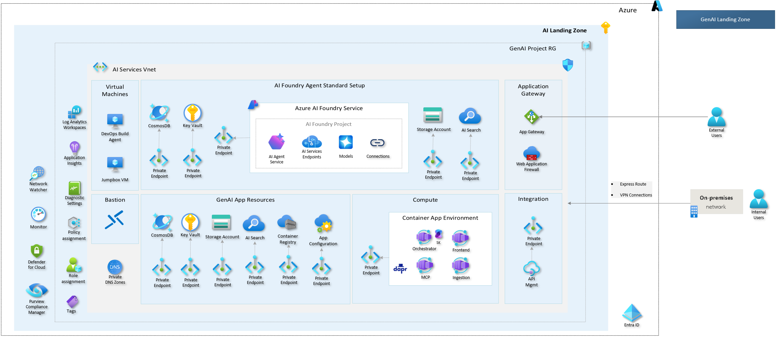
Building Use Case architecture diagram Step by Step
Notes:
Container app
Front End
Storage-> cosmos
Models: gpt40mini Standard, PTU
Remove “deploy”
Azd ? CD pipeline for dev env: Github actions/ado
An API management platform for back-end Azure OpenAI endpoint access. It provides monitoring and logging capabilities that aren't available natively in Azure OpenAI. API Management also provides monitoring, logging, and managed access to Azure OpenAI resources.

Slide 51
Demonstration
Provisioning Resources, AI Foundry Project Set Up, APIM integration “Building & Augmentation” Stage in GenAI LifeCycle
Notes:
15min
Show AZD / Provisioning / IaC
- Show Resources in the Portal
- Show AI Foundry (Hub/Project) - Explore project setup
- Show APIM Integration

Slide 52
Demonstration
Evaluations “Building & Augmentation” Stage in GenAI LifeCycle
Notes:
- 10 min
-Demo evaluation using GenAI metrics targeting the RAG orchestrator.
- Show results in the evaluation screen.

Slide 53
GenAI Lifecycle and Best Practices
ADVANCE PROJECT
Orchestraion Integration Debugging
ADVANCE PROJECT
Security and data privacy
Deploy LLM App, UI, Model, Workflow
Define Metrics Evaluation
Continuous Evaluation & Monitoring Quota & Cost Management
Techniques - Prompt Engineering, RAG, Fine-tuning
BUSINESS
NEED
Test Prompts
Choose LLM or SLM
Establish feasibility
Define Use Case
Prove that it works
Building & Augmenting
Deploying & Monitoring
Data
REVERT PROJECT
REVERT PROJECT
Prototyping
Ideating & Explore
Optimizing
Design & Customize
Operationalizing
Manage & Optimize
Notes:
Thank you, Paulo, for the excellent demo. Now, lets continue with the third circle “Operationalizing” stage. This stage is crucial as it encompasses deployment, monitoring, and ensuring that Large Language Models (LLMs) are seamlessly integrated into systems while maintaining safety and filtering out any harmful content.
As you can see in the diagram, this stage captures the transition from development to production.
Now, let’s move to the next slide to explore Azure capabilities for operationalization.

Slide 54

Azure Capabilities for GenAI Operationalization
Ops
AI Foundry
APIM
Azure Monitor
Azure DevOps
Github Actions
Built-in Safety
Built-in Github Actions Integration (Preview)
Performance/ Safety Monitoring
Quota Management
Managed Online
Endpoint
Secure Infra
Centralized Logging
Audit Trail
Secure Access
High availability
Charge back
Operational Monitoring
Alerts
Notes:
Azure provides a robust suite of tools for operationalizing your GenAI solution.
Let's start with the Ops section. Azure DevOps and GitHub Actions are essential for continuous integration and continuous deployment (CI/CD). They ensure that your code and models are seamlessly integrated and deployed without manual intervention. This is crucial for maintaining a smooth workflow and minimizing downtime.
Moving on to AI Foundry, which plays a pivotal role across all aspects of development. It offers built-in safety features and GitHub Actions, monitoring performance and safety metrics, including token usage per the deployed model. You can do quota management and secure infra set up.
Next one, APIM, or Azure API Management, is another critical component. It offers centralized logging, secure access, audit trails, high availability, and chargeback features. This ensures that your APIs are secure, reliable, and cost-effective.
Lastly, we have Azure Monitor, which provides operational monitoring and alerts. This is essential for keeping an eye on the health and performance of your AI applications. With Azure Monitor, you can set up alerts to notify you of any issues, so you can address them promptly.
Now, let's move on to the next slide where we will explore the options for deploying GenAI workflows.

Slide 55
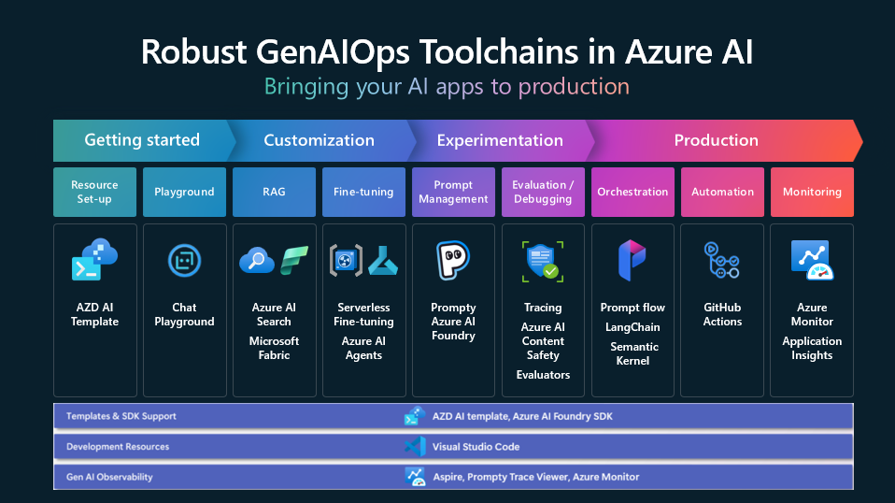

Slide 56

AI Workflow Deployment Options
Name
When to Use It
Advantages
Considerations
Managed Online Endpoints | For users who want a managed model deployment and enhances MLOps experience. | Users don't need to worry about the infrastructure, maintenance or logging & monitoring as its all managed by Ai Foundry preconfigured environment. | You'll get less control about how the deployment environment will be configured compared to other deployment options.
App Service | For users who want to build, deploy, and scale web apps quickly | Fully managed platform with built-in DevOps capabilities | Less control over underlying infrastructure. Not suitable for complex container orchestration.
Azure Container App | For users who want to deploy and manage containerized applications without dealing with Kubernetes complexities, | Simplifies deployment in a serverless environment while providing Kubernetes features | Limited customization compared to full Kubernetes access
Azure Kubernetes Service | For users who prefer Kubernetes and can self-manage the infrastructure requirements. | Gives the user control over more aspects of the deployment that they may not get with other options. | Virtual networks, compute type, monitoring & logging and node provisioning & maintenance, are the user's responsibility. Mirrored traffic is not supported.
Notes:
When we look to deploy our GenAI application, we have a handful of different choices available on Azure. We have four main options to discuss: Managed Online Endpoints, App Service, Azure Container Apps, and Azure Kubernetes Service.
Each of these options comes with its own set of advantages and considerations. Let's start with Managed Online Endpoints. This is ideal for users who want a managed model deployment, out of the box monitoring capabilities. The key advantage here is that users don't need to worry about infrastructure, maintenance, or logging. However, the trade-off is less control over how the deployment environment is configured compared to other options.
Moving on to App Service, this option is perfect for users who want to build, deploy, and scale web apps quickly. It offers a fully managed platform with built-in DevOps capabilities, making it very user-friendly. The downside is that it offers less control over the underlying infrastructure and is not suitable for complex container orchestration.
Then we have Azure Container Apps. This is designed for users who want to deploy and manage containerized applications without dealing with Kubernetes complexities.
Finally, there's Azure Kubernetes Service (AKS), which is for users who prefer Kubernetes and want to self-manage the infrastructure requirements.

Slide 57
Deploy LLM flows to Managed Online Endpoint
Optimize cost
Choose the right SKU
Auto Scale
Monitor and manage costs
Streamline development
LLMOps /DevOps with CLI
Local endpoints for
development & debugging
Shadow Traffic to dev environments
Enhance operations
Managed compute—no need to create and manage clusters
Safe rollout with
Traffic Management
Log and analyze metrics
Notes:
Value prop (“Why”) Managed Online Endpoint
Optimize cost: by allowing wide range of SKUs to choose from, by supporting auto-scale, and granular cost monitoring
Streamline development: with git, and local testing with vscode, and no code deployment.
Streamline operations: managed infrastructure, safe rollout, SLA monitoring etc
---
"As an ML engineer, I want to use DevOps pipelines to safely rollout new version of a model in production with validation gates in order to maintain production SLA and efficiently manage the rollout process"

Slide 58
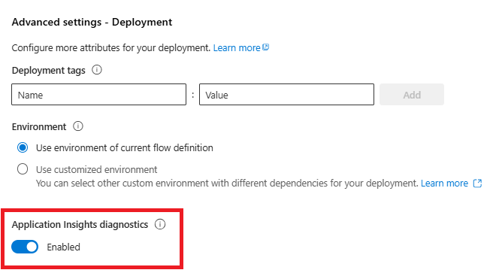
Tracing With Prompt Flow
Build in with managed endpoint
Monitoring per deployment

Slide 59
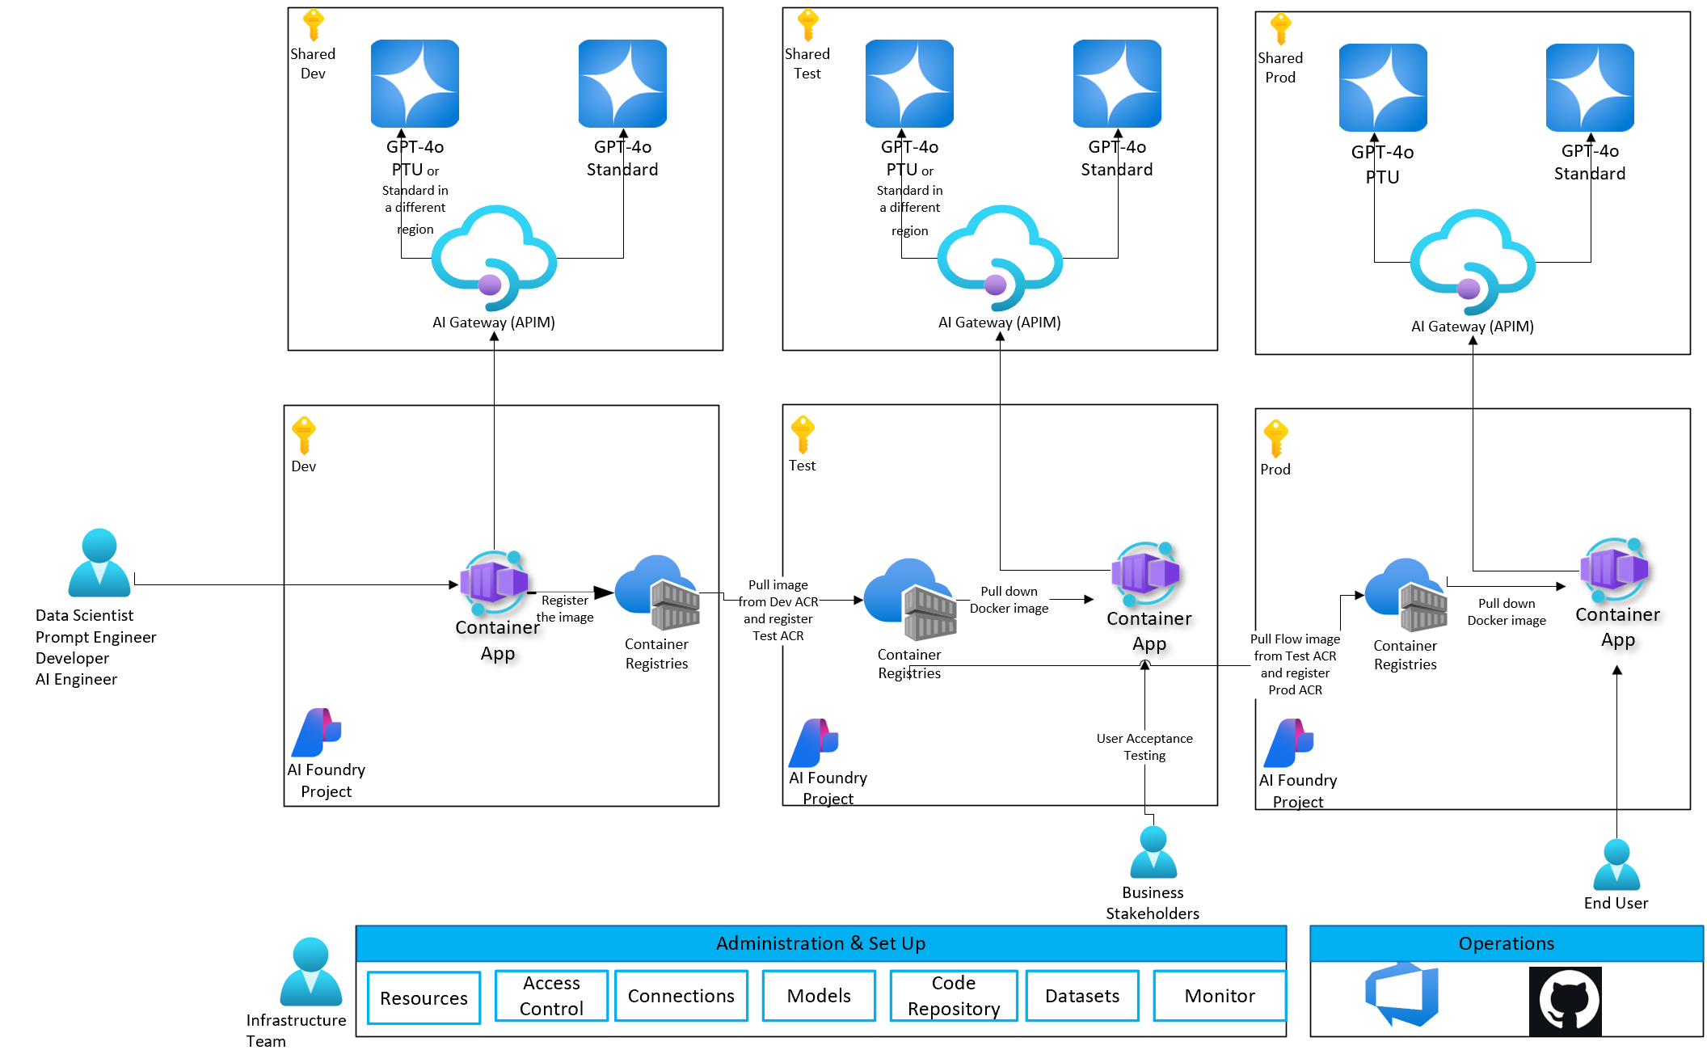
Final Use Case Architecture
Notes:
We assume all AI Landing Zone configurations done properly such firewall, private endpoints etc. We are not showing them in this arch.
The core approach involves deploying the solution via a container app and promoting the image across environments while adhering to the principle of immutability in higher environments.

Slide 60
Demonstration
E2E Demo
Notes:
Yes, so far, we’ve built the solution in development env. We would like to demonstrate how to integrate the GenAI solution with proper steps in github actions, which automates deployments and provide structured, customized operations tailored to your company’s needs.
This step is crucial for managing the fast-paced nature of GenAI technology and handling model retirements effectively.
Lets see it in action!
------------------------
E2E Demo (Feature Branch > (PR, CI, CD pipelines) Develop > Main) 40min
- Environments
- Pipelines
- GIt workflow
- Versioning / Tagging
You will see how to promote gen ai solution to test env for UAT and production env.
1- Version Control: Model versions monitoring in prod and other configurations
2- Lineage to data, model, prompt for auditability

Slide 61
How to monitor GenAI Apps in production?
Notes:
Yes, how to monitor GenAI Solutions in production…

Slide 62



Monitoring Options
Azure OpenAI Resource Level
AI Foundry Built-in Data collection: Azure OpenAI stored completions &distillation (Preview)
Evaluation SDK for performance metrics and safety metrics
Azure Monitor
AI Foundry Built-in Tracing for detailed logs of the workflow by Inference SDK(Preview).
Application Level
Application Insight: Application level log and metric stored in Log Analytics Workspace
Evaluation SDK for performance metrics and safety metrics
Built-in Monitoring: Generative AI Applications Dashboard (Preview)
API Management
Built-in Monitoring: Request and response is stored in Log Analytics Workspace
Evaluation SDK for performance metrics and safety metrics
Audit Trail
Notes:
There are various monitoring options available on Azure and it's crucial to understand how each of these can optimize your operations.
At the Azure OpenAI Resource Level, tools such as AI Foundry Built-in Data Collection, Built-in Tracing, Evaluation SDK and Azure Monitor play a vital role. They collect detailed logs and metrics, which are essential for performance evaluation and maintaining resource efficiency.
Looking at the capabilities at the Application Level, you have Application Insight for storing logs and metrics in the Log Analytics Workspace. And we can run Evaluation SDK on top of the data collected in the Log Analytics Workspace to measure performance and safety metrics.
And at the API Management level, you have built-in monitoring logs, requests and responses. Again, after you collect the data, you can leverage Evaluation SDK for performance and safety metrics, and use those logs for audit trails, chargebacks or SLA monitoring.
To encapsulate, all these monitoring options provide a comprehensive framework to ensure robust and efficient system operations. They allow you to manage production SLAs effectively and roll out new versions of models in production, maintaining high operational standards.

Slide 63
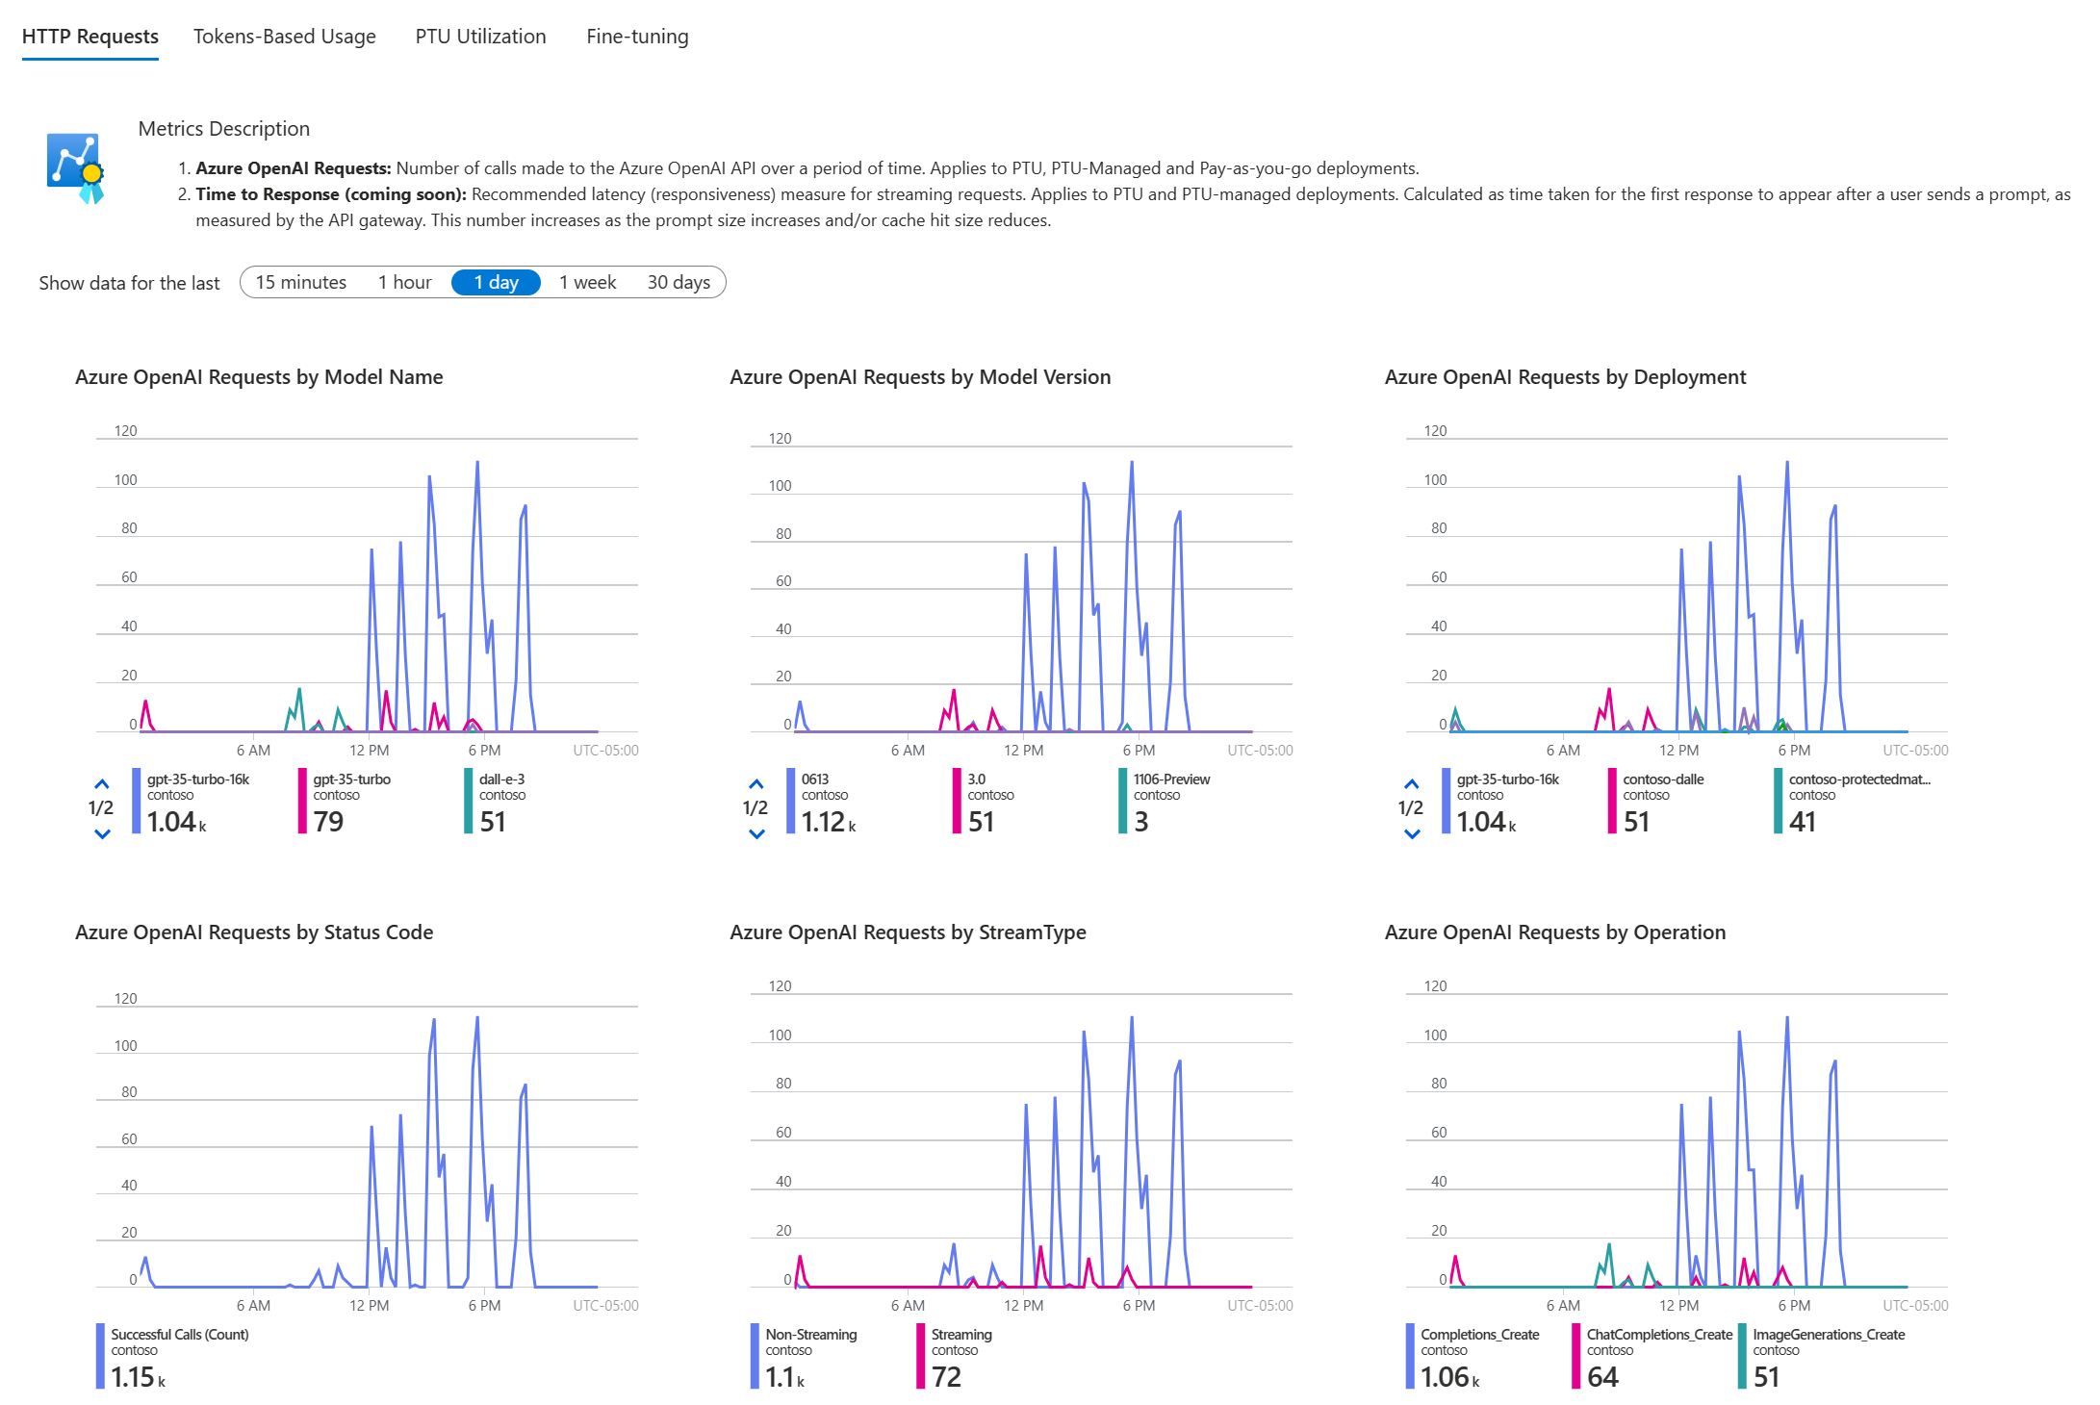

Azure OpenAI Resource Level: Operational Monitoring
Out-of-the-box dashboard for Azure OpenAI resources
Key features:
    4 categories: HTTP Requests, Token-based Usage, PTU Utilization, Fine-Tuning, Latency
Metric examples: Processed Prompt Tokens by Model Name, Generated Completions Tokens by Deployment, Azure OpenAI requests by deployment, Azure OpenAI Requests by Status Code, Provisioned Managed Utilization by Model Name, Processed Finetuned Training hours by deployment, Time to Response etc.
    Create alert rules based on signals.
Enable diagnostics setting to collect data
Notes:
This dashboard is out of the box and you can reach this on the AOAI resource level from Overview tab. This is segmented into four key categories: HTTP Requests, Token-based Usage, PTU Utilization, and Fine-Tuning. Each of these categories offers critical metrics to help you monitor and optimize your AI deployments.
For example, you can track Azure OpenAI requests by model name, model version, deployment, and status code. This allows you to understand the usage patterns and performance across different models and deployments, ensuring that you can quickly identify and resolve any issues.
And let's not forget the ability to create alert rules based on specific signals.
Additionally, enabling diagnostic settings allows you to collect detailed data, further enhancing your monitoring capabilities.
As large organizations increasingly adopt generative AI models, it becomes crucial to audit and log their usage to ensure responsible use and maintain corporate compliance.
This leads us to our next topic: API Management Logging Options.

Slide 64
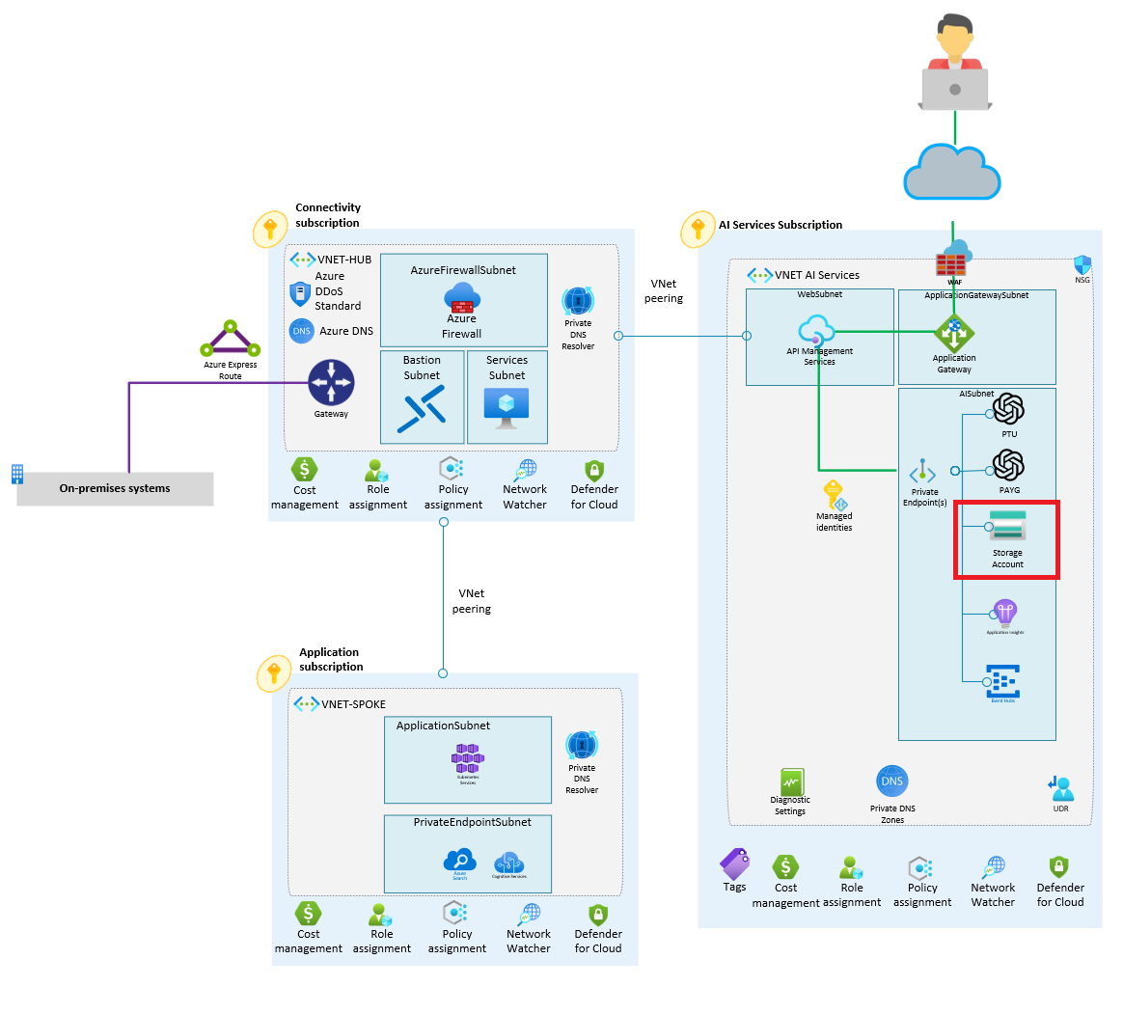
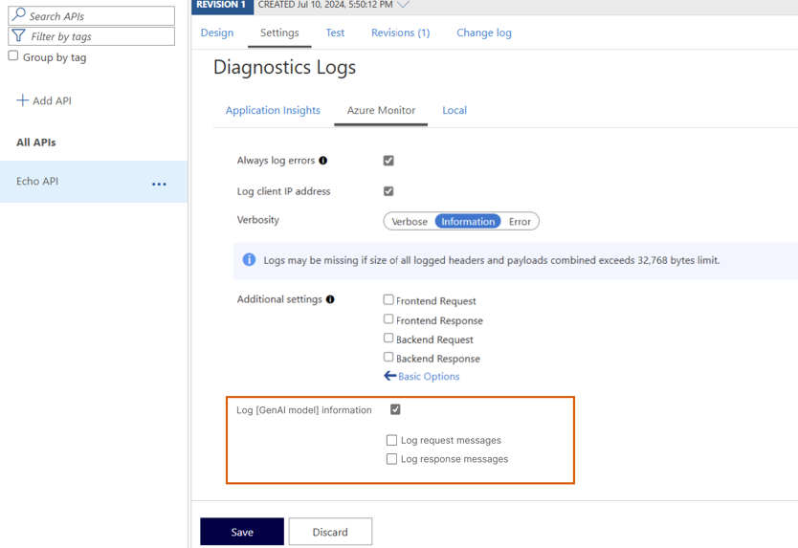
API Management
Logging Options
Blob Storage
Application Insights
Event Hub
APIM AI Monitoring
Notes:
Yes, the APIM Logging Options solution provides organization-level logging and monitoring capabilities for all interactions with AI models.
The various logging options available include Blob Storage, Application Insights, Event Hub, and APIM AI Monitoring. Each of these options offers unique advantages for storing and analyzing log data. For instance, Application Insights provides powerful analytics and visualization capabilities.
You can decide which logging option is best for your company to use while designing APIM in your AI Landing Zone.

Slide 65


Natural language and Reasoning engine
ONGOING PERFORMANCE TRACKING
Monitoring & Continuous Improvement
Post-prod
Incident response!!
Notes:
Now, speaking of monitoring, once we have these logging mechanisms in place, the next step is to ensure ongoing performance tracking and continuous improvement, even after going into production.
Post-production, it's essential to have a robust monitoring system integrated with evaluations in place for continuous performance tracking. Evaluations aren't just for the initial deployment; they are crucial for ongoing monitoring and continuous improvement.
By doing so, we can maintain high standards of service.

Slide 66
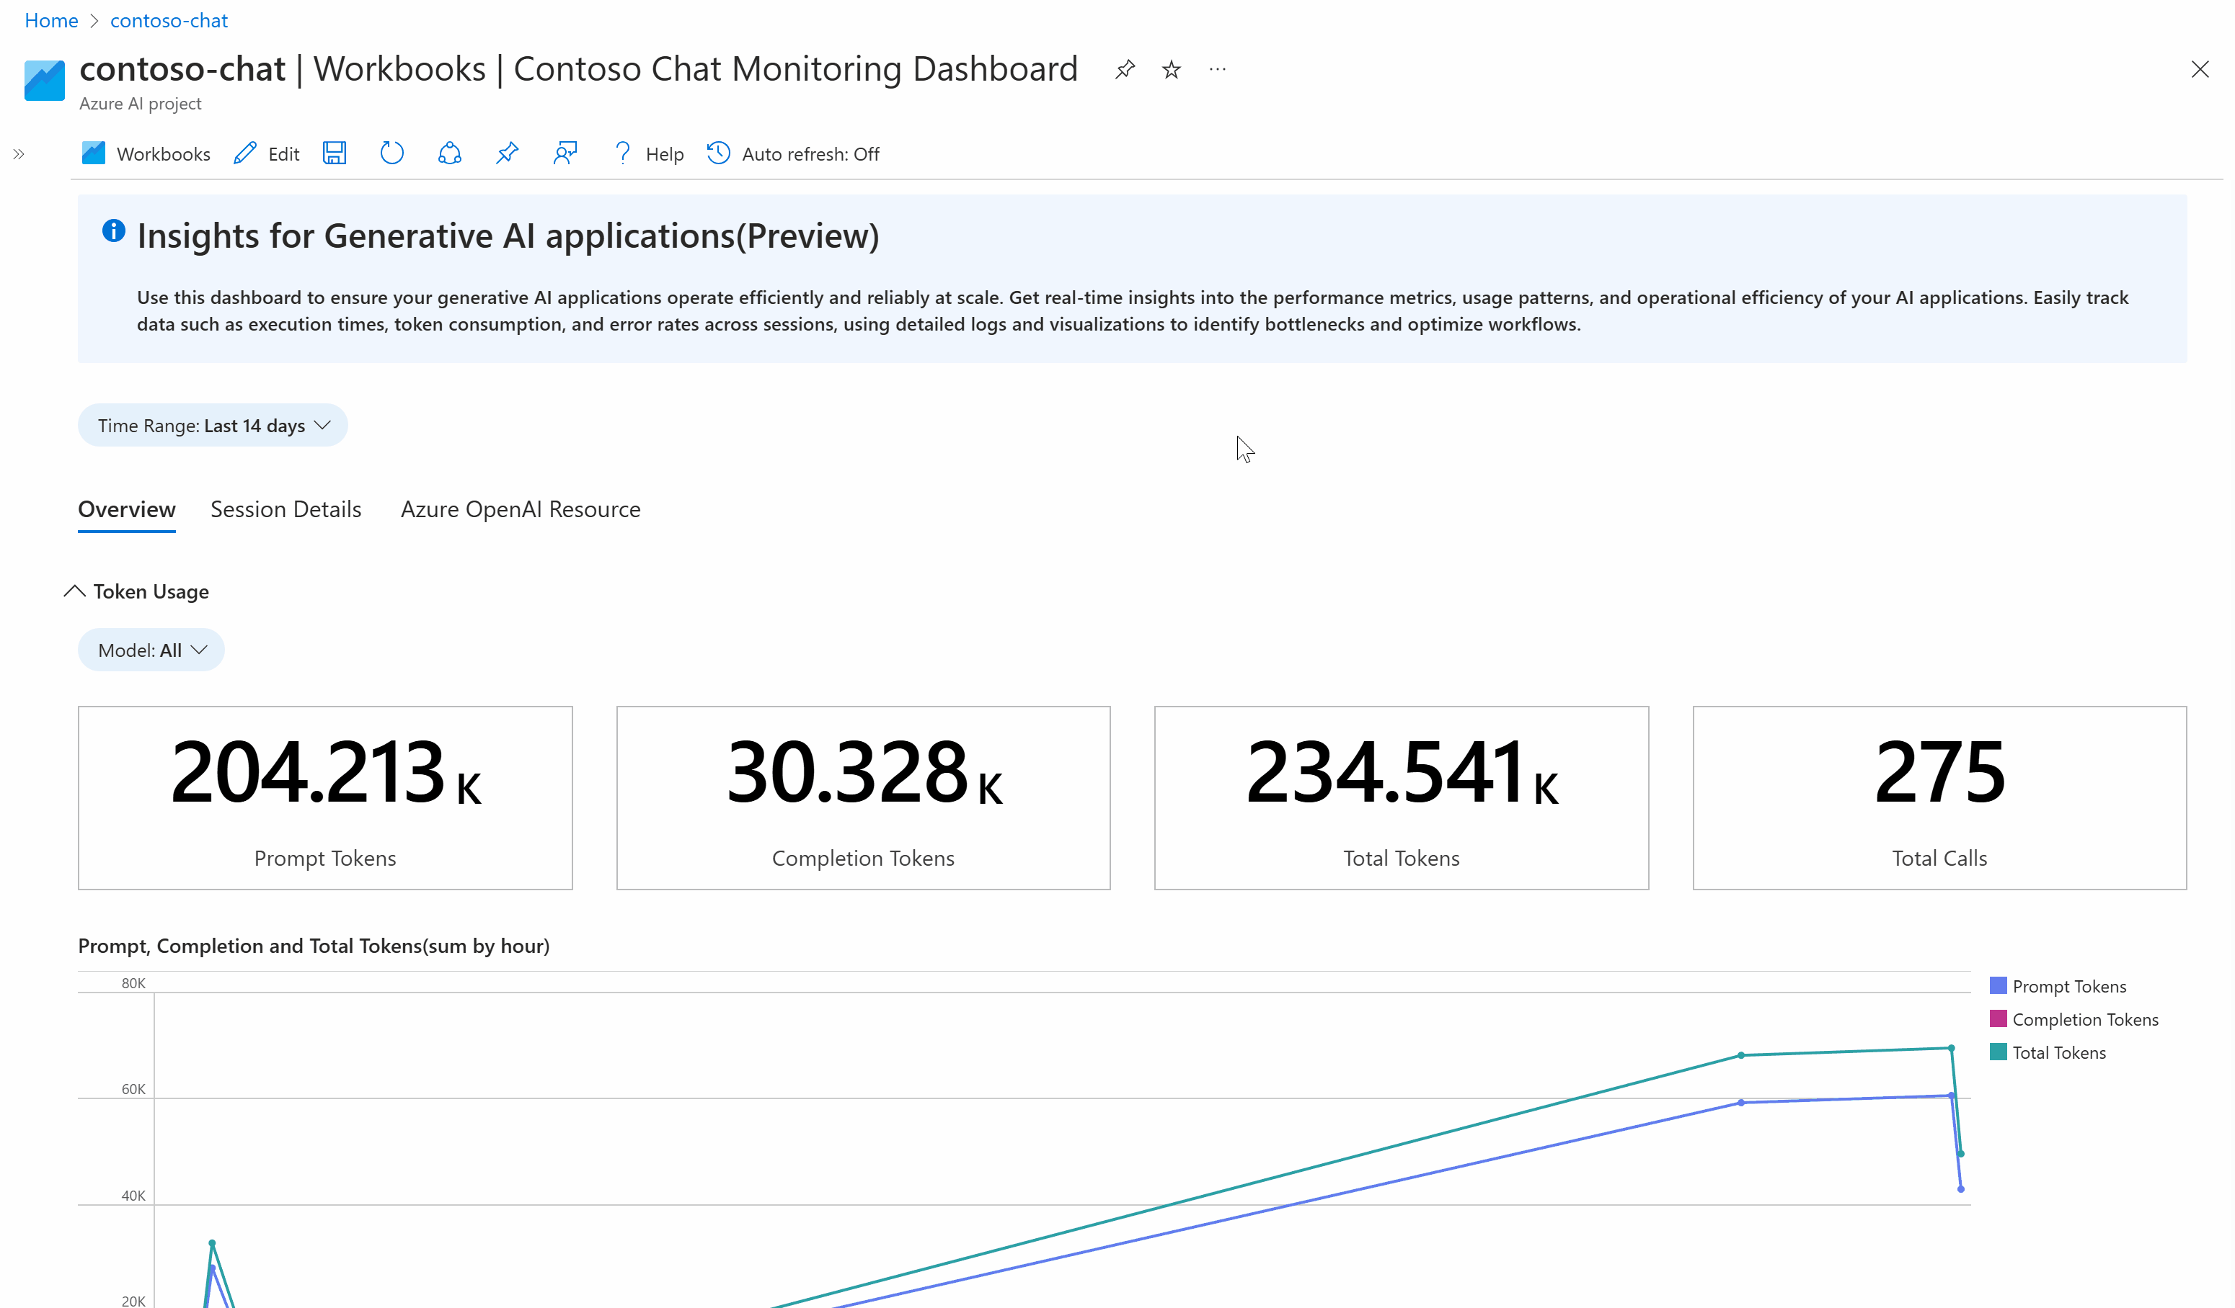
Online Evaluation: Generative AI App Dashboard (Preview)
Token Consumption
Evaluation Metrics
Support debugging
Notes:
In that case, let's now delve into the Online Evaluation which is named ad Generative AI App Dashboard. This preview feature is designed to provide real-time insights into the performance and usage of your generative AI applications.
The dashboard offers several key metrics that are essential for monitoring and evaluating AI applications. This provides you to view Evaluation Metrics to assess the performance of your GenAI solutions.
The dashboard also supports debugging by offering detailed logs and metrics that help identify and resolve issues quickly. We can see some of these detailed logs in the video being played on the slide.
By providing a comprehensive view of token consumption, evaluation metrics, and support for debugging, this dashboard empowers developers to manage and optimize their AI applications effectively.

Slide 67
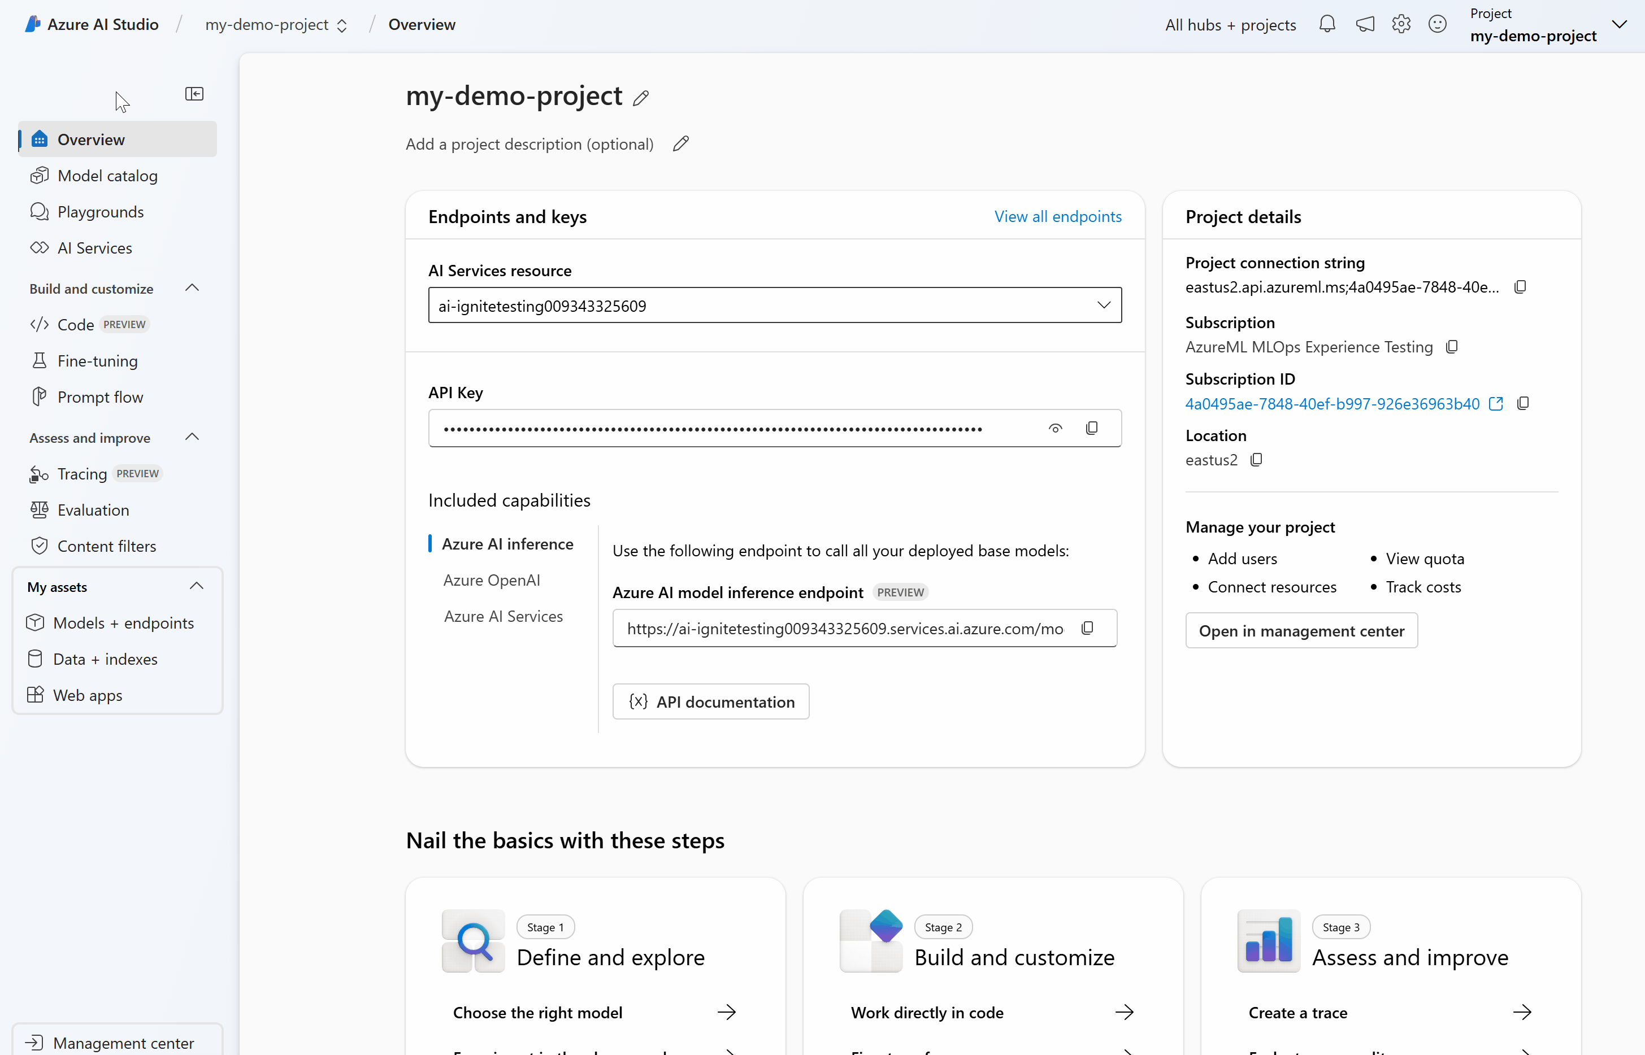
Tracing on AI Foundry(Preview)
Enhanced observability
User-centric design
Seamless instrumentation
OTEL based tracing
Secure data handling
Feedback logging
Notes:
And Tracing feature which is designed to provide enhanced observability and debugging tools for any GenAI applications.
It provides Enhanced Observability. This feature offers clear insights into the entire Gen AI Application lifecycle, making it easier to identify and resolve issues.
This means that developers can spend more time on innovation and less time on troubleshooting.
Seamless Instrumentation is also a key feature. It allows for the seamless integration of telemetry into the Azure AI Inference API. This ensures that you can monitor performance and debug issues without any additional overhead.
All these features combined make Tracing on AI Foundry a powerful tool for developers. It enhances observability, simplifies debugging, and ensures secure data handling, all while maintaining a user-centric approach.

Slide 68
Demonstration
Monitoring
Notes:
And our final demo will focus on Monitoring, specifically the "Deploying & Monitoring" stage in the GenAI Lifecycle. This demo will showcase how to effectively monitor GenAI applications to ensure they operate safely and meet both business and ethical standards.

Slide 69
GenAI Lifecycle and Best Practices
Managing
ADVANCE PROJECT
Orchestraion Integration Debugging
ADVANCE PROJECT
Security and data privacy
Deploy LLM App, UI, Model, Workflow
Define Metrics Evaluation
Continuous Evaluation & Monitoring Quota & Cost Management
Techniques - Prompt Engineering, RAG, Fine-tuning
BUSINESS
NEED
Test Prompts
Choose LLM or SLM
Establish feasibility
Define Use Case
Prove that it works
Building & Augmenting
Deploying & Monitoring
Data
REVERT PROJECT
REVERT PROJECT
Prototyping
Ideating & Explore
Optimizing
Design & Customize
Operationalizing
Manage & Optimize
Notes:
The Management loop encompasses the prototyping, building, and operationalization phases, focusing on governance, security, and compliance. This loop ensures that all activities align with strict standards while preserving the agility required for rapid development. It establishes a framework that balances speed with a rigorous commitment to best practices.
Azure AI services are designed to address and simplify the inherent complexities of the Enterprise GenAI Lifecycle.

Slide 70
Azure Capabilities for Management
RBAC
Azure AI Foundry
For all Azure AI Services
Management Center
Policies
APIM
For all Azure AI Services
Authentication Control
Quota Control
AI Services Consumption Control
Etc.
Notes:
Lets talk about the specific Azure capabilities for “management” . These include Role-Based Access Control (RBAC), Policies, Azure API Management (APIM), and the Azure AI Foundry Management Center. These tools are integral to ensuring secure, compliant, and efficient AI operations.
One of the foundational elements is Role-Based Access Control, or RBAC. This feature is essential for managing permissions across all Azure AI services.
Next, we have Policies. Policies are crucial for maintaining security and compliance across your Azure environment. With policies, you can enforce organizational standards and assess compliance at scale. For example ,you can use built-in policy forcing to use only approved GenAI models in production.
Moving on to Azure API Management, or APIM, this tool provides enhanced security controls and allows you to audit and monitor Azure OpenAI models. Through APIM, you can manage authentication, control quotas, and oversee AI services consumption. It's an all-in-one solution for managing API interactions securely and efficiently.
And another powerful feature is the Azure AI Foundry Management Center. This centralized hub brings all essential subscription information into one place. It includes details like connected resources, access privileges, and quota usage. This centralization saves simplifies management of the GenAI project. IT admins can also use the Management Center to enable simplified self-serve experiences for developers, supporting rapid innovation at scale while maintaining enterprise-level security. This balance between flexibility and control is crucial for fostering a productive development environment.

Slide 71

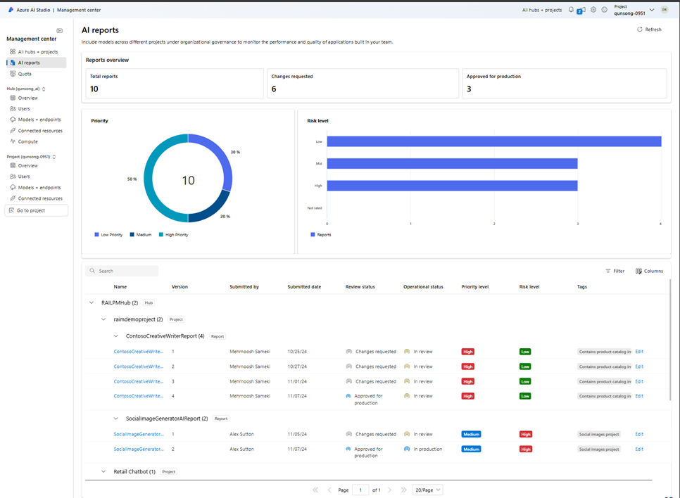
New management and governance controls in Azure AI Foundry : AI Report (Preview)
Manage key subscription details from a centralized management center
Simplify the setup of hubs, projects, and resources
Create and export AI reports to help govern AI apps and models
AI.Azure.com
Notes:
And another exciting feature, AI reports for “management” stage in GenAI lifecycle. These reports are a game-changer for governance and compliance. Developers can use templates to quickly assemble key project details, such as model versions, content filters, and evaluation metrics, into a unified report. These reports can then be exported and reviewed by internal stakeholders, ensuring that all AI projects meet governance, risk, and compliance requirements.
AI reports not only help in documenting project details but also facilitate ongoing audits and ensure production readiness. This is especially valuable for maintaining a high standard of AI governance and simplifying cross-functional collaboration.
So, as you can see, Azure offers a comprehensive suite of management capabilities that support the entire AI lifecycle.
And one last thing remained to consider: Managing costs.

Slide 72
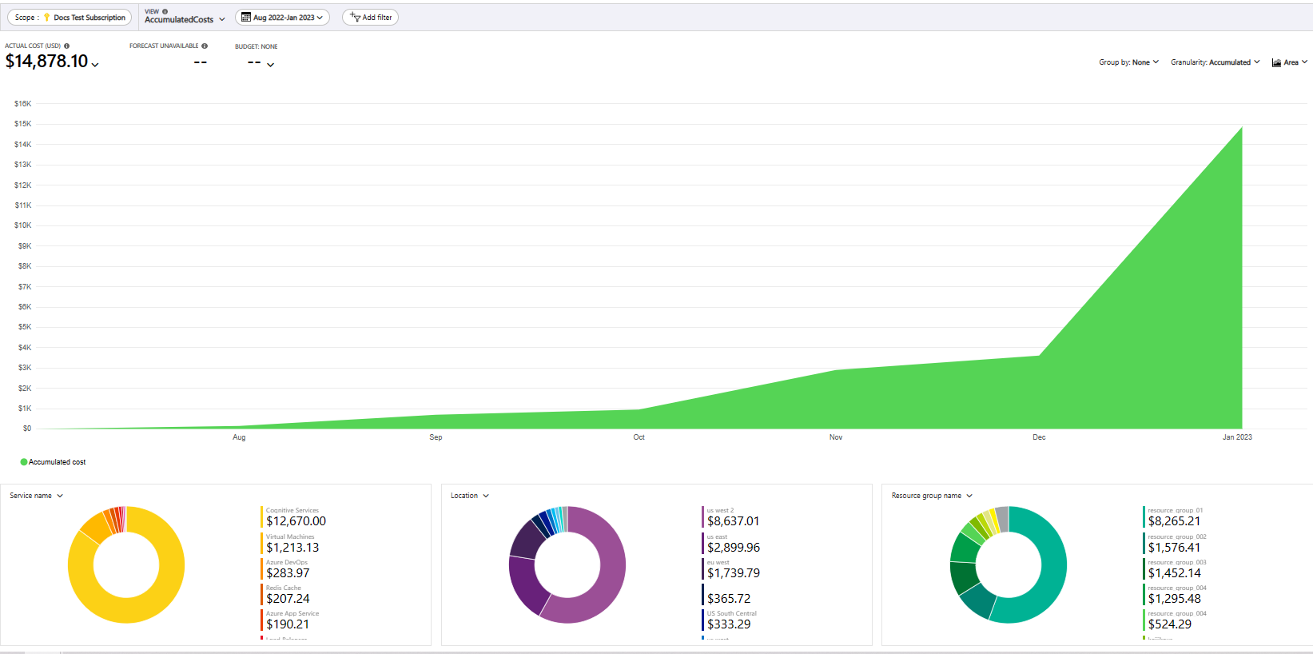
Cost Management
Understand the Billing model for the Azure OpenAI, Open Source Models, Fine-tuned models and AI Services
Review forecasted costs and identify spending trends to identify areas where you might want to act
Azure pricing calculator to estimate costs
Monitor costs. (Cost Analysis)
Export Cost data for further analysis
Create budgets
Create Alerts
Notes:
Yes, effective cost management is vital for any organization. Azure provides a comprehensive suite of tools to help you estimate, monitor, and control your spending.
One of the first tools you can use is the Azure pricing calculator.
Once you have a project underway, understanding the billing model for Azure OpenAI, Open Source Models, Fine-tuned Models, and AI Services becomes essential. By understanding these billing models, you can better predict and manage your costs.
Customers can set up budgets to keep your spending in check and also can create alerts to notify you when your spending approaches a predefined threshold.
They can Monitor their costs through cost analysis ,allowing you to review forecasted costs and identify trends. This helps you make informed decisions on where to allocate resources and where to cut back.
Finally, they can export cost data for further analysis. This feature is particularly useful for detailed financial planning and reporting, enabling you to integrate Azure cost data with other financial tools and processes.
By leveraging these cost management tools, organizations can maintain financial control over their AI projects, ensuring that they stay within budget while maximizing the value of their investments.
Effective cost management, combined with robust governance and management controls, creates a strong foundation for deploying AI solutions at scale. This holistic approach ensures that AI initiatives are not only innovative but also sustainable and compliant.

Slide 73



GenAIOps Landscape
Platform
Toolset
SDK / Plugin
CICD
Evaluation / Test / RAI
Deployment
Monitor
Copilot Studio
M365 Copilot
Prompt flow
Semantic Kernel
AI Foundry
Playground
LangChain
GitHub Actions
Evaluation SDK
APIM
App Insights
Azure ML Studio
AI Foundry SDK
ADO Pipelines
PyRIT
Managed endpoint
Azure Monitor
VS Code
Prompt flow SDK
Container service: AKS, ACI, etc
AI Foundry Deployment Monitoring
Codespaces
IDE (other)
Semantic Kernel / LangChain
App Service
Dev Box
Github Copilot
Local container
AML
Local install
Playground
App Service

Slide 74
Key Takeaways
Understanding the distinct activities on each GenAI Lifecycle.
Azure offers a robust set of tools for every stage of the GenAI lifecycle, including Azure Machine Learning, AI Foundry, Azure DevOps, GitHub Actions, APIM, and Azure Monitor etc.
Deploying GenAI solutions involves not only technical considerations but also governance, security, and compliance. (Management Loop)
Effective cost management is crucial for sustaining GenAI projects. Azure provides tools like the pricing calculator, budgeting, cost alerts, and detailed cost analysis
Robust monitoring, evaluations and tracing capabilities are essential for maintaining the health and performance of GenAI applications.
Notes:
To summarize, today's GenAIOps session has provided an extensive overview of how to operationalize generative AI applications from development to production. We've discussed the critical stages of the GenAI lifecycle, including Prototyping, Optimizing, and Operationalizing, and explored the comprehensive suite of Azure tools and capabilities designed to support each phase.
Key Takeaways:
GenAI Lifecycle Stages: Understanding the distinct activities and focuses of each phase—Prototyping, Optimizing, and Operationalizing—is essential for successful AI model development and deployment.
Azure Capabilities: Azure offers a robust set of tools for every stage of the AI lifecycle, including Azure Machine Learning, AI Foundry, Azure DevOps, GitHub Actions, APIM, and Azure Monitor. These tools support everything from model selection and fine-tuning to deployment, monitoring, and cost management.
Operational Excellence: Deploying AI models involves not only technical considerations but also governance, security, and compliance. The Management loop ensures that all activities adhere to strict standards while maintaining agility.
Cost Management: Effective cost management is crucial for sustaining AI projects. Azure provides tools like the pricing calculator, budgeting, cost alerts, and detailed cost analysis to help organizations maintain financial control over their AI initiatives.
Monitoring and Tracing: Robust monitoring and tracing capabilities are essential for maintaining the health and performance of AI applications. Azure's built-in monitoring tools and comprehensive tracing features in AI Foundry ensure continuous evaluation and improvement.

Slide 75
Lab Name
Lab Description
Paulo to update

Slide 76
Thank you!
Notes:
We hope today's session has provided valuable insights and practical guidance on operationalizing generative AI applications. Thank you for participating!

