Slide 1

SCRUM pre-game and first sprint planning
Team:
Alessandro Marchesano
Valentina Micera
Raffaele Sbardella
Amos Tecce

Slide 2
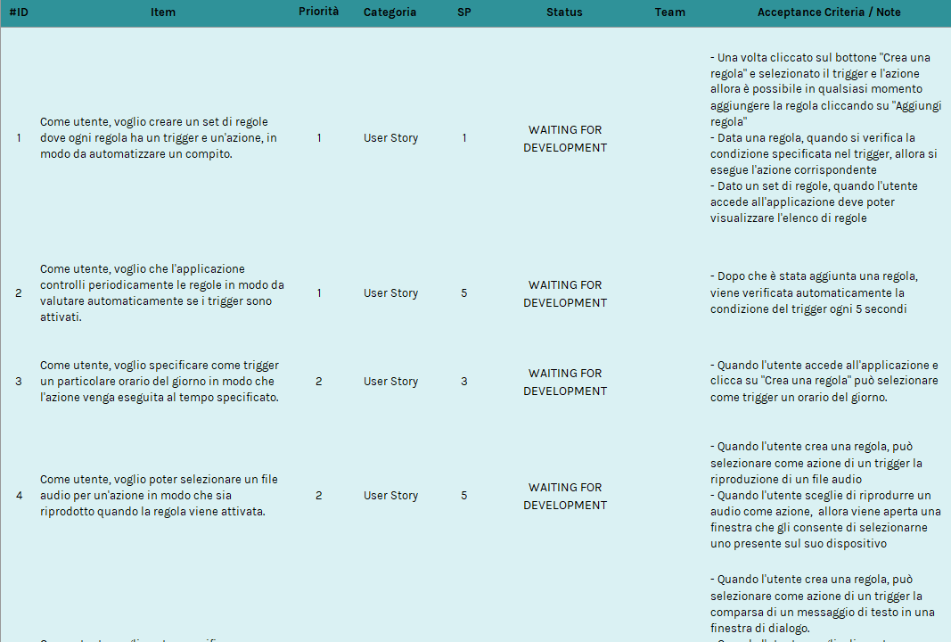
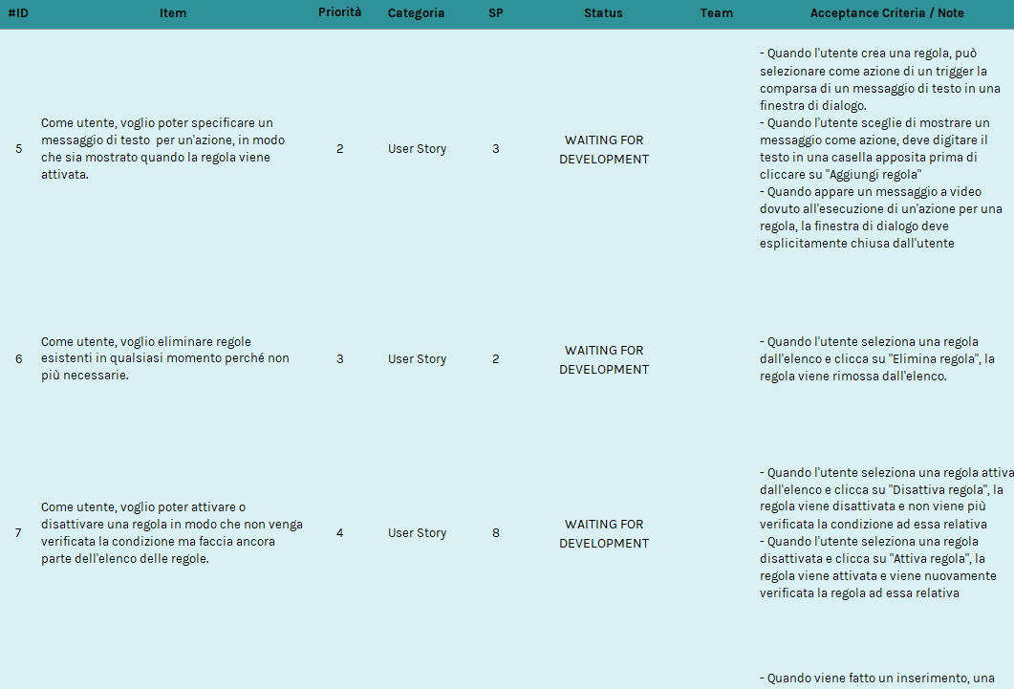
ARCHITECTURE
PRODUCT BACKLOG

Slide 3
PRODUCT BACKLOG
UML DIAGRAM
ARCHITECTURE
Model
updates
manipulates
View
Controller
Sends user input

Slide 4
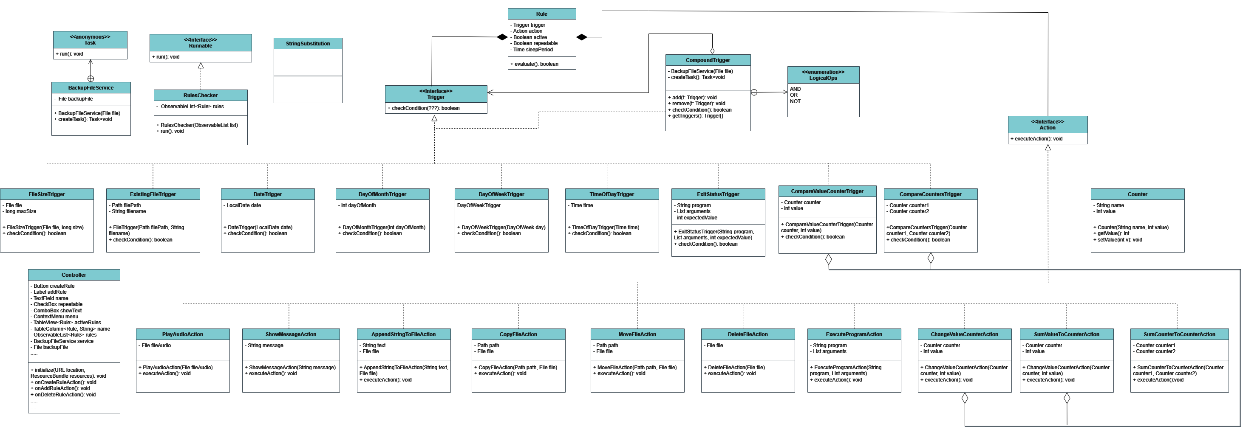
GUI
ARCHITECTURE
UML DIAGRAM

Slide 5
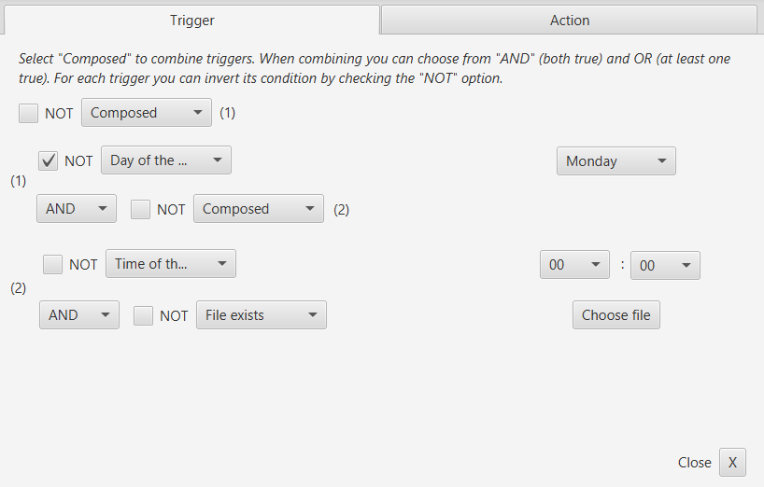
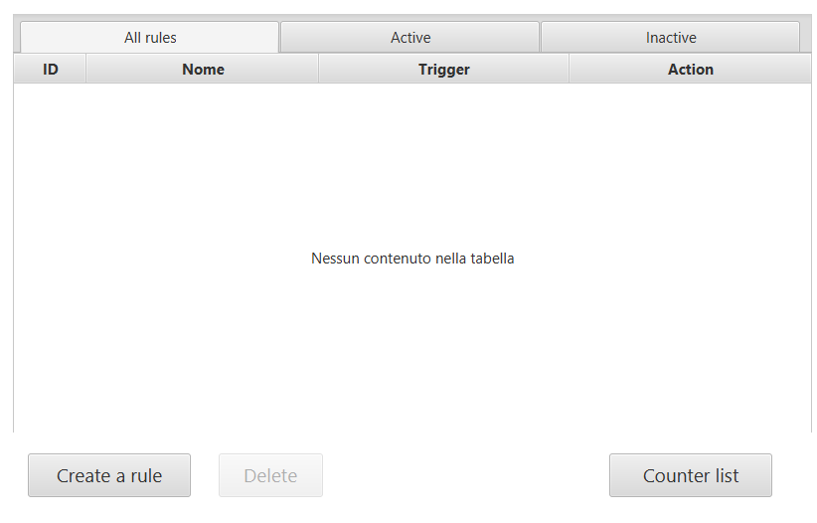
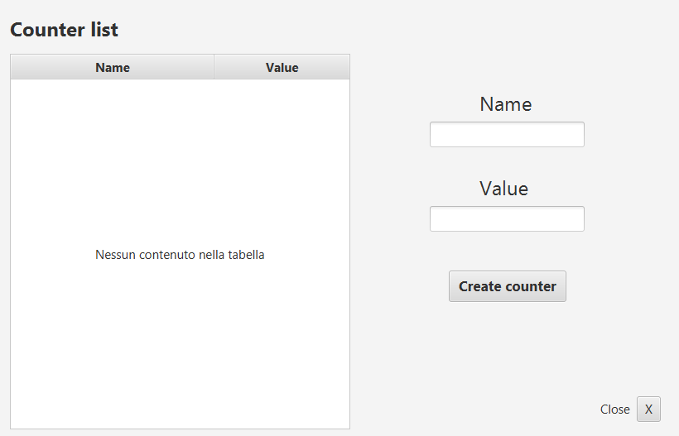
UML DIAGRAM
SPRINT BACKLOG
GUI

Slide 6
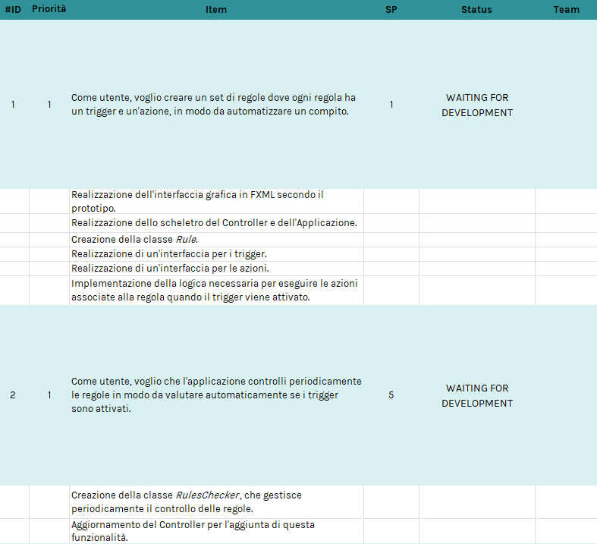
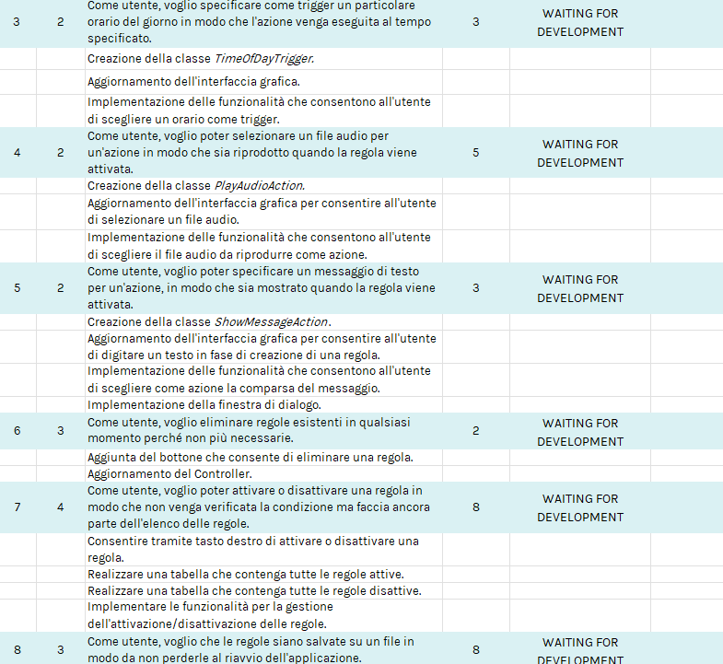
GUI
DEFINITION OF DONE
SPRINT BACKLOG

Slide 7
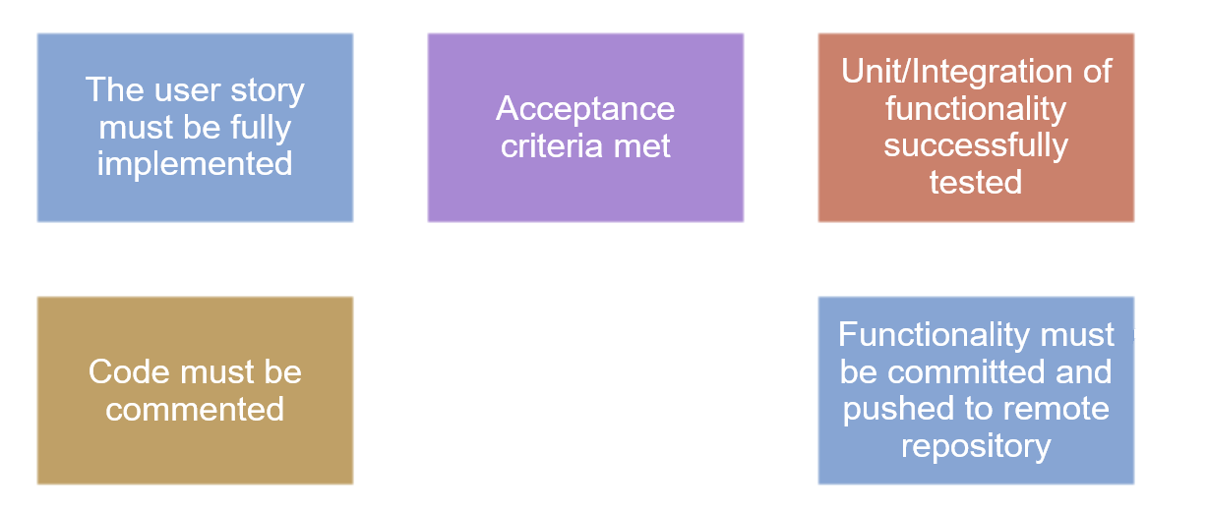
SPRINT BACKLOG
CODING STANDARD
DEFINITION OF DONE

Slide 8
TOOLS
DEFINITION OF DONE
CODING STANDARD
Name of attributes, variables and methods have to follow the Cames Case convention.
Name of classes have to followe the Upper Camel Case convention.
Name of attributes, variables, methos and classes have to be in English.
The code must be correctly indented.
Variables should be declared at the beginning.
Portions of codes should be separated thanks to a blank line.
Portions of codes should be commented.

Slide 9





CODING STANDARD
TOOLS
Programming
Managing

