Slide 1

Exploring the Application of Data Analytics to Minimize Waste in the Fast Fashion Industry
Valentina Martucci
September 2024
Supervisor: Taufique Ahmed

Slide 2
Introduction
Problem Statement: Fast fashion is an industry characterized by a big sustainability issue: inaccurate inventory predictions lead to overproduction or stockouts, which results in waste.
Research Question: Can data analytics be leveraged to optimize inventory management and reduce waste in the fast fashion industry?
Purpose of the Research: Exploring the application of data analytics to improve inventory management and reduce waste.
Research Objectives:
Investigate current inventory management and waste reduction practices in fast fashion.
Explore how data analytics can improve inventory control and reduce waste.
Develop and test a data-driven model for fast fashion companies to optimize inventory and reduce waste.

Slide 3
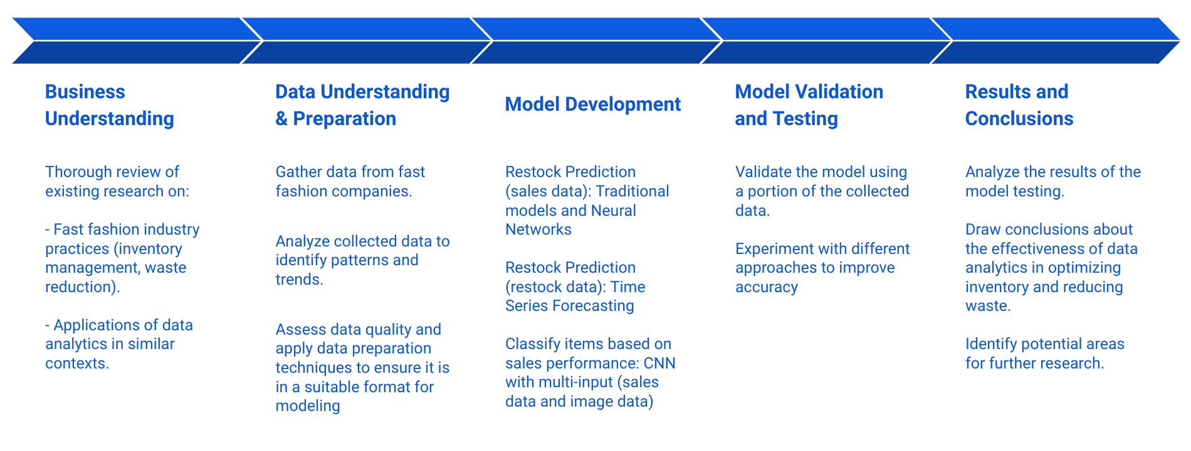
Methodology
Data Sources: Visuelle 2.0 - real data for 5355 clothing products of the retail fast-fashion Italian company, Nuna Lie.
Framework: CRISP-DM Framework – workflow details below

Slide 4
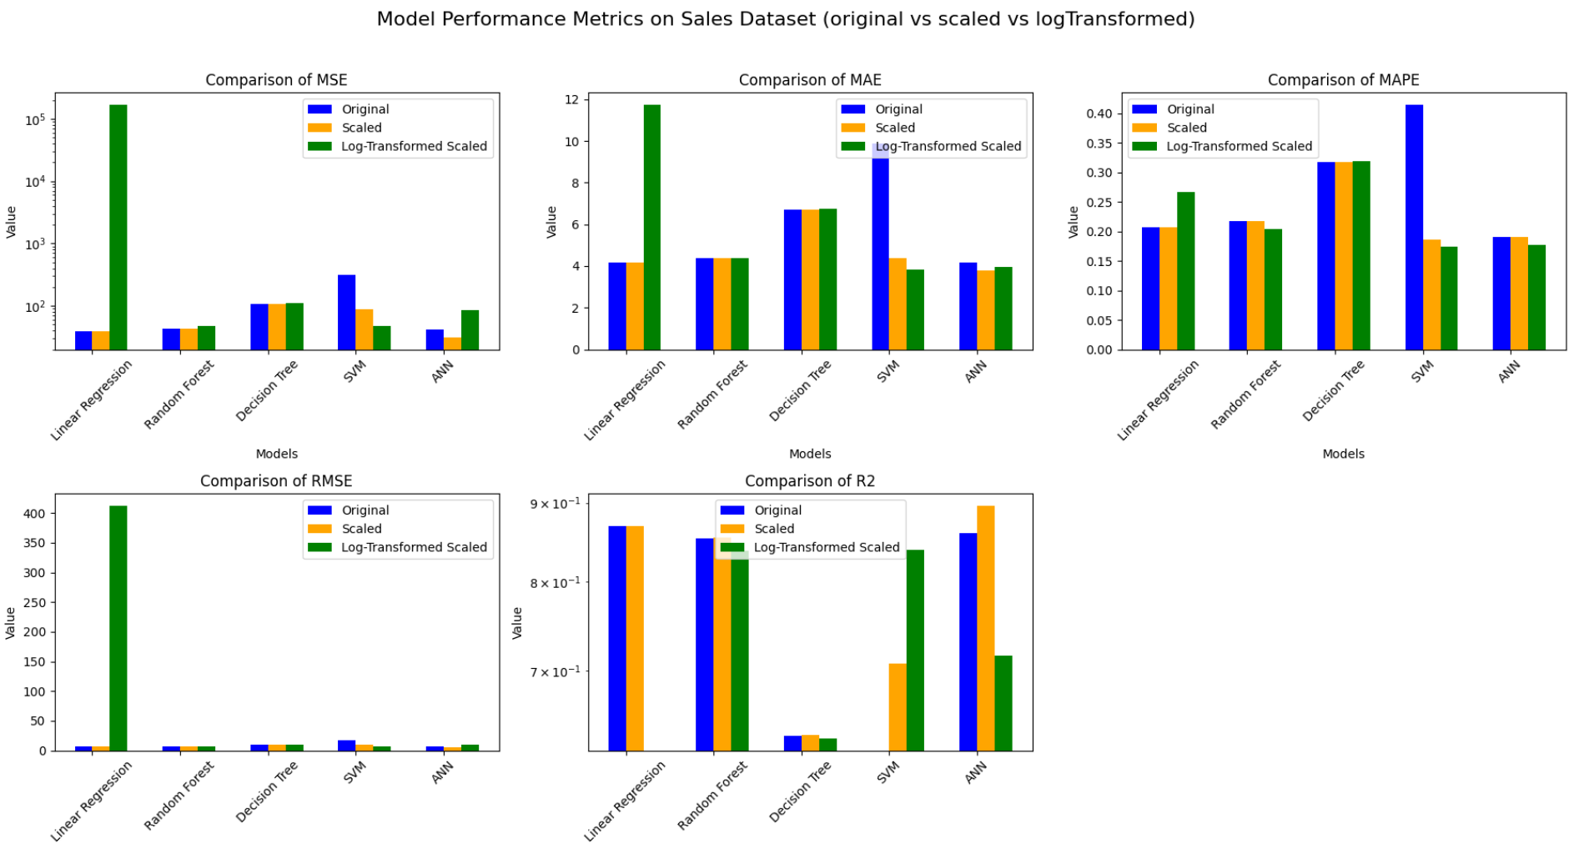
Results - restock prediction using sales data (1/2)

Slide 5
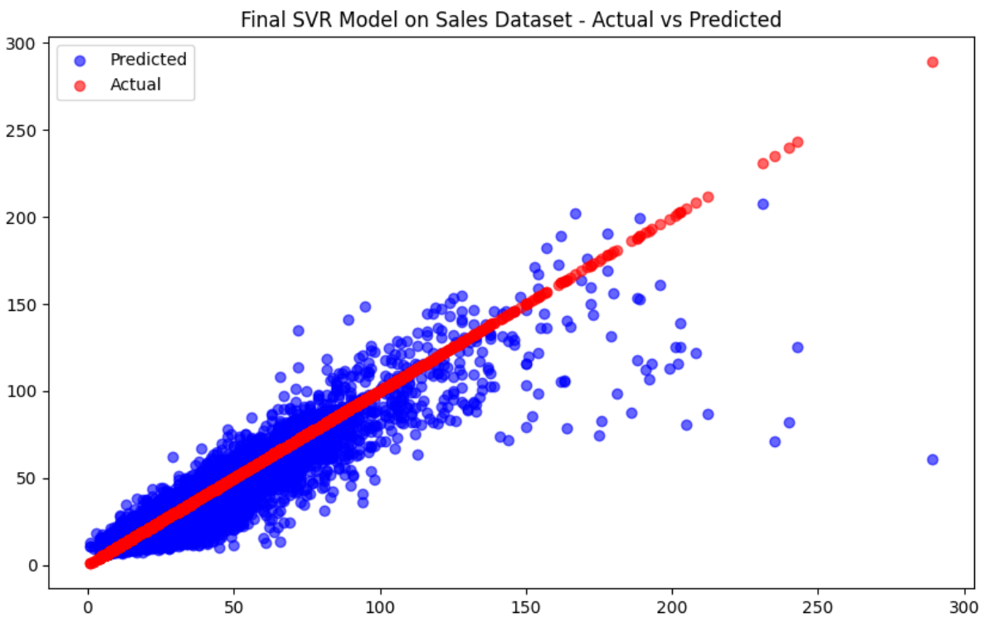
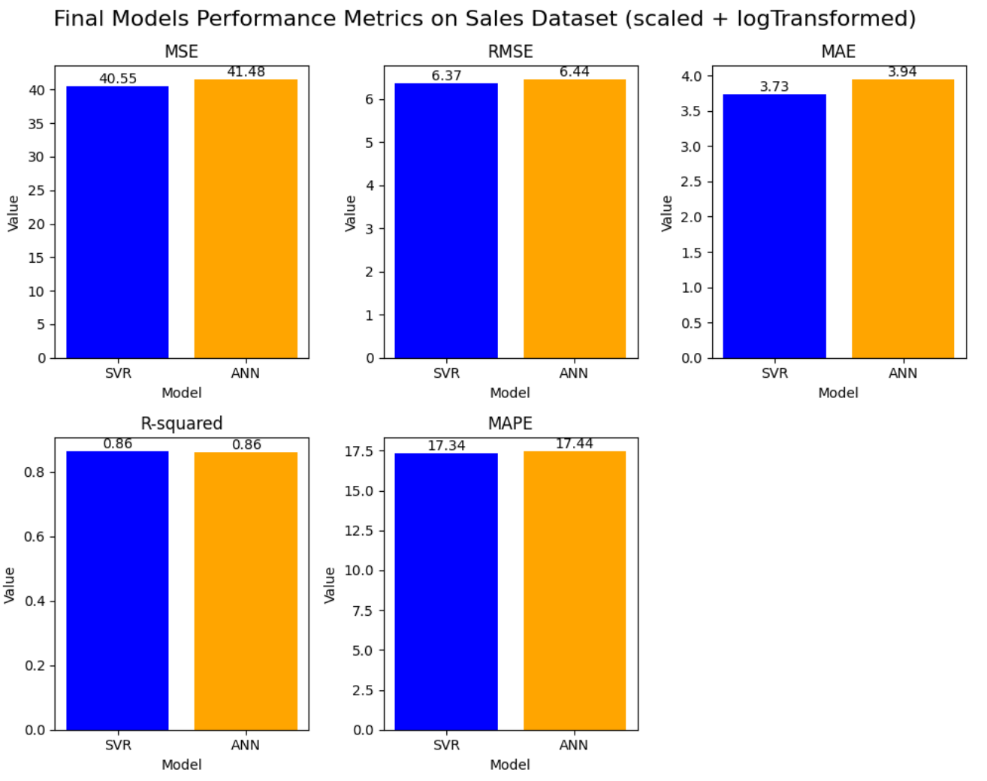
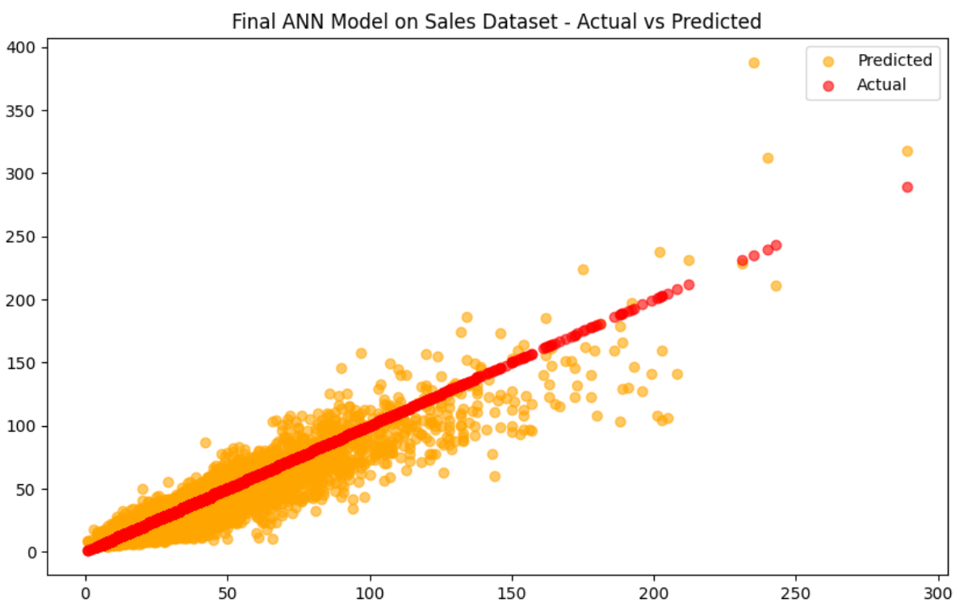
Results - restock prediction using sales data (2/2)

Slide 6
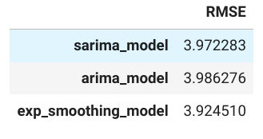
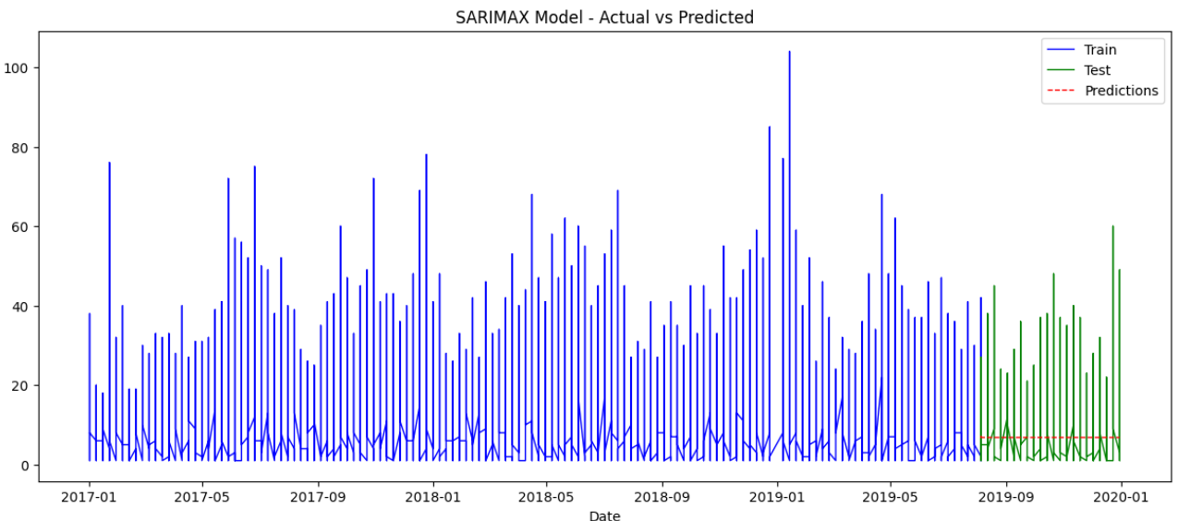
Results - Time series forecast of restock data (no covid)
After Hyperparameters Tuning..

Slide 7
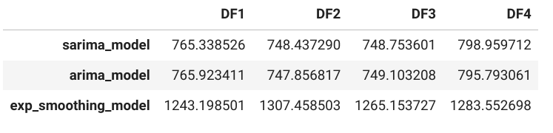
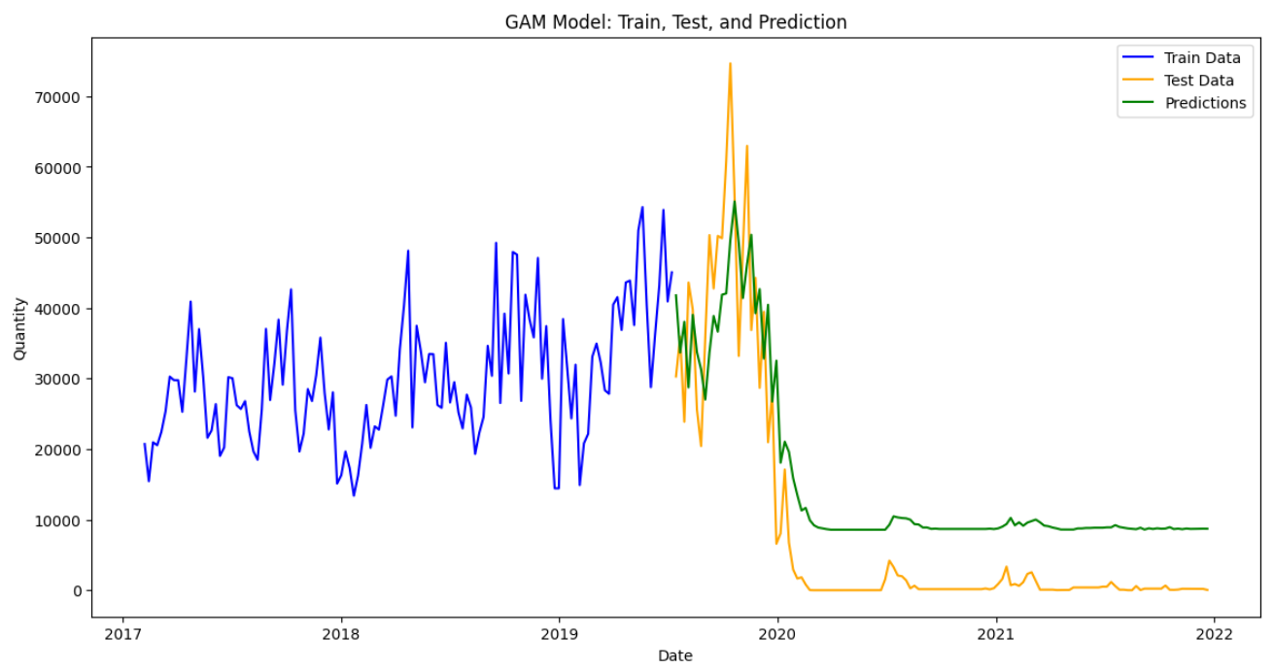
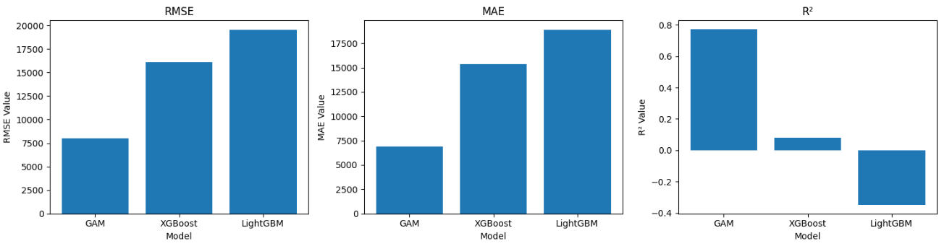
Results - Time series forecast of restock data (covid)
DF1 = bfill
DF2 = ffill
DF3 = int
DF4 = cub
Step 1: Evaluate and pick interpolation technique
Step 2: Evaluate and tune best model

Slide 8
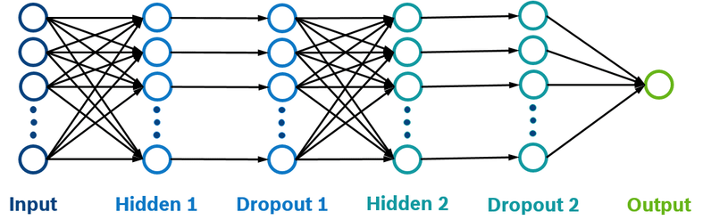
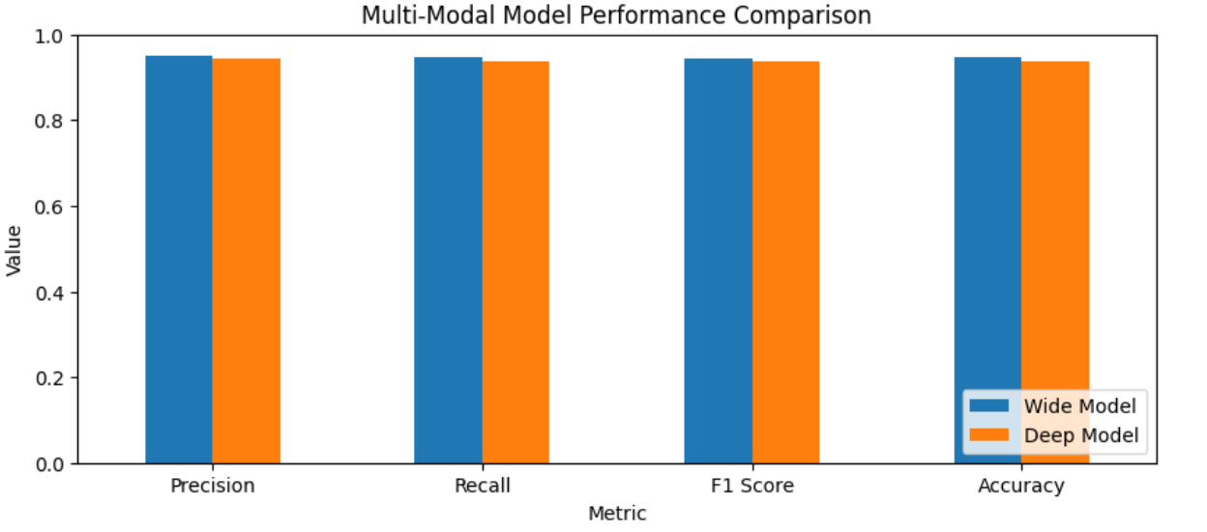
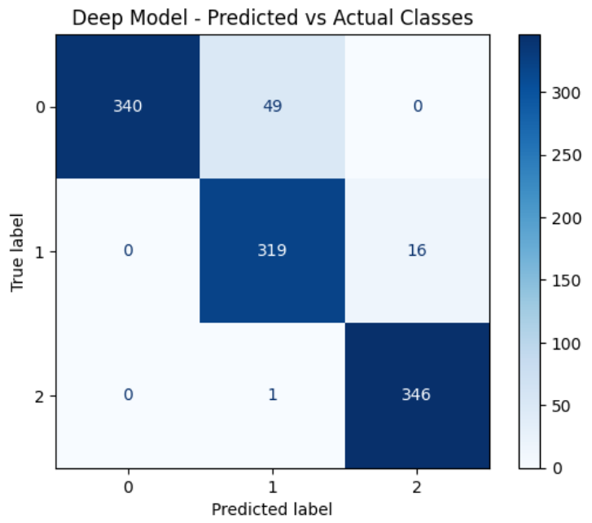
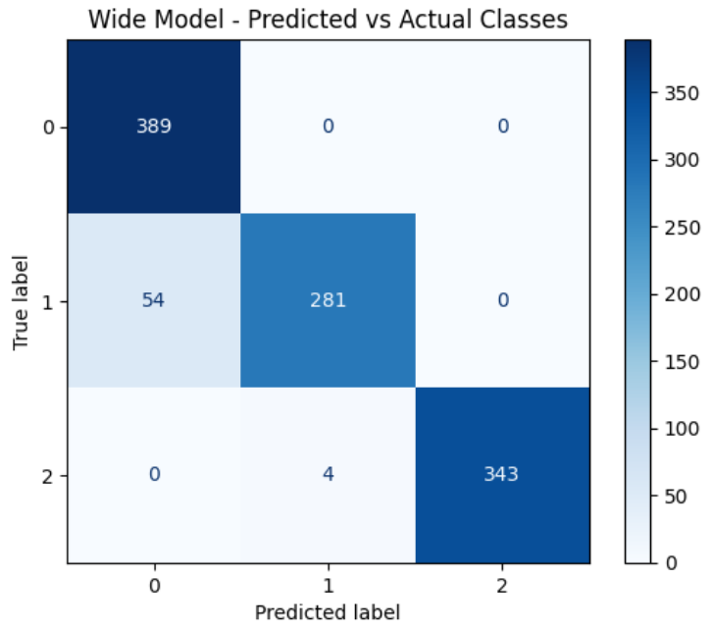
Results - Multimodal model
Goal: train a model to classify images (high/medium/low selling) combining sales dataset and images
MODELS
Baseline | Deeper | Wide
Input Dense Output | Input Dense Dropout Dense Output | Input Dense (+ neurons) Dropout Dense (+neurons) Output
Sales features
Images features (ResNet)
Contact
(Sales + Images)

Slide 9
Conclusion
Data analytics holds significant promise for optimizing inventory in fast fashion and reducing its environmental impact.
Companies would need big datasets to leverage Time Series Forecasting techniques
Leveraging image data as well can help in fast-fashion, where trends change quickly and there is no prior data to compare
Hardware resources are important!!

Slide 10
Q&A

