Slide 1
Developing Pairwise Sequence Alignment Algorithms
Dr. Nancy Warter-Perez

Slide 2
Outline
Group assignments for project
Overview of global and local alignment
References for sequence alignment algorithms
Discussion of Needleman-Wunsch iterative approach to global alignment
Discussion of Smith-Waterman recursive approach to local alignment
Discussion Discussion of how to extend LCS for
  Global alignment (Needleman-Wunsch)
  Local alignment (Smith-Waterman)
  Affine gap penalties
Developing Pairwise Sequence Alignment Algorithms

Slide 3
Project Teams and Presentation Assignments
Pre-Project (Pam/Blosum Matrix Creation)
  Osvaldo and Omar
Base Project (Global Alignment):
  Angela and Judith
Extension 1 (Ends-Free Global Alignment):
  Charmaine and Sandra
Extension 2 (Local Alignment):
  Amber and Thomas
Extension 3 (Database):
  Scott D.
Extension 5 (Affine Gap Penalty):
  Scott P. and John
Developing Pairwise Sequence Alignment Algorithms

Slide 4
Overview of Pairwise Sequence Alignment
Dynamic Programming
  Applied to optimization problems
  Useful when
    Problem can be recursively divided into sub-problems
    Sub-problems are not independent
Needleman-Wunsch is a global alignment technique that uses an iterative algorithm and no gap penalty (could extend to fixed gap penalty).
Smith-Waterman is a local alignment technique that uses a recursive algorithm and can use alternative gap penalties (such as affine). Smith-Waterman’s algorithm is an extension of Longest Common Substring (LCS) problem and can be generalized to solve both local and global alignment.
Note: Needleman-Wunsch is usually used to refer to global alignment regardless of the algorithm used.
Developing Pairwise Sequence Alignment Algorithms

Slide 5
Project References
http://www.sbc.su.se/~arne/kurser/swell/pairwise_alignments.html
Bioinformatics Algorithms – Jones and Pevzner
Computational Molecular Biology – An Algorithmic Approach, Pavel Pevzner
Introduction to Computational Biology – Maps, sequences, and genomes, Michael Waterman
Algorithms on Strings, Trees, and Sequences – Computer Science and Computational Biology, Dan Gusfield
Developing Pairwise Sequence Alignment Algorithms

Slide 6
Classic Papers
Needleman, S.B. and Wunsch, C.D. A General Method Applicable to the Search for Similarities in Amino Acid Sequence of Two Proteins. J. Mol. Biol., 48, pp. 443-453, 1970. (http://www.cs.umd.edu/class/spring2003/cmsc838t/papers/needlemanandwunsch1970.pdf)
Smith, T.F. and Waterman, M.S. Identification of Common Molecular Subsequences. J. Mol. Biol., 147, pp. 195-197, 1981.(http://www.cmb.usc.edu/papers/msw_papers/msw-042.pdf)
Developing Pairwise Sequence Alignment Algorithms

Slide 7
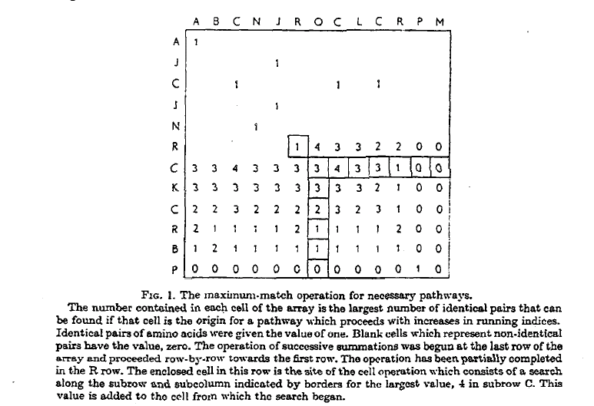
Needleman-Wunsch (1 of 3)
Match = 1
Mismatch = 0
Gap = 0
Developing Pairwise Sequence Alignment Algorithms

Slide 8
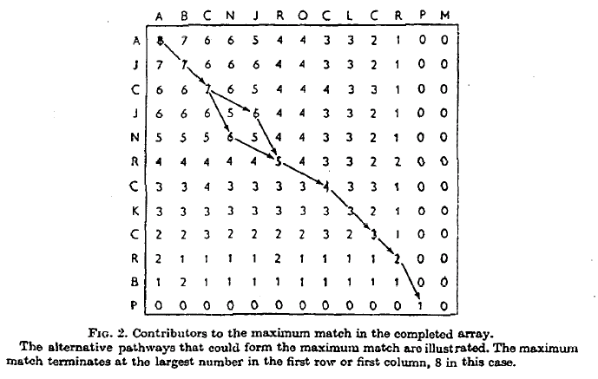
Needleman-Wunsch (2 of 3)
Developing Pairwise Sequence Alignment Algorithms

Slide 9
Needleman-Wunsch (3 of 3)
From page 446:
It is apparent that the above array operation can begin at any of a number of points along the borders of the array, which is equivalent to a comparison of N-terminal residues or C-terminal residues only. As long as the appropriate rules for pathways are followed, the maximum match will be the same. The cells of the array which contributed to the maximum match, may be determined by recording the origin of the number that was added to each cell when the array was operated upon.
Developing Pairwise Sequence Alignment Algorithms

Slide 10
Smith-Waterman (1 of 3)
Algorithm
The two molecular sequences will be A=a₁a₂ . . . a_{n}, and B=b₁b₂ . . . b_{m}. A similarity s(a,b) is given between sequence elements a and b. Deletions of length k are given weight W_{k}. To find pairs of segments with high degrees of similarity, we set up a matrix H . First set
H_{k0} = H_{ol} = 0 for 0 <= k <= n and 0 <= l <= m.
Preliminary values of H have the interpretation that H _{i j} is the maximum similarity of two segments ending in a_{i} and b_{j}. respectively. These values are obtained from the relationship
H_{ij}=max{H_{i-1,j-1} + s(a_{i},b_{j}), max {H_{i-k,j} – W_{k}}, max{H_{i,j-l} - W_{l} }, 0} ( 1 ) k >= 1 l >= 1
1 <= i <= n and 1 <= j <= m.
Developing Pairwise Sequence Alignment Algorithms

Slide 11
Smith-Waterman (2 of 3)
The formula for H_{ij} follows by considering the possibilities for ending the segments at any a_{i} and b_{j}.
If a_{i} and b_{j} are associated, the similarity is
  H_{i-l,j-l} + s(a_{i},b_{j}).
(2) If a_{i} is at the end of a deletion of length k, the similarity is
H_{i – k, j} - W_{k} .
(3) If b_{j} is at the end of a deletion of length 1, the similarity is
H_{i,j-l} - W_{l}. (typo in paper)
(4) Finally, a zero is included to prevent calculated negative similarity, indicating no similarity up to a_{i} and b_{j}.
Developing Pairwise Sequence Alignment Algorithms

Slide 12
Smith-Waterman (3 of 3)
The pair of segments with maximum similarity is found by first locating the maximum element of H. The other matrix elements leading to this maximum value are than sequentially determined with a traceback procedure ending with an element of H equal to zero. This procedure identifies the segments as well as produces the corresponding alignment. The pair of segments with the next best similarity is found by applying the traceback procedure to the second largest element of H not associated with the first traceback.
Developing Pairwise Sequence Alignment Algorithms

Slide 13
Extend LCS to Global Alignment
si-1,j + δ(vi, -)
si,j = max { si,j-1 + δ(-, wj)
si-1,j-1 + δ(vi, wj)
δ(vi, -) = δ(-, wj) = -ρ = fixed gap penalty
δ(vi, wj) = score for match or mismatch – can be fixed or from PAM or BLOSUM
Modify LCS and PRINT-LCS algorithms to support global alignment (On board discussion)
  How should the first row and column of s and b be initialized?
Developing Pairwise Sequence Alignment Algorithms

Slide 14
Ends-Free Global Alignment
Don’t penalize gaps at the beginning or end
  How should the first row and column of s and b be initialized?
  Where is the score of the ends-free alignment?
  How should trace back (b) be adjusted to ensure ends-free?
Developing Pairwise Sequence Alignment Algorithms

Slide 15
Extend to Local Alignment
0 (no negative scores)
si-1,j + δ(vi, -)
si,j = max { si,j-1 + δ(-, wj)
si-1,j-1 + δ(vi, wj)
δ(vi, -) = δ(-, wj) = -ρ = fixed gap penalty
δ(vi, wj) = score for match or mismatch – can be fixed, from PAM or BLOSUM
How should the first row and column of s and b be initialized?
Developing Pairwise Sequence Alignment Algorithms

Slide 16
Local Alignment Trace back
Where should local alignment trace back begin?
Where should local alignment trace back end?
Developing Pairwise Sequence Alignment Algorithms

Slide 17
All Possible Local Alignments
The maximum score may occur multiple times in s
For each maximum score, there may be multiple alignments (trace back paths that yield the same score)
  Occurs when s_{i-1,j} = s_{i,j-1}
Developing Pairwise Sequence Alignment Algorithms

Slide 18
Gap Penalties
Gap penalties account for the introduction of a gap - on the evolutionary model, an insertion or deletion mutation - in both nucleotide and protein sequences, and therefore the penalty values should be proportional to the expected rate of such mutations.
http://en.wikipedia.org/wiki/Sequence_alignment#Assessment_of_significance
Developing Pairwise Sequence Alignment Algorithms

Slide 19
Discussion on adding affine gap penalties
Affine gap penalty
  Score for a gap of length x
  -(ρ + σx)
  Where
    ρ > 0 is the insert gap penalty
    σ > 0 is the extend gap penalty
Developing Pairwise Sequence Alignment Algorithms

Slide 20
Alignment with Gap Penalties
Can apply to global or local (w/ zero) algorithms
↑si,j = max { ↑si-1,j - σ
si-1,j - (ρ + σ)
←si,j = max { ←si1,j-1 - σ
si,j-1 - (ρ + σ)
si-1,j-1 + δ(vi, wj)
si,j = max { ↑si,j
←si,j
Note: keeping with traversal order in Figure 6.1, ↓ is replaced by ↑, and → is replaced by ←
Developing Pairwise Sequence Alignment Algorithms

Slide 21
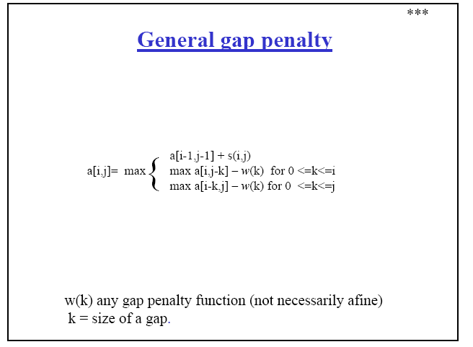
Developing Pairwise Sequence Alignment Algorithms

Slide 22
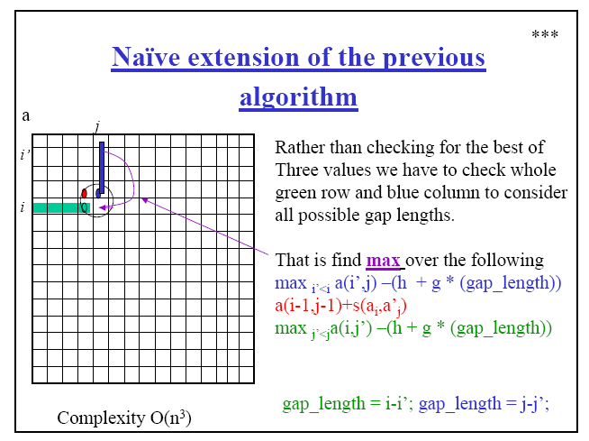
Source: http://www.apl.jhu.edu/~przytyck/Lect03_2005.pdf
Developing Pairwise Sequence Alignment Algorithms

Slide 23
Developing Pairwise Sequence Alignment Algorithms

Slide 24
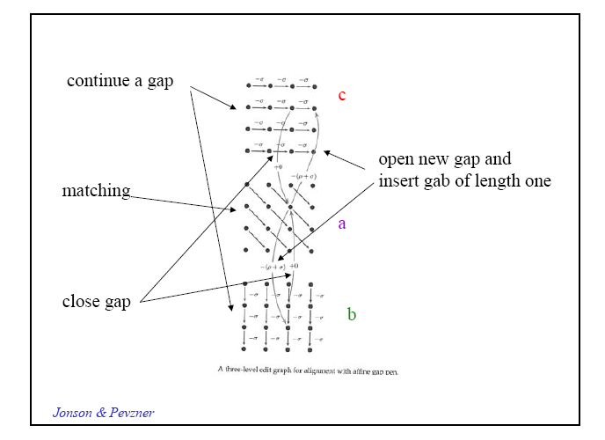
Developing Pairwise Sequence Alignment Algorithms

Slide 25
Developing Pairwise Sequence Alignment Algorithms

Slide 26
Developing Pairwise Sequence Alignment Algorithms

Slide 27
Developing Pairwise Sequence Alignment Algorithms

