Slide 1


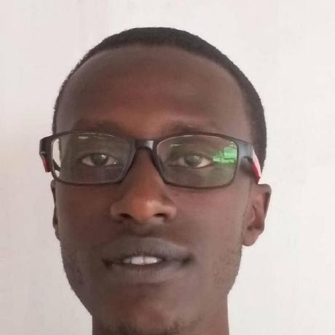
my Linkedin
my git
Introduction:
Hello, my name is Niyonkuru Valens (ID: 25097), a 2nd Year student at Adventist University of Central Africa (AUCA) specializing in Information Management. I have a passion for leveraging technology to optimize data management and enhance decision-making processes. From: Kigali, Rwanda
Reason for My Choice:
I chose Information Management because I believe in the power of data to drive change and innovation. Through this field, I aim to develop solutions that simplify data handling, ensuring it is accessible, accurate, and secure.
Use of Digital Information:
I use digital tools to organize my studies and manage data efficiently.
Expectation for the Course:
I aim to learn effective data management strategies.
What They Do Not Know About Me:
I enjoy learning new programming languages.

