Slide 1


Università degli Studi dell’Aquila
Dipartimento di Ingegneria e Scienze
dell’Informazione e Matematica
Corso di Laurea in Informatica
Generation of Textual Modelling Environments for
Metamodel-specific Languages
Relatore:
Prof.
Alfonso Pierantonio
Candidato:
Stefano Valentini
Matr.: 227718

Slide 2

Introduction
This thesis describes an automated process that generates web-based text modeling environments. In particular, starting from a meta-model, it has been defined:
a canonical mapping for the definition of the textual (concrete) syntax;
the generation of its modeling environment.
The whole process is carried out by a Java command line application that uses the interaction of models transformation engines and frameworks such as Acceleo and Xtext.

Slide 3
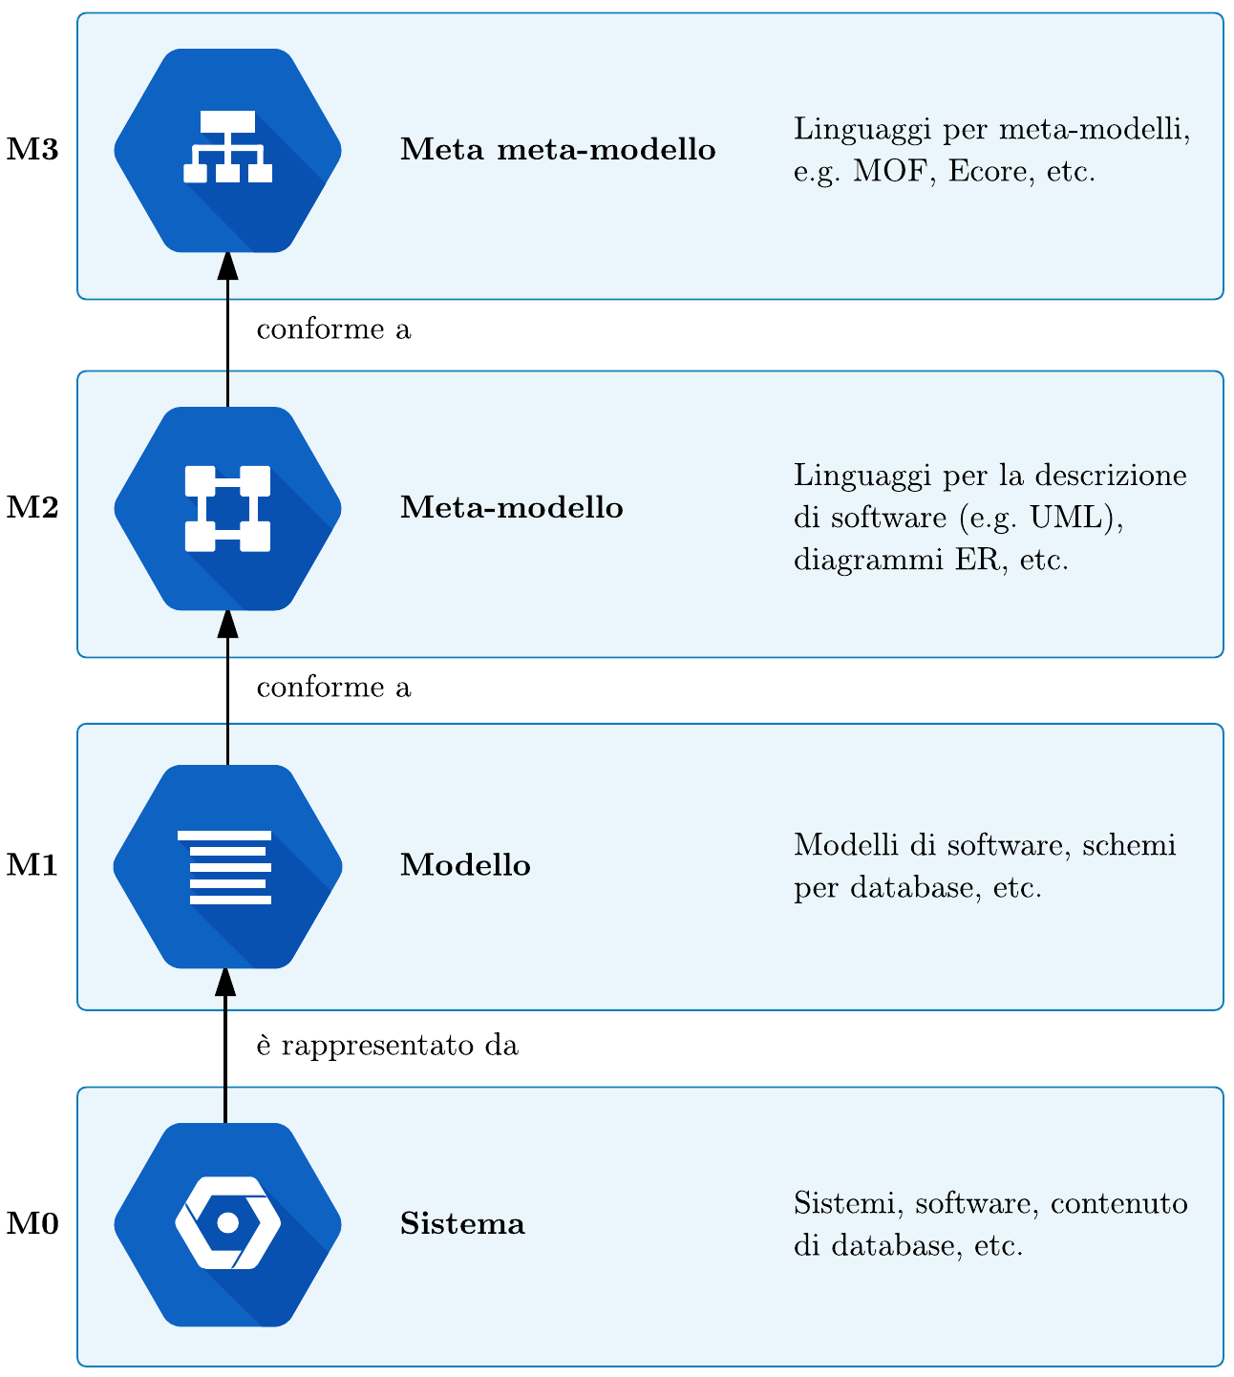
Model Driven Engineering
Model Driven Engineering technologies and tools have been used. MDE is a software development methodology based on key concepts such as:
Models: given a purpose, we can define a model as an artefact that represents a certain system by abstracting the details that are not useful for achieving that purpose.
Meta-models: a meta-model is a formal description for the creation of models.
Models transformations: programs for the generation of new models starting from existing models and/or textual artefacts.
MDE refers to a meta-modeling hierarchy for which :
in the lower level, M0, there is the system that needs to be modeled;
in the M1 level there is the model (or models) that represent the system;
for each model, in the M2 level, there is the respective meta-model to which it conforms;
similarly, in the M3 level, for each meta-model, there is the meta meta-model to which it conforms.
Fig. 1. Meta-modeling Hierarchy.

Slide 4
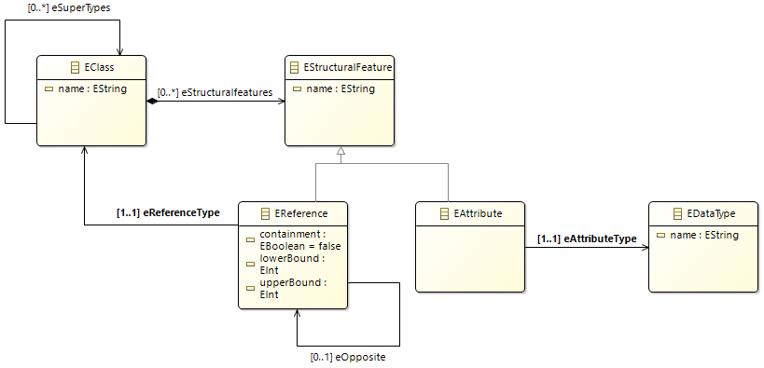
Eclipse Modeling Framework
The tools that have been used are part of the Eclipse Modeling Framework (EMF). EMF is a framework that exposes tools for model manipulation. In particular, EMF provides a meta-model for the creation of models called Ecore. The main concepts of the Ecore standard are the EClasses, EStructuralFeatures, EReferences and EAttributes. In general, an EClass may contain more EStructuralFeatures or EReferences and/or EAttributes.
Fig. 2. Structure of the Ecore standard.

Slide 5
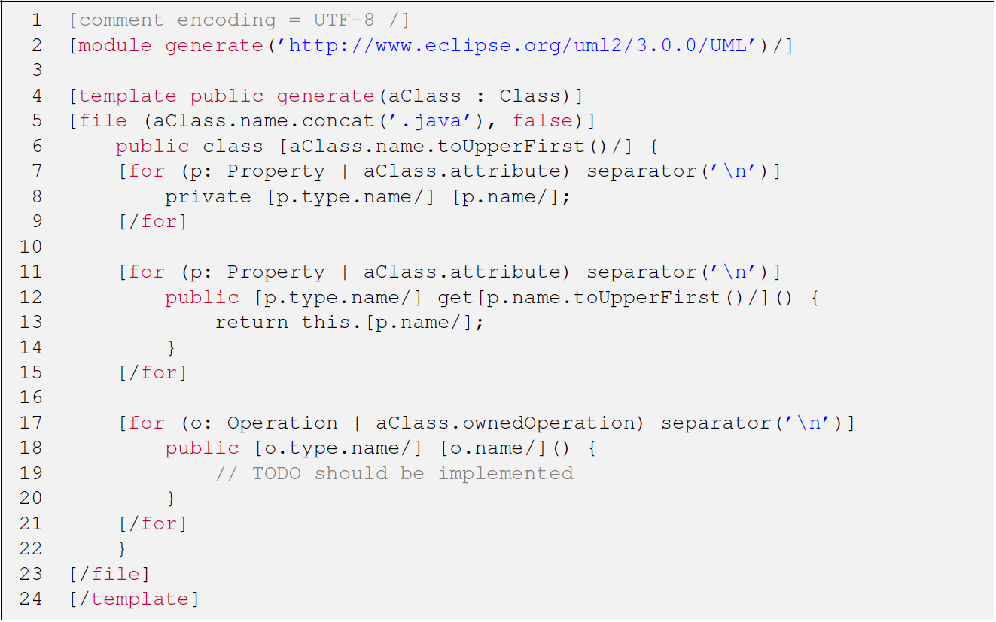
Acceleo
Acceleo is a M2T model transformation language. A M2T transformation in Acceleo is composed by one or more modules, that are .mtl files that contains templates and queries.
Templates are portions of code that are delimited by the [template... ][/template] tag that contains text generation instructions.
Queries are portions of code that are delimited by the [query... /] tag and are used to query and then extract information from the input models.
Exemple of a ìn Acceleo template that generates a JavaBean for each class that is contained in the UML input model.
Fig. 3. Example of an .mtl file

Slide 6
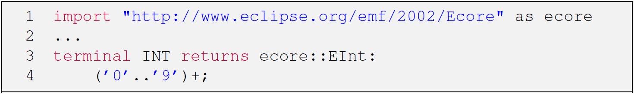
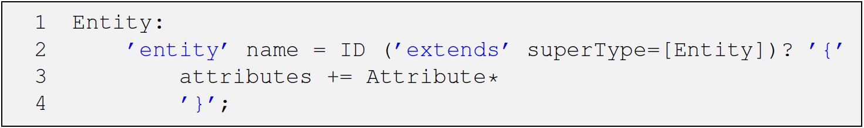
Xtext
Xtext is an Eclipse framework used to implement programming languages and DSLs starting from a grammatical specification. From this specification Xtext generates an Ecore meta-model representing the entities expressed in the grammar and the associated parser; Xtext also offers the possibility to integrate the project with support for text editors. The editors are implemented in JavaScript. Language-specific resources and support services (such as syntax checks, syntax highlighting, and code completion) are provided via HTTP requests to the server component (also generated by Xtext).
The grammatical specification describes the concrete syntax and how it is represented in memory. It consists of several types of rules:
Terminal rules: describe DSL tokens, they are usually used to express basic data types such as INT, STRING etc.
Parsing rules: they describe the entities of the DSL, they are used as a pattern for the production of EClasses in the Ecore model derived from the grammar.
Type rules: they are used to express complex data types, lead to the generation of EDataTypes instances instead of Eclasses,
Enumeration rules: can be seen as shortcuts for type rules; allow to define a set of possible "options" for a given rule.
Fig. 4.1. Example of a terminal rule.
Fig. 4.2. Example of a parsing rule.
Fig. 4.3. Example of a type rule.
Fig. 4.4. Example of an enumeration rule.

Slide 7
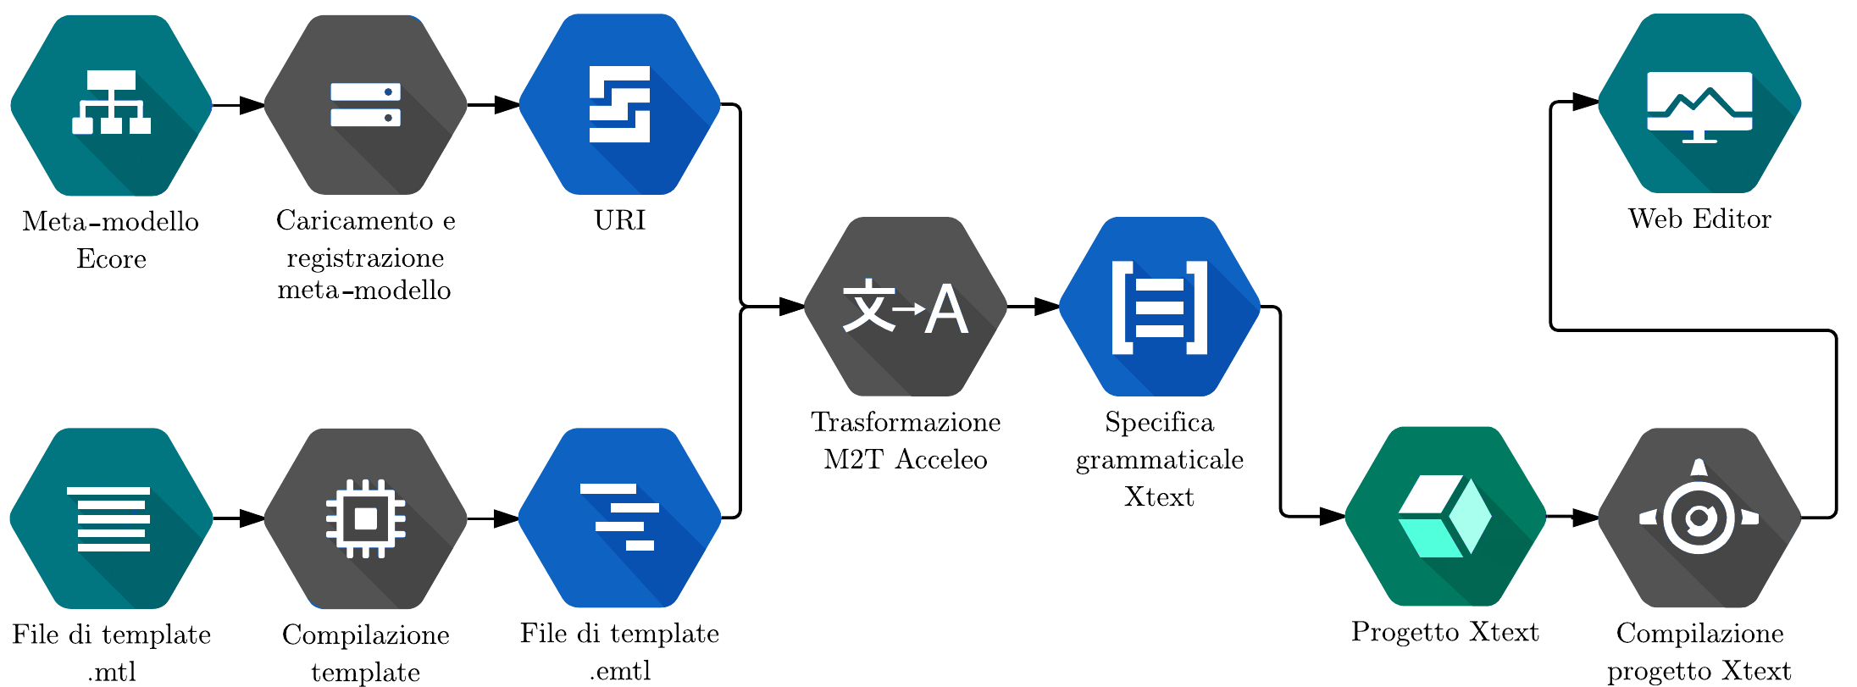
Implementation
The developed application performs the following steps: after having loaded and registered the Ecore meta-model, and after having compiled the Acceleo template, performs the M2T transformation that generates the .xtext file containing the grammatical specification produced from the input meta-model. This file is inserted in a dedicated Xtext project created by the application itself; the compilation of this project leads to the generation of the web editor and the server component that provides support services.
Fig. 5. Application execution flow.

Slide 8
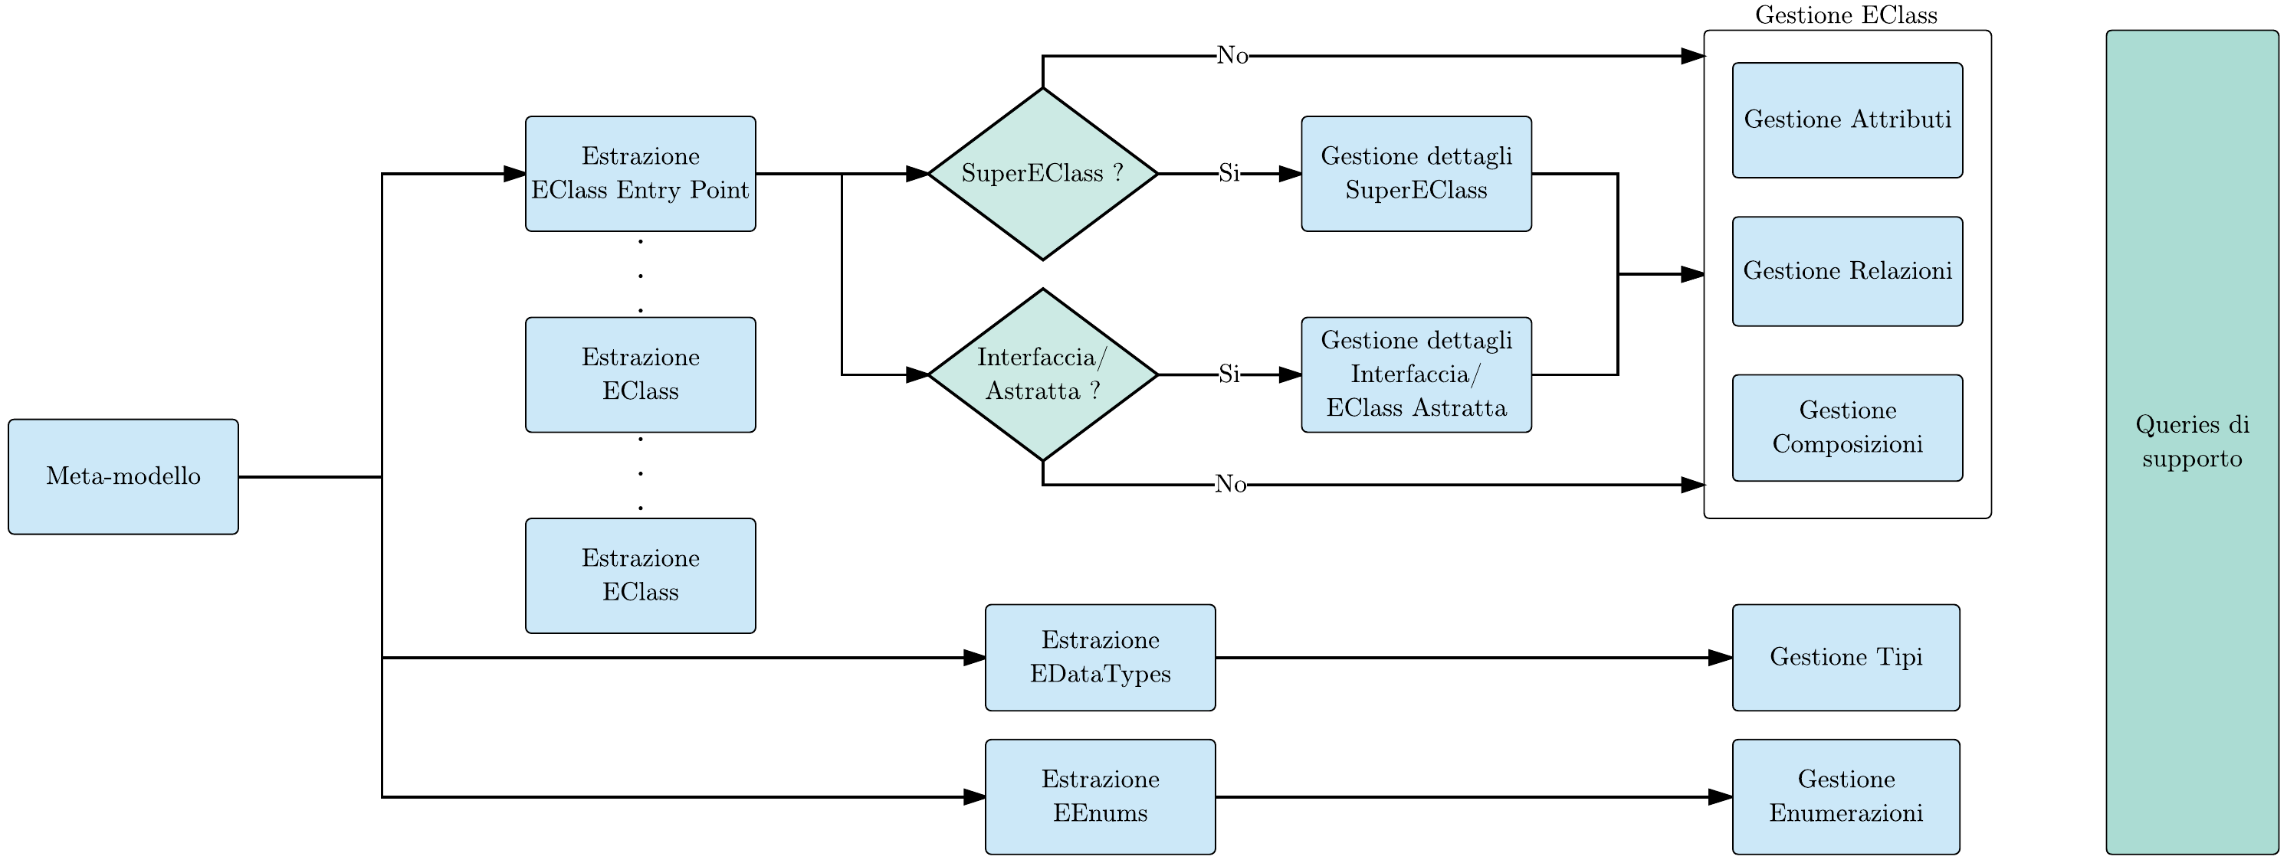
generate.mtl Acceleo Template
The essence of the application resides in the template; to obtain a .xtext file, it is necessary to provide the Acceleo template with the URI of the Ecore meta-model in input and the entry point. The entry point is the name of the EClass from where the generation starts, it can be considered as the main entity of the meta-model or the entity that somehow "encloses" the other entities. The Acceleo template generates grammar rules this way:
the entry point EClass is analyzed, generating parsing rules that reflect its characteristics (attributes, relationships, compositions, considering the case in which it can be a superclass of other EClasses and/or an interface/abstract EClass).
following the same procedure the parsing rules for the other EClasses are generated.
for each EDataType in the input meta-model a type rule is generated.
Enumeration rules are generated for each EEnum in the input meta-model.
Fig. 6. generate.mtl Acceleo template structure

Slide 9
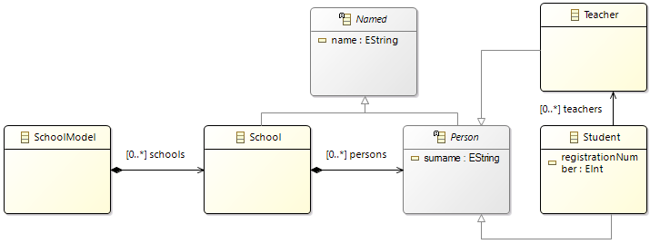
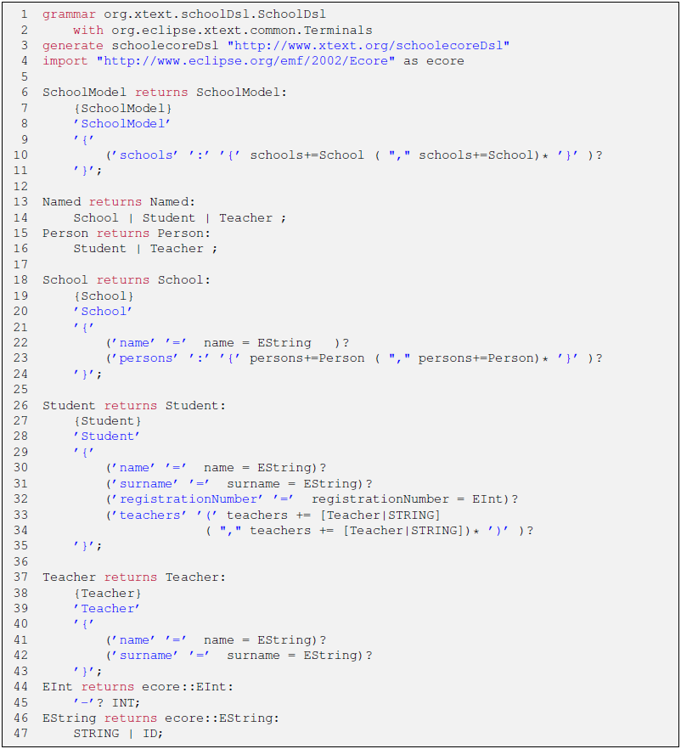
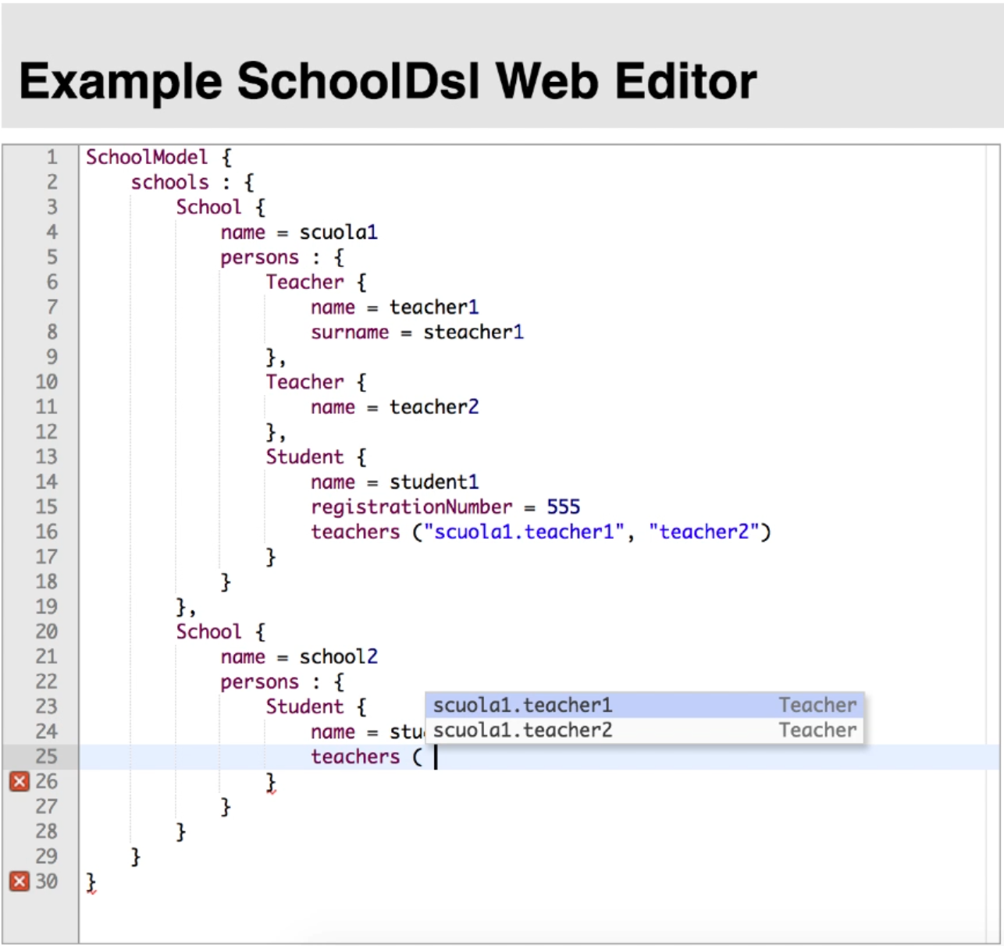
Running example
Let's take a look at the school.ecore meta-model in Fig. 7. From this meta-model, through the M2T Acceleo transformation, we obtain the grammatical specification in Fig. 8. This file is subsequently placed inside the dedicated Xtext project. After compiling the project, we get the web editor in Fig. 9.
Fig. 7. school.ecore meta-model.
Fig. 9. Web editor for the school.ecore meta-model.
Fig. 8. Grammar generated from the school.ecore meta-model.

Slide 10
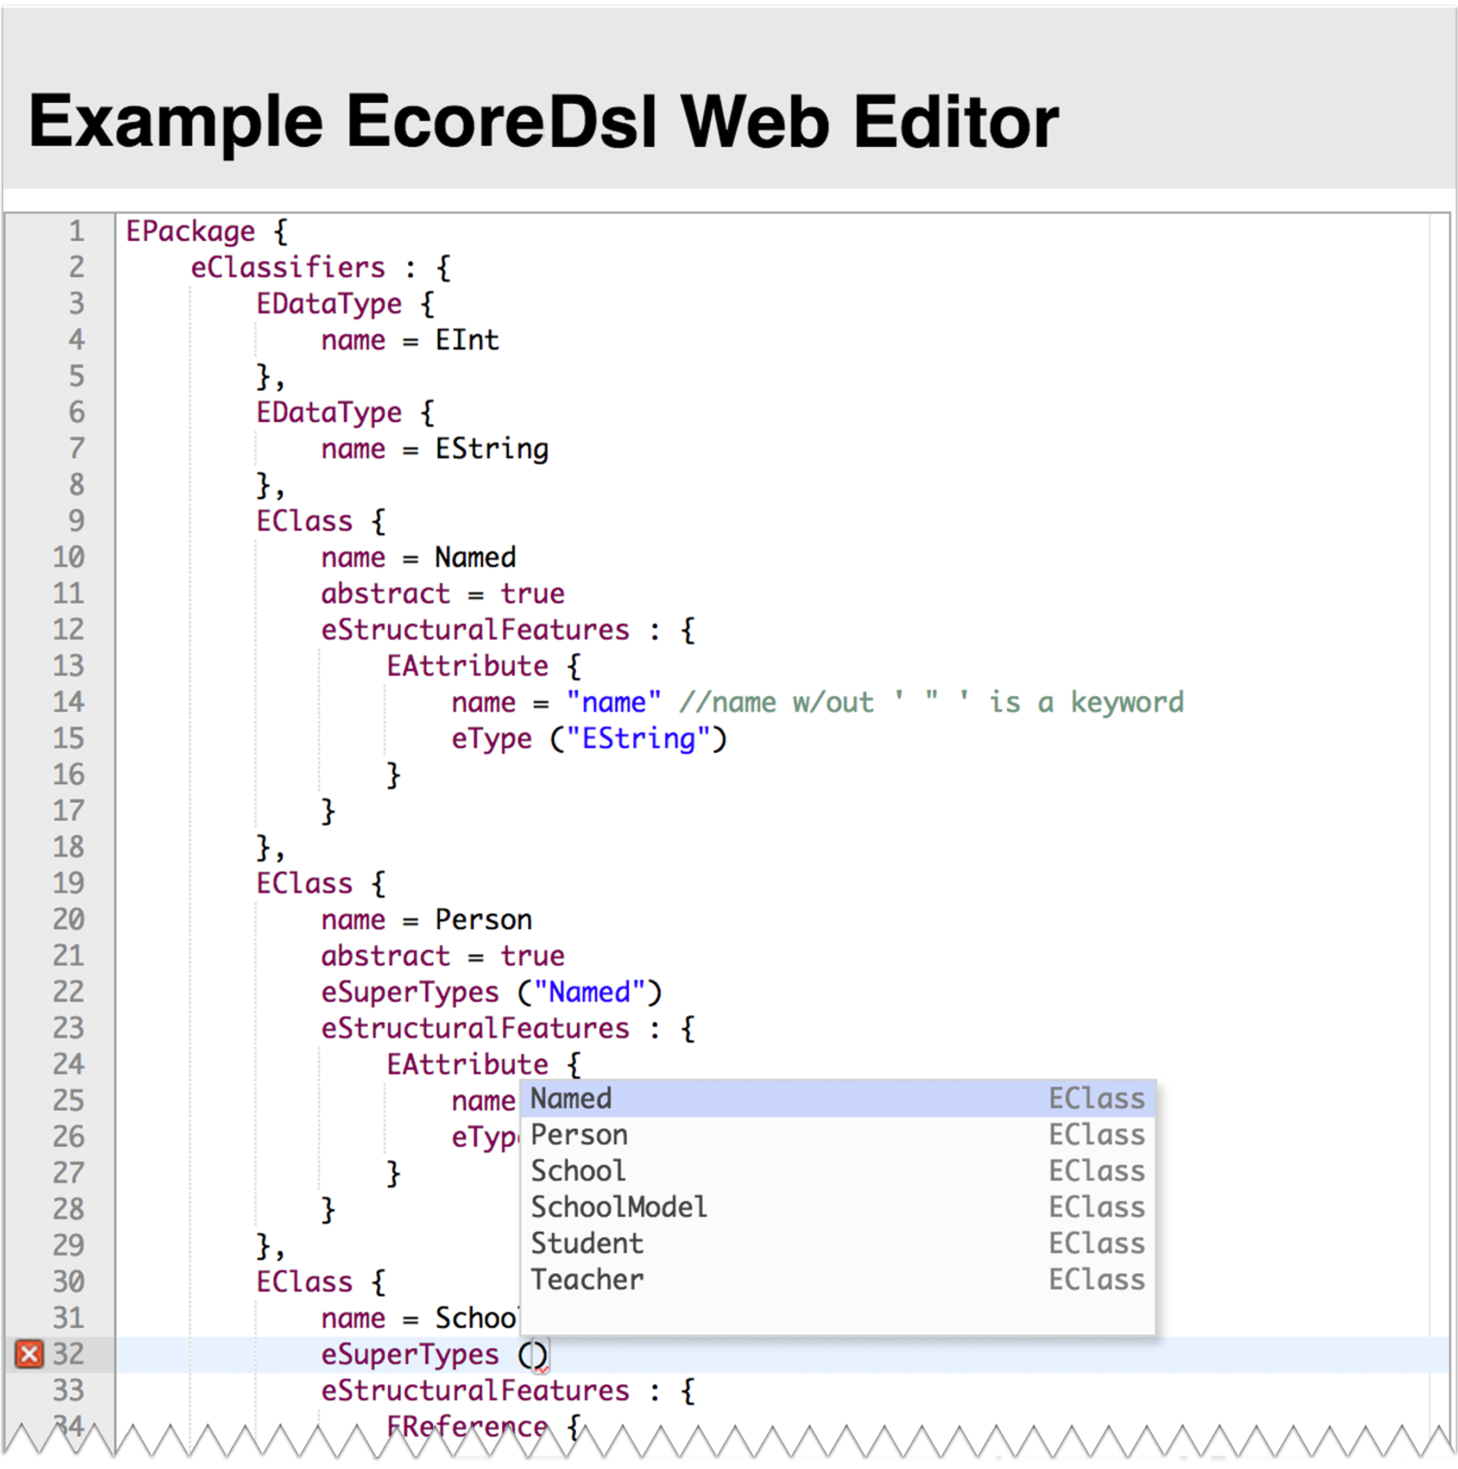
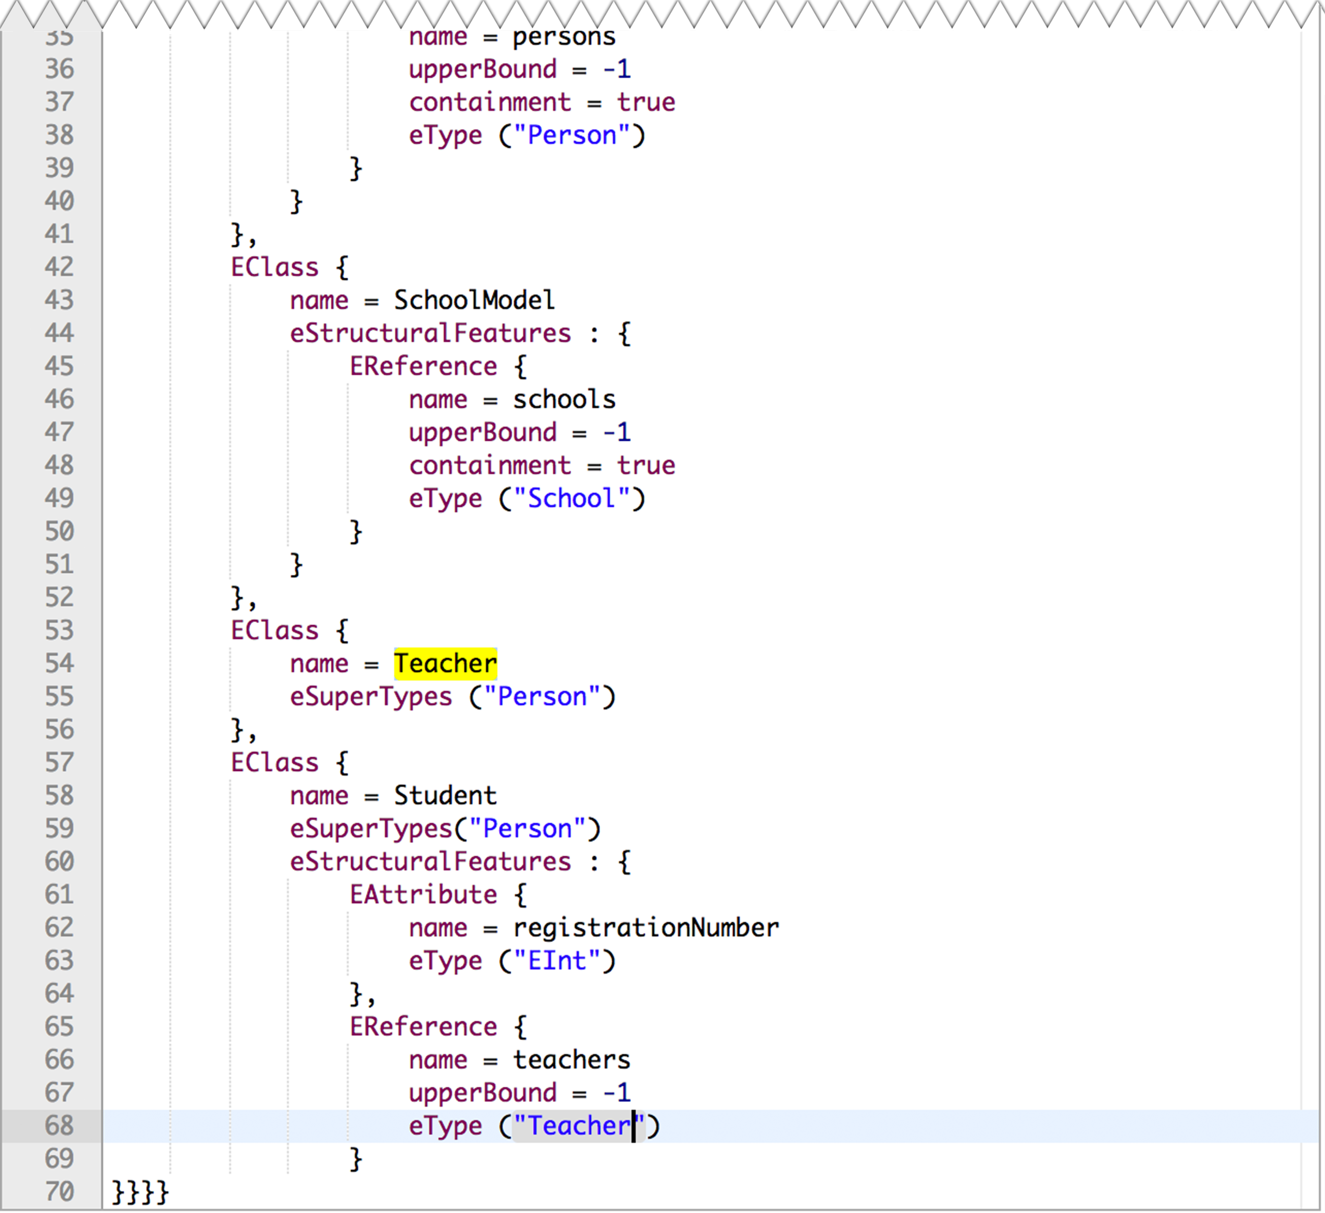
Case study: generation of the web modeling environment for the meta meta-model ecore.ecore
Having a generator of modeling environments we can experiment with more complex meta-models; in particular, being the meta meta-model for the Ecore standard considered in any case a meta-model, we can generate, using the developed application, a textual development environment for the Ecore meta-models themselves. Considering as an entry point the EClassifier EPackage, what we obtain is a grammatical specification that reflects the modeling constraints expressed by the standard itself; that is, we get a web-based modeling environment for generic meta-models that conform to the Ecore standard. Fig. 10 shows a practical example of modeling; in detail, through the generated web editor, the meta-model school.ecore (shown in Fig. 7 of the previous slide) has been constructed.
Fig. 10. ecore.ecore meta meta-model web editor.

