Slide 1
Media Framing and Public Preferences in Swiss Referenda Exploratory Project

Slide 2

OUR OBJECTIVES
1
Project Overview
Motivation. Main Research Question.
2
Data Retrival & Preprocessing
Presentation of Data Sources and Cleaning
3
Descriptive Analysis
Initial insights into the dataset
4
Modelling & Interpretation
Sentiment Analysis, Stance Detection and ML approach

Slide 3
PROJECT OVERVIEW
RESEARCH QUESTION:
Does media coverage reflect public sentiment ahead of Swiss referenda?
Objective:
To explore whether the tone, framing, and vocabulary of news articles published before national referenda correlate with the final voting outcomes – using NLP and ML techniques.
Theoretical Background:
Agenda Setting Theory (McCombs & Shaw, 1972)
“The media doesn’t tell people what to think, but what to think about.”
Framing Theory
The media frames information through specific language and emotional tone, influencing how an issue is perceived and interpreted by the audience.
Mirror Hypothesis:
Meida content primarily reflects the views, priorities, and interest of the public rather than shaping them.

Slide 4
Data Retrival and Preprocessing
Data Collection:
Sources: 113 articles from SRF, 20 Minuten, and NZZ, covering 20 national referenda (2011-2024), published before vote
Method: Automated scraping for SRF and 20 Minuten using request, BeautifulSoup
Limitations: While covering the most important news for the key initiatives there is a limited amount of initiatives which can lead to overfitting
Text Cleaning:
Custom cleaning function to remove:
Footers, disclaimers, author blocks (e.g. SRF’s JavaScript warning)
Game lists and irrelevant phrases
NLP Preprocessing
Pipeline implemented with SpaCy and a custom compound splitter
Steps including:
Lowercasing, punctuation/number removal
Tokenization & stopword filtering
Compound splitting
Lemmatization

Slide 5
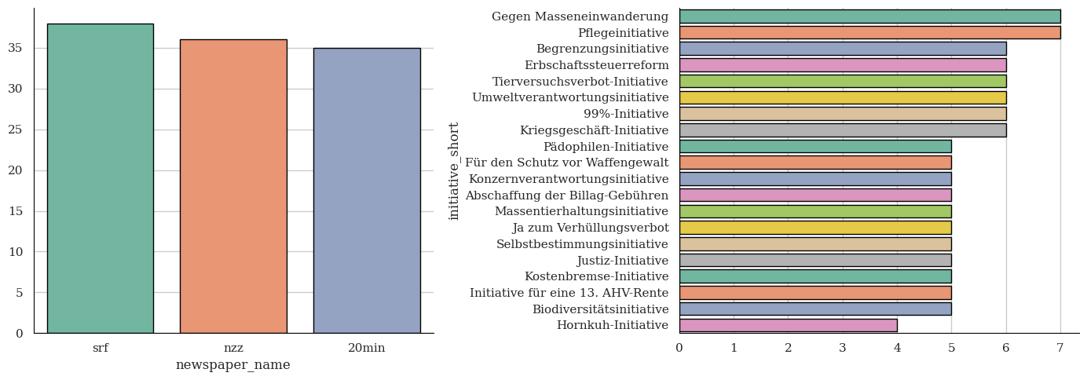
Descriptive Analysis
Distribution of Articles by Newsoutlet and Intiative:

Slide 6
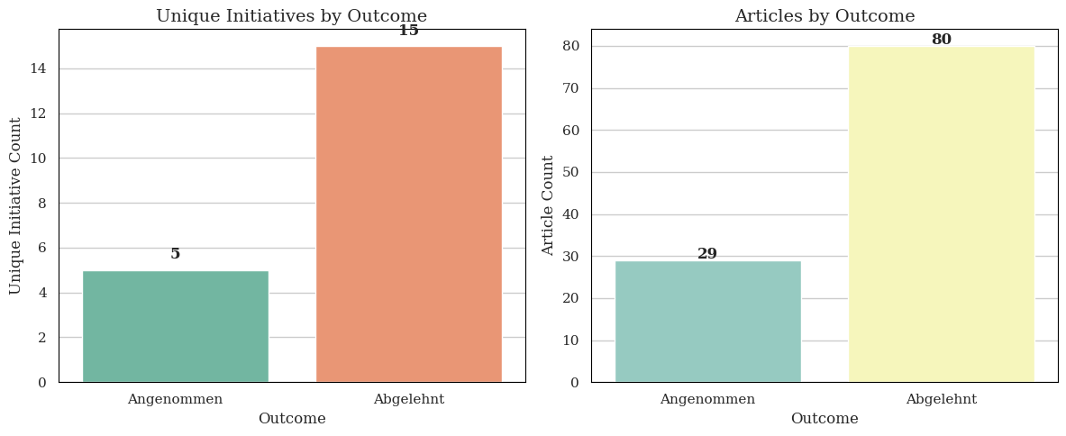
Descriptive Analysis
Distribution of Initiatives and Articles by Outcome
This class imbalances affects both taining and evaluation of classification models and may bias results toward the majority class (→ rejected initiatives)

Slide 7
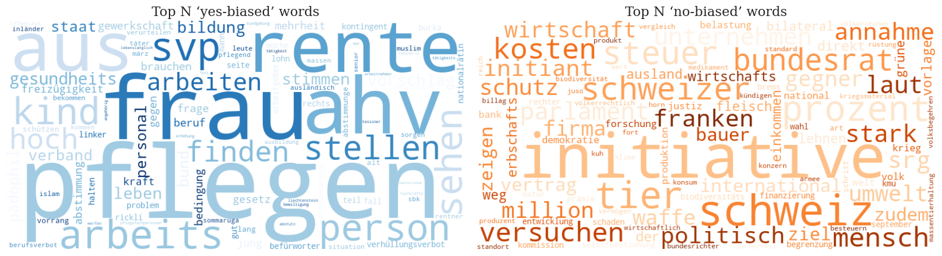
Descriptive Analysis
Wordclouds by Voting Outcome
Yes-Biased Words: to care, women, pension, work, education, health, etc.
Terms relating to social issues, care work, education and labor, often found in emotionally charged or socially supportive framing
No-Biased Words: Switzerland, cost, tax, farmer, economy, weapon, etc.
Terms more technical, institutional, and abstract, reflecting administrative or economic framing

Slide 8
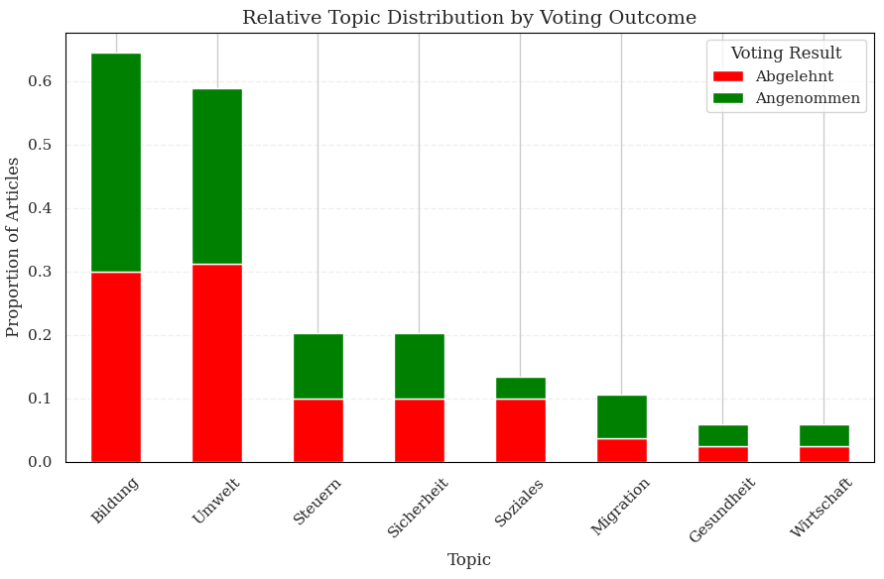
Descriptive Analysis
Zero-Shot Topic Classification
Applied zero-shot topic classification using the pre-trained multilingual model facebook/bart-large-mnli via HuggingFace
Input: News article + set of topic labels
Output: Confidence (classification) score for each topic
Why Zero-Shot
No need for model training
Works well on German texts
Supports custom topic labels

Slide 9
Data Modelling & Interpretation
1. Sentiment Analysis of News Articles:
Method: German transformer model fine-tuned for sentiment detection: oliverguhr/german-sentiment-bert
Input: Full article text (shortened to 512 tokens, approx. 5000 characters)
Output:
Label: positive, neutral, or negative
Score: confidence value (between 0 and 1)
Result:
Neutral: 94 articles
Negative: 15 articles
Positive: 0 articles
Interpretation:
This outcome reflects both the objective tone of political journalism and the limitations of sentiment models trained on emotionally expressive texts
Problem: Due to the dominance of neutral sentiment, no meaningful variation across outcome groups (accepted vs. rejected) can be observed

Slide 10
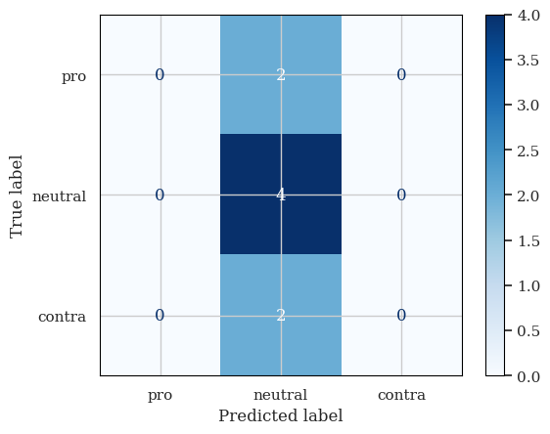
Data Modelling & Interpretation
2. Stance Detection via Fine-Tuned BERT:
Motivation: Sentiment analysis yielded mostly neutral results, reflecting the formal style of new texts. To capture directional alignment toward the voting proposal we implement stance detection
Method: Fine-tuning a BERT model (bert-base-german-cased) on 40 manually labeled articles(pro, neutral, contra)
Train/Split: Stratified 80/20
Tokenization: Max length 512 tokens
Training: 5 epochs, batch size = 4, learning rate = 2e-5
Result (results from weighted loss function approach in brackets):
Accuracy: 0.5 (0.25-0.5)
F1 Macro: 0.22-0.26 (0.133-0.22)
Validation Loss: 1.05 → 0.96 (1.09-1.04)
Interpretation:
Model predicts mostly the majority class (neutral), indicating underfitting and class imbalance issue
Solution: Apply weighted loss function to give more importance to minority classes (pro, contra)
→ Due to limited and unbalanced dataset, the model fails to detect class-specific patterns.

Slide 11
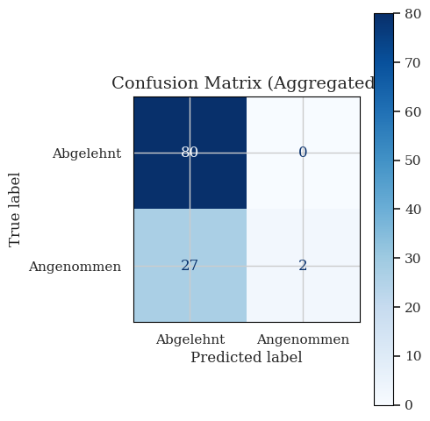
Data Modelling & Interpretation
3. Logistic Regression Classifier:
Motivation: What characteristics are associated with the acceptance or rejections of initiatives.
Method:
Classification:
- Logistic Regression
- Gradient Boosting
- Random Forest
compared to Baseline most frequent
Result:
Baseline accuracy: 0.734 ± 0.014
Logistic CV accuracy: 0.752 ± 0.021
RF & GB accuracy: 0.744±0.06 / 0.744±0.03
Interpretation: The model fails to identify the accepted initiatives reliably
Limitation: Initiative-specific terms might further push the accuracy of prediction
Notes:
In this section, we ask whether the same fully-preprocessed article texts that we analyzed descriptively can actually predict referendum outcomes—and do so with a simple, interpretable model. By mapping each article’s cleaned text to a binary label (“Abgelehnt” = 0, “Angenommen” = 1) and training a logistic-regression classifier on TF-IDF features, we can both gauge predictive power and inspect which words drive the decision.

Slide 12
Data Modelling & Interpretation
Final Conclusion & Interpretation
Overall tone: Swiss media coverage tends to be neutral, fact-based and institutionally consistent
Neither framing theory nor mirror theory receives strong empirical support:.
Summary:
Topic Patterns: Social terms (e.g., pension, women, nursing, work, health, child) appear more in accepted initiatives and economic/institutional terms (e.g. tax, firm, economy, Switzerland) in rejected ones
Sentiment & Stance: Most texts labeled neutral, stance detection failed due to both neutral journalistic style and potentially due to small, imbalanced data
Outcome prediction: Predictive features often initiative-specific, limiting generalization
Limitations:
Article-level splitting risks data leakage, inflating model metrics
Neutrality may reflect true reporting norms or results from dataset limitations

