Slide 1




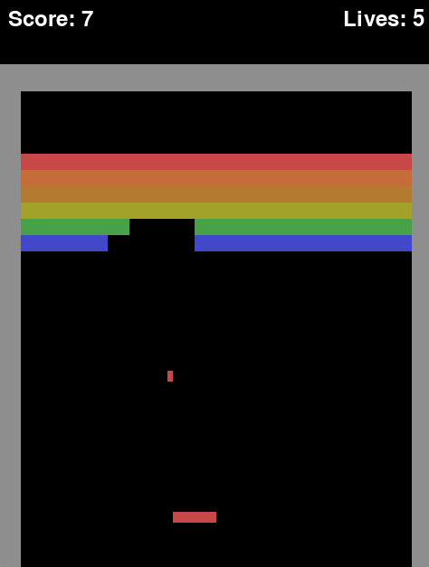
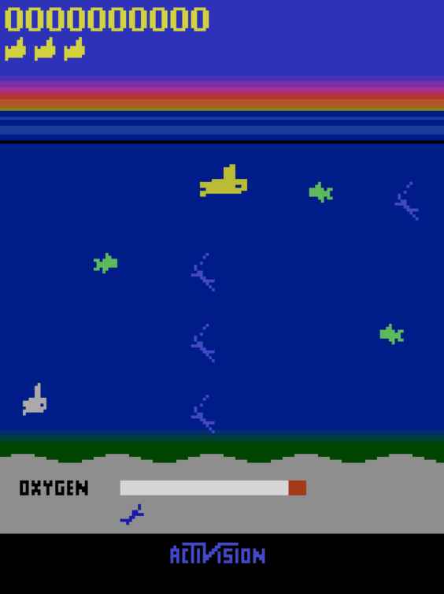

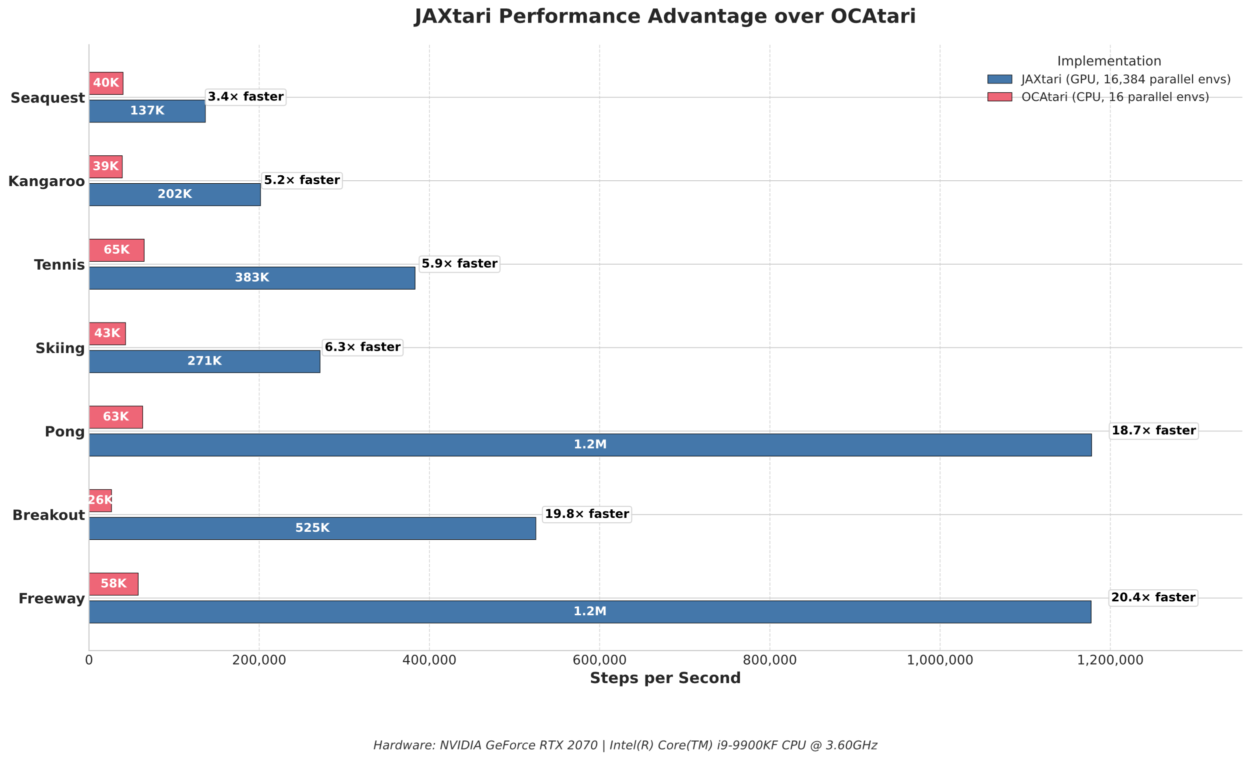
 | Artificial Intelligence and Machine Learning (AIML) Lab, TU Darmstadt
JAXtari: JAX Object centric Atari environments
Daniel Kirn*, Dominik Mandok*, Paul Seitz*, Lars Teubner*, Sebastian Wette*
Visit the GitHub Repository:
https://www.ml.informatik.tu-darmstadt.de/
* All authors had equal contribution
TL;DR
Motivation
1
2
JAX-based object-centric Atari environments to accelerate RL with GPU parallelization and structured object representations.
Training RL agents on emulated Atari Environments with ALE and PyTorch is slow due to significant overhead. By switching to JAX, we can leverage GPU acceleration and compiled operations to decrease training time.
Key Contributions
7 Atari games implemented in JAX for scalable training.
Object-centric RL enables faster, more efficient learning.
Uniform API for seamless integration and extensibility.
JAX-powered runtime optimizations
Our object-centric Atari environment, JAXtari, enables pixel-based representations as well as efficient object representations—enabling flexible, scalable, and faster learning optimized for modern RL research.
Environment
Core Features and JAX Concepts
4
3
jax_environment
We selected seven Atari games (Seaquest, Pong, Tennis, Skiing, Kangaroo, Freeway, Breakout) and studied ALE & OCAtari to analyze mechanics, behaviors, and object structures. Using this insight, we implemented JAX-based environments, ensuring compatibility with a uniform API via our base wrapper.
reset()
update game logic
Key JAX Concepts
GPU Parallelization
Just In Time Compilation
Vectorization
Functional Control Flow
Immutable Arrays
NumPy-like API
initial state
one time
step()
state
render()
render game states as pixel frames¹
¹ The rendering system to represent game states as pixel frames was developed by Group 1.4.2
Evaluation and Conclusion
5
Our benchmark shows that JAXtari outperforms OCAtari, achieving up to 20x more steps per second in some environments. Even the slowest case shows a 3.4x speedup.
Performance gains decrease with game complexity, due to increased branching and reduced vectorization efficiency.
These results highlight the scalability and speed of JAX-powered, object-centric RL environments — making JAXtari a strong foundation for modern RL research.

