Slide 1
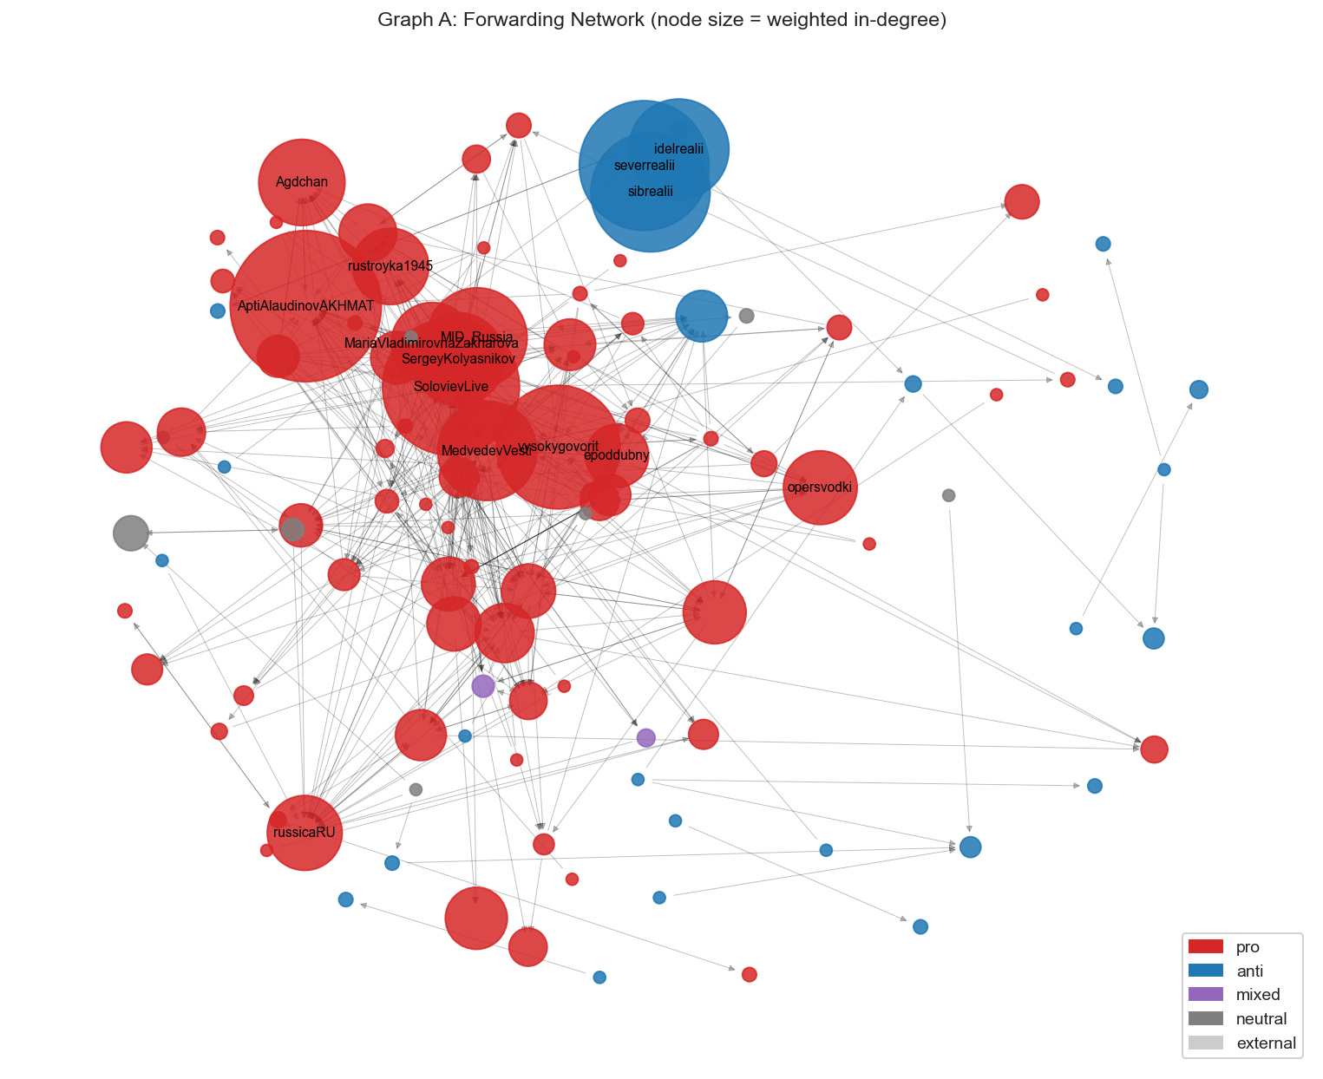
WEB AND SOCIAL MEDIA SEARCH AND ANALYSIS · 2025 / 2026
Coordinated Propaganda Networks
in Russian-Language Telegram
Maksim Okulov · Valentina Shvetsova

Slide 2
AGENDA
How we'll tell this story
01
The question
02
The data
Why Russian political Telegram, and what we set out to find.
How we collected 410K messages without a Telegram account.
03
The network
04
The coordination
Who talks to whom - communities, echo chambers, bridges.
Hidden signs of orchestrated, inauthentic behaviour.
05
The content
06
The payoff
What they say - emotion, entities, topics, and framing.
Pseudo-neutral propaganda and what it all means.
WSA · Coordinated Propaganda Networks in Russian Telegram
02

Slide 3
THE QUESTION
Telegram is the dominant platform for Russian-language political discourse
State media, independent outlets, military bloggers and opposition channels all broadcast and re-publish each other on the same platform. We ask whether that activity is coordinated, and how the camps differ.
RQ1
What communities exist, and do they match political alignment?
RQ2
Are there measurable signs of coordinated behaviour?
RQ3
How does content — tone, emotion, topics, entities — differ?
RQ4
Which channels bridge otherwise separate bubbles?
02

Slide 4
THE DATA
Collecting the corpus
167
~410K
743K
8,600
seed channels
messages
URLs
near-duplicates
hand-labelled by lean
over 6 months
extracted & normalised
across channels
INSIGHT · LABELLING IS NOT TRIVIAL
Method - no account needed
Three channels' self-descriptions did not match their actual content profile: one labels itself as fact-checking but publishes predominantly one-sided commentary, and two present as Ukrainian-perspective channels but consistently align with a different editorial line. This motivated a two-pass labelling scheme where we verified the initial category assignment against actual content.
We parse the public web previews t.me/s/<channel> with a resume-safe, proxy-rotating scraper.
WSA · Coordinated Propaganda Networks in Russian Telegram
04

Slide 5
APPROACH
Two lenses: structure and content
NETWORK - who talks to whom
CONTENT - what they say
Graph A · Forwarding
Sentiment & Emotion
Directed. B forwards A's post — the most direct flow of information.
RuBERT models over all 408K messages.
NER + entity networks
Graph B · URL co-sharing
spaCy extracts actors; we map how each side links them.
Undirected. Two channels post the same link — latent coordination.
Topics & word clouds
Graph C · Temporal co-posting
BERTopic + TF-IDF surface distinctive themes.
Same link within 30 minutes — synchronised publishing.
LLM-as-judge
A local model flags propaganda techniques & framing.
WSA · Coordinated Propaganda Networks in Russian Telegram
05

Slide 6
THE NETWORK · RQ1
A map split in two
What the graph shows
Pro-Kremlin channels (red) form a dense, mutually-reinforcing core. Anti-Kremlin channels (blue) sit apart, in their own region.
Every one of the top channels by PageRank is pro-Kremlin - they amplify each other.
The opposition broadcaster's regional desks forward almost only among themselves - visibly isolated.
Takeaway alignment is written into behavior - we can see the politics in the wiring.
WSA · Coordinated Propaganda Networks in Russian Telegram
06

Slide 7
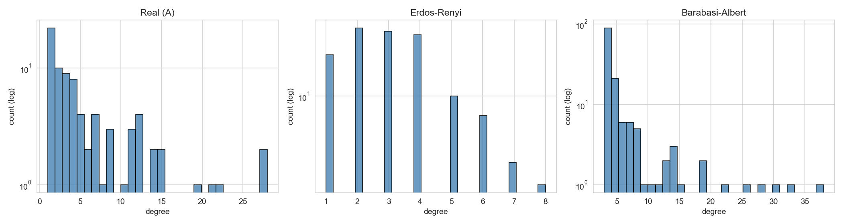
THE NETWORK
Not random - echo chambers
We compare the real network to two synthetic ones of the same size: random (Erdős–Rényi) and hub-driven (Barabási–Albert).
CLUSTERING COEFFICIENT
0.25
The real network is heavy-tailed — a few hubs dominate, like a scale-free graph.
But it is far more clustered than either model — the fingerprint of tight in-groups.
5× a random graph (0.05) and ~2× a hub model (0.13). Channels don't just follow hubs - everyone forwards everyone.
WSA · Coordinated Propaganda Networks in Russian Telegram
07

Slide 8
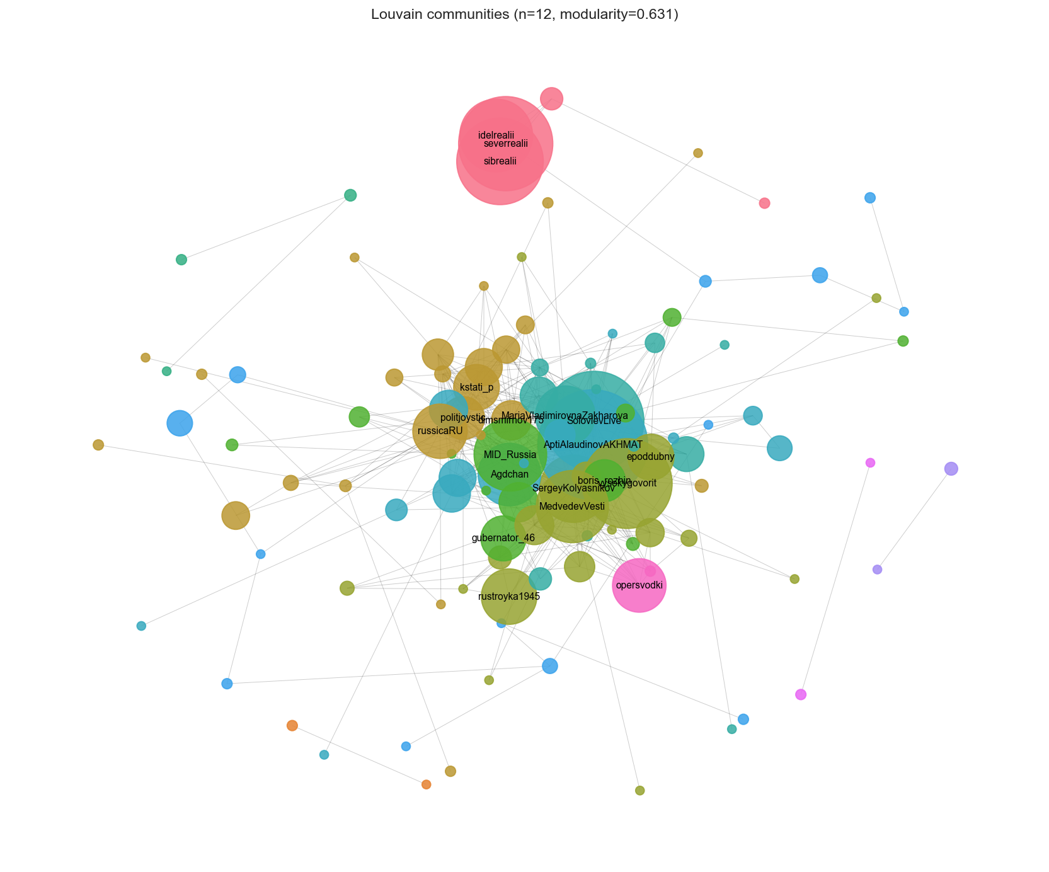
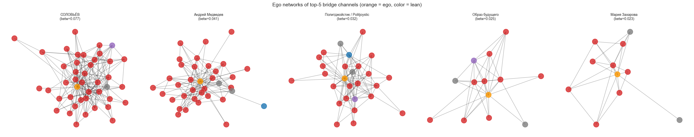
THE NETWORK · RQ1 & RQ4
Communities - and the rare bridge
Modularity 0.63 - 43 communities, agreeing with our labels at NMI 0.36. The split is real, but finer than pro/anti: voenkory, officials and analysts each cluster.
Bridge spotted Politjoystic links all four camps; Solovyov only looks central — his ties stay inside the pro core.
WSA · Coordinated Propaganda Networks in Russian Telegram
08

Slide 9
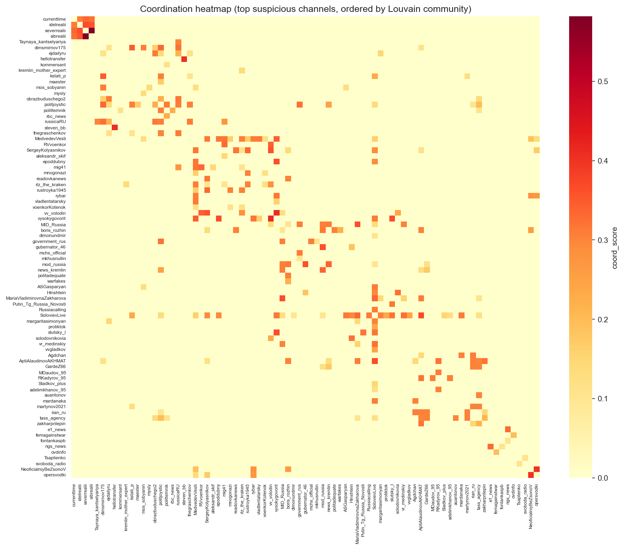
COORDINATION · RQ2
Signs of coordination
We score every channel pair on forwarding, shared links, timing and near-duplicate text.
8,600
near-duplicate posts copied across different channels
710
pairs posting the same link within 30 minutes
Mirror pairs
Ministry ↔ its spokesperson; military ↔ TV propagandist
Bright diagonal = within-group; off-diagonal flags hidden cross-group coordination.
WSA · Coordinated Propaganda Networks in Russian Telegram
09

Slide 10
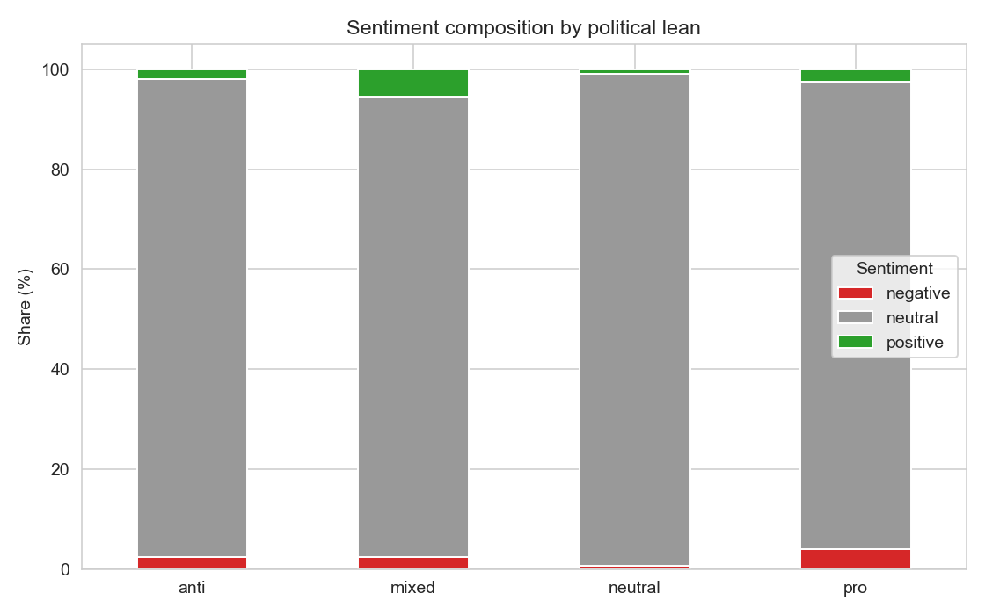
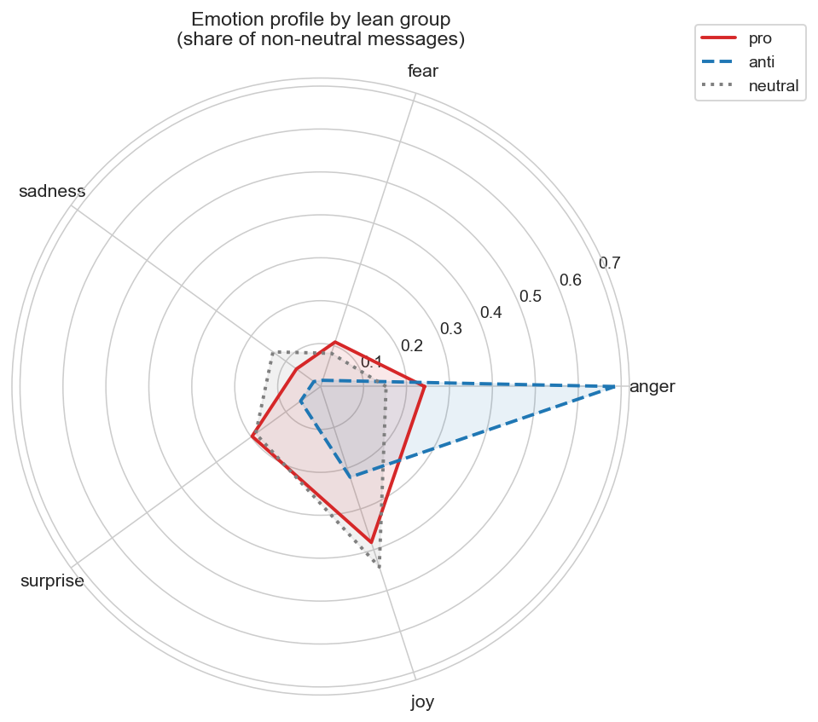
THE CONTENT · RQ3
How the camps feel
Anti-Kremlin = anger. 68% of their emotional posts are angry. Pro-Kremlin is more balanced - aggression mixed with triumphalism.
Counter-intuitive pro-Kremlin channels carry the highest negative-sentiment rate (4.0%) - yet 95% of all posts read as “neutral” to the model.
WSA · Coordinated Propaganda Networks in Russian Telegram
10

Slide 11
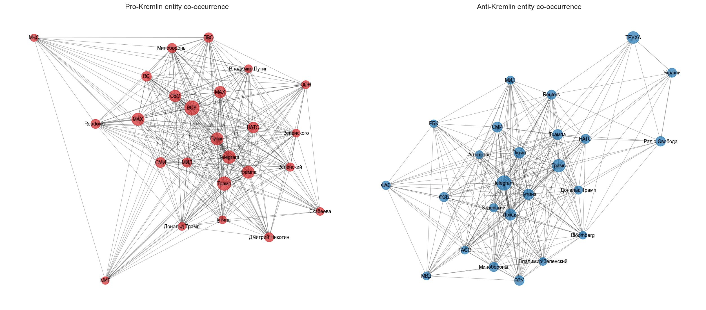
THE CONTENT · RQ3
Same events, different stories
Both sides orbit Trump and Putin, but wire them to different worlds.
Pro links military actors (the Ukrainian army, Akhmat, MoD) to politics; the network is denser.
Anti foregrounds media (Reuters, Dozhd) and security services (FSB).
TOPICS CONFIRM IT
A Ukrainian-language topic is 46% of anti content but ~2% of pro. The topic structure aligns with political lean beyond the shared news agenda
WSA · Coordinated Propaganda Networks in Russian Telegram
11

Slide 12
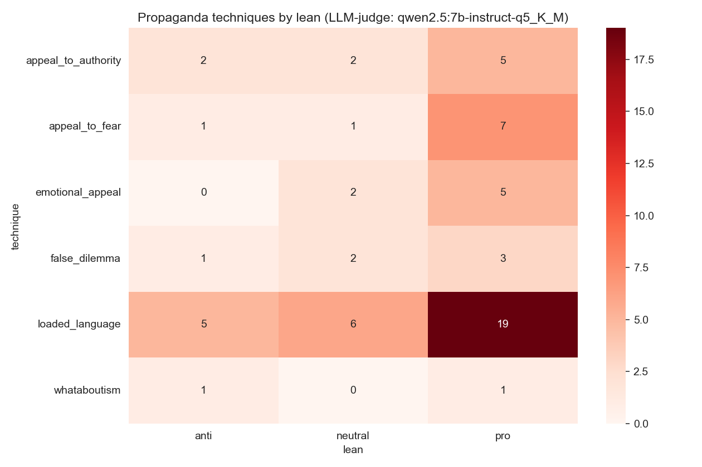
THE PAYOFF · RQ3
The payoff: pseudo-neutral propaganda
We asked a language model to flag propaganda techniques on a sample.
19 vs 5
loaded language in pro- vs anti-Kremlin posts. Appeal to fear is almost only pro (7 vs 1).
Here is the twist:
These are the very posts the sentiment model called “neutral.” This suggests that formal, news-like register can carry rhetorical techniques that automated sentiment classifiers do not detect
WSA · Coordinated Propaganda Networks in Russian Telegram
12

Slide 13
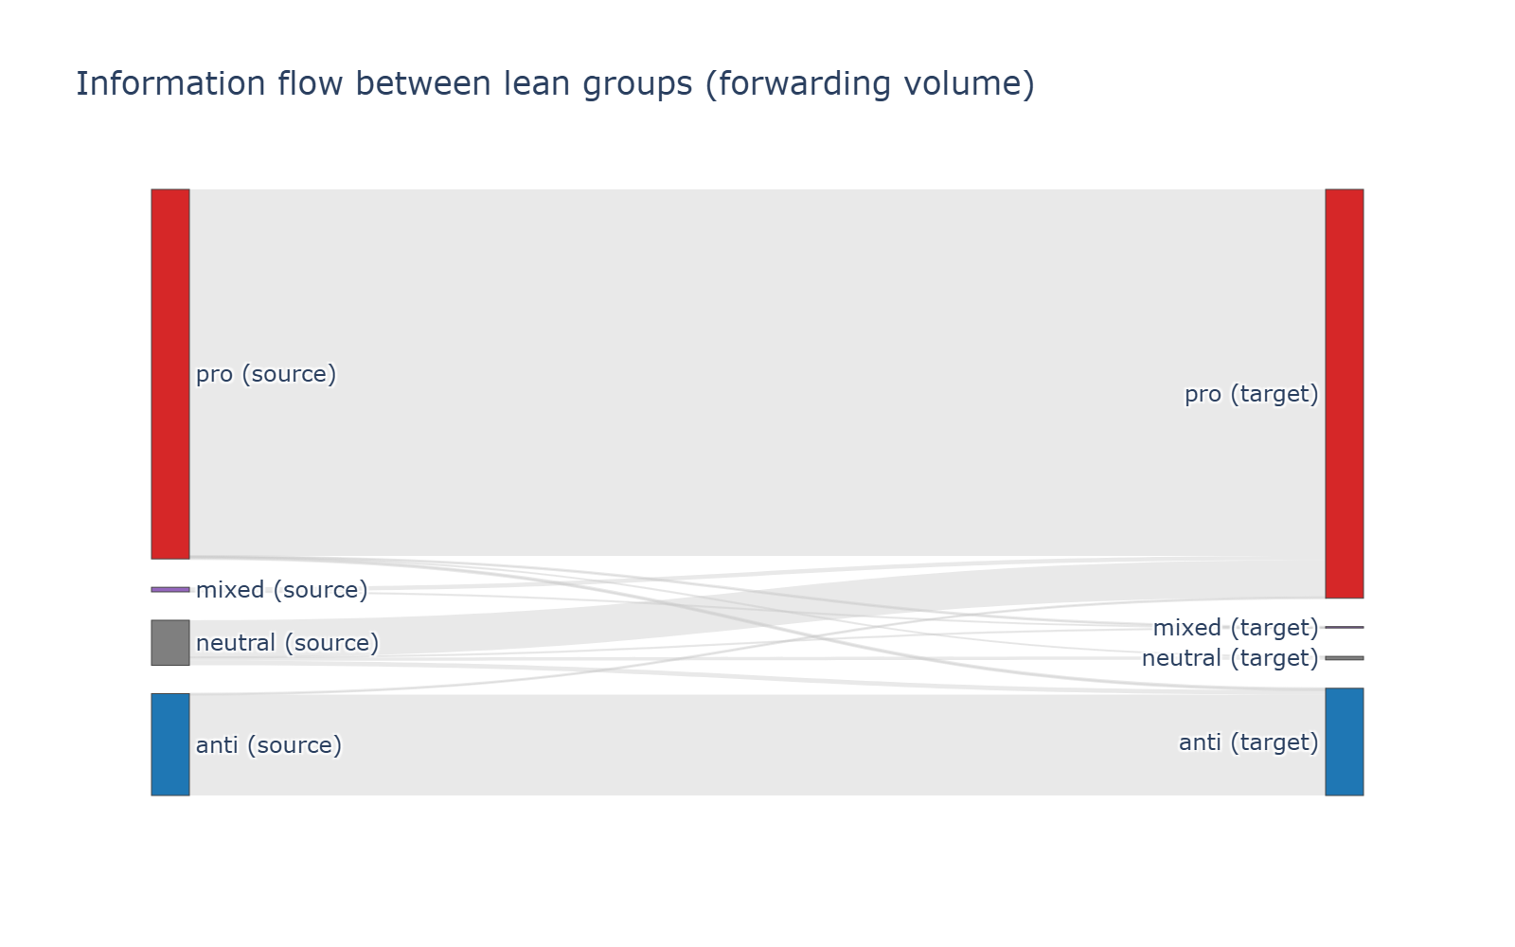
SYNTHESIS
Information stays inside the camp
Forwarding between groups
pro → pro dominates everything else.
anti → anti is a distant second.
Direct pro ↔ anti flow is negligible.
The structure (Section 2) and the content (Section 3) tell one story: two sealed echo chambers, with coordination concentrated inside the larger one.
WSA · Coordinated Propaganda Networks in Russian Telegram
13

Slide 14
CONCLUSIONS
Answering the four questions
RQ1 Communities
RQ2 Coordination
Two sealed camps; finer sub-clusters inside each. Structure mirrors politics (NMI 0.36).
Yes - 8,600 copies, synchronous posting, institutional mirror pairs, presemt in both camps.
RQ3 Content
RQ4 Bridges
Anti channels show dominant anger; pro channels use a formal register where LLM annotation detects more rhetorical techniques. Different actor-networks and topics across groups.
Rare. Politjoystic is the only true cross-camp connector; apparent hubs stay within their side.
WSA · Coordinated Propaganda Networks in Russian Telegram
14

Slide 15
Thank you
Questions & discussion

