Slide 1
Enron Email Network Analysis
To what extent does communication structure reflect hierarchy?
Team: [Fill names]
Course: Data Mining

Slide 2
Problem Statement
Hypothesis: hierarchy is partially reflected, with meaningful divergence.
Goal: identify hubs, communities, and bridge roles.

Slide 3
Dataset and Challenges
150 mailbox directories, 500K+ message files.
Challenges: duplicates, broadcasts, weak ties, identity noise.

Slide 4
Pipeline Overview
Parse sent folders
Validate + sanity checks
Build weighted graph
Louvain + centrality
Visualization + narrative

Slide 5
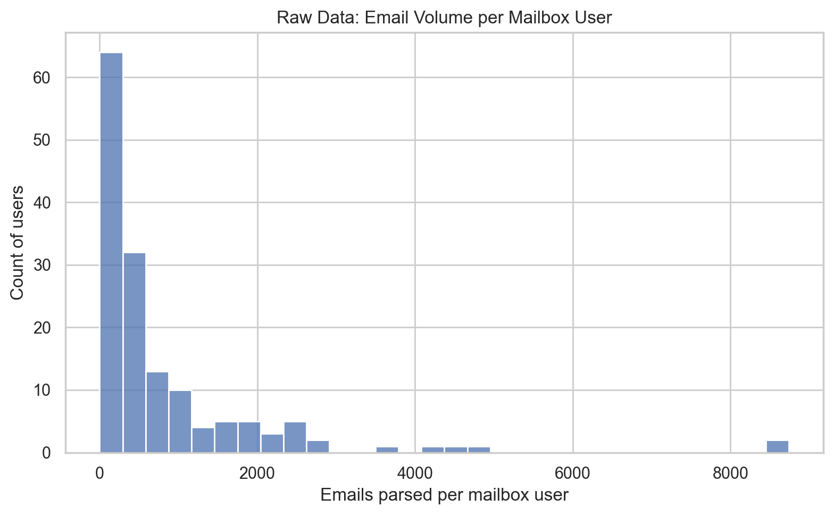
Raw Data Exploration
Email volume per user distribution
Monthly communication trend

Slide 6
Preprocessing Logic
Drop no-recipient emails
Drop broadcasts (>10 recipients)
Filter internal @enron.com
Keep edges with weight >= 2

Slide 7
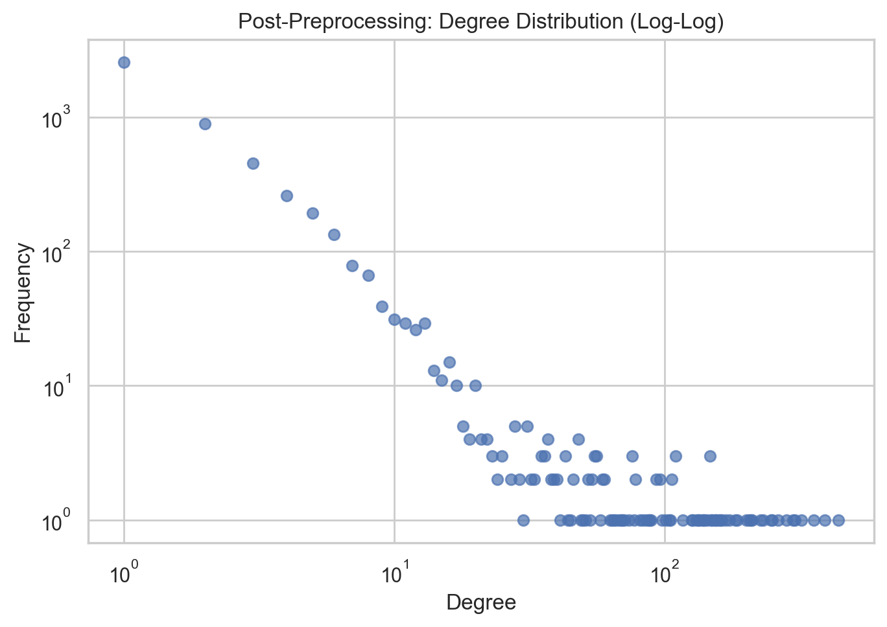
Post-Processing Checks
Degree distribution (log-log)
Edge weight distribution

Slide 8
Algorithm: Louvain
Community detection by modularity optimization
No preset k required
Run 3 seeds for stability check

Slide 9
Algorithm: Centrality
PageRank for influence
Betweenness for bridge detection
Degree for communication breadth

Slide 10
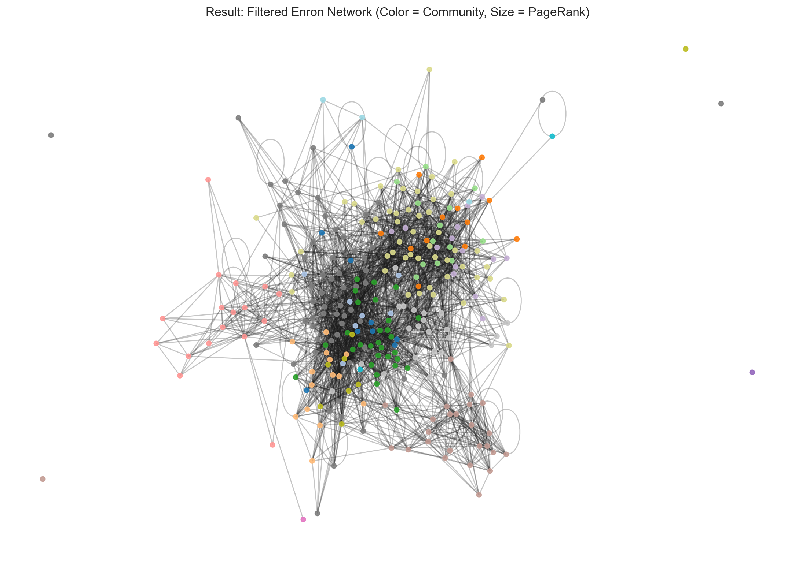
Network Result (Hero Figure)
Filtered network: size=PageRank, color=community

Slide 11
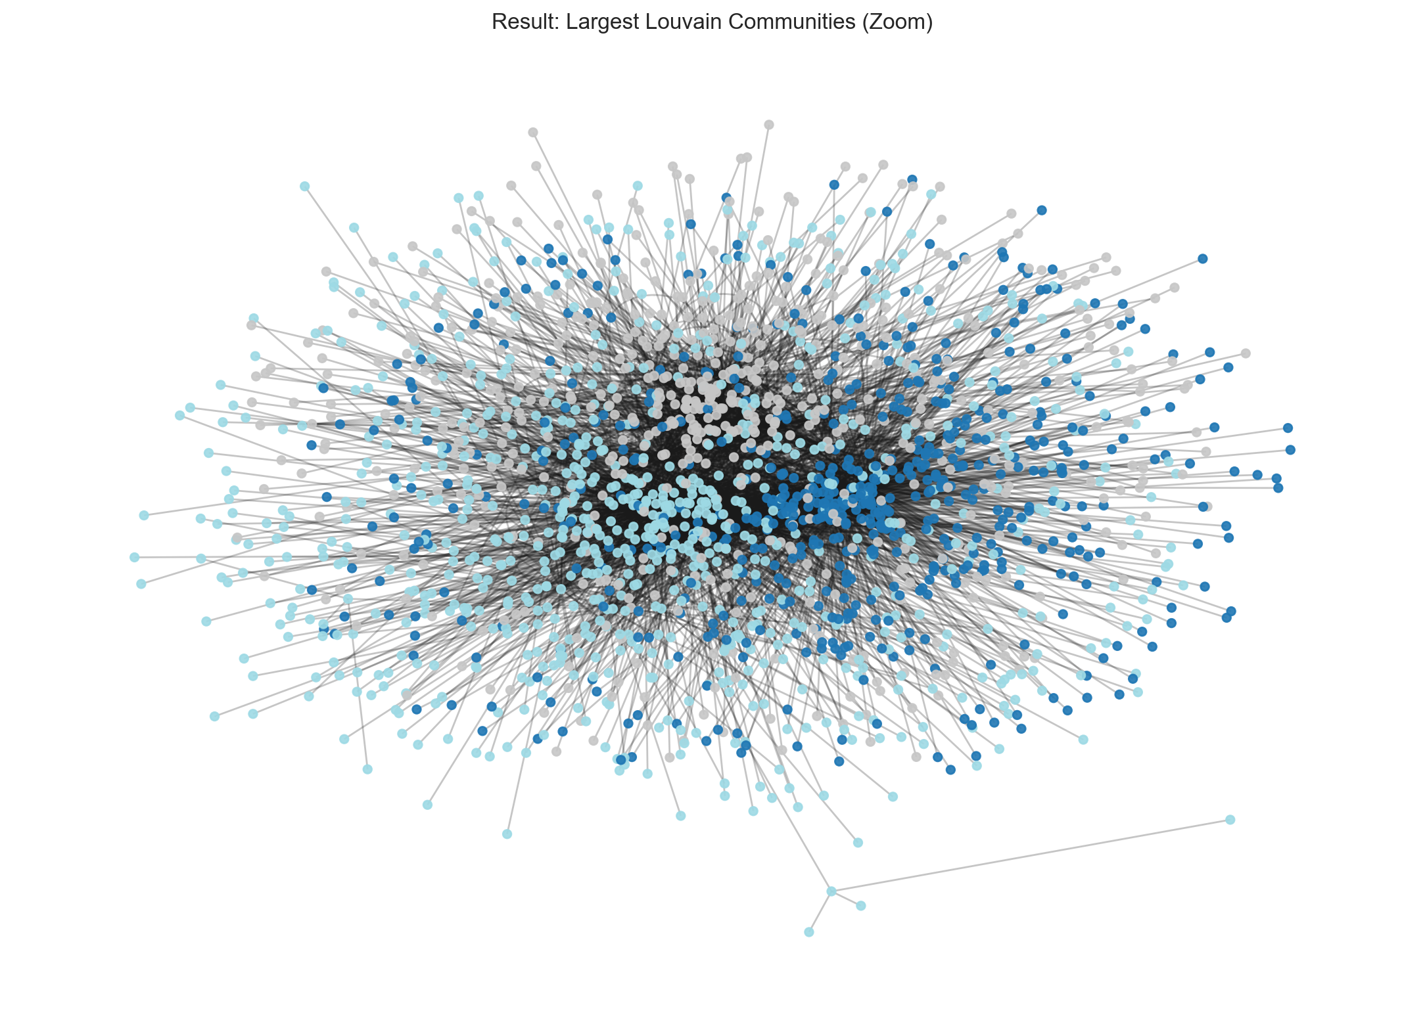
Community Result
Largest communities and modularity summary

Slide 12
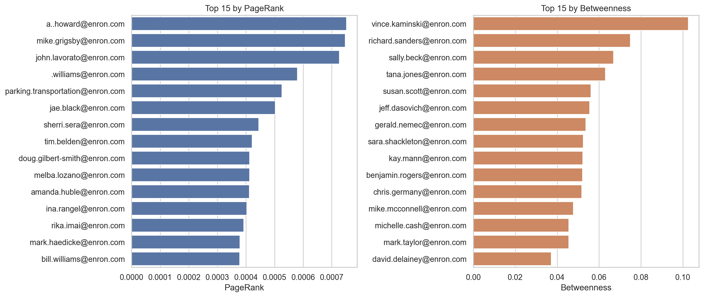
Centrality Result
Top nodes by PageRank and betweenness

Slide 13
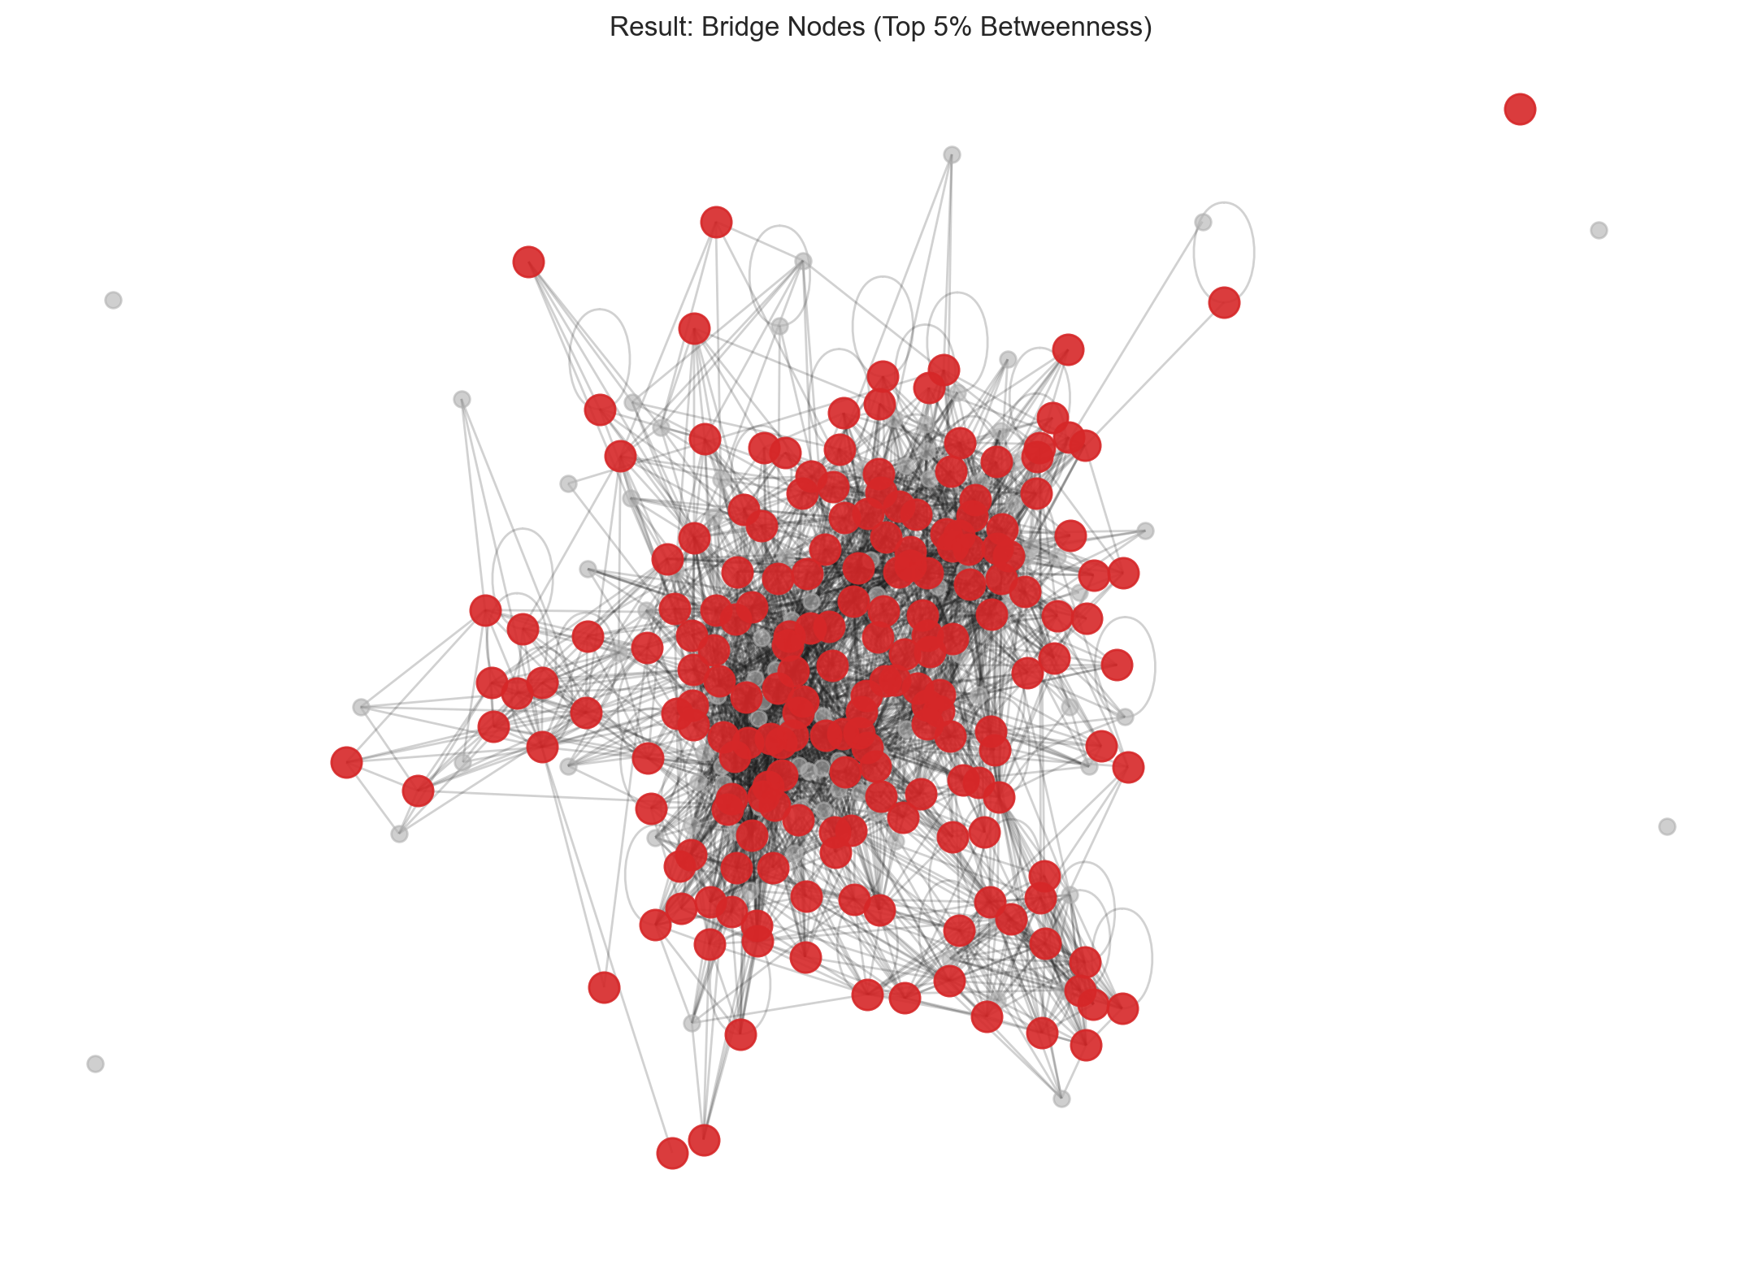
Bridge Result
Top 5% betweenness nodes as bridges
Compare bridge roles against hierarchy

Slide 14
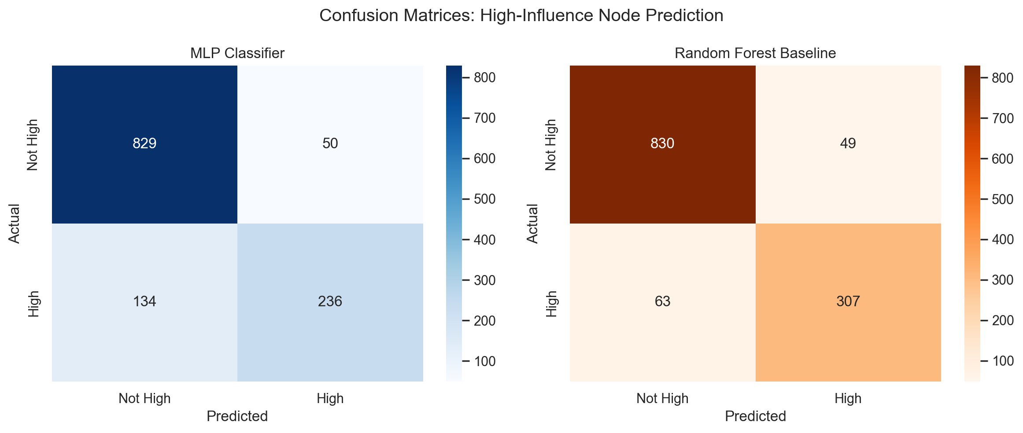
Neural Network Extension
Predict high-influence nodes from structural features
MLP: 85.3% acc, F1=0.72
Random Forest baseline: 91.0% acc, F1=0.85
Network position encodes role information

Slide 15
Conclusion and Future Work
Hierarchy partially supported; divergence is substantial.
Neural network confirms structural features predict influence.
Future: temporal, sentiment, external-network extensions.

Slide 16
References (APA)
Klimt & Yang (2004); Blondel et al. (2008); Hagberg et al. (2008).

