Slide 1


YOUR
PRODUCT PITCH
TRACK #
TEAM MEMBERS

Slide 2



AGENDA
01
PROBLEM
02
SOLUTION
03
SERVICE
04
TEAM
05
DEMO

Slide 3



CHALLENGES
What pain points are you tackling? What gaps are you going to fill?
01
Discuss a challenge
Briefly describe the impact of the pain point and why it matters.
02
Discuss a challenge
Briefly describe the impact of the pain point and why it matters.
03
Discuss a challenge
Briefly describe the impact of the pain point and why it matters.

Slide 4

SOLUTION
01
SOLUTION 1
Explain how your product addresses one of the challenges you identified earlier.
02
SOLUTION 2
Explain how your product addresses one of the challenges you identified earlier.
03
SOLUTION 3
Explain how your product addresses one of the challenges you identified earlier.

Slide 5


03
SERVICE
Describe your product in action. Highlight core capabilities and unique features.
Add any additional design details, capabilities, or product applications

Slide 6



HOW IT WORKS
01
Highlight a product feature
Bring it to life with key details.
List use cases or applications.
Include styles or feature options.
02
Highlight a product feature
Define what makes this feature distinctive.
Make it shine with vivid language.
Break down the technical aspects.
03
Highlight a product feature
Add notes on design or user experience.
Share important tech specs.
Duplicate this slide if you need more space.

Slide 7
SERVICE PIPELINE // PRODUCT DESIGN

Slide 8


DISCUSS INSIGHTS ABOUT YOUR USER
Persona Name
“Quote the persona on what they’re looking for.”
Introduce your target persona. Highlight some key traits and mention their age, profession, and location.
Needs and motivations
Pain points
How we can help
What does your persona want to achieve? What are their goals?
Identify an obstacle your persona struggles with. What interferes with their needs and motivations?
Explain where your product or service comes in. How will it help them achieve their goal or resolve a pain point?
Tech usage
Free time
Technology budget
Social media usage
Work time
Entertainment budget

Slide 9


YOUR PRODUCT’S EVOLUTION
Date
Date
Date
KEY MILESTONE
KEY MILESTONE
KEY MILESTONE
Describe an upcoming step or phase.
Steps can include further deliveries, check-ins, marketing events, etc.
Announce an advancement, improvement, or additional feature you plan to launch in the future.

Slide 10


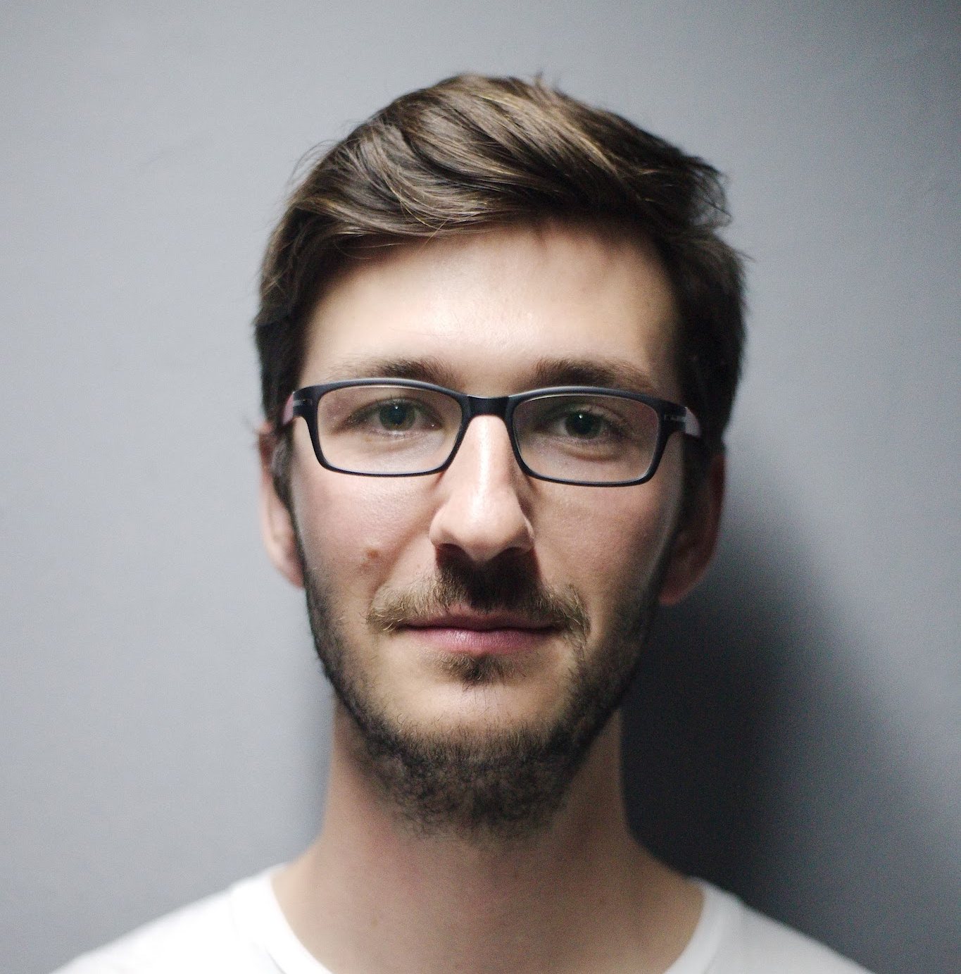

MEET THE TEAM
Full Name
Title
Full Name
Title
Full Name
Title
Full Name
Title
Write a brief bio of this team member. Include their background, expertise, and project responsibilities.
Write a brief bio of this team member. Include their background, expertise, and project responsibilities.
Write a brief bio of this team member. Include their background, expertise, and project responsibilities.
Write a brief bio of this team member. Include their background, expertise, and project responsibilities.

Slide 11

Product Demo
Encourage your audience to ask questions or give feedback about the presentation.
Share relevant contact details and invite your audience to continue the conversation beyond the presentation.
CONTACT OUR TEAM
name@example.com

Slide 12
EXAMPLE

Slide 13
office of marketing:
Agentic system of SNS manager
TRACK 3
Michelle

Slide 14
CHALLENGES
01
Human Rights Organizations do not have marketing teams
TrialWatch does not have a dedicated marketing office
02
Human Rights Lawyers lack SNS expertise
Limited resources in social media campaigns
03
HR lawyers need help
Briefly describe the impact of the pain point and why it matters.

Slide 15
SOLUTION
01
AI agents collect organization’s information and recent projects
AI agents will automatically data collect
02
AI agents trained on social media data
Agents are fine tuned with social media campaign knowledge
03
AI agents who do marketing on behalf
AI agents will curate a 3 month plans for marketing based on organization

Slide 16
03
SERVICE
An agentic system of SNS marketing devoted to TrialWatch
Add any additional design details, capabilities, or product applications

Slide 17
HOW IT WORKS
01
Automatically runs SNS marketing
Bring it to life with key details.
List use cases or applications.
Include styles or feature options.
02
Automatically writes monthly newsletters & Blogs
Define what makes this feature distinctive.
Make it shine with vivid language.
03
Multiple agents to reduce mistakes
Add notes on design or user experience.
Share important tech specs.
Duplicate this slide if you need more space.

Slide 18
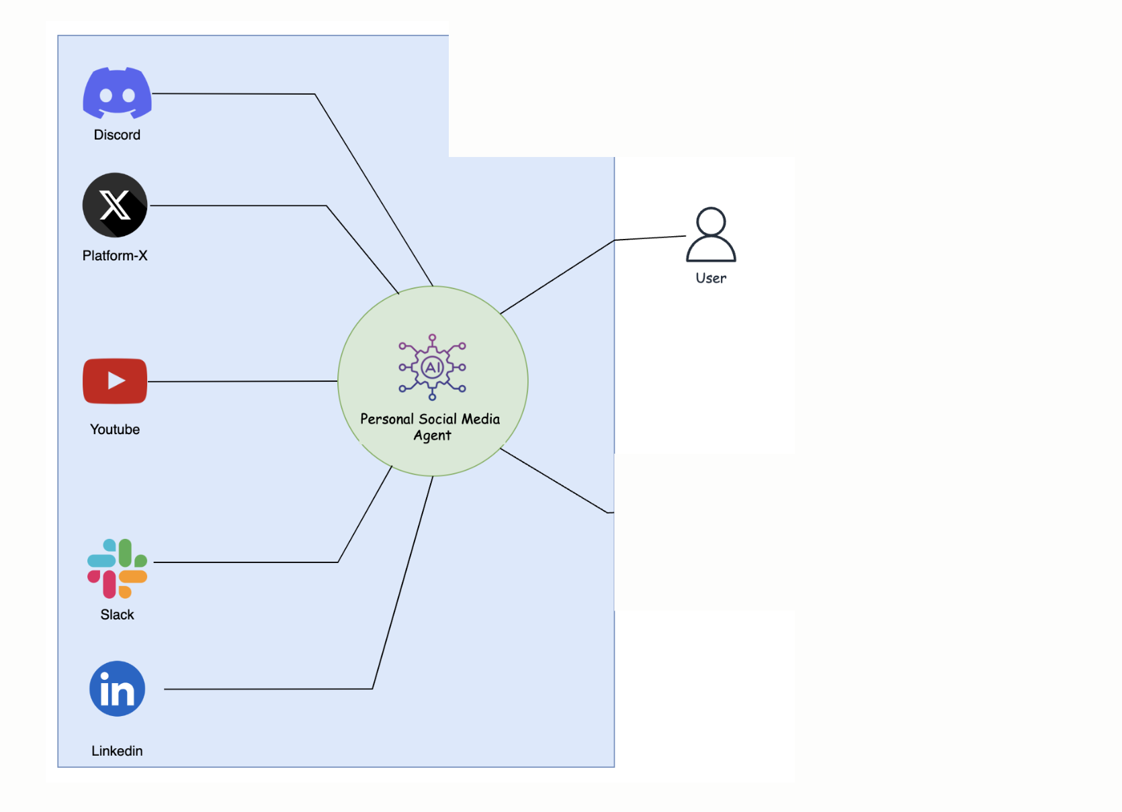
SERVICE PIPELINE

Slide 19
TrialWatch’s Feedback
Michelle
“Quote the persona on what they’re looking for.”
Introduce your target persona. Highlight some key traits and mention their age, profession, and location.
Needs and motivations
Pain points
How the service helps
Our team is lawyers, academics, students, and we do not have a dedicated marketing team who could help us promote our work & organization
We are not experts in SNS marketing
Wow! I am excited to see how the first newsletter will look like and how our instagram/tiktok will go viral!
Tech usage
Free time
Technology budget
Social media usage
Work time
Entertainment budget

Slide 20
Future Steps
Date
Date
Date
Make a tiktok account
Write monthly newsletter/ blogs
Implement feedback from organizations
Make 1 video per week
Steps can include further deliveries, check-ins, marketing events, etc.
Announce an advancement, improvement, or additional feature you plan to launch in the future.

