Slide 1


PAPER VS.
PRACTICE
An advocacy tracker for TrialWatch
TRACK 3 · ADVOCACY & IMPACT
Shreya · Valentina · Ungu · Layla · Yuki
Notes:
Indonesia reformed its speech law. We stress-tested the reform, and turned TrialWatch's own past reports into an Argument Bank and sourced UN letters for the next case.

Slide 2



AGENDA
01
PROBLEM
02
SOLUTION
03
SERVICE
04
TEAM
05
DEMO
Notes:
Problem, solution, how the service works, team, then the live demo.

Slide 3



CHALLENGES
Speech laws get reformed on paper. Nobody measures the practice, and past wins are buried in PDFs.
01
Reforms nobody measures
Indonesia revised its ITE Law (2024), the Constitutional Court narrowed it (2025) and the police pledged to comply. No one tracks whether prosecutions stop.
02
90 reports, not searchable
TrialWatch has graded 63 trials, but a lawyer can't find how a similar case was argued, which UN decisions applied, or what followed.
03
Letters written from scratch
Facts sit in court records, NGO reports and news, in English and Bahasa; each UN submission is written by hand.
Notes:
Three gaps: reforms nobody measures, TrialWatch's own reports aren't searchable by argument, and advocacy letters start from a blank page.

Slide 4

SOLUTION
01
REFORM STRESS TEST
Four rules from the 2024 law and 2025 ruling, in plain code. 5 of 13 past cases would likely be barred today (3–8 across legal readings).
02
ARGUMENT BANK
47 TrialWatch trials in 23 countries. Finds the closest past cases, good outcomes first, with the arguments used, page links and UN decisions.
03
SOURCED UN LETTER
A Special Rapporteur submission where every sentence cites its source, quotes are checked word for word, and a lawyer approves.
Notes:
One answer to each challenge: measure the reform, search what worked, draft the advocacy.

Slide 5


03
SERVICE
One tool that follows TrialWatch's own process: Monitoring → Evaluation → Advocacy.
Built from all 96 report pages on cfj.org · a simple web app · AI only where it helps, and always checked
Notes:
Built on TrialWatch's own reports and grading, in TrialWatch's own process.

Slide 6
03
HUMAN RIGHTS IMPACT
Behind each row is a person. Septia Dwi Pertiwi was detained 5+ months before a court found her posts true. Fatia & Haris spent about 3 years under prosecution for discussing a human rights report.
21 of 47 TrialWatch trials had a good outcome after TrialWatch's work: acquittal, dropped charges, overturned conviction, release, or a UN finding of arbitrary detention. We show what followed, never what caused it.
Notes:
The tool lets TrialWatch spot a case the reform should have stopped on the day the complaint is filed, before months of detention add up.

Slide 7



HOW IT WORKS
01
1 · Check the reform
Rules R1–R4 run as transparent code, no AI
Sensitivity analysis: 10 legal readings, 3–8 of 13
Paste a news story: Gemini suggests inputs, each with a checked quote
02
2 · Find what worked before
Matches on charge, speech, defendant and region, and says why
Good outcomes first, each confirmed with a source
Arguments, page links, UN decisions, impact on the defendant
03
3 · Draft the advocacy
Letter built only from numbered sources
Code rejects uncited sentences and invented quotes
A second check flags weak sentences; a named lawyer approves
Notes:
Walk the three steps on Fatia & Haris in the demo.

Slide 8
SERVICE PIPELINE
TrialWatch reports
96 cfj.org pages, 94 PDFs
Parse, no AI
63 grades · 2,304 arguments · 154 UN decisions
People confirm
47/47 outcomes · 288 impact sentences
Match current case
stress test + closest past trials, with reasons
Sourced UN letter
citation check · support check · lawyer approves
AI is used in two places only: suggesting case facts from a news story, and drafting the letter.
Both are checked by code against the sources, then approved by a person.
Notes:
Everything left of the letter is deterministic and tested. People confirm outcomes and impacts.

Slide 9


WHY TRIALWATCH LAWYERS USE IT
TrialWatch
legal monitor
Our user (illustrative)
Goal: “Show me how we argued a case like this, what happened, and give me a draft I can check.”
Reviews new speech prosecutions and drafts UN submissions under time pressure.
Needs
Pain points
How we help
Find precedent fast, cite TrialWatch's own findings, act the day a complaint is filed.
90 reports to read, sources in several languages, letters from scratch.
Minutes, not a day: closest cases, arguments with page links, a sourced draft to approve.
EASY · web app, no install
CHECKABLE · every claim links to its page
SPECIFIC · built from TrialWatch's own reports
Notes:
The user is illustrative, not a real person.

Slide 10
RESPONSIBLE AI
01
No AI where rules will do
Stress test, parsing, grades and matching are plain, tested code. AI only suggests inputs and drafts letters.
02
Every claim has a source
Quotes checked word for word; uncited sentences rejected; a person approves.
03
Honest and safe
No predictions: “followed”, never “caused”. 2 at-risk people hidden and never sent to AI. Only cited excerpts published, © CFJ.
Notes:
Responsible AI is 20% of judging: deterministic core, sources everywhere, human approval.

Slide 11
VALIDATION
01
Sources check out
2,304 / 2,304 arguments on the page they cite
288 / 288 impact sentences on the page they cite
Every grade stored with the sentence it came from
02
People confirmed the data
47 / 47 TrialWatch outcomes confirmed with a source
14 of 16 Indonesian cases signed off by a teammate
03
We know our limits
Headline 5 of 13; 3–8 across legal readings
Argument categories about 75–80% right in a hand-read sample
149 automated tests on every change
Notes:
Every number on these slides is recomputed from the data by scripts/build_slides.py.

Slide 12

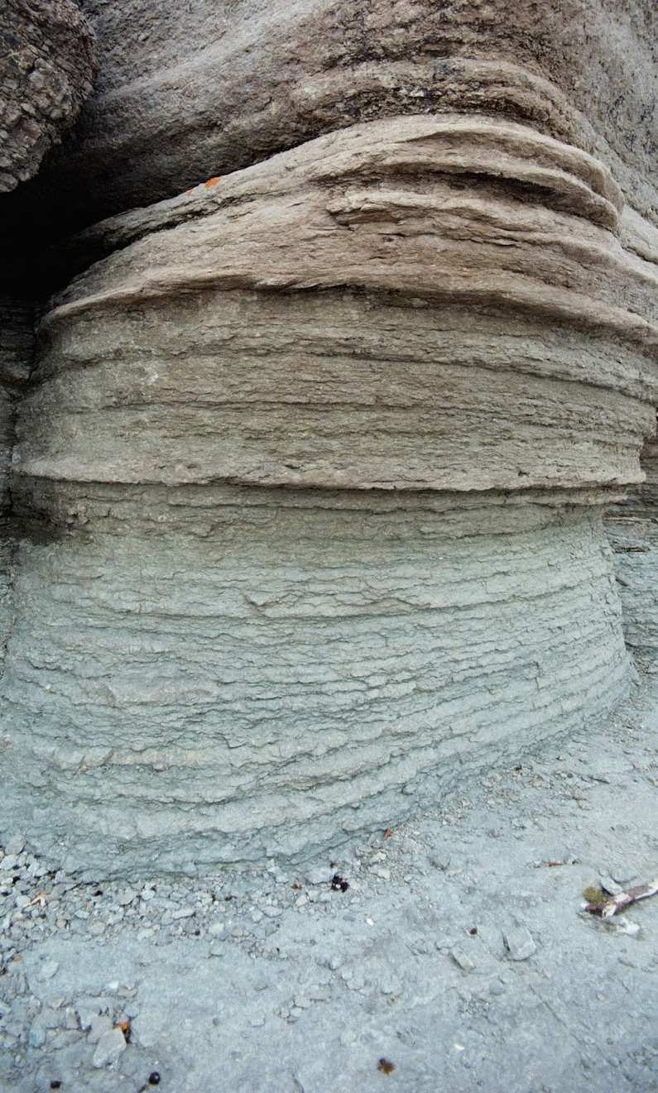
NEXT STEPS
Today
With TrialWatch
Next reform
DEMO & HANDOVER
LAWYER REVIEW
SCALE
Live app, open-source repo and written guide. Every number here recomputed from the data.
Confirm rules R1–R4 and the argument categories with TrialWatch lawyers; add the 73-case Indonesia dataset.
Swap the rules file for the next country's reform; add a live news intake that feeds a review queue.
Notes:
The tool is ready to hand over; the next step is lawyer review.

Slide 13


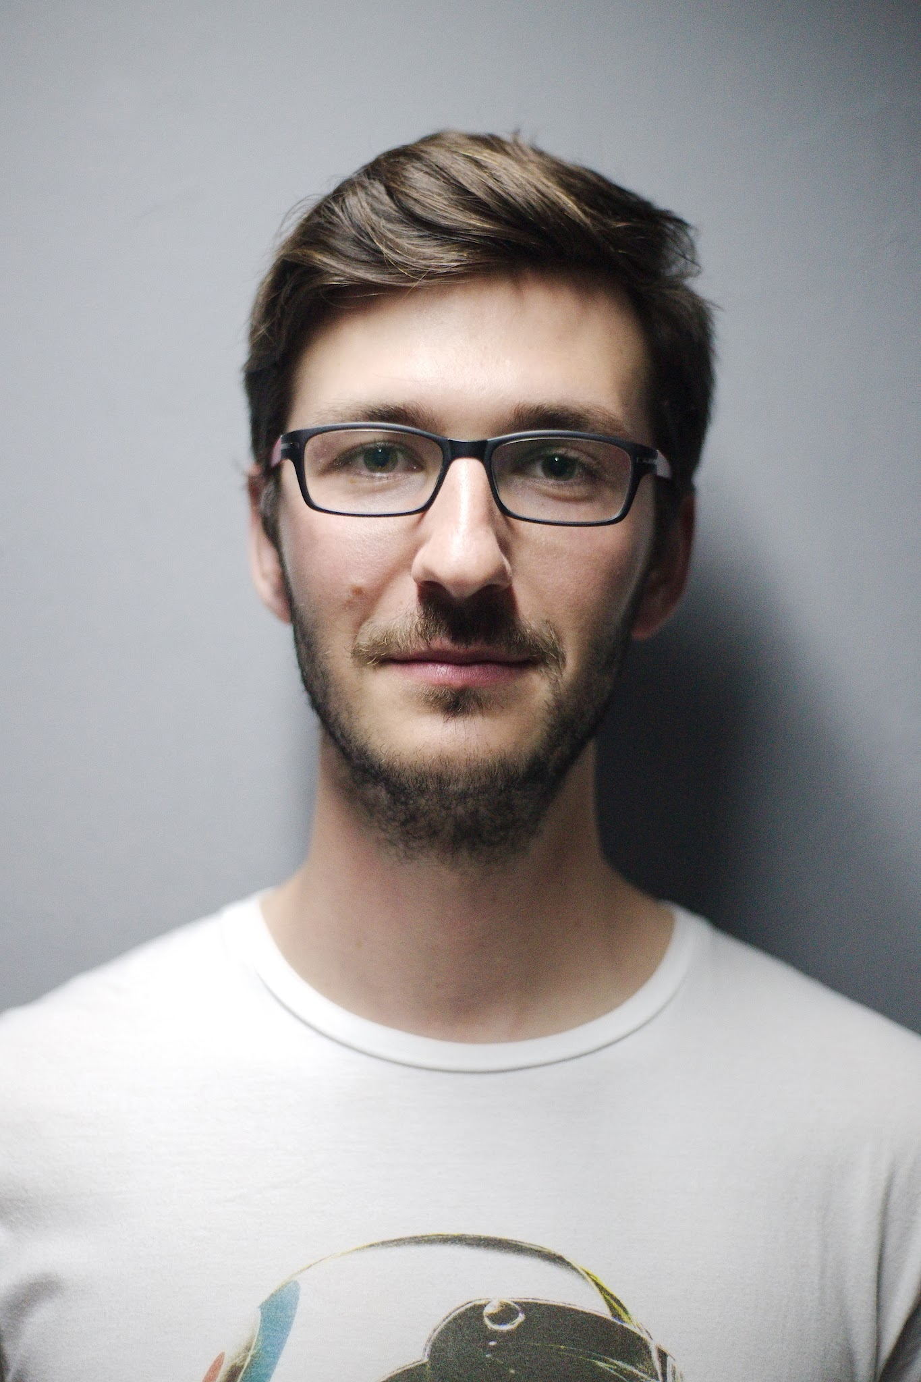

MEET THE TEAM
S
V
Y
U
L
Shreya
Stress test & Argument Bank
Valentina
App & case data
Yuki
Outcome checks
Ungu
Case research & impacts
Layla
Data lead & pitch
Rule engine, sensitivity analysis, Argument Bank, UN letter
Repository, case tracker page, case verification
Confirmed all 47 TrialWatch outcomes, each with a source
Indonesian case verification, impact categories
Meila & Asrul cases, sensitive-case review, slides
Notes:
Five data science students; legal claims come from cited sources, not our own judgment.

Slide 14

Live Demo
Questions and feedback welcome, especially from TrialWatch's lawyers: are our rules and argument categories right?
OPEN SOURCE
github.com/valentinasilva8/fairtrial-ai-hackathon
Code MIT · report excerpts © Clooney Foundation for Justice
Notes:
Demo: Home → Stress Test (Fatia & Haris) → Argument Bank → UN Letter. Start from the Home link.

