Slide 1

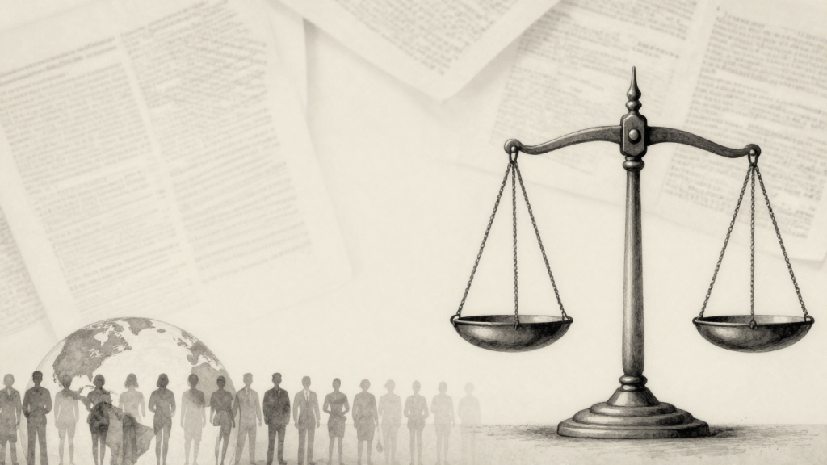
PRECEDENT &
PRACTICE
A HUMAN RIGHTS ADVOCACY TRACKER BUILT ON TRIALWATCH'S FAIRNESS REPORTS
TRACK 3 · ADVOCACY & IMPACT
SHREYA · VALENTINA · UNGU · LAYLA · YUKI

Slide 2


Table of Contents
3
4
5
Problem
Solution
Why Now?
6
7
8
Services Overview
Demo
Roadmap
9
Team

Slide 3
Problem
90 reports, not searchable
Reforms nobody measures
TrialWatch has graded 63 trials, but a lawyer can't find how a similar case was argued, which UN decisions applied, or what followed
Indonesia revised its speech law (2024–25) and police pledged to comply; no one tracks whether prosecutions stop.
1
3
Letters written from scratch
Facts sit in court records, NGO reports and news in several languages; each UN submission is written by hand.
2
3
TrialWatch's human rights analysis is buried in PDFs, advocacy starts from a blank page, and reforms go unmeasured.

Slide 4




Solution
47 TrialWatch trials in 23 countries. For any case: the closest trials, good outcomes first, and their arguments on legality, vagueness, broadness, necessity and proportionality, with author and page.
A Special Rapporteur submission where every sentence cites its source, quotes are checked word for word, and a lawyer approves.
Where a law just changed: 5 of 13 past Indonesian cases would likely be barred today (3–9 across legal readings).
STUDIO SHODWE
4

Slide 5


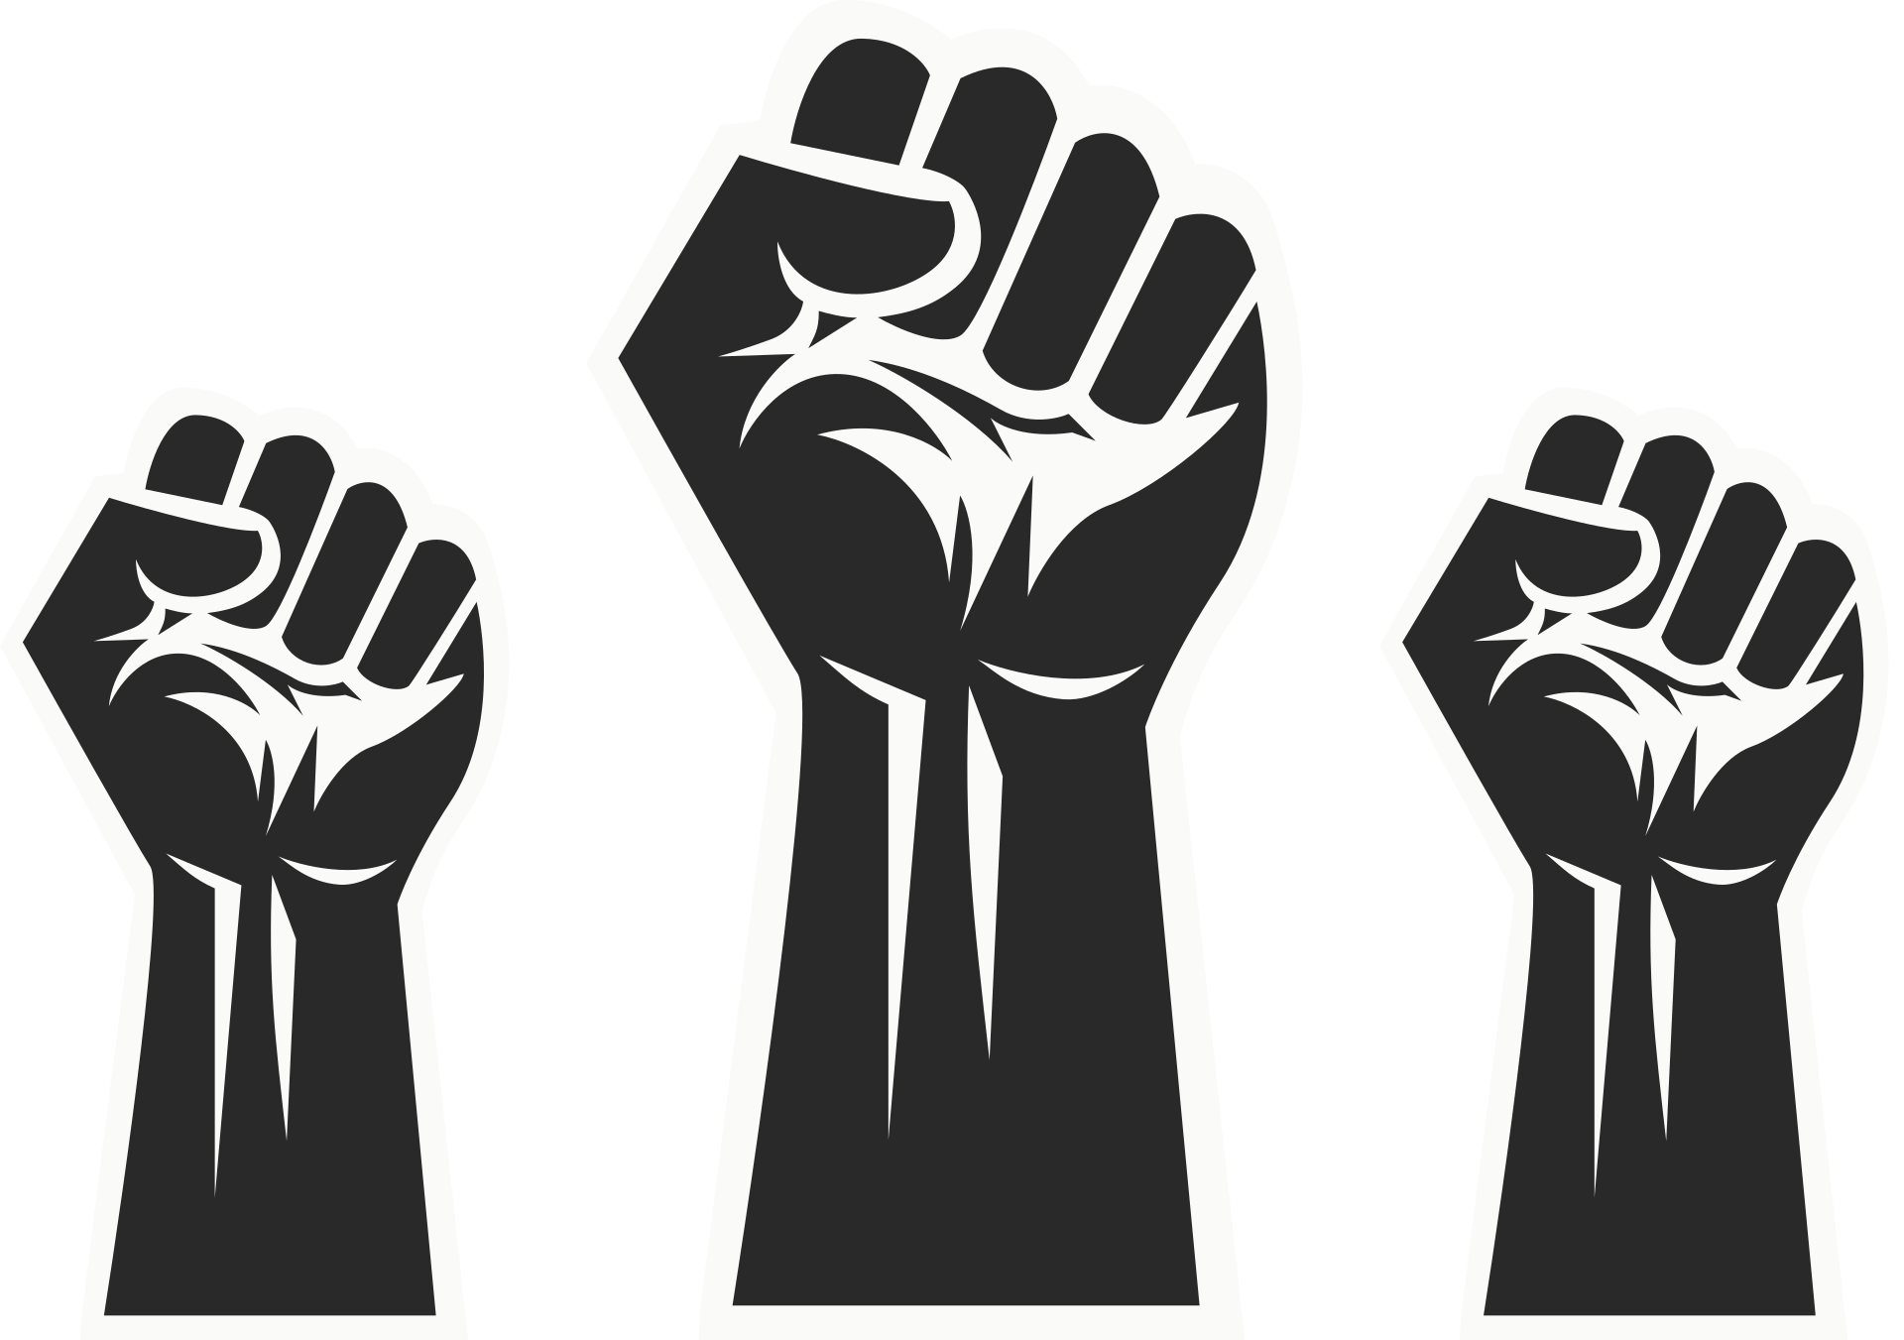



WHY NOW? HUMAN RIGHTS IMPACT
Behind each row is a person. Laras Faizati Khairunnisa shared an Instagram Story about a police headquarters during the August 2025 unrest and was convicted in January 2026, receiving six months of supervision rather than prison
Fatia & Haris spent about 3 years under prosecution for discussing a human rights report.

Slide 6
How It Works
1
2
3
Pick a case or describe a new one; matches say why
Arguments grouped by the five labels, with author and page
Good outcomes first, each confirmed with a source
Rules R1–R4 run as transparent code, no AI
Sensitivity analysis: 10 legal readings, 3–9 of 13
Paste a news story: Gemini suggests inputs with checked quotes
Letter built only from numbered sources
Code rejects uncited sentences and invented quotes
A second check flags weak sentences; a named lawyer approves
4

Slide 7
Product Demo
4

Slide 8

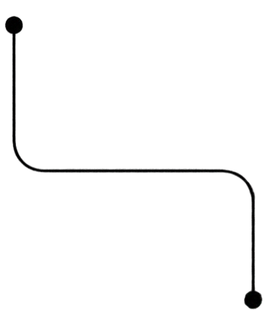
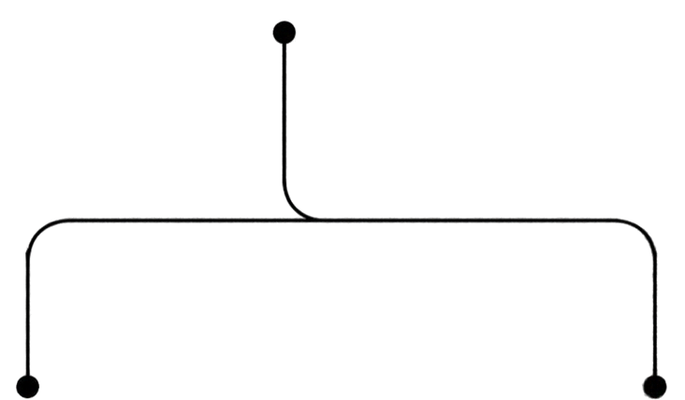
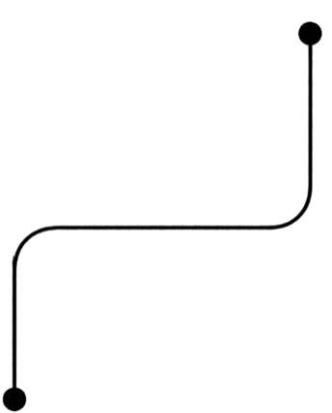
SERVICE PIPELINE
AI is used in two places only: suggesting case facts from a news story, and drafting the letter. Both are checked by code against the sources, then approved by a person.
Phase 1
Phase 3
Phase 5
TrialWatch reports
96 cfj.org listings, 94
PDFs
People confirm
47/47 outcomes • 288 impact sentences
Sourced UN letter
citation check • support check • lawyer approves
Phase 2
Phase 4
Parse, no AI
63 grades • 47 authors • 2,381 arguments • 154 UN decisions
Match current case
stress test + closest
past trials, with reasons
10

Slide 9








WHY TRIALWATCH LAWYERS USE IT
Our user (illustrative)
Goal:
TrialWatch
legal monitor
“Show me how we argued a case like this, what happened, and give me a draft I can check.”
Reviews new speech prosecutions and drafts UN submissions under time pressure.
Needs
Pain points
How we help
Find precedent fast, cite TrialWatch’s own findings, act the day a complaint is filed.
90 reports to read, sources in several languages, letters from scratch.
Minutes, not a day: closest cases, arguments with page links, a sourced draft to approve.
CHECKABLE:
SPECIFIC:
EASY:
built from
TrialWatch’s
own reports
every claim links to its page
web app, no install

Slide 10
RESPONSIBLE AI
No AI where rules will do
Every claim has a source
Honest and safe
  Stress test, parsing, grades and matching are plain, tested code. AI only suggests inputs and drafts letters.
  Quotes checked word for word; uncited sentences rejected; each argument credited to its report's author; a person approves.
  No predictions: “followed”, never “caused”. 2 at-risk people hidden and never sent to AI. Only cited excerpts published, © CFJ.
STUDIO SHODWE
7

Slide 11
VALIDATION
Sources check out
People confirmed the data
We know our limits
  2,381 / 2,381 arguments on the page they cite
  288 / 288 impact sentences on the page they cite
  Authors for 47 / 47 reports, each with its source sentence
=
  47 / 47 TrialWatch outcomes confirmed with a source
  14 of 16 Indonesian cases signed off by a teammate
  Headline 5 of 13; 3–9 across legal readings
  Argument categories about 75–80% right in a hand-read sample
  168 automated tests on every change
STUDIO SHODWE
7

Slide 12
NEXT STEPS
Today | With TrialWatch | Next reform
DEMO & HANDOVER | LAWYER REVIEW | SCALE
Live app, open-source repo and written guide. Every number here recomputed from the data. | Confirm rules R1–R4 and the argument categories with TrialWatch lawyers; add the 73-case Indonesia dataset. | Swap the rules file for the next country's reform; add a live news intake that feeds a review queue.
8

Slide 13
MEET THE TEAM
Shreya
Stress test & Argument Bank
Valentina
App & case data
Yuki
Outcome checks
Ungu
Case research & impacts
Layla
Data lead & pitch
Rule engine, sensitivity analysis, Argument Bank, UN letter
Repository, case tracker page, case verification
Confirmed all 47 TrialWatch outcomes, each with a source
Indonesian case verification, impact categories
Meila & Asrul cases, sensitive-case review, slides
9

Slide 14
The End
THANK YOU FOR LISTENING

