Slide 1

Attacking stud106
Group: stud103

Slide 2
Information gathering
Login to valid account without submitting password
Resistant to SQL injection
Resistant to cross site scripting XSS
STUD don’t have password from https://github.com/danielmiessler/SecLists/blob/master/Passwords/Common-Credentials/10-million-password-list-top-1000.txt

Slide 3
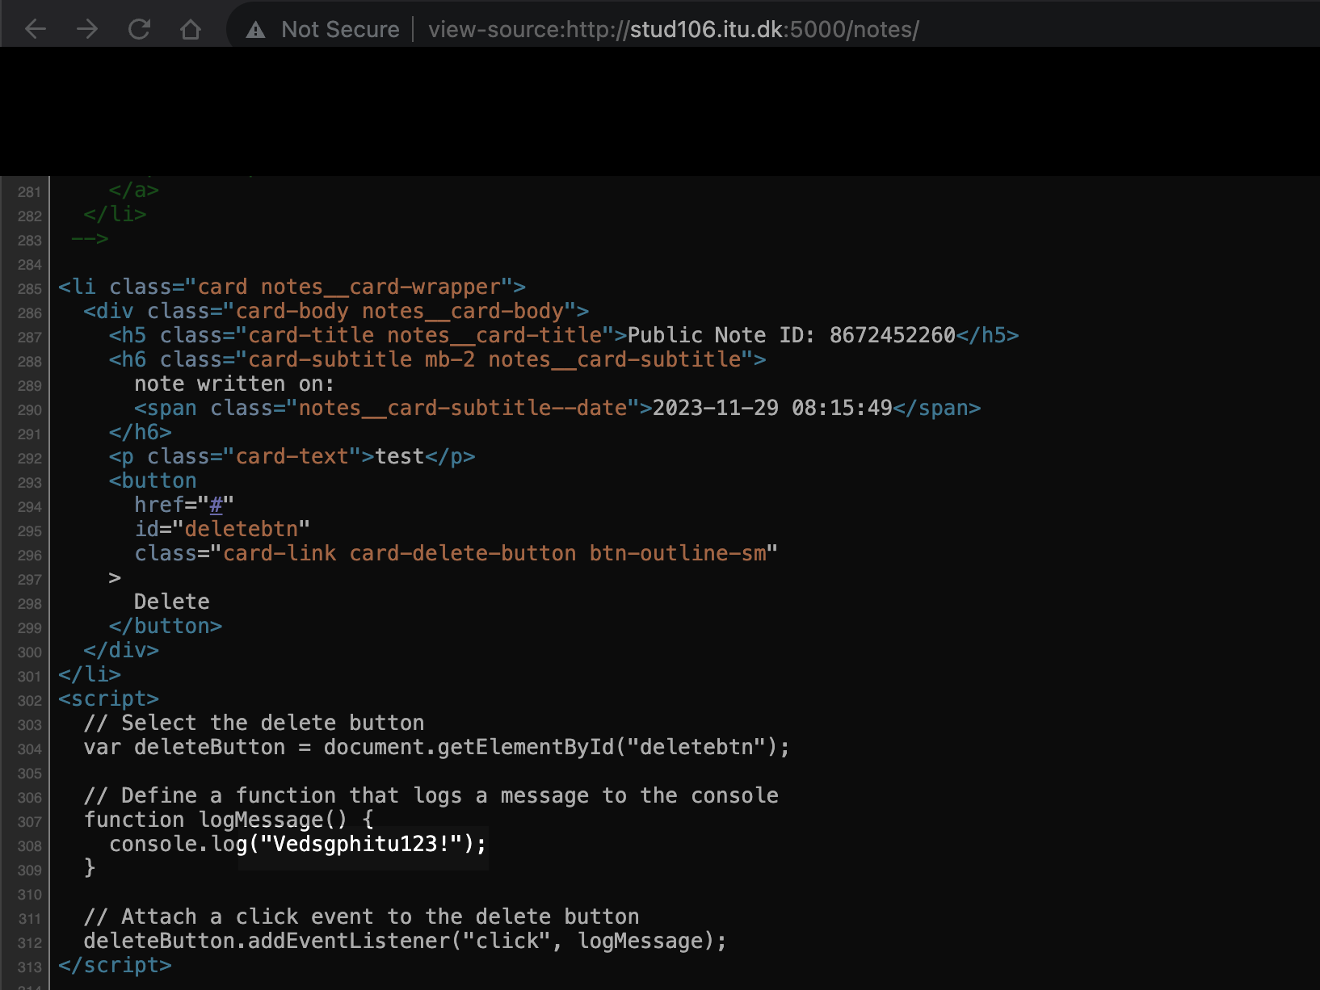
Initial access
When user submits new note
Inspect source
Delete note -> see cosole

Slide 4
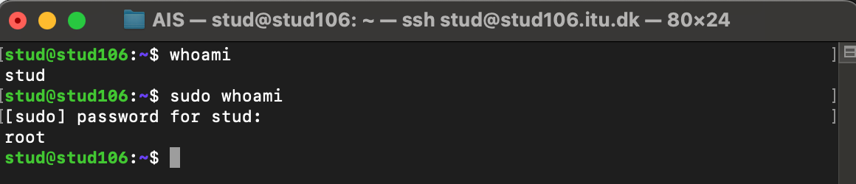
Privilege escalation
Misconfigured permissions (stud is part of sudo group)

Slide 5
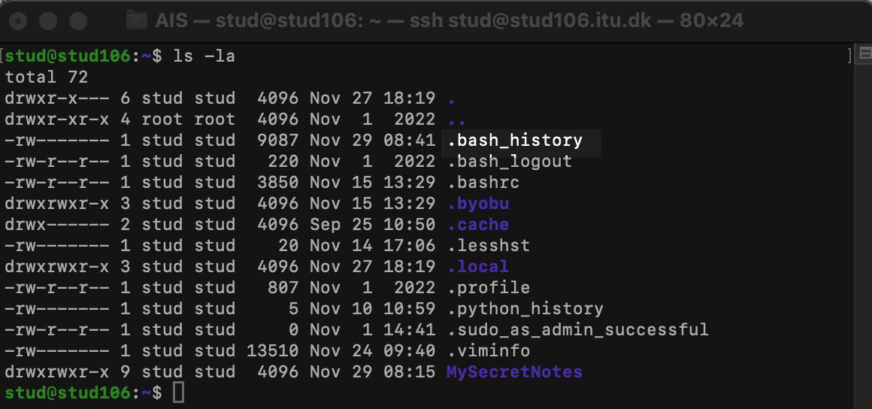
Maintaining access
Search for useful gadgets

Slide 6
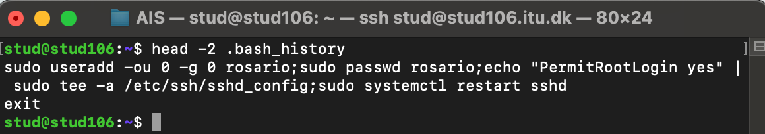
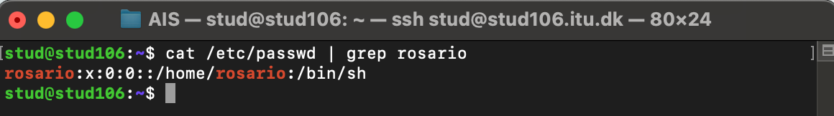
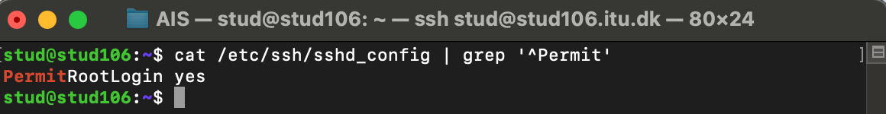
Maintaining access
Verification that Rossario’s UID and GID are really set to 0 (he is root):
And that “PermitRootLogin” is set to “yes”:

Slide 7
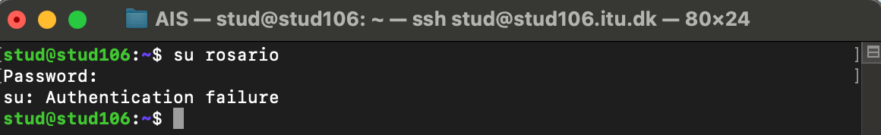
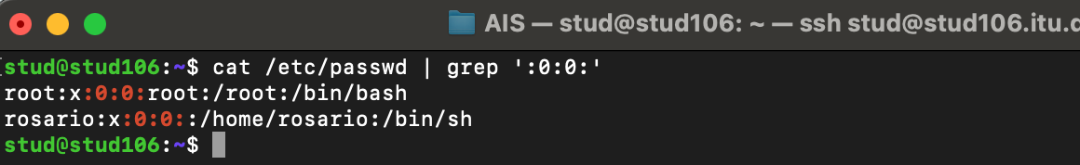
Maintaining access
However, password of Rossario’s account has been changed from `rosario`
Creating backdoor port vulnerability or new account with UID and GID set to 0 could
cause a suspicion if someone would checked /etc/passwd file:

Slide 8
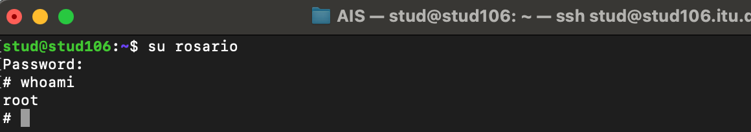
Maintaining access
We used already set root account and just change it’s password so only we can login:
Further upgrade:
- set script that sends email when someone tries to access server using account ‘Rosario’
- that would give us time to create new / change existing backdoor before we lost access
- could potentially use 3rd party SMTP

