Slide 1



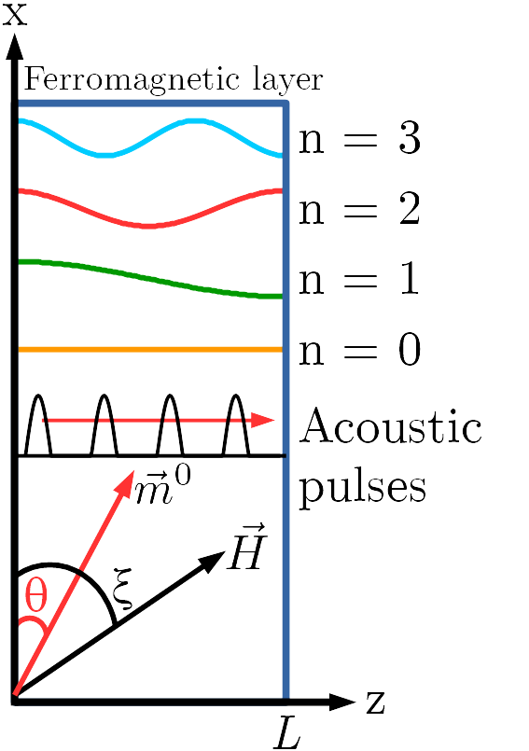
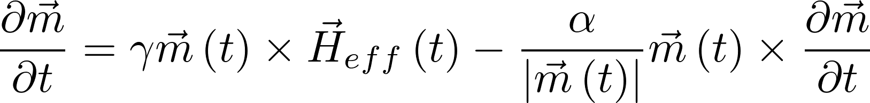
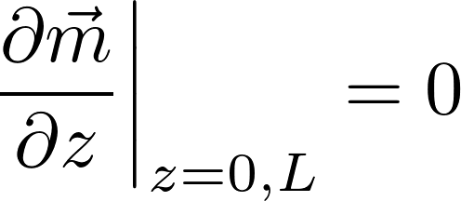
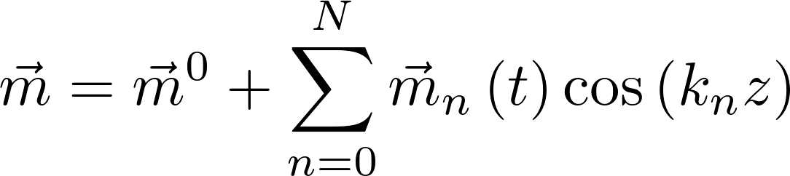
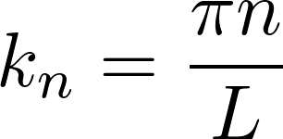
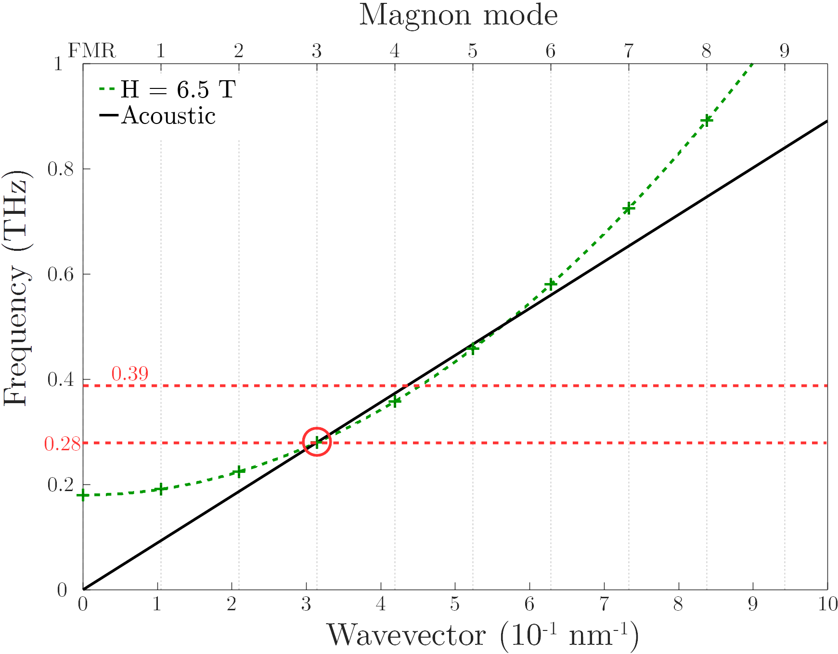
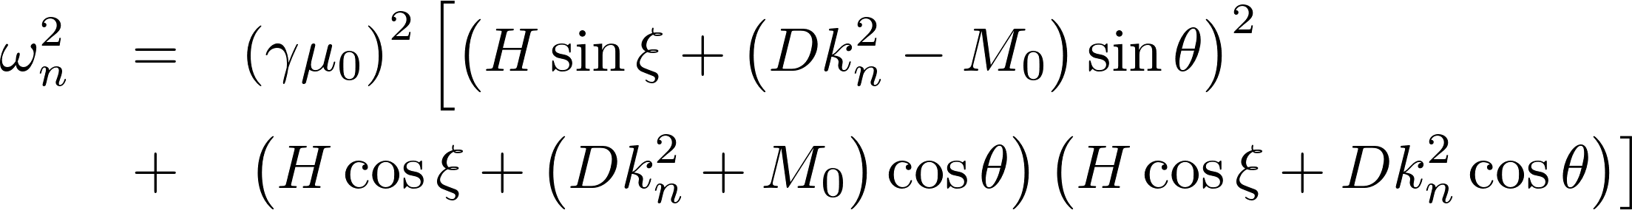
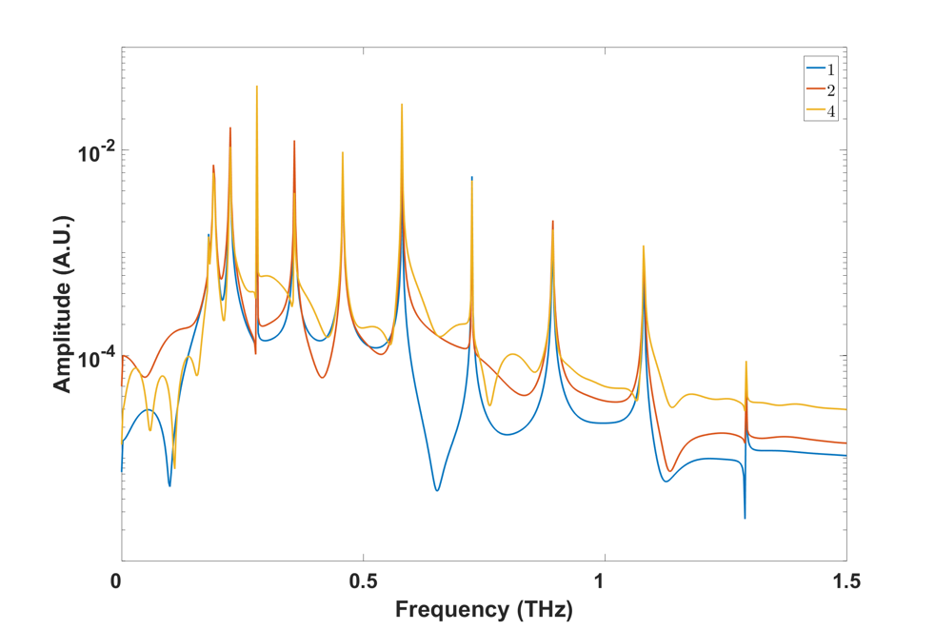
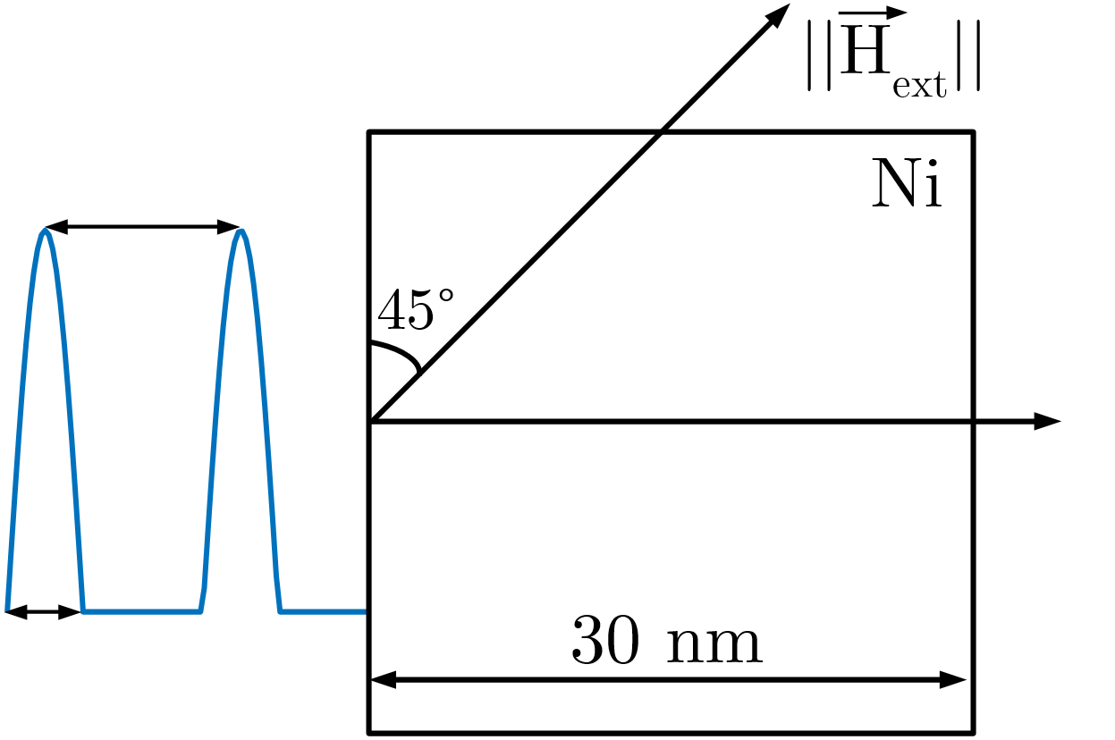
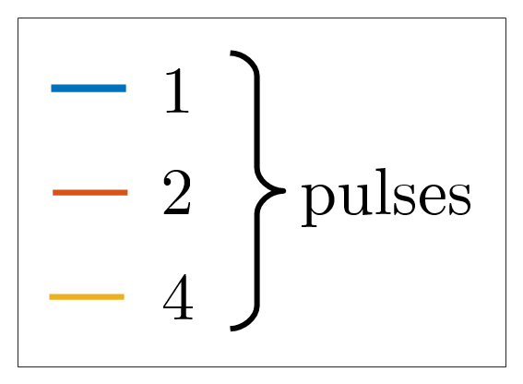
Exchange Magnon in Ferromagnetic Thin Films Exited by a Series of Acoustic Pulses
V. Besse¹, A.V. Golov², V.S. Vlasov², A. Alekhin¹ and V.V. Temnov¹
¹ Institut des Molécules et Matériaux du Mans (IMMM) UMR CNRS 6283, Le Mans Université, 72085 Le Mans, France
² Syktyvkar State University named after Pitirim Sorokin, 167001, Syktyvkar, Russia
Introduction
Ultrafast demagnetization and precession of the magnetization induced by ultrashort laser pulses are very active topics¹⁻⁴ even though their demonstration is quite recent⁵. The idea of data transmission by using the spins rather than electric currents had a large impact. Ultrafast manipulation of the magnetization is a key for further development of spintronics. Magnetization dynamics can be driven by different mechanisms⁶. Since we consider a single ferromagnetic layer, we can limit our consideration just to two mechanisms: laser-induced heating^{2,6} and phonon-magnon interaction⁷. Here we only consider the second mechanism. We report a numerical study of the magnetization dynamics in nickel thin films excited by a series of picosecond acoustic pulses. This situation can be realized in an optical pump-probe experiment using a train of laser pump pulses. Absorption of each pump pulse leads to the excitation of an acoustic pulse. Acoustic pulses propagate through a ferromagnetic film and alter the direction of the effective magnetic field thereby driving precessional motion of the magnetization.
Theory
Geometry
(1)
Landau-Lifschitz-Gilbert Equation
Boundary conditions
(2)
(3)
(4)
This model
includes:
(1) magnetic moment
Magnetization
(2) gyromagnetic ratio
(3) effective magnetic field
(4) Gilbert damping
demagnetization field
(3) includes:
external magnetic field
exchange field
inverse magnetostrictive effect
Numerical results and analysis
Spinwaves resonant frequencies
ξ = 45°
θ = 42,3°
L = 30 nm
By playing on the magnitude of the external magnetic field it is possible to tune the position of crossing points between the magnonic and the acoustic dispersion curves. So there is different configurations/matching conditions :
Frequency
Phase
Group
3.58 ps
6.5 T
Frequency and phase matching conditions
1 ps
With the appropriate matching condition (here frequency and phase) it is possible to amplify one magnon mode (here the third one).
By varying the number of acoustic pulses it is possible to amplify this excitation.
It is possible to drive the magnetization with acoustic pulses by playing on:
their shapes.
their number.
the delay between them.
Frequency and phase matching, together, lead to the highest amplification. Spinwaves could be highly damped.
Excitation
[1] Razdolski Ilya, et al.; Nanoscale interface confinement of ultrafast spin transfer torque driving non-uniform spin dynamics; Nature Communications, 8; 2017.
[2] Van Kampen M. et al.; All- optical probe of coherent spin waves; Physical review letters, 88(22):227201; 2002.
[3] Guidoni L. et al.; Magneto-optics in the ultrafast regime: Thermalization of spin populations in ferromagnetic films; Physical Review Letters; 89:17401; 2002.
[4] Kim J. W., Bigot J. Y.; Magnetization precession induced by picosecond acoustic pulses in a freestanding film acting as an acoustic cavity; Physical Review B; 95(14):144422; 2017.
[5] Beaurepaire E. et al.; Ultrafast spin dynamics in ferromagnetic nickel; Physical Review Letters; 76:4250-4253; 1996.
[6] Kirilyuk A. et al.; Ultrafast optical manipulation of magnetic order; Reviews of Modern Physics; 82(3): 2731; 2010.
[7] Temnov V. V.; Ultrafast acousto-magneto-plasmonics; Nature Photonics; 6(11):728-736; 2012.

