Slide 1
EMSC4033/8033
Semester 1 2020
Computational Geoscience
Andrew Valentine
Research School of Earth Sciences
andrew.valentine@anu.edu.au

Slide 2
Who, what, where?
The course team:
Andrew Valentine
Rebecca McGirr
For the next three weeks:
Mon/Wed/Thur/Fri: 10-12
Wed/Fri: 2-5
All classes will be online via Zoom
Classes will be focused on practical exercises

Slide 3
Assessment
In-class assessment (20%)
10-12 Thurs 7th May
Please see me today if there is any chance you cannot attend for this
Assessed programming project
More details towards the end of the course
Due: 5pm Friday 5th June
Four optional drop-in sessions will be held:
Dates/times tbc...
Opportunity to ask questions and get help
No need to attend if you have no questions!

Slide 4
Assessment
Assessed programming project
More details towards the end of the course
Due: 5pm Friday 5th June
When you get stuck, you are encouraged to:
Talk to friends/colleagues
Make use of online resources
However, you must
Write your code yourself: don’t copy and paste from a friend’s solution or a website
Understand how your solution works
Be able to explain why you chose to solve the problem the way you did

Slide 5
Assessment
Assessed programming project
More details towards the end of the course
Due: 5pm Friday 5th June
Graded based on:
Submitted solution to the task, and
Oral examination (via Zoom; 15-20 minutes)
If you do not attend the oral examination you will receive no credit!
Oral examinations will be arranged for the week commencing 8th June (dates and times to be confirmed). If you expect to be unavailable during this week please talk to me today.

Slide 6
Please give us feedback…!
If you have any comments or suggestions about the course (or its online delivery), please get in touch!
Talk to/email me or Rebecca
Send a message via the AD Honours/Masters (Dr Rhodri Davies)
SELT? – Not running during COVID-19?
“I think it would be worthwhile to mention in the first lecture that learning programming can be a steep learning curve for some people and that it does get easier the more you use it and once you are able to debug code. Initially, I was doubtful at my ability to learn python and do well in the course which temporarily decreased my productivity and motivation to succeed.”
Student, 2019

Slide 7
Why?
Why does a geoscientist need to know about programming?

Slide 8
What is a programming language?

Slide 9
What is an algorithm?

Slide 10

How do you make a cup of coffee?

Slide 11
Need to spell everything out carefully – no shortcuts or assumptions
Task can be broken into sub-tasks, e.g. “boil kettle”, provided they are well-defined
Sub-task may appear in other contexts, e.g. to make tea or hot chocolate

Slide 12
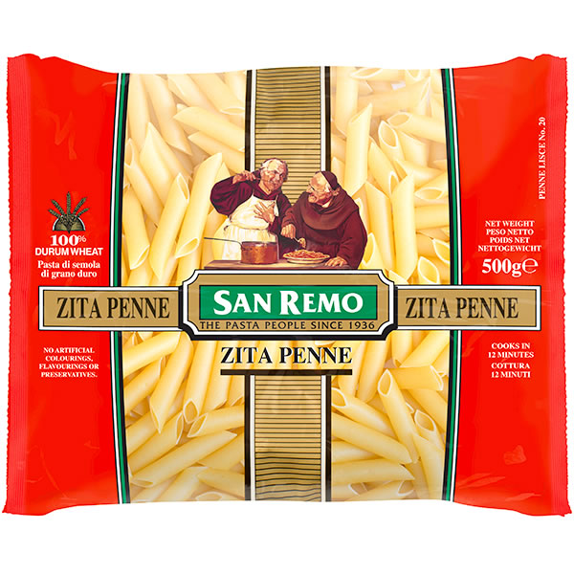
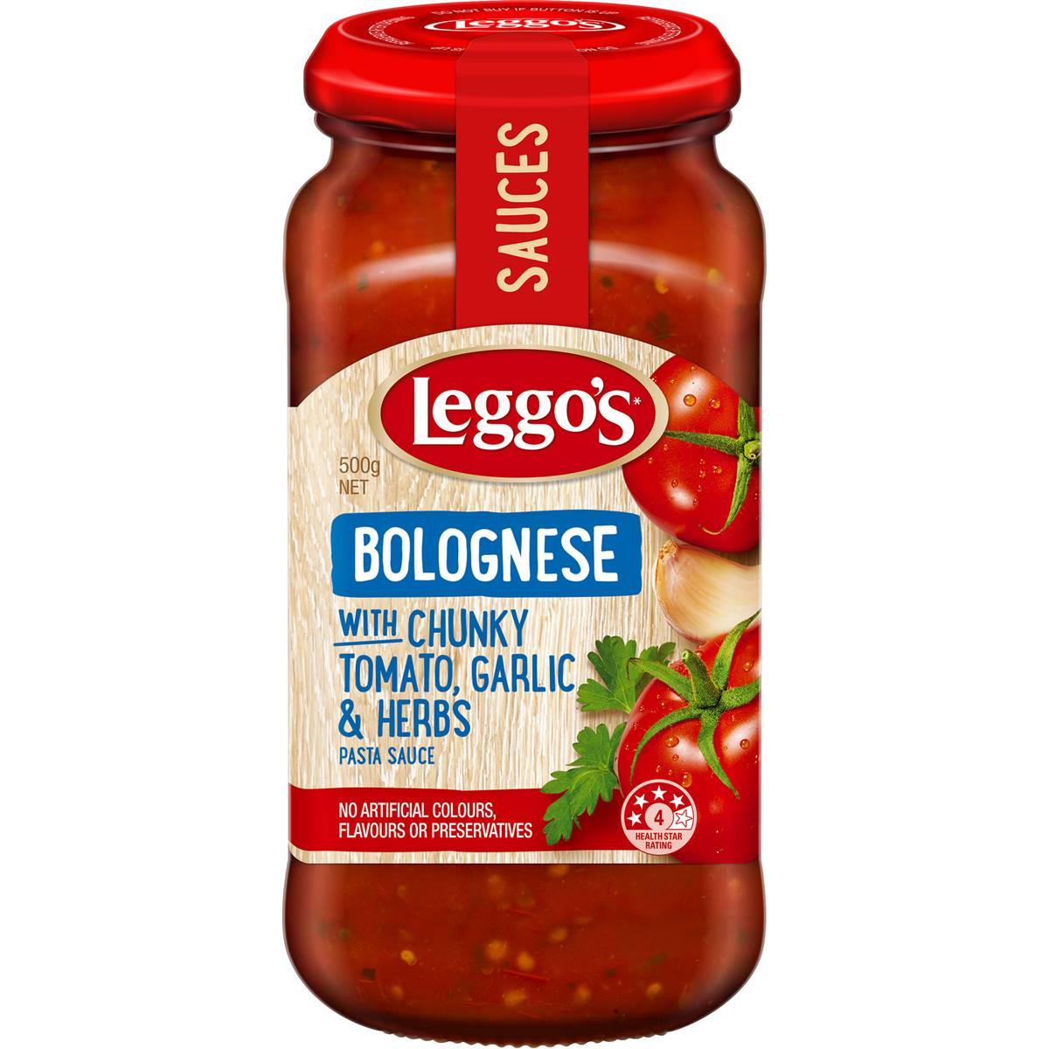
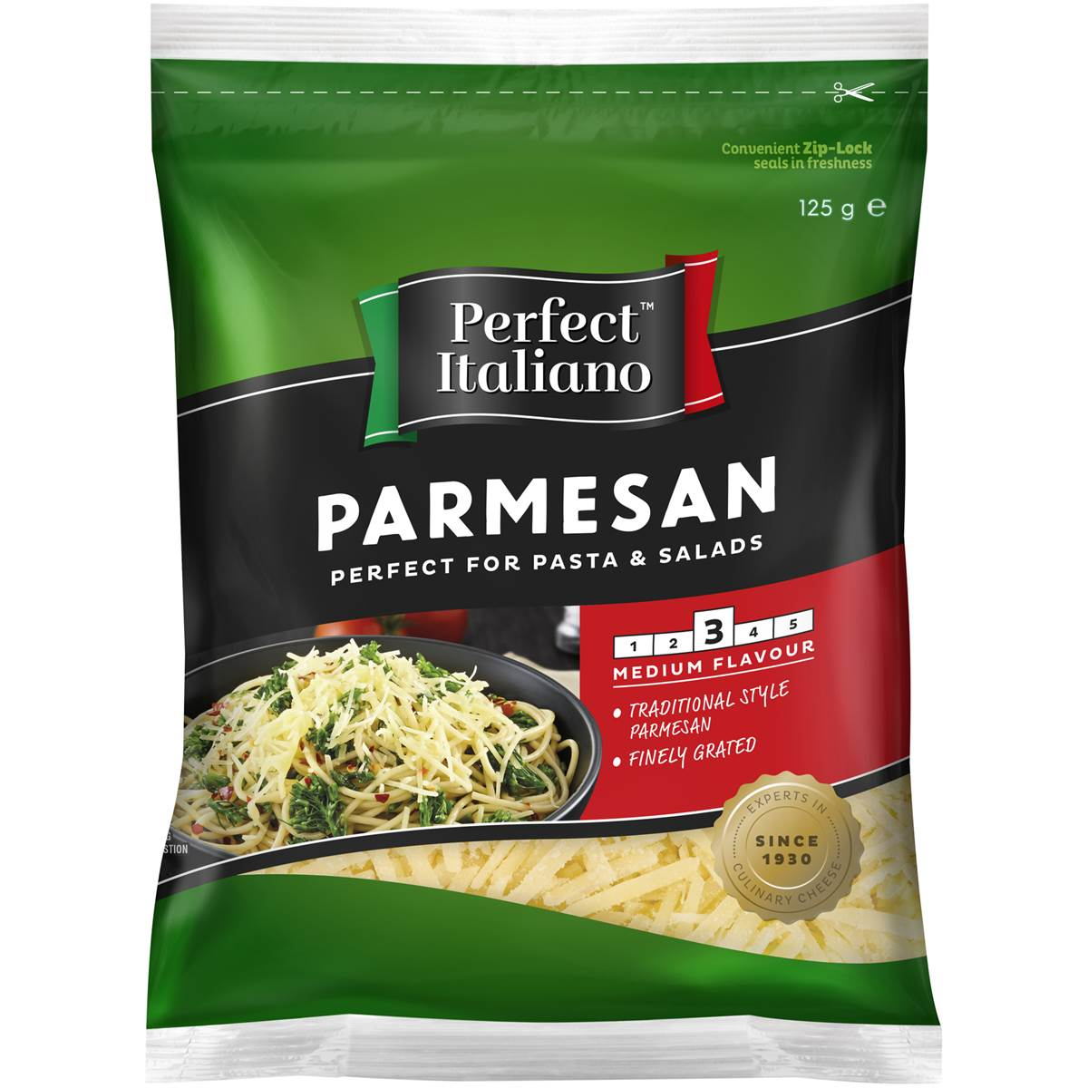
How do you make dinner?

Slide 13
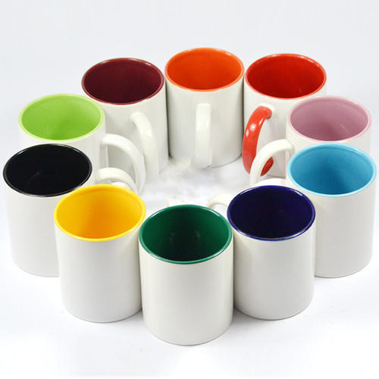
Our ‘recipe’ for coffee works with any mug
‘Mug’ in the recipe is an abstract object assumed to have certain properties

Slide 14
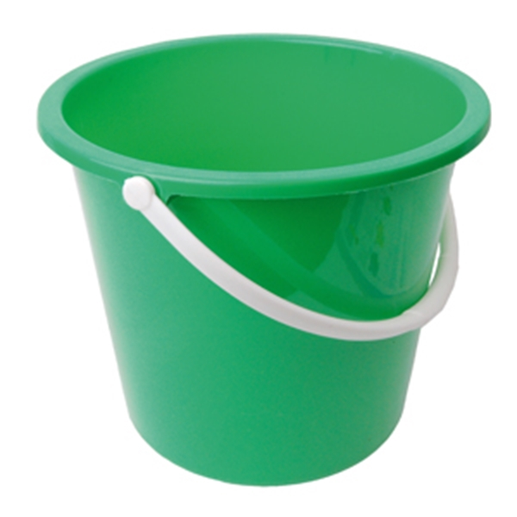

Can you make coffee in a bucket?
Can you make coffee in a cat?

Slide 15
A type definition is a set of rules defining the properties and behaviours we can expect a certain object to have.
Every object is an instance of some abstract type. It is guaranteed to have all the properties and behaviours set out in the type definition.

Slide 16
Our ‘recipe’ for coffee works with any mug
‘Mug’ in the recipe is an abstract object assumed to have certain properties
When we execute the recipe, we select a real, physical mug and let it ‘stand in for’ the abstract entity

Slide 17
A function or subroutine is a sequence of instructions designed to perform a particular task, packaged into readily-reusable form.
To use a function, we only need to understand its interface – we don’t care about how it works internally
What information do we have to give to the function? (‘Arguments’)
What information does it give us back? (‘Return value’)

Slide 18

Programming is like Lego - we connect lots of simple pieces together to make something much more sophisticated

Slide 19
1+2+3+…+10 = ?

Slide 20
Recap
To tackle a complex problem, we break it down into manageable pieces.
First understand the algorithm we want to create, then worry about how to implement that in a particular programming language.
Important to spell everything out in detail – computers are dumb.
Write generic ‘recipes’ or functions that work for all objects of a certain type
Then call the function passing it specific instances as arguments

Slide 21
I am thinking of a number between 1 and 10…

Slide 22
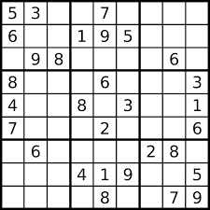

Slide 23
A variable is a named ‘slot’ in which a piece of information can be stored temporarily, accessed and updated.
A variable has an associated type.
A constant is a piece of information which is built into a program and cannot be changed.
Variables and constants are stored in your computer’s RAM (random access memory)

Slide 24


Computing is built around the binary system
Information is stored using bits (binary digits)
A bit can take the value 0 or 1 – it’s essentially a switch
To represent more complex information we combine bits

Slide 25
A 2-bit system has 4 states

Slide 26
A 3-bit system has 8 states

Slide 27
In general, a set of N bits can represent 2^{N} different states
We can only represent a finite, discrete (countable) set of quantities
Every kind of information must be mapped onto this discrete set
N | 2^{N}
1 | 2
2 | 4
3 | 8
4 | 16
5 | 32
6 | 64
7 | 128
8 | 256
16 | 65536
32 | 4294967296
64 | ≈ 1.845 x 10¹⁹

Slide 28
A byte is a unit of 8 bits
A kilobyte is 2¹⁰=1024 bytes
A megabyte is 2²⁰ bytes (1024 kilobytes)
A gigabyte is 2³⁰ bytes (1024 megabytes)
And so on: terabytes, petabytes, exabytes…
NB: Sometimes kilo-/mega-/giga- etc are used in their usual SI sense, i.e. 10³/10⁶/10⁹ bytes. An SI terabyte is only 90% the size of a base-2 terabyte!

Slide 29
Three main ‘building blocks’ of information:
Integers (1,2,3,…)
Real/floating-point numbers (1.326, -2.33162, π,...)
Alphanumeric characters (‘a’, ‘b’, ‘1’,...

Slide 30
Integers are already discrete, so can easily be mapped onto binary system
Choose how many bits you are going to use (typically 32 bits/4 bytes)
Decide whether you need to represent negative numbers
Decide whether to read the bits from left-to-right or right-to-left (‘big endian or little endian’)
0 0 0 → 0
0 0 1 → 1
0 1 0 → 2
0 1 1 → 3
1 0 0 → 4
1 0 1 → 5
1 1 0 → 6
1 1 1 → 7
0 0 0 → 0
0 0 1 → 1
0 1 0 → 2
0 1 1 → 3
1 0 0 → ?
1 0 1 → -1
1 1 0 → -2
1 1 1 → -3
Unsigned
Signed

Slide 31
Alphanumeric data is also discrete and easy to map, by defining a standard ordering:
0 0 0 → a
0 0 1 → b
0 1 0 → c
0 1 1 → d
1 0 0 → A
1 0 1 → B
1 1 0 → C
1 1 1 → D
Usually the ASCII (American Standard Code for Information Interchange) table is used…

Slide 32
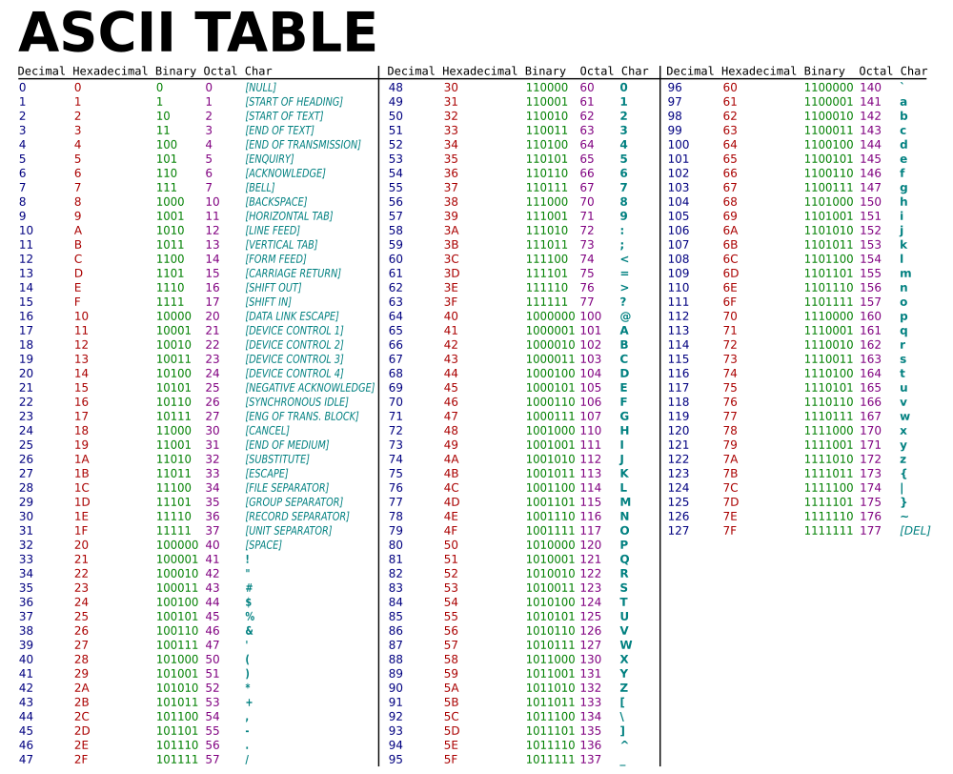

Slide 33
Real numbers are harder: we have to discretize them
Cannot represent most numbers exactly
Common source of ‘numerical error’ in calculations
Represent a.bcde as p x 2^{q} where p and q are integers
0.13 → 8724152 x 2⁻²⁶ = 0.12999999952 ≈ 0.13
+
-
0 100001010001111010111000 1 011010
8724152 (24 bits)
26 (6 bits)

Slide 34
Floating point arithmetic can give weird results…
0.1+0.1+ ... + 0.1 = 0.999999999999
Any number ‘too large’ to be representable is assumed to be infinity
Any number ‘too small’ to be representable is assumed to be 0
You will sometimes see values of ‘NaN’, meaning ‘Not A Number’ – this means something weird happened in your calculation

