Slide 1
HEALTH INFORMATION SYSTEM TASK PRESENTATION
Software engineering intern task
Done by : Valentine Hoka Indieka
Date: 26/04/2025

Slide 2
Project overview
Build a simple web based health information system
Key features
Create health programs
Register new clients
Enroll clients in one or more programs
Search and view clients profile
Expose clients information via an API

Slide 3
TOOLS AND TECHNOLOGIES
HTML - Structure of the web application
CSS - Styling and layout
JavaScript - Logic and functionality
Server: XAMPP
localStorage - Data persistence on the browser

Slide 4
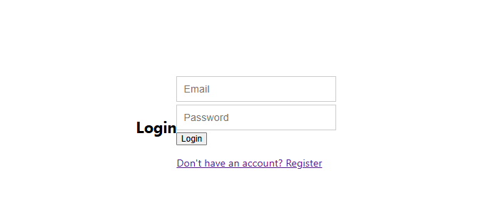
DEMONSTRATION
Login feature

Slide 5
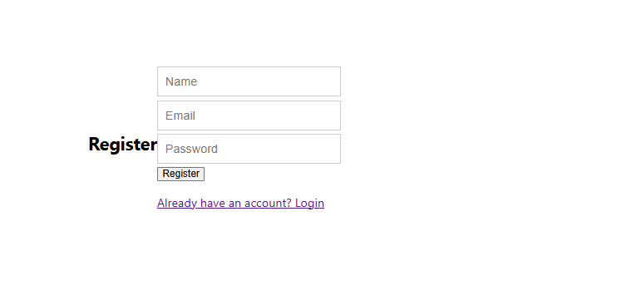
Register feature

Slide 6
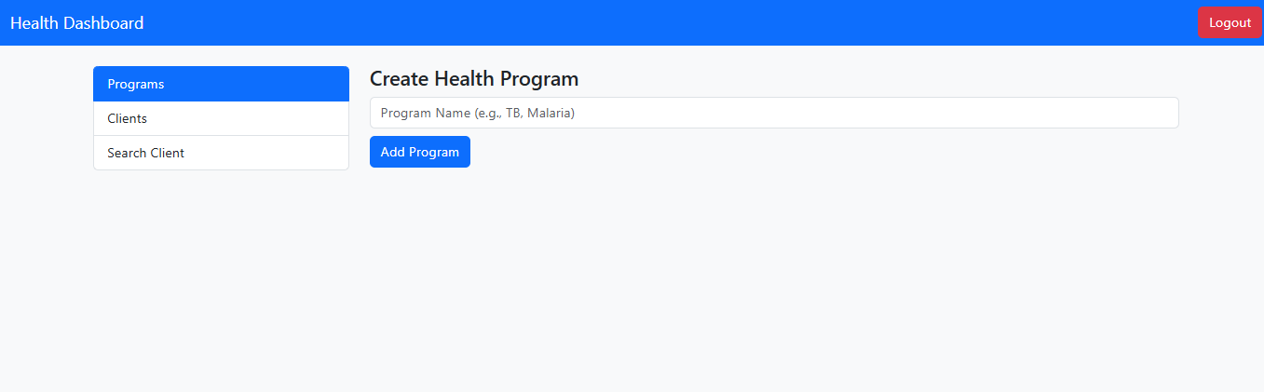

Slide 7
Link to the prototype video demonstration
https://drive.google.com/drive/folders/184SqyiqFz6JxqQ1t-vbKPJ079jYltJNQ?usp=drive_link

