Slide 1
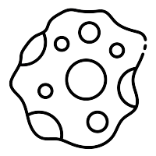

4
CAS N°1
2
5
1
3
Detect 5 asteroid
Save cursor coordinates + distance to asteroid in asteroid_list_temp list
Delete doublons
For asteroid in asteroid_list_temp
Click on nearest asteroid
If distance < 2000 alors scan
If scan = water:
Shoot_asteroid() method

