Slide 1
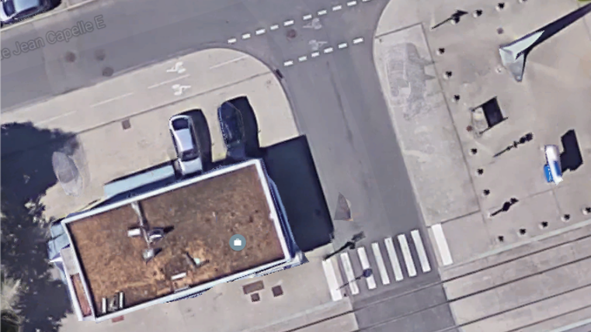
Véhicule
AS

Slide 2
