Slide 1
Review: Exercise Sheet 08
HPCSE I
30.11.2018
Renato Bellotti

Slide 2
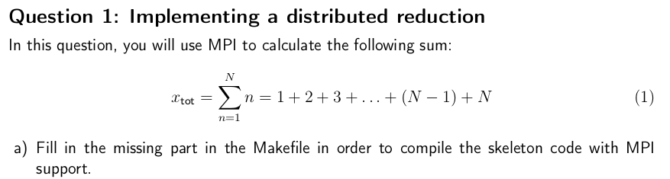
Question 1: Implement a distributed reduction

Slide 3
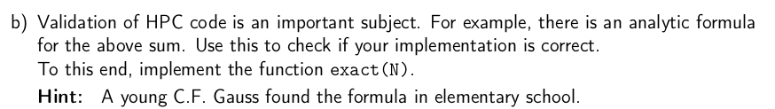
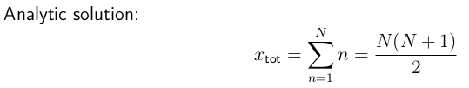
Question 1: Implement a distributed reduction

Slide 4
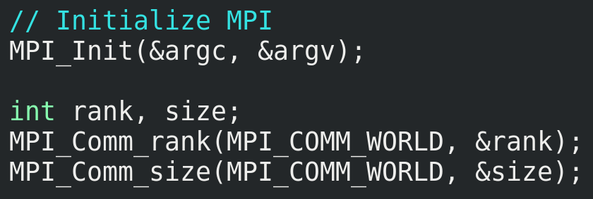

Question 1: Implement a distributed reduction

Slide 5
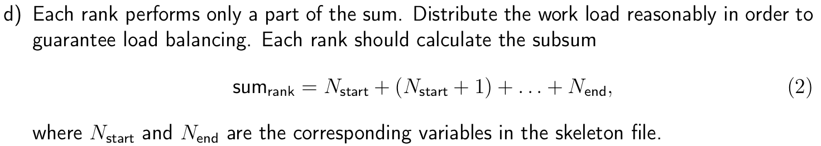
Question 1: Implement a distributed reduction

Slide 6
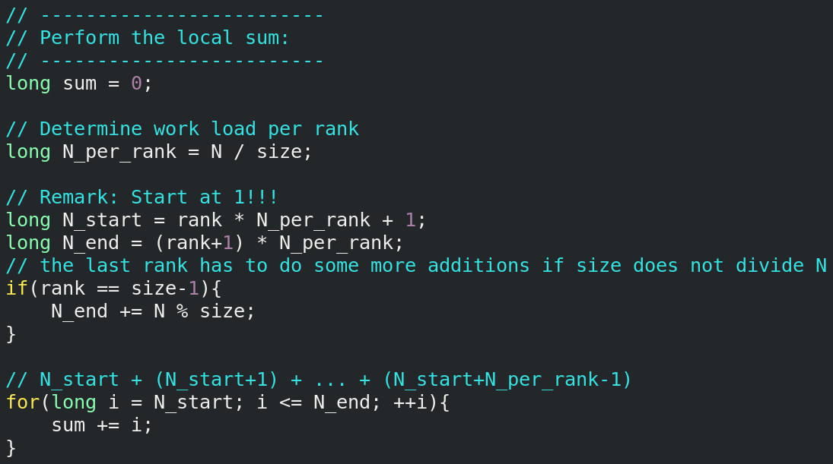
Question 1: Implement a distributed reduction

Slide 7
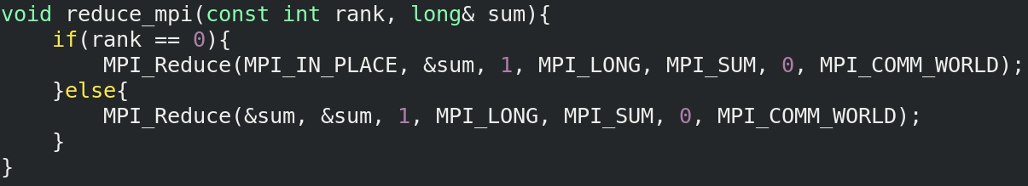
Question 1: Implement a distributed reduction
Using MPI blocking collectives:

Slide 8
Question 1: Implement a distributed reduction
Be careful:
Collective operations:
Broadcast, gather, reduce, …
Point-to-point communication:
Send, Recv, ...

Slide 9
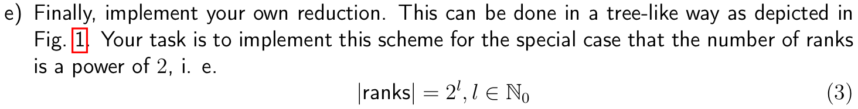
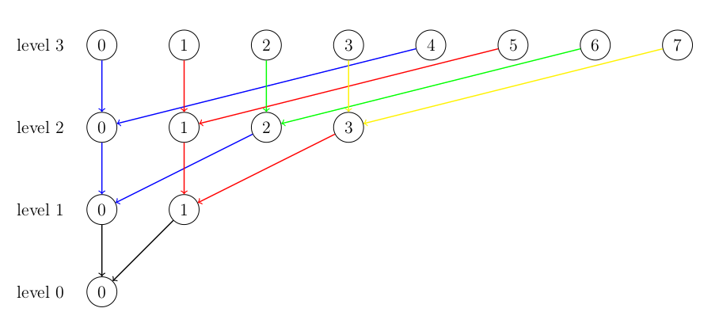
Question 1: Implement a distributed reduction

Slide 10
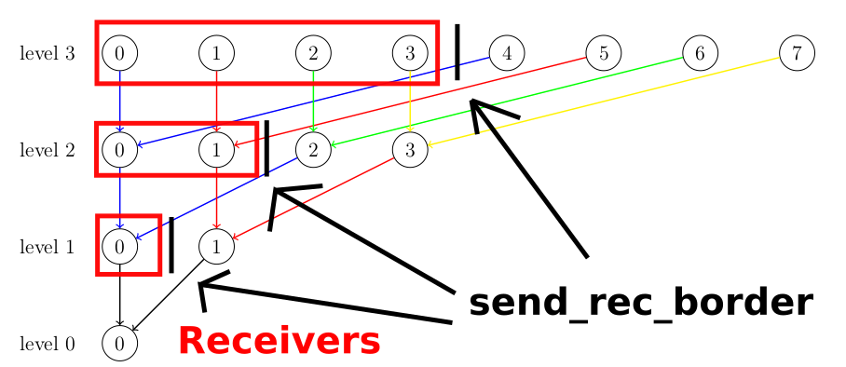
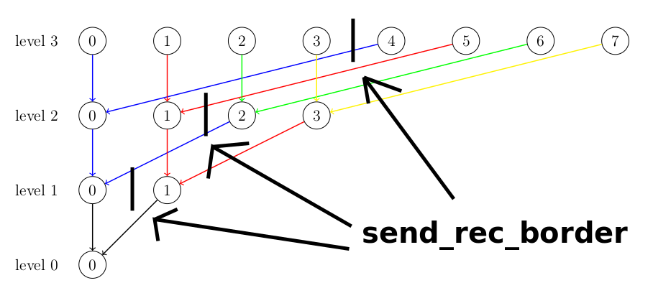
Question 1: Implement a distributed reduction
Idea:
In each level, the first half of the processes receives, the second half sends

Slide 11
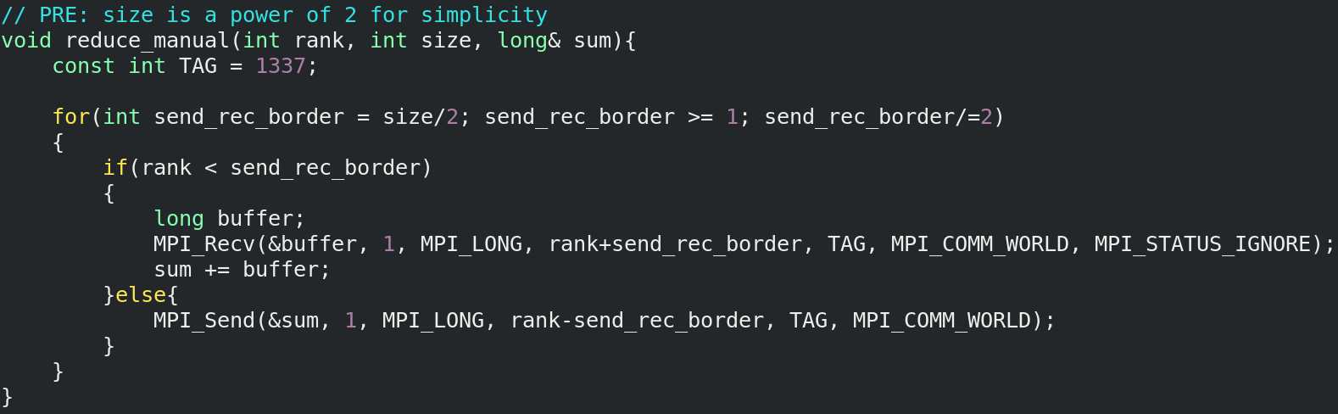
Question 1: Implement a distributed reduction

Slide 12
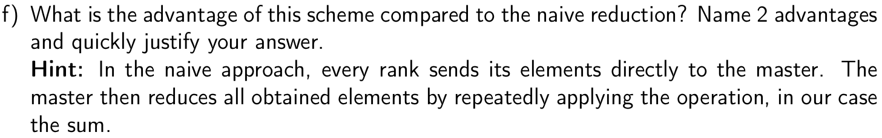
Question 1: Implement a distributed reduction
More ranks communicate:
Potentially higher bandwidth (but NOT less communication!)
Reduction operation is performed in parallel:
Better load balancing & faster execution because of less time wasted waiting for communication
Naive: O(n)
Tree-based: O(log n)

Slide 13
Question 1: General remark I
The basis is not needed in asymptotic complexities:
O(log n) instead of O(log_2 n)
Don't forget to run your MPI code with mpiexec!

Slide 14
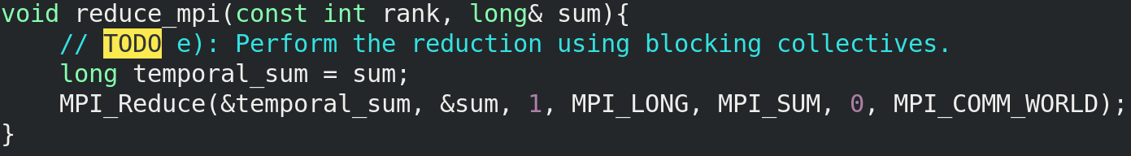
Question 1: General remark II
What is wrong here?
The program expects that the reduced value is written to sum.
This does not happen!
Reason:
temporal_sum is assigned the value of sum at that time.
When temporal_sum changes later, the change is not visible!
→ No return value!
Fix: Change temporal_sum to long& (or leave it away entirely)

Slide 15
Question 2: MPI Bug Hunt
In future:
When we talk about MPI programs, assume that the code is run by multiple processes.
In exam: Stated explicitly.
Sorry for the confusion!

Slide 16
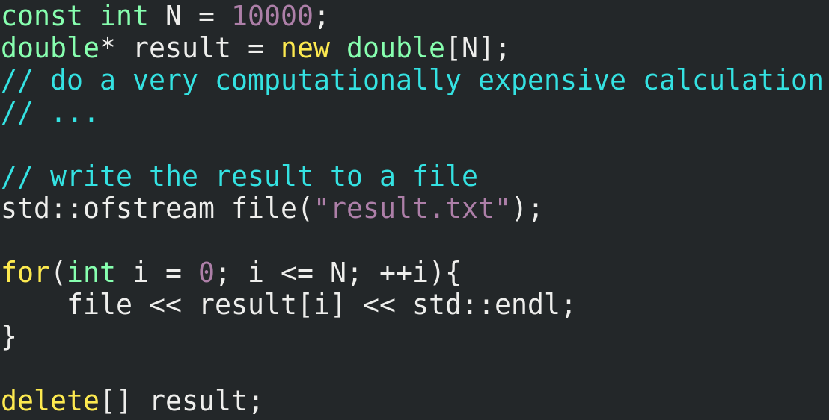
Question 2.a): MPI Bug Hunt
Fix: < instead of <=
Use MPI I/O
Alternative:
send all the data to root (might be inefficient)
Segmentation fault!
All ranks write to same file!

Slide 17
Question 2.a): MPI Bug Hunt - Remark
Some people said to parallelize the «computationally expensive calculation»
This might already be done, we have not said anything about that section
(only that there is no error in there)

Slide 18
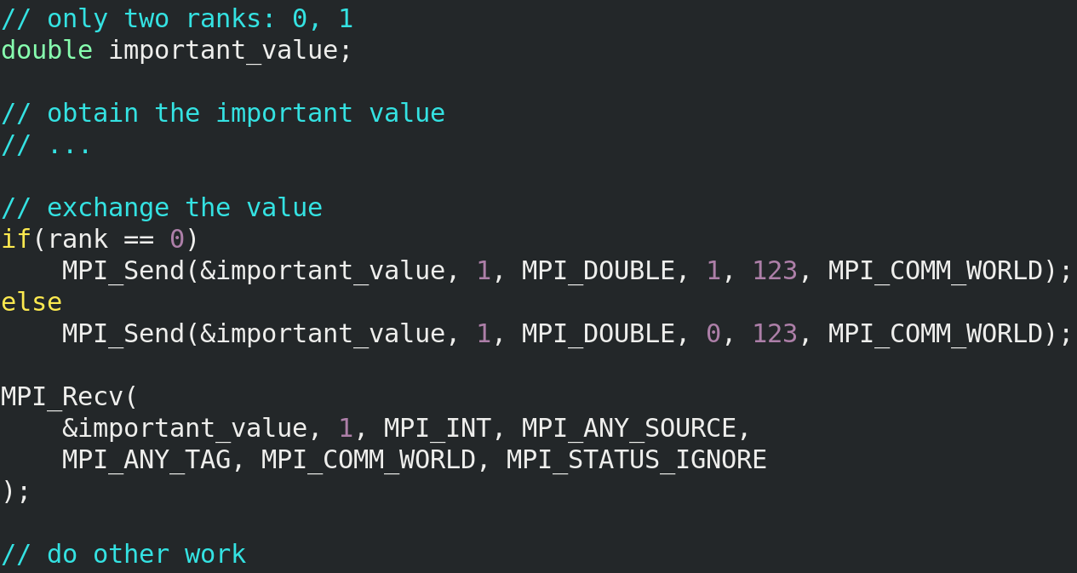
Question 2.b): MPI Bug Hunt
Deadlock:
Both processes block because they want to send, but nobody can receive
Must be MPI_DOUBLE

Slide 19
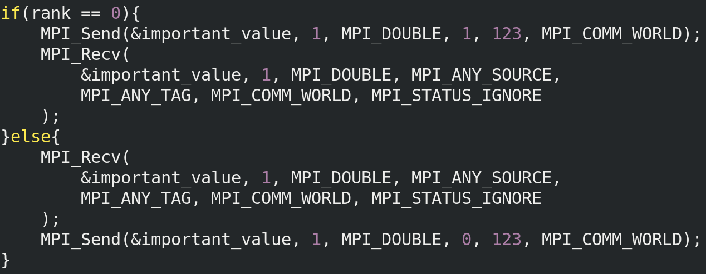
Question 2.b): MPI Bug Hunt
Possible solution:

Slide 20
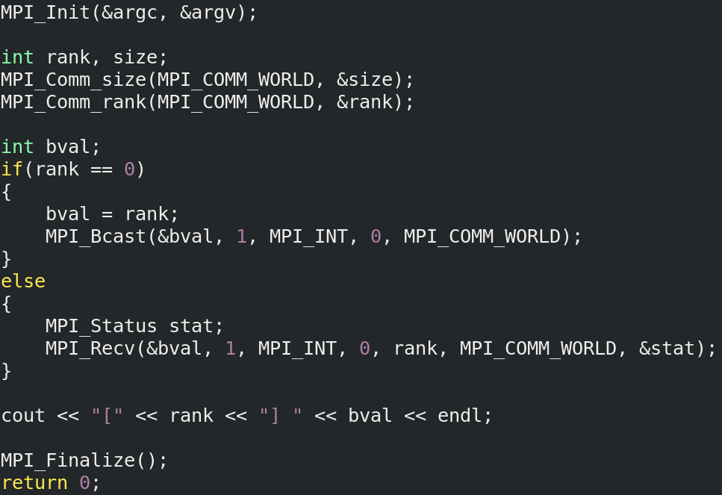
Question 2.c): MPI Bug Hunt
Output with 1 process?
[0] 0
Output with 2 processes?
Deadlock!
Blocking collectives must be called by all processes!

Slide 21

Questions?

