Slide 1
AMR in Multilingual Contexts
LLMs and Cognition Project
Group 412
Semen Valentin-Ion
Stoica Elias-Valeriu
February 3, 2025

Slide 2
Agenda
Introduction to AMR
Research Overview
Methods and Dataset
Training the T5-small Model on Irish
Training the T5-small Model on Irish and Welsh
Training the T5-small Model on Welsh
Training the T5-small Model on all languages
Multilingual Training Results
Model Performance Comparison
Discussion and Insights
Conclusions and Future Improvements
Related Work

Slide 3
Introduction to AMR
Overview
Abstract Meaning Representation (AMR) is a way of representing the meaning of a sentence as a structured graph.
Instead of just dealing with words, AMR captures who does what to whom, the relationships between concepts, and the overall meaning of a sentence in a format that a computer can understand.
It’s widely used in machine translation, question answering, and text summarization because it provides a deeper understanding of language compared to raw text.

Slide 4
Research Overview
Introduction
The purpose of this study is to document different attempts of studying how AMR generation behaves from language to language.
The tested languages in the study are English, Welsh, and Irish, utilizing a sample of about 1600 sentences from the massive AMR dataset.
The model used for AMR training was Google’s T5-small and MarianMT was utilized for translating the dataset into Irish and Welsh.

Slide 5
Methods and Dataset
Methods
Dataset Overview
The project utilized a sample of the Massive-AMR dataset containing over 1600 English sentences with their related Abstract Meaning Representation graphs. This dataset encompasses various domains, including question answering, factual statements, and commands.
Translation Process
To enable multilingual generation, the OPUS-mt API based on the MarianMT model was used to translate English sentences into Welsh and Irish, creating new datasets for training.
Translation Process
Fine-tuned models were trained to generate AMR graphs for each sentence in the three languages. The AMR graphs were compiled into a CSV, which included the original sentence, language, and generated AMR graphs.

Slide 6
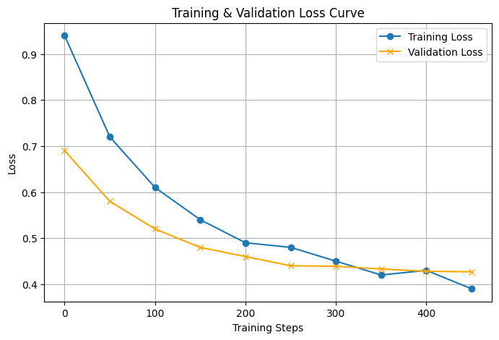

Training the T5-small Model on Irish
Methods
Training Process and Results
The Irish data was loaded from a JSON file, filtering out entries with missing sentences or AMRs, retaining only valid sentence-AMR pairs.
Data was split into training (80%), validation (10%), and test (10%) subsets to evaluate the model's performance effectively.
The model was trained for 10 epochs with a batch size of 8, using a learning rate of 3e-4 and a weight decay of 0.01 to prevent overfitting.
Performance was evaluated using the Smatch score, which indicated the model's precision at 6.14%, recall at 11.76%, and F1 score at 11.08%.
Challenges included ensuring valid AMR graphs were used in the evaluation, as invalid ones were skipped, in order to not affect the overall performance assessment.

Slide 7
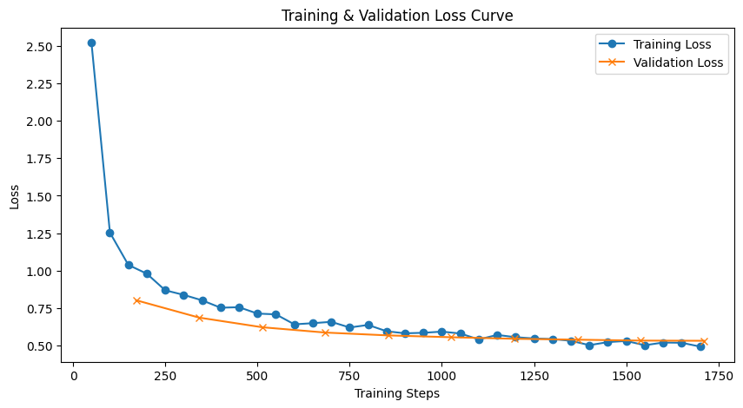
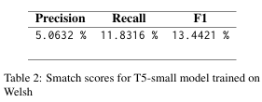
Training the T5-small Model on Welsh
Methods
Approach and Outcomes of Model Training on Welsh Data
In order to train an AMR parsing model for Welsh, we fine-tuned T5-small, a sequence-to-sequence transformer model. We opted for it because it is commonly used for text-to-text tasks, meaning that it fits the task of converting natural language sentences into structured AMR graphs.
We filtered out any incomplete entries from the MASSIVE-AMR dataset, splitting it into 80% training data, 10% validation data, and 10% test data to ensure an efficient and correct training.
Each input sentence was formatted with the prefix 'parse: [sentence]' to help the T5 model understand its task of parsing into AMR graphs.
The model was initialized with a learning rate of 3e-4, trained for 10 epochs with a batch size of 8, while a data collator was used for efficient batch processing. The loss function ignored padding tokens in the labels to prevent unnecessary penalization.
To track model performance, we recorded training and validation loss. The loss curve shows the training progress. We observe a decline in both scores, indicating that the learning process works well on Welsh text.
The model achieved Smatch scores with precision of 5.0632%, recall of 11.8316%, and F1 of 13.4421%, indicating moderate performance and areas for improvement.

Slide 8
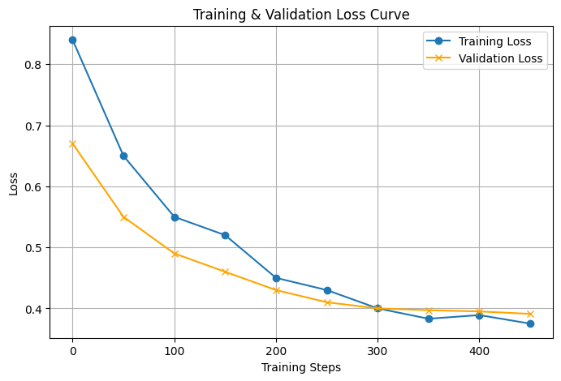

Training the T5-small Model on Irish and Welsh
Methods
Training Process and Results
In order to make the model multilingual and to better improve its performance, we trained the T5-small Model on a combined dataset of Welsh and Irish sentences and AMR pairs.
The training parameters were similar, with the sentences along the "Parse: " prompt as the input and the AMR graphs as the targets.
We maintained the learning rate of 3e-4, the number of training epochs of 10 and a batch size of 8, along with the data collator for processing in batches. The weight decay was kept at 0.01 in order to prevent overfitting.
The Smatch score for this model was calculated using the combined dataset of both Welsh and Irish sentences, with the AMRs that are not valid being skipped during the evaluation.
The model trained on both languages showed a slight improvement, scoring a Smatch score precision of 6.32 %, recall of 12.28 % and F1 of 11.83 %.

Slide 9
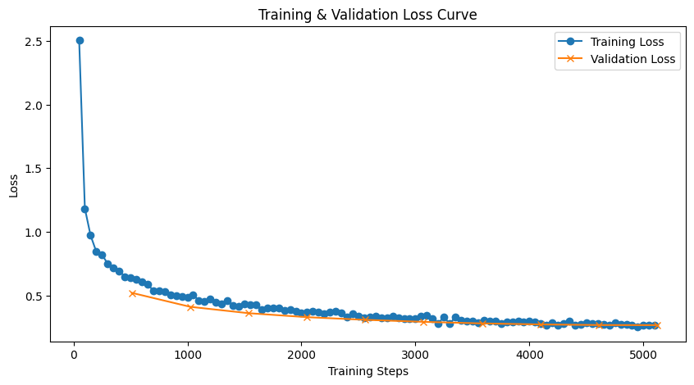
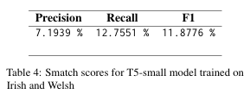
Training the T5-small Model on All Languages (English, Irish, Welsh)
Methods
Approach and Outcomes of Model Training on Welsh Data
To improve the generalization of AMR parsing across different languages, we fine-tuned T5-small on a merged dataset containing Welsh, English and Irish AMRs. The goal was to train a single model capable of parsing AMRs for multiple languages.
We combined the three datasets and removed in complete entries, ensuring all examples contained both the sentence and the corresponding AMR graph. We shuffled and split the dataset as before: 80-10-10.
The model was trained following the same sequence-to-sequence paradigm, each input sentence being prefixed with "parse: " to specify the task. We maintained the learning rate of 3e-4, training for 10 epochs with a batch size of 8 per device. We used gradient accumulation to balance computational efficiency with model convergence. The optimizer also included weight decay to prevent overfitting.
To track model performance, we monitored training and validation loss at every epoch. As illustrated in the figure, both losses steadily decreased, confirming that the model successfully learned to map multilingual sentences to AMRs. Notably, the validation loss remained close to the training loss, suggesting minimal overfitting and stable generalization across languages.
This model which was trained on all languages obtained the best results, scoring a Smatch score precision of 7.1939%, recall of 12.7551% and F1 of 11.8776%.

Slide 10
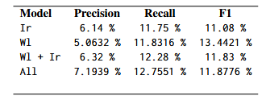
Model Performance Comparison
Results
Smatch Score Results Across Languages
The best Smatch score was output by the small T5 that was trained on the data set made up of the sentences in all three languages, with a Smatch score precision of 7.1939 %, recall of 12.7551 % and F1 of 11.8776 %.
All models were used to generate AMR graphs that where then compiled in a csv that contain the following columns: the original sentence, the language,original AMR graph, the AMR predicted by the model that was trained on all languages, AMR predicted by the model trained on Welsh, AMR predicted by the model trained on Welsh and Irish, AMR predicted by the model trained on Irish, AMR generated by the original STOG model from the AMRlib. The compiled CSV contained 5055 entries.
AMR graph generation using all models

Slide 11
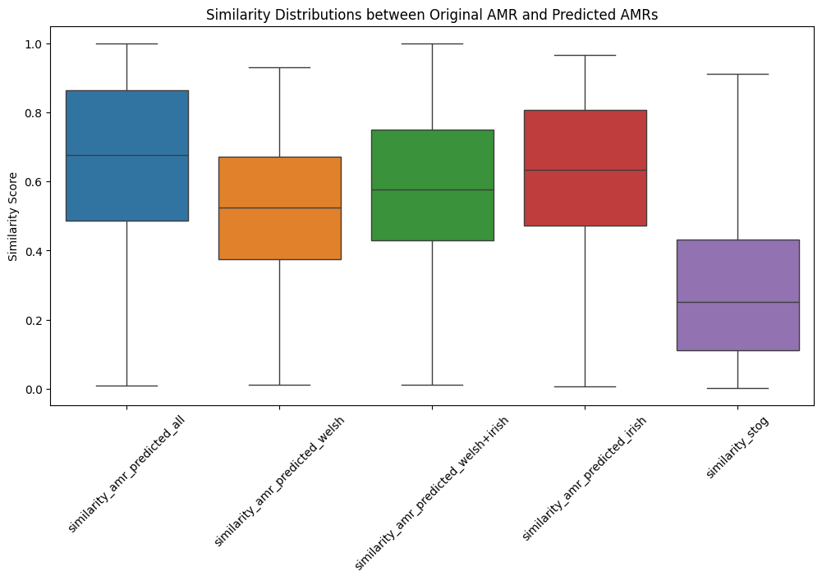
Discussion and Insights
Analysis
Similarity Distributions
Overall, the T5-small models that were fine-tuned on specific languages (Welsh and Irish) outperform the default STOG model in the AMRlib when it comes to AMR similarity.
The plot of similarity distributions shows that the AMR graphs predicted by the model trained on Welsh and Irish data produce a higher variance, while the Irish model maintains a more stable prediction structure.
The low scores produced by the STOG model show that the default model from the AMRlib requires fine-tuning in order to improve its performance on non-English languages.

Slide 12
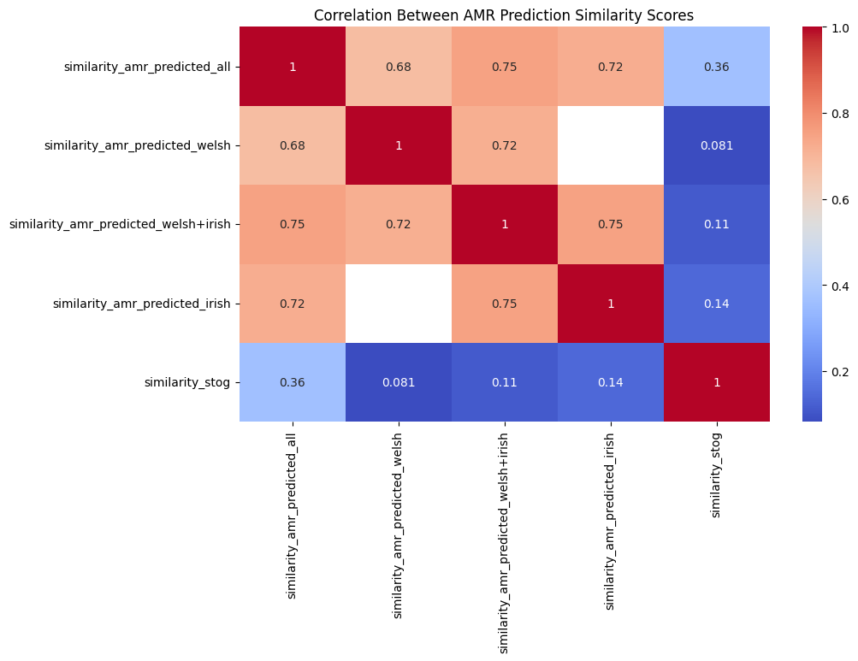
Discussion and Insights
Analysis
Correlation Heatmap
The correlation heatmap provides further insights into the relationships between different AMR representations.
The model trained on Welsh and Irish and the model trained only on Irish show a strong correlation of 0.75, indicating that these models share similar patterns.
In contrast, the STOG AMRs show weak correlation with the other models, showing that dialects and non-English sentences require previous training.

Slide 13
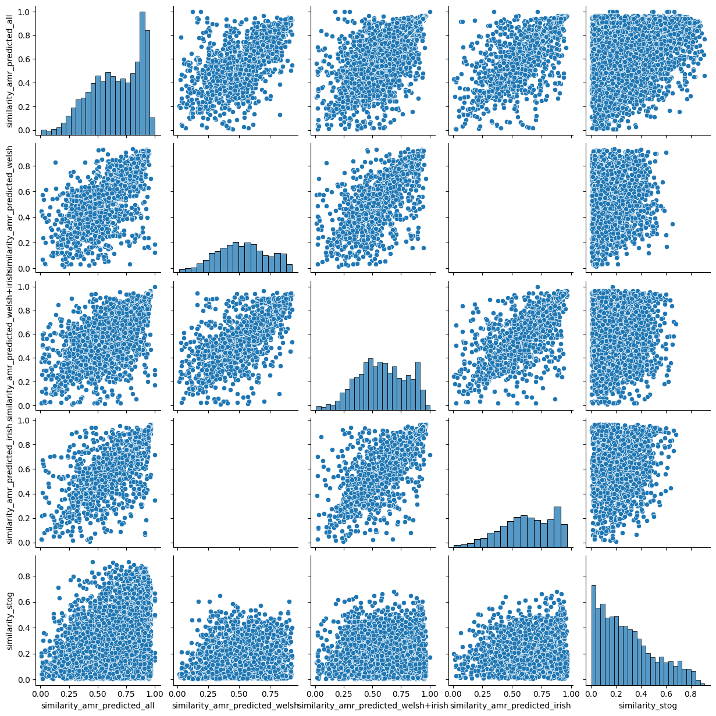
Discussion and Insights
Analysis
Scatter Plots to Analyze Relationships between Models
We generated scatter plots which show the relationships between different types of similarity scores for American English (AMR) and other dialects.
If points in a scatter plot tend to cluster together, it indicates a strong correlation between the two of them. For example, the plots showing the relationship between "similarity_amr_predicted_irish" and "similarity_amr_predicted_welsh+irish" show a clear clustering pattern, suggesting a strong correlation between these two measures. This implies that models trained on Irish and Welsh languages are producing similar scores.
When points are more spread out, it suggests a weaker correlation between the two variables. The spread of points in the plots comparing "similar ity_amr_predicted_stog" with the other models indicates a weaker correlation. This implies that standard English models struggle to produce similarity scores consistent with those of the dialectal 4 models.

Slide 14
Conclusions and Future Improvements
Results
Model Performance Summary
The model for generating AMR graphs require fine-tuning on different languages to produce more accurate results in terms of similarity and Smatch scores.
Dataset Generation
We managed to generate a dataset of over 5000 AMR graphs in three different languages using different models trained on different combinations of datasets.
Need for Enhanced Metrics
However, all metrics could be heavily improved, indicating the necessity for further refinement and development.
Future Training Directions
Future improvements could focus on training models on larger datasets, using more performant pre-trained models or incorporating additional languages, such as Scottish, to enhance performance.

Slide 15
Related Work in Multilingual & Dialectal NLP
Literature Review
Multilingual AMR for Celtic Languages
Multi-dialect NMT & Dialectometry
Heinecke & Shimorina (2022) developed an mT5-based model for Welsh, Irish, and Scottish-Gaelic.
Abe et al. (2018) explored Japanese dialect NMT with embedding visualization for linguistic analysis.
MASSIVE-AMR Dataset
Domain & Dialect Adaptation for Egyptian Arabic
Monti (2025) created a dataset with 84,000 AMR annotations across 50+ languages for information-seeking utterances.
Jeblee et al. (2014) used Modern Standard Arabic as a pivot for English-to-Dialectal Arabic translation.

Slide 16
Thank you.

