Slide 1

Literary Text Analysis
Linguistics Project
Valentin-Ion Semen - 412

Slide 2
Introduction
The aim of this project is training different Large Language Models on the task of outputting the text analysis of pieces of summaries from literary works.
The dataset that was used to train the models was scraped from LitCharts, a site offering a range of study guides for many books.
The models trained for the project are the T5-Small, T5-Base and GPT2.
To Showcase the functionalities of the models, an interface was created using React.js.

Slide 3
Scraping The Data
The LitCharts website contains a section named Summary and Analysis that consists of a study guide made out of pieces of the book's summary and their analysis. Thus, the purpose of the scraping script is to extract pairs of summary pieces and their analysis, along with the book title and add them to a csv.

Slide 4
Scraping The Data
The first attempt was done using the Requests Python Library and BeautifulSoup to process the HTML. However, the site's policies didn't allow the script to extract data without timeouts, thus making the process take a long time.
Therefore, I used the Selenium API that helped me extract the data in a way more similar to a human, so that the script could bypass the site's policies.

Slide 5
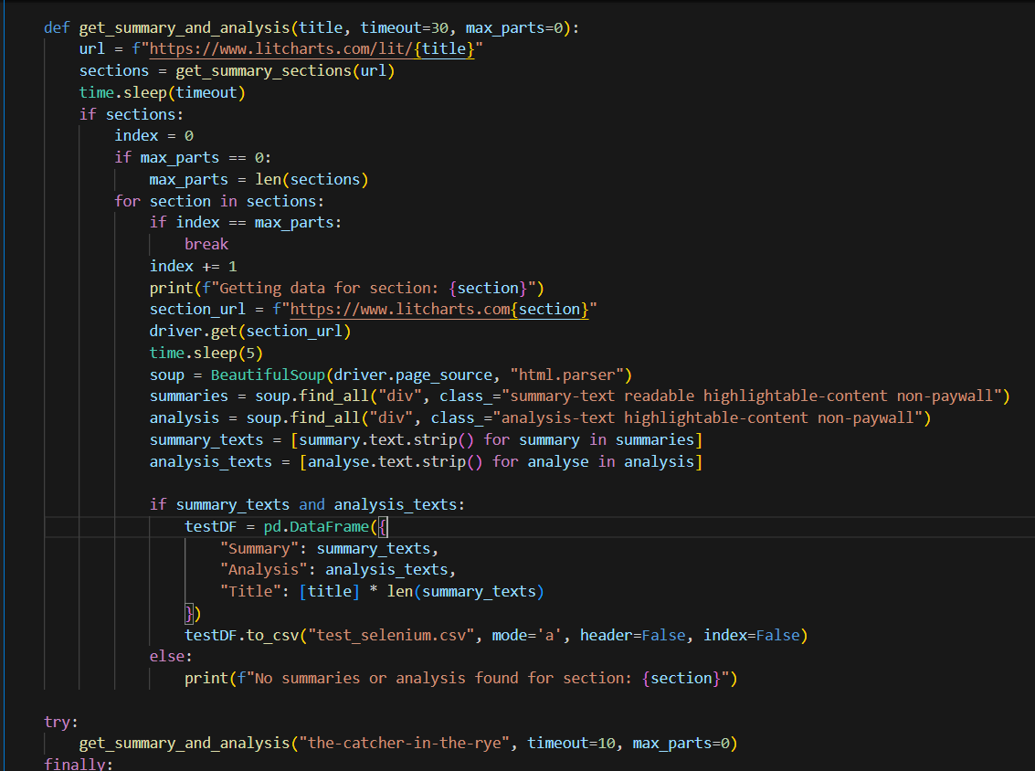
Scraping The Data

Slide 6
Scraping The Data
In the end, the scraping script collected over 5000 rows of summaries and their analysis from over 40 different titles.

Slide 7
Fine-Tuning The T5-Small Model
The scraped dataset was firstly used to fine-tune a T5-Small model.
The first step was to divide the dataset into inputs and labels. The summary parts were used as the inputs and their analysis as the labels/output. The data was tokenized and fed to the Seq2Seq Trainer.

Slide 8
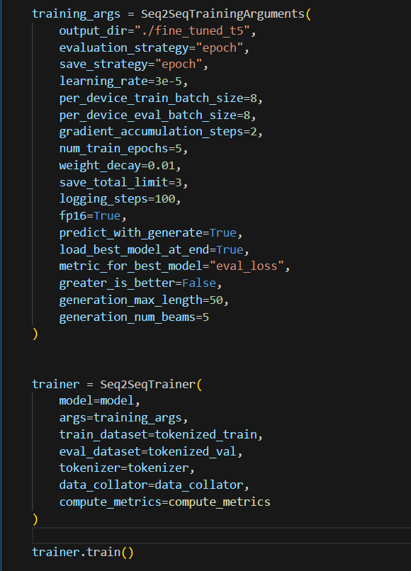
Fine-Tuning The T5-Small Model

Slide 9
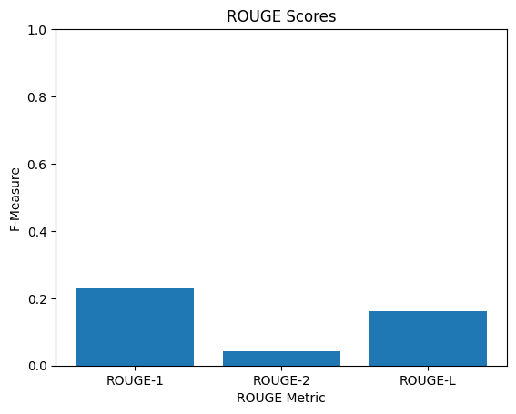
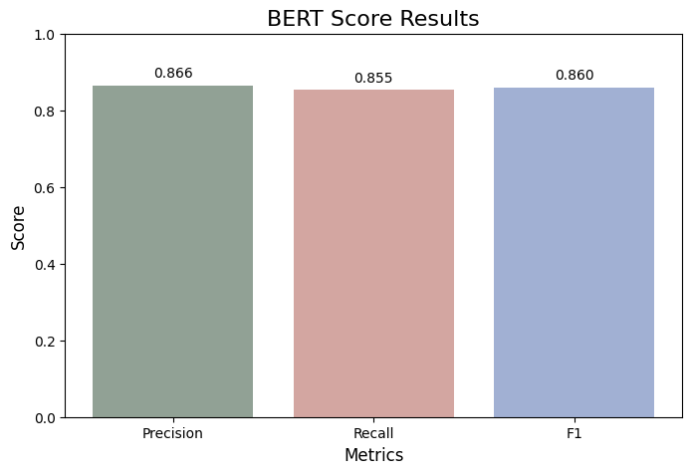
Fine-Tuning The T5-Small Model - Metrics

Slide 10
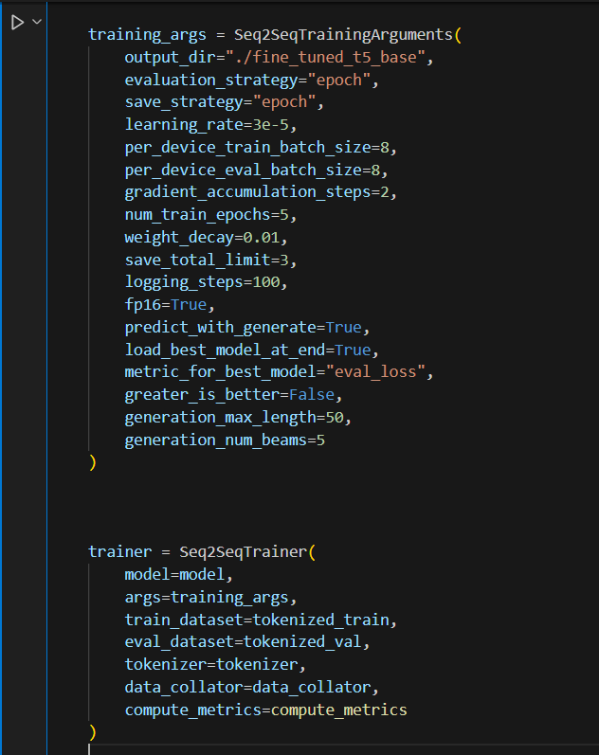
Fine-Tuning The T5-Base Model
The T5-Base Model was trained with similar settings.

Slide 11
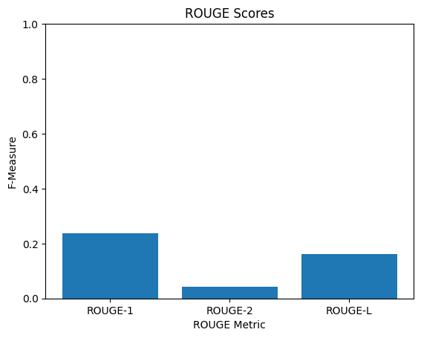
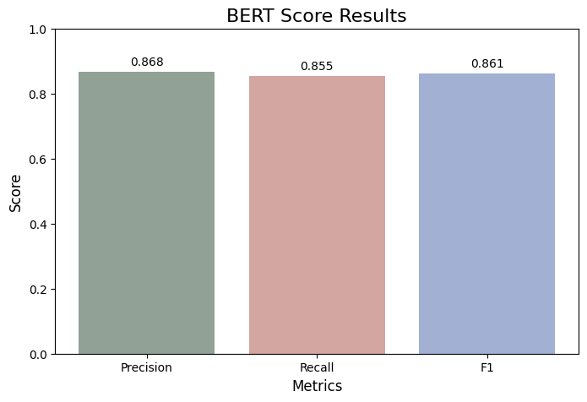
Fine-Tuning The T5-Base Model - Metrics

Slide 12
Fine-Tuning The GPT2 Model
For the GPT2 Model, the summary parts and their analysis are combined and treated as input, with the output being the same as the input id's, because the model does not support separate input and output sequences. The model is then trained with similar hyperparameters.

Slide 13
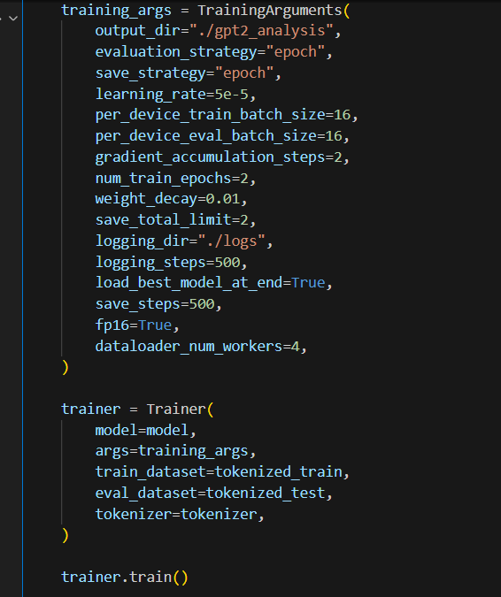
Fine-Tuning The GPT2 Model

Slide 14
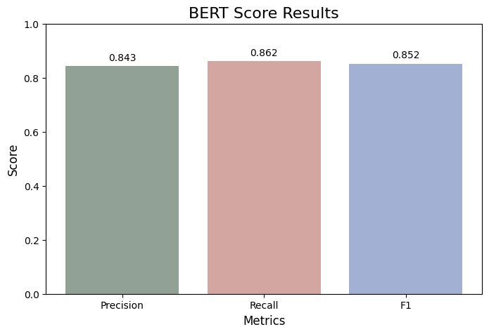
Fine-Tuning The T5-Base Model - Metrics

Slide 15
Getting Main Themes
The other functionality of this project is getting the main themes of the input text by using each model's tokenizer to get the input text's embeddings in order to use Agglomerative clustering on them, using KeyBert to extract the key phrases. The centroids of the clusters are then returned to get the themes.

Slide 16
Creating The Interface
I used Flask to create a simple Python API with an endpoint for each model that return the text analysis and the 5 main themes. The user inputs the text on a pixelated book-like interface created using React.js and is able to select which model they want to use for the prediction. The output that contains the analysis along with the main themes is typed letter-by-letter on the right page of the book using the React Typing Animation Component.

Slide 17
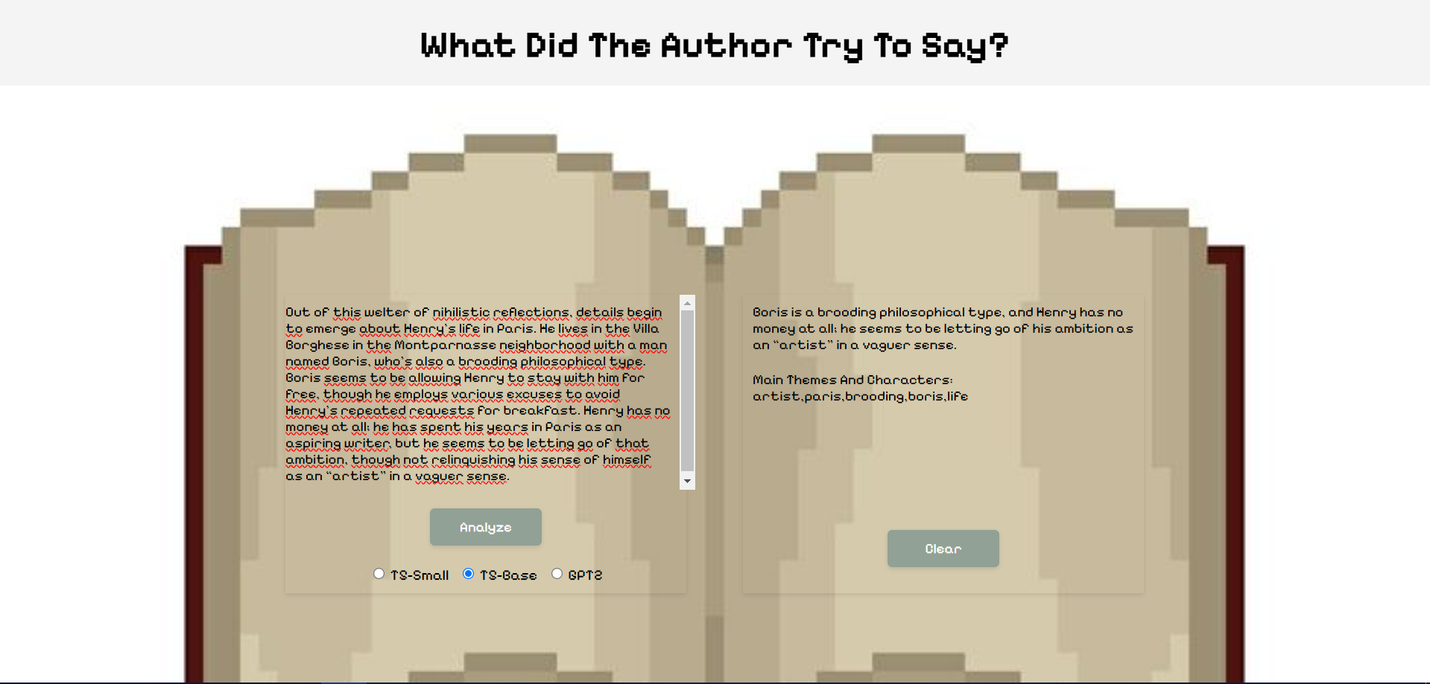
Creating The Interface

Slide 18
Conclussions And Possible Improvements
In conclussion, I managed to create a simple application that takes the user's literary input and outputs a fairly accurate analysis along with the main themes on an interactive and animated interface, using three fine-tuned Large Language Models, although the metrics results could be heavily improved with more extensive training.
Some possible improvements include hyperparameter tuning and improving the dataset, although more time for training and data scraping would be required.
In addition, the title of the work could be used in training for creating a better correlation between related summary parts.

Slide 19
Important Links
Scraped Site: https://www.litcharts.com/lit/
Project Github Repo: https://github.com/valentinvale/WhatDidTheAuthorTryToSay--LinguisticsProject

