Slide 1
Sentences from retrieved articles
(n = 171,678)
Retrieved articles
(n = 9,764)
Sentences from GDELT articles
(n = 364,870)
GDELT articles
(n = 18,383)
Syntax trees
Potential full triplets
(n = 705,134)
Named entity recognition
Triplets with relevant entities
(n = 113,426)
Triplets without relevant entities
(n = 591,708)
Dictionary matching
Triplets matched with CAMEO dictionary (n = 65,494)
Triplets not matched with CAMEO dictionary (n = 47,932)
Entailment prediction
Triplets with entailed relationships
(n = 24,674)
Triplets without entailed relationships
(n = 40,820)
Sentences in dataset
(n = 24,674)

Slide 2
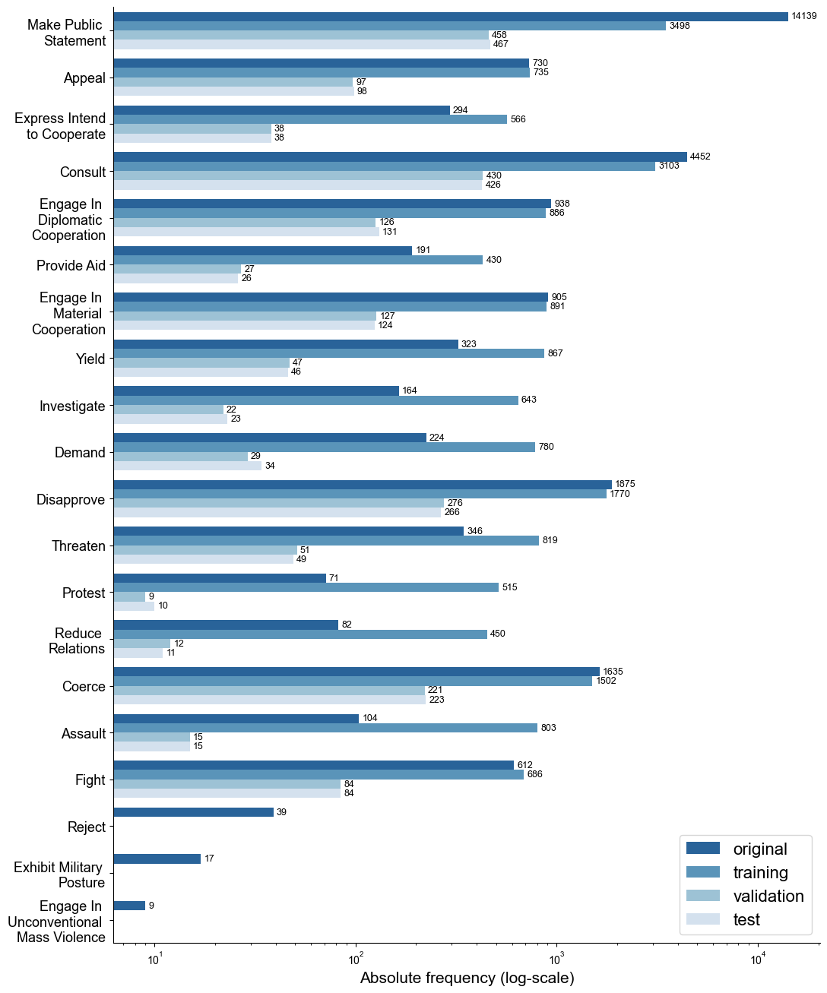
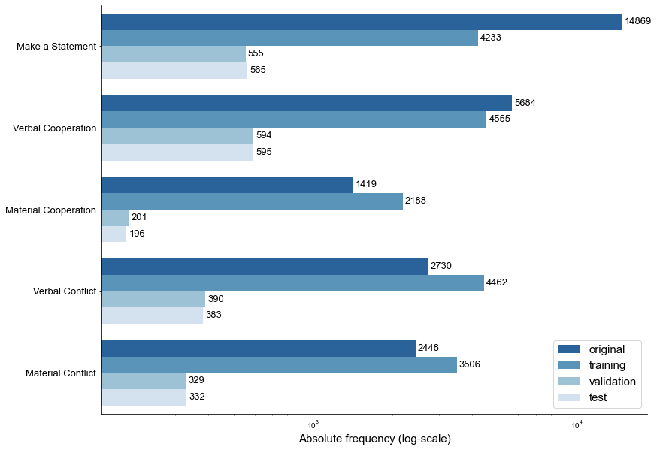

Slide 3
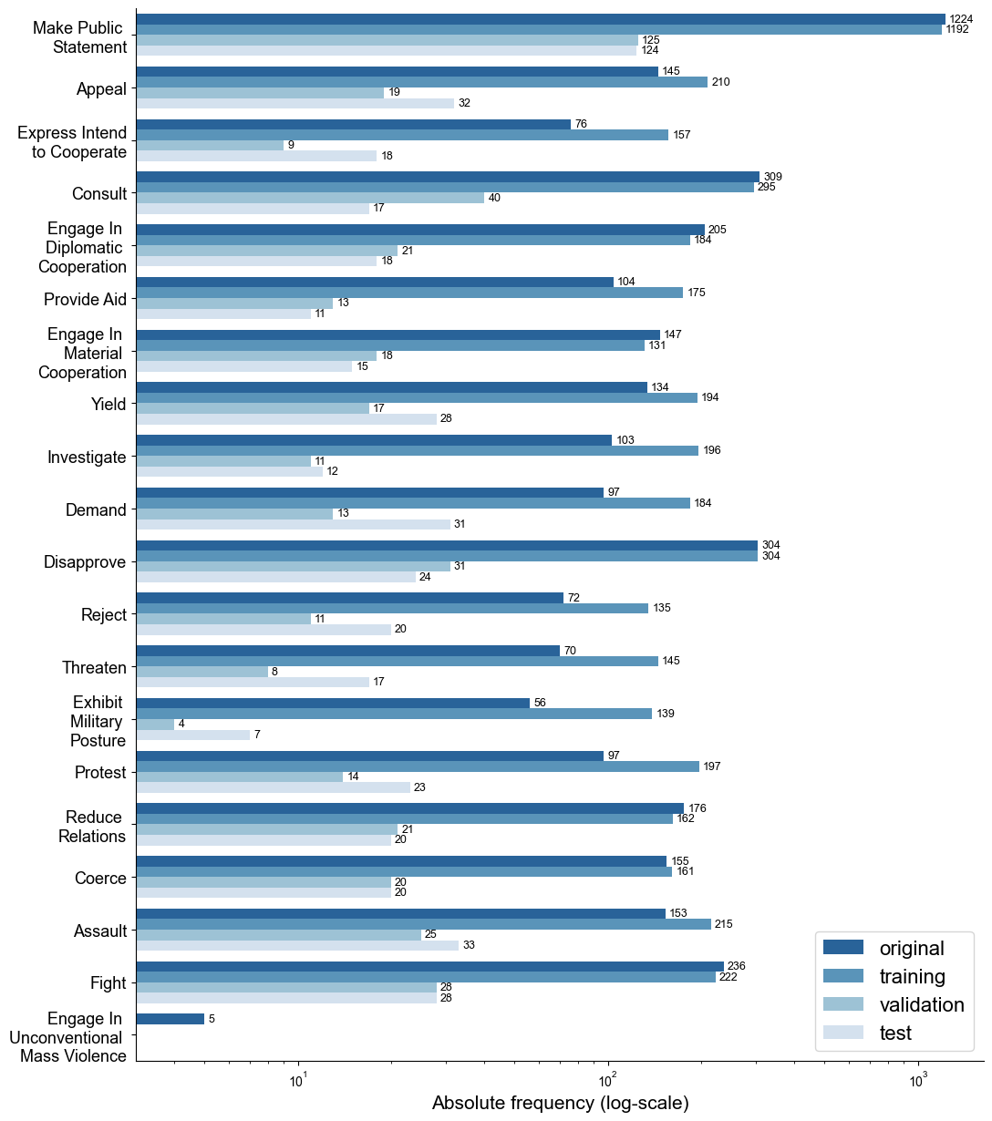
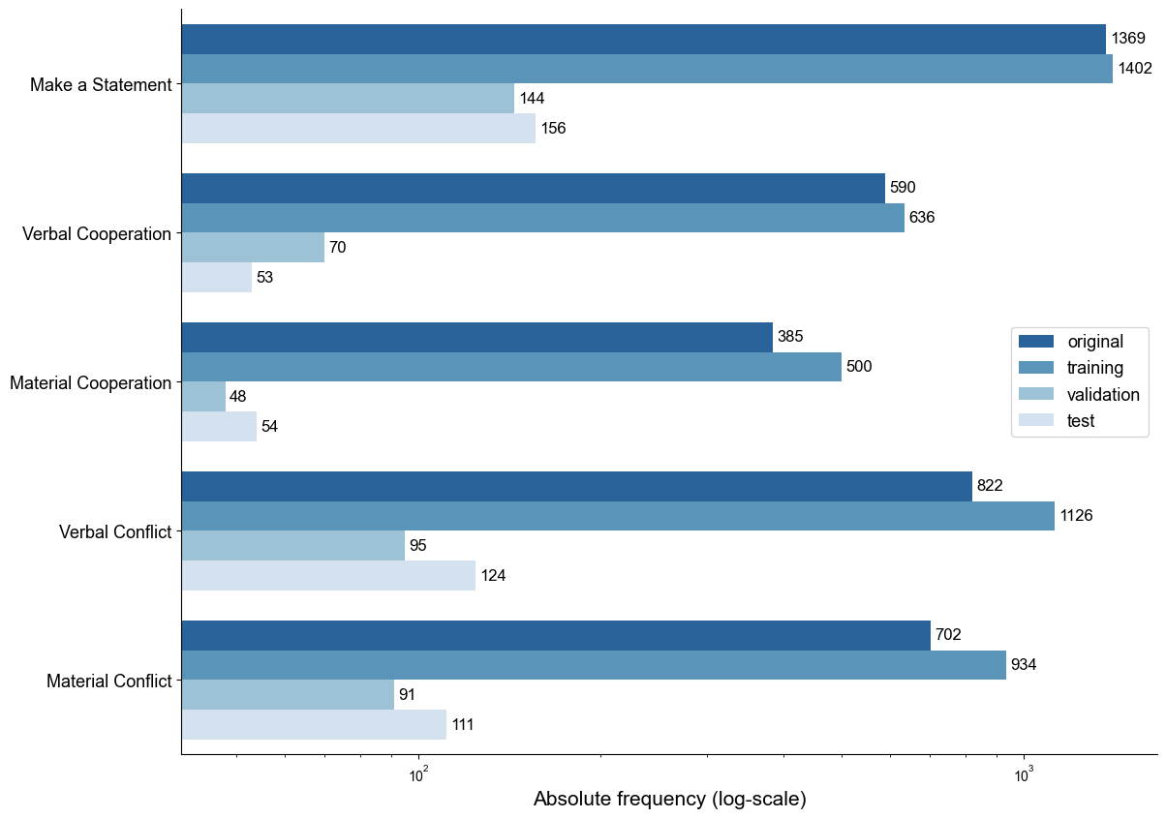

Slide 4


Slide 5
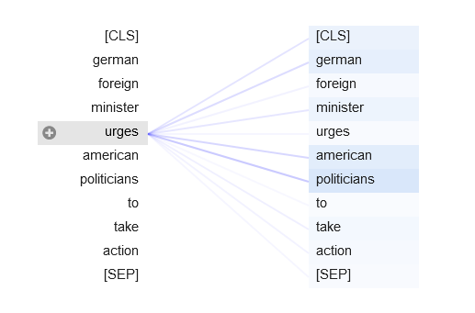

Slide 6
