Slide 1

Microbiome Differences of preen oil and cloaca in two bird species
Alejandra Valenzuela

Slide 2
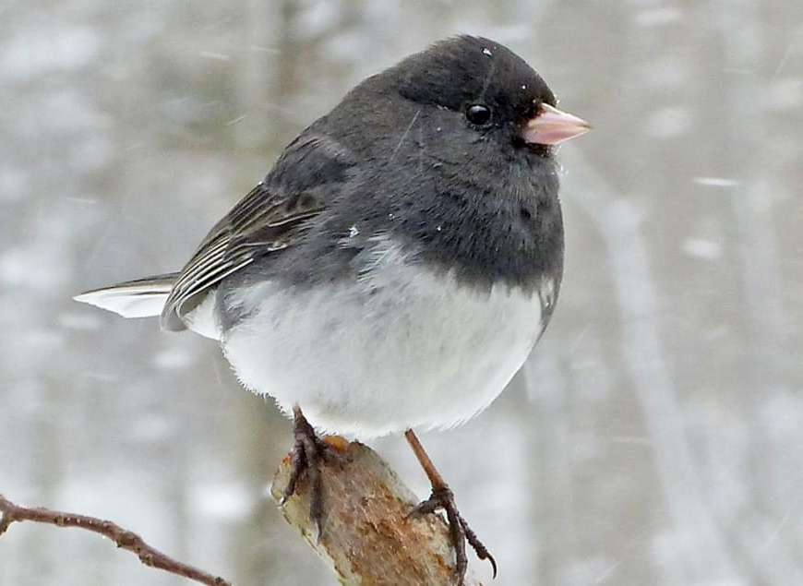
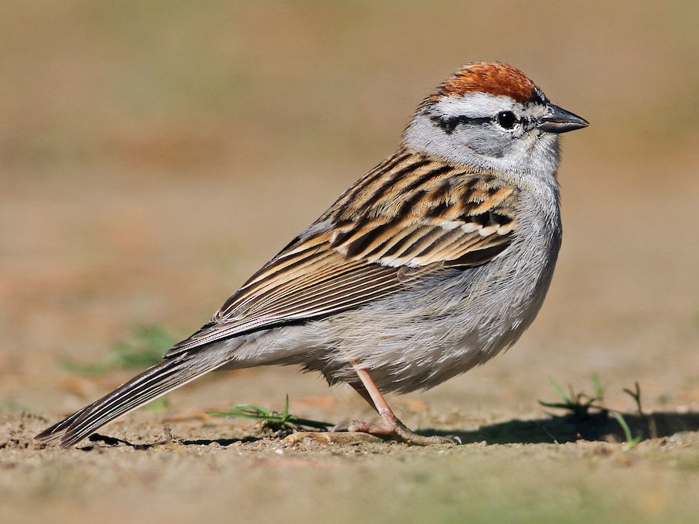
introduction
Social interactions of the uropygial microbial community
Have an influence on preen oil odors
Data set from preen oil and cloaca
Dark-eyed junco
Chipping Sparrow
Observe differences in microbiomes

Slide 3
Methods
R v4.3.2
DADA2 v.3.18
Filter and trim errors
Infer amplicon sequence variants
Merge paired ends
Phyloseq v.1.46.0
Nonbacterial variants
Alpha diversity
Beta diversity

Slide 4
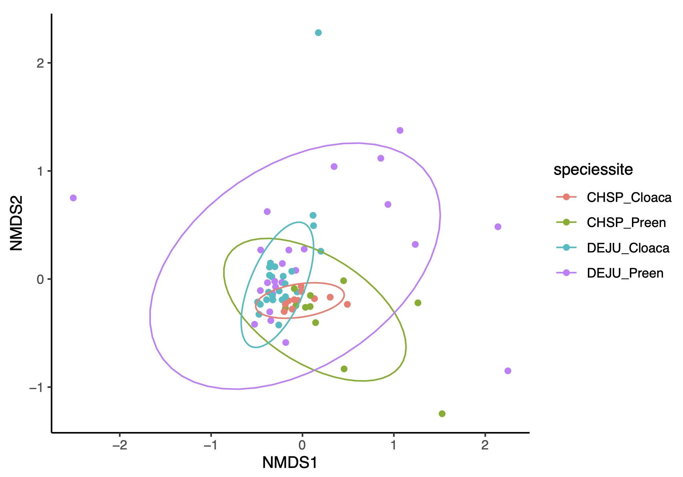
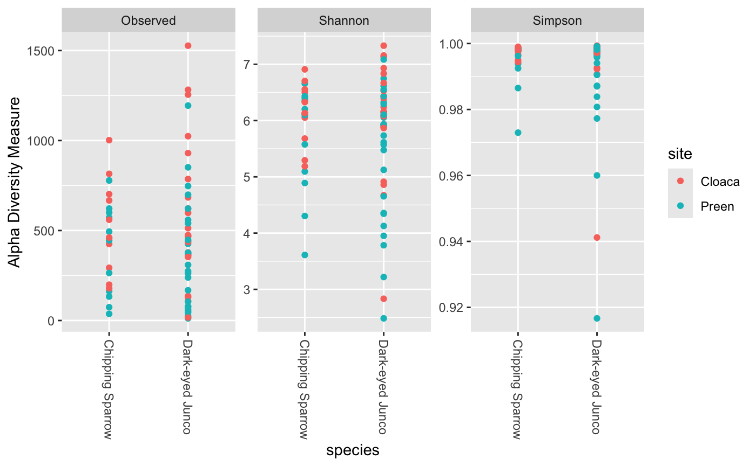
Results
Beta Diversity
 | CHSP_C | CHSP-P | DEJU_C | DEJU_P
CHSP_C |  | 5.0e-2 | 6.80e-2 | .001
CHSP_P | 3.93e-2 |  | 6.17e-1 | 0.052
DEJU_C | 4.83e-2 | 6.21e-1 |  | 0.005
DEJU_P | 5.84e-5 | 5.63e-2 | 2.64e-3
Alpha
Site | 0.01822
Species | 0.6532
Notes:
Observed Shannon, Simpson not normally distributed
Mann Whitney U test was done for Alpha diversity
Pairwise comparison was done to see the significance between the similarities between site

Slide 5
References
Whittaker, D.J., et al. 2023/ Effects of short-term experimental manipulation of captive social environment on uropygial gland microbiome and preen oil volatile composition. Frontiers in Ecology and Evolution. 10:1027399

